Slide 1
Statistical Analysis on Fundamental reactions in Kinetics using Weighted Relative Error Least Square Fitting
Albert Wang
Princeton University Summer Intern
08-20-2018

Slide 2
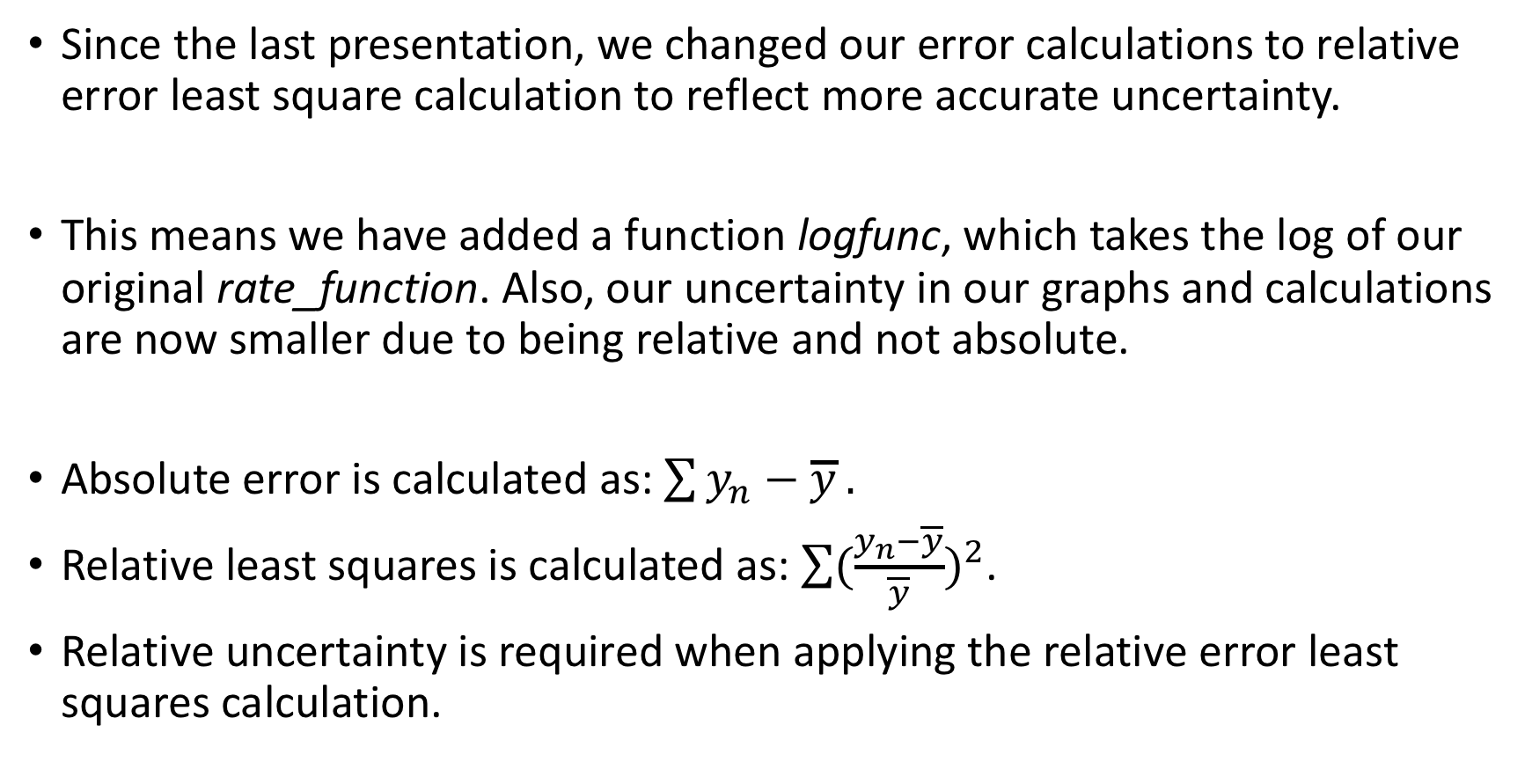
Absolute to Relative Uncertainty
Since the last presentation, we changed our error calculations to relative error least square calculation to reflect more accurate uncertainty.
This means we have added a function logfunc, which takes the log of our original rate_function. Also, our uncertainty in our graphs and calculations are now smaller due to being relative and not absolute.
Absolute error is calculated as: $\sum{y_{n}−\overline{y}}.$
Relative least squares is calculated as: $\sum{{(\frac{y_{n}−\overline{y}}{\overline{y}})}^{2}}$.
Relative uncertainty is required when applying the relative error least squares calculation.

Slide 3


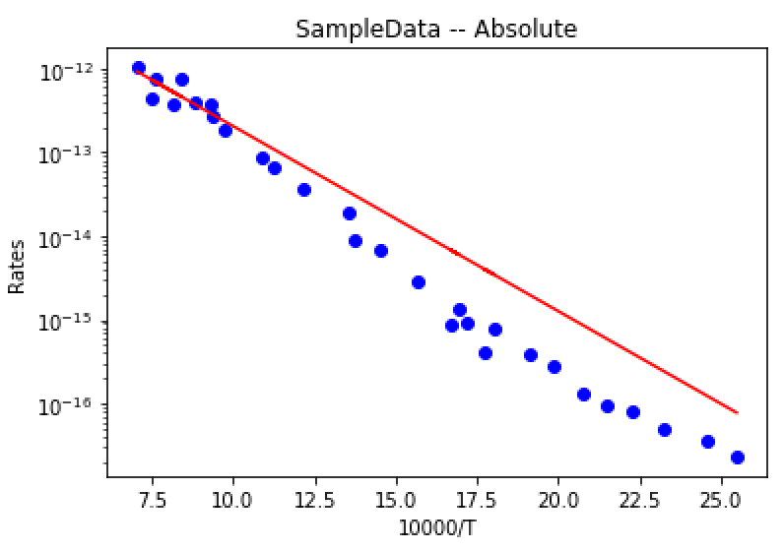
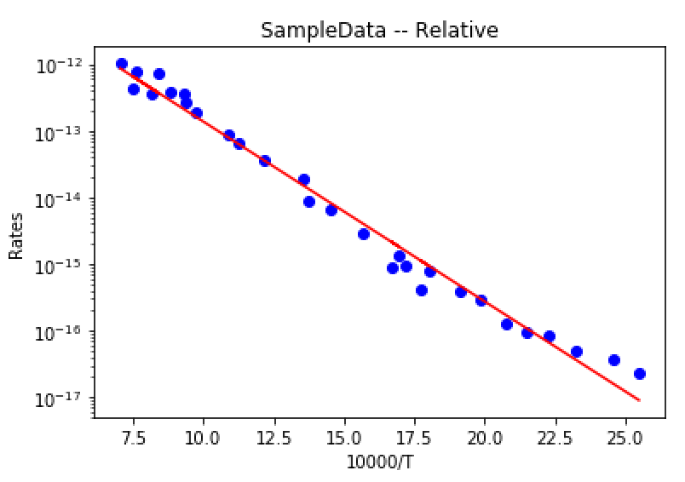
Power of Relative Uncertainty
Absolute Error Least Squares Calculation
Relative Error Least Squares Calculation

Slide 4
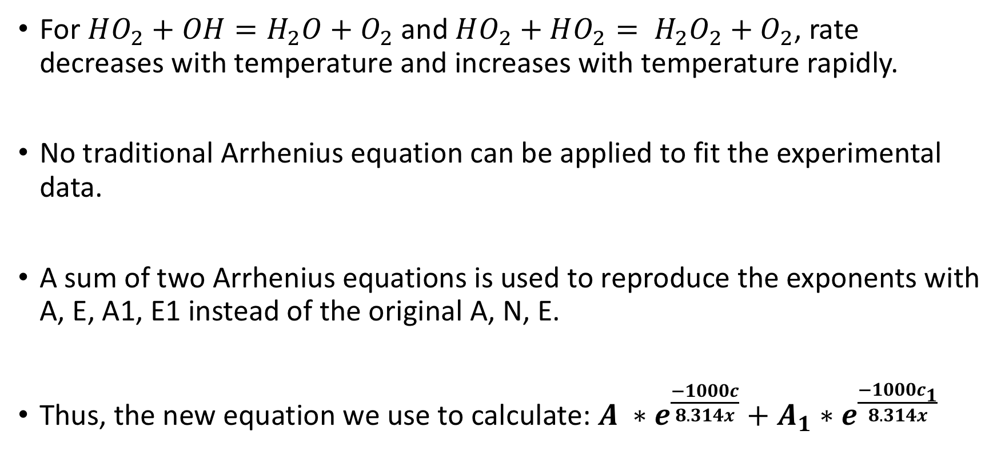
RateEvalMultEq for negative-positive Temperature Dependence
For $HO_{2}+OH=H_{2}O+O_{2}$ and $HO_{2}+HO_{2}= H_{2}O_{2}+O_{2}$, rate decreases with temperature and increases with temperature rapidly.
No traditional Arrhenius equation can be applied to fit the experimental data.
A sum of two Arrhenius equations is used to reproduce the exponents with A, E, A1, E1 instead of the original A, N, E.
Thus, the new equation we use to calculate: $A ∗e^{\frac{−1000c}{8.314x}}+A_{1}∗e^{\frac{−1000c_{1}}{8.314x}}$

Slide 5
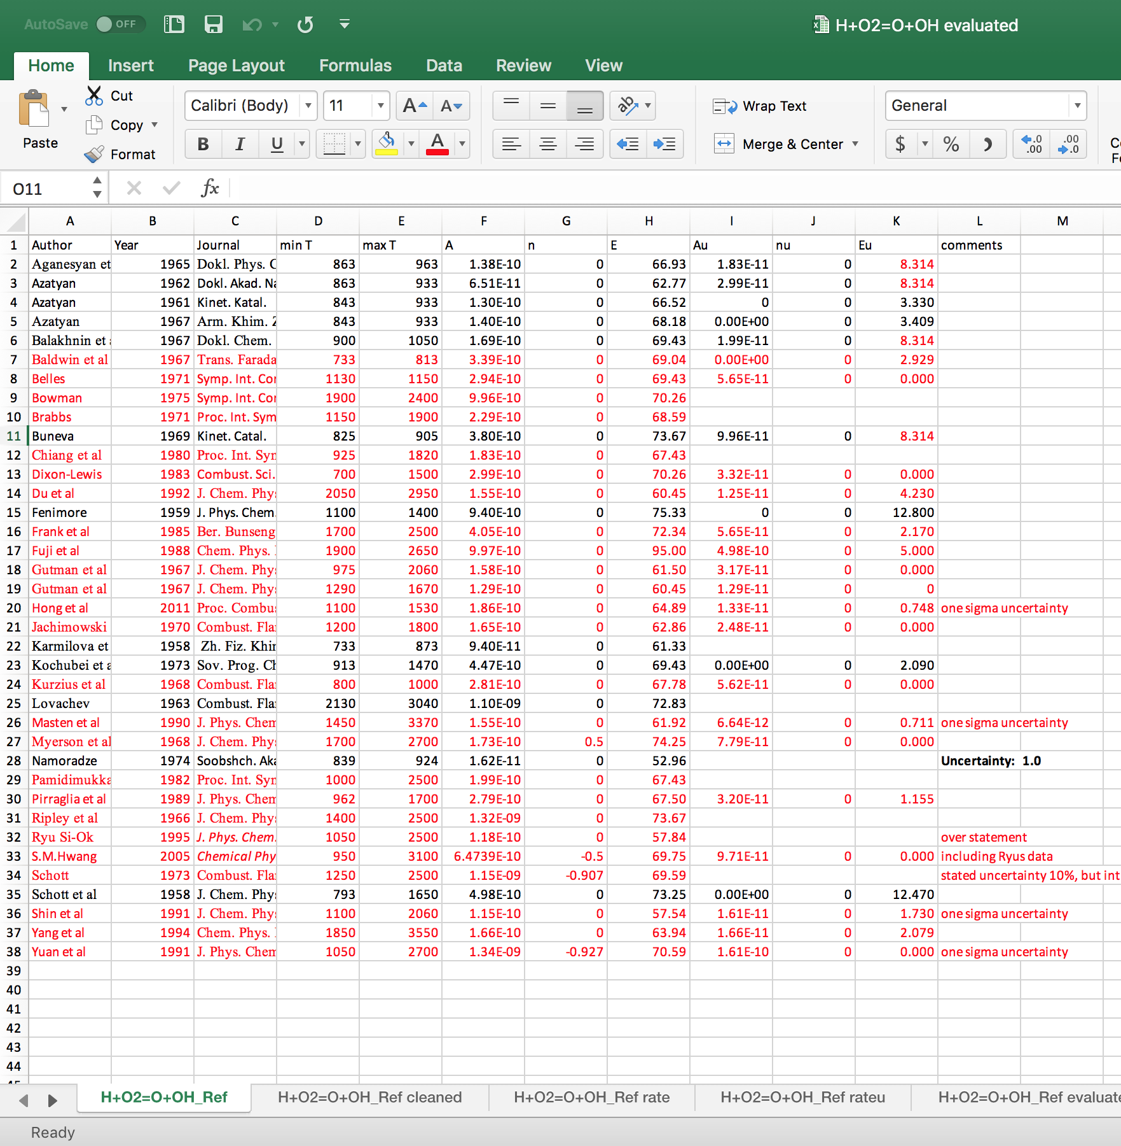
How we deal with Input
Input Data looks like this:
When dealing with the data, we get rid of the comments column. Moreover, we rid of any rows that do not have any uncertainty being Au, Nu, Eu.
Finally, we apply our program based off of the data’s min T, max T, and variables.

Slide 6
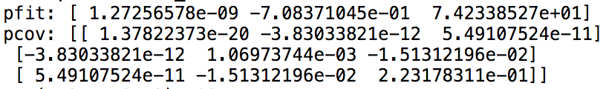

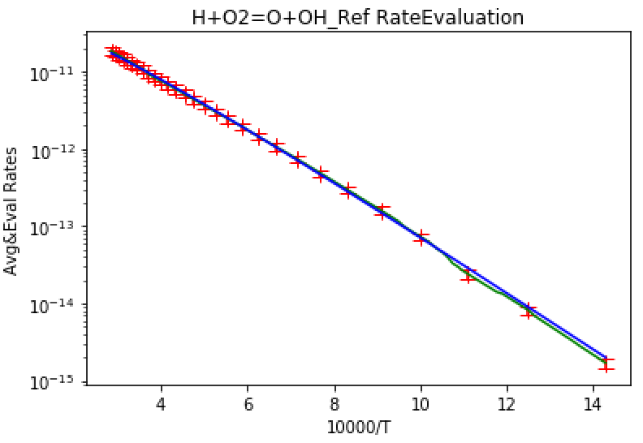
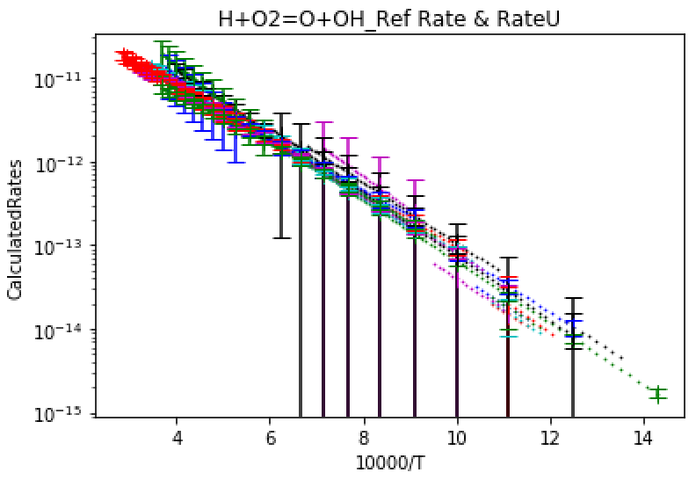

Example 1: $H+O_{2}=O+OH$ reaction

Slide 7
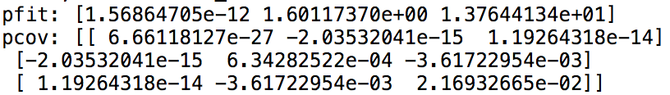

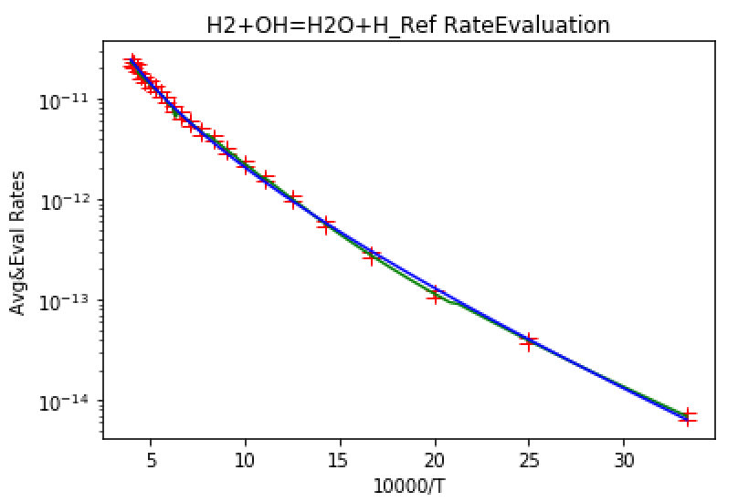
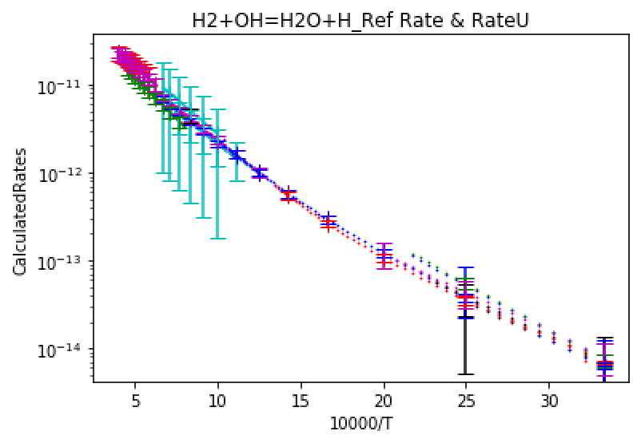

Example 2: $H_{2}+OH=H_{2}O+H$ reaction

Slide 8
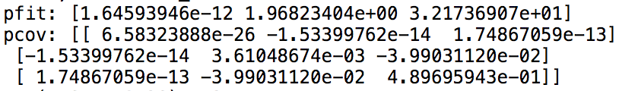

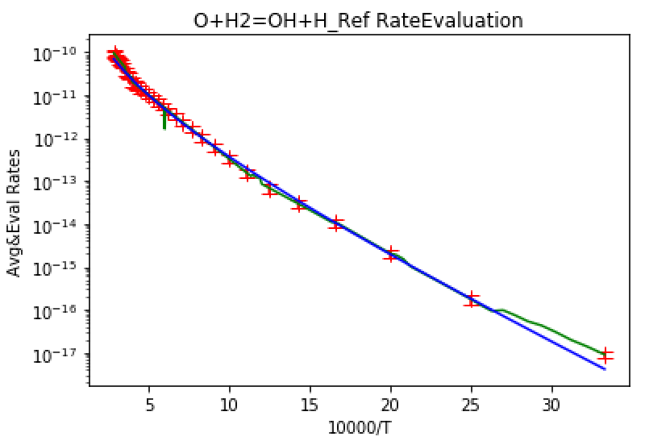
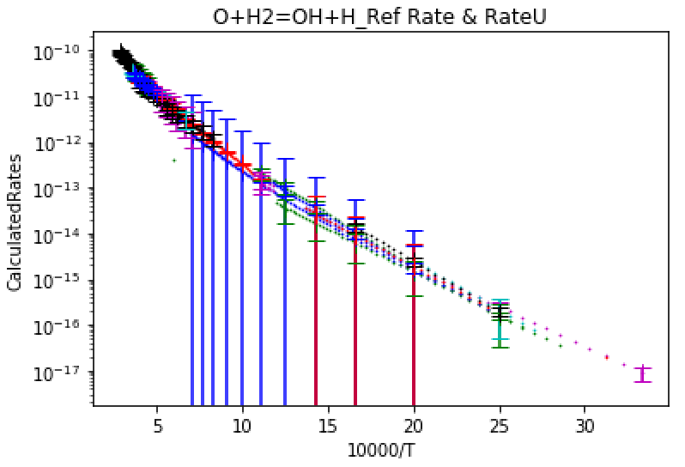

Example 3: $O+H_{2}=OH+H$ reaction

Slide 9
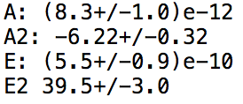
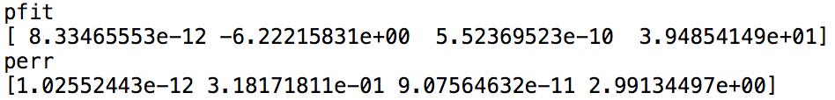
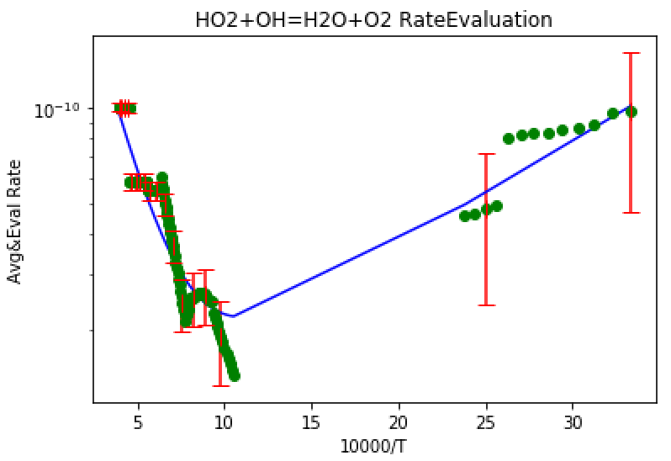
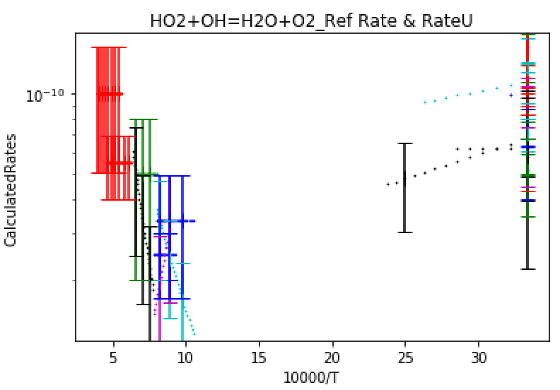

Example 4: $HO_{2}+OH=H_{2}O+O_{2}$ reaction
This reaction uses RateEvalMultEq:

Slide 10
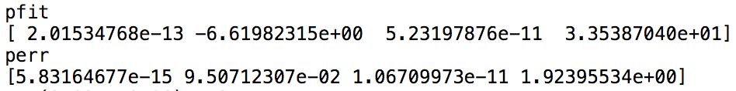
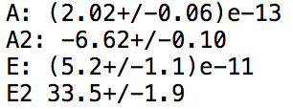
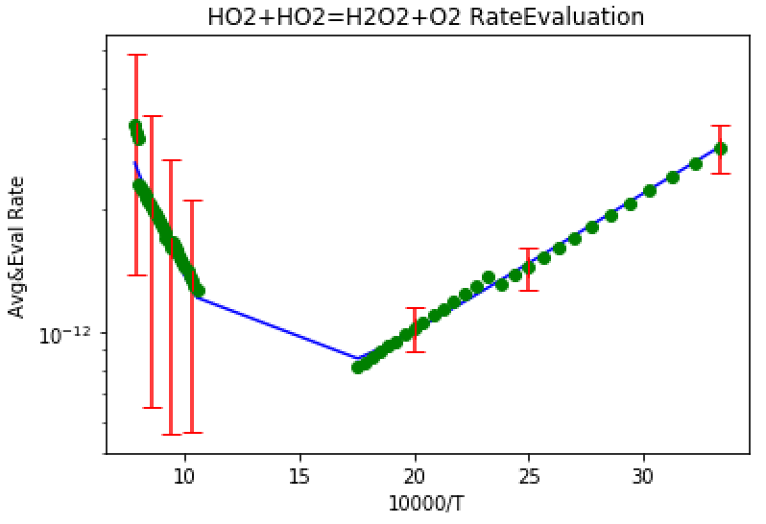
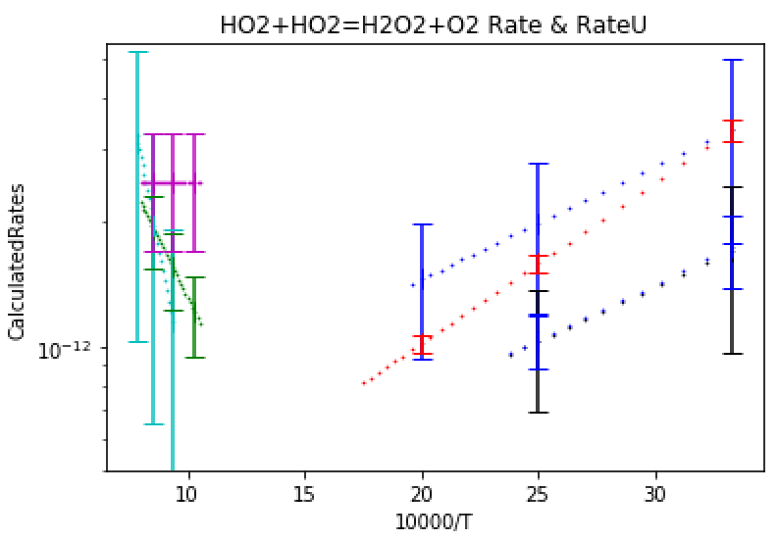

Example 5: $HO_{2}+HO_{2}=H_{2}O_{2}+O_{2}$reaction
This reaction uses RateEvalMultEq:

Slide 11
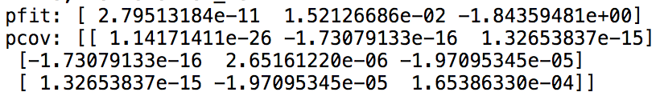

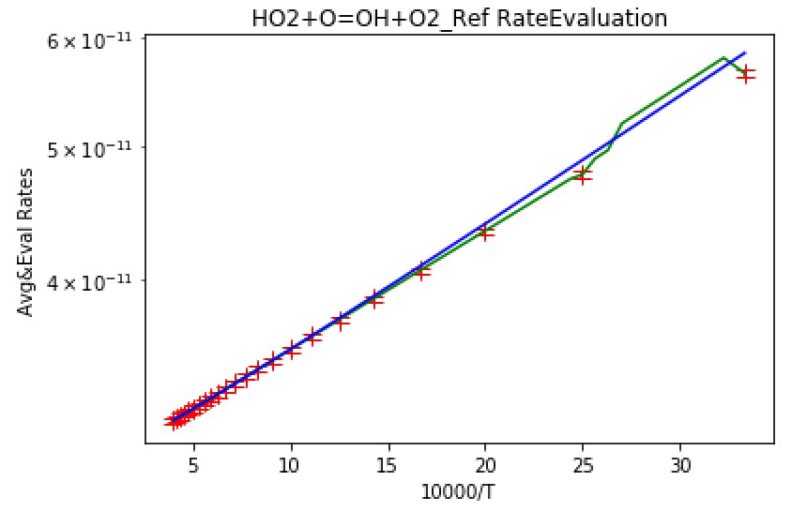
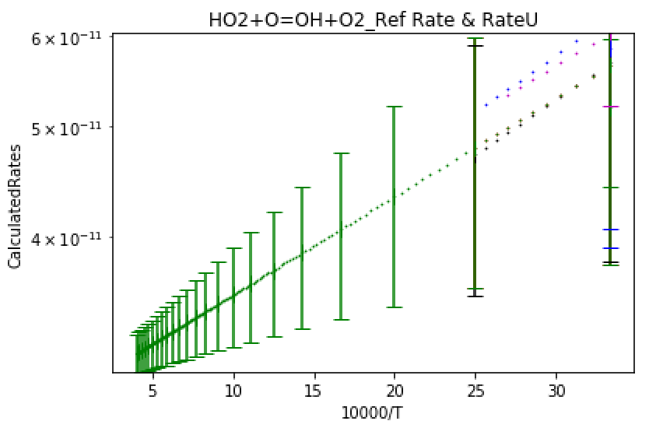

Example 6: $HO_{2}+O=OH+O_{2}$ reaction

Slide 12
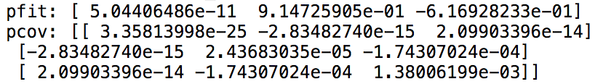

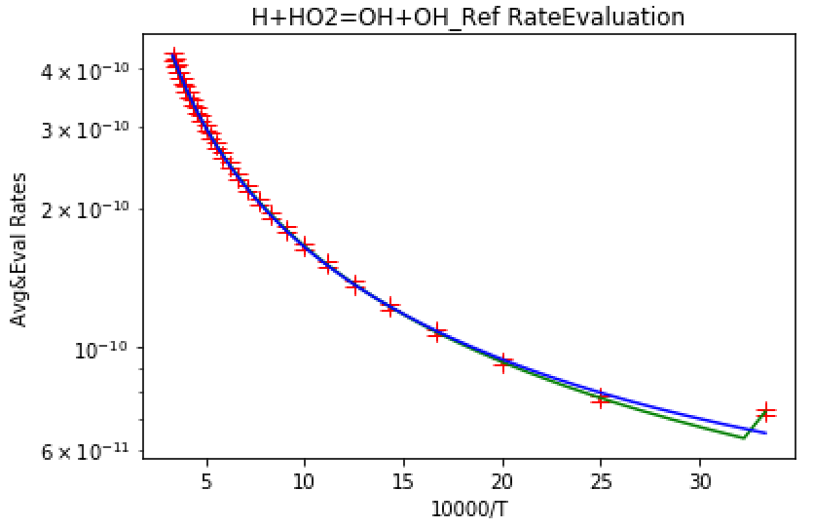
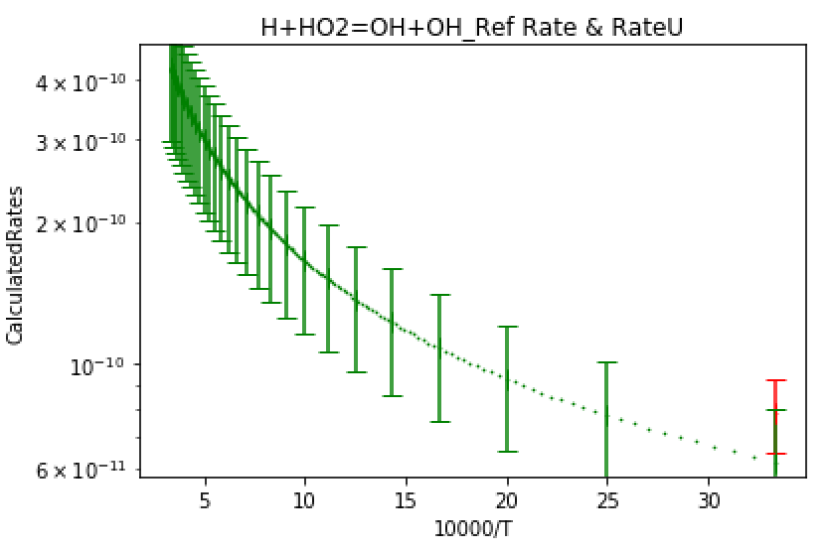

Example 7: $H+HO_{2}=OH+OH$ reaction

Slide 13
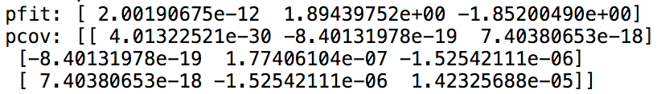

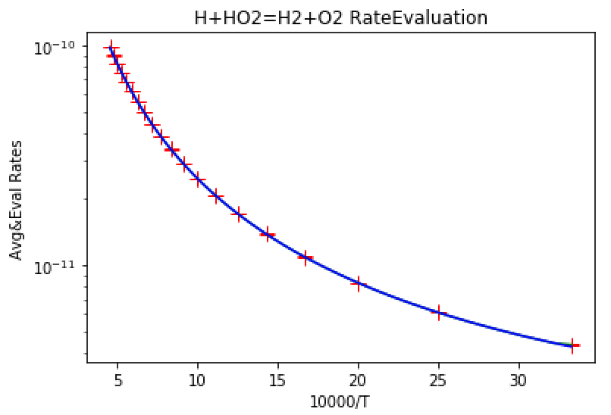
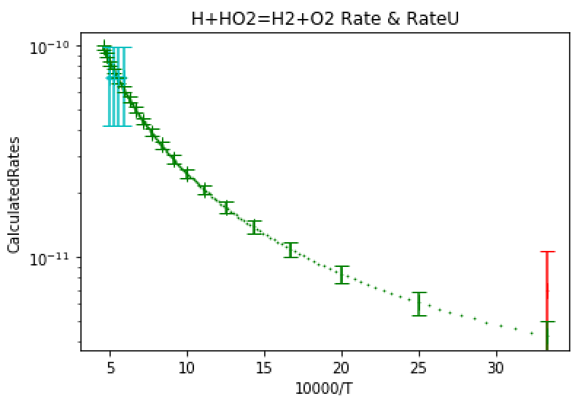

Example 8: $H+HO_{2}=H_{2}+O_{2}$ reaction

Slide 14
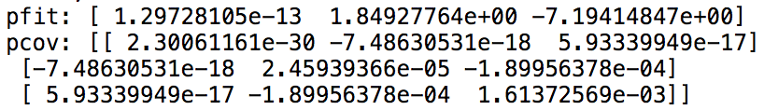

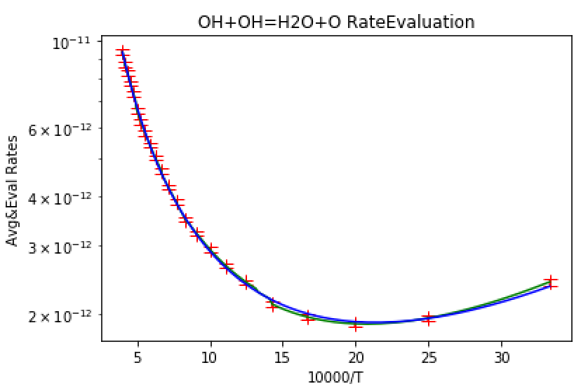
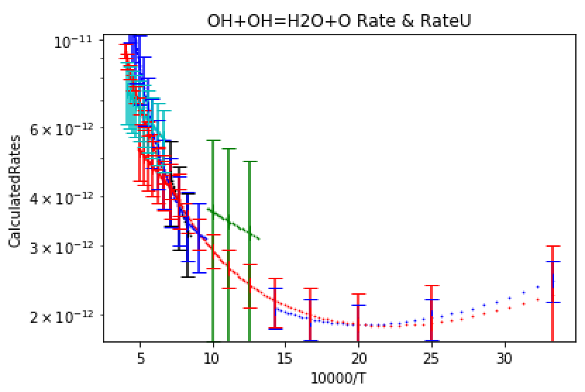

Example 9: $OH+OH=H_{2}O+O$ reaction

Slide 15
Conclusion
Before I finish, I’d like to thank my mentors Prof. Law, Liang Shu Shu, and Yang Shu Shu for giving me such an incredible opportunity. They have advised me on my scientific research I will continue to learn more about how to apply math and computer programming to study combustion problems.
I have learned how to communicate quickly and effectively to get the necessary job done.
I have learned how to do correct/reliable statistical analysis on massive experimental data, starting with simple least square fitting, then relative error least square, and finally weighted simulation using uncertainty of the exponents.
I have learned extensive python programming skills utilizing pandas, matplotlib, scipy, and openpyxl to clean/analyze, plot and output the data.

