Slide 1
Code Camp
Angular Environment Setup, Components and Data Binding

Slide 2
VSC, node.js/npm, angular cli, bootstrap3
Visual Studio Code
Node.js/npm
local: npm install –save bootstrap@3or npm uninstall to remove
global: npm install –g @angular/cli
install all dependencies: npm install
package.json
Angular cli
Create a new project: ng new
Create an component: ng g c
Delete an component: no ng command. Have to delete manually
Start server: ng serve → localhost:4200

Slide 3
Typescript
Watch course video 1-10

Slide 4
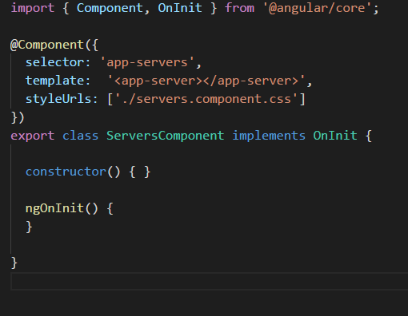
Let’s create a new project
ng new my-first-app
Notes:
In app.component.ts change title=‘app’ to name=“My first name”; remove all content in app.component.html, add <input type=“text” [(ngModel)]=“name”> <p>{{name}}</p>. In app.module.ts add FormsModule
2. In package.json add "styles": [
"../node_modules/bootstrap/dist/css/bootstrap.min.css",
"styles.css"
],

Slide 5
Component and Module
Watch component video 2-15
Watch Module Video 2-17
Notes:
Generate a server component manual
<h4>The server component</h4>
import { Component } from '@angular/core';
@Component({
selector:'app-server',
templateUrl: './server.component.html'
})
export class ServerComponent{
}
3. Generate servers component by cli <app-server></app-server><app-server></app-server>
4. Change to inline template.
5. Add bootstrap to app.component.ts
<div class="container">
<div class="row">
<div class="col-xs-12">
<h3>I am here!</h3>
<hr>
<app-servers></app-servers>
</div>
</div>
</div>
6. Add style to app.component.css
h3 {
color:blue;
}
7. Change to inline style
styles: [`
h3 {
color: dodgerblue;
}
`]

Slide 6
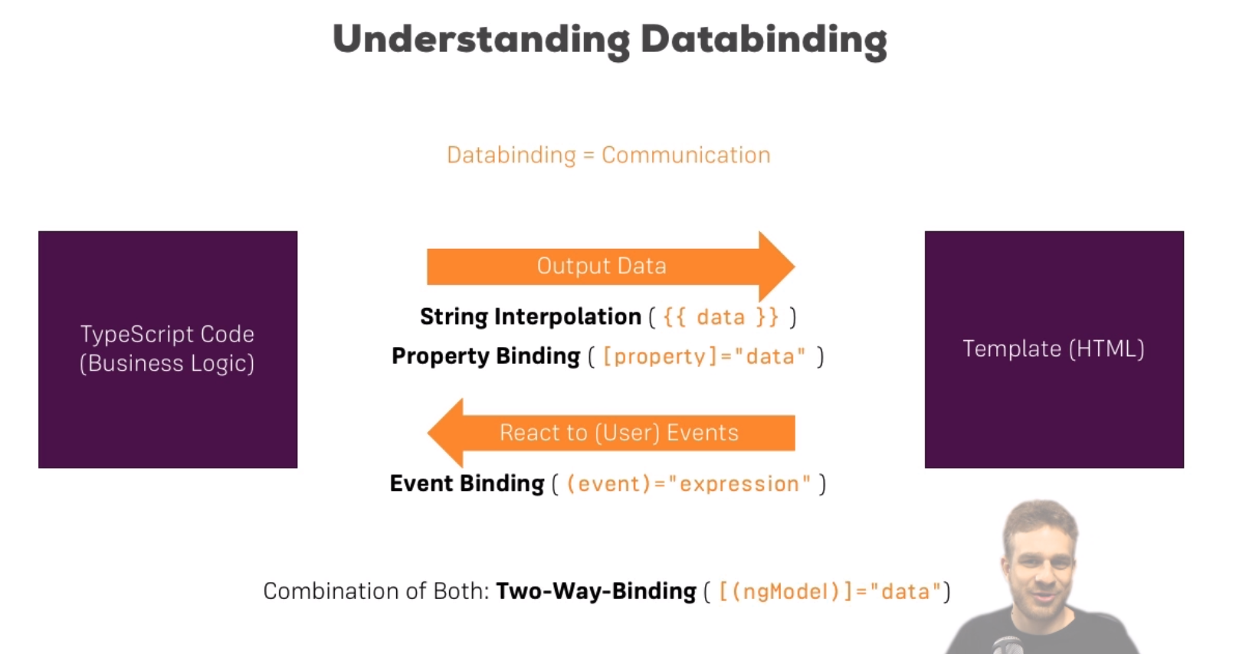
Data Binding
Watch Data Binding introduction video 2-23

Slide 7
String Interpolation
Property Binding
String Interpolation can be exchanged with Property binding
Event Binding
Pass Data in Event Binding
Two way binding ---combo of event binding and property binding
Notes:
Add serverId and serverStatus and getServerStatus() return serverStatus in ts and {{getServerStatus()}} in html
Property binding
servers.ts
allowNewServer = false;
constructor() {
setTimeout(() => {
this.allowNewServer = true;
}, 2000);
}
html <button class="btn btn-primary" [disabled]="!allowNewServer" (click)="onCreateServer()">Add Server</button>
3. <p>{{allowNewServe}}</p> or <p [innerText]=“allowNewServe”></p>
4. servers.ts
serverCreationStatus = 'No server was created!’;
onCreateServer() {
this.serverCreationStatus = 'Server was created!’}
<p>{{serverCreationStatus}}</p>
5. servers.html
<label>Server Name</label>
<!--<input-->
<!--type="text"-->
<!--class="form-control"-->
<!--(input)="onUpdateServerName($event)">-->
{{ serverName }}
Servers.ts
serverName = ‘’;
onUpdateServerName(event: Event) {
//console.log(event);
this.serverName = (<HTMLInputElement>event.target).value;
}
6.
Html
<input
type="text"
class="form-control"
[(ngModel)]="serverName">
Servers.ts change serverName=“TestServer” ----keep two inputs to see two way binding
7. Comments out first input and {{ serverName }}
To make server name linked to button click.
onCreateServer() {
this.serverCreationStatus = 'Server was created! Name is ' + this.serverName;
}

Slide 8
Directives
Watch Video Built-in Directives
ngIf (show or hide components)
ngStyle (conditional style)
ngClass( dynamically set CSS classes)
ngFor (loop)
Notes:
ngIf servers.html comments out {{servername}}
<p *ngIf="serverCreated">Server was created, server name is {{ serverName }}</p>
Servers.ts
serverCreated = false;
onCreateServer() {
this.serverCreated = true;
this.serverCreationStatus = 'Server was created! Name is ' + this.serverName;
}
<p *ngIf="serverCreated; else noServer">Server was created, server name is {{ serverName }}</p>
<ng-template>
<p>No server was created!</p>
</ng-template>
2. ngStyle
server.ts
serverStatus: string = 'offline';
constructor() {
this.serverStatus = Math.random() > 0.5 ? 'online' : 'offline’;
}
getColor() {
return this.serverStatus === 'online' ? 'green' : 'red';
}
<p [ngStyle]="{backgroundColor: getColor()}“>
{{ 'Server' }} with ID {{ serverId }} is {{ getServerStatus() }}
</p>
3. ngClass
Server.ts selector
styles: [`
.online {
color: white;
}
`]
Html
<p
[ngStyle]="{backgroundColor: getColor()}"
[ngClass]="{online: serverStatus === 'online'}">
{{ 'Server' }} with ID {{ serverId }} is {{ getServerStatus() }}
</p>
4. ngFor
Servers.ts
servers = ['Testserver', 'Testserver 2’];
onCreateServer() {
this.serverCreated = true;
this.servers.push(this.serverName);
this.serverCreationStatus = 'Server was created! Name is ' + this.serverName;
}
Html
<app-server *ngFor="let server of servers"></app-server>

Slide 9
Advanced Components and Data Binding
Download project start code
Generate new components:
ng g c cockpit –spec false
ng g c server-element –spec false
Notes:
App html 2-17 line to cockpit html app ts 13-27 line to cockpit.ts
Move from app.ts
newServerName = '';
newServerContent = ‘’;
To cockpit.ts
2. App html 6-16 line to server element html in server html, delete ngfor line
3. app.html line 2 add <app-cockpit></app-cockpit>
line 6 add
<app-server-element
*ngFor="let serverElement of serverElements“>
</app-server-element>

Slide 10
Property and Event Binding (Customermized)
Watch Video 5-61
@Input
@Output
View Encapsulation
Local Reference
@ViewChild
ng-content
@ContentChild
Notes:
1.cockpit.ts comments out contents inside two functions.
2. Server element.ts create element: {type: string, name: string, content: string};
3. app.ts create serverElements = [{type: 'server', name: 'Testserver', content: 'Just a test!’}];
4. app.ts add [srvElement]="serverElement“ insde <app-server-element> because all property only available inside its own component
So in server element ts add @Input('srvElement’) element: {type: string, name: string, content: string}; parents pass data into child components
5.

