Slide 1


COMP20008 Elements of Data Processing Phase 4 Presentation
Semester 1 2018
Name: Xulin Yang
Student id: 904904

Slide 2

Table of content
Structure of the talk:
1 research questions
2 why questions are valuable?
3 data sets used & why
4 data preprocessing methods used
5 findings
6 challenges

Slide 3
research questions
Questions:
(1) Identify the correlation between community citizens’ chronic disease risks and citizens’ health risks.
(2) What are features in communities that causes citizens to have high risks?
outcomes
Notes:
For each lga in victoria

Slide 4
why questions are valuable?
Purpose
Who benefits & interests?
Innovation

Slide 5
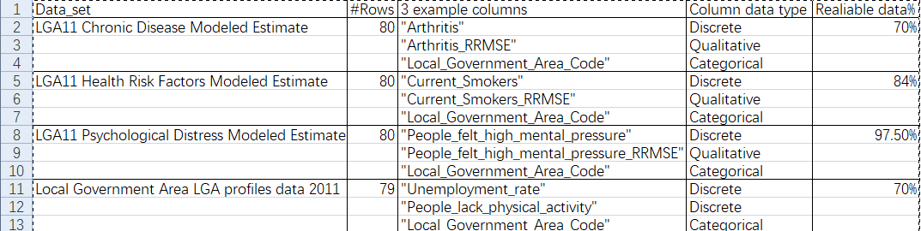
data sets used & why
LGA11 Chronic Disease Modeled Estimate
LGA11 Health Risk Factors Modeled Estimate
LGA11 Psychological Distress Modeled Estimate
Local Government Area LGA profiles data 2011
All downloaded from aurin

Slide 6
data preprocessing methods used
Wrong data corrected
Unreliable data dropped
Missing data
Columns replaced by schema
Data normalization
Deriving data from raw data
Finally have three DataFrame: disease_risks, health_risks, lga_features

Slide 7
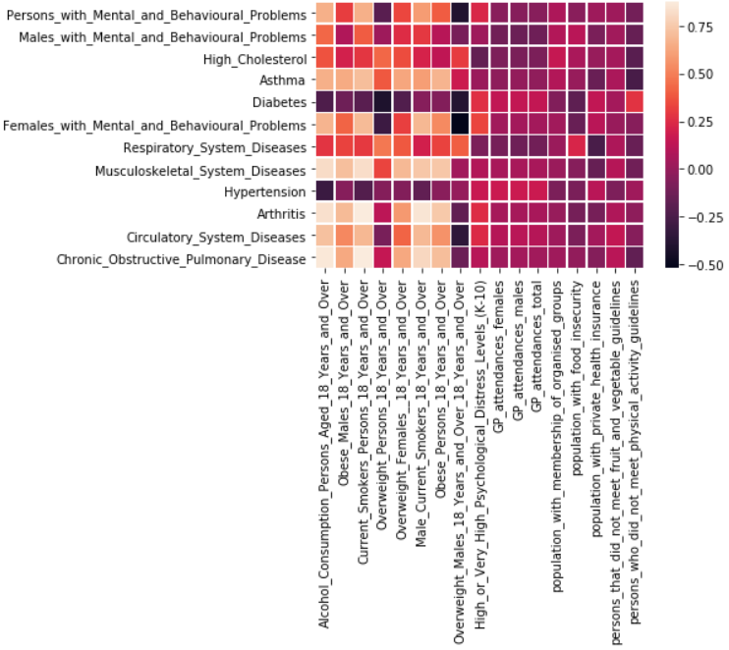
findings
heat map against disease risk and health risk

Slide 8
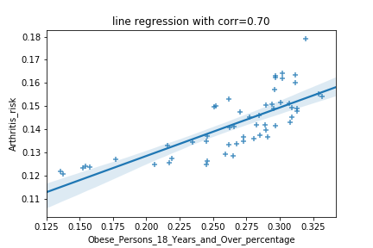
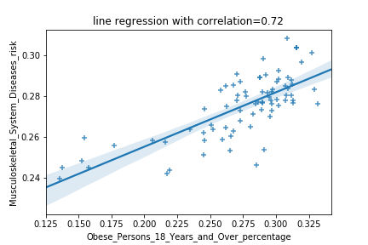
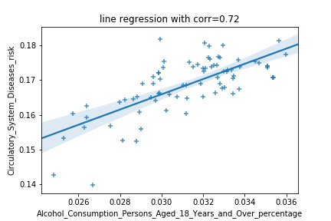
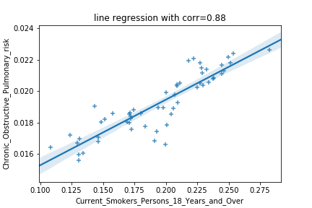
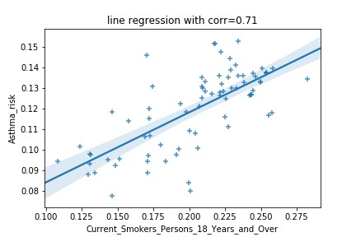
findings
1) obese v.s. arthritis risk 2) obese v.s. musculoskeletal system diseases risk
5) alcohol v.s. circulatory system disease
3) smoke v.s. chronic obstructive pulmonary risk 4) smoke v.s. asthma

Slide 9
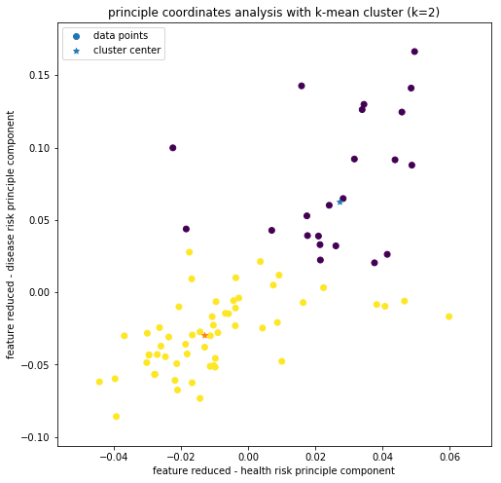
findings
The sixteen communities with high risks：
Moreland，
Kingston，
etc
principle coordinated analysis with K-mean (k=2) clustering

Slide 10
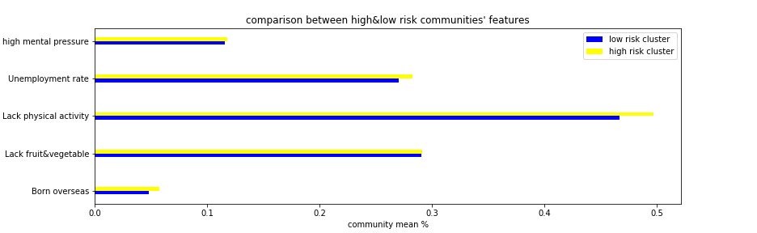
findings
community feature for clustered data

Slide 11
findings from analysis
circulatory system disease <> drinking alcohol
musculoskeletal system diseases & arthritis <> obese adults
Asthma & chronic obstructive pulmonary disease <> smokers
high people felt high mental pressure,
high unemployment rate
High rate of lack of exercises
High immigrants’ population percentages
<> : correlated
Features of Community with
High risk

Slide 12
challenges
Appropriate data sets to use
Selecting columns(100+ columns in lga census data set) also consumes a lot of time
Notes:
limits of investigation

Slide 13
The end
Thanks for your attentions

Slide 14
Q & A
Any questions and queries?

