Slide 1
RxJS
yangyanbin

Slide 2
Action
import {createAction,props } from ‘@ngrx/store’;
export const getTodoList = createAction(‘[Todo] get Todo list’);
//此action供组件dispatch使用
export const getTodoListSuccess = createAction(‘[Todo] get Todo list success’,props<{list:string[]}>());
//此action供effect请求service成功后调用更新数据

Slide 3
Reducer
import { createReducer, on } from ‘@ngrx/store’;
import {getTodoList,getTodoListSuccess} from ‘todo.action’;
const initialState = {};
export todoReducer = createReducer(initialState,
on(getTodoListSuccess, (state,action)=>{
const newState = …;
//返回最新的state
return {…state,…newState};
});
);

Slide 4
service
import { Injectable } from "@angular/core";
import { HttpService } from "../../utilities/http.service";
@Injectable({
providedIn: "root",
})
export class EmployeeProfileService {
constructor(private http: HttpService) {}
getTodoListAjax() {
return this.http.get<EmployeeProfile>(url);
}
}

Slide 5
Effects
import { Injectable } from "@angular/core";
import { Actions, ofType, createEffect } from "@ngrx/effects";
import { EMPTY } from "rxjs";
import { catchError, map, mergeMap, concatMap } from "rxjs/operators";
import { getTodoList, getTodoListSuccess } from ‘todo.action’;
@Injectable()
export class TodoEffects{
constructor(private action$:Actions){}
getTodoList$ = createEffect(()=>{
return this.action$.pipe(
ofType(getTodoList), //处理此action
map(()=>{}), // map处理上一步流出的数据，此处为空或action，返回值会留到下一步
concatMap/mergeMap((action)=> getTodoListAjax()),
catchError(()=>Empty)
);
。。。

Slide 6
Effects和Reducer
当在组件中dispatch一个action时，reducer和effects中同type的方法都会执行，所以同一个action不用同时存在effects和reducer中即可

Slide 7
selector
import { createSelector, createFeatureSelector } from ‘@ngrx/store’;
//获取的todo下所有的state
export const todoSelector = createFeatureSelector(‘todo’);
//获取经过处理的state数据
export const todoItemSelector = createSelector(todoSelector,state=>{
const newState = …;
return newState;
});

Slide 8
组件应用
import { Store, select } from ‘@ngrx/store’
import { Subscription } from ‘rxjs’
class Component implements OnInit{
subscribe: Subscription;
constructor(private store$:Store){}
ngOnInit(){
this.subscribe = this.this.store$.pipe(select(selector)).subscribe(state=>{});
}
…
this. subscribe.unSubscribe();
}

Slide 9
Async
Data$: Observable = store.select(selector)
组件中直接使用Data$ | async
通过async通道可以直接subscribe数据，同时会在组件销毁时 unsubscribe
多个地方使用async会产生多次订阅，尽量在统一的一个地方进行订阅。
使用ngIf=”data$ | async as data”
安装@ngrx/component，然后使用ngrxLet=“data$ | async as data”

Slide 10
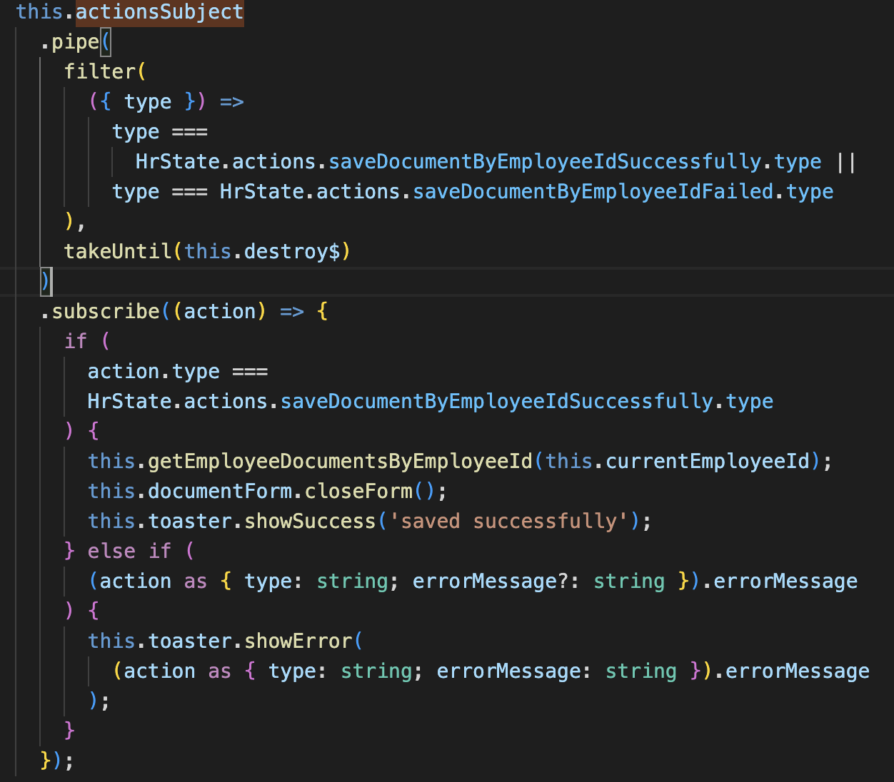
监听effect执行结束
import { select, Store, ActionsSubject } from '@ngrx/store';

