Slide 1


An Improved YOLOv8-Based Rice Pest and
Disease Detection
Yang Yang¹, Jianlin Zhu¹, Bo Yang¹, Xiao Zhang^{1,2}, and Jin Huang³
1 South-Central Minzu University, a. College of Computer Science; b. Hubei Provincial Engineering Research Center for Intelligent Management of Manufacturing Enterprises, Wuhan 430074, China;
2 School of Computer Science and Technology, University of Science and Technology of China, Hefei 230026, China
3 School of Computer Science and Artificial Intelligence, Wuhan Textile University, Wuhan 430200, China
Yang Yang

Slide 2
1
Research Background
2
Research Methods
3
Experiment Results
4
Conclusions

Slide 3
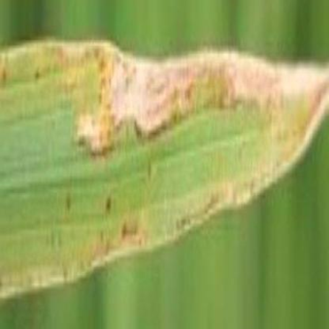
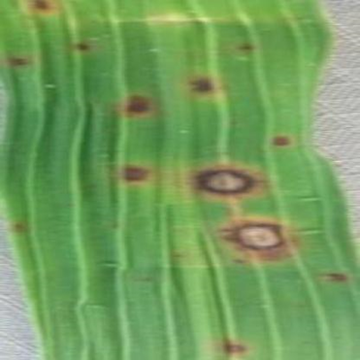
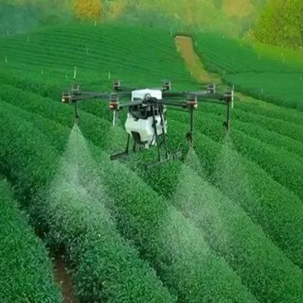
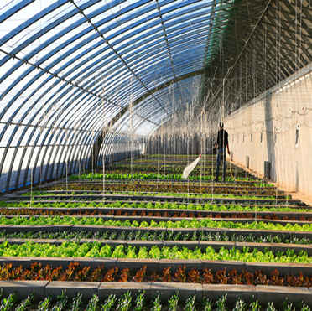
Deep learning-based detection of pests and diseases in farmland is widely used in agricultural production areas
Increasing global emphasis on green and ecological agriculture
Fig. 1
Fig. 2
Fig. 3
Fig. 4

Slide 4
Traditional machine learning-based disease recognition methods mainly rely on accurately extracted feature parameters, but generally only a few typical features can be extracted to express all the information of several diseases
Recognition methods based on deep learning usually require a large amount of data as the basis for training the model to obtain high recognition accuracy

Slide 5
1
Research Background
2
Research Methods
3
Experiment Results
4
Conclusions

Slide 6
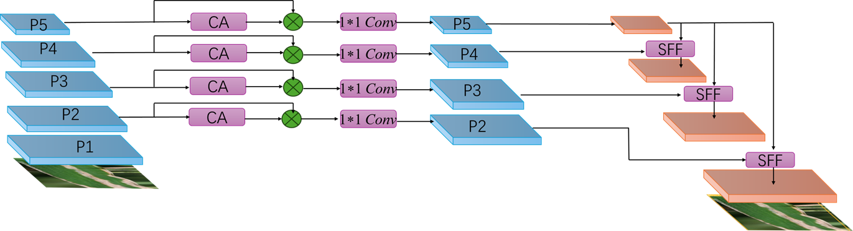
Backbone
Feature Selection
Feature Fusion
Fig. 5 The structure of YOLOv8-HSFPN
The backbone network is mainly used to extract multi-scale image features, and HSFPN solves the challenges posed by limited features, realizes the fusion of multi-scale features, and improves the feature expression capability of the model

Slide 7
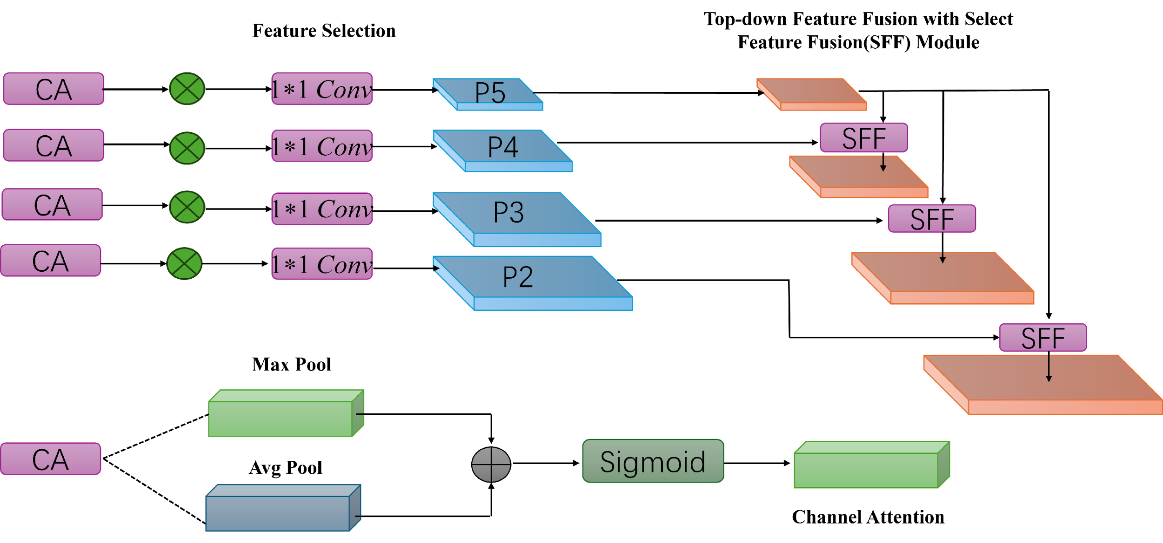
Fig. 6 The structure of HSFPN
The architecture is comprised of two principal components: the feature selection module and the feature fusion module

Slide 8
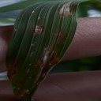

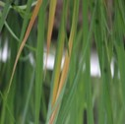
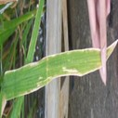
Fig. 7 Leaf Spot Disease
Fig. 8 Brownspot
Fig. 9 Tungro
Fig. 10 Bacterial Blight
Categories | Train Set | Validation Set | Test Set
Leaf Spot Disease | 2237 | 313 | 108
Brownspot | 3261 | 275 | 95
Tungro | 1692 | 163 | 124
Bacterial Blight | 2678 | 198 | 148

Slide 9
1
Research Background
2
Research Methods
3
Experiment Results
4
Conclusions

Slide 10
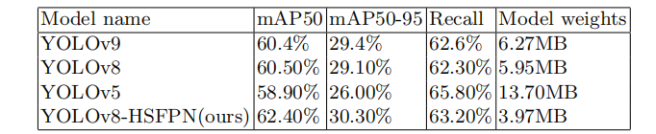

Slide 11
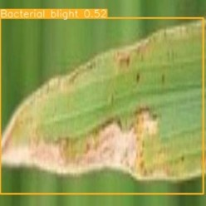
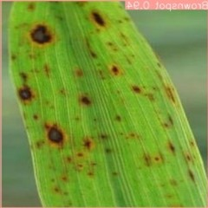
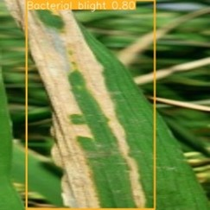
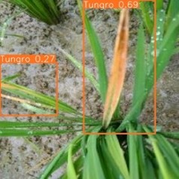
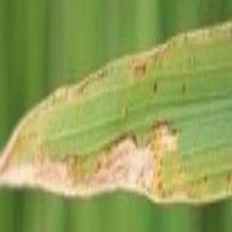
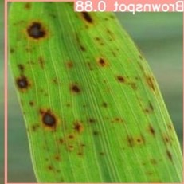
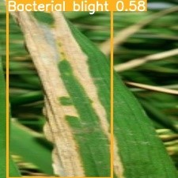
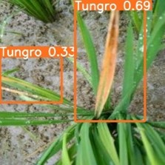
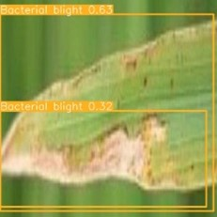
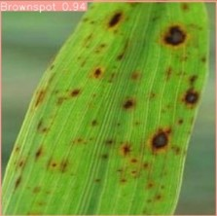
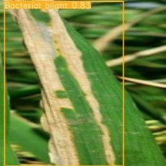
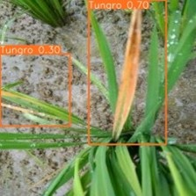
Fig. 11 YOLOv8
Fig. 12 YOLOv5
Fig. 13 YOLOv8-HSFPN

Slide 12
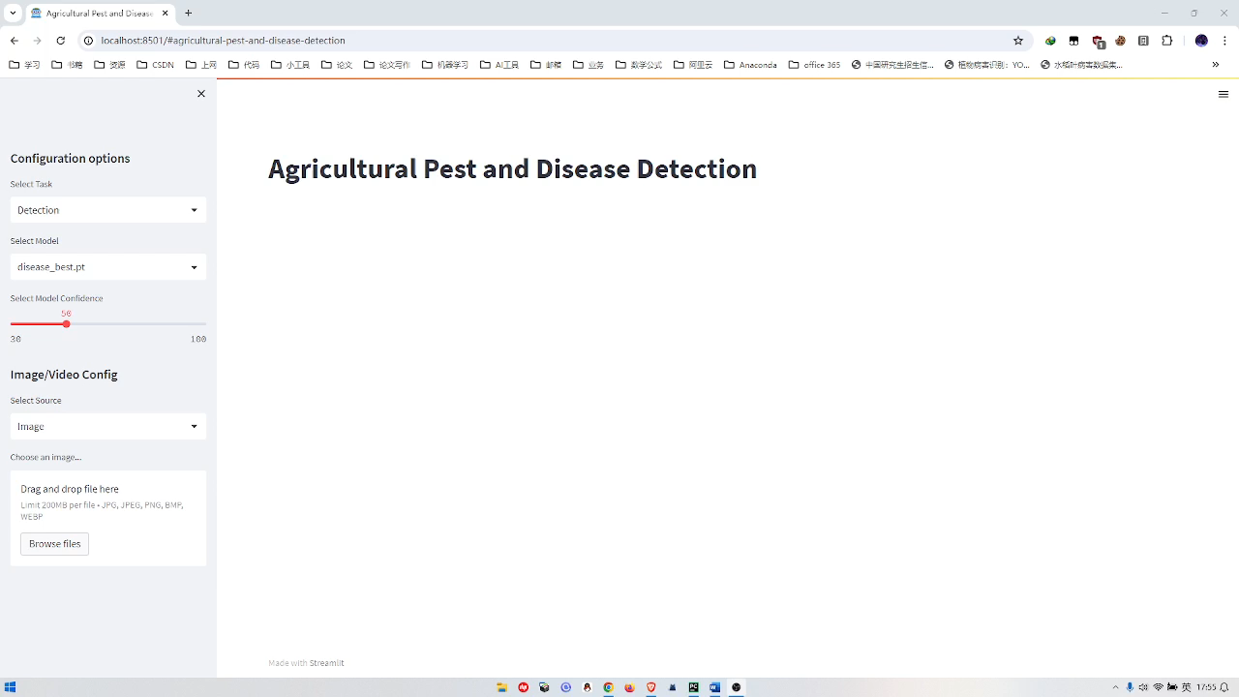
Video Demonstration

Slide 13
1
Research Background
2
Research Methods
3
Experiment Results
4
Conclusions

Slide 14
In this paper, we propose a novel High-level Select Feature Pyramid Network
(HSFPN) that substitutes the Neck component of the traditional YOLOv8 architecture. Enhancements incorporating multilevel feature fusion and deformable
self-attention mechanisms facilitate more efficient image feature extraction. The
resultant model is not only more lightweight but also exhibits improvements in
detection accuracy, while concurrently requiring fewer computational resources.

Slide 15
Acknowledgments
This work was supported in part by the Fund for Academic Innovation Teams and Research Platform of South-Central Minzu University (Grant Number: XTZ24003, PTZ24001),
Knowledge Innovation Program of Wuhan-Basic Research (Project No.: 2023010201010151), and the Research Start-up Funds of SouthCentral Minzu University under grant YZZ18006,
and the Spring Sunshine Program of Ministry of Education of the People’s Republic of China under grant HZKY20220331.

Slide 16
Thank you! Yang Yang South-Central Minzu University 2024.07.05

