Slide 1
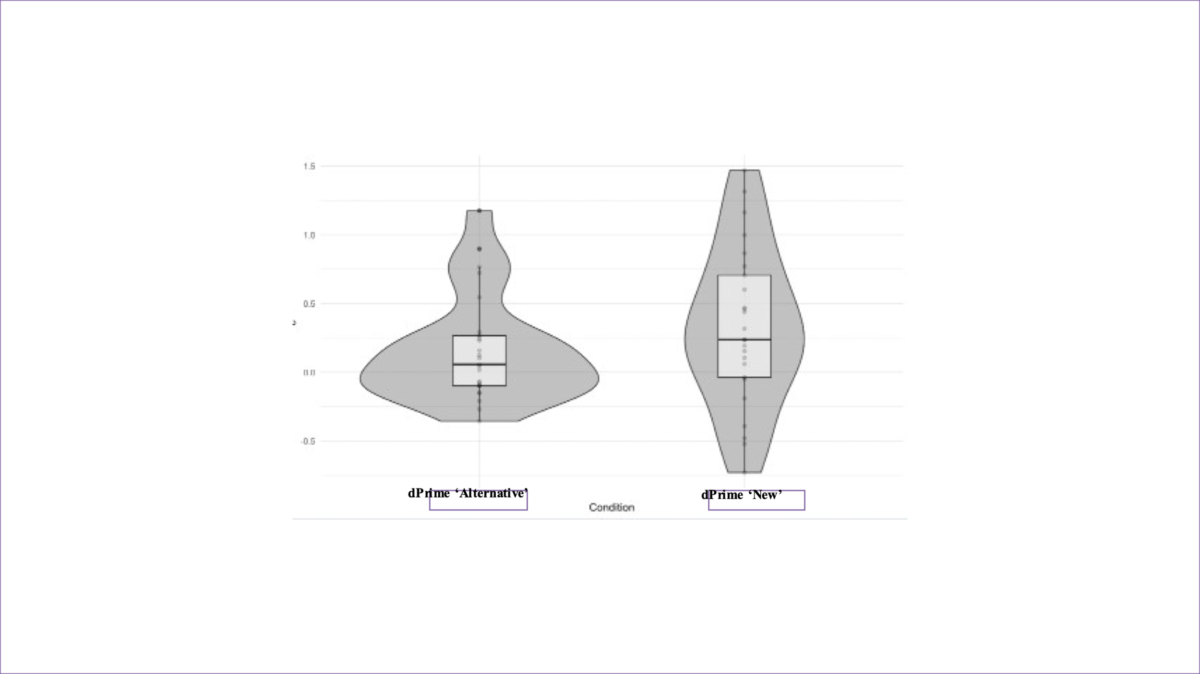
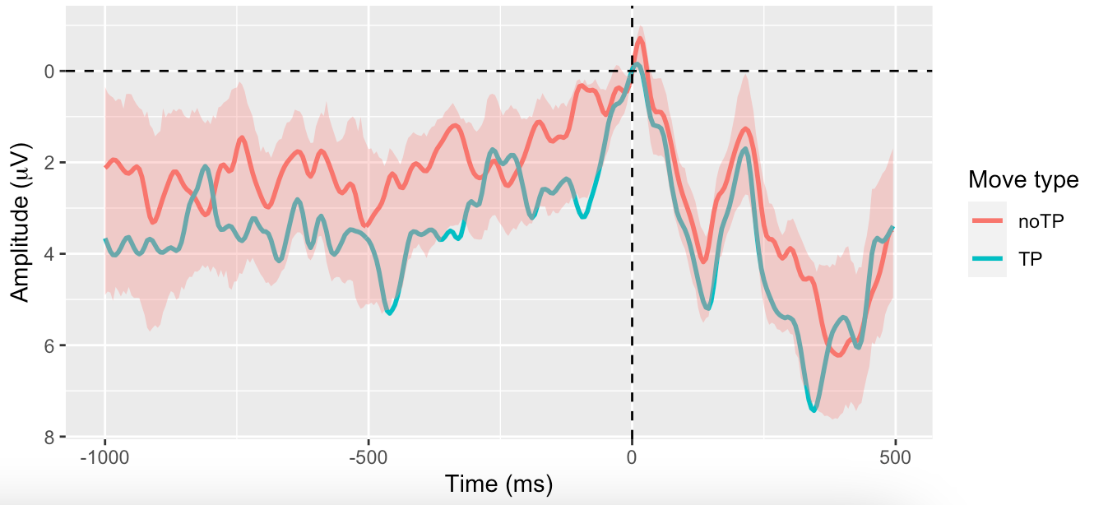
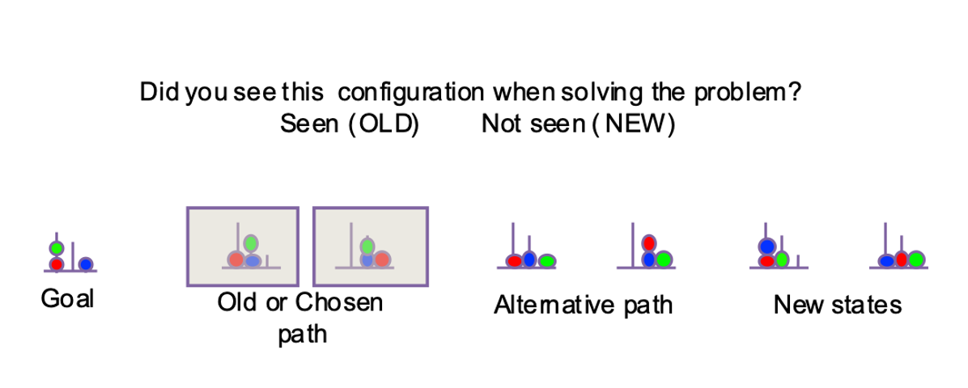
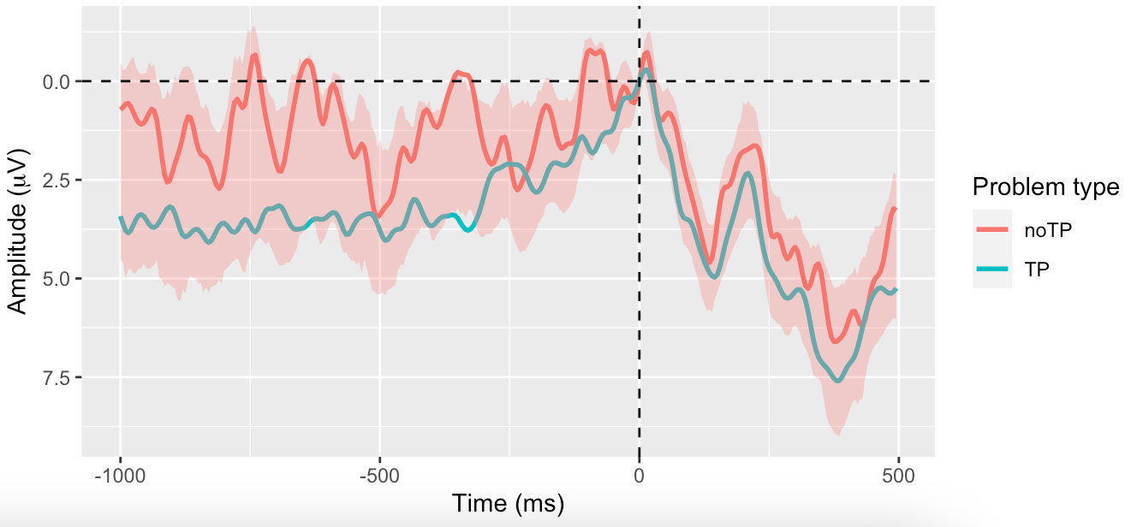
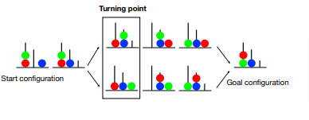
=
Representations, consciousness and memory in goal directed behavior
^{Student number: 20014372} Supervisor name: Patrick Haggard
Institute of Cognitive Neurosciences
1. Introduction
2. Methods
Experiment 1
(N=25) participants solved ToL problems on a computer, moving the pegs from start to goal configuration.
They were asked to plan out their solution for the problem.
The ToL problems were selected to include a Turning point (TP), where the participants commit to one of the alternatives of solving.
In the memory test, participants had to look at 7 different ball configurations and classify them ‘old’ or ‘new’ based on whether they thought they had seen them or not.
2.1 Key press diagram and design of experimental paradigm: Participants move from left to right.
2.2 Memory task based on ToL problem 1.1: 7 configurations given, participants chose ‘Seen’ or ‘Unseen’ for each configuration
Experiment 2
(N=20) participants played with ToL tasks.
The trials were divided into Stimuli or Control (guided with instructions) and Testing (active-planning to find solution).
We recorded and compared the Readiness Potential amplitude for those trials with Turning Point and without Turning Point
Also, we looked the effect of the Turning Point as the first step in the problem.
3. Results
Experiment 1
3.1.1 Larger false alarm rate, and thereby d prime obtained for alternative trials compared to the new configurations. Difference significant (p-values=0.035). Null hypothesis rejected.
Experiment 2
First Turning Point move vs Other moves
3.2.2 RP amplitude between first move and other moves within Turning Point problems No significant difference (p-value=0.2626)
1.1 Voluntary actions
Voluntary actions are characterized as an internal, spontaneous, and goal-directed behavior initiated out of an individual’s own will.
Implication in many ethical and moral debates.
Readiness Potential (RP) a biomarker describes as ramping up of negativity preceding a voluntary action
1.2 Goal directed feature in Voluntary actions
One idea of volition is a typical scenario in which a person is presented with many ways to do a thing, the participant should have no preference to pick one alternative over the other, but the person still breaks the symmetry by committing to one of the options. We expect this action taken to be a prototype for an internal generated movement. This is also called Buridan’s choice.
1.3 Problem Solving Tasks for studying voluntary actions
Existing experimental paradigms are confined to studying voluntary actions in “meaningless” actions.
In this experiment, a problem-solving activity called Tower of London (ToL) was implemented. (Shallice, 1982).
ToL tasks offers a novel and rich way to study voluntary actions, linking ToL to problem solving (which generates internally generated actions)
. The moment when participants commit to one of the choices is called the Turning Point (TP).
1.1 ToL problem with TP: Bifurcation point where either of the 2 alternatives can be taken to solve the problem
4. Discussion
Experiment 1
The results of the memory test show that subjects represent the alternative unchosen option
This means that during problem-solving people represent the ‘means to solve the problem by representing both alternatives that they could had chosen.
Experiment 2
The RP amplitude is not sensitive to the presence of Turning Point.
We can interpret this results as:
RP not the correct neural marker to measure representation of choices
Process of committing to one choice occurs earlier than the onset of RP
Sample size not large enough to produce significant results.
Experiment 2
Turning Point vs no Turning Point problems
3.2.1 RP amplitude between TP problems and no TP problems No significant difference (p-value=0.105)
5. References
Haggard, P. (2019). The Neurocognitive Bases of Human Volition. Annual Review of Psychology, 70(1), 9–28. https://doi.org/10.1146/annurev-psych-010418-103348
Sumner, P., Nachev, P., Morris, P., Peters, A. M., Jackson, S. R., Kennard, C., & Husain, M. (2007). Human Medial Frontal Cortex Mediates Unconscious Inhibition of Voluntary Action. Neuron, 54(5), 697–711. https://doi.org/10.1016/j.neuron.2007.05.016
Zhang, L., Zhang, R., Yao, D., Shi, L., Gao, J., & Hu, Y. (2020). Differences in Intersubject Early Readiness Potentials Between Voluntary and Instructed Actions. Frontiers in Psychology, 11. https://doi.org/10.3389/fpsyg.2020.529821
Travers, E., Friedemann, M., & Haggard, P. (2021). The Readiness Potential reflects planning-based expectation, not uncertainty, in the timing of action. Cognitive Neuroscience, 12(1), 14–27. https://doi.org/10.1080/17588928.2020.1824176
Khalighinejad, N., Schurger, A., Desantis, A., Zmigrod, L., & Haggard, P. (2018). Precursor processes of human self-initiated action. NeuroImage, 165, 35–47. https://doi.org/10.1016/j.neuroimage.2017.09.057
Notes:
For us to understand the studies purpose and significance, I must first provide some background regarding the nature of Voluntary actions. Voluntary actions or also called ‘self-initiated’ actions’ are characterized usually by a set of features. The action must be internal, spontaneous, and goal-directed behaviour that is initiated out of an individual's own will. It is commonly acknowledged by society that only fully conscious acts are conceived as being entitled of credit or blame. Thereby studying whether our actions are controlled by ‘ourselves’ is a vital question we must ask to comprehend many human behaviours and reconsider any ethical and moral debates. Readiness Potential is a widely used biomarker of voluntary action that is described by the progressive accumulation of negativity in the motor cortex preceding an action onset.
One idea of volition is a typical scenario in which a person is presented with many ways to do a thing, the participant should have no preference to pick one alternative over the other, but the person still breaks the symmetry by committing to one of the options. We expect this action to break the symmetry to be a prototype for an internal generated movement. This is also called Buridan’s choice.
Our main objective of this experiment was to address the key limitations that previous volition studies have encountered. Conventional studies were limited to studying meaningless actions without a purpose, for this reason we looked to employ goal directed ToL problems instead. In the problem, subjects aim to match the start configuration of the colored balls to end configuration. During the process, they encountered a TP where they can solve the problem either through path A or B. In the first experiment, we followed each ToL problem with memory task where participants state whether they had seen each configuration of pegs or not. We gave them 7 configurations for each problem, including 2 alternative unchosen options, 2 new configurations, 2 old configurations and a goal as sanity check. We analysed the results of the memory task applying signal detection theory, and then using Shapiro-Wilk test to test the normality and afterwards using paired 2 sample t test to analyse the significancy of the results. And we discovered that participants were significantly more likely, given by p-value 0.035 to correctly detect ‘new configurations’ as new, instead of ‘alternative’ as new. This disparity may result from unconscious memory representation of the ‘alternative pathway’ even before decision takes place,
The RP amplitude, described as the ramping up of negativity in the neurons preceding the intention to move, has been interpreted as a biomarker for voluntary action. In this experimental paradigm with the presence of a TP, as both alternative choices were equally optimal, that is solved by minimum number of moves, the action driving a choice to be made when there is no reason to pick one alternative over the other, is thought to be a key feature of volition. In the second experiment, we hypothesize that we would be able to measure a greater RP amplitude preceding TP problems vs noTP problems as there is greater freedom of choice and therefore more alike self generated moves. We used a 2-sample t-test to compare the magnitude of the RP, and this test showed that the p-value was 0.105, which is greater than the set alpha value, so we fail to reject the null hypothesis and we conclude that the results were not significant. We also recorded the RP amplitude of the actions preceding the first move of a TP problem and any other moves within the problem. Again, the p-value was greater than the value we would conclude the results as significant. Both of these results in the second experiment show that the RP amplitude is not sensitive to the presence of a TP move. Although the results of the second experiment does not match our hypothesis, we have several different interpretations to explain this. Either we can say that the RP is not the suitable biomarker to measure representation of choice, as voluntary action may not be directly linked to decision making. But it could also be the case that the representation of the alternatives moves occur much earlier than the onset of the RP, so we are not able to detect the signal at -1000msec were we expected the RP onset. Finally, another reason why we failed to prove our hypothesis of the EEG experiment could be due to the limited sample size. As commonly acknowledged a larger sample size increases the likelihood of finding significant results, so we may need to further expand the sample size to analyze the sensitivity of RP amplitude again.

