Slide 1
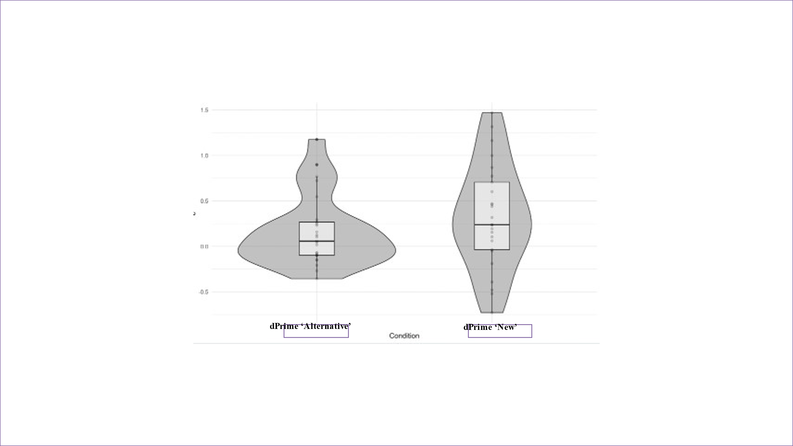
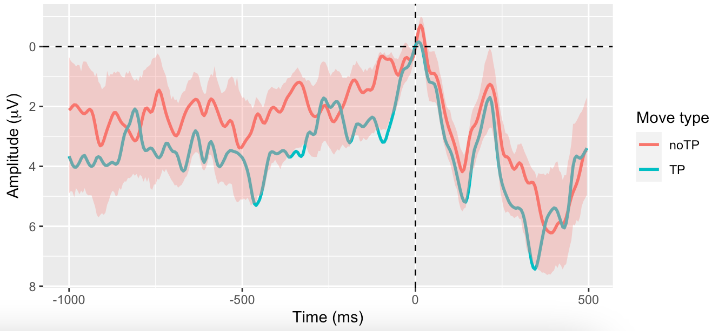
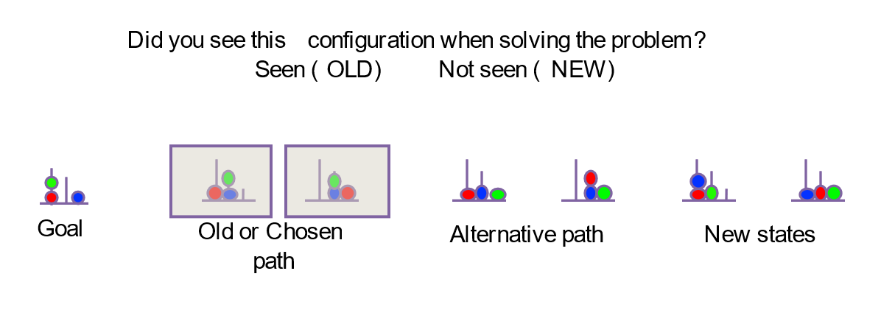
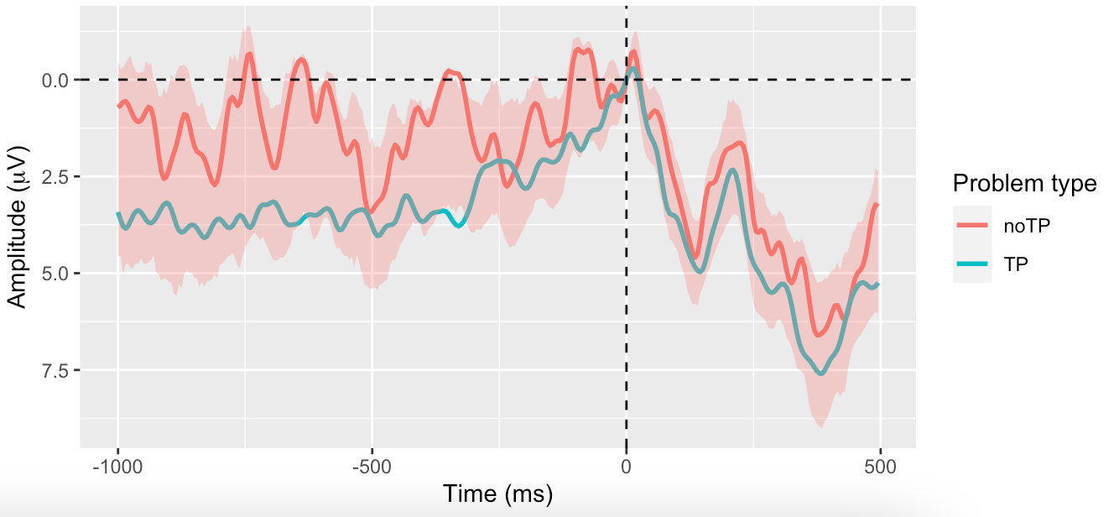
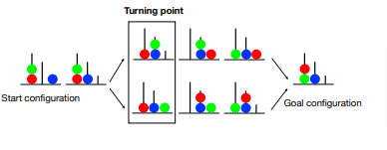

=
Representations, consciousness and memory in goal directed behavior
^{Student number: 20014372} Supervisor name: Patrick Haggard
Institute of Cognitive Neurosciences
1. Introduction
2. Methods
Experiment 1
(N=25) participants solved ToL problems on a computer, moving the pegs from start to goal configuration.
They were asked to plan out their solution for the problem.
The ToL problems were selected to include a Turning point (TP), where the participants commit to one of the alternatives of solving.
In the memory test, participants had to look at 7 different ball configurations and classify them ‘old’ or ‘new’ based on whether they thought they had seen them or not.
2.1 Key press diagram and design of experimental paradigm: Participants move from left to right.
2.2 Memory task based on ToL problem 1.1: 7 configurations given, participants chose ‘Seen’ or ‘Unseen’ for each configuration
Experiment 2
(N=20) participants played with ToL tasks.
The trials were divided into Stimuli or Control (guided with instructions) and Testing (active-planning to find solution).
We recorded and compared the Readiness Potential amplitude for those trials with Turning Point and without Turning Point
Also, we looked the effect of the Turning Point as the first step in the problem.
3. Results
Experiment 1
3.1.1 Larger false alarm rate, and thereby d prime obtained for alternative trials compared to the new configurations. Difference significant (p-values=0.035). Null hypothesis rejected.
Experiment 2
First Turning Point move vs Other moves
3.2.2 RP amplitude between first move and other moves within Turning Point problems No significant difference (p-value=0.2626)
1.1 Voluntary actions
Voluntary actions are characterized as an internal, spontaneous, and goal-directed behavior initiated out of an individual’s own will.
Implication in many ethical and moral debates.
Readiness Potential (RP) a biomarker describes as ramping up of negativity preceding a voluntary action
1.2 Goal directed feature in Voluntary actions
One idea of volition is a typical scenario in which a person is presented with many ways to do a thing, the participant should have no preference to pick one alternative over the other, but the person still breaks the symmetry by committing to one of the options. We expect this action taken to be a prototype for an internal generated movement. This is also called Buridan’s choice.
1.3 Problem Solving Tasks for studying voluntary actions
Existing experimental paradigms are confined to studying voluntary actions in “meaningless” actions.
In this experiment, a problem-solving activity called Tower of London (ToL) was implemented. (Shallice, 1982).
ToL tasks offers a novel and rich way to study voluntary actions, linking ToL to problem solving (which generates internally generated actions)
. The moment when participants commit to one of the choices is called the Turning Point (TP).
1.1 ToL problem with TP: Bifurcation point where either of the 2 alternatives can be taken to solve the problem
4. Discussion
Experiment 1
The results of the memory test show that subjects represent the alternative unchosen option
This means that during problem-solving people represent the ‘means to solve the problem by representing both alternatives that they could had chosen.
Experiment 2
The RP amplitude is not sensitive to the presence of Turning Point.
We can interpret this results as:
RP not the correct neural marker to measure representation of choices
Process of committing to one choice occurs earlier than the onset of RP
Sample size not large enough to produce significant results.
Experiment 2
Turning Point vs no Turning Point problems
3.2.1 RP amplitude between TP problems and no TP problems No significant difference (p-value=0.105)
5. References
Haggard, P. (2019). The Neurocognitive Bases of Human Volition. Annual Review of Psychology, 70(1), 9–28. https://doi.org/10.1146/annurev-psych-010418-103348
Sumner, P., Nachev, P., Morris, P., Peters, A. M., Jackson, S. R., Kennard, C., & Husain, M. (2007). Human Medial Frontal Cortex Mediates Unconscious Inhibition of Voluntary Action. Neuron, 54(5), 697–711. https://doi.org/10.1016/j.neuron.2007.05.016
Zhang, L., Zhang, R., Yao, D., Shi, L., Gao, J., & Hu, Y. (2020). Differences in Intersubject Early Readiness Potentials Between Voluntary and Instructed Actions. Frontiers in Psychology, 11. https://doi.org/10.3389/fpsyg.2020.529821
Travers, E., Friedemann, M., & Haggard, P. (2021). The Readiness Potential reflects planning-based expectation, not uncertainty, in the timing of action. Cognitive Neuroscience, 12(1), 14–27. https://doi.org/10.1080/17588928.2020.1824176
Khalighinejad, N., Schurger, A., Desantis, A., Zmigrod, L., & Haggard, P. (2018). Precursor processes of human self-initiated action. NeuroImage, 165, 35–47. https://doi.org/10.1016/j.neuroimage.2017.09.057

