Slide 1


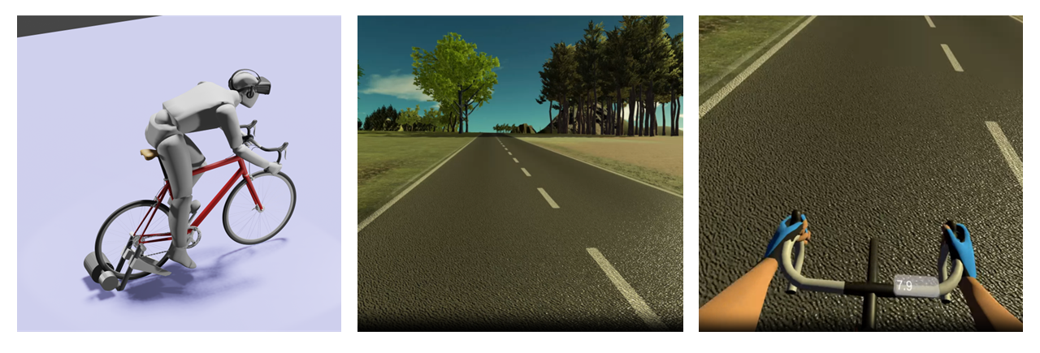
Exploring the Effort-Reward Paradox in sports under the experimental paradigm of DOMS model
Introduction
Experimental Design
Analysis
- how human brain is susceptible to a feeling of ‘reward’ and ‘achievement’ when undergoing through physically straining exercises, even under the influence of discomfort or pain
- DOMS model will be induced in the participant simulating the painful discomfort scenario that the participant will have to overcome.
Prior to experiment:
Participants randomized into 2 groups: rest and exercise group
Brief questionnaires, demographic, sleep conditions, physical activity (Tegner Activity scale)
Relationship between variables
Time Frequency EEG analysis
- Before each trial, the participant can be either notified or blinded of the inclination for the following task
- For all trials, participants need to press a button to start the task
- Looking for an event related potential difference to commence a tasks that require more physical effort and mental commitment e.g. RP
 | High Incline (difficult) | Low Incline (low difficulty) | No incline (control)
Pain rating | high | medium | low
Reward rating | 1-10 | 1-10 | 1-10
 | Rest (control) | Exercise
Pain rating | 1-10 | 1-10
Reward rating | 1-10 | 1-10
Inducing DOMS
Participants that are randomised to exercise group are invited to attend DOMS induction session
The experimental protocol to induce DOMS include knee extension repetitions
A leg extension machine has been purchased to ensure to ensure safety and comfort of participants
Weight implemented will be dependent on each participants ability (1-RM)
Delayed onset of Muscle Soreness (DOMS)
DOMS is described as the muscle soreness caused by repetitive eccentric exercise which causes low level muscle injury
As DOMS is pain associated with active dynamic movements, subjects should not feel pain when at rest, but only when engaging affected muscles. (Hotfiel et al, 2018)
People often associate exercise related muscle pain e.g. DOMS, as positive, often related to reward and progress
Experiment
-Participants will be asked to rate pain using Visual analogue scale of pain (VAS) ~48h after the DOMS induction session
- If the rating is above +2 of VAS scale, the participant will be classified into the exercise group and invited to attend the EEG session.
- During the session, participants are asked to pedal on a fixed-turbo bike. While being immersed in a VR scenario simulating different mountain ascents.
- The steepness of the mountain climb will be directly coupled with resistance on the pedals of the bike
- By the end of each trial, the participants are asked to rate their reward level and pain level
- EEG will also be recorded throughout the experiment (Tamburro et al, 2020).
Objectives of the study
a) Do people report a greater rating of achievement or reward when the task is greater in difficulty
Does pain level reported influence the feeling of reward in a task, and what is the relationship between them.
Relationship between pain reported and reward rating of participants in rest and exercise group
d) Based on each participant cases, does the relationship between pain and reward reported vary largely? This may show that each person is different in their likelihood to gain reward from self-induced suffering.
Looking at the lifestyle questionnaire, do those with a positive relationship between reward and pain, also engage more often in physical exercise, and do they have history of overexertion injury.
Why is exercise related pain positively associated?
’Effort-Reward Paradox’
Common conception: Biological systems devalue mental or physical activities involving more effort, to reduce energy expenditure (Westbrook & Braver, 2015)
The concept of ‘effort-reward paradox’ contradicts this conception. This is observed in sports enthusiasts as well as ordinary people as they often report greater levels of satisfaction after enduring trough intense or even painful training (Lev et al, 2023, Whitton et al, 2020, Wang & Demerin, 2023).
References
Westbrook A, Braver TS. Cognitive effort: A neuroeconomic approach. Cogn Affect Behav Neurosci. 2015 Jun;15(2):395-415. doi: 10.3758/s13415-015-0334-y
Inzlicht M, Shenhav A, Olivola CY. The Effort Paradox: Effort Is Both Costly and Valued. Trends Cogn Sci. 2018 Apr;22(4):337-349. doi: 10.1016/j.tics.2018.01.007.
Lev, A. (2023). “The Glorious Pain”: Attaining Pleasure and Gratification in Times of Delayed Onset Muscle Soreness (DOMS) among Gym Goers. Journal of Contemporary Ethnography, 52(3), 295-316. https://doi.org/10.1177/08912416221113369
Hotfiel T, Freiwald J, Hoppe MW, Lutter C, Forst R, Grim C, Bloch W, Hüttel M, Heiss R. Advances in Delayed-Onset Muscle Soreness (DOMS): Part I: Pathogenesis and Diagnostics. Sportverletz Sportschaden. 2018 Dec;32(4):243-250. English. doi: 10.1055/a-0753-1884.
Hodges, P. W., & Tucker, K. (2011). Moving differently in pain: A new theory to explain the adaptation to pain. Pain, 152(3), S90–S98. https://doi.org/10.1016/j.pain.2010.10.020
Whitton, O. M., Bowtell, J., & Jones, M. (2020). A critical consideration of the role of mental toughness and pain in the acute pain experiences of athletes. International Review of Sport and Exercise Psychology, 1–21. https://doi.org/10.1080/1750984X.2020.1836672
Contact: email@sample.ox.ac.uk

