Slide 1
Using machine learning in chat box for heart disease prediction
COMP4105
Lingyun Yang -20341447
05/25/2022

Slide 2
Overview
Background Introduction
Project Object
Experiment
Chat box building
Model building and parameter optimization
Model Evaluation
Feature work & Conclusion

Slide 3

Background Information
According the CDC and NHS England reports, heart disease is one of the deadly disease with high incidence[1].
The median number of waiting time in NHS England was 11.5 weeks[2].
Such long wait times may miss the best prevention and treatment period for early-stage patients.
[3]

Slide 4
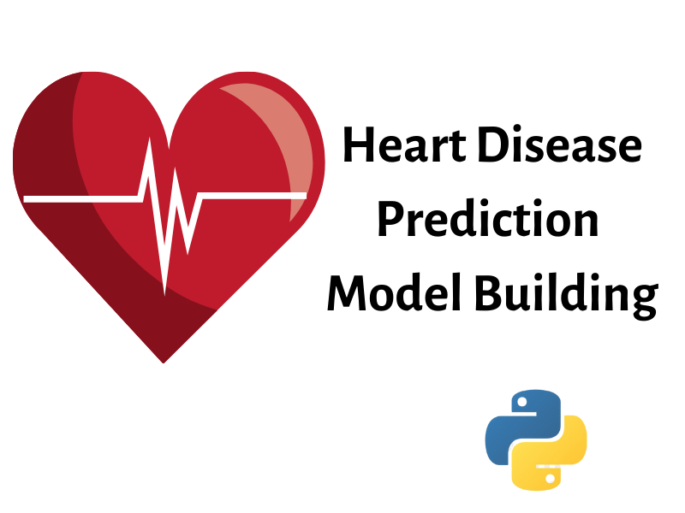
Project Object
Heart disease prediction model
Help possible high-risk groups to prevent heart disease by building a heart disease prediction model
[4]

Slide 5

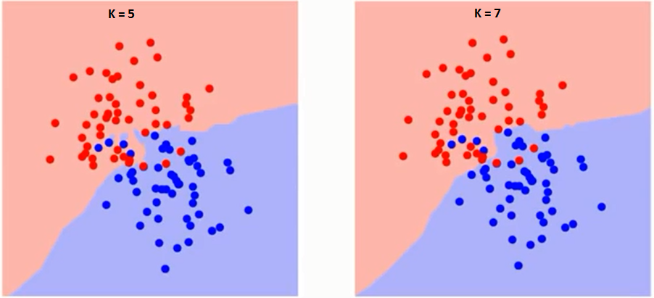
Experiment
Key Approach
KNN & SVC
Data collection
Model Building
[5]
[6]
collect data using simple conversations and apply machine learning methods KNN and SVC to build the model.

Slide 6
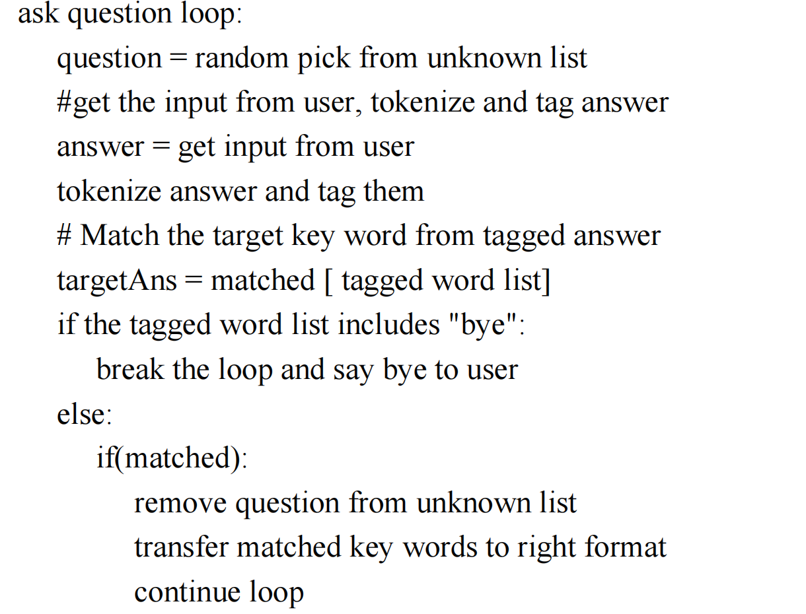
Experiment
Chat Box design
Design and group questions based on the answer type: binary, numerical, categorical etc.
NLTK toolkit to tokenize the answer and tagging each word.
If there is an target word in the answer, then convert it into the correct format to be used as input to the model to make predictions.
Error handling: If user’s answer out of the restricted answer, ask the user answer this question again;

Slide 7
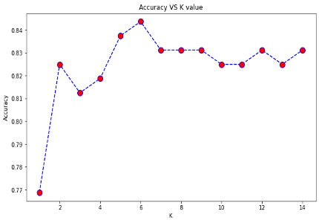
Experiment
K_NN Model and optimization
KNN manipulates the training data and classifies the new test data using distance measures and then classifies the data based on the majority vote.
No pre-defined statistical methods to find the best K.
Randomly pick a K value and start the computing.
Iterate over all possible K values.

Slide 8
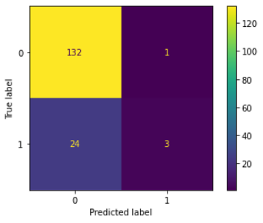
Model Experiment
K_NN Model, Confusion matrix
Set the K = 6 and calculate the confusion metrics.

Slide 9

Model Experiment
SVC Model, Confusion matrix
Support Vectors Classifier attempts to identify the optimal hyperplane for classifying data by optimising the distance between sample points and the hyperplane.
C is the mistake term's penalty parameter. It regulates the trade-off between a smooth decision boundary and the proper classification of training points.
Set Parameter range of C [0.1,1,10,1000]. The best C is 0.1 with an accuracy of 0.7875. And get the confusion matrix.

Slide 10
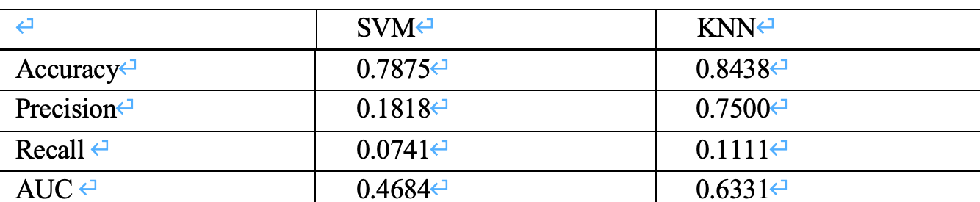

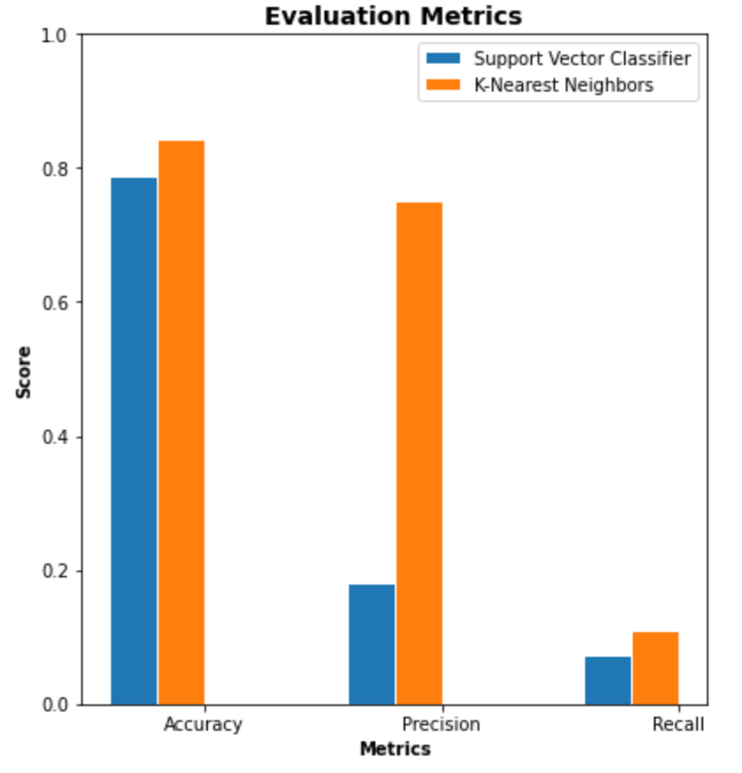

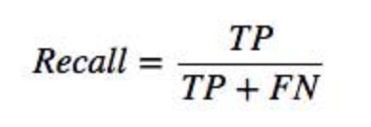
Model Evaluation
Evaluation Metrics
Accuracy is ratio of properly predicted observations to the total number of observations
Precision is the ratio of correctly predicted positive observations to the total predicted positive observation
Recall actually calculates how many of the Actual Positives that model capture through labeling it as Positive

Slide 11
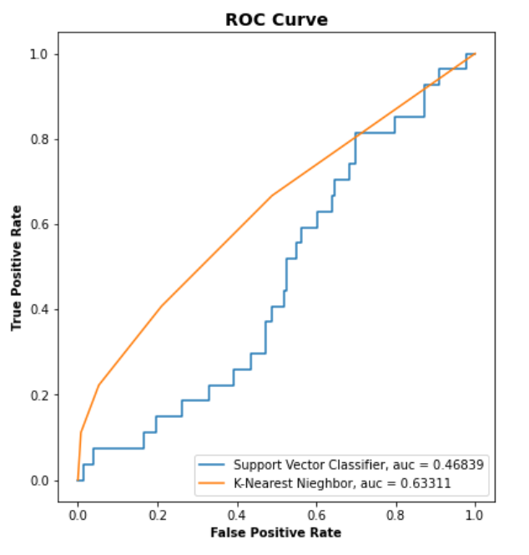
Model Evaluation
ROC and AUC
ROC curve (receiver operating characteristic curve) is a graph showing the performance of a classification model at all classification thresholds
AUC stands for "Area under the ROC Curve." That is, AUC measures the entire two-dimensional area underneath the entire ROC.

Slide 12
Future work
Chat box
Prediction Model
More user-friendly
More robust
Minimising Data bias
Improve accuracy rate
Select an almost equal number of positive and negative instances
More training samples
More interactive between users and chat agent.
Reducing error sensitivity of chat box.

Slide 13
Reference
[1] PYTLAK, K. 2022. Personal Key Indicators of Heart Diseas. kaggle.com/datasets/kamilpytlak/....
[2] BAKER, C. 2022. NHS Key Statistics: England, February 2022.
[3] Stephanie Stephensh.(March 2018). Worth the Wait? 15 Ways to Reduce Patient Wait Times. healthecareers.com/articles/healthcare-news...
[4] PRIYANKA SHARMA.(2019). Heart Disease Prediction in Python. machinemantra.in....
[5] Amnah khatun.(March 2018). Chatbot: the Next Big Thin. chatbotsmagazine.com/....
[6] Tavish Srivastava. (March 2018). Introduction to k-Nearest Neighbors: A powerful Machine Learning Algorithm (with implementation in Python & R). analyticsvidhya.com/blog/....

Slide 14
Thanks!

