Slide 1
Border Peeling Clustering
谭永卿 苏越 孙陈希 肖俊伦 杜孟君

Slide 2
Content
Introduction
The Algorithm
  Border Points Identification
  Border Points Association
  Border Peeling Termination Criterion
  Bottom-up Clustering
Comments
Conclusions

Slide 3
Introduction
Non-parametric
A notable quality of the Border-Peeling algorithm is that it does not require any parameter tuning in order to outperform state-of-the-art finely-tuned non-parametric clustering methods, including Mean-Shift and DBSCAN.

Slide 4
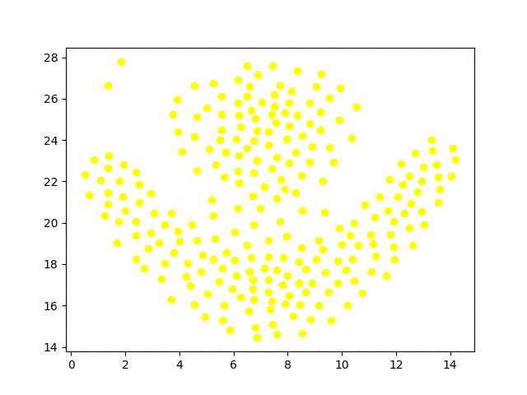
Introduction

Slide 5
The Algorithm
Border Points Identification
Border Points Association
Border Peeling Termination Criterion
Bottom-up Clustering

Slide 6
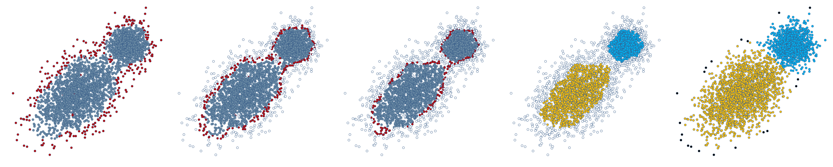
The Algorithm

Slide 7
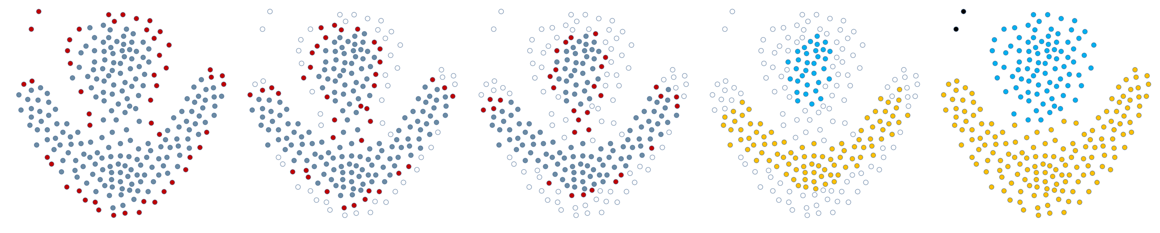
The Algorithm

Slide 8
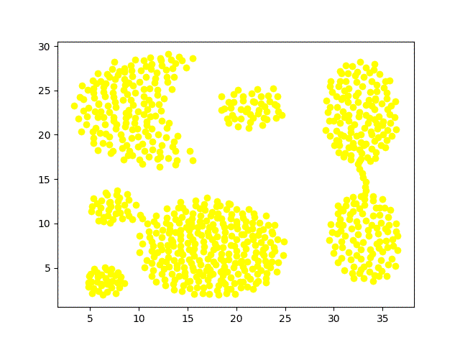
Border Points Identification

Slide 9
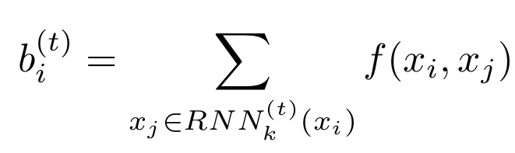
Border Points Identification

Slide 10
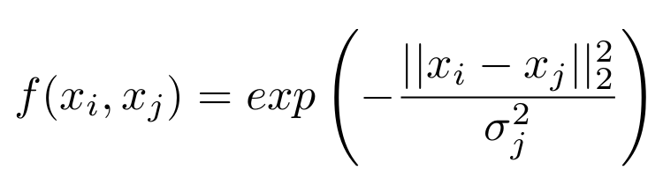
Border Points Identification

Slide 11
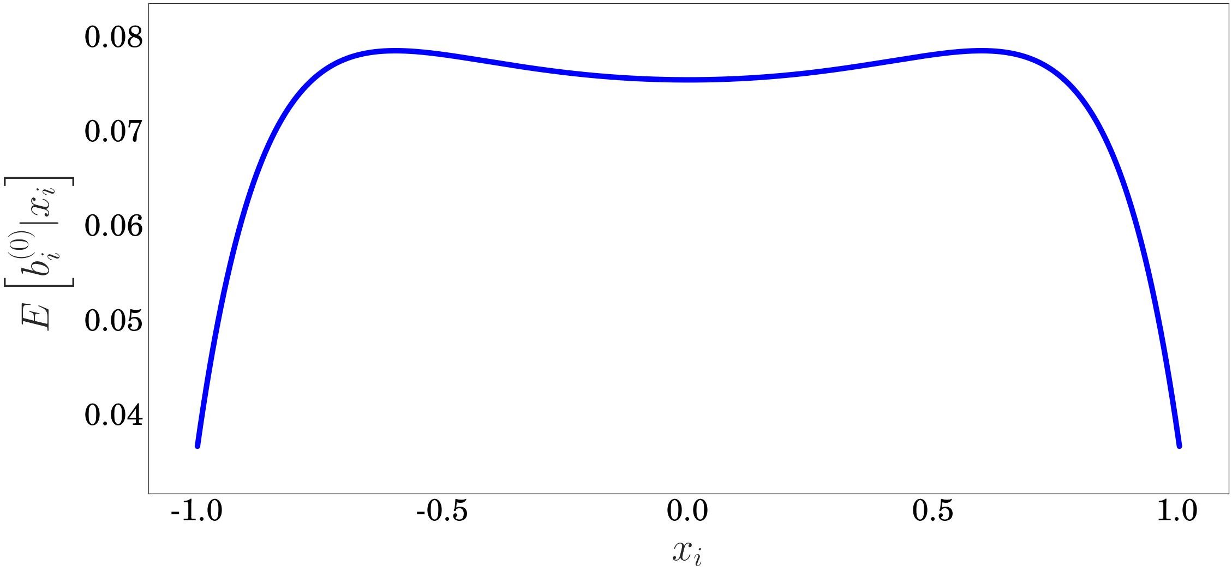
Border Points Identification

Slide 12
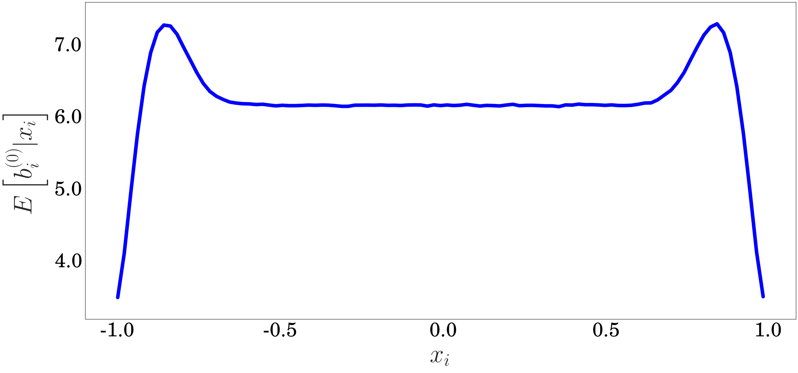
Border Points Identification

Slide 13
Border Points Identification

Slide 14
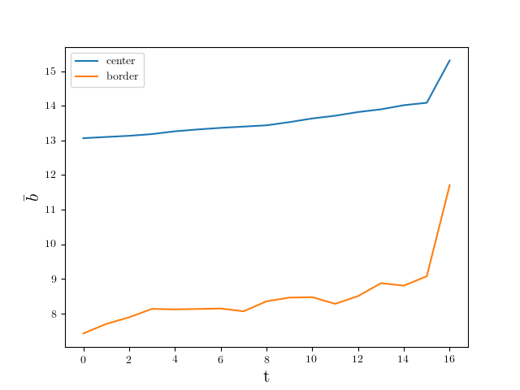
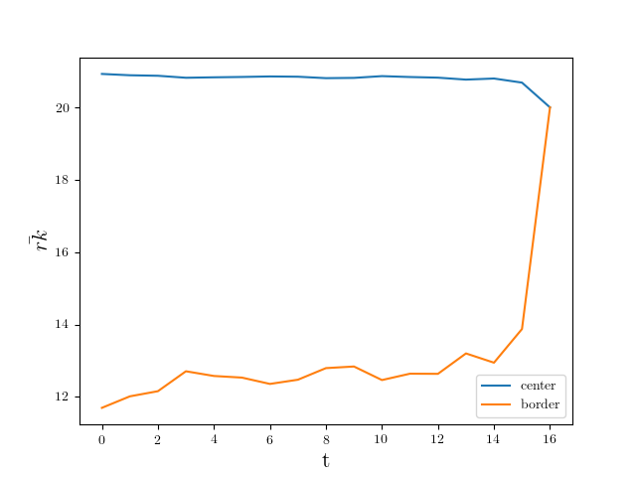
Border Points Identification

Slide 15
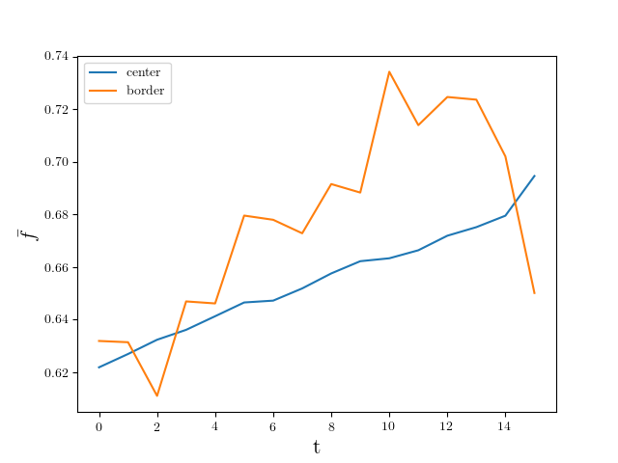
Border Points Identification

Slide 16
Border Points Identification
ARI | BP | BP’
Aggregation | 0.993 | 0.998
Compound | 0.646 | 0.828
R15 | 0.987 | 0.987
flame | 0.955
0.013
AMI | BP | BP’
Aggregation | 0.987 | 0.996
Compound | 0.765 | 0.804
R15 | 0.985 | 0.985
flame | 0.884
0.009

Slide 17
Border Points Identification

Slide 18
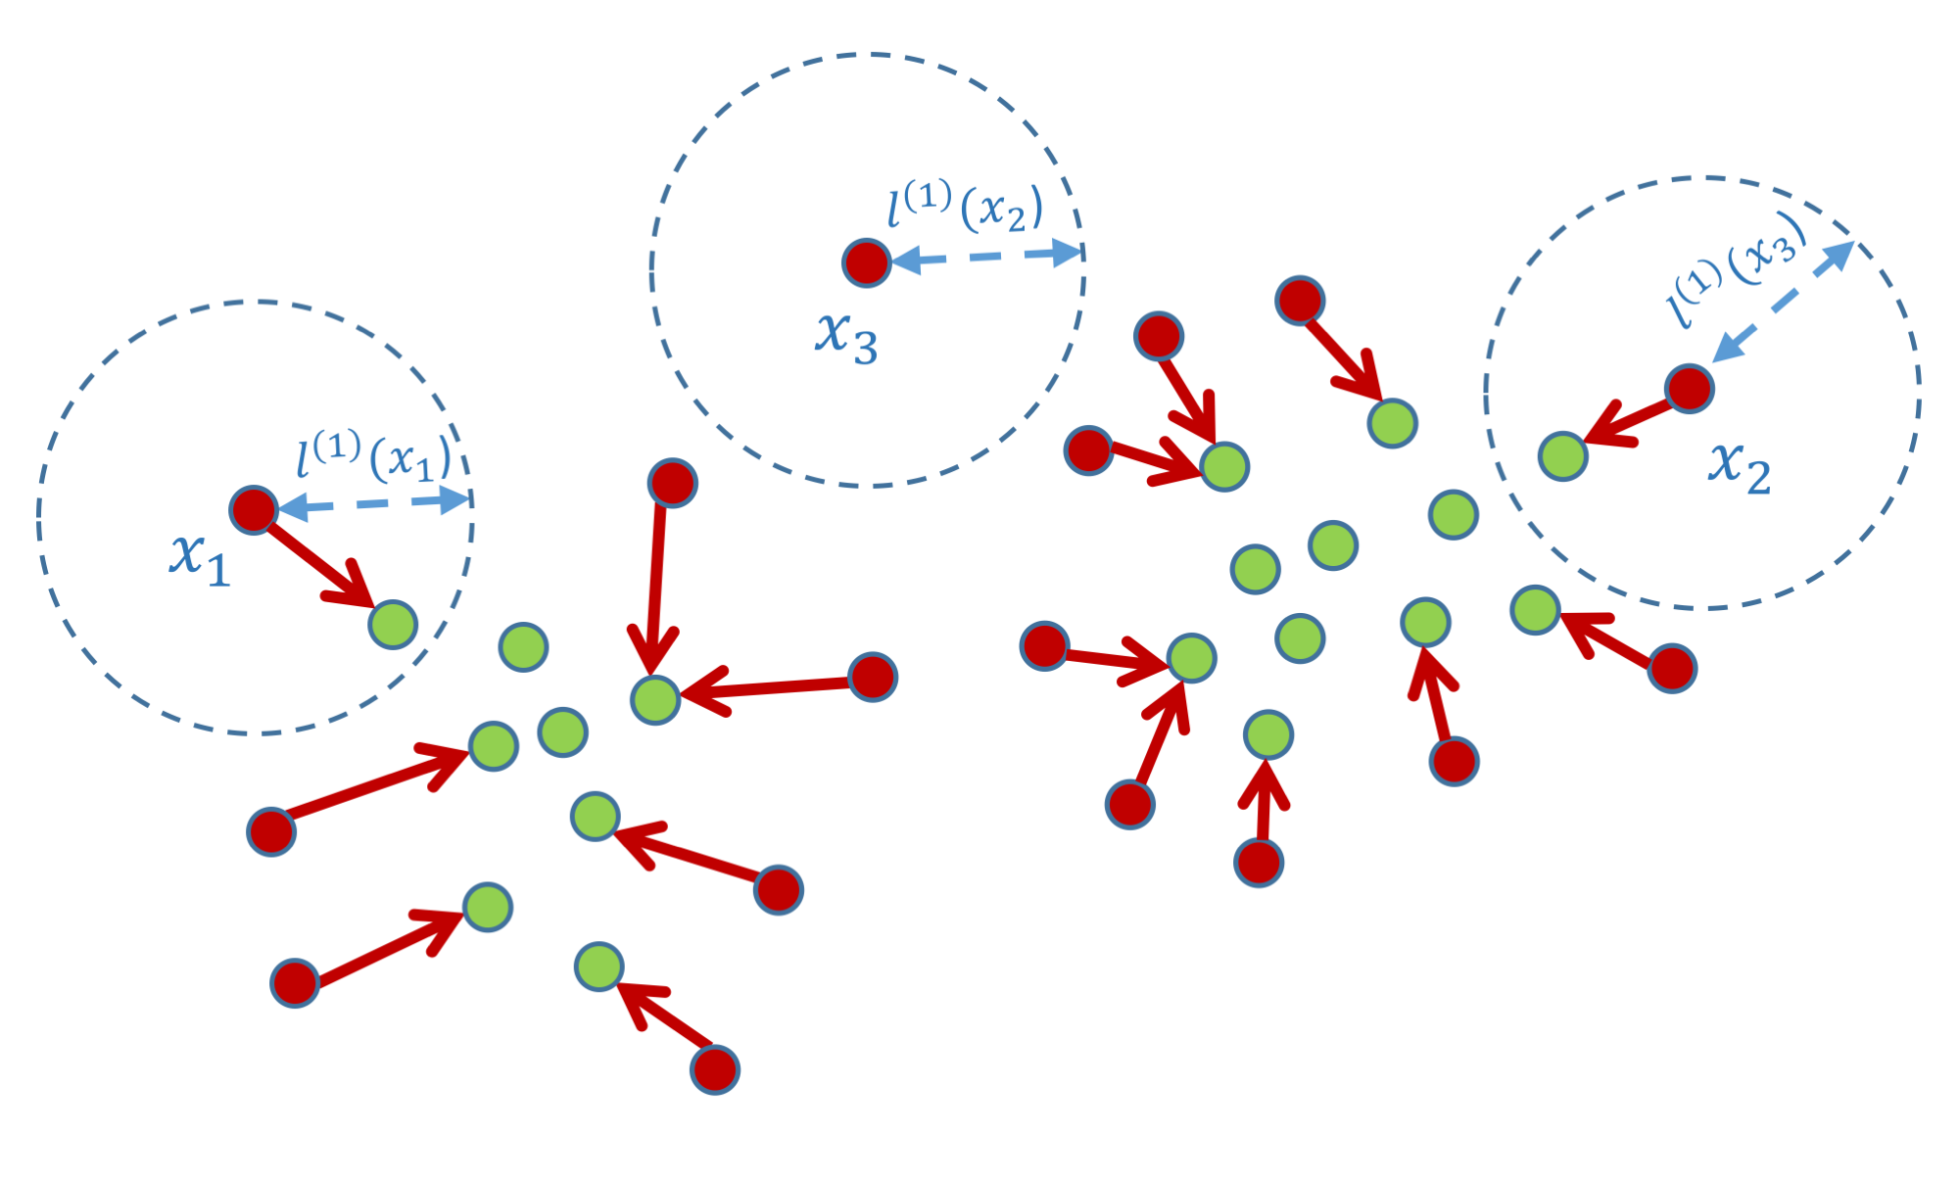
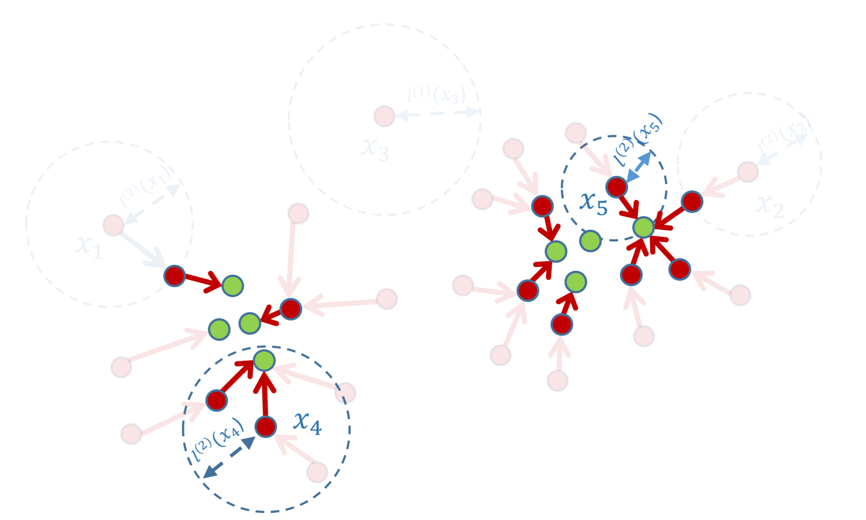
Border Points Association

Slide 19
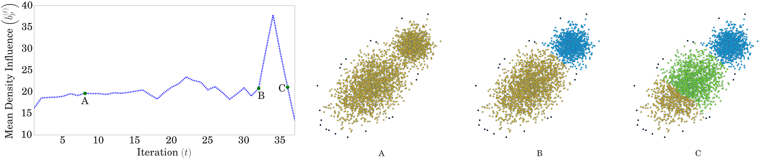
Border Peeling Termination Criterion

Slide 20
Border Peeling Termination Criterion
we make the following observation: peeled border points should reside in denser areas than the border points of the previous iteration. Therefore, the assigned density influence values should increase in average.

Slide 21
Border Peeling Termination Criterion

Slide 22
Bottom-up Clustering
Merge if connected

Slide 23
Comments

Slide 24
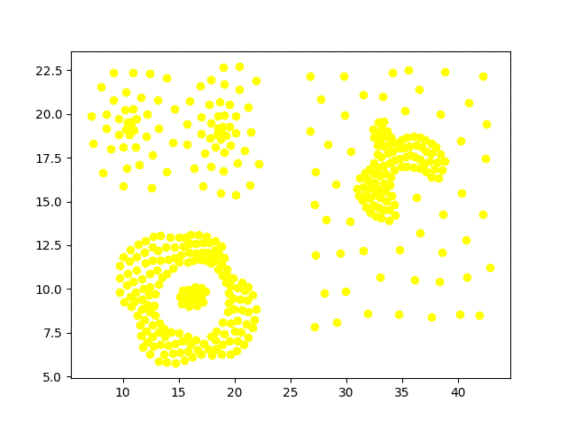
Comments

Slide 25
Conclusions

Slide 26
Thank you
谭永卿 苏越 孙陈希 肖俊伦 杜孟君

