Slide 1
Prediction of a hit TV show
Team 6
Howard Chien
Miaoyan Zhang
Yao-Chia Yang

Slide 2
Outline
Objective
Implementation
Audience Review
Normalize
Predictive Model
Data Analysis and Discussion
Conclusion
Demo

Slide 3
Objective
To predict TV ratings using three types of features:
Audience-based
Release-based
TV-based

Slide 4
Audience Review
Use sentiment analysis to analyse review data from IMDB to get each actor/producer/creator’s:
Positive review points
Negative review points

Slide 5
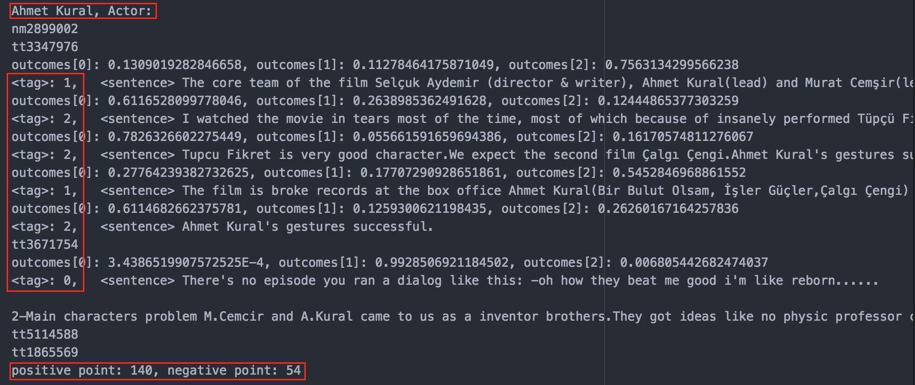
Audience Review
Log data:

Slide 6
Audience Review
Sentiment analysis accurate rates:
(0.1% samples from the logs)
 | Actual # | Classified as 0 # | Classified as 1 # | Classified as 2 # | accuracy
0 - negative | 34 | 25 | 8 | 1 | 73.53%
1- neutral | 105 | 20 | 78 | 7 | 74.29%
2 - positive | 135 | 19 | 25 | 91 | 67%

Slide 7
Normalization
For normalization, we applied the following simple method to map each attribute value into an rank of 0 to 1.
(V - min V)/(max V - min V)

Slide 8
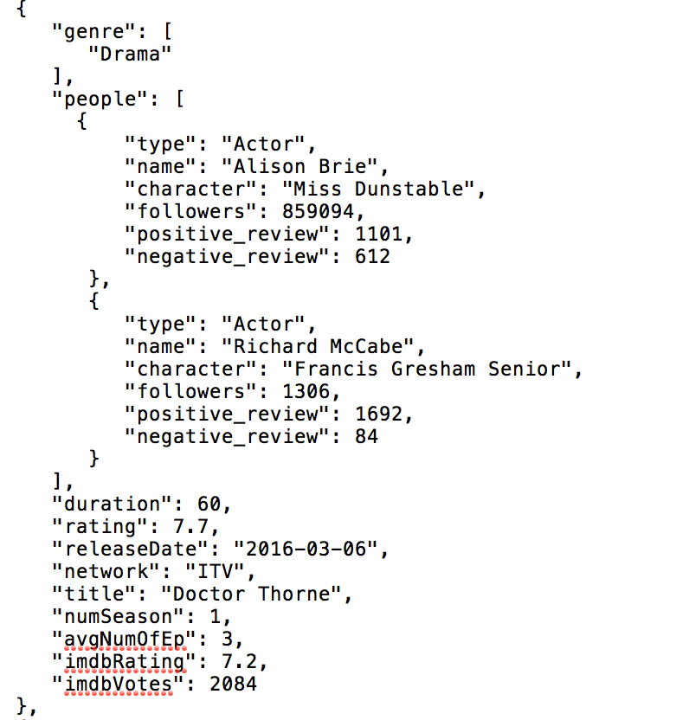
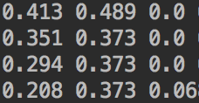
Normalization
->

Slide 9
Predicted
Rating
5-fold
cross validation
Feature
Rating
TV SHOW
A
B
C
SVD
Nelder-Mead
Optimization
A: Content-based info
B: Episode-Related Info
C: TV channel
Feature
weighting
Performance
Matric: MSE

Slide 10
Performance
Data Source | 5-fold MSE
A -> | 0.696
A + B -> | 0.726
A + B + C -> | 0.715
(A) -> SVD -> | 0.547
(A + B) -> SVD -> | 0.554
(A + B + C) -> SVD -> | 0.517

Slide 11
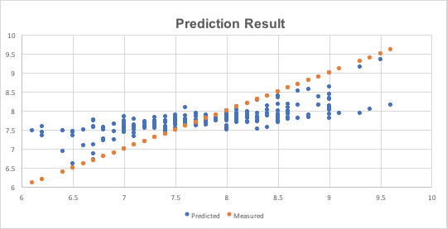
Result

Slide 12
Result
Original Rating | Class | Counts | # Correctly Prediction | # Missed Prediction | Total # Miss | Total Miss Rate
>= 8.5 | Very good | 44 | 1 | 43 | 75 | 33.93%
>= 7.0 | Good | 146 | 142 | 4
< 7.0 | Fair | 30 | 2 | 28

Slide 13
Abnormal Case Explanation
Data Source | 84: Anne | 46: Lovesick | 192: The Doctor Blake Mysteries
Rating | 9.6 | 9.3 | 9.4
Predicted Rating | 7.82 | 7.6 | 7.91
1st similar show | The last Tycoon 7.6 | Casual 8.3 | Murder in the First 7.7
2nd similar show | Pitch 7.8 | Fleabag 7.4 | Stan Lee’s Lucky Man 8.1
3rd similar show | Halt and Catch Fire 8.1 | Those Who Can't 8 | 100 Code 8.3

Slide 14
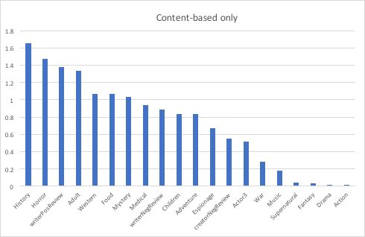
Important Feature

Slide 15
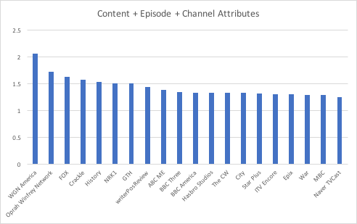
Important Feature

Slide 16
Important Feature
Data Source | A | A + B | A+B+C
f1 v1^2 | GENRE_HISTORY 1.65 | GENRE_CHILDREN 1.83 | CH_WGN_AMERICA 2.05
f2 v2^2 | GENRE_HORROR 1.47 | GENRE_HORROR 1.55 | CH_OPRAH_NETWORK 1.72
f3 v3^2 | WRITER_POS_REVIEW 1.37 | AVG_NUM_EPISODE 1.46 | CH_FOX 1.62
f4 v4^2 | GENRE_ADULT 1.33 | GENRE_MEDICAL 1.38 | CH_CRACKLE 1.56
f5 v5^2 | GENRE_WESTERN 1.07 | WRITER_NEG_REVIEW 1.13 | GENRE_HISTORY 1.52

Slide 17
Conclusion
This kernel-based method heavily depends on the hypothesis that similar tv shows share similar rating.
Different data attributes of tv shows indeed could increase the accuracy of predicting the rating.

Slide 18

Thank you!

