Slide 1
第一次习题课
助教：鲍增晖
baozh18@mails.Tsinghua.edu.cn

Slide 2

多光束干涉（法布里-珀罗干涉仪及应用）
$$I_{T}=I_{0}\left(\frac{1}{1+\frac{4R\sin^{2}{δ/2}}{{\left(1−R\right)}^{2}}}\right)$$
$$⟹F=\frac{4R}{{\left(1−R\right)}^{2}}⟹ε=\frac{4}{\sqrt{F}}=\frac{2\left(1−R\right)}{\sqrt{R}}⟹f=\frac{2π}{ε}=π\frac{\sqrt{R}}{1−R}$$
$$⟹δ=k_{0}ΔL=\frac{4πnh\cos{i}}{λ_{0}}⟹2nh=mλ_{m}⟹λ_{m}=\frac{2nh}{m}, ν_{fsr}=\frac{c}{2nh}$$
$$⟹f=\frac{2π}{ε}=\frac{v_{fsr}}{δν}=\frac{λ_{m}}{mδλ_{m}}$$

Slide 3
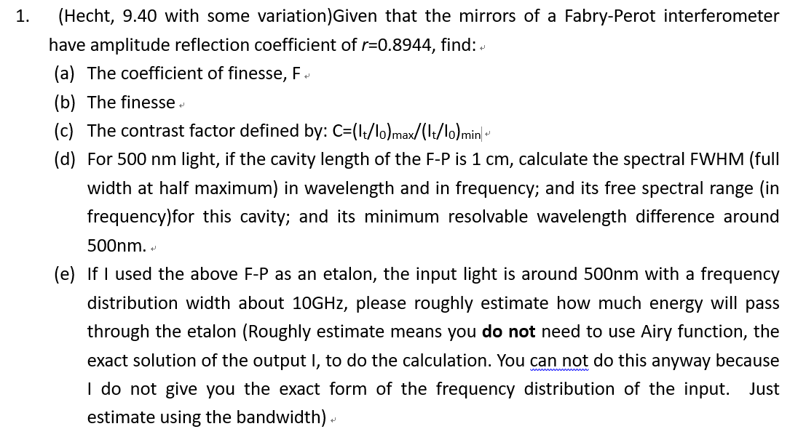
Homework1 T1

Slide 4
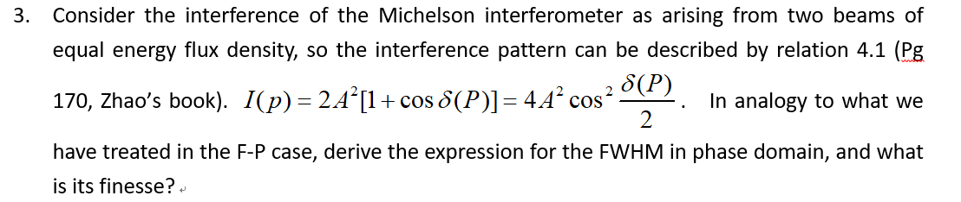
Homework1 T3

Slide 5
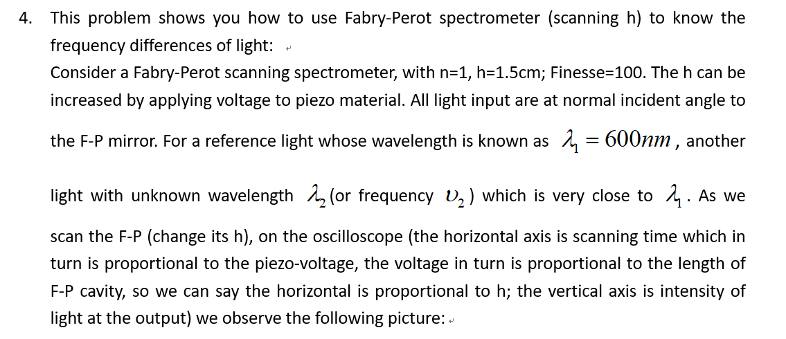
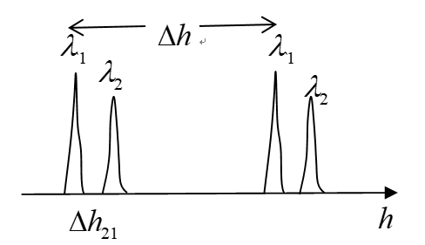
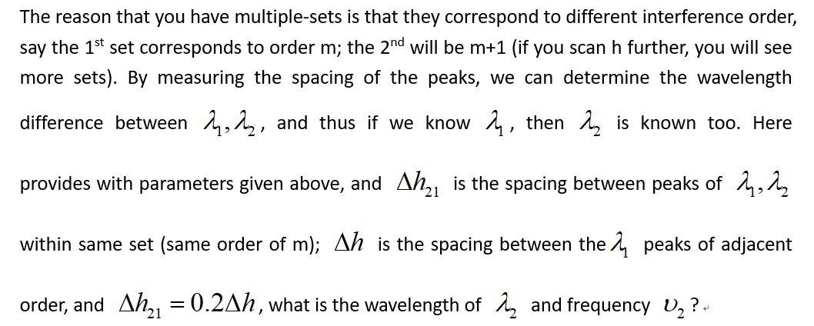
Homework1 T4

Slide 6
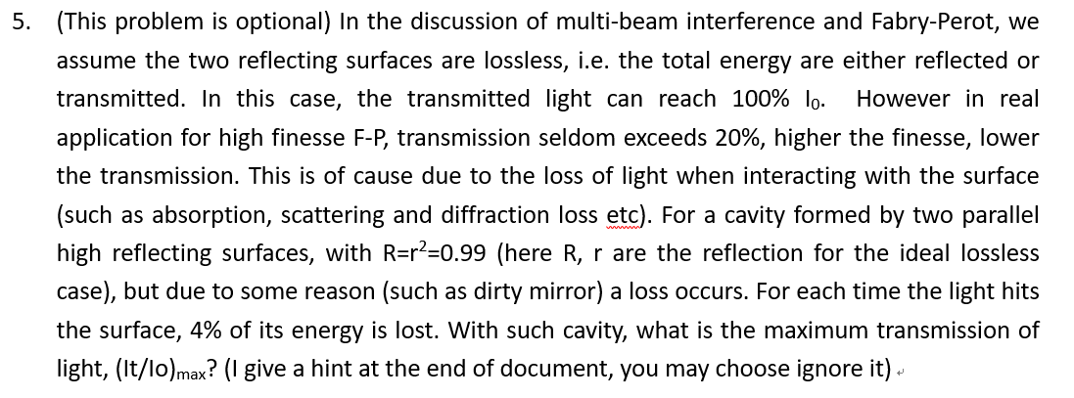
Homework1 T5

Slide 7
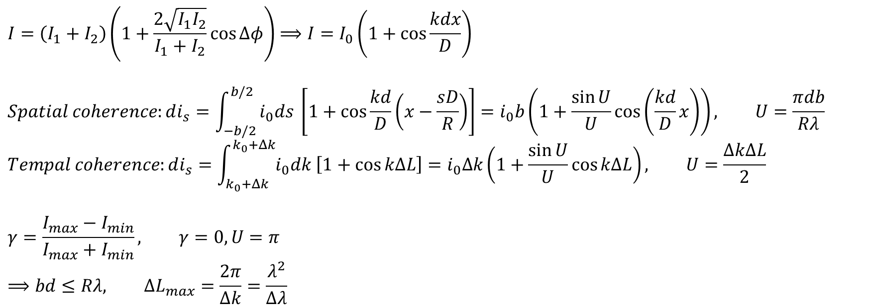
相干性（空间相干性&时间相干性）
$$I=\left(I_{1}+I_{2}\right)\left(1+\frac{2\sqrt{I_{1}I_{2}}}{I_{1}+I_{2}}\cos{Δφ}\right)⟹I=I_{0}\left(1+\cos{\frac{kdx}{D}}\right)$$
$$Spatial coherence:di_{s}=\int_{−b/2}^{b/2}{i_{0}ds \left[1+\cos{\frac{kd}{D}\left(x−\frac{sD}{R}\right)}\right]}=i_{0}b\left(1+\frac{\sin{U}}{U}\cos\left(\frac{kd}{D}x\right)\right), U=\frac{πdb}{Rλ}$$
$$Tempal coherence:di_{s}=\int_{k_{0}+Δk}^{k_{0}+Δk}{i_{0}dk \left[1+\cos{kΔL}\right]}=i_{0}Δk\left(1+\frac{\sin{U}}{U}\cos{kΔL}\right), U=\frac{ΔkΔL}{2}$$
$$γ=\frac{I_{max}−I_{min}}{I_{max}+I_{min}}, γ=0,U=π$$
$$⟹bd≤Rλ, ΔL_{max}=\frac{2π}{Δk}=\frac{λ^{2}}{Δλ}$$

Slide 8
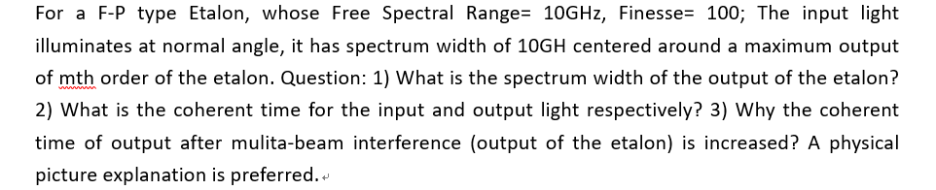
Extra problem

Slide 9
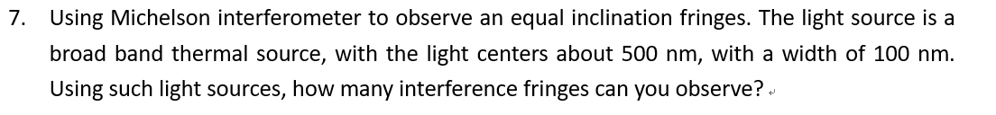
Homework1 T7

Slide 10
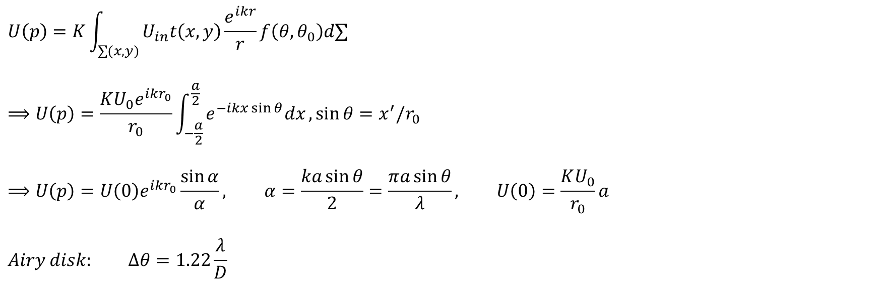
夫琅和费衍射（单缝情况）
$$U\left(p\right)=K\int_{∑(x,y)}{U_{in}t\left(x,y\right)\frac{e^{ikr}}{r}f\left(θ,θ_{0}\right)d∑}$$
$$⟹U\left(p\right)=\frac{KU_{0}e^{ikr_{0}}}{r_{0}}\int_{−\frac{a}{2}}^{\frac{a}{2}}{e^{−ikx\sin{θ}}dx}, \sin{θ}=x^{′}/r_{0}$$
$$⟹U\left(p\right)=U\left(0\right)e^{ikr_{0}}\frac{\sin{α}}{α}, α=\frac{ka\sin{θ}}{2}=\frac{πa\sin{θ}}{λ}, U\left(0\right)=\frac{KU_{0}}{r_{0}}a$$
$$Airy disk: Δθ=1.22\frac{λ}{D}$$

Slide 11
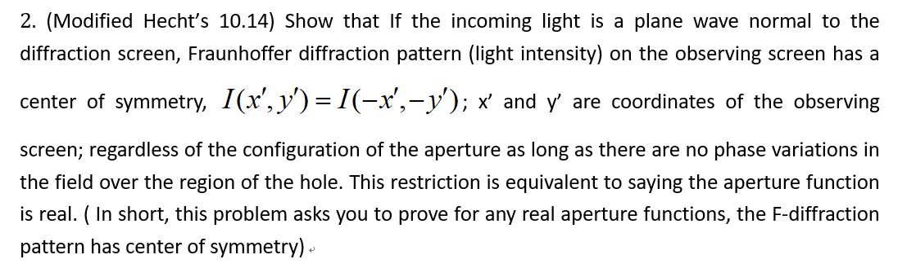
Homework2 T2

Slide 12
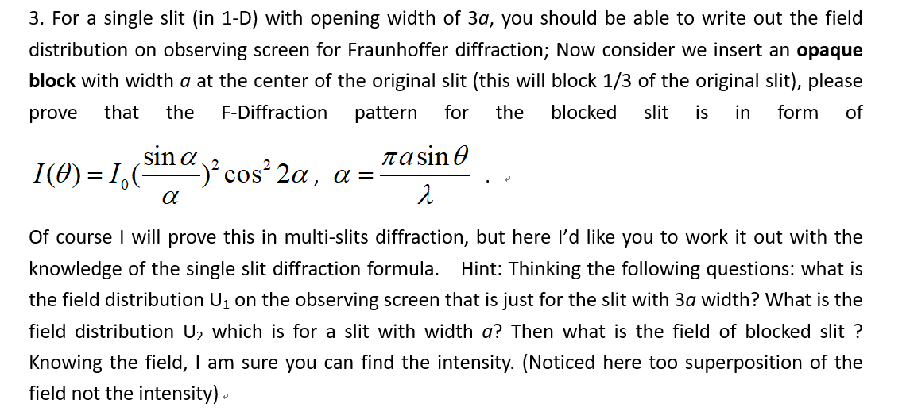
Homework2 T3

Slide 13
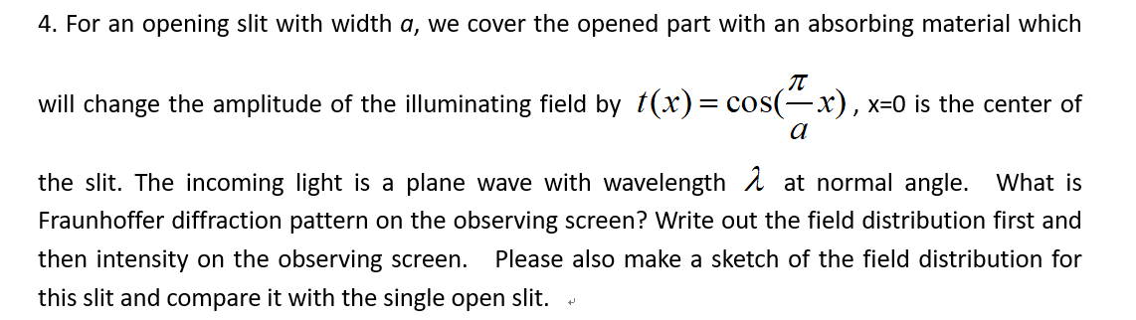
Homework2 T4

Slide 14
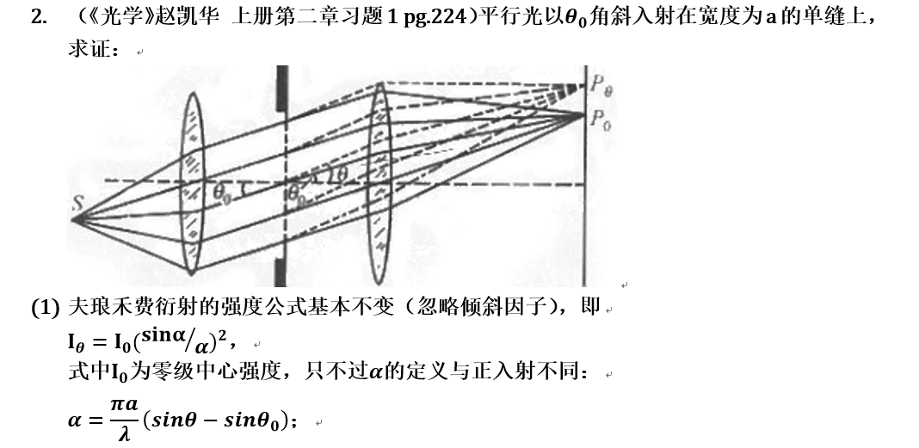
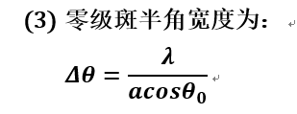
Homework2 T5

Slide 15
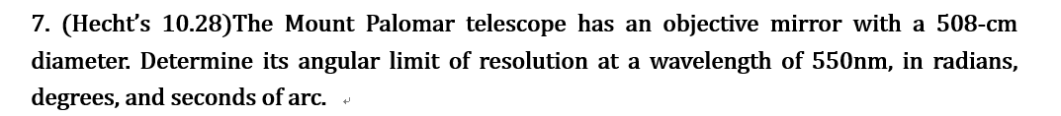
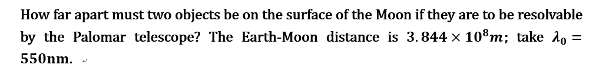
Homework2 T7

Slide 16
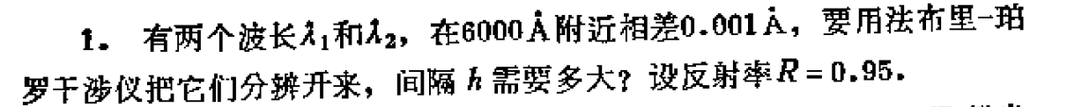
Extra problem

Slide 17
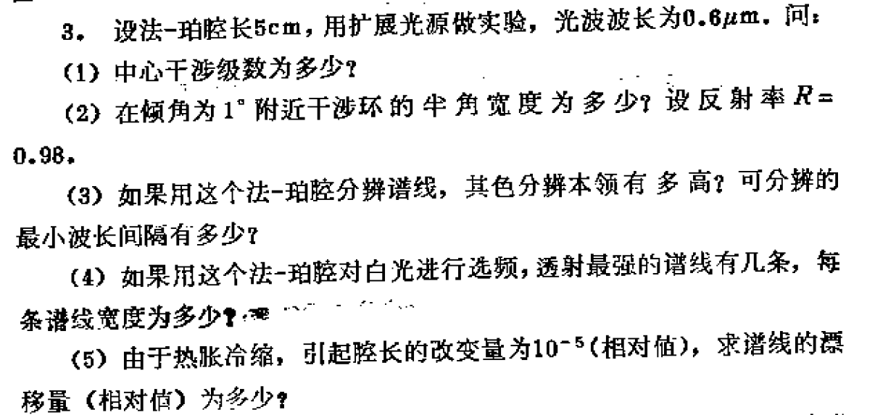
Extra problem

Slide 18
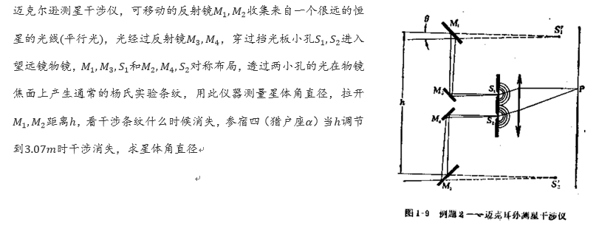
Extra problem

