Slide 1
第三次习题课
助教：鲍增晖
baozh18@mails.Tsinghua.edu.cn

Slide 2
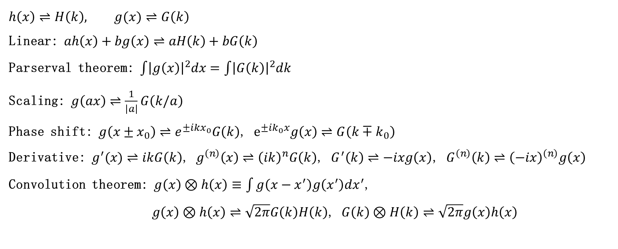
傅里叶变换基本性质
$$h\left(x\right)⇌H\left(k\right), g(x)⇌G\left(k\right)$$
Linear: $ah\left(x\right)+bg\left(x\right)⇌aH\left(k\right)+bG\left(k\right)$
Parserval theorem: $\int{{\left|g\left(x\right)\right|}^{2}dx}=\int{{\left|G\left(k\right)\right|}^{2}dk}$
Scaling: $g\left(ax\right)⇌\frac{1}{\left|a\right|}G\left(k/a\right)$
Phase shift: $g\left(x±x_{0}\right)⇌e^{±ikx_{0}}G\left(k\right)$, $e^{±ik_{0}x}g\left(x\right)⇌G\left(k∓k_{0}\right)$
Derivative: $g^{′}(x)⇌ikG\left(k\right)$, $g^{\left(n\right)}\left(x\right)⇌{\left(ik\right)}^{n}G\left(k\right)$, $G^{′}\left(k\right)⇌−ixg\left(x\right)\text{, }G^{\left(n\right)}\left(k\right)⇌{\left(−ix\right)}^{\left(n\right)}g\left(x\right)$
Convolution theorem: $g\left(x\right)⊗h\left(x\right)≡\int{g\left(x−x^{′}\right)g\left(x^{′}\right)dx^{′}}$,
$g\left(x\right)⊗h\left(x\right)⇌\sqrt{2π}G\left(k\right)H\left(k\right)$, $G\left(k\right)⊗H\left(k\right)⇌\sqrt{2π}g\left(x\right)h\left(x\right)$

Slide 3
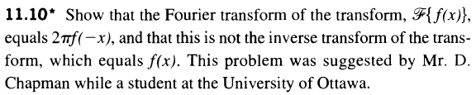
Homework5 T1

Slide 4

Extra exercises
$(Zhao^{′}s \text{Problem}\text{ 14 }\text{on} \text{pg}\text{. }\text{112}\text{)}$
大量点源无规地分布在$x$轴上，其振幅分布可写为
$$\tilde{U}\left(x\right)=\sum_{a=1}^{N}{δ\left(x−x_{a}\right)}$$
求$F\left\{\tilde{U}\left(x\right)\right\}$
试论证$FF^{∗}=N$

Slide 5

傅里叶变换与夫琅和费衍射
$$U\left(x^{′}\right)=C\int{t\left(x\right)U_{in}e^{−ik\sin{θ}x}dx}, \sin{θ}=\frac{x^{′}}{Z} \\ =CU_{in}\int{t\left(x\right)e^{−iKx}dx}, K=k\sin{θ}$$
$$U\left(x′\right)∝F\left\{t\left(x\right)\right\}⟹I=I\left(0\right){\left|F\left\{t\left(x\right)\right\}\right|}^{2}$$
$$K_{max}=k\frac{D}{2f}=\frac{2π}{d_{min}}⟹Δθ=\frac{d_{min}}{f}=\frac{2λ}{D}$$

Slide 6
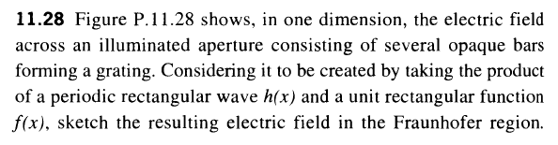
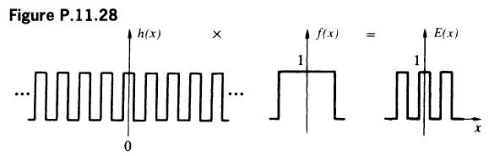
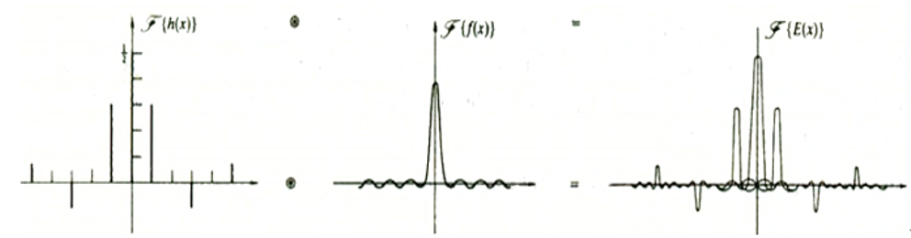
Homework5 T6

Slide 7

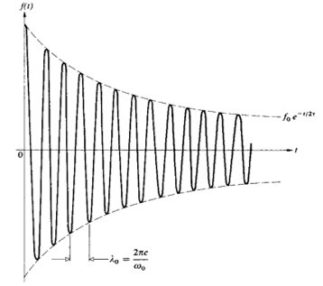
Homework5 T7

Slide 8

高斯积分公式
$$\int_{−∞}^{∞}{e^{−αx^{2}−iβx−iγx^{2}}dx}=e^{−\frac{β^{2}}{4\left(α+iγ\right)}}\sqrt{\frac{π}{α+iγ}} (α>0)$$
$$\int_{−∞}^{∞}{e^{−α{\left|β\right|}^{2}−Aβ−Bβ^{∗}}dβ^{2}}=\frac{π}{α}e^{\frac{AB}{α}}$$

Slide 9
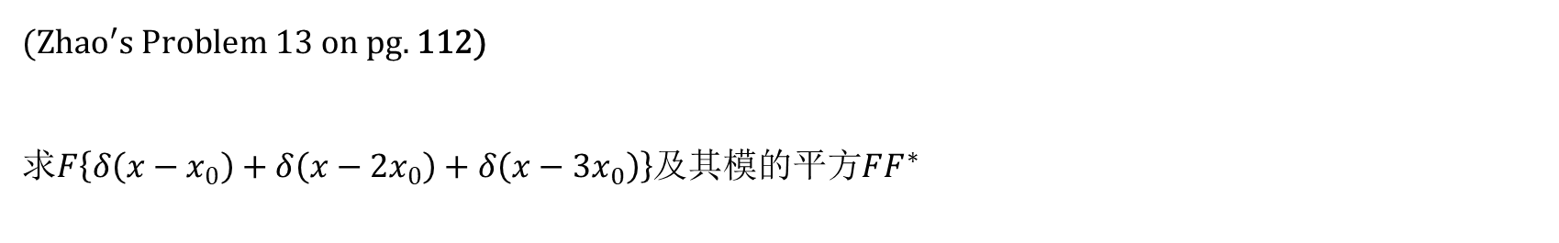
Extra exercises
$(Zhao^{′}s \text{Problem}\text{ 13 }\text{on} \text{pg}\text{. }\text{112}\text{)}$
求$F\left\{δ\left(x−x_{0}\right)+δ\left(x−2x_{0}\right)+δ\left(x−3x_{0}\right)\right\}$及其模的平方$FF^{∗}$

Slide 10

Extra exercises
$(Zhao^{′}s \text{Problem}\text{ 10 }\text{on} \text{pg}\text{. }\text{69}\text{)}$
设光栅的复振幅透过率函数为
$$\tilde{t}\left(x\right)=t_{0}+t_{1}\cos{2πfx}+t_{1}\cos\left(2πfx+\frac{π}{2}\right)$$
这块光栅的夫琅和费衍射场中将出现几个衍射斑？各斑得中心强度与0级斑得比值是多少？

Slide 11

光的偏振
Jones Vector form: $\left[\begin{aligned}A \\ Be^{iφ}\end{aligned}\right]$
Linear Polarized light: $\left[\begin{aligned}A \\ B\end{aligned}\right]e^{−iωt}$
Circular Polarized light: $A\left[\begin{aligned}1 \\ e^{±\frac{iπ}{2}}\end{aligned}\right]e^{−iωt}$,
Elliptical Polarized light: $\left[\begin{aligned}A \\ Be^{iφ}\end{aligned}\right]$

Slide 12
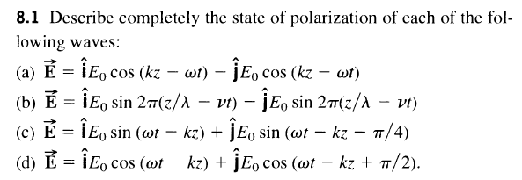
Extra exercises

Slide 13

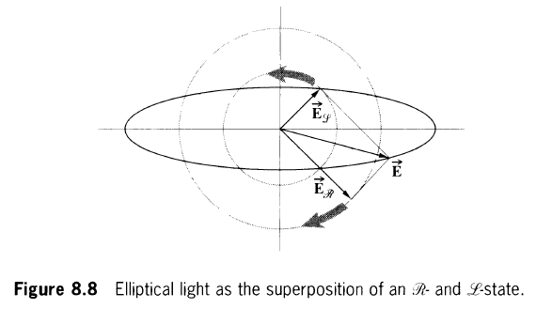
Extra exercises

