Slide 1
第四次习题课
助教：鲍增晖
baozh18@mails.Tsinghua.edu.cn

Slide 2
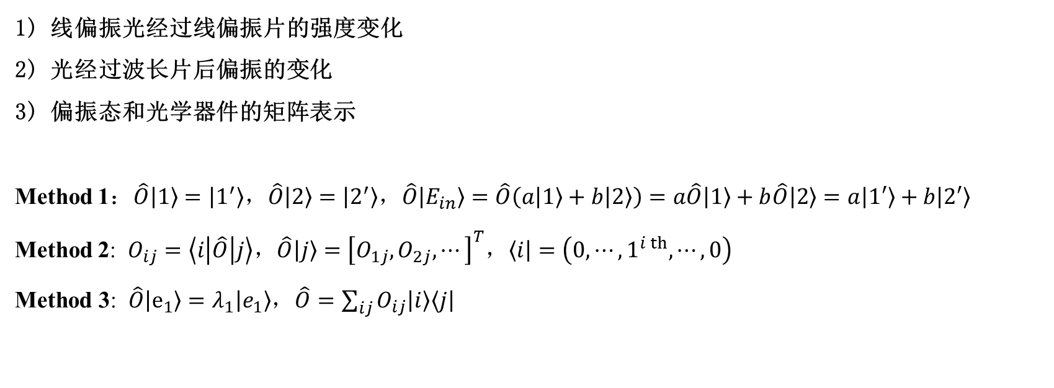
偏振的矩阵表示
1) 线偏振光经过线偏振片的强度变化
2) 光经过波长片后偏振的变化
3) 偏振态和光学器件的矩阵表示
Method 1：$\hat{O}\left|1\right\rangle =\left|1^{′}\right\rangle ，\hat{O}\left|2\right\rangle =\left|2^{′}\right\rangle ，\hat{O}\left|E_{in}\right\rangle =\hat{O}\left(a\left|1\right\rangle +b\left|2\right\rangle \right)=a\hat{O}\left|1\right\rangle +b\hat{O}\left|2\right\rangle =a\left|1′\right\rangle +b\left|2′\right\rangle$
Method 2: $O_{ij}=\left\langle i\left|\hat{O}\right|j\right\rangle ，\hat{O}\left|j\right\rangle ={\left[O_{1j},O_{2j},⋯\right]}^{T}，\left\langle i\right|=\left(0,⋯,1^{i th},⋯,0\right)$
$\text{Method}\text{ 3}\text{: }\hat{O}\left|e_{1}\right\rangle =λ_{1}\left|e_{1}\right\rangle$，$\hat{O}=\sum_{ij}{O_{ij}\left|i\right\rangle \left\langle j\right|}$

Slide 3
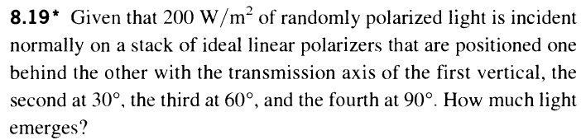
Homework6 T4

Slide 4
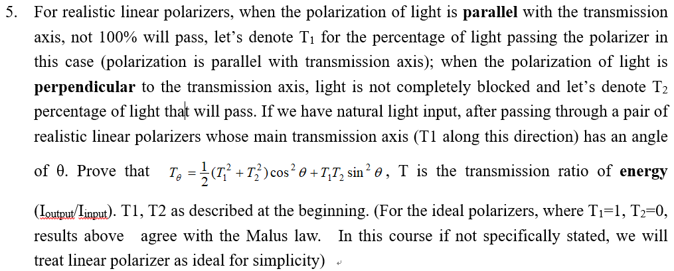
Homework6 T5

Slide 5
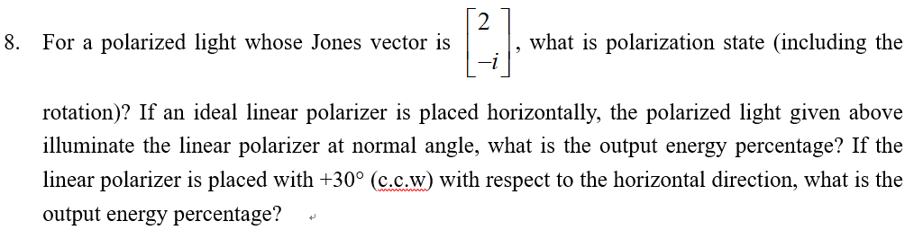
Homework6 T8

Slide 6
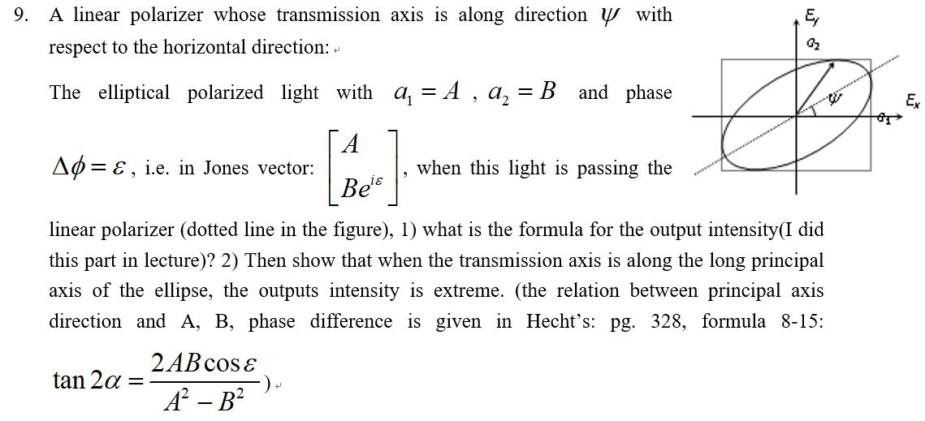
Homework6 T9

Slide 7
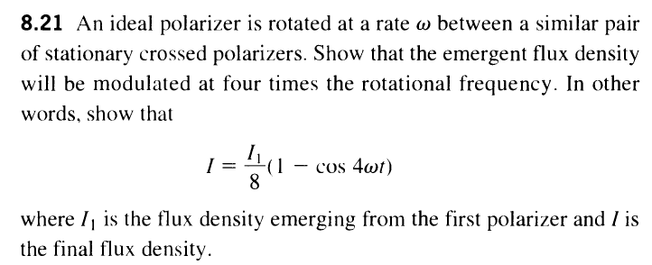
Extra exercises
$(\text{Hecht}\text{’}\text{s}\text{ 8.21)}$

Slide 8
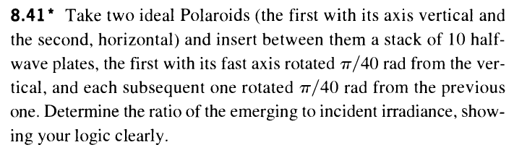
Homework6 T13

Slide 9
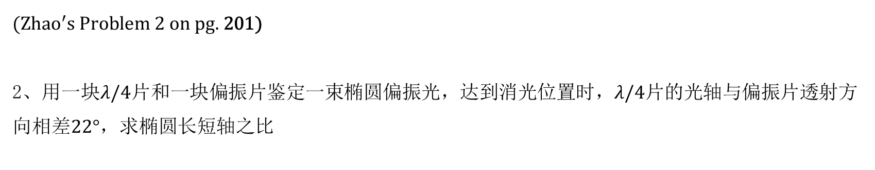
Extra exercises
$(Zhao^{′}s \text{Problem}\text{ 2 }\text{on} \text{pg}\text{. }\text{201}\text{)}$
2、用一块$λ/4$片和一块偏振片鉴定一束椭圆偏振光，达到消光位置时，$λ/4片$的光轴与偏振片透射方向相差$22°$，求椭圆长短轴之比

Slide 10
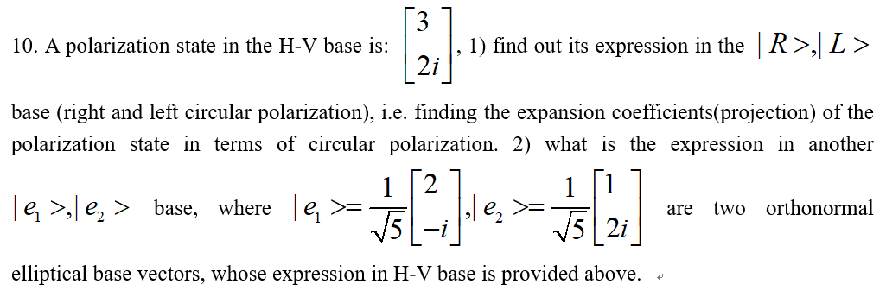
Homework6 T10

Slide 11
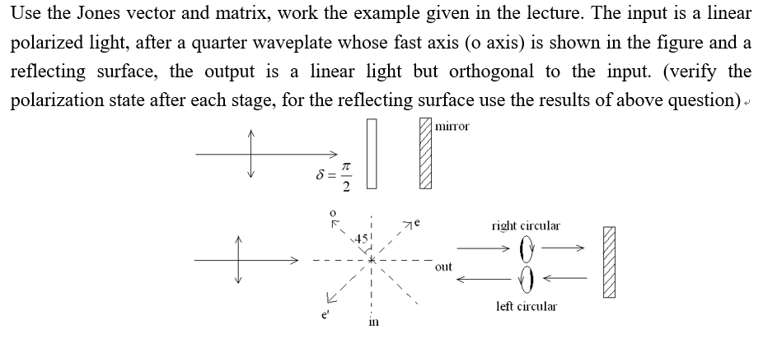
Homework6 T12

Slide 12
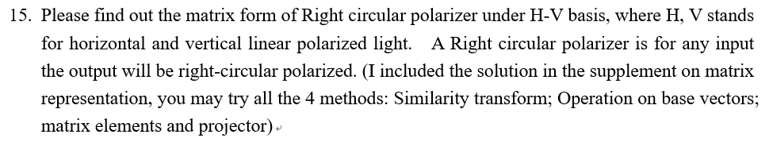
Homework6 T15

