Slide 1
MATLAB Programming Lecture 1
俞冀阳
Yu, Jiyang
Jiyang Yu
YU Jiyang
yujiy@tsinghua.edu.cn
Office: Room 904# of Liuqing Building
Tsinghua University
Notes:
Program: a set of instructions given to a computer to make it perform an operation: example- a word processing program
the American spelling of programme

Slide 2
Text and Learning Materials
Text
Stephen J. Chapman. MATLAB Programming for Engineers, 2nd or 4th Edition
MATLAB编程(第2版)，科学出版社2003
MATLAB编程(第4版)，科学出版社2011
邢树军,郑碧波,叶维民 译. 俞冀阳校. MATLAB 编程（第2版）
reference The International Association for the Properties of Water and Steam
Internet
Notes:
Reference
a book, article etc from which information has been obtained

Slide 3


MATLAB编程

Slide 4
Contents
What is MATLAB?
Why should I learn MATLAB?
How to learn MATLAB?
Introduction to the Final project.
Introduction of the MATLAB Environment

Slide 5

What is MATLAB？
MATLAB is a kind of language.
A language is a system of signs for encoding and decoding information.
Notes:
language
n.
a system of communication by written or spoken words, which is used by the people of a particular country or area
语言, 语言文学, 术语, 语言表达能力, (运用语言的)方式、能力、风格, [自]（机器）代码
index
1 plural indexes
an alphabetical list of names, subjects etc at the back of a book, with the numbers of the pages where they can be found.
a set of cards or a database containing information, usually arranged in alphabetical order and used especially in a library.
2 plural indices
a standard by which the level of something can be judged or measured
encode
to put a message or other information into code
ￚ opposite (if one thing or person is opposite another, they are facing each other) decode, decipher

Slide 6
What is MATLAB？
MATLAB is a kind of programming language
A programming language is an artificial language designed to express orders that can be performed by a machine, particularly a computer.
How many programming languages we have today?
92+
Notes:
artificial
not real or not made of natural things but made to be like something that is real or natural
ￚ antonym (a word that means the opposite of another word) natural
ￚ synonym (a word with the same meaning as another word in the same language ) false
programming
the activity of writing programs for computers, or something written by a programmer
Particularly
more than usual or more than others
ￚ synonym especially

Slide 7
Programming languages
ActionScript Ada ALGOL APL Assembly AutoHotkey AutoIt
BASIC BeanShell BLISS BlitzMax Boo
C (C++,C#) Caml Clean Clojure CLU COBOL Cobra ColdFusion Comal Curl
D Dylan Delphi Eiffel Erlang Euphoria
Factor FP F# Forth Fortran
Gambas GameMaker Go GraphTalk Groovy
Harbour Haskell HyperNext
Io J JADE Java Joy LabVIEW Lisp Lua
Mathematica MATLAB ML Modula Mythryl
Oberon Occam Oxygene Oz
Pascal Pawn Perl PHP PL/I Prolog Python
REBOL RPG Ruby
S Scala Scheme Simula Smalltalk SNOBOL
Tcl TDL PowerShell XL
Notes:
Assembly
a group of people who are elected to make decisions or laws for a particular country, area, or organization
Cobra
a poisonous African or Asian snake that can spread the skin of its neck to make itself look bigger
Scheme
an official plan that is intended to help people in some way, for example by providing education or training

Slide 8
Why should we learn MATLAB?
From MATrix LABoratory
Language for Engineers
Ease of Use
Platform Independence
Predefined Functions
Graphical User Interface
MATLAB Compiler
Notes:
Platform
the type of computer system or software that someone uses
Independence
the freedom and ability to make your own decisions in life, without having to ask other people for permission, help, or money
Interface
the way in which you see the information from a computer program on a screen, or how you type information into the program

Slide 9
How to learn MATLAB?
How to learn English?
Grammar, Vocabulary …
Reading, Writing, Practising …
How to learn MATLAB?
Syntax, Keywords, functions …
Practising by Project
Notes:
Grammar
the rules by which words change their forms and are combined into sentences, or the study or use of these rules
Vocabulary
all the words that someone knows or uses
Syntax
the way words are arranged to form sentences or phrases, or the rules of grammar which control this

Slide 10
Version of MATLAB
MATLAB | 6.5 | R13 | 2002
MATLAB | 6.5.1 | R13SP1 | 2003
MATLAB | 6.5.2 | R13SP2 | 2003
MATLAB | 7 | R14 | 2004
MATLAB | 7.0.1 | R14SP1 | 2004
MATLAB | 7.0.4 | R14SP2 | 2005
MATLAB | 7.1 | R14SP3 | 2005
MATLAB | 7.2 | R2006a | 2006
MATLAB | 7.3 | R2006b | 2006
MATLAB | 7.4 | R2007a | 2007
MATLAB | 7.5 | R2007b | 2007
MATLAB | 7.6 | R2008a | 2008
MATLAB | 7.7 | R2008b | 2008
MATLAB | 7.8 | R2009a | 2009.3.6
MATLAB | 7.9 | R2009b | 2009.9.4
MATLAB | 7.10 | R2010a | 2010.3.5
MATLAB | 7.11 | R2010b | 2010.9.3
MATLAB | 7.12 | R2011a | 2011.4.8
MATLAB | 7.13 | R2011b | 2011.9.3
MATLAB | 8.3 | R2014a | 2014.3.9

Slide 11
Final Project
Given any two state properties of water
Pressure, temperature, enthalpy, …
Get Heat capacities of water
Enthalpy
Entropy
Density
Heat Capacity
…
Notes:
Temperature
a measure of how hot or cold a place or thing is
Properties
a quality or power that a substance, plant etc has
ￚ synonym quality, characteristic
Enthalpy
enthalpy (denoted as H; specific enthalpy denoted as h) is a thermodynamic property of a thermodynamic system. It is used to calculate the heat transfer during a quasistatic process taking place in a closed thermodynamic system under constant pressure (isobaric process)
Conductivity
able to conduct electricity, heat etc

Slide 12
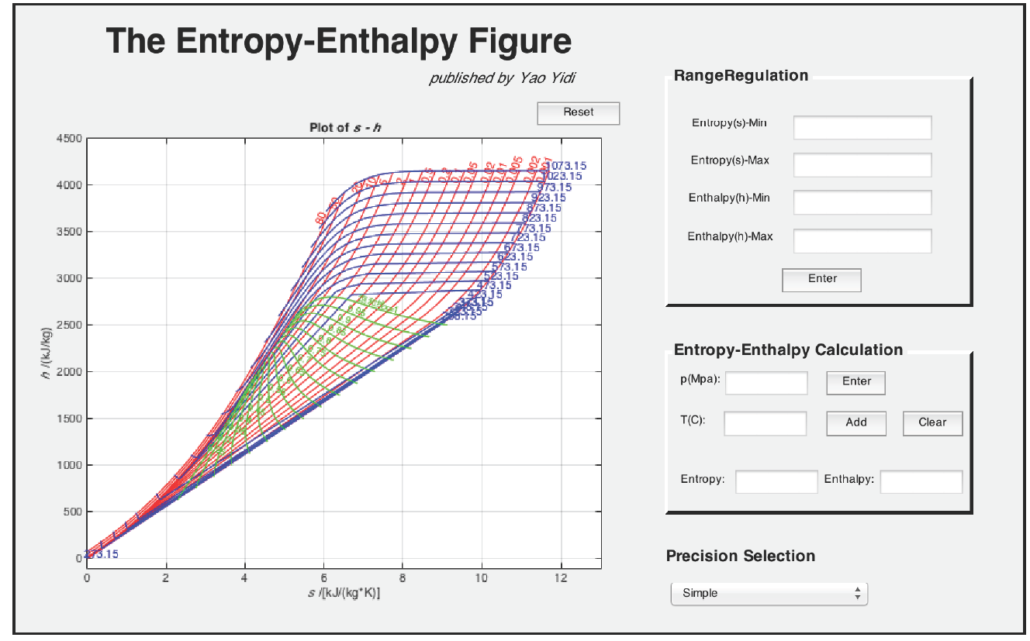
2017

Slide 13
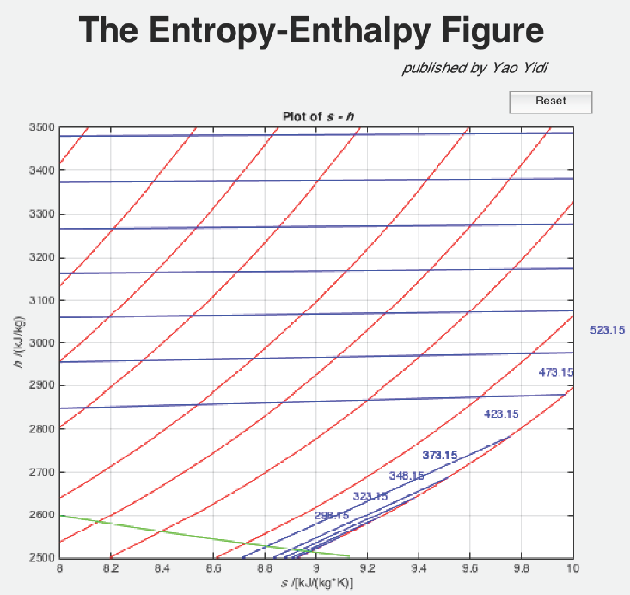

Slide 14
Deadline
Deadline for the final project:
7月15日

Slide 15
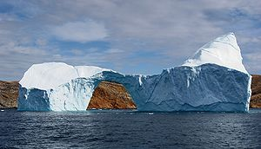
What is water?
Water is a chemical substance that is composed of hydrogen and oxygen and is vital for all known forms of life.
Water in three states: liquid, solid (ice), and water vapor (invisible) in the air.
Notes:
Compose
to be formed from a number of substances, parts, or people
Hydrogen
a colorless gas that is the lightest of all gases, forms water when it combines with oxygen, and is used to produce ammonia and other chemicals. It is a chemical element: symbol H
Oxygen
a gas that has no color or smell, is present in air, and is necessary for most animals and plants to live. It is a chemical element: symbol O
Vital
extremely important and necessary for something to succeed or exist
ￚ synonym crucial
Invisible
something that is invisible cannot be seen
ￚ opposite visible

Slide 16
Why should we be familiar with water in nuclear engineering?
Coolant of Nuclear Reactor
A coolant is a fluid which flows through a device to prevent its overheating, transferring the heat produced by the device to other devices that use it.
Moderator of Nuclear Reactions
In nuclear engineering, a neutron moderator is a medium which reduces the speed of fast neutrons, thereby turning them into thermal neutrons capable of sustaining a nuclear chain reaction.
Notes:
Coolant
a liquid or gas used to cool something, especially an engine
Prevent
to stop something from happening, or stop someone from doing something
Transfer
to move from one place, school, job etc to another, or to make someone do this, especially within the same organization
Moderator
1
someone whose job is to control a discussion or an argument between people
2
British English someone who makes sure that an examination is fair, and that the marks given are fair and correct
3
a religious leader who is in charge of the council of the Presbyterian and United Reformed Churches
Reduce
to make something smaller or less in size, amount, or price
ￚ synonym cut
Neutrons
a part of an atom that has no electrical charge
Sustaining
to make something continue to exist or happen for a period of time
ￚ synonym maintain

Slide 17
Thermodynamic properties
Pressure
Pressure is a measure of the force exerted per unit area on the boundaries of a substance.
Temperature
Temperature is a measure of the molecular activity of a substance.
Density
The density of a substance is the total mass of that substance divided by the total volume occupied by that substance.

Slide 18
The International Association for the Properties of Water and Steam (IAPWS)
This release has been authorized by the IAPWS at its meeting in Erlangen, Germany, 14-20 September 1997. The members of IAPWS are Argentina, Canada, the Czech Republic, Denmark, Germany, France, Italy, Japan, Russia, the United Kingdom, and the United States of America.
The formulation provided in this release is recommended for industrial use, and is called "IAPWS Industrial Formulation 1997 for the Thermodynamic Properties of Water and Steam"
The IAPWS-IF97 replaces the previous industrial formulation "The 1967 IFC-Formulation for Industrial Use“ (IFC-67)
Notes:
The International Association for the Properties of Water and Steam
Erlangen, Germany
September 1997
Release on the IAPWS Industrial Formulation 1997
for the Thermodynamic Properties of Water and Steam
Ó1997 International Association for the Properties of Water and Steam
Publication in whole or in part is allowed in all countries provided that attribution is given to the
International Association for the Properties of Water and Steam
This release has been authorized by the International Association for the Properties of
Water and Steam (IAPWS) at its meeting in Erlangen, Germany, 14-20 September 1997, for
issue by its Secretariat. The members of IAPWS are Argentina, Canada, the Czech Republic,
Denmark, Germany, France, Italy, Japan, Russia, the United Kingdom, and the United States
of America.
The formulation provided in this release is recommended for industrial use, and is called
"IAPWS Industrial Formulation 1997 for the Thermodynamic Properties of Water and Steam"
abbreviated to "IAPWS Industrial Formulation 1997" (IAPWS-IF97). The IAPWS-IF97
replaces the previous industrial formulation "The 1967 IFC-Formulation for Industrial Use"
(IFC-67) [1]. Further details about the formulation can be found in the corresponding article
by W. Wagner et al. [2].
IAPWS also has a formulation intended for general and scientific use.
Further information about this release and other documents issued by IAPWS can be
obtained from the Executive Secretary of IAPWS.

Slide 19
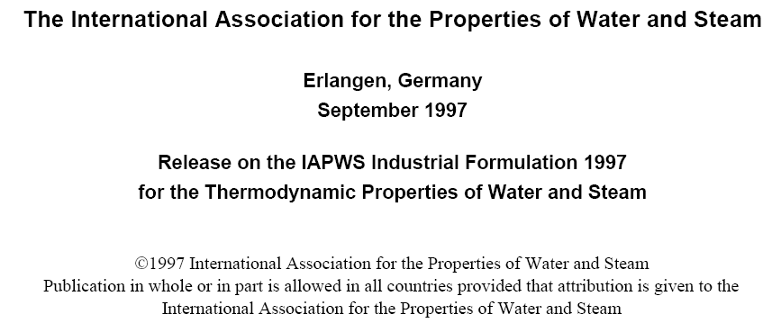
The International Association for the Properties of Water and Steam (IAPWS)
IAPWS also has a formulation intended for general and scientific use that has been released in 1996. This formulation provides the most accurate representation of the thermodynamic properties of the fluid phases of water substance over a wide range of conditions available at the time this release was prepared.
Notes:
The International Association for the Properties of Water and Steam
Erlangen, Germany
September 1997
Release on the IAPWS Industrial Formulation 1997
for the Thermodynamic Properties of Water and Steam
Ó1997 International Association for the Properties of Water and Steam
Publication in whole or in part is allowed in all countries provided that attribution is given to the
International Association for the Properties of Water and Steam
This release has been authorized by the International Association for the Properties of
Water and Steam (IAPWS) at its meeting in Erlangen, Germany, 14-20 September 1997, for
issue by its Secretariat. The members of IAPWS are Argentina, Canada, the Czech Republic,
Denmark, Germany, France, Italy, Japan, Russia, the United Kingdom, and the United States
of America.
The formulation provided in this release is recommended for industrial use, and is called
"IAPWS Industrial Formulation 1997 for the Thermodynamic Properties of Water and Steam"
abbreviated to "IAPWS Industrial Formulation 1997" (IAPWS-IF97). The IAPWS-IF97
replaces the previous industrial formulation "The 1967 IFC-Formulation for Industrial Use"
(IFC-67) [1]. Further details about the formulation can be found in the corresponding article
by W. Wagner et al. [2].
IAPWS also has a formulation intended for general and scientific use.
Further information about this release and other documents issued by IAPWS can be
obtained from the Executive Secretary of IAPWS.

Slide 20
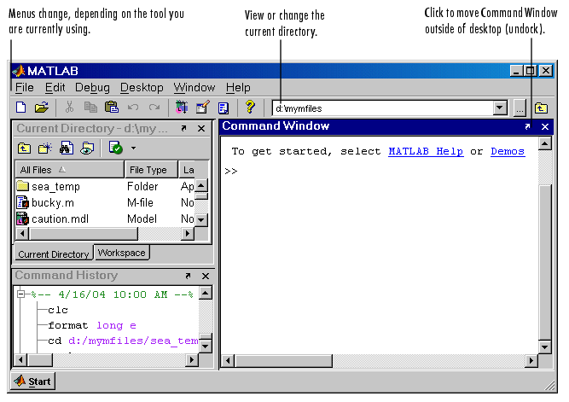
Environments of MATLAB

Slide 21
The MATLAB Environment
The MATLAB Desktop
The Command Window
The Command History Window
The Launch Pad -> Start
The Edit/Debug Window
Figure Windows
The MATLAB Workspace
The Workspace Browser
The MATLAB Search Path
Notes:
desktop noun
desk‧top / ˈdesktɒp $ -tɑːp / [countable]
1
the main area on a computer where you can find the icons that represent programs, and where you can do things to manage the information on the computer
2
the top surface of a desk
launch pad noun
ˈlaunch pad also ˈlaunching pad [countable]
1
a base from which a weapon or spacecraft is sent up into the sky
2
an event, group, or activity that helps someone start something
launch pad for
Ellington's band was a launching pad for many gifted jazz musicians.
space 1 noun
space / speɪs /
1
▶EMPTY AREA◀
[uncountable]the amount of an area, room, container etc that is empty or available to be used

Slide 22
Arranging the Desk
These are some common ways to customize the desktop:
Show or hide desktop tools via the Desktop menu.
Resize any tool by dragging one of its edges.
Move a tool outside of the desktop by clicking the undock button in the tool's title bar.
Reposition a tool within the desktop by dragging its title bar to the new location.
Tools can occupy the same position, as shown for the Current Directory and Workspace browser in the preceding illustration, in which case, you access a tool via its tab.
Change fonts and other options by using File -> Preferences.

Slide 23
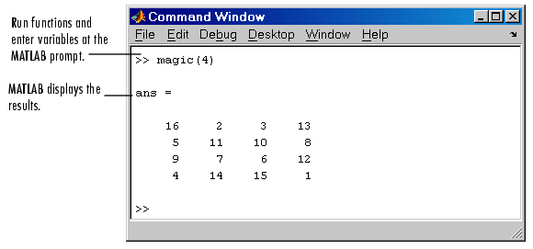
Command Window
Use the Command Window to enter variables and to run functions and M-file scripts.

Slide 24
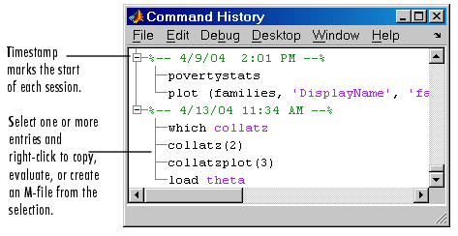
Command History
Statements you enter in the Command Window are logged in the Command History. From the Command History, you can view previously run statements, as well as copy and execute selected statements. You can also create an M-file from selected statements.

Slide 25
How to get help in MATLAB？
Help Browser.
help xxx
Searches for an exact function name match.
lookfor xxx
Searches the quick summary information in each function for a match.
Question: What’s the meaning of function here?
Notes:
browser noun
brows‧er / ˈbraʊzə $ -ər / [countable]
a computer program that finds information on the Internet and shows it on your computer screen
Match
a situation in which something is suitable for something else, so that the two things work together successfully
function 1 noun
func‧tion / ˈfʌŋkʆn /
the purpose that something has, or the job that someone or something does
technical a quantity or quality whose value changes according to another quantity or quality that is related to it
one of the basic operations performed by a computer

Slide 26
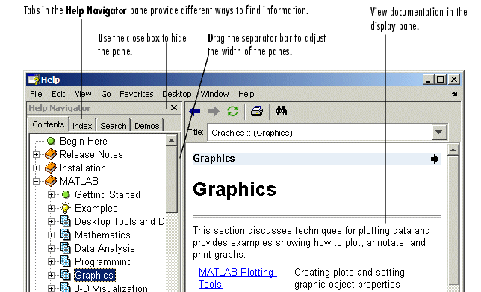
Help Browser
Use the Help browser to search for and view documentation and demos.The Help browser is an HTML viewer integrated into the MATLAB desktop.

Slide 27
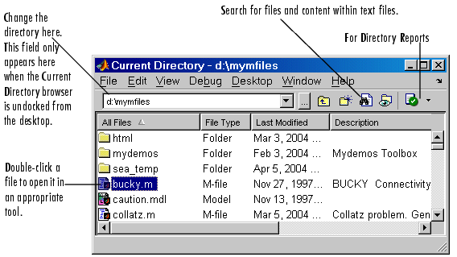
Current Directory Browser and Search Path
MATLAB file operations use the current directory and the search path as reference points. Any file you want to run must either be in the current directory or on the search path.

Slide 28
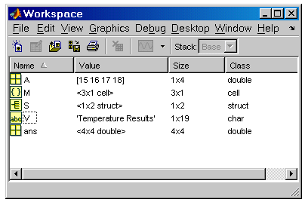
Workspace Browser and Array Editor
The MATLAB workspace consists of the set of variables (named arrays) built up during a MATLAB session and stored in memory. You add variables to the workspace by using functions, running M-files, and loading saved workspaces.

Slide 29
Save and load
Save and load can be used to write data to disk and load data from disk
It is not recommended that use save and load function to transfer data between functions since the speed of writing data to disk is slow compared with memory.
Before using save and load, you must be clear what will be saved and what will be loaded.

Slide 30
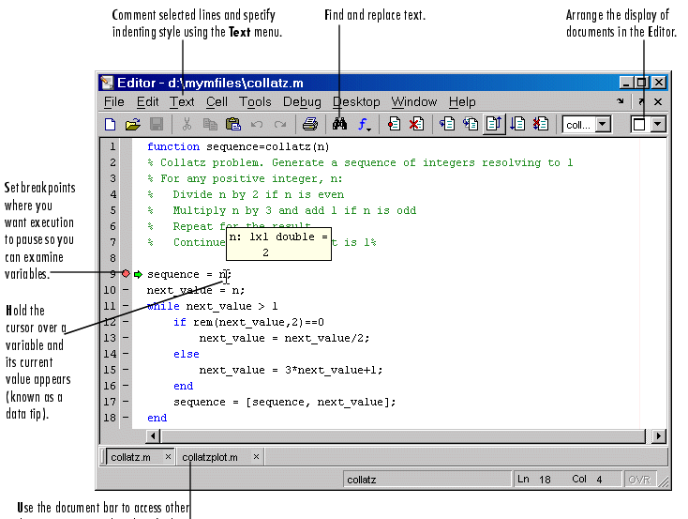
Editor/Debugger
Use the Editor/Debugger to create and debug M-files, which are programs you write to run MATLAB functions. The Editor/Debugger provides a graphical user interface for text editing, as well as for M-file debugging. To create or edit an M-file use File -> New or File -> Open, or use the edit function.

Slide 31
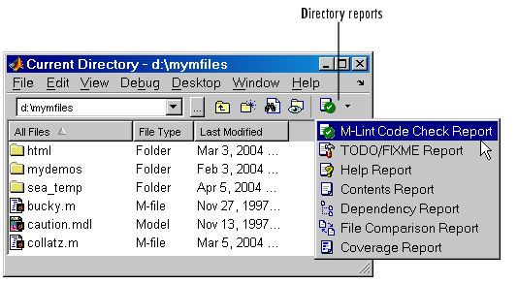
M-Lint Code Check and Profiler Reports
MATLAB provides tools to help you manage and improve your M-files, including the M-Lint Code Check and Profiler Reports.
The M-Lint Code Check Report displays potential errors and problems, as well as opportunities for improvement in your M-files.
Access the M-Lint Code Check Report and other directory reports from the Current Directory browser. You run a report for all files in the current directory. Alternatively, you can use the mlint function to get results for a single M-file.

Slide 32
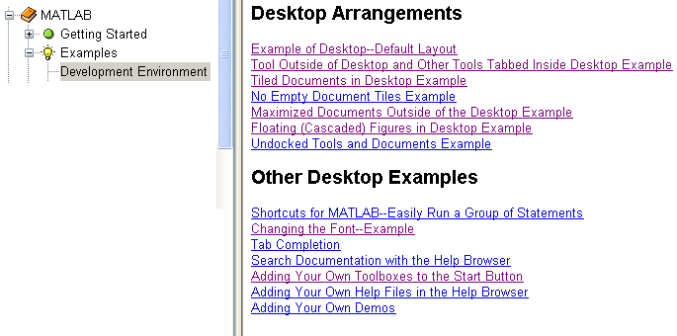
Some Examples on Development Enviroment

Slide 33
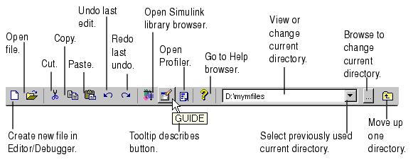
Common Desktop Features-Toolbars

Slide 34
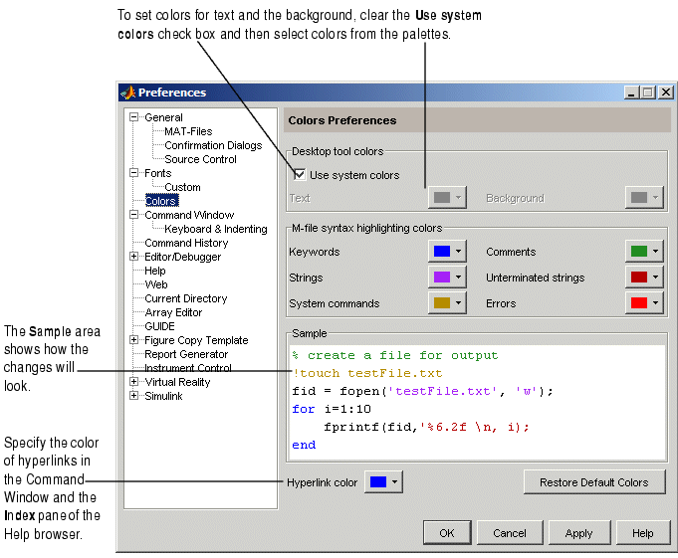
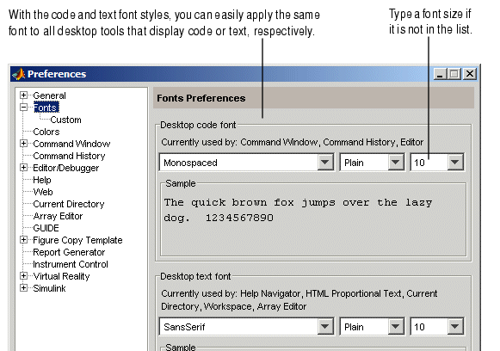
Fonts, Colors, and Other Preferences

Slide 35
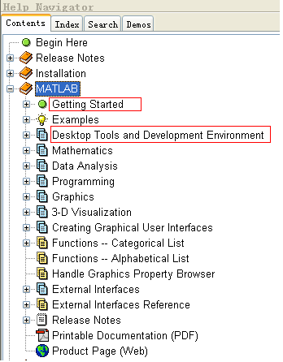

Slide 36
Homework
Read the text from page 1 to 20.
Exercises 1.1 to 1.8
Read the reference The International Association for the Properties of Water and Steam as much as possible.
Notes:
Association
an organization that consists of a group of people who have the same aims, do the same kind of work etc

