Slide 1
MATLAB for Math Lecture 10
Yu, Jiyang
yujiy@tsinghua.edu.cn
, Office: Room 904# of Liuqing Building
Department of Engineering Physics
Tsinghua University

Slide 2
总复习- pitfalls
Variables and Arrays
[] ; , : ‘’ { } | \ / ( ) * & ^ % ~
Logical Arrays
s = t > 273.15;
h(s) = hfunc (p(s),t(s));

Slide 3
Branches and Loops
if () elseif () else
switch() case otherwise
break continue
try/catch
while ()
for ()
end

Slide 4
UDF and scripts
function [outarg1, outarg2, ...] = fname(inarg1, inarg2, ...)
%H1 comment line
%Other comment lines
...
(Executable code)
...
H1 comment line will be searched and displayed by the lookfor command.
Other comment line will be listed by help command.
Save as a file named fname.m in the working directory.
m file is a kind of script file. It is just a collection of MATLAB statements that are stored in a file.
An example of script file is the BAT file in DOS system.

Slide 5
微积分问题
极限问题
syms x a b;
f = x*(1+a/x)^x*sin(b/x);
L = limit(f,x,inf)
L = b*exp(a)
syms x;
limit((exp(x^3)-1)/(1-cos(sqrt(x-sin(x)))),x,0,'right')

Slide 6
微积分问题
导数问题
syms x;
f = sin(x)/(x^2+4*x+3);
f4 = diff(f,x,4)
f4 =
sin(x)/(x^2 + 4*x + 3) + (12*sin(x))/(x^2 + 4*x + 3)^2 + (24*sin(x))/(x^2 + 4*x + 3)^3 - (24*cos(x)*(2*x + 4)^3)/(x^2 + 4*x + 3)^4 - (12*sin(x)*(2*x + 4)^2)/(x^2 + 4*x + 3)^3 - (48*sin(x)*(2*x + 4)^2)/(x^2 + 4*x + 3)^4 + (24*sin(x)*(2*x + 4)^4)/(x^2 + 4*x + 3)^5 + (4*cos(x)*(2*x + 4))/(x^2 + 4*x + 3)^2 + (16*cos(x)*(2*x + 4))/(x^2 + 4*x + 3)^3 + (8*cos(x)*(8*x + 16))/(x^2 + 4*x + 3)^3 - (6*sin(x)*(2*x + 4)*(8*x + 16))/(x^2 + 4*x + 3)^4

Slide 7
微积分问题
导数问题
syms t; y = sym(‘f(t)’);
G = simple(diff(t^2*sin(t)*y,t,3))
G =
(sin(t)*diff(f(t), t, t, t) + 3*cos(t)*diff(f(t), t, t) - 3*sin(t)*diff(f(t), t) - cos(t)*f(t))*t^2 + (6*sin(t)*diff(f(t), t, t) + 12*cos(t)*diff(f(t), t) - 6*f(t)*sin(t))*t + 6*sin(t)*diff(f(t), t) + 6*cos(t)*f(t)

Slide 8
微积分问题
积分问题
syms x;
y=sin(x)/(x^2+4*x+3);
y1 = diff(y);
y0 = int(y1);
y0 =
sin(x)/((x + 1)*(x + 3))
taylor(f,x,9)

Slide 9
MATLAB在光学中的应用举例
问题：理想情况下的双缝干涉

Slide 10
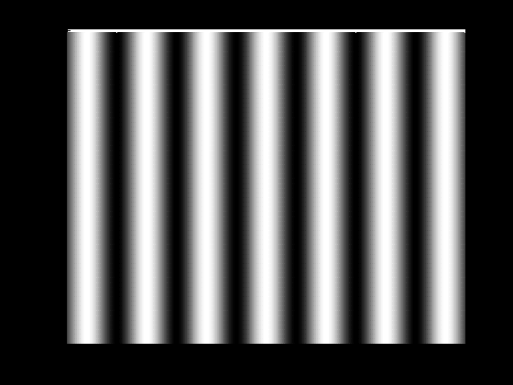
双缝干涉
x = -0.01:0.00003:0.01;
y = -0.01:0.0003:0.01;
z0 = 1;
lamda = 600e-9;
a = 2*pi/lamda;
[X,Y] = meshgrid(x,y);
R1 = sqrt((X+0.0001).^2 + z0^2);
R2 = sqrt((X-0.0001).^2 + z0^2);
I1 = 1./R1;
I2 = 1./R2;
I = I1 + I2 + 2. *sqrt(I1.*I2).*cos(a.*(R2-R1));
figure;
hold on
colormap(gray);
view(0,90);
mesh(X,Y,I);

Slide 11
MATLAB在量子物理中的应用举例
问题：一维稳态薛定谔方程的数值解
其中， E为能量，单位eV，x的单位为10⁻¹⁰m
对于电子有

Slide 12
假设：
边界条件为：

Slide 13
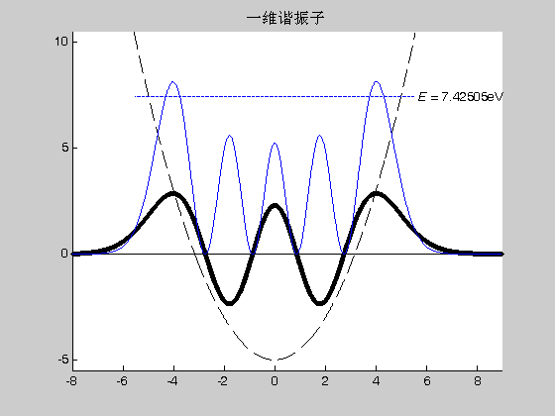
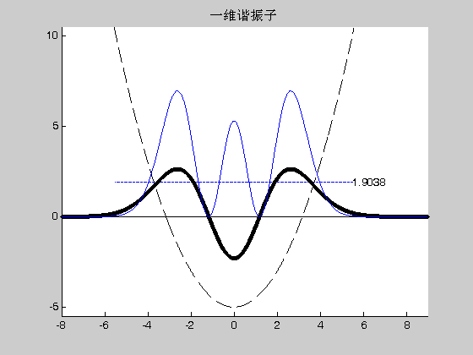
MATLAB代码
A = 1/3.8141;
E = 1.9038125;%4.665288;%7.42505
B = 500;
hold on;
axis([-8,9,-5.5,10.5]);
title(‘一维谐振子');
a = [-8:0.01:9];
a1 = -5.5 : 0.05 : 5.5;
b2 = 0.5 .* a.^2 -5;
b3 = E;
plot(a,0,'k-',a,b2,'k--',a1,b3,'b-');
text(5.5,7.42505,'\it E \rm= 7.42505eV','fontsize',10);
[x,p] = ode45('zfun',a,[0,0.00001],[],A,E);
p1 = B * p;
p2 = p1.^2;
plot(x,p1(:,1),'k.');
plot(x,p2(:,1),'b-');
hold off
function ydot = zfun(x,p,flag,A,E)
ydot = [p(2);
A*(0.5*x^2-5-E)*p(1)];

