Slide 1
MATLAB Programming Lecture 2
Yu, Jiyang
yujiy@tsinghua.edu.cn
Office: Room 904# of Liuqing Building
Department of Engineering Physics
Tsinghua University

Slide 2
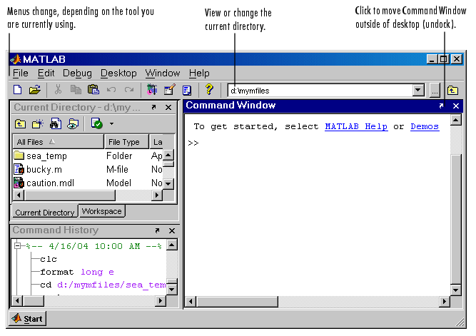
Environments of MATLAB

Slide 3
Predefined functions
help
lookfor
magic
sin
save
load

Slide 4
Contents
Matrix
MATLAB Basics
Variables and Arrays
Initializing variables
Subarrays
Special values
Displaying output data
Data files
Operations
Built-in functions
Plotting
Example: Carbon 14 Dating
Debugging MATLAB Programs
Notes:
environment noun
en‧vi‧ron‧ment / ɪnˈvaɪrənmənt /
1
the environment
the air, water, and land on Earth, which can be harmed by man's activities
array 1 noun
ar‧ray / əˈreɪ / [countable]
1
[usually singular] a group of people or things, especially one that is large or impressive
plot 1 noun
plot / plɒt $ plɑːt / [countable]
▶DRAWING◀
American English a drawing that shows the plan of a building at ground level
ￚ synonym ground plan

Slide 5
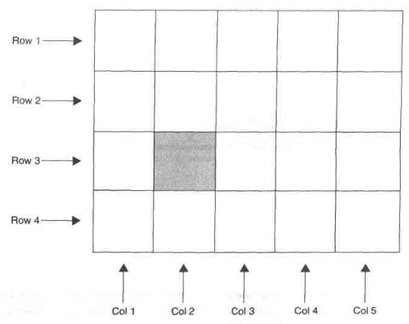
MATLAB Basics
Variables and Arrays
Fundamental unit of data is the array.
The size of an array is specified by the number of rows and columns.
Variable is a region of memory containing an array, which is known by a user-specified name.
Try: size(a)
a is a variable
Notes:
row
row / rəʊ $ roʊ / [countable]
a line of things or people next to each other
column
col‧umn / ˈkɒləm $ ˈkɑː- / [countable]
a line of numbers or words written under each other that goes down a page
variable 1 adjective
var‧i‧a‧ble / ˈveəriəbl $ ˈver- /
1
likely to change often
Expect variable cloudiness and fog tomorrow.Interest rates can be highly variable . variable in size/shape/colour etc These fish are highly variable in color and pattern.
2
sometimes good and sometimes bad
The quality of pork is often less variable than beef.
3
able to be changed
The heater has variable temperature settings.

Slide 6
Rules for name of variables
Must begin with a letter
Followed by any combination of letters, numbers and underscore.
MATLAB is case sensitive
MATLAB uses only the first N characters of the name, (where N is the number returned by the function namelengthmax), and ignores the rest.
These characters can not be used in the name of a variable:
` ~ , - = + * / “ ; : | & ^ % $ # @ ! .
See the exercise 2.2

Slide 7
Variables
MATLAB does not require any type declarations or dimension statements.
When MATLAB encounters a new variable name, it automatically creates the variable and allocates the appropriate amount of storage. If the variable already exists, MATLAB changes its contents and, if necessary, allocates new storage.
To view the matrix assigned to any variable, simply enter the variable name.

Slide 8
Examples
A = [1 2 3; 2,3,4];
What is echoed by size(A) ?
>> size(A)
ans =
2 3
[rows col] = size(A)
[rows col] = size(A)
rows =
2
col =
3

Slide 9
MATLAB Basics
Initializing variables
Assign data to the variable in an assignment statement.
A = 6;
B = [1 2 3 4 5 6];
C = [1, 2, 3; 4, 5, 6];
D = 1 : 2 : 10;
With shortcut expressions
first:incr:last

Slide 10
MATLAB Basics
Initializing variables
Input data into the variable from the keyboard.
A = input(‘请输入:’);
Read data from a file.
load A
Using built-in functions
E = zeros(5);

Slide 11
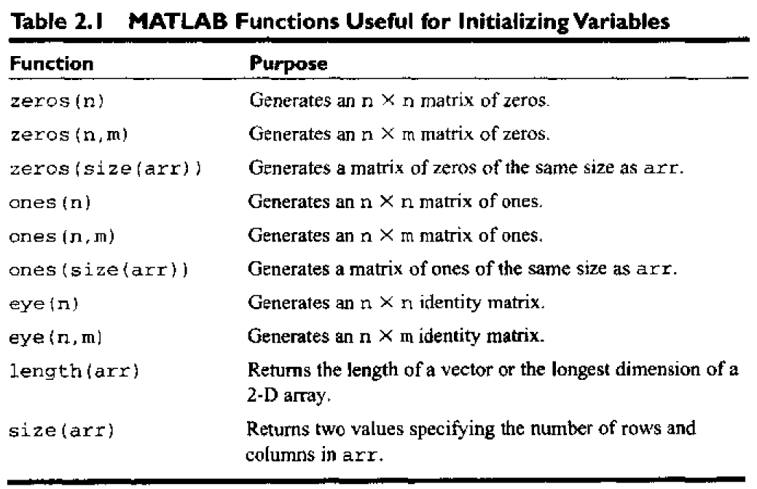
Functions for initializing

Slide 12
Good programming practice
Use a semicolon at the end of all MATLAB assignment statements to suppress echoing of assigned values in the Command Window. This greatly speeds program execution.
If you need to examine the results of a statement during program debugging, you may remove the semicolon from that statement only so that its results are echoed in the command window.

Slide 13
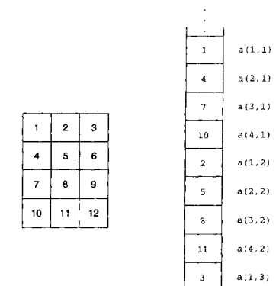
Multidimensional Arrays
An example of 3-D arrays
C(:,:,1) = [1 2 3;4 5 6];
C(:,:,2) = [7 8 9; 1 2 3];
Storing of Multidimensional arrays
column, row, level …

Slide 14
Programming Pitfalls
Make sure your variable names are unique in the first namelengthmax characters. Otherwise, MATLAB will not be able to tell the difference between them.
The number of elements in every row or column of an array must be the same. Otherwise, it will produce an error when the statement is executed.

Slide 15
Matrix
In MATLAB, a matrix is a rectangular array of numbers. The operations in MATLAB are designed to be as natural as possible.
A good example matrix, used throughout this book, appears in the Renaissance engraving Melencolia I by the German artist and amateur mathematician Albrecht Dürer.
Try type magic(4) in the command window

Slide 16
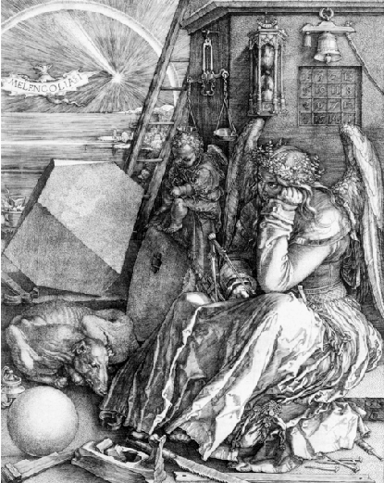
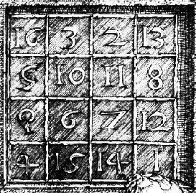
Matrix

Slide 17
Matrix
Try
>> magic(4)
ans =
16 2 3 13
5 11 10 8
9 7 6 12
4 14 15 1
See: Help-> MATLAB -> Getting Started -> Matrices and Arrays -> Matices and Magic Squares

Slide 18
Entering Matrices
The best way for you to get started with MATLAB is to learn how to handle matrices.
You can enter matrices into MATLAB in several different ways:
Enter an explicit list of elements.
Load matrices from external data files.
Generate matrices using built-in functions.
Create matrices with your own m-functions.

Slide 19
Some functions for Matrix
sum(A)
ans =
34 34 34 34
sum(A’)’
diag(A)
sum(diag(A))
sum(diag(fliplr(A)))

Slide 20
Subscripts
The element in ith row and jth column of matrix A is denoted by A(i,j).
A(1,4) + A(2,4) + A(3,4) + A(4,4)
It is also possible to refer to the elements of a matrix with a single subscript, A(k).
So, for the magic square, A(8) is another way of referring to the value 15 stored in A(4,2).

Slide 21
Concatenation
Concatenation is the process of joining small matrices to make bigger ones.
In fact, you made your first matrix by concatenating its individual elements. The pair of square brackets, [], is the concatenation operator.
For an example, start with the 4-by-4 magic square, A, and form
B = [A A+32; A+48 A+16]

Slide 22
Deleting Rows and Columns
You can delete rows and columns from a matrix using just a pair of square brackets.
X = magic(4);
X(:,2) = []
This changes X to
X =
16 2 13
5 11 8
9 7 12
4 14 1

Slide 23
Deleting Rows and Columns
If you delete a single element from a matrix, the result is not a matrix anymore. So, expressions like
X(1,2) = []
result in an error.

Slide 24
Deleting Rows and Columns
However, using a single subscript deletes a single element, or sequence of elements, and reshapes the remaining elements into a row vector. So
X(2:2:10) = []
results in
X =
16 9 2 7 13 12 1
X =
16 2 13
5 11 8
9 7 12
4 14 1

Slide 25
Good programming practice
Always give your variables descriptive and easy to remember name. For example, a currency exchange rate could be given the name exchange_rate.
This will give your programs clearer and easier to understand.
Create a data dictionary for each program to make program maintenance easier.
A data dictionary lists the definition of each variable used in a program.
Be sure to capitalize a variable exactly the same way each time that it is used.
It is a good practice to use only lowercase letters in variable names.

Slide 26
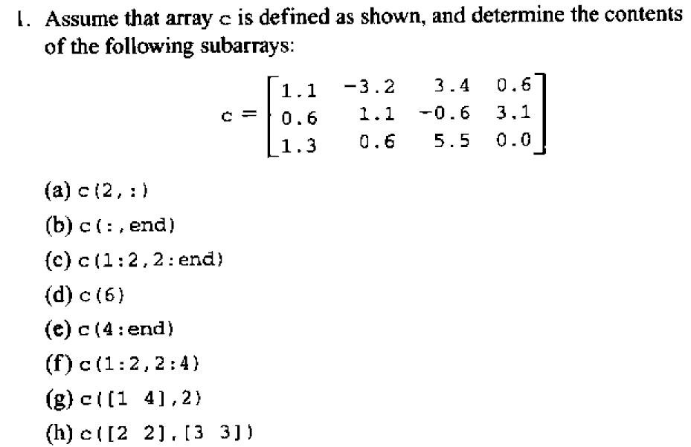
Subarrays

Slide 27
Pitfalls
For assignment statements involving sub-arrays, the shapes of the sub-arrays on both sides of the equal sign must match. MATLAB will produce an error if they do not match.
Be sure to distinguish between assigning values to a sub-array and assigning values to an array. MATLAB behaves differently in these two cases.

Slide 28
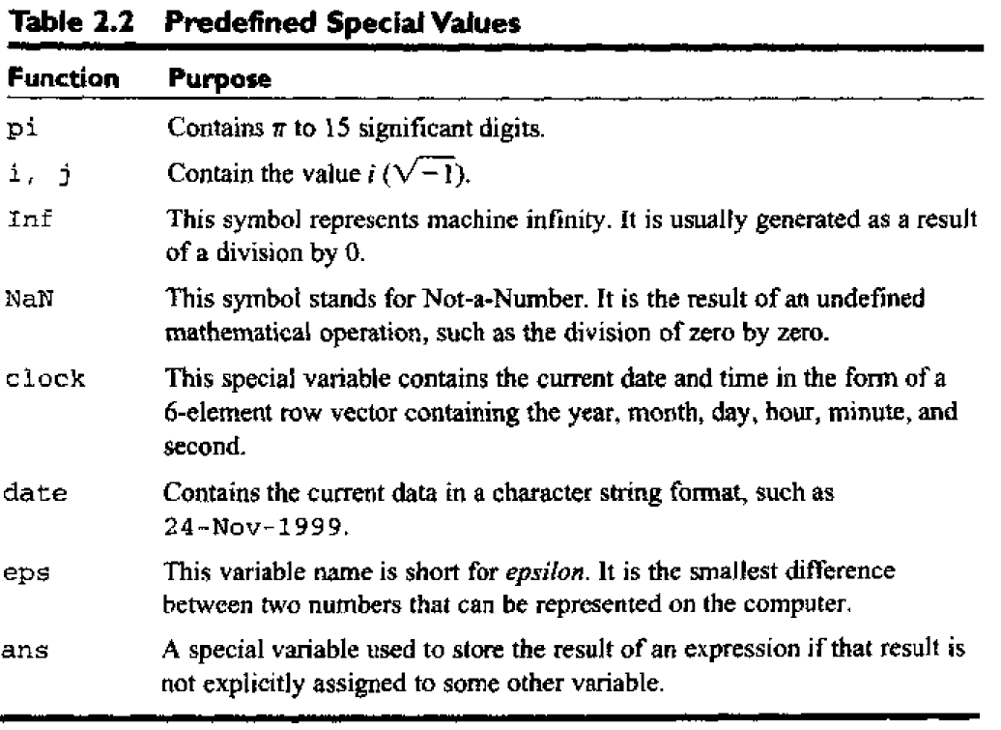
Special values

Slide 29
Pitfalls
Never redefine the meaning of a predefined variables in MATLAB. It is a recipe for disaster, producing subtle and hard-to-find bugs.

Slide 30
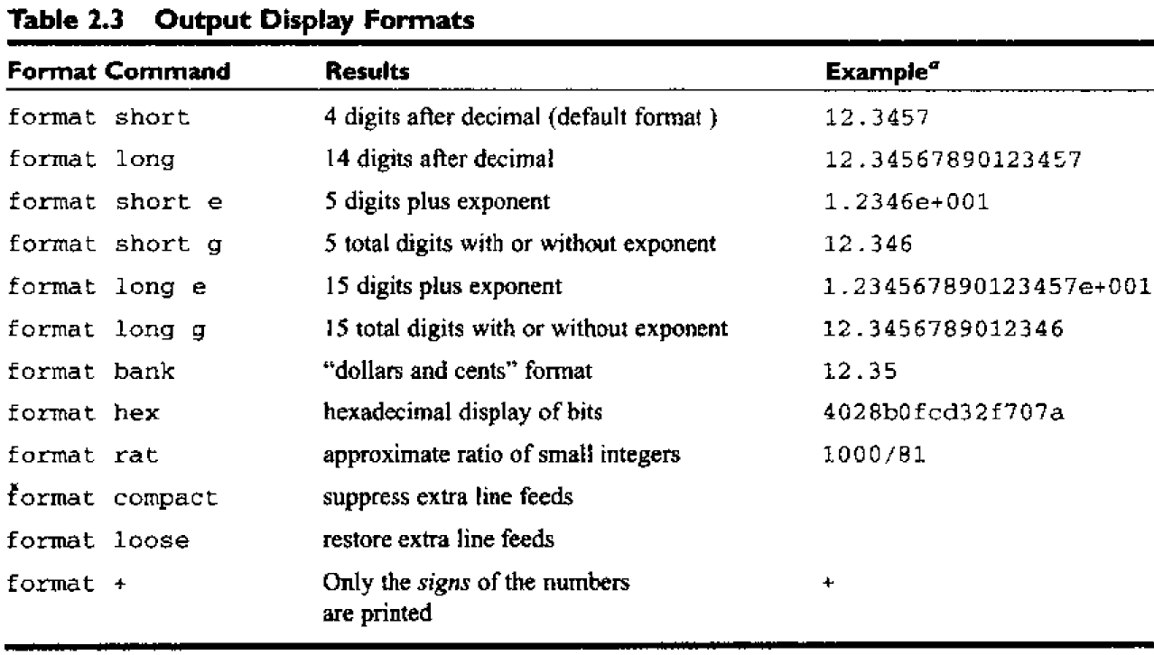
Displaying output data

Slide 31
Numbers
MATLAB uses conventional decimal notation, with an optional decimal point and leading plus or minus sign, for numbers.
Scientific notation uses the letter e or d to specify a power-of-ten scale factor.
Imaginary numbers use either i or j as a suffix. Some examples of legal numbers are
3 -99 0.0001
9.6397238 1.60210e-20 6.02252e23
1i -3.14159j 3e5i
All numbers are stored internally using the long format specified by the IEEE floating-point standard. Floating-point numbers have a finite precision of roughly 16 significant decimal digits and a finite range of roughly 1.0e-308 to 1.0e+308.

Slide 32
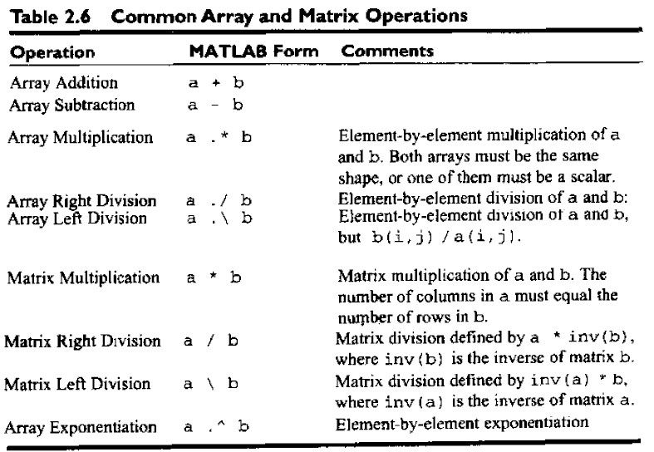
Operations

Slide 33
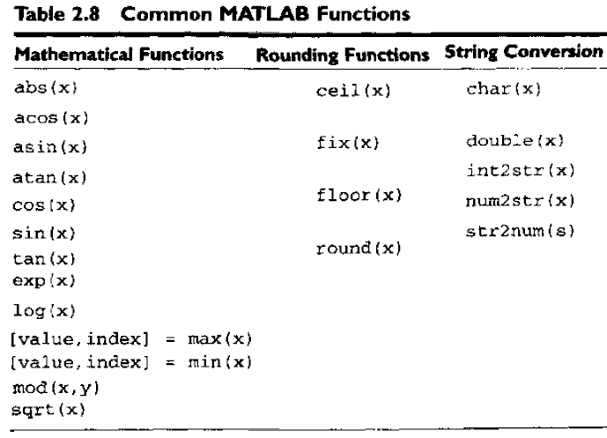
Built-in functions

Slide 34
Examples of Expressions
rho = (1+sqrt(5))/2
rho = 1.6180
a = abs(3+4i)
a = 5
z = sqrt(-5+i)
z = 0.2225 + 2.2471i
huge = exp(log(realmax))
huge = 1.7977e+308
toobig = pi*huge
toobig = Inf

Slide 35
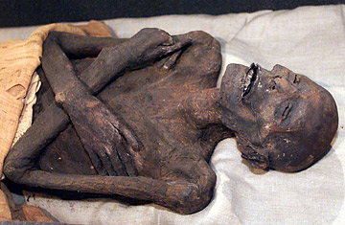
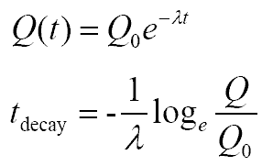
Example 2.5 Carbon 14 Dating
Introduce this example
in the environment of MATLAB
plotting
comments
variable list
testing

Slide 36
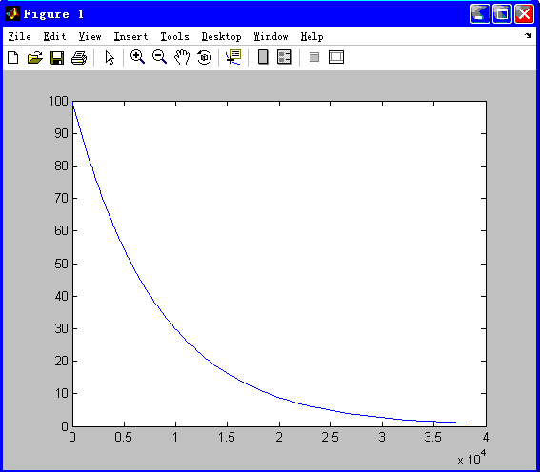
Plotting
Save following sentences to the file age.m
function a=age(x)
a=(-1.0/0.00012097)*log(x/100);
x=1:1:100;
plot(age(x),x);

Slide 37
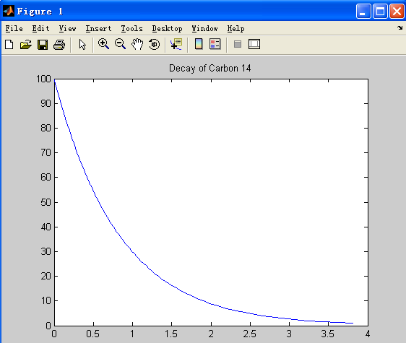
Modify the features of plot
title('Decay of Carbon 14')

Slide 38
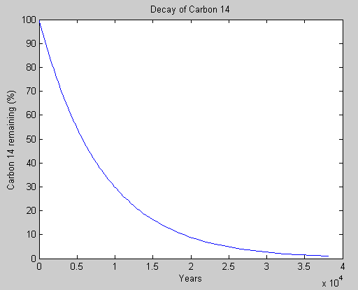
Modify the features of plot
>> xlabel('Years');
>> ylabel('Carbon 14 remaining (%)')

Slide 39
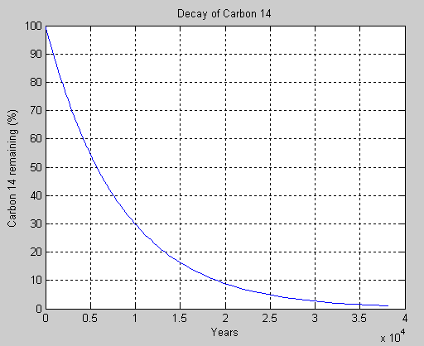
Modify the features of plot
>> grid on;

Slide 40
Modify the features of plot
>> print -dtiff my_image.tif

Slide 41
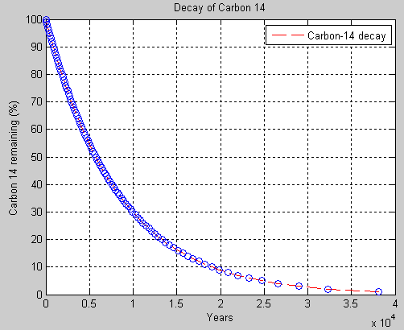
Modify the features of plot
>> plot(x,y,’r--',x,y,’bo’);
legend('Carbon-14 decay');

Slide 42
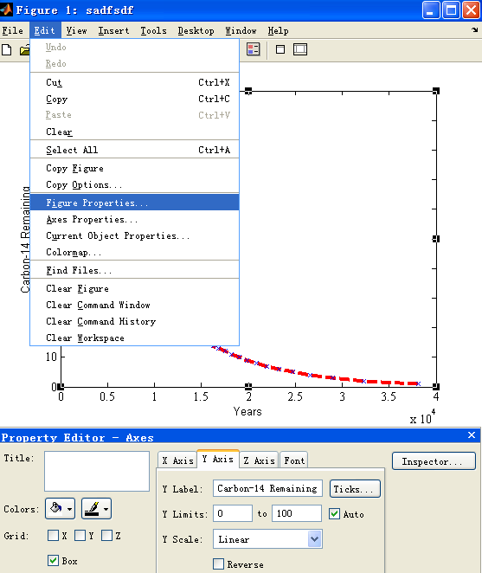
Advanced
Figure Properties

Slide 43
Data files
save filename var1 var2 var3
‘mat’ files
save x.dat x –ascii
If data must be exchanged between MATLAB and other programs, save the MATLAB data in ASCII format.
Save ASCII data files with a ‘dat’ file extent to distinguish them from ‘mat’ files.
load filename

Slide 44
Debugging MATLAB Programs
Stephen: There is an old saying that the only sure things in life are death and taxes. We can add one more certainly to that list: if you write a program of any significant size, it will not work the first time you try it!
Debugging is a process of finding and reducing the number of bugs, or defects, in a computer program, thus making it behave as expected.

Slide 45
Types of errors
Syntax error
x = (y + 3) / 2);
Run-time error
x = 0
y = 1.0/x
Warning: Divide by zero.
Logical error
You will get the wrong answer!
Symbolic debugger

Slide 46
Debugging tools
Break points
Step
Step in
Step out
Run
Stop

Slide 47
Review of Basics
Variables and arrays
Initializing variables
Multidimensional arrays
Sub-arrays
Special values
Displaying output data
Scalar and array operations
Hierarchy of operations
Built-in MATLAB functions
Introduction of plotting
Debugging MATLAB programs

Slide 48
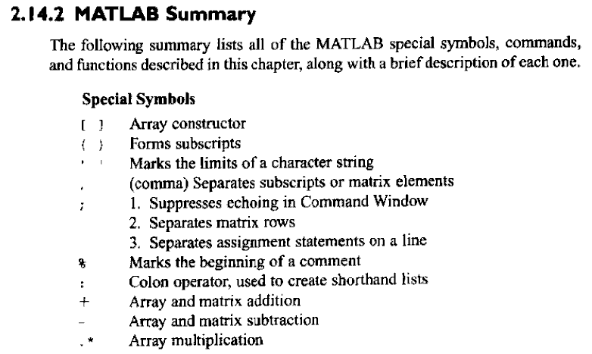
Summary

Slide 49
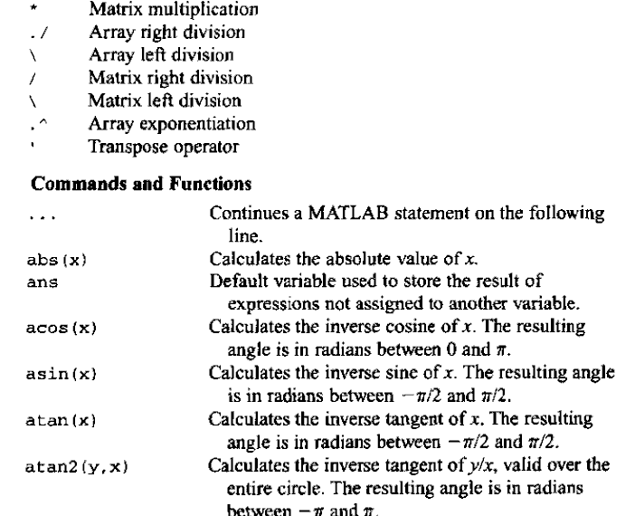

Slide 50
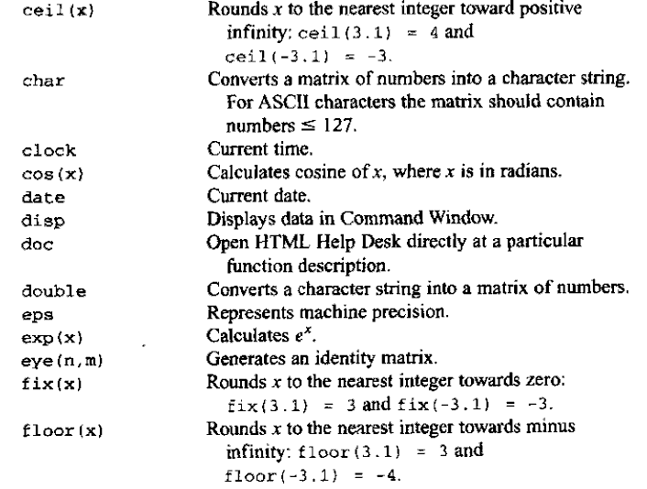

Slide 51
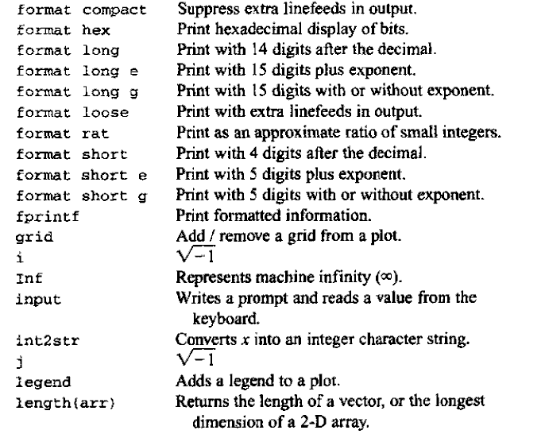

Slide 52
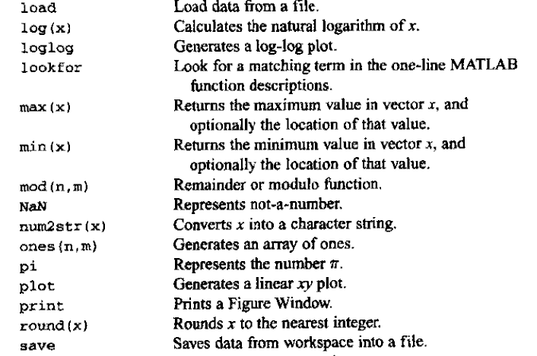

Slide 53
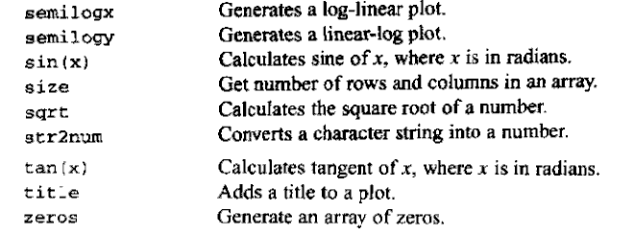
Summary

Slide 54
Homework
Review the text from page 21 to 79.
Exercises 2.1 to 2.18
Read the reference The International Association for the Properties of Water and Steam as much as possible.

