Slide 1
MATLAB Programming Lecture 3
Yu, Jiyang
yujiy@tsinghua.edu.cn
Tel: 62794070, Cell:17097723858
Office: Room 904# of Liuqing Building
Department of Engineering Physics
Tsinghua University

Slide 2
Review of Basics
Variables and arrays
Initializing variables
Multidimensional arrays
Sub-arrays
Special values
Displaying output data
Scalar and array operations
Built-in MATLAB functions
Introduction of plotting

Slide 3
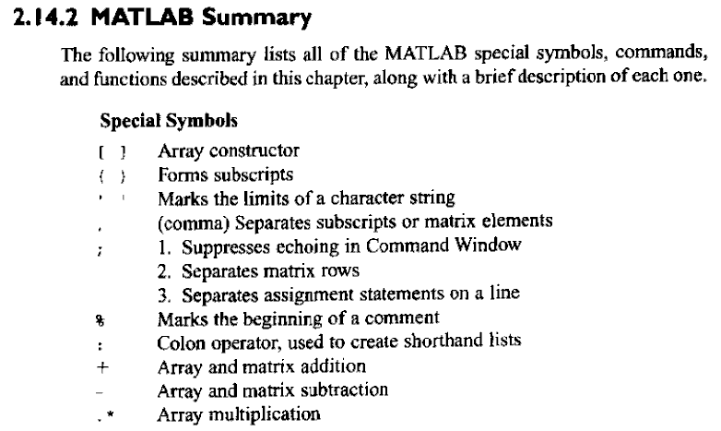
Summary

Slide 4
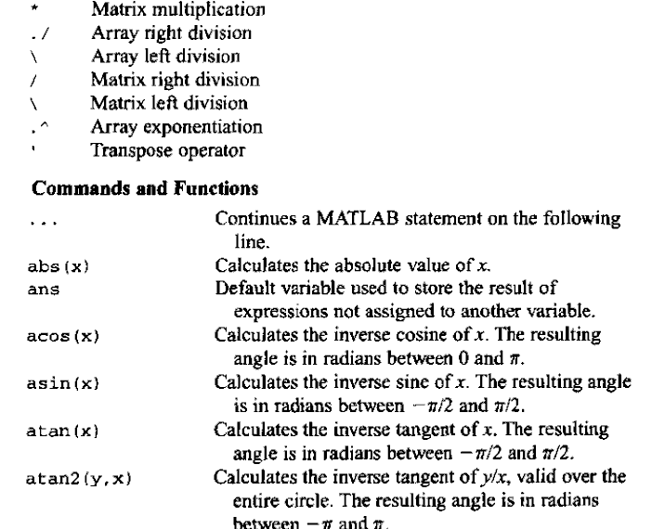

Slide 5
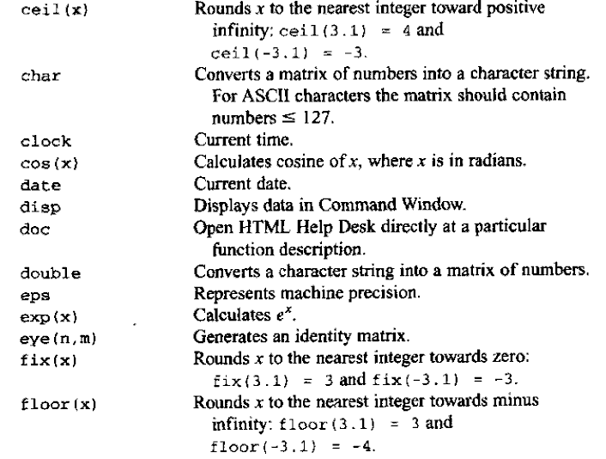

Slide 6
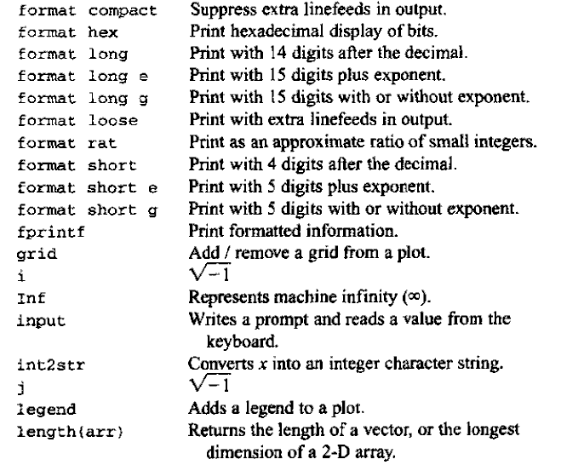

Slide 7
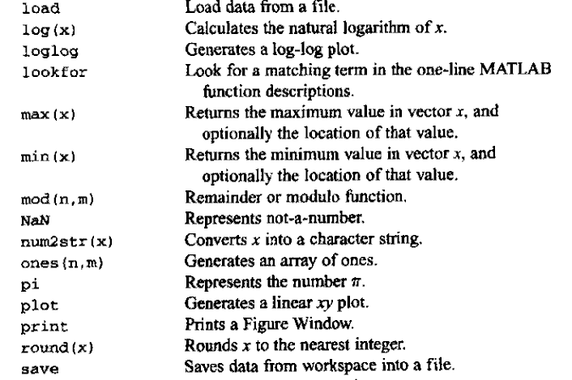

Slide 8
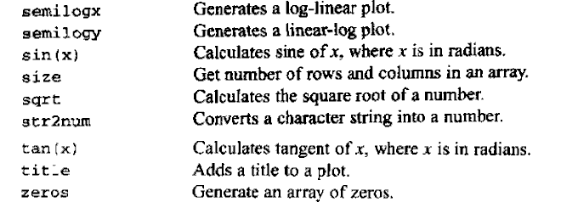

Slide 9
Contents
Top-Down Design Techniques
Relational and Logic Operations
Branches
The if Construct
The switch Construct
The try/catch Construct
Additional Plotting Features

Slide 10
How do you begin?
Suppose you need to write a program to solve the problem of water properties.
On the fly?
Without “wasting” a lot of time thinking about the problem first.
Completely think out the problem.
Stephen’s professor told him: “Programming is easy. It’s knowing what to program that’s hard.”
The most difficult part: to understand the problem.

Slide 11
Top-Down Design Techniques
Break a large task down into smaller subtasks.
Each subtask may in turn be subdivided into smaller and smaller pieces.
Each piece can be coded and tested independently.
5 Steps:
Step 1: Clearly state the problem that you are trying to solve
Step 2: Define the inputs required by the program and the outputs to be produced by the program
Step 3: Design the algorithm that you intend to implement in the program
Step 4: Turn the algorithm into MATLAB statements
Step 5: Test the resulting MATLAB program

Slide 12
Use of pseudocode
As a part of the design process, it is necessary to describe the algorithm that you intend to implement. The description of the algorithm should be in a standard form that is easy for both you and other people to understand, and the description should aid you in turning your concept Into MATLAB code.
The standard forms that we use to describe algorithms are called constructs (or sometimes structures).

Slide 13
Pseudocode
The constructs used to build algorithms can be described in a special way called pseudocode.
Pseudoeode is a hybrid mixture of MATLAB and English. It is structured like MATLAB, with a separate line for each distinct idea or segment of code, but the descriptions on each line are in English.
Pseudocode is very useful for developing algorithms since it is flexible and easy to modify.

Slide 14
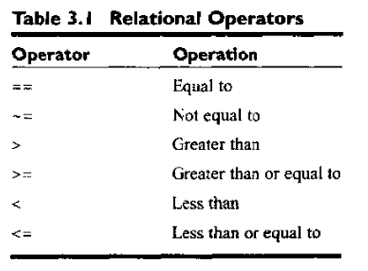
Relational Operators
Operation Result
3 < 4 1
3 <= 4 1
3 == 4 0
3 > 4 0
4 <= 4 1
'A' < 'B' 1

Slide 15
Pitfalls
Be careful not to confuse the equivalence relational operator ( == ) with the assignment operator ( = ).

Slide 16
== and ~=
a = 0;
b = sin(pi);
>> a == b
ans =
0
Round off error!
>> abs(a - b) < 1.0E-14

Slide 17
Good programming practice
Be cautious about testing for equality with numeric values, since roundoff errors can cause two variables that should be equal to fail a test for equality.
Instead, test to see if the variables are nearly equal within the roundoff error to be expected on the computer you are working with.

Slide 18
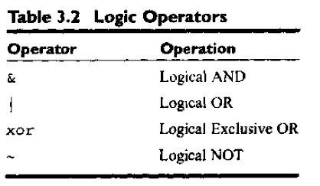
Logical Operators
Hierarchy of operations
Parentheses > arithmetic > relational > logic
~ > & > |

Slide 19
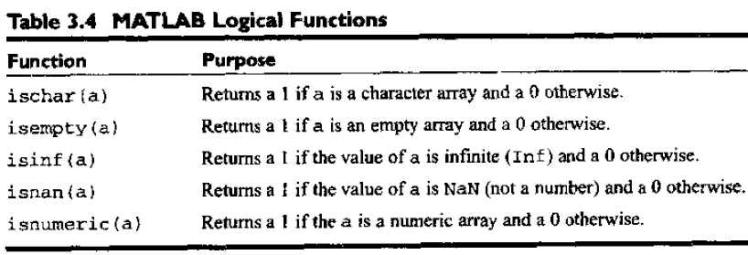
Logical functions

Slide 20
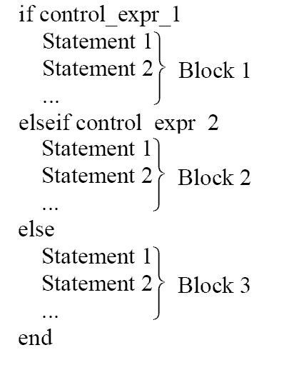
Branches——The if construct

Slide 21
Example 3.2 The quadratic equation
Design and write a program to solve for the roots of a quadratic equation, regardless of type.
Steps of top-down design techniques
1. State the problem
2. Define the inputs and outputs
3. Design the algorothm
4. Turn the algorithm into MATLAB statements
5. Test the program.

Slide 22
1. State the problem
The problem statement for this example is very simple. We want to write a program that will solve for the roots of a quadratic equation, whether they are distinct real roots, repeated real tools, or complex roots.
a*x**2 + b*x + c = 0.

Slide 23
2. Define the inputs and outputs
The inputs required by this program are the coefficients a, b. and c of the quadratic equation.
The output from the program will be the roots of the quadratic equation, whether they are distinct real roots, repeated real roots, or complex roots.

Slide 24
3. Design the algorothm
This task can be broken down into three major sections. whose functions arc input, processing, and output
We now break each of the above major sections into smaller, more detailed pieces. There are three possible ways to calculate the roots, depending on the value of the discriminant, so it is logical to implement this algorithm with a thee-branched if construct.

Slide 25
4. MATLAB statements
discriminant = b^2 - 4 * a * c;
if discriminant > 0
x1 = (-b + sqrt(discriminant)) / (2*a);
x2 = (-b - sqrt(discriminant)) / (2*a);
elseif discriminant == 0
x1 = ( -b ) / (2*a);
else
real_part = (-b)/(2*a);
imag_part = sqrt(abs(discriminant))/(2*a);
end

Slide 26
% Script file: calc_roots.m
%
% Purpose:
% This program solves for the roots of a quadratic equation
% of the form a*x**2 + b*x + c = 0. It calculates the answers
% regardless of the type of roots that the equation possesses.
%
% Record of revisions:
% Date Programmer Description of change
% ==== ========== =====================
% 12/04/97 S. J. Chapman Original code
%
% Define variables:
% a -- Coefficient of x^2 term of equation
% b -- Coefficient of x term of equation
% c -- Constant term of equation
% discriminant -- Discriminant of the equation
% imag_part -- Imag part of equation (for complex roots)
% real_part -- Real part of equation (for complex roots)
% x1 -- First solution of equation (for real roots)
% x2 -- Second solution of equation (for real roots)
% Prompt the user for the coefficients of the equation

Slide 27
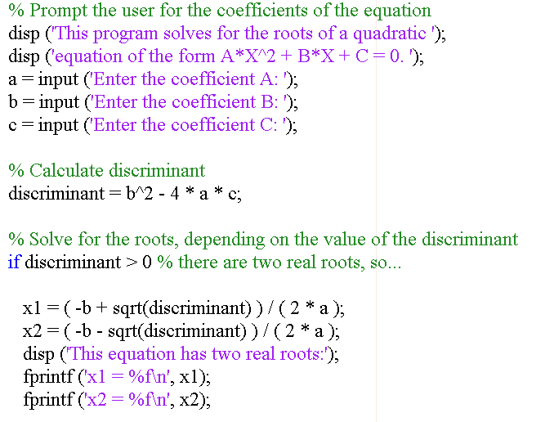

Slide 28
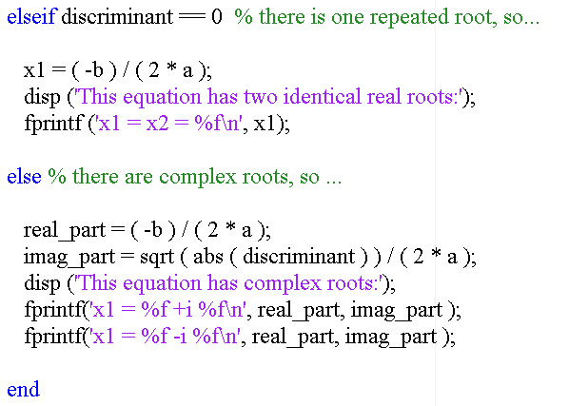

Slide 29
5. Test the program
>> calc_roots
This program solves for the roots of a quadratic
equation of the form A*X^2 + B*X + C = 0.
Enter the coefficient A: 1
Enter the coefficient B: 5
Enter the coefficient C: 6
This equation has two real roots:
x1 = -2.000000
x2 = -3.000000

Slide 30
5. Test the program
>> calc_roots
This program solves for the roots of a quadratic
equation of the form A*X^2 + B*X + C = 0.
Enter the coefficient A: 1
Enter the coefficient B: 4
Enter the coefficient C: 4
This equation has two identical real roots:
x1 = x2 = -2.000000

Slide 31
5. Test the program
>> calc_roots
This program solves for the roots of a quadratic
equation of the form A*X^2 + B*X + C = 0.
Enter the coefficient A: 1
Enter the coefficient B: 2
Enter the coefficient C: 5
This equation has complex roots:
x1 = -1.000000 + i 2.000000
x1 = -1.000000 - i 2.000000

Slide 32
Notes of if statement
The if construct is very flexible. It must have one if statement and one end statement.
In between, it can have any number of elseif clauses, and can also have one else clause. With this combination of features, it is possible to implement any desired branching construct.

Slide 33
Notes of if statement
if constructs can be nested. Two if constructs are said to be nested if one of them lies entirely within a single code block of the other one.
if x > 0
if y < 0
end
end
The MATLAB interpreter always associates a given end statement with the most recent if statement, so the first end closes the if y < 0 statement, while the second end closes the if x > 0 statement.

Slide 34
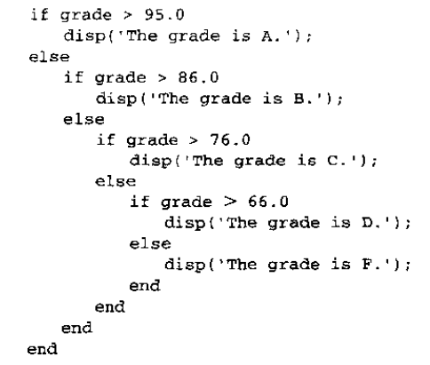
Good programming practice
Always indent the body of an if construct by 2 or more spaces to improve the readability of the code.
if x > 0
if y < 0
end
end
For branches in which there are many mutually exclusive options, use a single if construct with multiple elseif clauses in preference to nested if constructs.

Slide 35
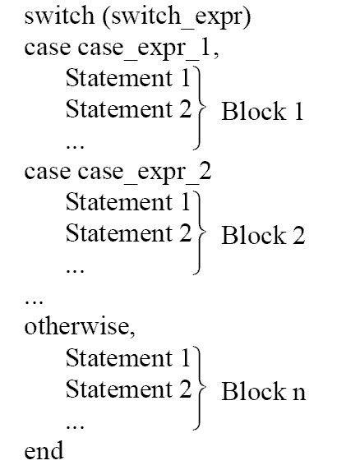
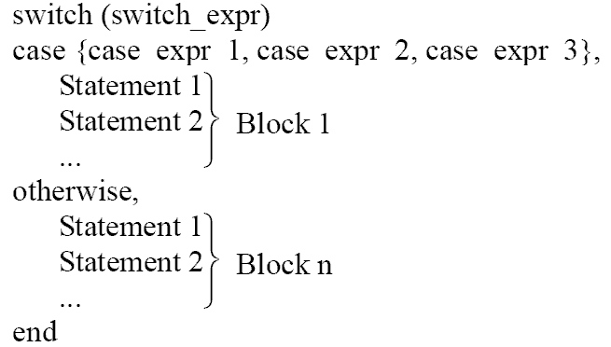
Branches——The switch Construct

Slide 36
Branches——The switch Construct
switch (value)
case {1, 3, 5, 7, 9},
disp('The value is odd.');
case {2, 4, 6, 8, 10},
disp('The value is even.');
otherwise,
disp('The value is out of range.');
end

Slide 37
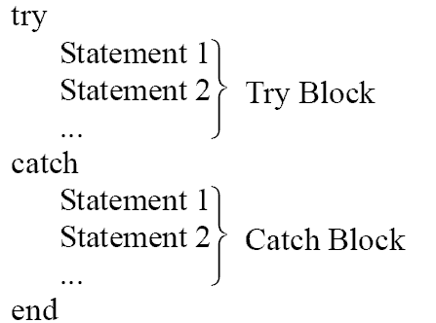
Branches—The try/catch Construct
Used to trap errors.

Slide 38
Branches—The try/catch Construct
% Initialize array
a = [ 1 -3 2 5];
try % Try to display an element
index = input('Enter subscript of element to display: ');
disp(['a(' int2str(index) ') = ' num2str(a(index))] );
catch % If we get here an error occurred
disp( ['Illegal subscript: ' int2str(index)] );
end

Slide 39
Branches—The try/catch Construct
>> try_catch
Enter subscript of element to display: 3
a(3) = 2
>> try_catch
Enter subscript of element to display: 8
Illegal subscript: 8

Slide 40
Additional Plotting Features
Controlling x- and y-axis plotting limits
Plotting multiple plots on the same axes
Creating multiple figures
Subplots
Enhanced control of plotted lines
Enhanced control of text strings
Polar plots
Annotating and saving plots

Slide 41
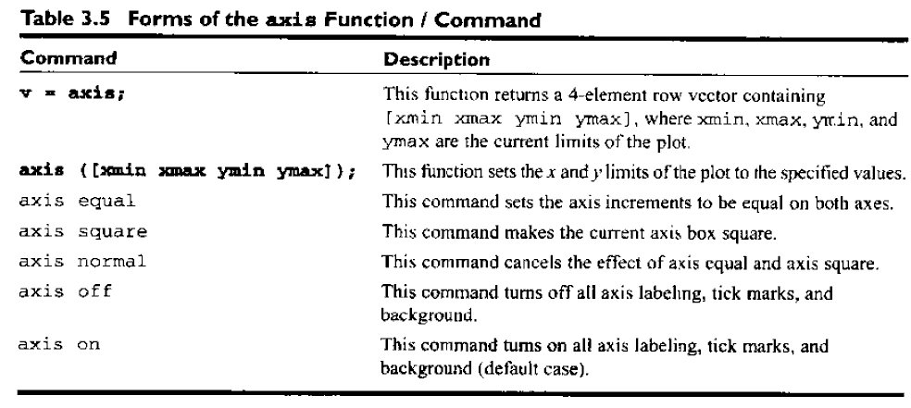
Controlling x- and y-axis plotting limits

Slide 42
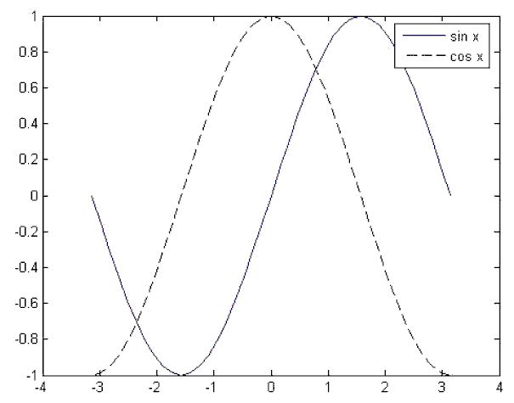
Plotting multiple plots on the same axes
hold on
hold off

Slide 43
Creating multiple figures
figure(1);
x = x:0.05:2;
y1 = exp(x);
plot(x,y1);
figure(2);
y2 = exp(-x);
plot(x,y2);

Slide 44
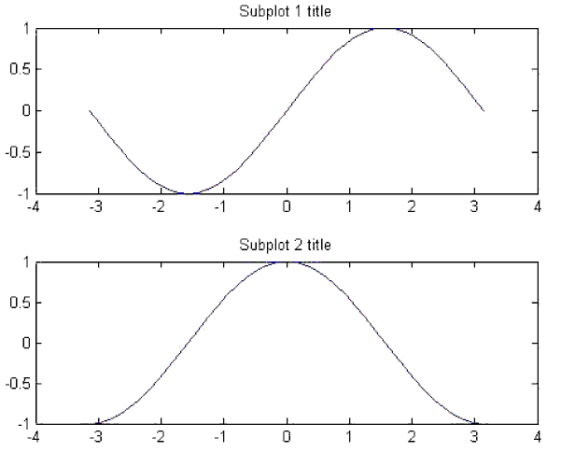
Subplots
figure(1);
subplot(2,1,1);
x = -pi:pi/20:pi;
y = sin(x);
plot(x,y);
title('Subplot 1 title');
subplot(2,1,2);
x = -pi:pi/20:pi;
y = cos(x);
plot(x,y);
title('Subplot 2 title');

Slide 45
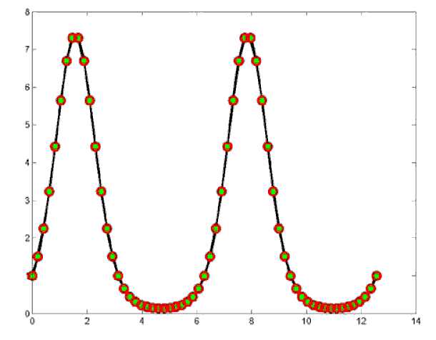
Enhanced control of plotted lines
LineWidth
MarkerEdgeColor
MarkerFaceColor
MarkerSize
x = 0:pi/15:4*pi;
y = exp(2*sin(x));
plot(x,y,’-ko’,’LineWidth”,3.0,’MarkerSize’,6, …
MarkerEdgeColor’, ‘r’, ‘MarkerFaceColor’, ‘g’);

Slide 46
Enhanced control of text strings
\bf Boldface
\it Italics
\rm Restore to normal font
\fontname{} Specify the font name to use
\fontsize{} Specify the font size
_{xxx} xxx is subscripts
^{xxx} xxx is superscripts

Slide 47
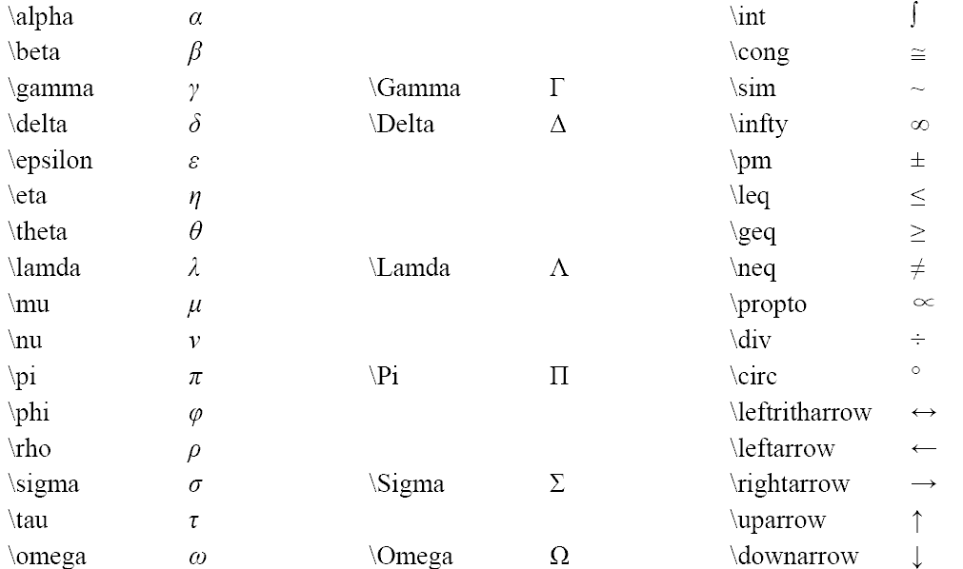
Greek and Mathematical Symbols
Notes:
lambda

Slide 48
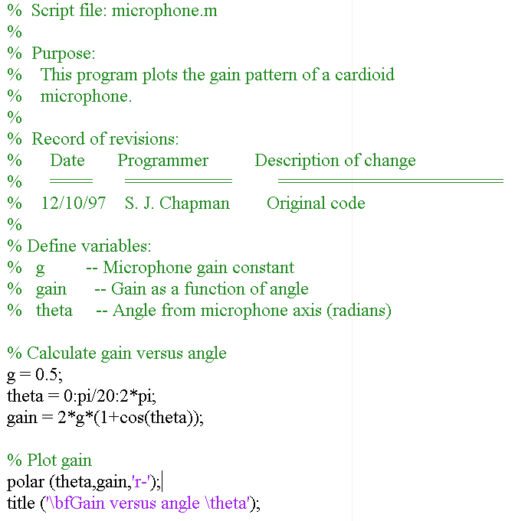
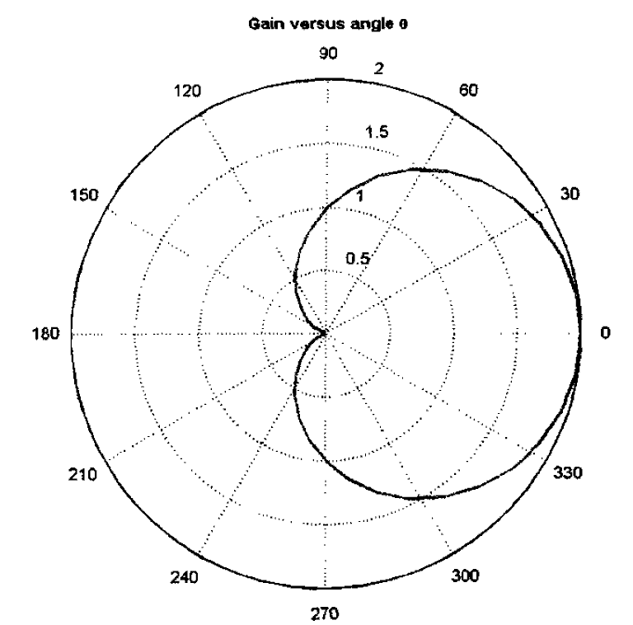
Polar plots

Slide 49
Example 3.7 Thermaldynamics: The Ideal Gas Law
理想气体是指发生在分子之间的碰撞均为弹性碰撞。你可以把理想气体中的每一个分子想象成一个刚性小弹，每次碰撞，总动能不会改变。这样的气体可以用三个变量来描述：绝对气压（P），体积（V）和绝对温度（T）. 三者之间的关系式就是我们所熟知的理想气体定律
PV=nRT
P 代表气压，单位为千帕，V 代表气体的体积，单位为升，n 代表分子的摩尔数，T 代表绝对温度，单位为K。
假设一理想气体样品在273K 温度下，有一摩尔分子，请问:
（a）当气压从1 到1000 千帕变化，气体的体积将会如何变化？设置合适的坐标，画出这个气体的压力-体积图。
（b）假设这个气体的温度上升到373K，气体体积将会随气压如何变化。在与（a）相同的坐标系内，画出气体的压力—体积图象。轨迹用虚绿线，宽度为2pixel。在图象上包含有一个大标题，x，y 轴的标签，还有各轨迹的图例。

Slide 50
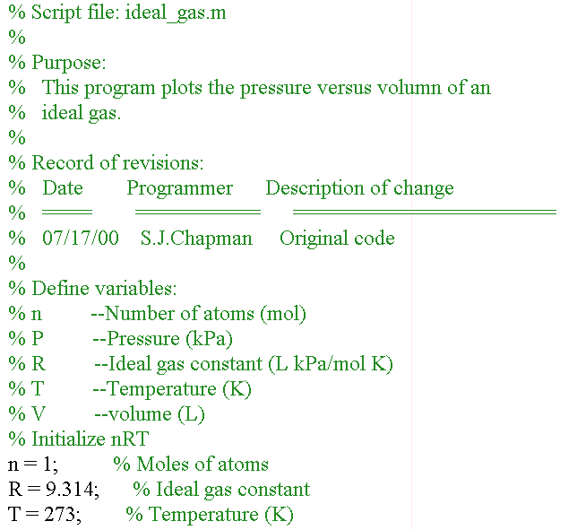
The Ideal Gas Law

Slide 51
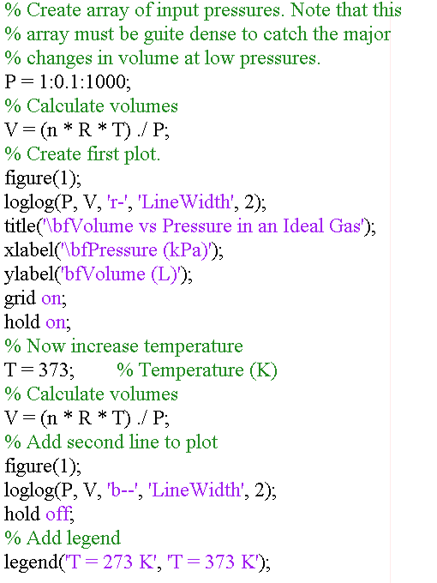

Slide 52
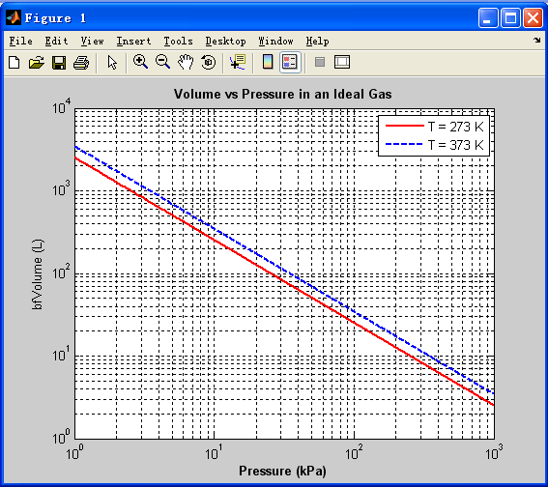
The Ideal Gas Law

Slide 53
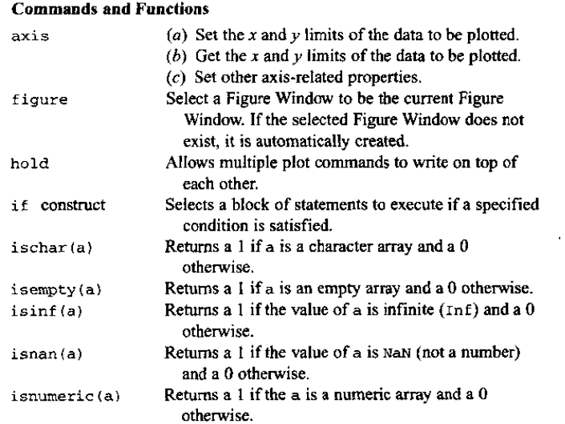
Summary

Slide 54
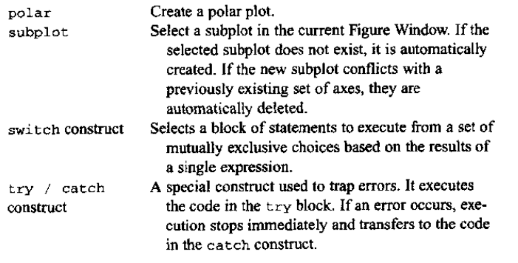
Summary

Slide 55
Homework
Review the text from page 81 to 135.
Exercises 3.1 to 3.14
Read the reference The International Association for the Properties of Water and Steam as much as possible.

