Slide 1
MATLAB Programming Lecture 4
Yu, Jiyang
yujiy@tsinghua.edu.cn
Office: Room 904# of Liuqing Building
Department of Engineering Physics
Tsinghua University

Slide 2
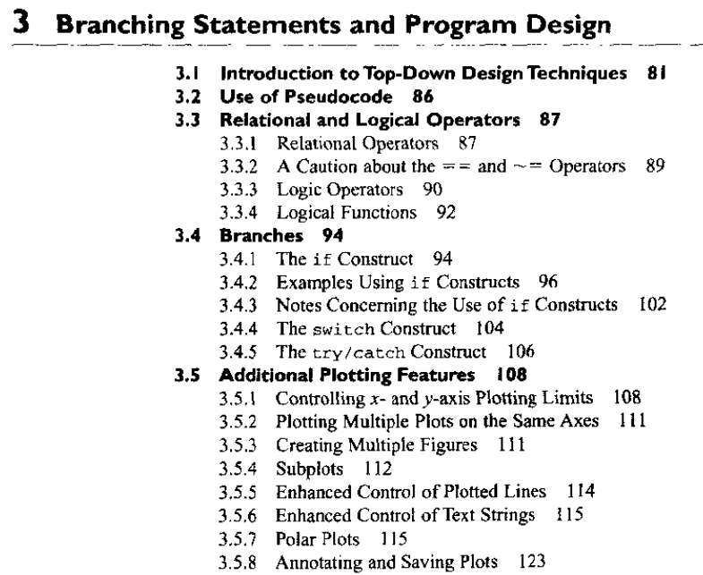
Review

Slide 3
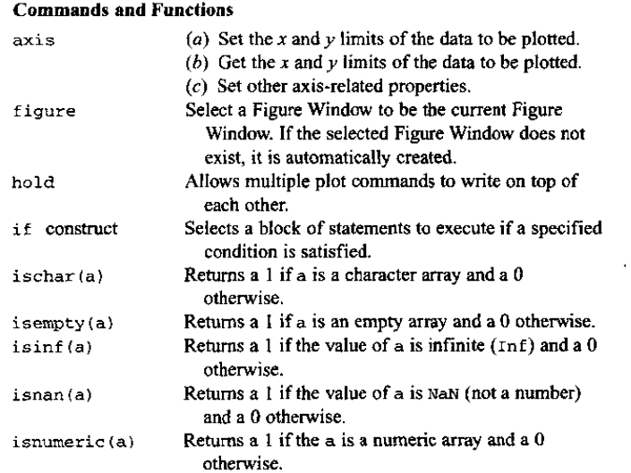
Review

Slide 4
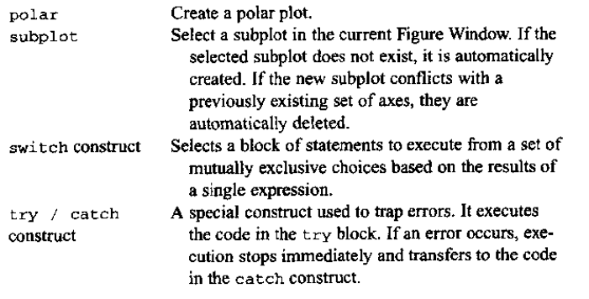
Review

Slide 5
Contents
Loops
The while loop
The for loop
Vectorization
Additional examples
Introduction of IF97 water properties
The boundary of region 2 and 3

Slide 6
Loops
Loops are MATLAB constructs that permit us to execute a sequence of statements more than once. There are two basic forms of loop constructs: while loops and for loops.
The major difference between these two types of loops is in how the repetition is controlled. The code in a while loop is repeated an indefinite number of times until some user specified condition is satisfied. By contrast, the code in a for loop is repeated a specified number of times, and the number of repetitions is known before the loops starts.

Slide 7
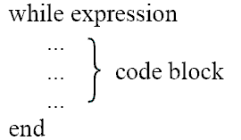
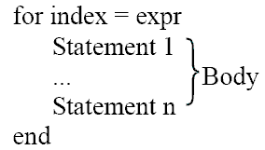
Loops
The while Loop
The for Loop

Slide 8
Pitfalls and advices
Never modify the value of a loop index within the body of the loop.
Always pre-allocate all arrays used in a loop before executing the loop. This practice greatly increases the execution speed of the loop.
If it is possible to implement a calculation either with a for loop or using vectors, always implement the calculation with vectors. Your program will be much faster.

Slide 9
Vectorization- timings.m
Example 4.5 comparing loops and vectorization
To compare the execution speeds of loops and vectorized statements, perform time the following three sets of calculations.
1. Calculate the squares of every integer from 1 to 10,000 in a for loop without initializing the array of squares first.
2. Calculate the squares of every integer from 1 to 10,000 in a for loop, using the zeros function to pre-allocate the array of squares first.
3. Calculate the squares of every integer from l to 10,000 with vectors.

Slide 10
Comparing loops and vectorization
maxcount = 1;
tic;
for jj = 1:maxcount
clear square;
for ii = 1:10000
square(ii) = ii^2;
end
end
average1 = (toc)/maxcount;

Slide 11
Comparing loops and vectorization
maxcount = 10;
tic;
for jj = 1:maxcount
clear square;
square = zeros(1,10000);
for ii = 1:10000
square(ii) = ii^2;
end
end
average2 = (toc)/maxcount;

Slide 12
Comparing loops and vectorization
maxcount = 100;
tic;
for jj = 1:maxcount
clear square;
ii = 1:10000;
square = ii.^2;
end
average3 = (toc)/maxcount;
fprintf('Loop / uninitialized array = %18.8f\n', average1);
fprintf('Loop / initialized array = %18.8f\n', average2);
fprintf('Vectorized = %18.8f\n', average3);

Slide 13
Additional statements
break
terminates the execution of a loop, passes the control to the next statement after the end of the loop
continue
If it is executed in the body of a loop, the execution of the current pass through the loop will stop and control will return to the top of the loop.
There is a tiny error in the example of test_continue for continue statement in the page 155.
The break and continue statements work with both while loops and for loops.

Slide 14
Nesting Loops
One loop to be completely inside another loop.
When MATLAB encounters an end statement, it associates that statement with the innermost currently open construct.
If for loops are nested, they should have independent loop index variables.
How about a break or continue statement appears inside a set of nested loops?

Slide 15
Logical arrays and vectorization
Data type in MATLAB
Numeric , string, logical
Logical data
A standard numeric array with a special “logical” property added.
Are created by all relational and logic operators.
Can be distinguished in the Workspace Browser.
What’s c = logical(a) means?
To add a logical property to an array.
Serve as a mask for arithmetic operations.
a = [1 2 3; 4 5 6; 7 8 9]; b = a > 5; a(b) = sqrt(a(b));

Slide 16
Compare
for ii = 1:size(a,1)
for jj = 1:size(a,2)
if a(ii,jj) > 5
a(ii,jj)=sqrt(a(ii,jj));
end
end
end
b = a > 5;
a(b) = sqrt(a(b));
Comments: This is a very fast and clever way of performing an operation on a subset of an array without needing loops and branches.
One can see the difference in the example 4.6 in the page of 159. It can speed up the code!

Slide 17
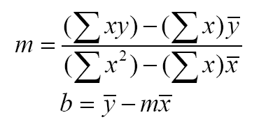
Additional examples
Example 4.7 Fitting a line to a set of measurements.
The velocity of a falling object in the presence of a constant gravitational field is given by the equation v(t) = a t + v0
If you measure the velocity versus time, what will happen?
There is noise or error of measurement.
That’s why we need to find the “best fits” for the measurement.
A standard method is the method of least squares.

Slide 18
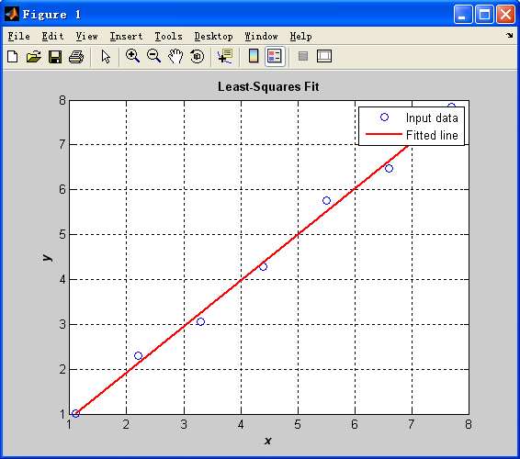
lsqfit.m
This program performs a least-squares fit of an
input data set to a straight line.
Enter the number of input [x y] points: 7
Enter [x y] pair: [1.1 1.01]
Enter [x y] pair: [2.2 2.3]
Enter [x y] pair: [3.3 3.05]
Enter [x y] pair: [4.4 4.28]
Enter [x y] pair: [5.5 5.75]
Enter [x y] pair: [6.6 6.48]
Enter [x y] pair: [7.7 7.84]
Regression coefficients for the least-squares line:
Slope (m) = 1.024
Intercept (b) = -0.120
No of points = 7

Slide 19
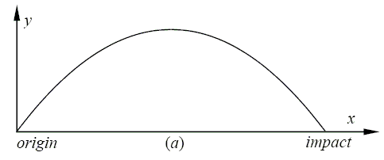
Additional examples
Example 4.8 The flight of a ball.
If we ignore the air friction and the curvature of the earth, what is the flight path of a ball that is thrown into the air?
Parabolic!

Slide 20
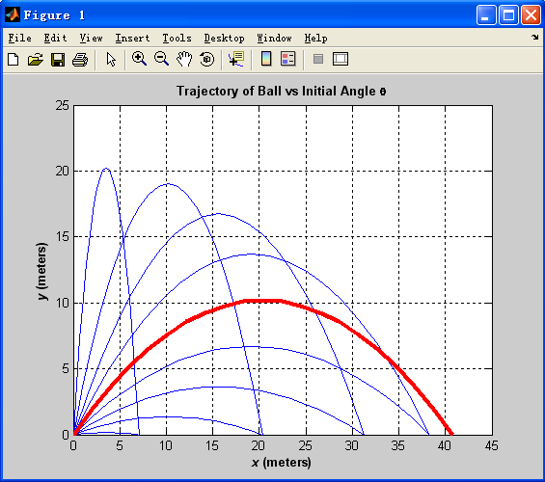
ball.m

Slide 21
Examples
stats_1.m
stats_2.m
doy.m
stats_3.m
timings.m
lsqfit.m
ball.m

Slide 22
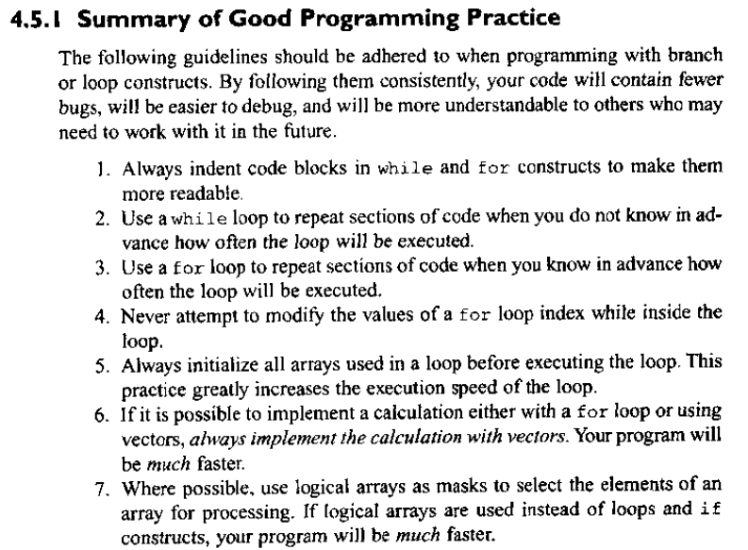
Summary

Slide 23
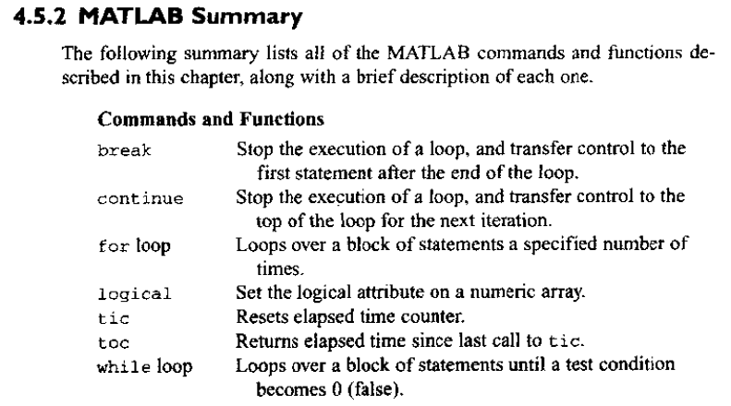
Summary

Slide 24
Introduction of IF97 water properties
International Association for the Properties of Water and Steam (IAPWS) at its meeting in Erlangen, Germany, 14-20 September 1997
The formulation is recommended for industrial use, and is called "IAPWS Industrial Formulation 1997 for the Thermodynamic Properties of Water and Steam " (IAPWS-IF97). The IAPWS-IF97 replaces the previous industrial formulation "The 1967 IFC-Formulation for Industrial Use“ (IFC-67) .
IAPWS also has a formulation intended for general and scientific use.

Slide 25
Thermodynamic properties
Specific Volume / Density
Temperature
Pressure
Specific internal energy
Specific enthalpy
Specific entropy

Slide 26
Specific Volume
Specific Volume
The specific volume of a substance is the total volume of that substance divided by the total mass of that substance (volume per unit mass). It has units of cubic meter per kg mass.

Slide 27
Temperature
Temperature
Temperature is a measure of the molecular activity of a substance. The greater the movement of molecules, the higher the temperature. It is a relative measure of how “hot” or “cold” a substance is and can be used to predict the direction of heat transfer.
Temperature Scales
K Kelvin scale K=C+273
R Rankine scale R=F+460
C Celsius scale
F Fahrenheit scale F=32+9/5C

Slide 28
Pressure
Pressure
Pressure is a measure of the force exerted per unit area on the boundaries of a substance. It is caused by the collisions of the molecules of the substance with the boundaries of the system. As molecules hit the walls, they exert forces that try to push the walls outward. The forces resulting from all of these collisions cause the pressure exerted by a system on its surroundings. Pressure is frequently measured in units of Newton per square meter.(Pa)

Slide 29
Specific internal energy
Potential energy and kinetic energy are macroscopic forms of energy. In addition to these macroscopic forms of energy, a substance possesses several microscopic forms of energy. Microscopic forms of energy include those due to the rotation, vibration, translation, and interactions among the molecules of a substance. None of these forms of energy can be measured or evaluated directly, but techniques have been developed to evaluate the change in the total sum of all these microscopic terms of energy. These microscopic forms of energy are collectively called internal energy.
The specific internal energy (u) of a substance is its internal energy per unit mass. It equals the total internal energy (U) divided by the total mass (m), in J/kg.

Slide 30
Specific enthalpy
Specific enthalpy is defined as u + pv, where u is the specific internal energy of the system being studied, p is the pressure of the system and v is the specific volume of the system.

Slide 31
Specific entropy
Entropy is a property of a substance, as are pressure, temperature, volume, and enthalpy. Because entropy is a property, changes in it can be determined by knowing the initial and final conditions of a substance. Entropy quantifies the energy of a substance that is no longer available to perform useful work. Because entropy tells so much about the usefulness of an amount of heat transferred in performing work, the steam tables include values of specific entropy as part of the information.

Slide 32
Final project
UNITS
PRESSURE MPa
TEMPERATURE K
SPECIFIC VOLUME m³/kg
SPECIFIC ENTHALPY kJ/kg
SPECIFIC ENTROPY kJ/(kg.K)
THERMAL CONDUCTIVITY W/(m.K)
HEAT CAPACITY kJ/(kg.K)
SPEED OF SOUND m/s

Slide 33
Final project
FUNCTIONS
SPECIFIC_INTERNAL_ENERGY(P, T)
SPECIFIC_ENTHALPY(P, T)
SPECIFIC_ENTROPY(P, T)
SPECIFIC_VOLUME(P, T)
HEATCAPACITY_P(P, T) and HEATCAPACITY_V(P, T)
TEMPERATURE_PH(P, H) and TEMPERATURE_PS(P, S)
PRESSURE(RO,T)
SATPRES(T) and SATTEMP(P)
SPEED_OF_SOUND(P, T)
SPECIFIC_INTERNAL_ENERGY_GS(RO,T)
SPECIFIC_ENTROPY_GS(RO,T)
SPECIFIC_ENTHALPY_GS(RO,T)
HEATCAPACITY_V_GS(RO,T)
HEATCAPACITY_P_GS(RO,T)

Slide 34
Structure of the Formulation
The IAPWS Industrial Formulation 1997 consists of a set of equations for different regions which cover the following range of validity:
273.15 K ≤ T ≤ 1073.15 K p ≤ 100 MPa
1073.15 K ≤ T ≤ 2273.15 K p ≤ 10 MPa

Slide 35
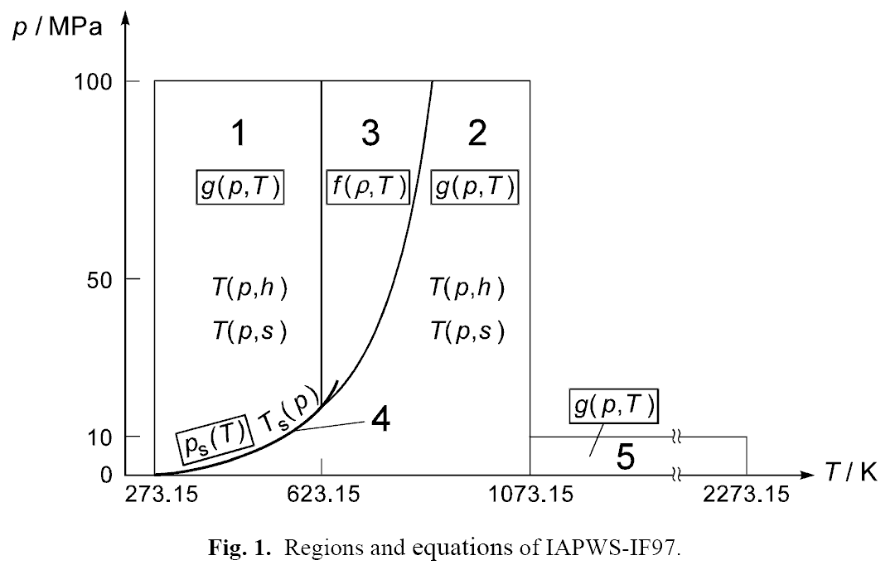
Regions of IF97

Slide 36
Reference Constants
The specific gas constant of ordinary water used for this formulation is
R = 0.461 526 kJ kg⁻¹ K⁻¹
The values of the critical parameters
T_{c} = 647.096 K
p_{c} = 22.064 MPa
ρ_{c} = 322 kg m⁻³

Slide 37
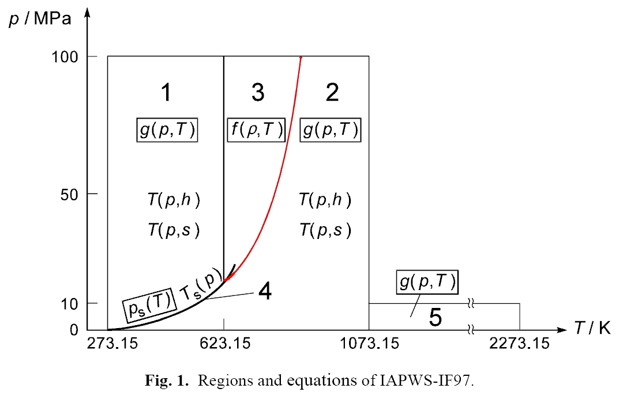
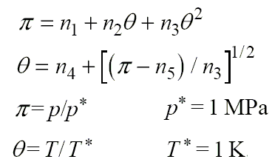
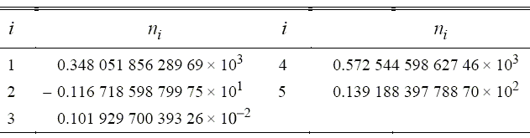
Boundary between Region 2 and 3

Slide 38
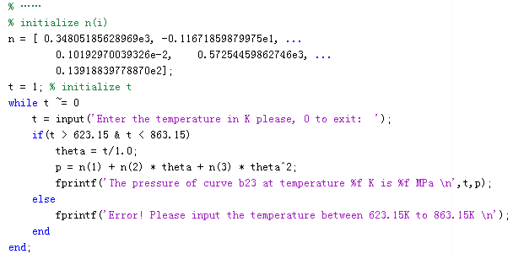

Slide 39
Homework
Review the text from page 136 to 186.
Exercises 4.1,2,6,7,8,9,19,20,28
Build the function for the boundary of region 2 and 3
Try to build some functions in the region 1 of the properties of water.

