Slide 1
MATLAB Programming Lecture 5
Yu, Jiyang
yujiy@tsinghua.edu.cn
Office: Room 904# of Liuqing Building
Department of Engineering Physics
Tsinghua University

Slide 2
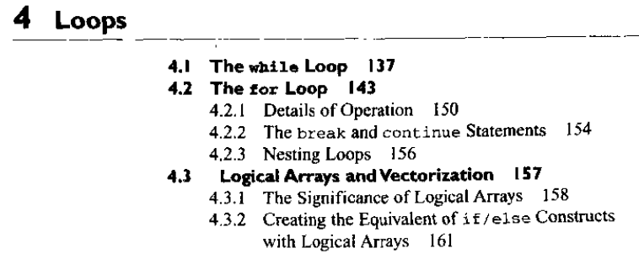
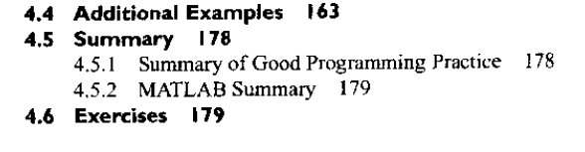
Reviews

Slide 3
Top-Down Design Techniques
5 Steps:
Step 1: Clearly state the problem that you are trying to solve
Step 2: Define the inputs required by the program and the outputs to be produced by the program
Step 3: Design the algorithm that you intend to implement in the program
Step 4: Turn the algorithm into MATLAB statements
Step 5: Test the resulting MATLAB program

Slide 4
Logical arrays and vectorization
Data type in MATLAB
Numeric , string, logical
Logical data
A standard numeric array with a special “logical” property added.
Are created by all relational and logic operators.
Can be distinguished in the Workspace Browser.
What’s c = logical(a) means?
To add a logical property to an array.
Serve as a mask for arithmetic operations.
a = [1 2 3; 4 5 6; 7 8 9]; b = a > 5; a(b) = sqrt(a(b));

Slide 5
Contents
User defined functions
Variable passing
Global memory
Preserving data
Function functions
Subfunctions and private functions
Functions for the Region 1 of water

Slide 6
User-Defined Functions
Need to break the algorithm down into logical subdivisions called subtasks.
Each subtask does a clearly understandable job.
Then we have to use user-defined functions to code each subtask.
Each function can be tested and debugged independently.
Benefits:
Independently testing of subtasks
Reusable of code
Isolation from unintended side effects
Input argument list
Output argument list
Accidental programming mistakes within a function can only affect the variables within the function in which the mistake occurred.
Maintenance of a large program

Slide 7
The benefits of user defined functions
Independent Testing of Subtasks
Each subtask can be written as an independent unit. The subtask can be tested separately to ensure that it performs properly by itself before combining it into the larger program This step is known as unit testing. It eliminates a major source of problems before the final program is even built.

Slide 8
The benefits of user defined functions
Reusable Code
In many cases, the same basic subtask is needed in many parts of a program. This reusable code has two major advantages: it reduces the total programming effort required and it simplifies debugging.

Slide 9
The benefits of user defined functions
Isolation from Unintended Side Effects
Functions receive input data from the program that revokes them through a list of variables called an input argument list and return results to the program through an output argument list. The only variables in the calling program that can be seen by the function are those in the input argument list, and the only variables in the function that can be seen by the calling program are those in the output argument list.

Slide 10
Introduction of MATLAB functions
function [outarg1, outarg2, ...] = fname(inarg1, inarg2, ...)
%H1 comment line
%Other comment lines
...
(Executable code)
...
H1 comment line will be searched and displayed by the lookfor command.
Other comment line will be listed by help command.
Save as a file named fname.m in the working directory.
m file is a kind of script file. It is just a collection of MATLAB statements that are stored in a file.
An example of script file is the BAT file in DOS system.

Slide 11
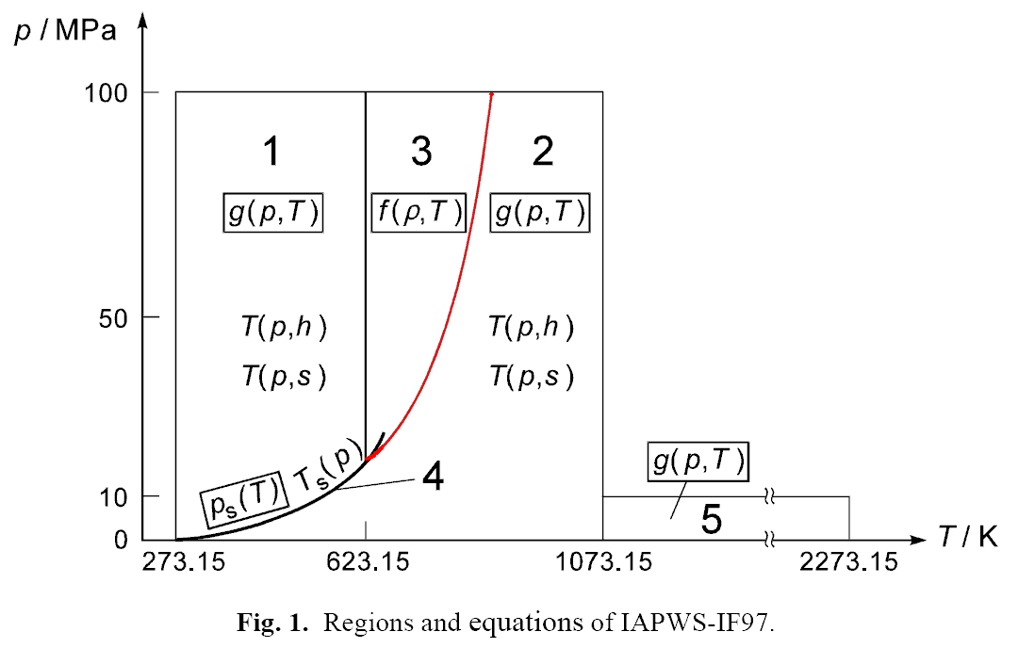
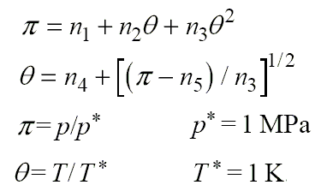
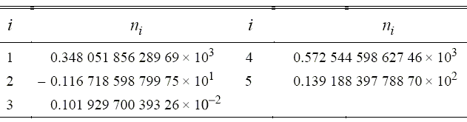
Boundary between Region 2 and 3 again

Slide 12
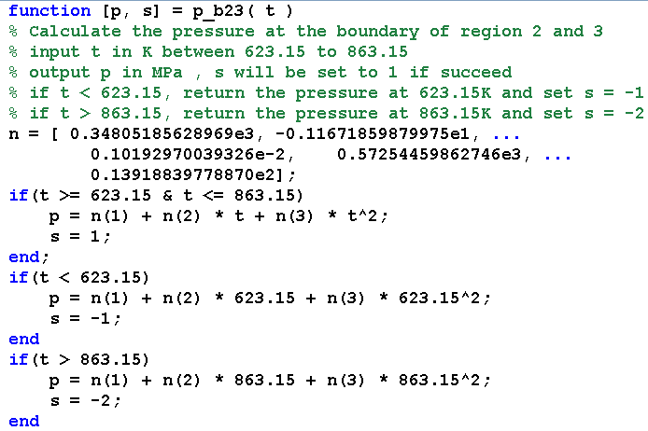
p_b23(t)

Slide 13
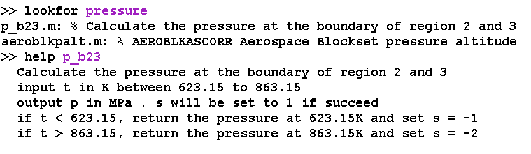
Try lookfor and help

Slide 14
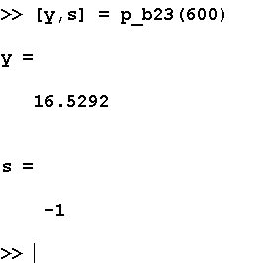
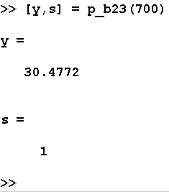
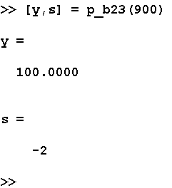
Testing

Slide 15
Variable passing in MATLAB
Pass by value scheme
Makes a copy of the actual arguments and passes them to the function
Some languages use pass by address
The copying is very significant because it means that even if the function modifies the input arguments, it will not affect the original data in the caller.
The implementation of argument passing in MATLAB is actually more intelligent: it analyzes each argument of each function and determines whether or not the function modifies that argument.

Slide 16
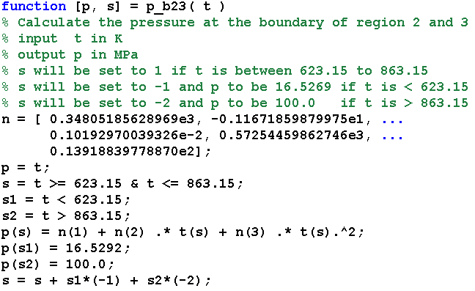
Improvement of p_b23(t)

Slide 17
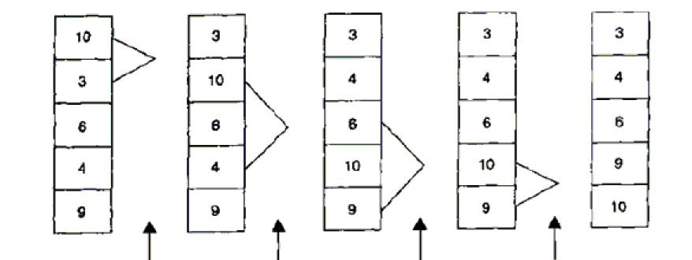
Examples
Example 5.1 Rectangular to polar conversion
reac2polar
polar2rect
Example 5.2 Sorting data
Selection sort
Try sort and
sortrows

Slide 18
Optional arguments for functions
Special functions
nargin
Returns the number of actual input arguments
nargout
Returns the number of actural output arguments
nargchk
Returns a standard error message if a function is called with too few or too many arguments
error
Display error message and abort the function.
warning
Display warning message and continue the function.
inputname
Returns the actual name of the variable that corresponds to a paticular argument number.
Practice the example 5.3 now.

Slide 19
Sharing data using global memory
Global memory is a special type of memory that can be accessed from any workspace.
Should be declared to be global.
Share the same memory between functions
global v1 v2 v3 …
Good programming practice
Declare global variables in all capital letters to make easy to distinguish from local variables.
Declare global variables immediately after the initial comments and before the first executable statement in each function that uses them.
It is used to pass large amounts of data among functions.

Slide 20
Preserving data between calls to a function
The special workspace created for a function will be destroyed after the calling.
It is sometimes useful to preserve some local information within a function between calls.
Persistent memory is a special type of memory that can only be accessed from within the function, but it preserved unchanged between calls to the function.
persistent v1 v2 v3 …

Slide 21
Function functions
Function functions are functions with input arguments that include the names of other functions.
fzero( ‘cos’, [0 pi])
fzero( ‘exp(x)-2’, [0 pi])
It is based on two special functions
eval
Evaluates a character string as though it had been typed in the command window.
feval
Evaluates a named function at a specific input value.

Slide 22
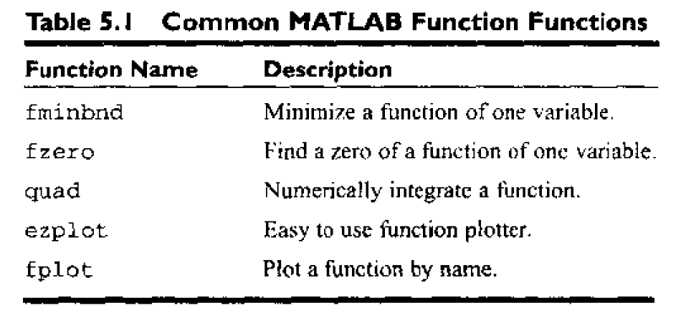
Some function functions

Slide 23
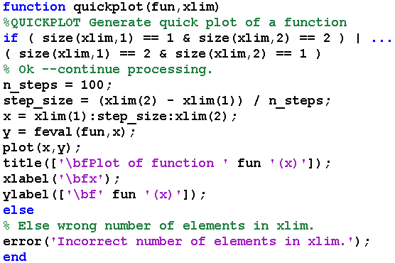
How to create a function function?
Example 5.6

Slide 24
Subfunctions and private functions
Is it possible to place more than one functions in the same m-file?
The top function is a normal function
The ones below it are subfunctions or internal functions
Subfunctions are only accessible to the other functions within the same m-file.
Private functions
Private functions are functions that reside in subdirectories with the special name private.
They are only visible to functions in the parent directory.
MATLAB looks for private functions before standard m-file functions.

Slide 25
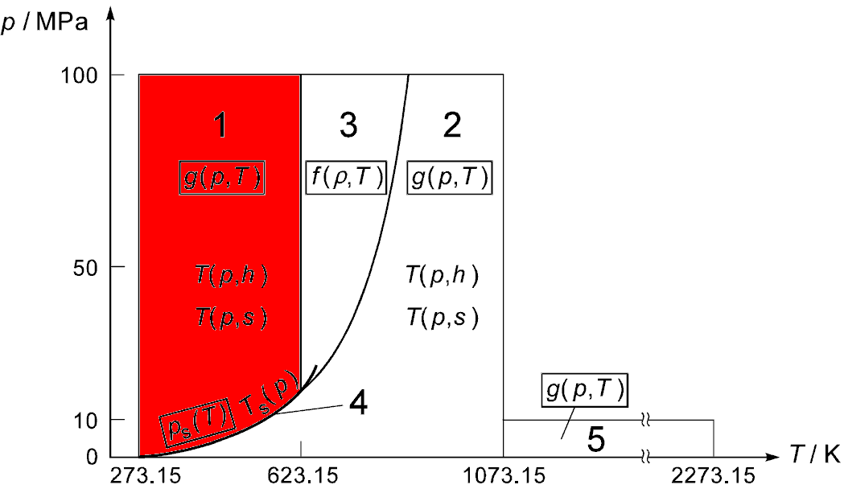
Region 1

Slide 26
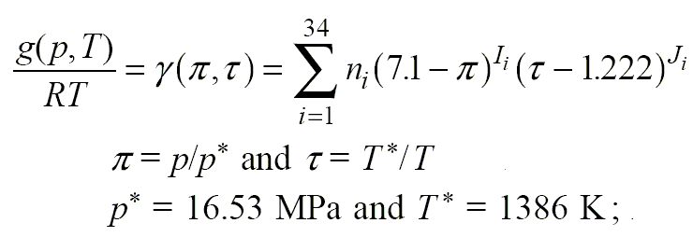
Basic equations
Specific Gibbs free energy equation in dimensionless form:

Slide 27
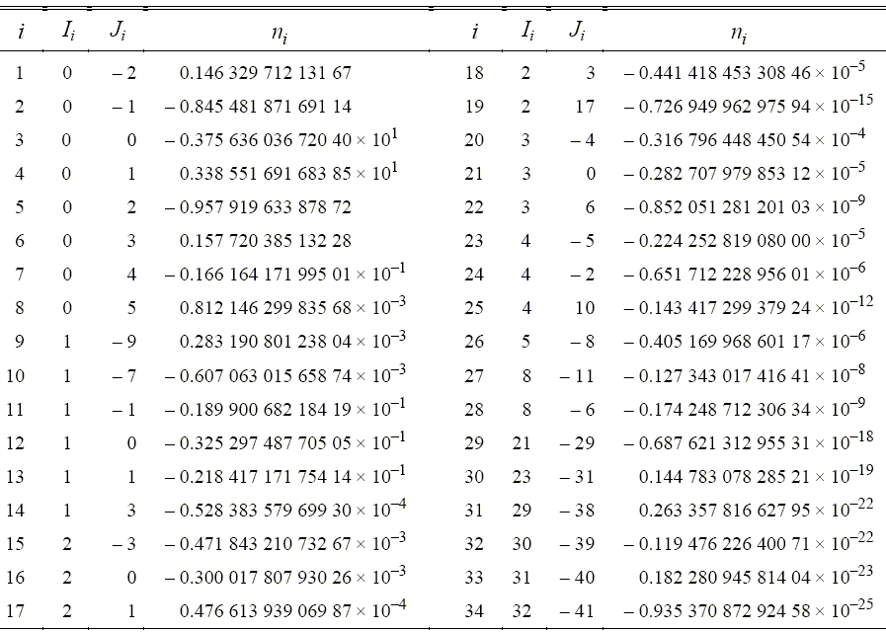

Slide 28
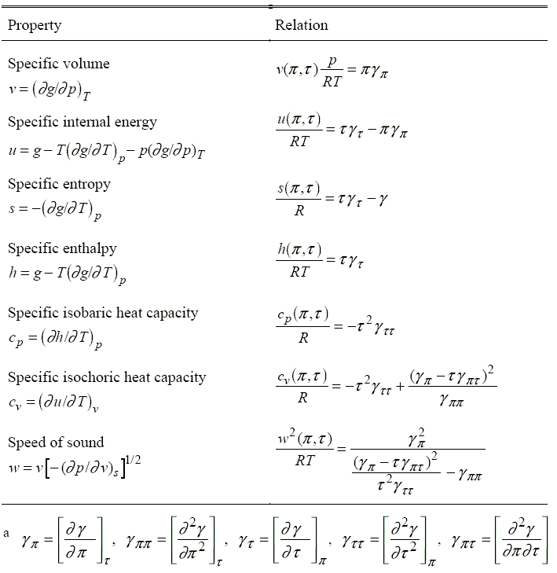

Slide 29
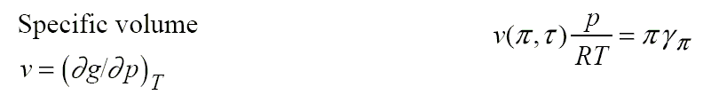
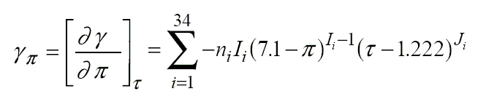
Specific volume
Specific volume (v) is the volume occupied by a unit of mass of a material.
It is equal to the reciprocal of its mass density.

Slide 30
Specific internal energy
In thermodynamics, the internal energy is the total of the kinetic energy due to the motion of particles (translational, rotational, vibrational) and the potential energy associated with the vibrational and electric energy of atoms. It is a state function of a system, and is an extensive quantity. The SI unit of energy is the joule.
One can have a corresponding intensive thermodynamic property called specific internal energy, which is internal energy per mass of the substance in question. As such, the SI unit of specific internal energy would be the J/kg.

Slide 31
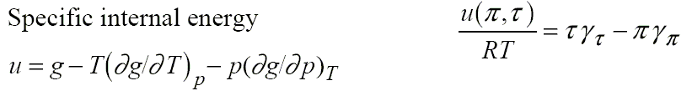
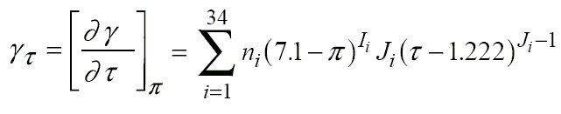
Specific internal energy

Slide 32
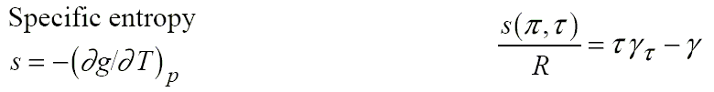
Specific entropy
Entropy is a measure of how organized or disorganized a system is: "Gain of entropy eventually is nothing more nor less than loss of information"
Entropy is an important part of the second law of thermodynamics. Thermodynamic systems consist of objects, e.g. atoms or molecules, which "carry" energy. In applied thermodynamics, as a matter of convention, entropy is measured in Joules of energy per kelvin. If thermodynamic systems are described using thermal energy instead of temperature, then entropy is just a number by which the thermal energy in the system is multiplied. The resulting energy is an energy for which no information is available which would be required to convert the energy in technical systems from one form (e.g. electrical) into another form (e.g. mechanical).

Slide 33
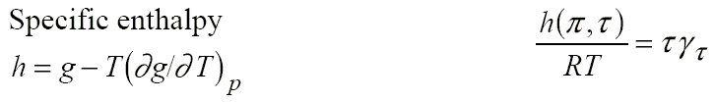
Specific enthalpy
In thermodynamics, enthalpy is used to calculate the heat transfer during a quasistatic process taking place in a closed thermodynamic system under constant pressure (isobaric process).
The specific enthalpy of a working mass is a property of that mass used in thermodynamics. It is defined as h = u + pv
where u is the specific internal energy, p is the pressure, and v is specific volume. The SI unit for specific enthalpy is joules per kilogram.

Slide 34
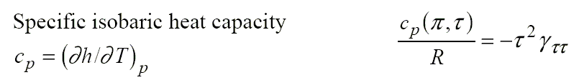
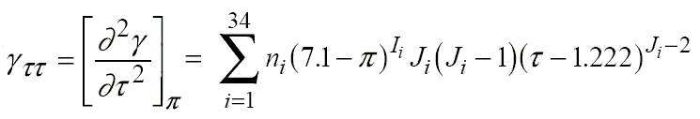
Specific isobaric heat capacity
Heat capacity is a measurable physical quantity that characterizes the amount of heat that is required to change a body's temperature by a given amount. In the International System of Units, heat capacity is expressed in units of joules per kelvin.
The specific heat capacity is the heat capacity per unit mass of a body. These quantities are "intensive quantities", meaning they are no longer dependent on amount of material, but capture more directly the dependence on the type of material, as well as the physical conditions of heating.

Slide 35
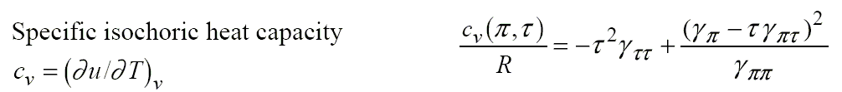
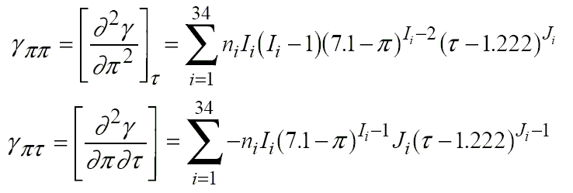
Specific isochoric heat capacity

Slide 36
Speed of sound
The speed of sound is the rate of travel of a sound wave through an elastic medium. In dry air at 20 °C , the speed of sound is 343 meters per second.
Although "the speed of sound" is commonly used to refer specifically to the speed of sound waves in air, the speed of sound can be measured in virtually any substance. Sound travels faster in liquids and non-porous solids than it does in air, traveling about 4.3 times faster in water than in air at 20 degrees Celsius.
Additionally, in solids, there occurs the possibility of two different types of sound waves: one type (called "longitudinal waves" when in solids) is associated with compression (the same as all sound waves in fluids) and the other is associated with shear stresses, which cannot occur in fluids.

Slide 37
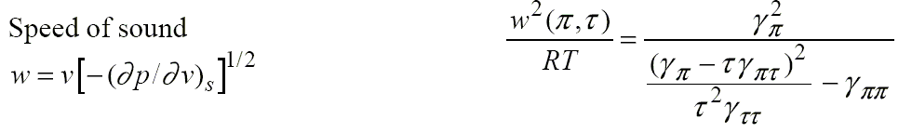
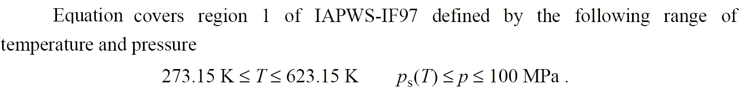
Speed of sound

Slide 38
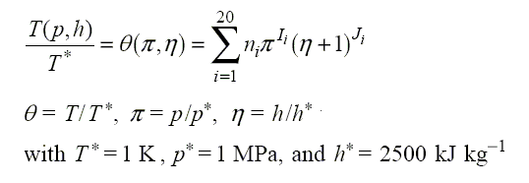
Backward equations

Slide 39
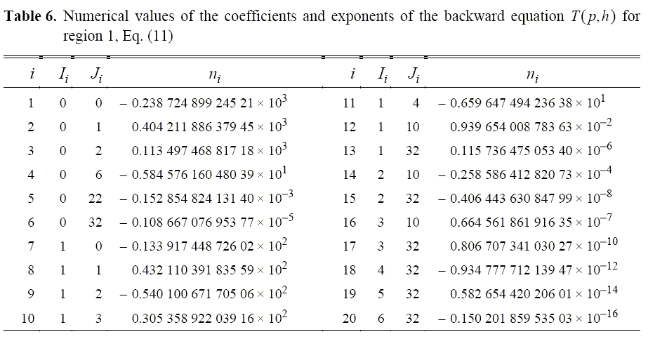
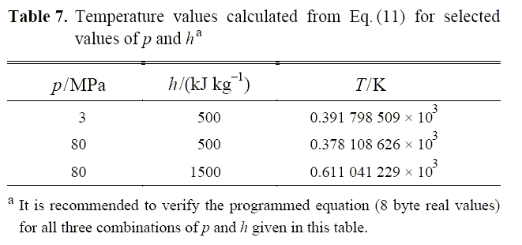

Slide 40
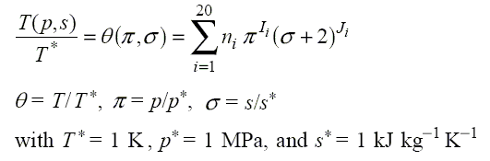
Backward equations

Slide 41
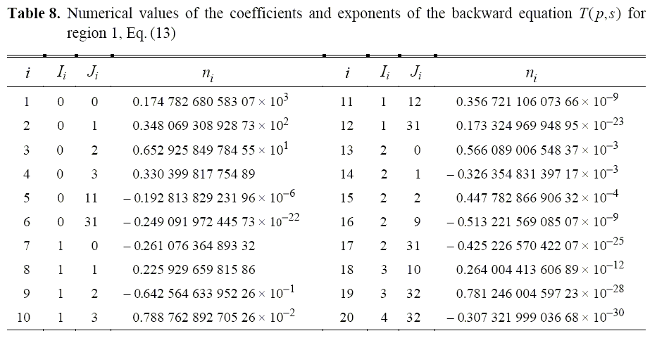
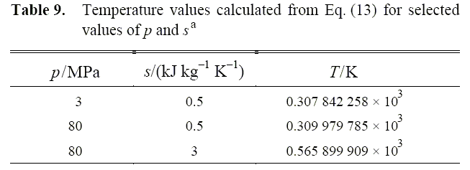

Slide 42
Reviews
Arguments are passed to functions using a pass-by value scheme, meaning that MATLAB copies each argument and passes the copy to the function. This copying is important, because the function can freely modify its input arguments without affecting the actual arguments in the calling program.

Slide 43
Reviews
MATLAB functions can support varying numbers of input and output arguments Function nargin reports the number of actual input arguments used in a function call. and function nargout reports the number of actual output arguments used in a function call.
Data can also be shared between MATLAB functions by placing the data in global memory. Global variables are declared using the global statement.
Global variables can be shared by all functions that declare them. By convention global variable names are written in all capital letters.

Slide 44
Reviews
Internal data within a function can be preserved between calls to that function by placing the data in persistent memory. Persistent variables are declared using the persistent statement.
Function functions are MATLAB functions with input arguments that include the names of other functions. The functions whose names are passed to the function function are normally used during that function's execution

Slide 45
Reviews
Sub-functions are additional functions placed within a single file. Sub-functions are only accessible from other functions within the same file.
Private functions are functions placed in a special subdirectory called private. They are only accessible to functions in the parent directory.
Both sub-functions and private functions can be used to restrict access to MATLAB functions.

Slide 46
Summary of Good Programming Practice
1. Break large program tasks into smaller, more understandable functions whenever possible.
2. Declare global variables in all capital letters to make them easy to distin guish from local variables.
3. Declare global variables immediately after the initial comments and before the first executable statement in each function that uses them.
4 You can use global memory to pass large amounts of data among functions within a program.

Slide 47
Summary of Good Programming Practice
5 Use persistent memory to preserve the values of local variables within a function between calls to the function.
6 Use sub-functions and private functions to hide special purpose MATLAB functions that should only be called by other functions. Hiding the functions will prevent their ,accidental use and will also prevent conflicts with other public functions of the same name.

Slide 48
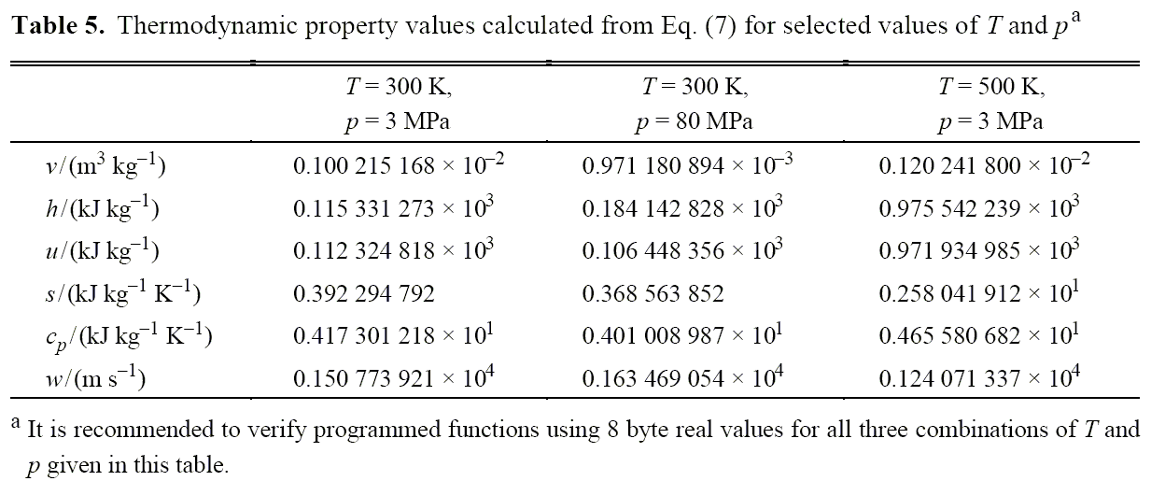
Homework
Review the text from page 187 to 240.
Exercises 5. 8,14,15,20,22,26
Build functions in the region 1 of the properties of water.
Testing the functions in the region 1 .

