Slide 1
MATLAB Programming Lecture 6
Yu, Jiyang
yujiy@tsinghua.edu.cn
Office: Room 904# of Liuqing Building
Department of Engineering Physics
Tsinghua University

Slide 2
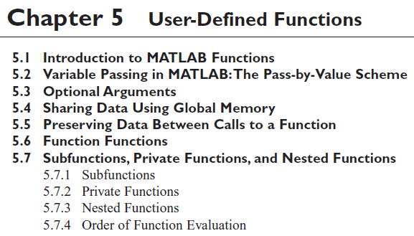
Review

Slide 3
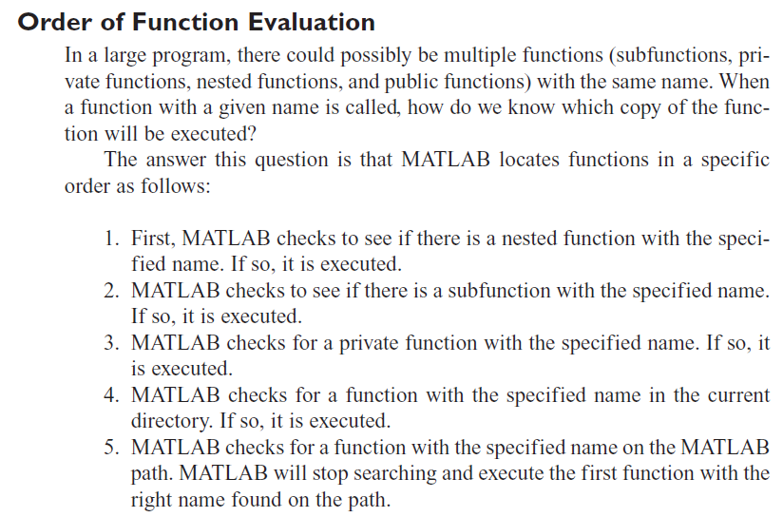

Slide 4
Contents
Complex data
String functions
Multidimensional arrays
Additional two dimensional plots
Three dimensional plots
The functions in the region 2 of water

Slide 5
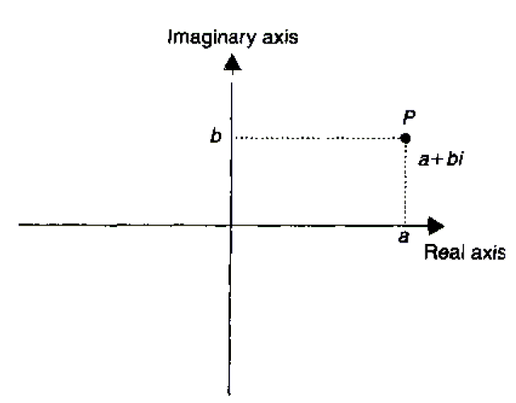
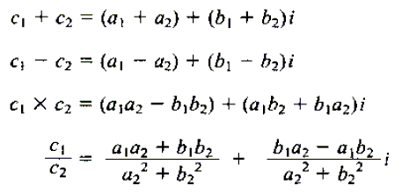
Complex data
The term complex data type (in contrast to primitive data types) is a synonym to the composite data type.
c = a + bi

Slide 6
Complex variables
Define： c1 = 4 + i * 3;
Try
isreal(c1)
abs(c1)

Slide 7
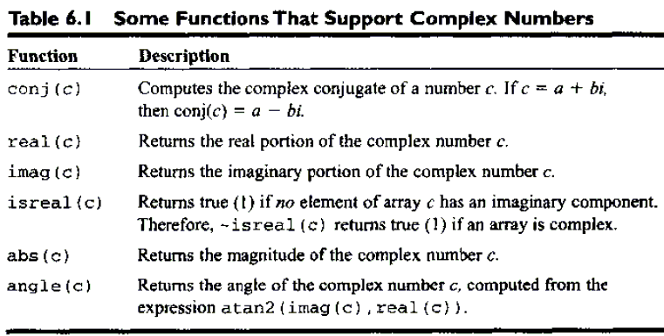
Complex variables
Complex functions

Slide 8
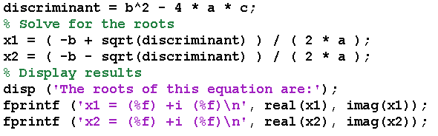
Example 6.1 The quadratic equation
discriminant = b^2 - 4 * a * c;
if discriminant > 0
x1 = (-b + sqrt(discriminant)) / (2*a);
x2 = (-b - sqrt(discriminant)) / (2*a);
elseif discriminant == 0
x1 = ( -b ) / (2*a);
else
real_part = (-b)/(2*a);
imag_part = sqrt(abs(discriminant))/(2*a);
end

Slide 9

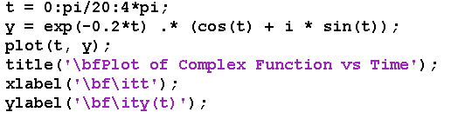
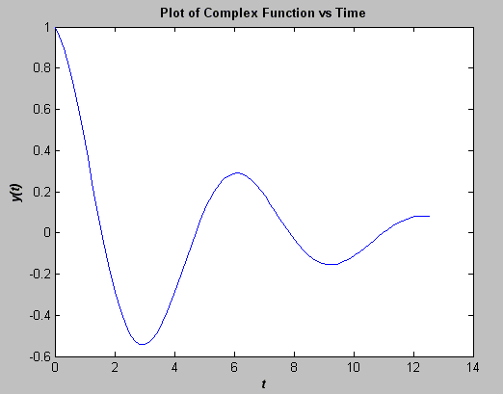
Plotting complex data

Slide 10
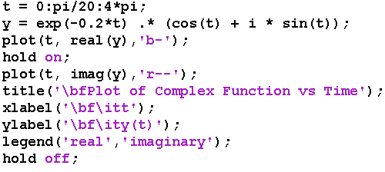
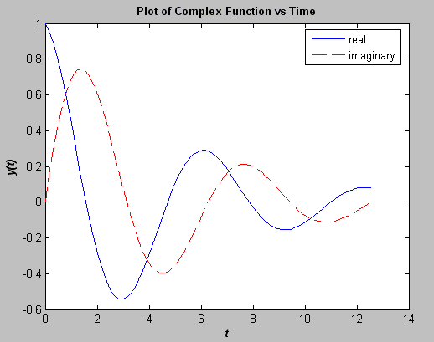
Plotting complex data

Slide 11

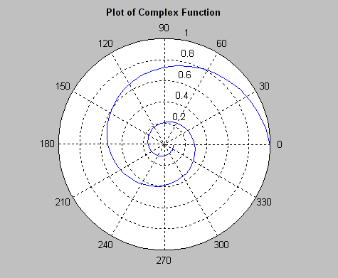
Plotting complex data

Slide 12
String functions
Generally, string is a thin, flexible piece of rope or twine which is used to tie, bind, or hang other objects.
In MATLAB, a string is an array of type char, it is sequence of symbols!
Each character is stored in two bytes of memory.
str = ‘this is a string’;
ischar can be used to check for character arrays.

Slide 13
String functions
Conversion
double(str), char(x), int2str(x), num2str(pi,7),mat2str(a),sprintf(‘…’),eval(str) ,upper(str),lower(str)
2 dimensional string
name = char(‘Jiyang’, ‘Yu’);
Concatenating
name = strcat(‘Jiyang’, ‘Yu’); name = strvcat(‘Jiyang’, ‘Yu’);
Comparing
strcmp(str1,str2) -- determines if two strings are identical.
strcmpi(str1,str2) -- determines if two strings are identical idnoring case.
strncmp(str1,str2,2) -- if the first n characters of two strings are identical.
strncmpi(str1,str2,2)
isletter, isspace, …
Searching / Replacing
findstr(str, ‘is’); strmatch, strrep, strtok, …

Slide 14
Multidimensional arrays
An array is a systematic arrangement of objects, usually in rows and columns. Specifically, it may refer to several things.
Find a picture and type the command as:
a = imread(‘filename.jpg',‘MPEG')
What you get?
image(a)

Slide 15
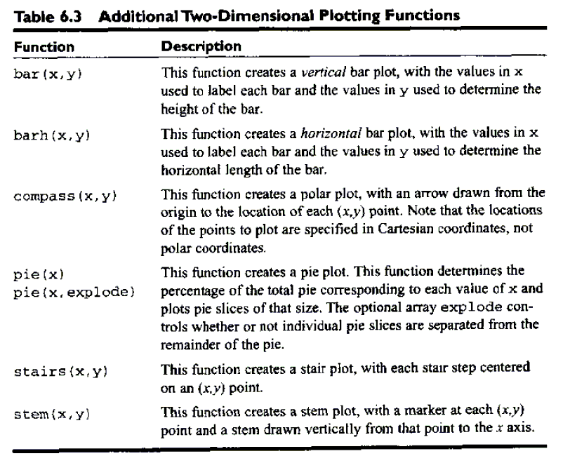
Additional 2-D plots

Slide 16
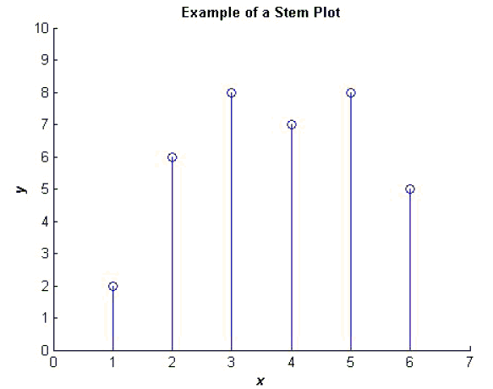
Stem plot

Slide 17
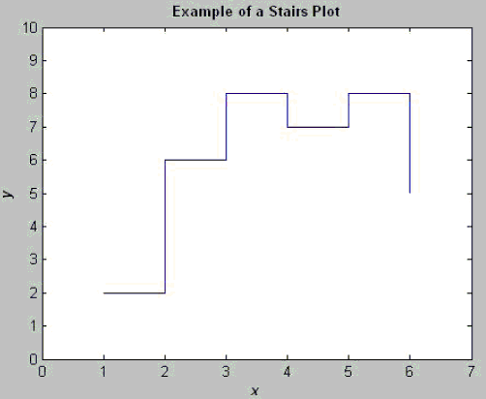
Stairs plot

Slide 18
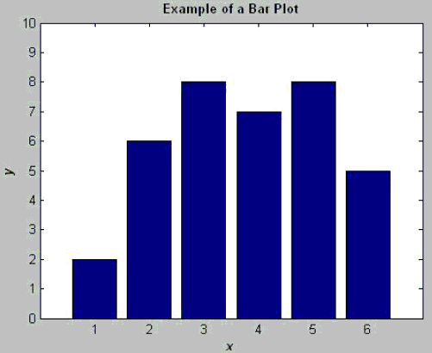
Bar plot

Slide 19
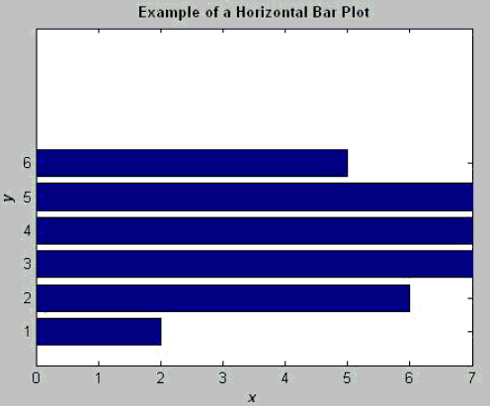
Horizontal bar plot

Slide 20
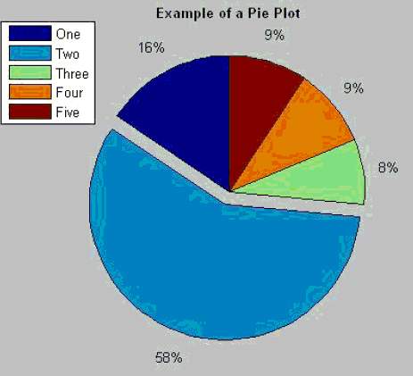
Pie plot

Slide 21
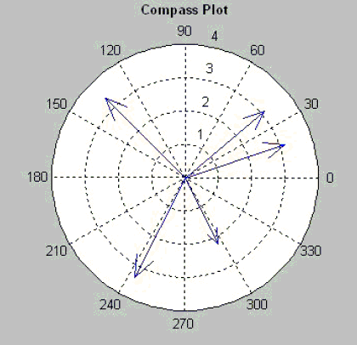
Compass plot

Slide 22
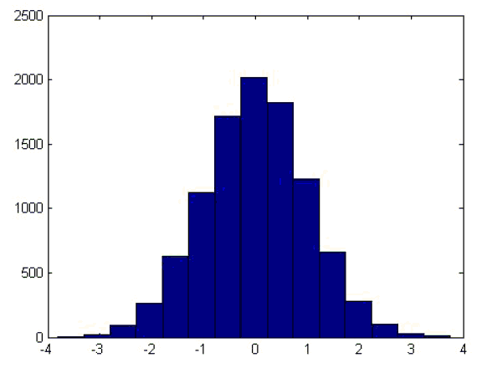
Plotting functions
ezplot('sin(x)')
fplot('sin(x)',[0 1])
fplot will calculates and displays more data points in the regions where the function being plotted is changing most rapidly.
hist(y)
Histogram is a plot showing the distribution of values.

Slide 23
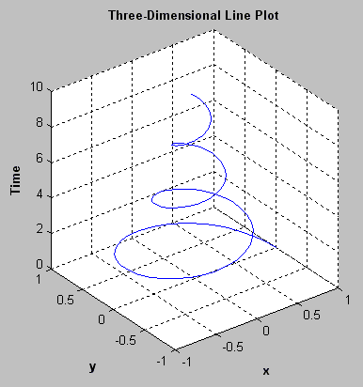
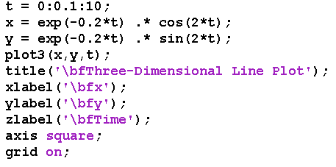
3-D plots
plot3(x,y,t)

Slide 24
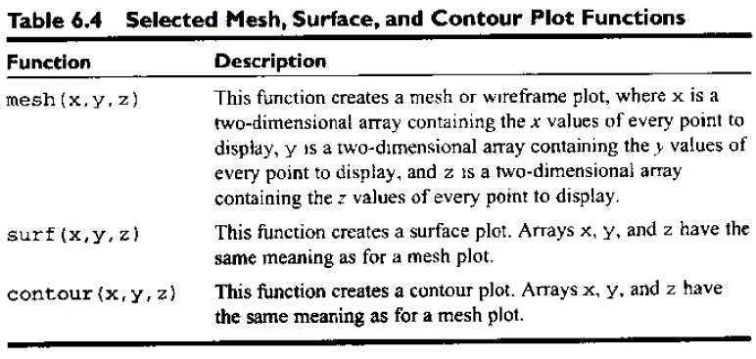
3-D plot functions

Slide 25
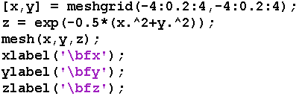
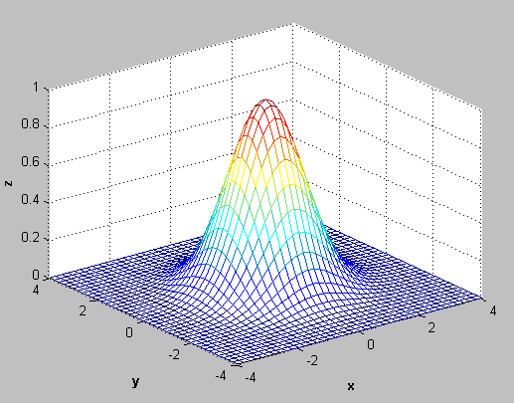

Slide 26
Summary
MATLAB supports complex numbers as an extension of the double data type. They can be defined using the i or j, both of which are predefined to be sqrt(-1).
Using complex numbers is straightforward, except that the relational operators >,> =, <, and < = only compare the real parts of complex numbers, not their magnitudes. They must be used with caution when working with complex values.
String functions are functions designed to work with strings, which are arrays of type char. These functions allow a user to manipulate strings in a variety of useful ways, including concatenation, comparison, replacement, case conversion, and numeric-to-string and string-to-numeric type conversions.

Slide 27
Summary
Multidimensional arrays are arrays with more than two dimensions. They may be created and used in a fashion similar to one- and two-dimensional arrays.
Multidimensional arrays appear naturally in certain classes of physical problems.
MATLAB includes a rich variety of two- and three-dimensional plots. In this chapter, we introduced stem, stair, bar, compass, mesh, surface, and contour plots.

Slide 28
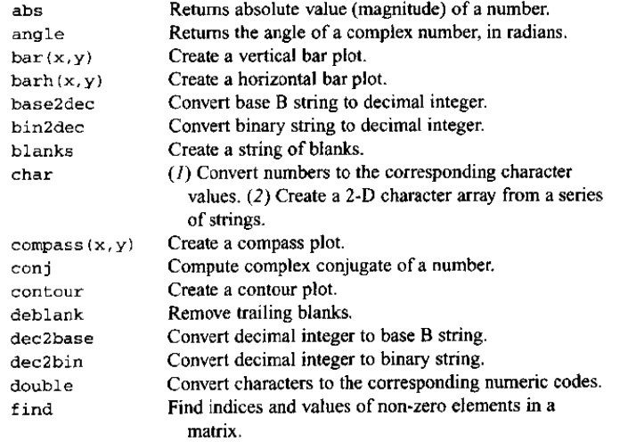
Built-in functions

Slide 29
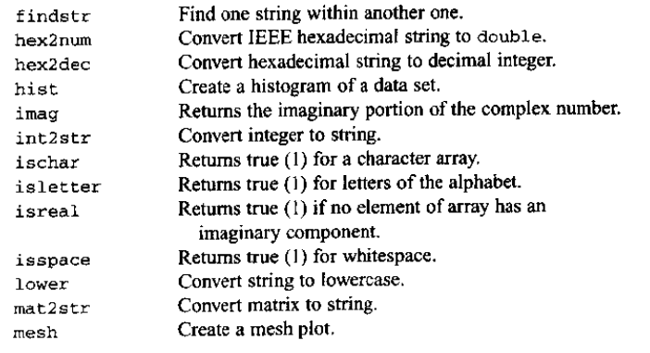
More

Slide 30
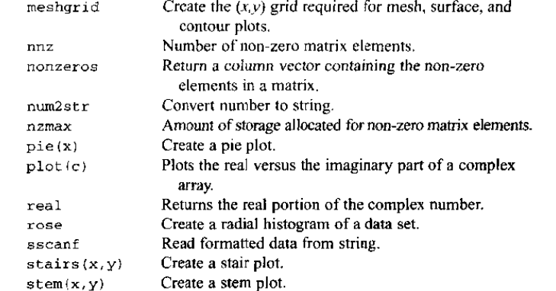
And more

Slide 31
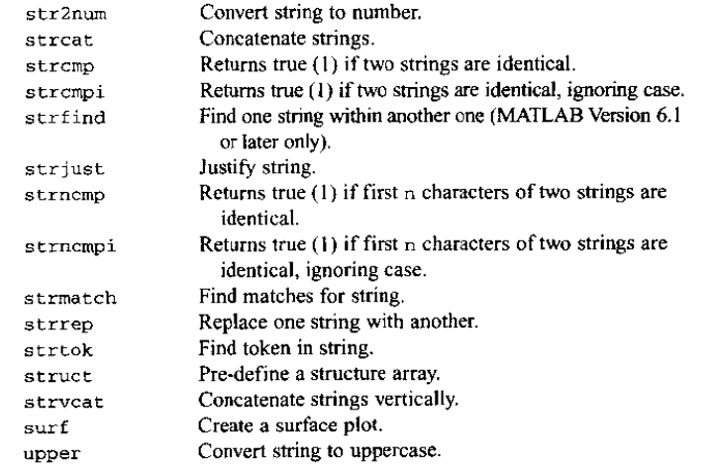
And more

Slide 32
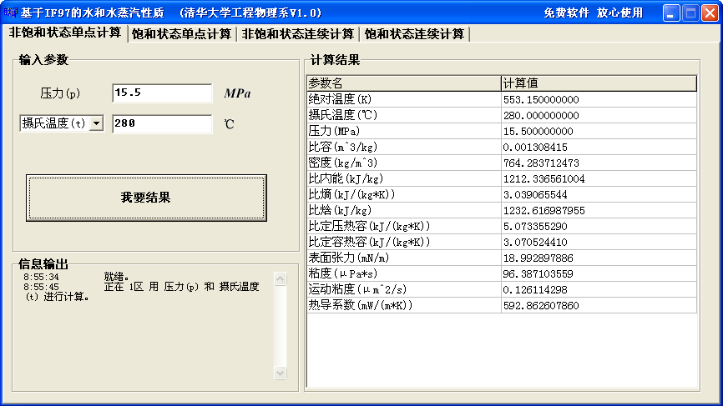
H2O.exe

Slide 33
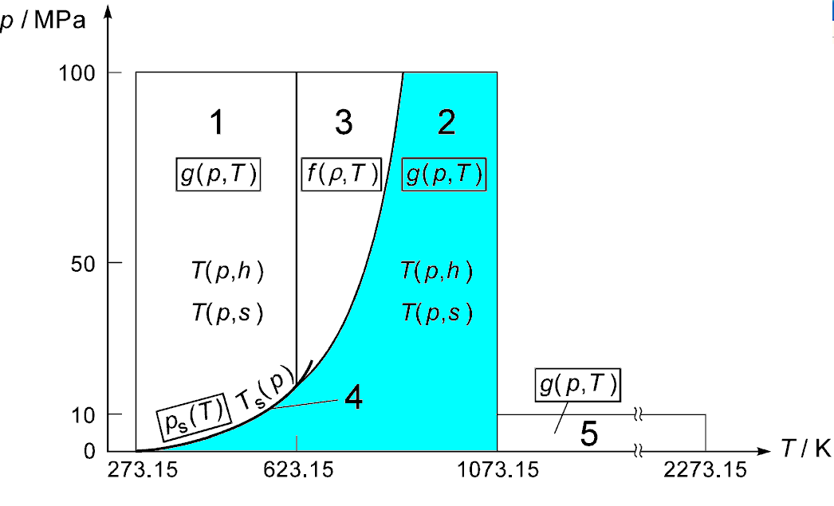
Region 2

Slide 34
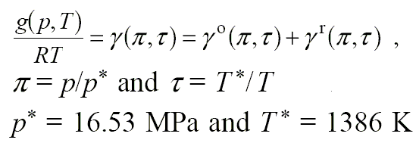
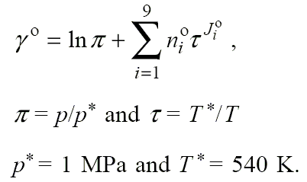
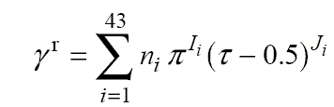
Basic equations
Specific Gibbs free energy equation in dimensionless form:

Slide 35
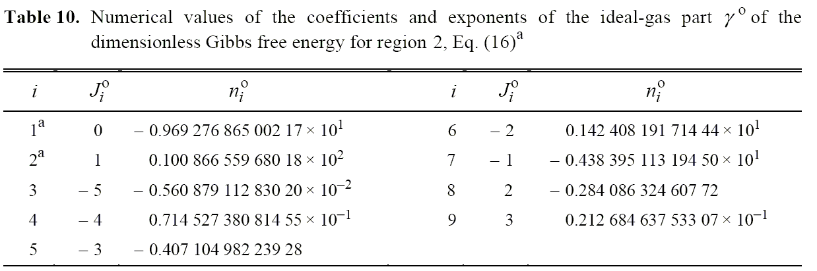

Slide 36
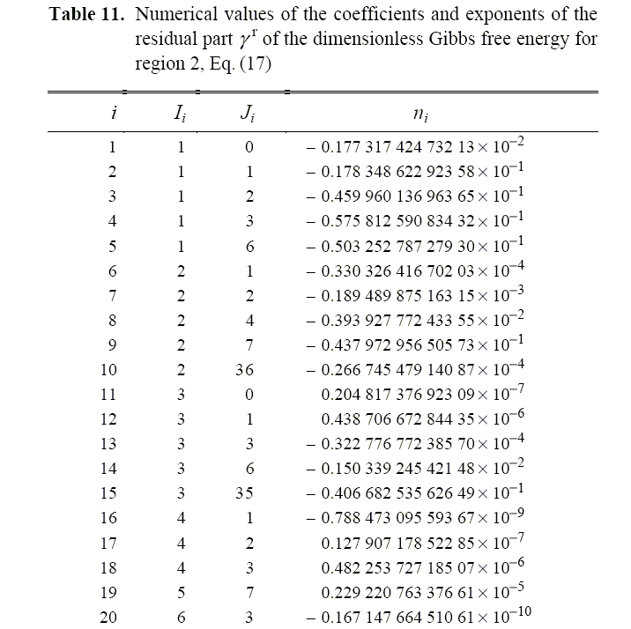

Slide 37
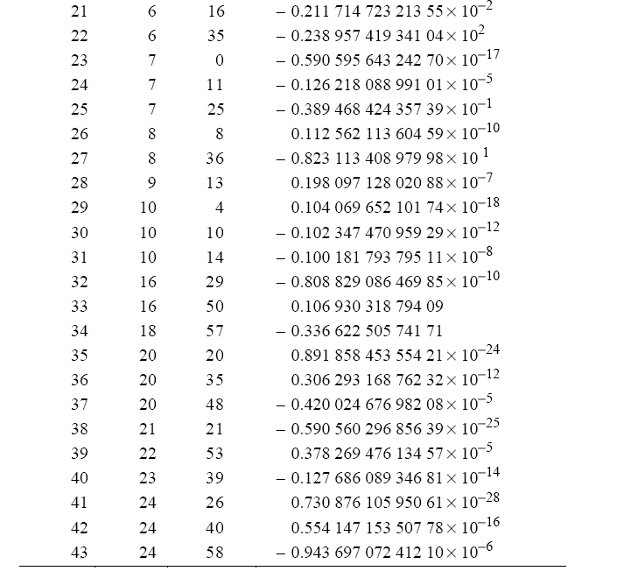

Slide 38
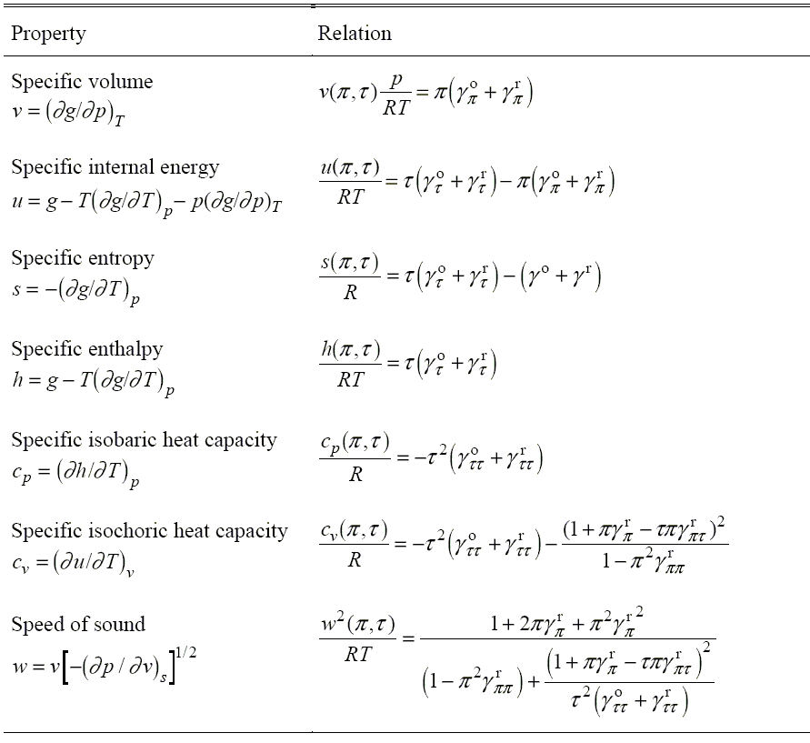

Slide 39
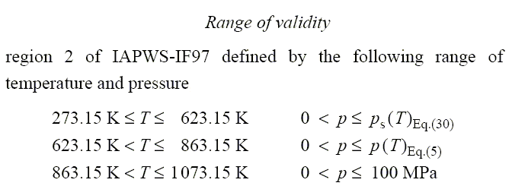
Ragion 2
p_b23

Slide 40
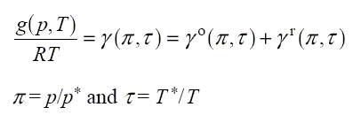


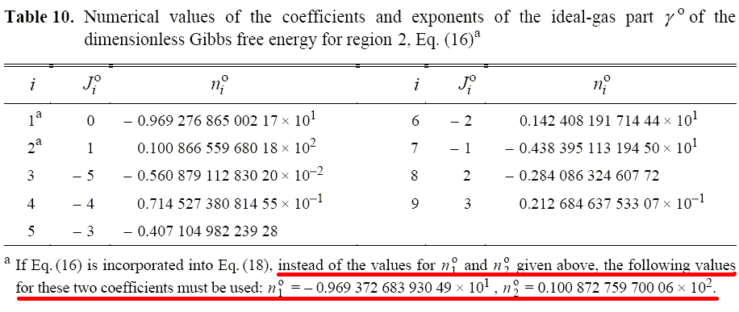
Metastable-Vapor Region

Slide 41
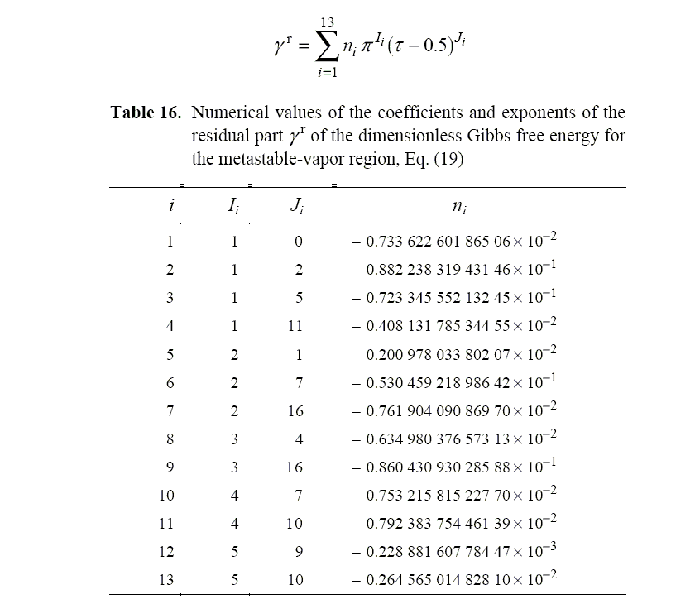

Slide 42
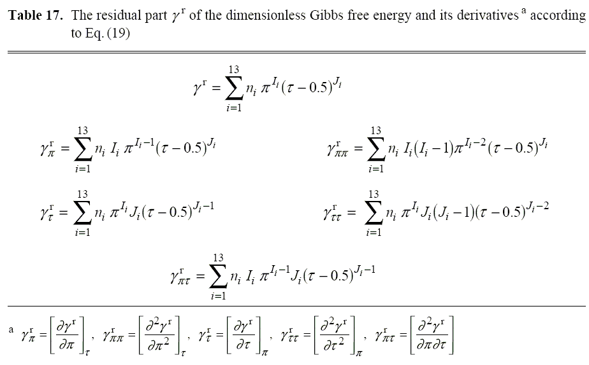

Slide 43
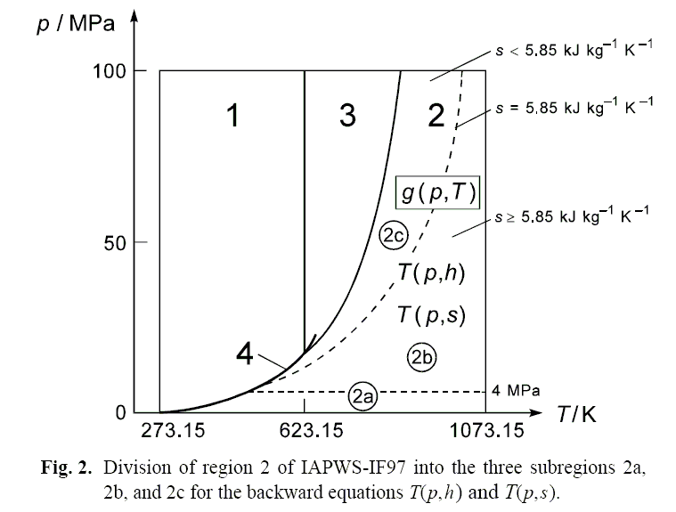
Backward equations

Slide 44
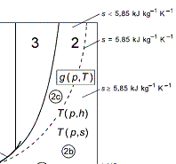
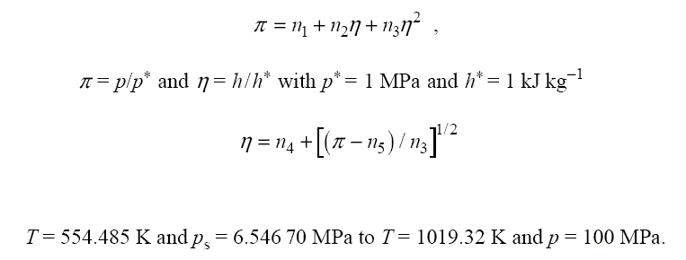
Boundary between 2b and 2c

Slide 45
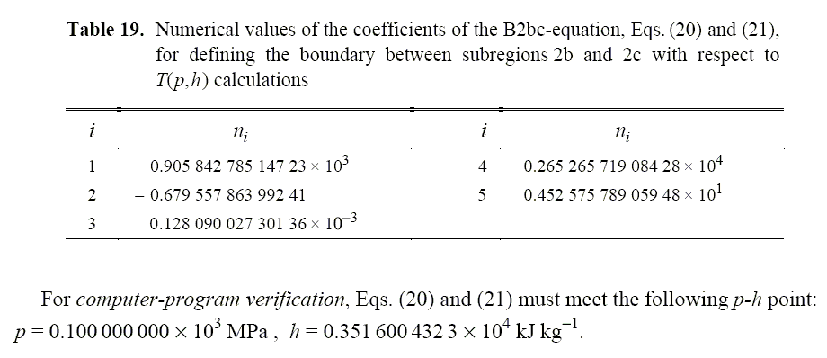
Boundary between 2b and 2c

Slide 46
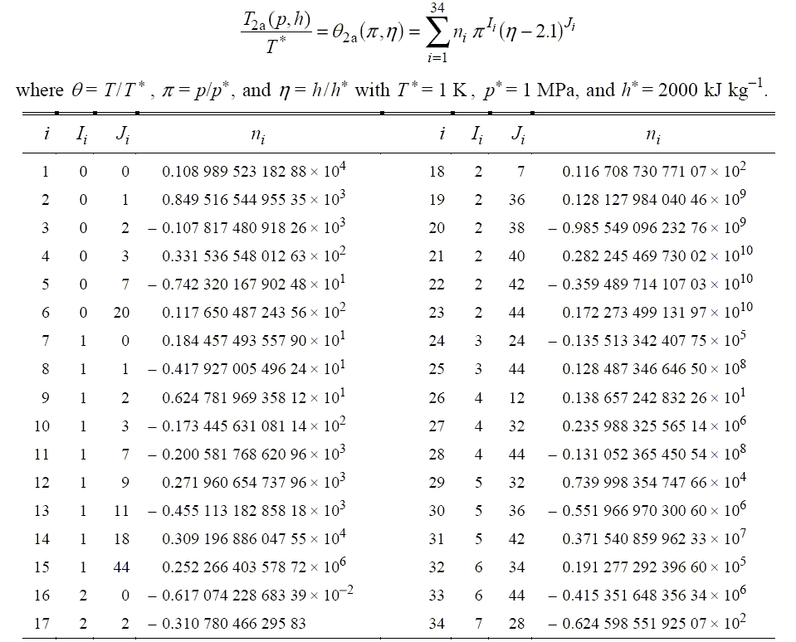
The Backward Equations T( p, h ) for Subregions 2a, 2b, and 2c

Slide 47
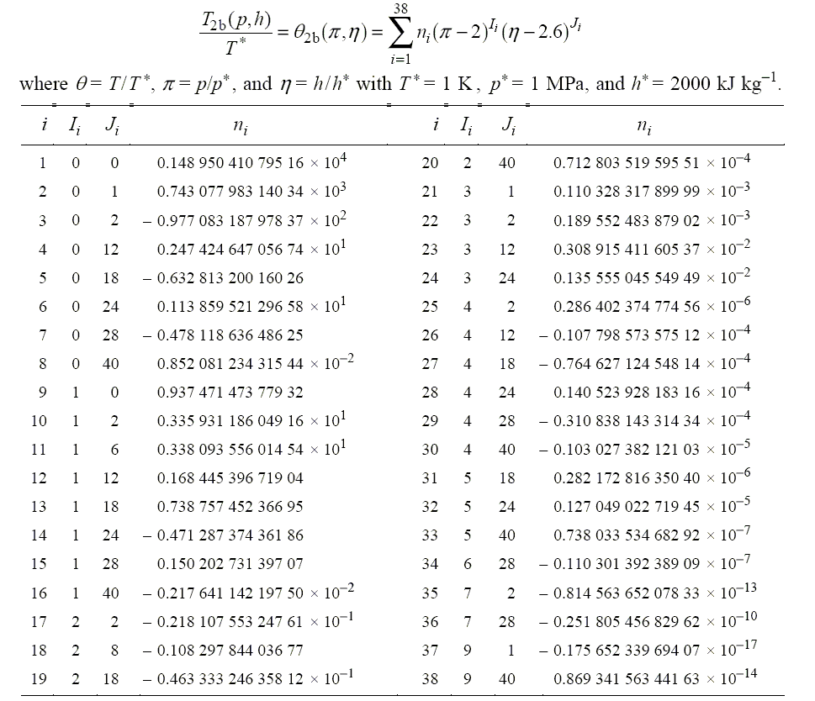
The Backward Equations T( p, h ) for Subregions 2a, 2b, and 2c

Slide 48
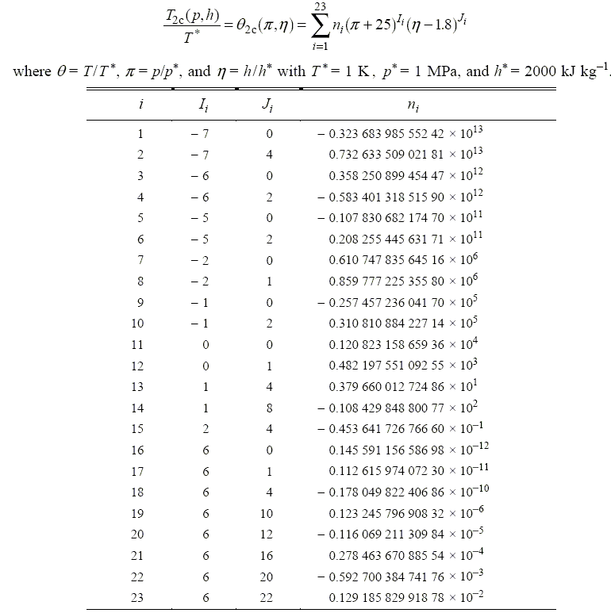
The Backward Equations T( p, h ) for Subregions 2a, 2b, and 2c

Slide 49
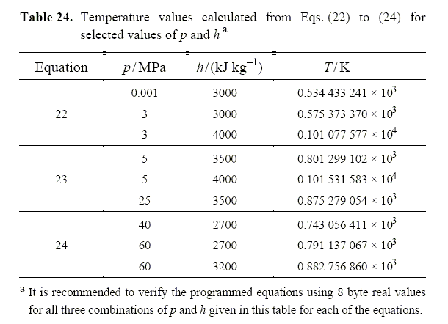
Testing the backward equations for 2a,2b and 2c

Slide 50

The Backward Equations T( p, s ) for Subregions 2a, 2b, and 2c

Slide 51

The Backward Equations T( p, s ) for Subregions 2a, 2b, and 2c

Slide 52

The Backward Equations T( p, s ) for Subregions 2a, 2b, and 2c

Slide 53

Testing the backward equations for 2a,2b and 2c

Slide 54

Homework
Review the text from page 241 to 286.
Exercises 6.6,7,8,9
Build functions in the region 2 of the properties of water.
Testing the functions in the region 2

