Slide 1
MATLAB Programming Lecture 7
Yu, Jiyang
yujiy@tsinghua.edu.cn
Office: Room 904# of Liuqing Building
Department of Engineering Physics
Tsinghua University

Slide 2
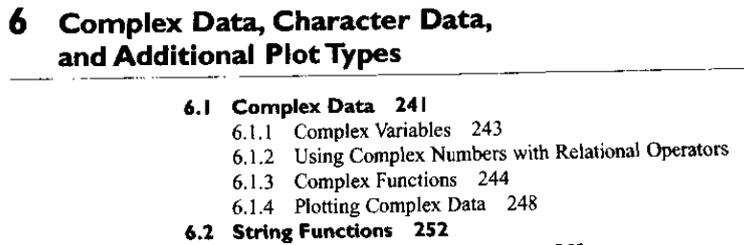
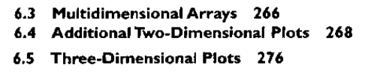
Review

Slide 3
Contents
Sparse arrays
Cell arrays
Structure arrays
The functions in the region 3,4 and 5

Slide 4
Sparse arrays
In computer science, a sparse array is an array in which most of the elements have the same value (known as the default value—usually 0 or null).
A naive implementation of an array may allocate space for the entire array, but in the case where there are few non-default values, this implementation is inefficient.
As an example, a spreadsheet containing 100×100 mostly empty cells might be more efficiently stored as a linked list rather than an array containing ten thousand array elements.

Slide 5
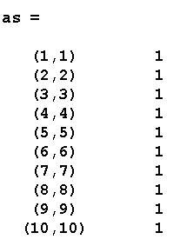
Example
a = eye(100)
as = sparse(a)
a=speye(100)
>> whos
Name Size Bytes Class
a 100x100 80000 double array
ans 1x1 8 double array
as 100x100 1604 double array (sparse)
Grand total is 10101 elements using 81612 bytes

Slide 6
Sparse matrices
MATLAB allows full and sparse matrices to be freely mixed and used in any combination, The result of an operation between a full matrix and a sparse matrix can be either a full matrix or a sparse matrix, depending on which result is the most efficient.
Any matrix technique that is supported for full matrices is also available for sparse matrices.

Slide 7
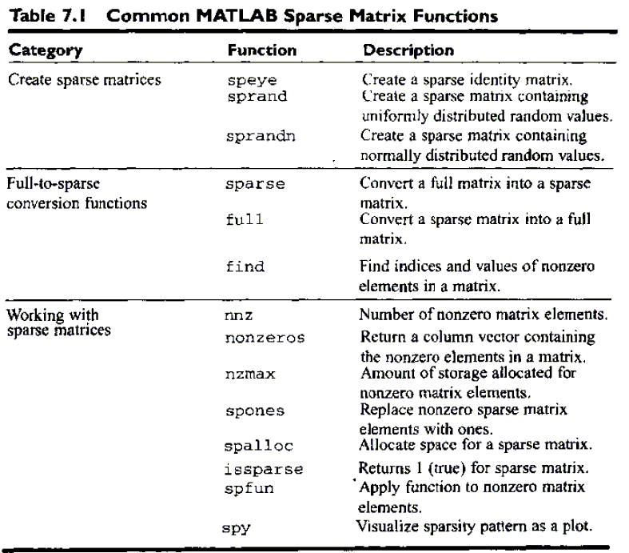

Slide 8
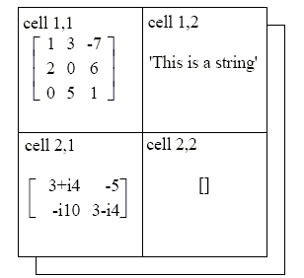
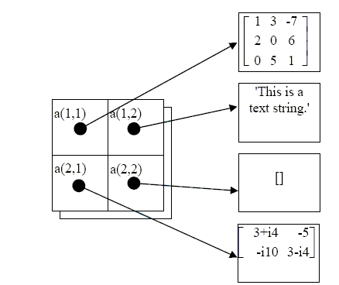
Cell arrays
Whose elements are cells.
a{ }

Slide 9
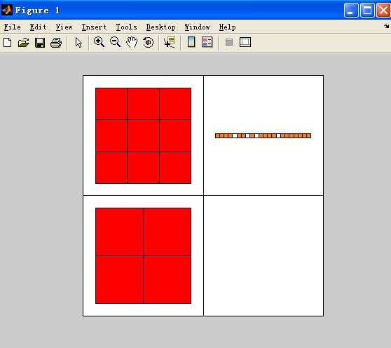
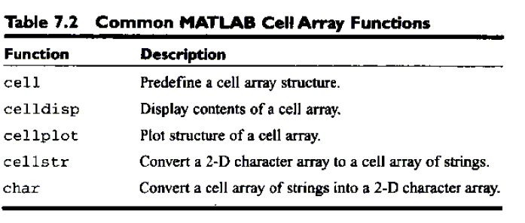
Cell arrays
a{1,1} = [1 3 -7; 2 0 6; 0 5 1];
a{1,2} = 'This is a text string.';
a{2,1} = [3+4*i -5; -10*i 3-4*i];
a{2,2} = [];
celldisp(a)

Slide 10
Creating Cell Arrays
Cell arrays can be created in two ways
By using assignment statements.
By pre-allocating a cell array using the cell function
The simplest way to create a cell array is to directly assign data structures to individual cells, one cell at a time. However, pre-allocating cell arrays is more efficient, so you should pre-allocate really large cell arrays.

Slide 11


Using Assignment Statements
There are two ways to assign data to cells, known as content indexing and cell indexing.
Content indexing involves placing braces "{ }" around the cell subscripts, together with cell contents in ordinary notation.
Cell indexing involves placing braces "{ }" around the data to be stored in a cell, together with cell subscripts in ordinary subscript notation.

Slide 12
Pre-allocating Cell Arrays with the cell Function
The cell function allows you to pre-allocate empty cell arrays of the specified size.
For example, the following slatement creates an empty 2 x 2 cell array.
a = cell(2,2)
Once a cell array is created, you can use assignment statements to fill values in the cells.

Slide 13
Function for Cells
Viewing the contents of cell arrays
celldisp(a)
Extending cell arrays
Extended automatically by assignment.
Deleting cells in arrays
a(3,:) = [];
Using data in cell arrays
c = {[1 2;3 4],'dogs';'cats',i};
c{1,1}?
c{1,1}(1,2)?

Slide 14
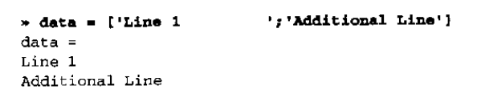
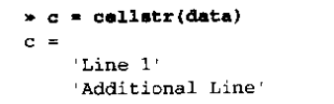
Cell arrays of strings
It is often convenient to store groups of strings in a cell array, instead of storing them in rows of a standard character array, because each string in a cell array can have a different length, while every row of a standard character array must have an identical length.
Cell arrays of strings can be created in one of two ways. Either the individual strings can be inserted into the array with brackets, or else function cellstr can be used to convert a 2-D string array into a cell array of strings.

Slide 15
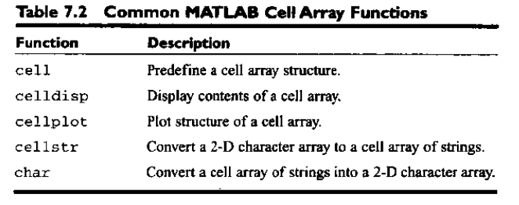
The significant of cell arrays
Cell arrays are extremely flexible, since any amount of any type of data can be stored in each cell.

Slide 16
Structure arrays
An array is a data type in which there is a name for the whole data structure, but individual elements within the array are only known by number and all of the individual elements in an army must be of the same type (numeric or character).
A cell array is also a data type in which there is a name for the whole data structure, and the individual elements within the array are only known by number. However, the individual elements in the cell array may be of different types.
In contrast, a structure is a data type in which each individual element is given a name. The individual elements of a structure are known as fields, and each field in a structure may have a different type. The individual fields are addressed by combining the name of the structure with the name of the field, separated by a period.

Slide 17
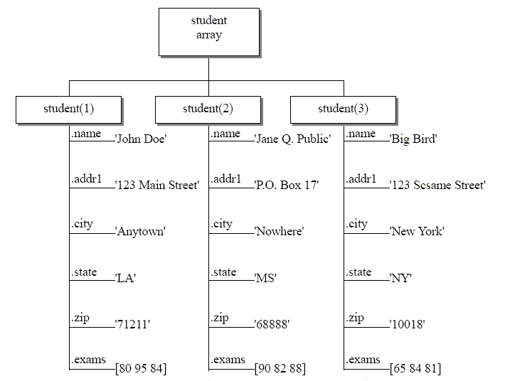
Structure arrays

Slide 18

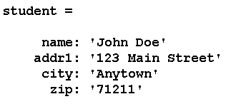

Slide 19
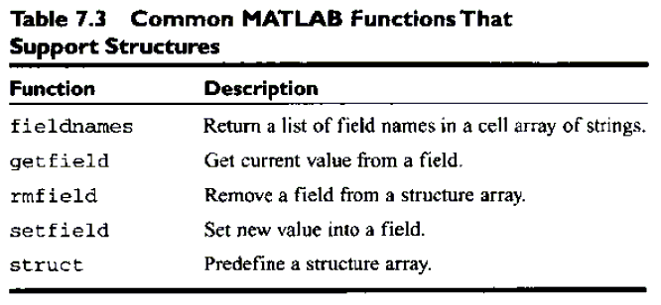
Adding and removing field from structures
student(2).exams = [90 82 88];
stu2 = rmfield(student, ‘zip’);
getfield()
setfield()

Slide 20
Summary
Sparse arrays
are special arrays in which memory is only allocated for non zero elements. Three values are saved for each nonzero elements --a row number, a column number, and the value itself. This form of storage is much more efficient than ordinary full arrays for the situation where only a tiny fraction of the elements are nonzero.
Cell arrays arc arrays whose elements are cells, containers that can hold other MATLAB arrays. Any sort of data can be stored in a cell, including structure arrays and other cell arrays.

Slide 21
Structure arrays
Structure arrays are a data type in which each individual element is given a name. The individual elements of a structure are known as fields, and each field in a structure may have a different type.
Structure arrays are useful for grouping together all of the data related to a particular person or thing into a single location.

Slide 22
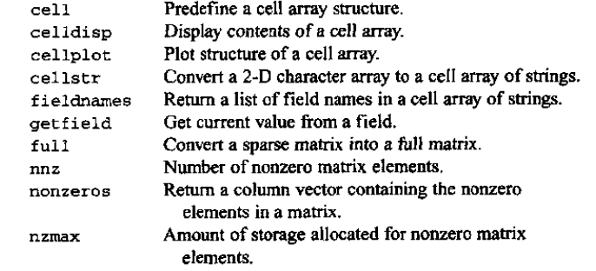
MATLAB summary

Slide 23
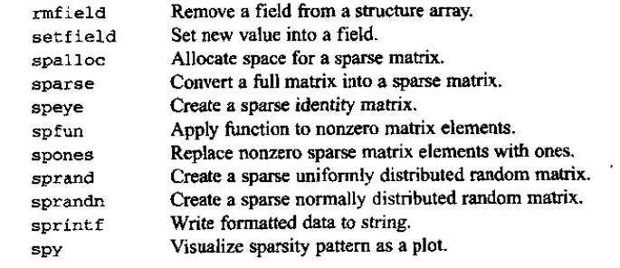
MATLAB summary

Slide 24
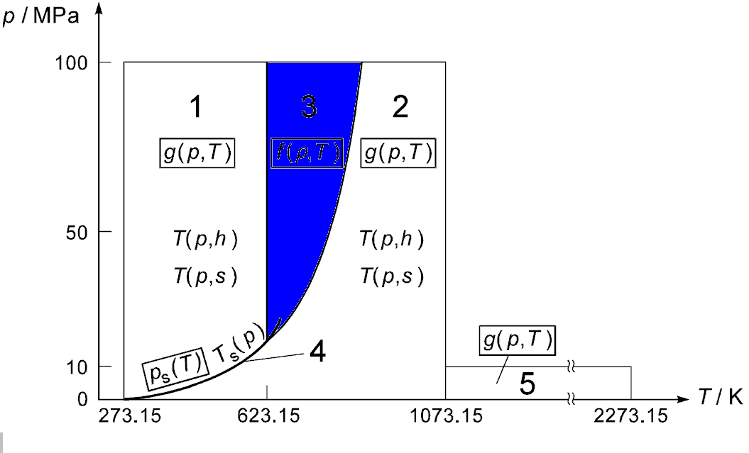
Region 3

Slide 25
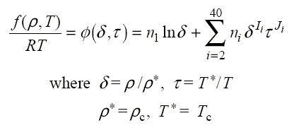
Basic equations
Specific Helmholtz free energy equation in dimensionless form:

Slide 26
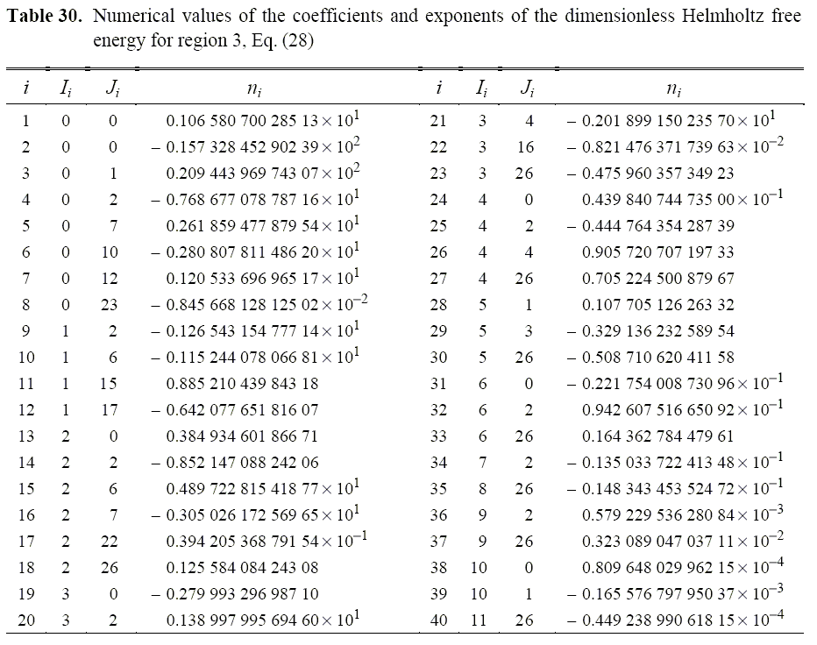

Slide 27
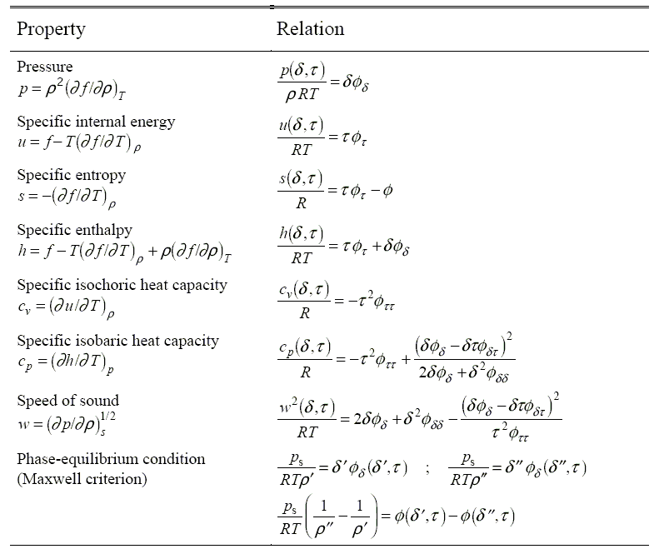

Slide 28
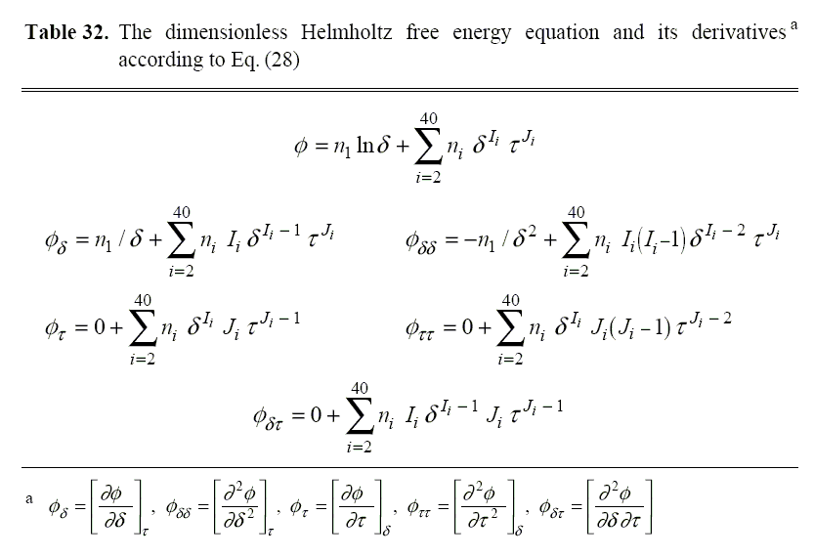

Slide 29
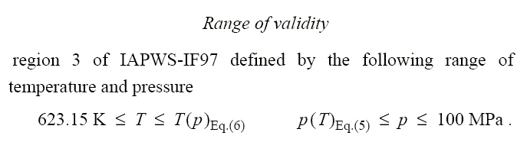
Ragion 3
We need t_b23(p)
p_b23(t)

Slide 30
Region 3
It’s about density and temperature.
Big question: How to get the properties when input pressure and temperature?

Slide 31
Backward equations
Suppose you have y = f(x).
How to get x = fb(y)?
Newton method
Mid – separate method
others

Slide 32
Newton method for y = f(x)
Since y = f(x), so
The question is to give a y0, we want to know the x0 corresponding to it.
That means we want to find the root of the equation of : y₀ – f(x) = 0, it is a equation of x.
Since we have y₂-y₁ = f’(x₁) * (x₂ – x₁)
We can guess a value as x₁
x_{k+1} = x_{k} + f’(x_{k})/(y₂-y₁)

Slide 33
Newton method for y = f(x)
Since we have y₂-y₁ = f’(x₁) * (x₂ – x₁)
We can guess a value as x₁
x_{k+1} = x_{k} + f’(x_{k})/(y_{k+1}-y_{k})
We assume y_{k+1} = 0
x_{k+1} = x_{k} + f’(x_{k})/(-y_{k})
How to stop the iteration?

Slide 34
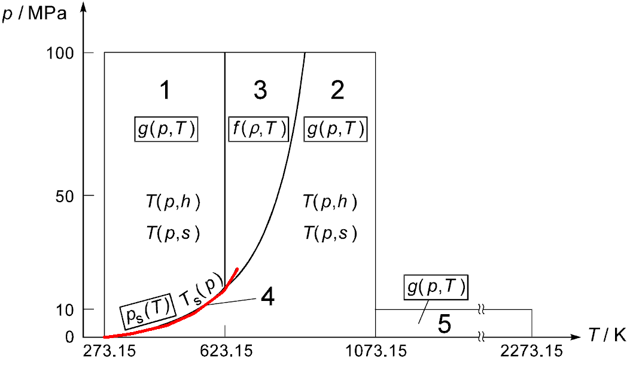
Region 4

Slide 35
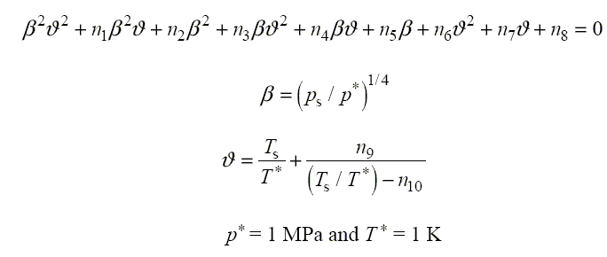
Basic equations

Slide 36
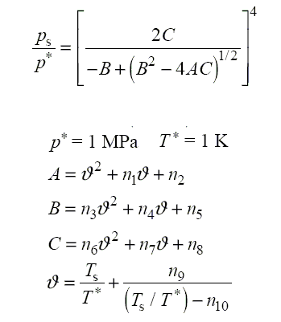
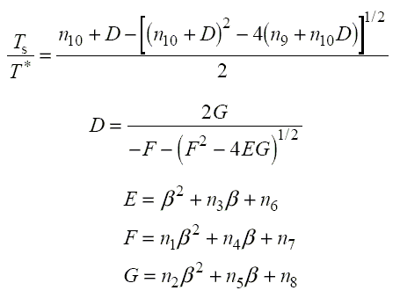


Basic equations

Slide 37
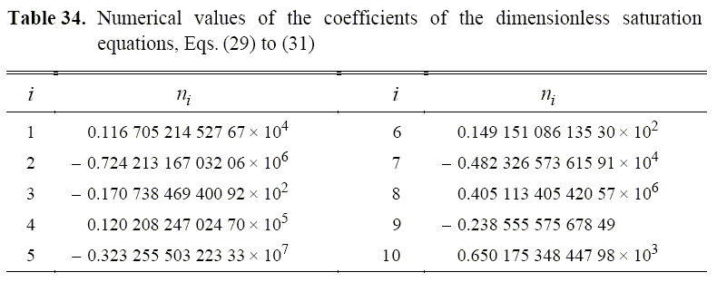

Slide 38
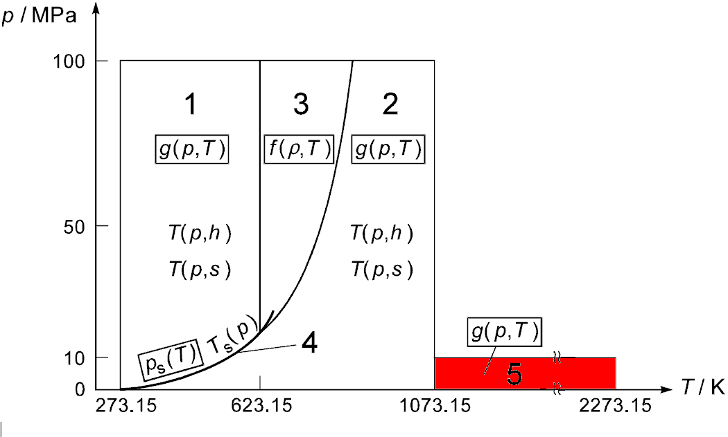
Region 5

Slide 39
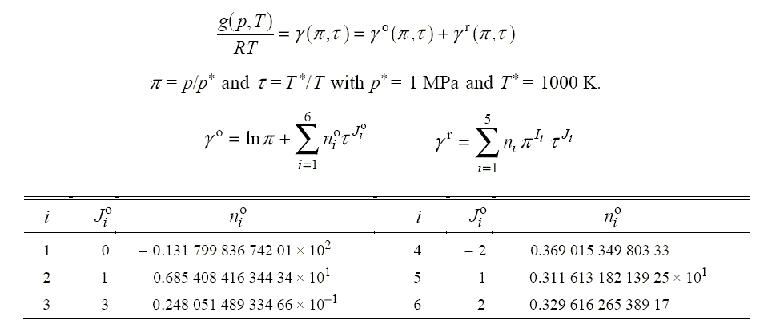
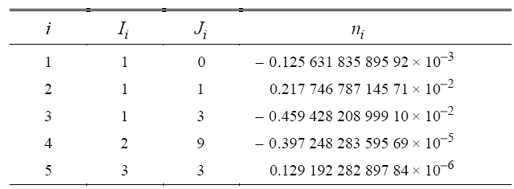
Region 5

Slide 40
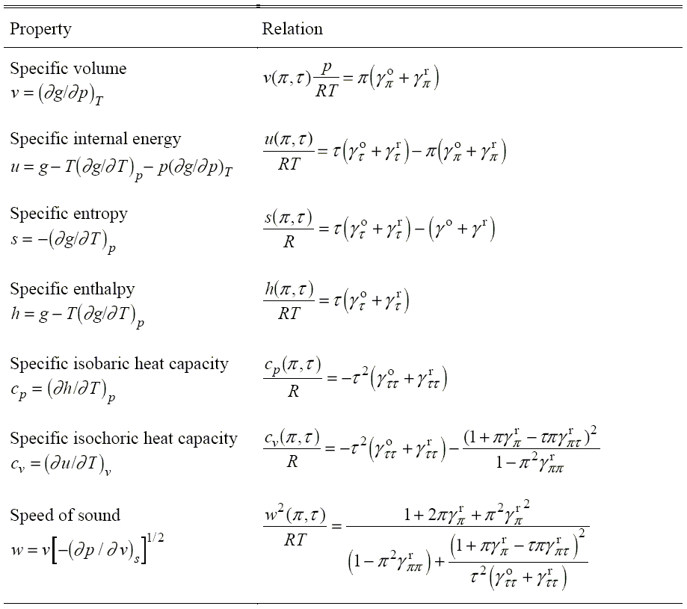

Slide 41
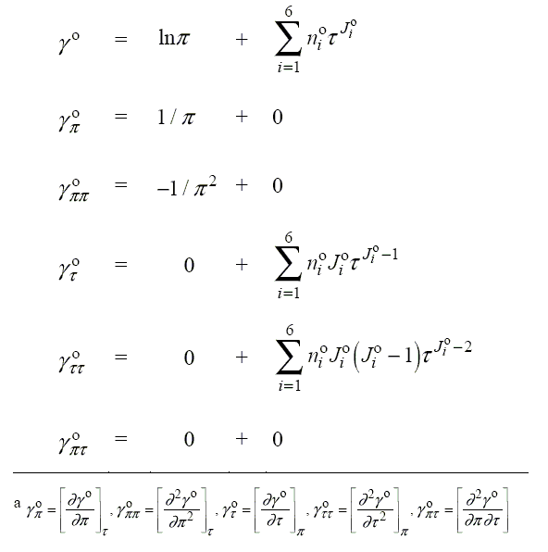

Slide 42
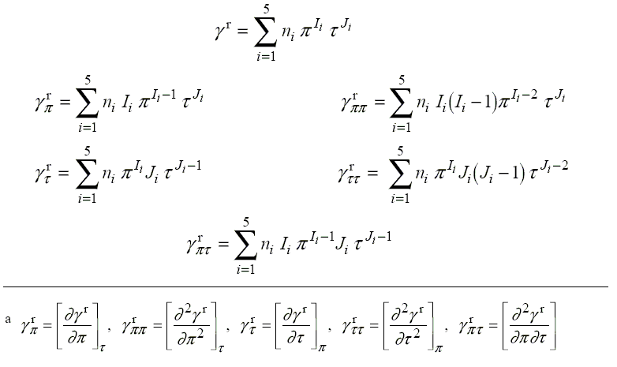

Slide 43
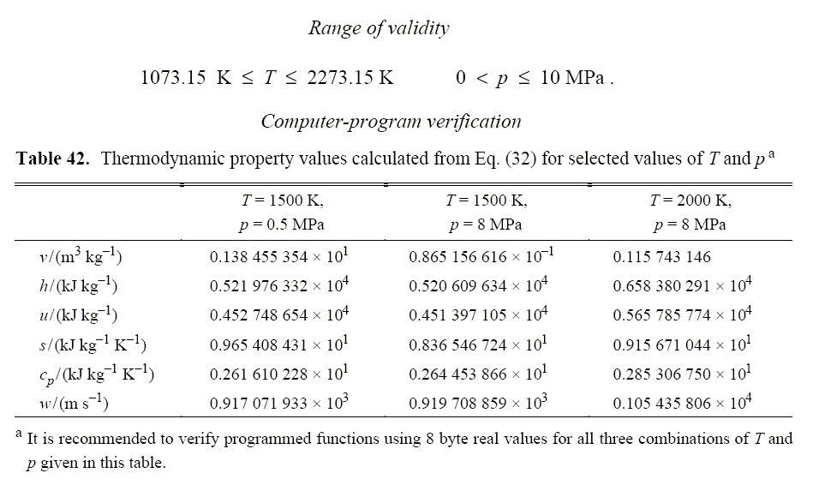
Testing of region 5

Slide 44
Homework
Review the text from page 287 to 317.
Exercises 7.1 to 7.6
Build functions in the region 3, 4 and 5.
Testing the functions in the region 3 , 4 and 5.

