Slide 1
MATLAB Programming Lecture 8
Yu, Jiyang
yujiy@tsinghua.edu.cn
Office: Room 904# of Liuqing Building
Department of Engineering Physics
Tsinghua University

Slide 2
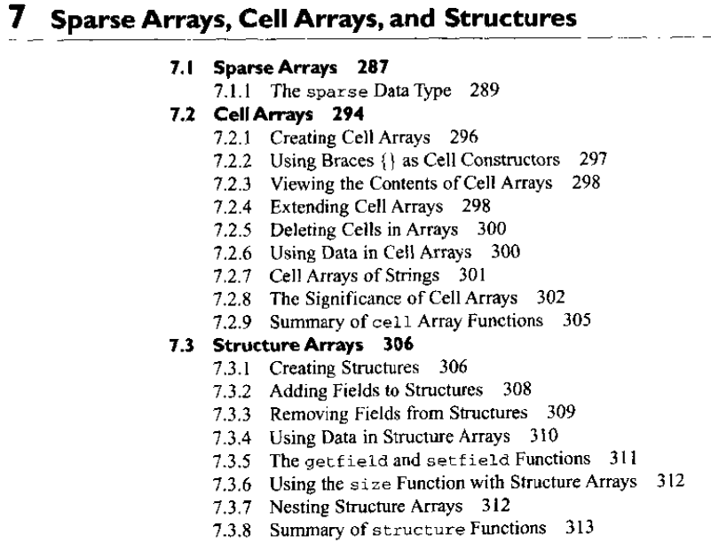
Review

Slide 3
Contents
I/O functions
Text read function
Load and save
File processing
File opening and closing
Binary file I/O
Formatted I/O
Handle graphics
Draw of water properties

Slide 4
Text read function
It is designed to read ASCII files that are formatted into columns of data, where each column can be of a different type.
It is very useful for importing tables of data printed out by other applications
[a , b , c , …] = textread(filename,format,n)

Slide 5
textread
>> help textread
TEXTREAD Read formatted data from text file.
A = TEXTREAD('FILENAME')
A = TEXTREAD('FILENAME','',N)
A = TEXTREAD('FILENAME','',param,value, ...)
A = TEXTREAD('FILENAME','',N,param,value, ...) reads numeric data from
the file FILENAME into a single variable. If the file contains any
text data, an error is produced.
[A,B,C, ...] = TEXTREAD('FILENAME','FORMAT')
[A,B,C, ...] = TEXTREAD('FILENAME','FORMAT',N)
[A,B,C, ...] = TEXTREAD('FILENAME','FORMAT',param,value, ...)
[A,B,C, ...] = TEXTREAD('FILENAME','FORMAT',N,param,value, ...) reads
data from the file FILENAME into the variables A,B,C,etc. The type of
each return argument is given by the FORMAT string. The number of
return arguments must match the number of conversion specifiers in the
FORMAT string. If there are fewer fields in the file than in the
format string, an error is produced. See FORMAT STRINGS below for
more information.

Slide 6
FORMAT STRINGS
If the FORMAT string is empty, TEXTREAD will only numeric data.
Supported conversion specifications:
%n - read a number - float or integer (returns double array)
%5n reads up to 5 digits or until next delimiter
%d - read a signed integer value (returns double array)
%5d reads up to 5 digits or until next delimiter
%u - read an integer value (returns double array)
%5u reads up to 5 digits or until next delimiter
%f - read a floating point value (returns double array)
%5f reads up to 5 digits or until next delimiter
%s - read a whitespace separated string (returns cellstr)
%5s reads up to 5 characters or until whitespace
……

Slide 7
save and load
They are very powerful and useful
Platform independent
Disk space efficiency
Preserve all information
The disadvantage is that the MAT-file is unique to MATLAB, and can not share data with other programs.

Slide 8
MATLAB file processing
File id 1 is the standard output device
File id 2 is the standard error device
Additional file ids are assigned as files are opened and are released as files are closed.
fopen and fclose
frewind and fseek

Slide 9
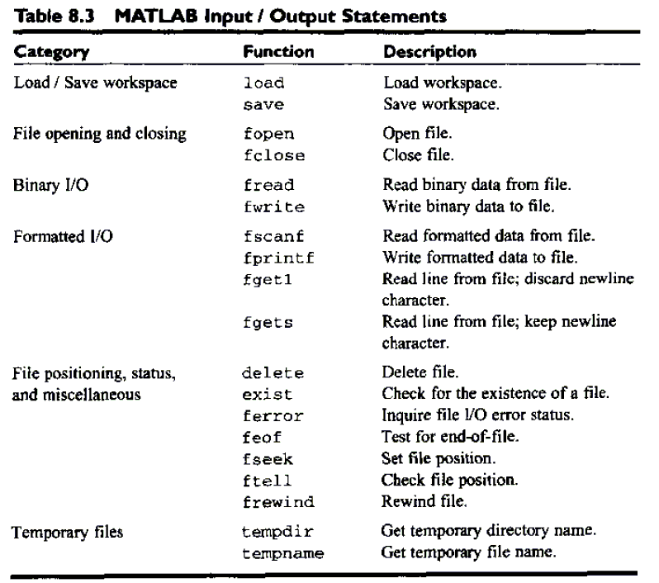

Slide 10
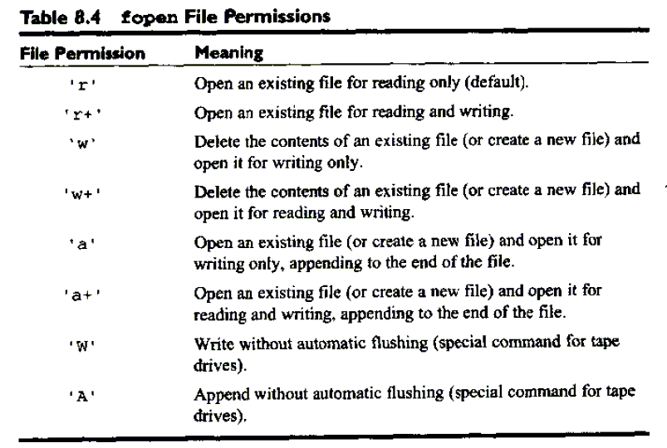
fopen
fid = fopen(filename, permission)
fopen(all)
[filename, permission, format] = fopen(fid)

Slide 11
Examples
fid = fopen(‘example.dat’,’r’)
fid = fopen(‘outdat’,’wt’)
fid = fopen(‘junk’,’r+’)
fid = fopen(‘junk’,’w+’)
fclose(fid) and fclose(‘all’)

Slide 12
Binary I/O functions
fwrite
count = fwrite(fid,array,precision)
count = fwrite(fid,array,precision,skip)
Write out in column order.

Slide 13
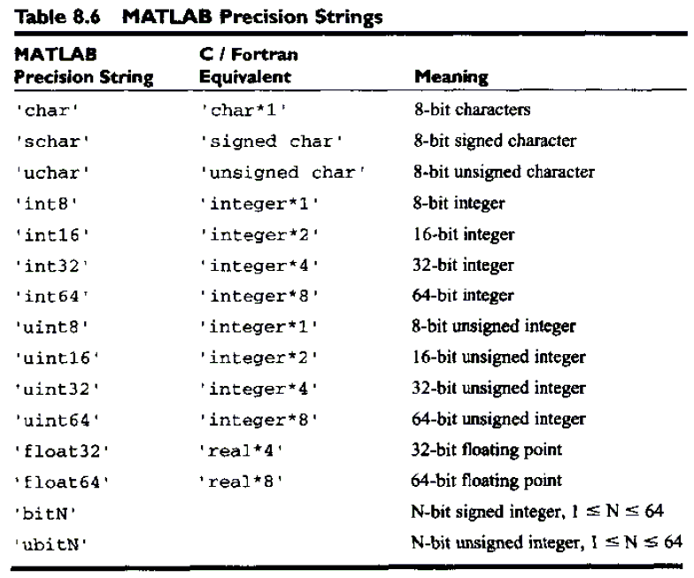
precision

Slide 14
Binary I/O functions
fread
[array,count] = fread(fid,size,precision)
[array,count] = fread(fid,size,precision,skip)
size has 3 options: n , Inf or [n m]

Slide 15

Formatted I/O functions
fprintf
count = fprintf(fid,foramt,v1, v2, …)
fprintf(fid, v1, v2, …)

Slide 16
FORMAT
FORMAT is a string containing C language conversion specifications.
Conversion specifications involve the character %, optional flags,
optional width and precision fields, optional subtype specifier, and
conversion characters d, i, o, u, x, X, f, e, E, g, G, c, and s.
The special formats \n,\r,\t,\b,\f can be used to produce linefeed,
carriage return, tab, backspace, and formfeed characters respectively.
Use \\ to produce a backslash character and %% to produce the percent character.

Slide 17
Formatted I/O functions
fscanf
array = fscanf(fid,foramt)
[array count] = fscanf(fid, format, size)

Slide 18
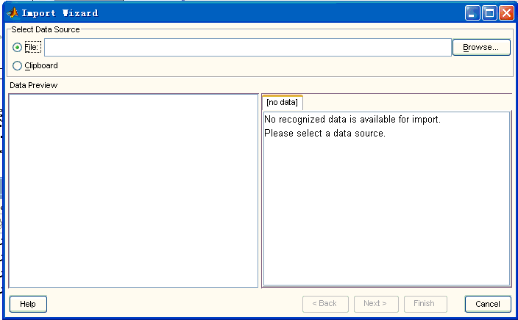
uiimport
A GUI-based way to import data from a file or from the clipboard.

Slide 19
Handle graphics
Handle graphics is the name of a set of low-level graphics functions that control the characteristic of graphics objects generated by MATLAB.
Very important to fine control of the appearance of the plots and graphics.
We have to know the structure of graphics system and how to control the properties of graphical objects.

Slide 20
The MATLAB graphics system
Is based on a hierarchical (there are some levels) system of graphics objects, each of which is known by a unique name called a handle.
Each graphics object has special data known as properties associated with it, and they can be modified.
Graphics objects including: line, axes …

Slide 21
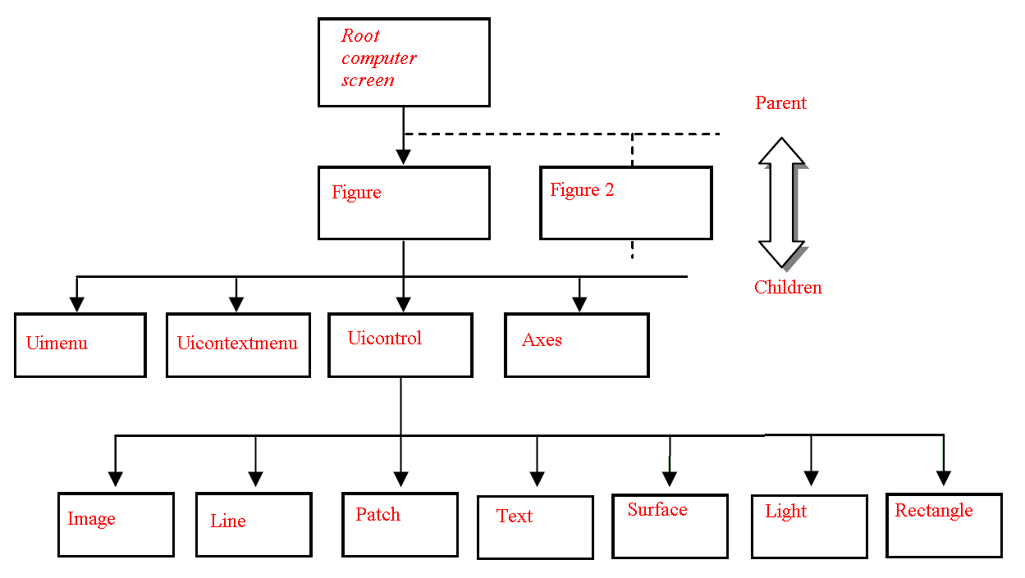
hie’rarchical system

Slide 22
handle
A handle is a particular kind of smart pointer. Handles are used when an application references blocks of memory or objects managed by another system, such as a database or an operating system.
A pointer is a programming language data type whose value refers directly to (or "points to") another value stored elsewhere in the computer memory using its address.
Handles were a popular solution to memory management in operating systems of the 1980s, such as Mac OS and Windows. Unix file descriptors are essentially handles. Like other desktop environments, the Windows API heavily uses handles to represent objects in the system and to provide a communication pathway between the operating system and user space. For example, a window on the desktop is represented by a handle of type hWnd.

Slide 23

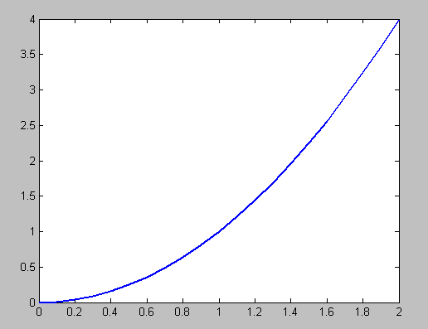
Changing object properties by handle

Slide 24
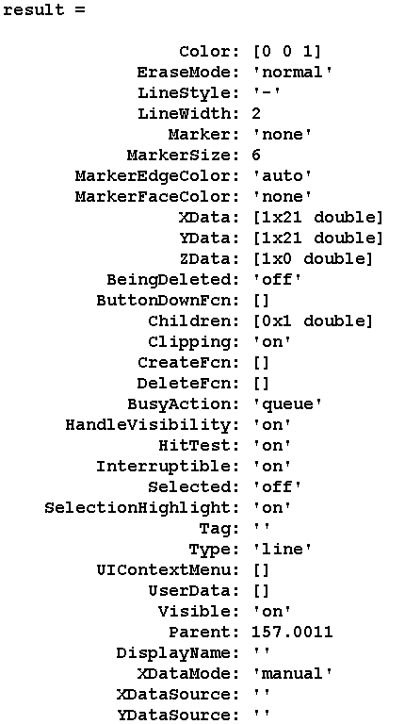

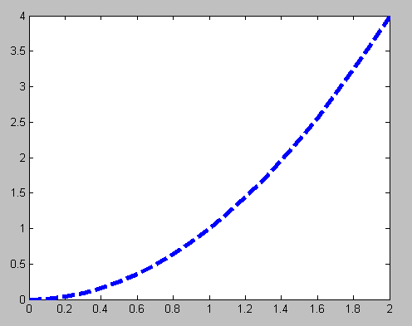
Changing object properties by handle

Slide 25
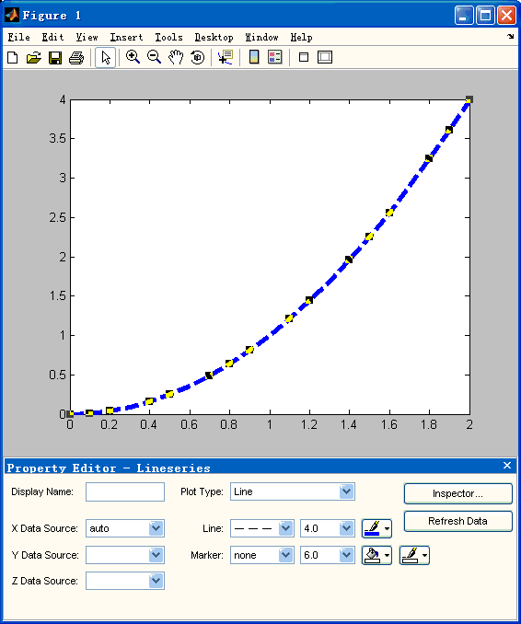
GUI- propedit(Hnd1)

Slide 26
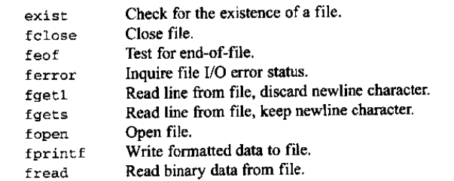
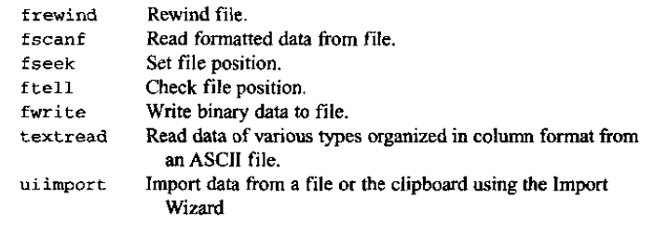
Summary

Slide 27
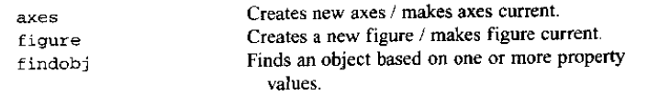
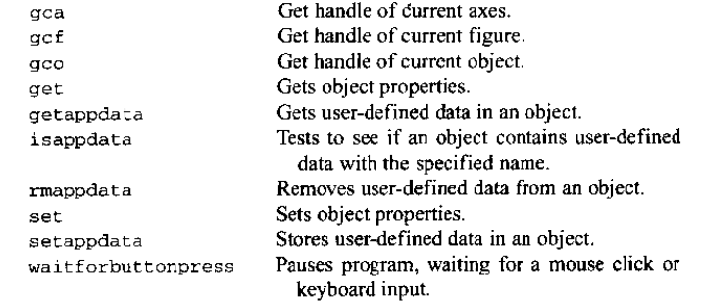
Summary

Slide 28
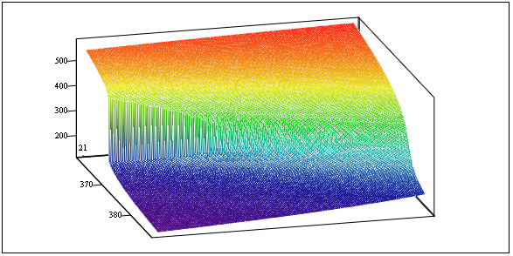
Homework
Review the text from page 319 to 390.
Exercises 8.1 to 8.13 and 9.1 to 9.6
Draw 3-D surface of the density, specific enthalpy, specific isobaric heat capacity of water in the region 1, 2 and 3.

