Slide 1
MATLAB Programming Lecture 9
Yu, Jiyang
yujiy@tsinghua.edu.cn
Office: Room 904# of Liuqing Building
Department of Engineering Physics
Tsinghua University

Slide 2
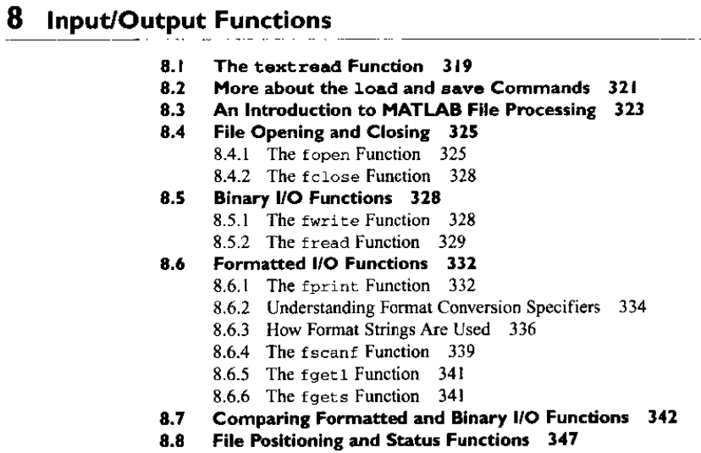
Review

Slide 3
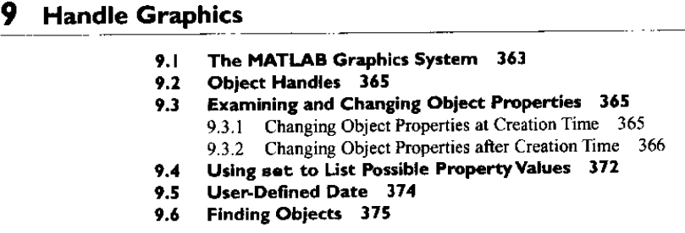
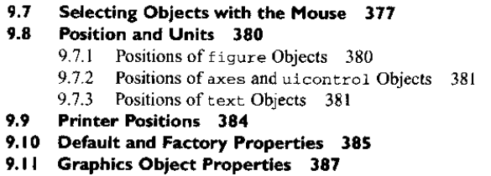
Review

Slide 4
Contents
Graphical User Interfaces
How GUI works
Creating and displaying a GUI
Object properties
GUI components
Dialog boxes
Menu editor
Design of water properties program

Slide 5
Define GUI
A graphical user interface (GUI) (sometimes pronounced gooey) is a type of user interface item that allows people to interact with programs in more ways than typing such as computers; hand-held devices such as MP3 Players, Portable Media Players or Gaming devices; household appliances and office equipment with images rather than text commands.
A GUI offers graphical icons, and visual indicators, as opposed to text-based interfaces, typed command labels or text navigation to fully represent the information and actions available to a user. The actions are usually performed through direct manipulation of the graphical elements.

Slide 6
How GUI works
Three principal elements:
Components
Controls : pushbuttons, lists, edit boxes, sliders …
Static elements: frames, text strings
Menus: submenus
Axes
Figures
Is a window on the computer screen.
Callbacks
Perform specific action by events

Slide 7
What Is GUIDE?
GUIDE, the MATLAB Graphical User Interface development environment, provides a set of tools for creating graphical user interfaces (GUIs). These tools greatly simplify the process of designing and building GUIs. You can use the GUIDE tools to Lay out the GUI
Using the GUIDE Layout Editor, you can lay out a GUI easily by clicking and dragging GUI components -- such as panels, buttons, text fields, sliders, menus, and so on -- into the layout area.

Slide 8
Program the GUI
GUIDE automatically generates an M-file that controls how the GUI operates. The M-file initializes the GUI and contains a framework for all the GUI callbacks -- the commands that are executed when a user clicks a GUI component. Using the M-file editor, you can add code to the callbacks to perform the functions you want them to.

Slide 9
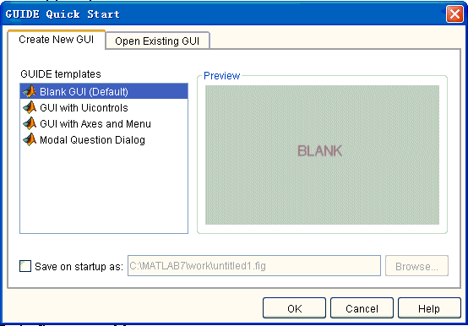
guide

Slide 10
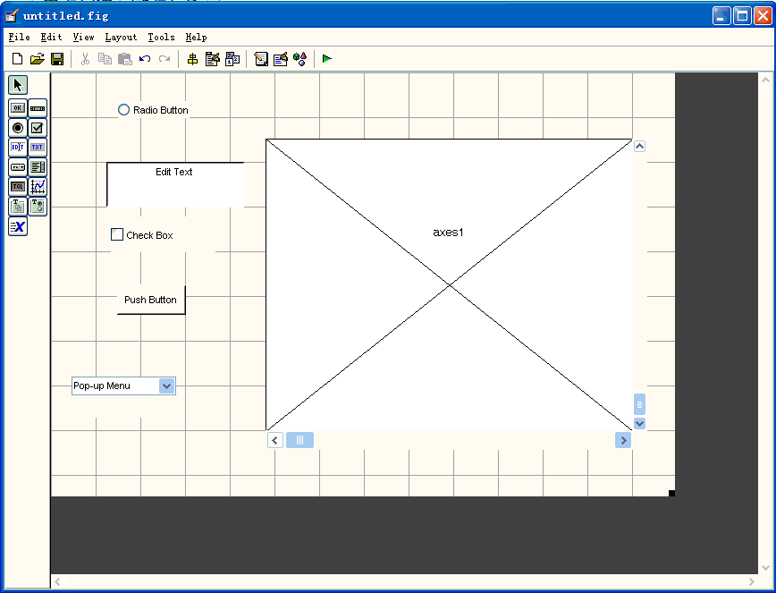
Layout

Slide 11
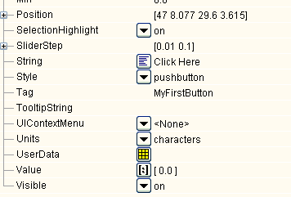
Example
Step 1 design the GUI
Step 2 run guide, put a pushbutton and a string
Step 3 set the properties of the Push Button and Static Text
Push Button
String Click Here
Tag MyFirstButton
Static Text
String Total Clicks: 0
Tag MyFirstString
Step 4 save it (a fig-file and a m-file automatically)
Step 5 implement the callback subfunction

Slide 12
Programming the GUI M-File
After laying out your GUI, you can program the GUI M-file using the M-file editor. GUIDE automatically generates this file from your layout the first time you save or run the GUI. The GUI M-file Initializes the GUI Contains code to perform tasks before the GUI appears on the screen, such as creating data or graphics Contains the callback functions that are executed each time a user clicks a GUI component.
Initially, each callback contains just a function definition line. You then use the M-file editor to add code that makes the component function the way you want it to. To open the M-file, click the M-file Editor icon on the Layout Editor toolbar. The following figure shows the M-file for the GUI with Axes and Menu template.

Slide 13
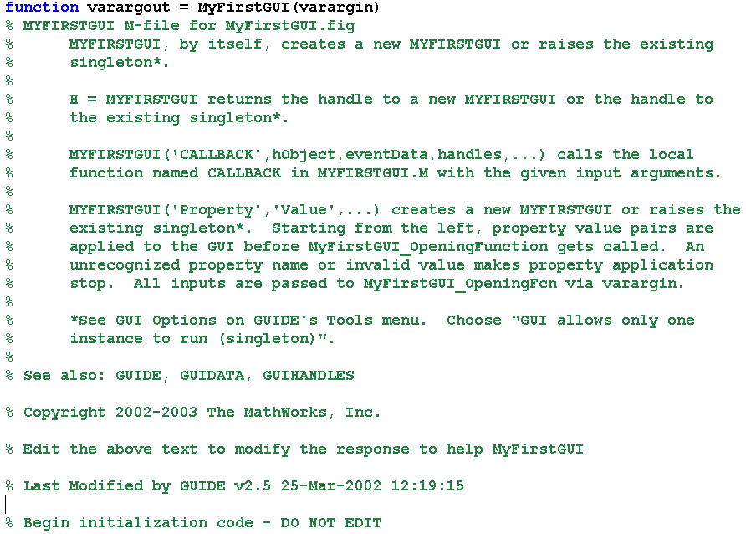
A look under the hood

Slide 14
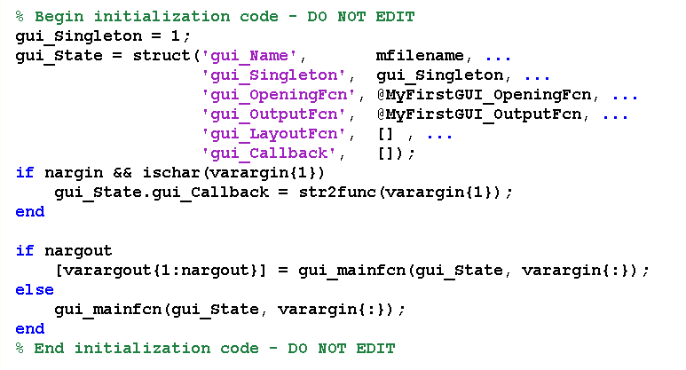

Slide 15
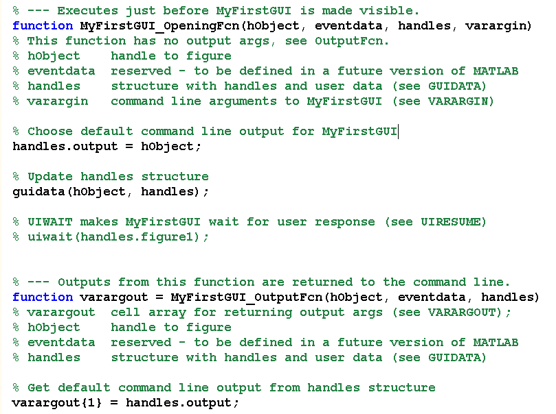

Slide 16
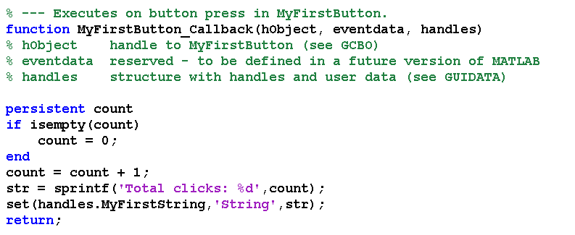
Step 5 implement the callback subfunction

Slide 17
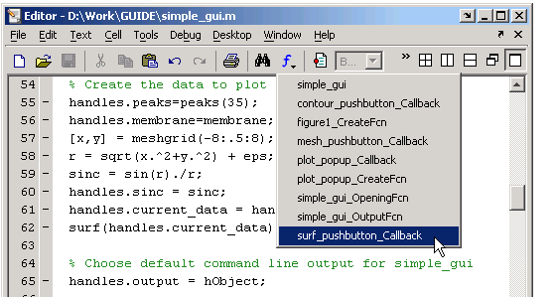
Callbacks
When the GUI is completed and running, and a user clicks a user interface control, such as a push button, MATLAB executes the callback specified by the component's Callback property.

Slide 18
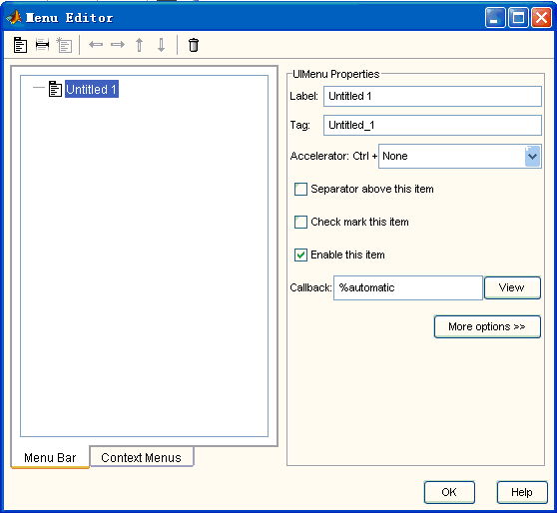
Menu editor

Slide 19
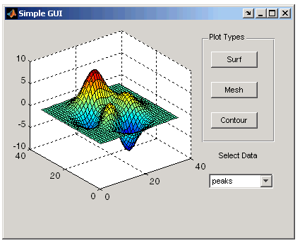
Examples
Simple Examples
Creating a GUI
An Animated Demo of Creating a GUI
Displaying an Image on an Axes
Passing Data Between Callbacks
Using the Modal Dialog to Confirm an Operation
Displaying an Image on an Axes

Slide 20
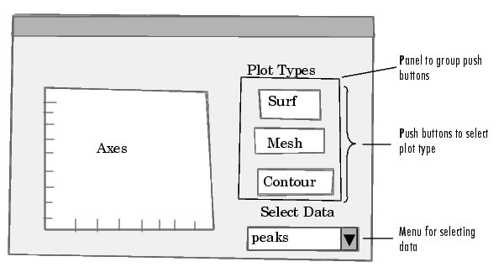
Step by Step
Step 1: Designing the GUI
The GUI used in this example contains an axes that displays either a surface, mesh, or contour plot of data selected from the pop-up menu. The following picture shows a sketch that you might use as a starting point for the design.

Slide 21
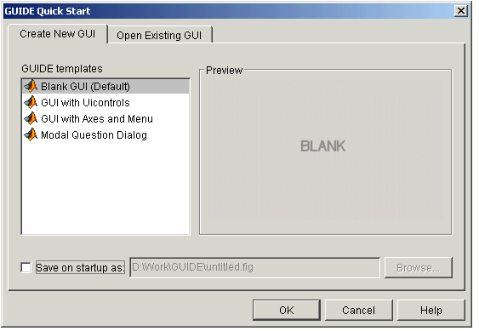
Step 2: Open a New GUI in the Layout Editor
Open GUIDE by typing guide at the MATLAB prompt. This displays the Guide Quick Start dialog shown in the following figure.

Slide 22
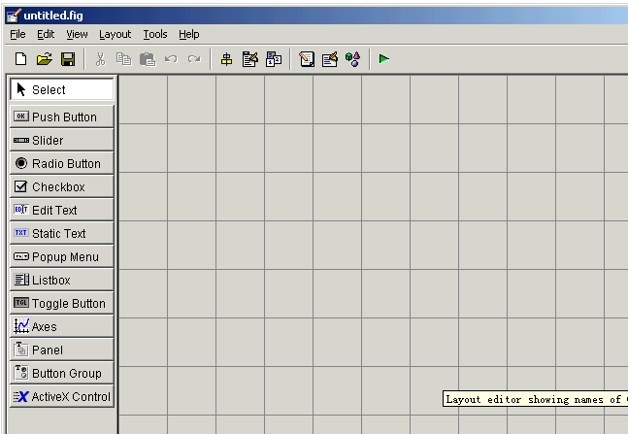
Preferences
To display the names of the GUI components in the component palette, select Preferences from the File menu, check the box next to Show names in component palette, and click OK. The Layout Editor then appears as shown in the following figure

Slide 23
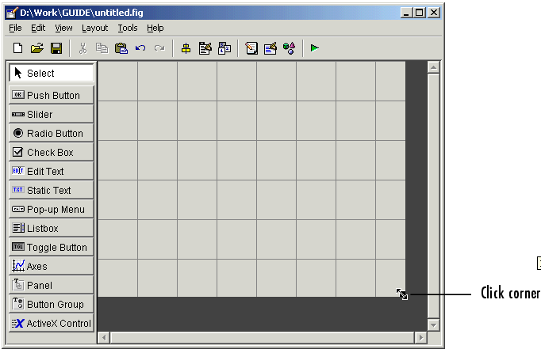
Set the GUI Figure Size

Slide 24
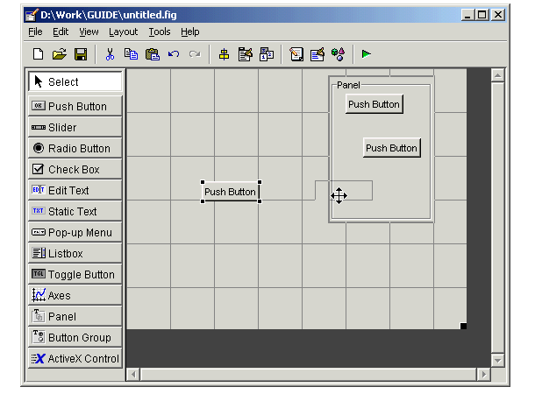
Add the Components
Add the panel and push buttons to the GUI. Select the following components from the component palette and drag them into the layout area: A panel Three push buttons
Select the panel and move it to where it appears in the original sketch. Resize the panel to approximately 1-by-1.5 inches by selecting it with the mouse, and then clicking and dragging the lower-left corner. Now, move the three push buttons into the panel. As you move each push button into the panel, GUIDE highlights the panel to indicate that the panel is the potential parent of the push button. The following figure shows the highlight.

Slide 25
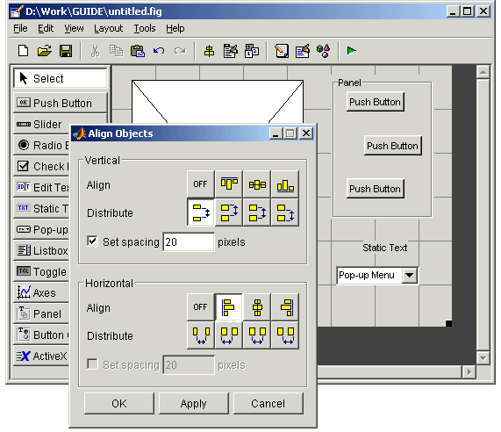
Align the Components
You can use the Alignment Tool to align components with respect to one another if they have the same parent.
For example, to align the three push buttons:
Select all three push buttons by pressing Ctrl and clicking them.
Select Align Objects from the Tools menu to display the Alignment Tool.
Make the following settings in the Alignment Tool, as shown in the following figure: 20 pixels spacing between push buttons in the vertical direction.
Left-aligned in the horizontal direction. Click OK.

Slide 26
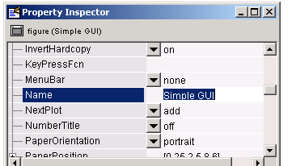
Step 3: Setting Properties for GUI Components
Name Property

Slide 27
Title Property
A panel's Title property controls the title that appears at the top or bottom of the panel. Select the panel in the Layout Editor and then scroll down in the Property Inspector until you come to Title. In the field to the right of Title, change Panel to Plot Types. Use the TitlePosition property to control the position of the title.

Slide 28
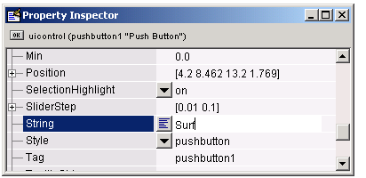
String Property for Push Buttons and Static Text

Slide 29
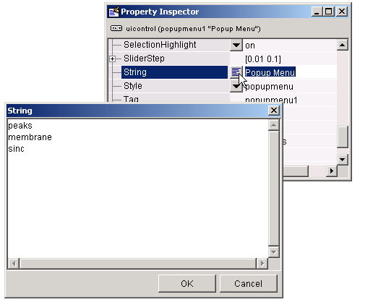
String Property for Pop-Up Menus

Slide 30
Callback Properties
Components use callbacks to do their work. A callback is a function that executes when a user performs a specific action such as clicking a push button, selecting a menu item, or pressing a keyboard key, or when a component is created or deleted.
Each component and menu item has properties that specify its callbacks. When you create a GUI, you must program the callbacks you need to control operation of the GUI.
A component can have many callback properties, but the most common one is the Callback property. The code you provide for the Callback property performs the primary work of the component. It executes, for example, when a user presses a push button, moves a slider, or selects a menu item.

Slide 31
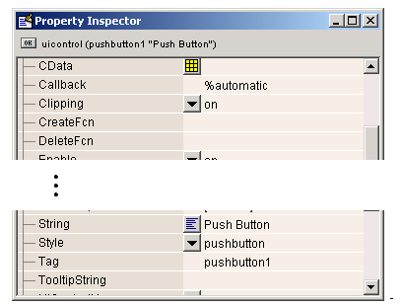
The Tag Property
The Tag property provides a string as a unique identifier for each component. GUIDE uses this identifier to construct unique callback names for the different components in the GUI.
When you first add a component to a layout, GUIDE sets the value of Tag to a default string such as pushbutton1. If the component has a Callback property, GUIDE also sets the value of Callback to the string %automatic.

Slide 32
Step 4: Programming the GUI
After laying out the GUI and setting component properties, the next step is to program it.
Creating the GUI M-File
Opening the GUI M-File
Sharing Data Between Callbacks
Adding Code to the Opening Function
Adding Code to the Callbacks
Using the Object Browser to Identify Callbacks

Slide 33
Creating the GUI M-File
When you first save or run the GUI, GUIDE generates a function M-file that contains the most commonly used callbacks for each component. It also contains some initialization code, an opening function callback, and an output function callback. Each callback is a subfunction that initially consists of a framework that contains just a function definition. You must add code to the callbacks to make them work.
You can save a GUI by selecting Save or Save as from the File menu, or by clicking the Save icon on the toolbar. You can run the GUI by selecting Run from the Tools menu or by clicking the Run icon on the toolbar.
After GUIDE generates the M-file, it opens the Save GUI as dialog. Type a name in the File name field. GUIDE assigns the same name to FIG-file and the M-file. When you click Save, GUIDE saves the M-file and opens it in the M-file Editor. If you are building the GUI in this example, use the filename simple_gui.

Slide 34
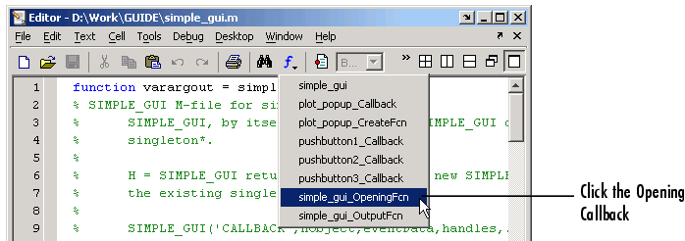
Opening the GUI M-File
Once GUIDE has created the M-file, you can open it in the MATLAB editor by clicking the M-file Editor icon on the toolbar.
In the editor, you can move the cursor to a specific callback by clicking the function icon on the toolbar, then selecting the callback you want in the pop-up menu that displays.

Slide 35
Sharing Data Between Callbacks
You can share data between callbacks by storing the data in the MATLAB handles structure. All components in a GUI share the same handles structure. It is passed as an input argument to all callbacks generated by GUIDE.
For example, to store data contained in vector X in the handles structure, you Choose a name for the field of the handles structure where you want to store the data, for example, handles.my_data Add the field to the handles structure and set it equal to X with the following statement:
handles.my_data = X;
Save the handles structure with the guidata function:
guidata(hObject,handles)

Slide 36
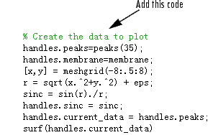
Adding Code to the Opening Function
The opening function is the first callback in every GUI M-file. You can use it to perform tasks that need to be done before the user has access to the GUI, for example, to create data or to read data from an external source.The code in the opening function is executed just before the GUI is made visible to the user, but after all the components have been created.
In this example, you add code that creates three data sets in the opening function, using the MATLAB functions peaks, membrane, and sinc.

Slide 37
Adding Code
The first six executable lines create the data using the MATLAB functions peaks, membrane and sinc to generate the data.
The next line, handles.current_data = handles.peaks, sets the current_data field of the handles structure equal to the data for peaks.
The last line displays the surf plot for peaks, which appears when the GUI is first opened.

Slide 38
Step 5: Adding Code to the Callbacks
When the GUI is completed and running, and a user clicks a user interface control, such as a push button, MATLAB executes the callback specified by the component's Callback property. In the example, the name of the Surf push button callback is surf_pushbutton_Callback. For information about the naming of callbacks see The Tag Property.
Each of the push buttons creates a different type of plot using the data specified by the current selection in the pop-up menu. Their callbacks get data from the handles structure and then plot it. To add code to the surf push button callback, click surf_pushbutton_Callback in the callback pop-up menu.

Slide 39
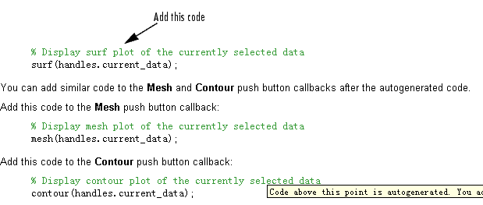
Surf push button callback
Add the code after the comments following the function definition, as shown below: Surf push button callback:

Slide 40
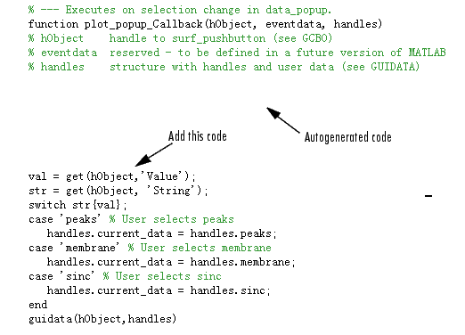
Pop-up Menu Callback
The pop-up menu enables users to select the data to plot. Every time a user selects one of the three plots, the pop-up menu callback reads the pop-up menu Value property to determine what item is currently displayed and sets handles.current_data accordingly. Add the following code to the plot_popup_Callback after the comments following the function definition.

Slide 41
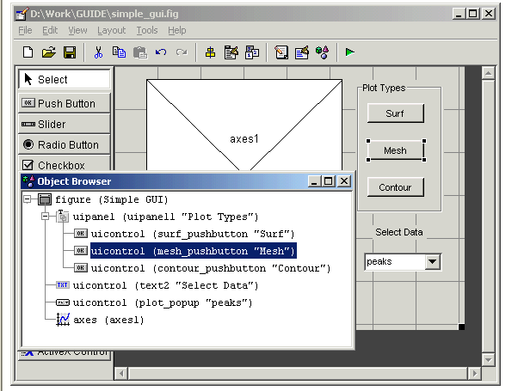
Step 6: Using the Object Browser to Identify Callbacks
In this example, it is easy to keep track of the GUI component that corresponds to each callback. But in a more complicated GUI, keeping track of callbacks can be more difficult. To identify the component corresponding to a callback, select Object Browser from the View menu in the Layout Editor or by clicking the Object Browser icon on the toolbar
The Object Browser lists the tag and string properties of each component of the GUI. Selecting the name of a component in the list also selects the component in the Layout Editor.

Slide 42
Finally
Testing the GUI

Slide 43
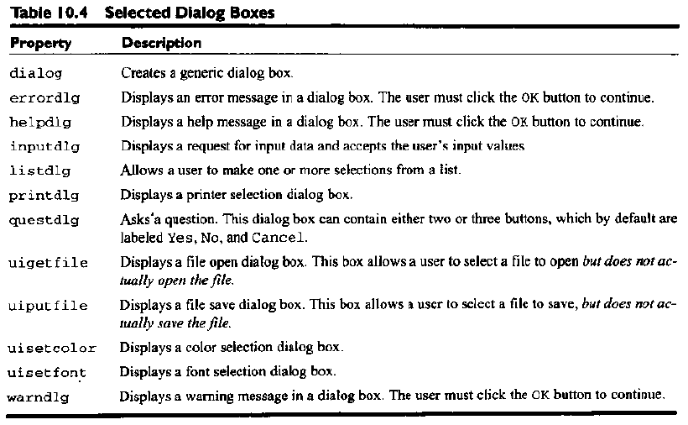
Dialog boxes

Slide 44
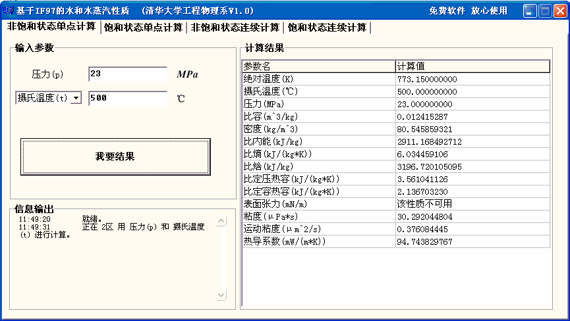
Homework
Review the text from page 391 to 447.
Exercises 10.1 to 10.13
Finish your own IF97 software.

