Slide 1
Look and Think Twice: Capturing Top-Down Visual Attention
with Feedback Convolutional Neural Networks
Chunshui Cao , Xianming Liu ,Yi Yang ,
Yinan Yu, Jiang Wang ,Zilei Wang,Yongzhen Huang ,Liang Wang , Chang Huang, Wei Xu ,Deva Ramanan ,Thomas S. Huang

Slide 2
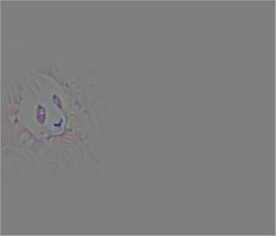
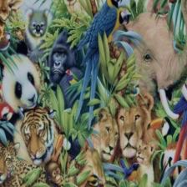
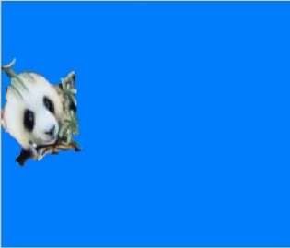
Motivation
In human’s brain, visual attention typically is dominated by “goals” from our mind easily in a top-down manner, especially in the case of object detection or attention. Cognitive science explains this in the “Biased Competition Theory” , that human visual cortex is enhanced by top-down stimuli and non-relevant neurons will be suppressed in feedback loops.
The states of relu and max pooling dominate everything. But for most of popular convolutional neural networks, the states of relu and max pooling are determined only by the input .
“PANDA”
Feedback Neural Networks

Slide 3
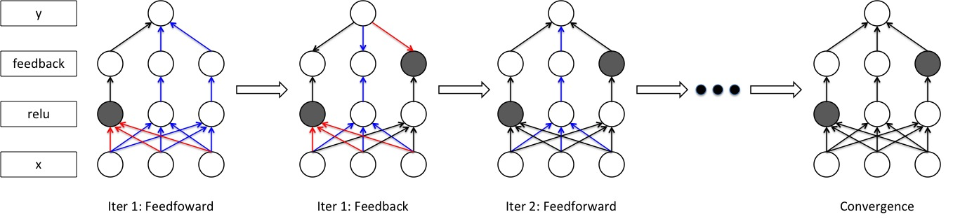
The iterative process
At the first iteration, the model performs as a feedforward neural net.
Then, the neurons in the feedback hidden layers update their activation status to maximize the confidence output of the target top neuron.
This process continues until convergence

Slide 4
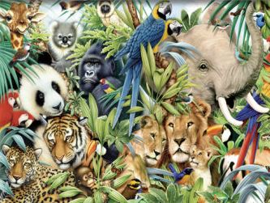
The iterative process demo
input
panda

Slide 5
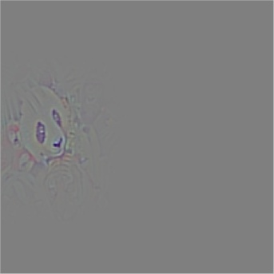
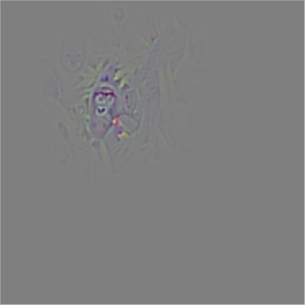
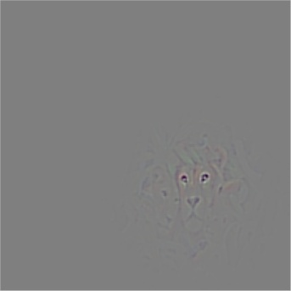
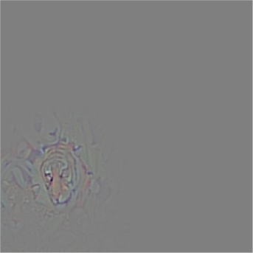
For different targets(googlenet)
input
panda
gorilla
lion
Tiger

Slide 6

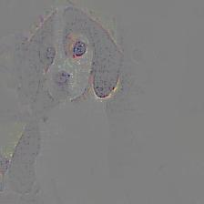
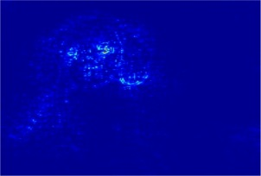
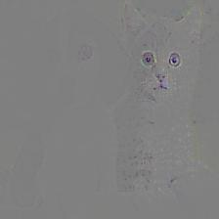
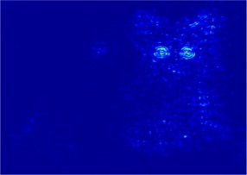
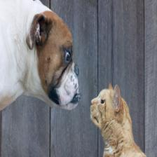
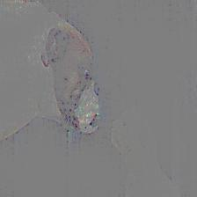
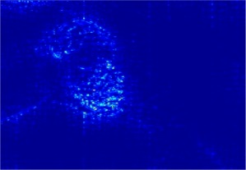
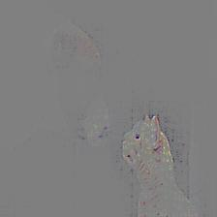
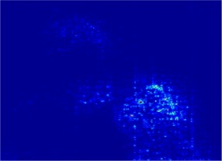
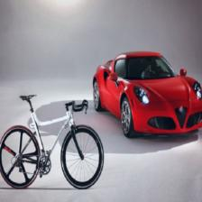
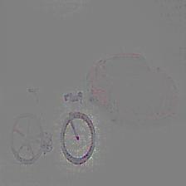
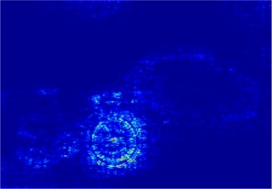
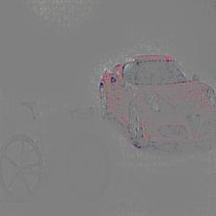
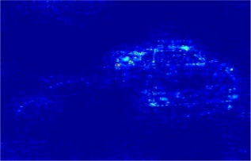
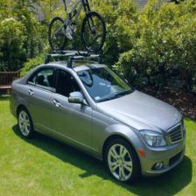
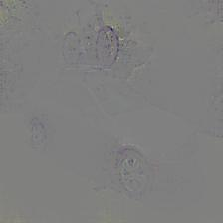
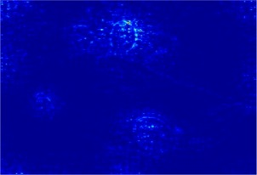
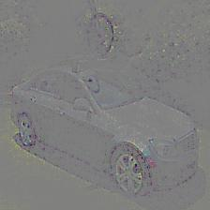
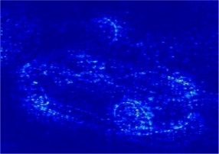
More visualization examples(vgg)

Slide 7
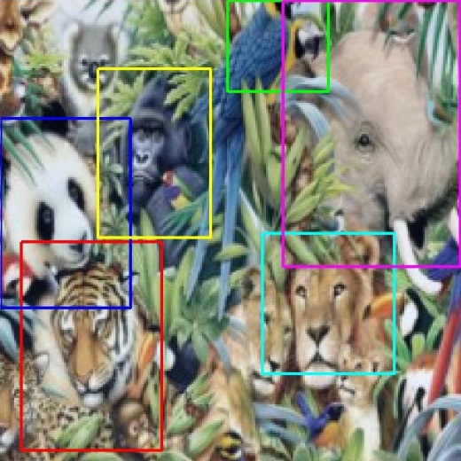
Weakly Supervised Object Localization
Method | Localization Error (%)
Oxford | 44.6
Feedback(ours’) | 38.8
Comparison of our weakly supervised localization results
on ImageNet 2014 validation set with the simplified testing protocol:
the bounding box is predicted from a single central crop of
images and the ground truth labels are provided. We show that
our feedback method significant outperforms the baseline method
(error rate 44.6%) that uses the original image gradient to localize
, both on GoogLeNet architecture.

Slide 8
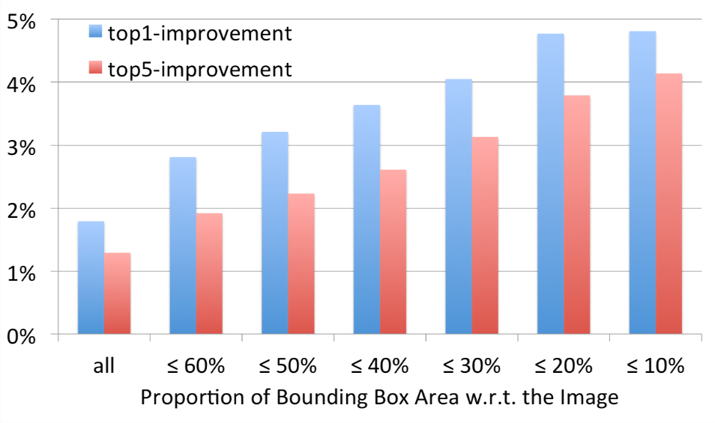
Image Re-Classification with Attention
Method | Top 1 (%) | Top 5 (%)
GoogleNet | 32.28 | 11.75
GoogleNet Feedback | 30.49 | 10.46
Classification errors on ImageNet 2014 validation set : the first row is the performance of GoogleNet given a single central crop of images, the second row shows classification results of the same GoogleNet given the attention cropped images.
We divide the ImageNet 2014 validation set based on the proportion of the object size in the image. Classification accruacy
using feedback crop for images increases with smaller objects.

Slide 9
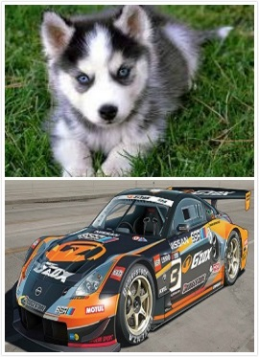
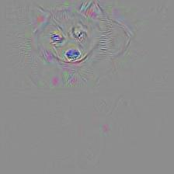
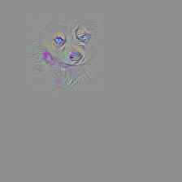
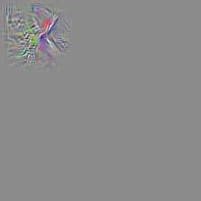
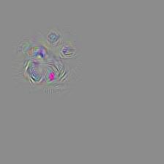
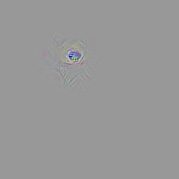
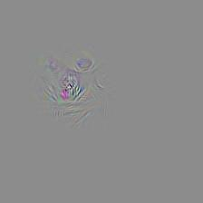
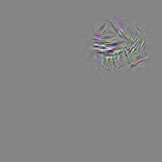
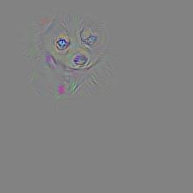
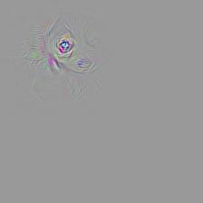
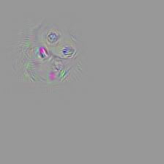

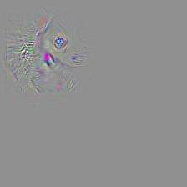
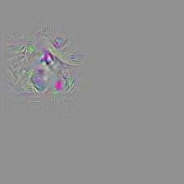
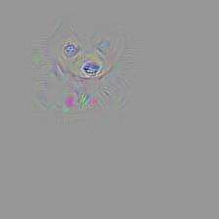
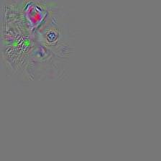
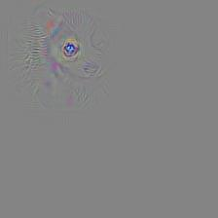
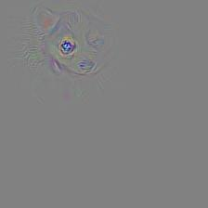
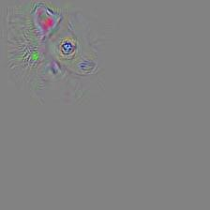
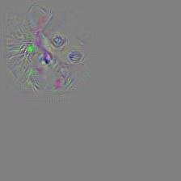
Visualization of feedback neurons(alexnet)
conv3
Notes:
1.Feedback for husky.
2.Visualize the remaining neurons of conv3,conv4,
conv5. The showing images are corresponding to neurons picked from top30 activations of each layer.
conv4
conv5

Slide 10
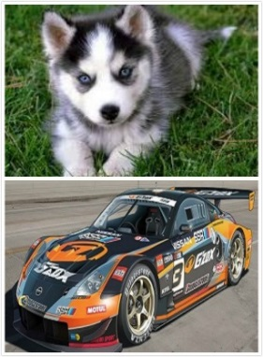



















Visualization of feedback neurons(alexnet)
conv3
Notes:
1.Feedback for race car.
2.Visualize the remaining neurons of conv3,conv4,
conv5. The showing images are corresponding to neurons picked from top30 activations of each layer.
conv4
conv5

