Slide 1
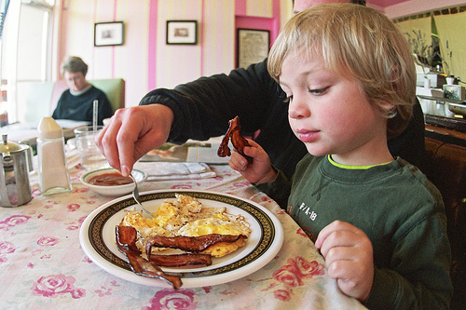
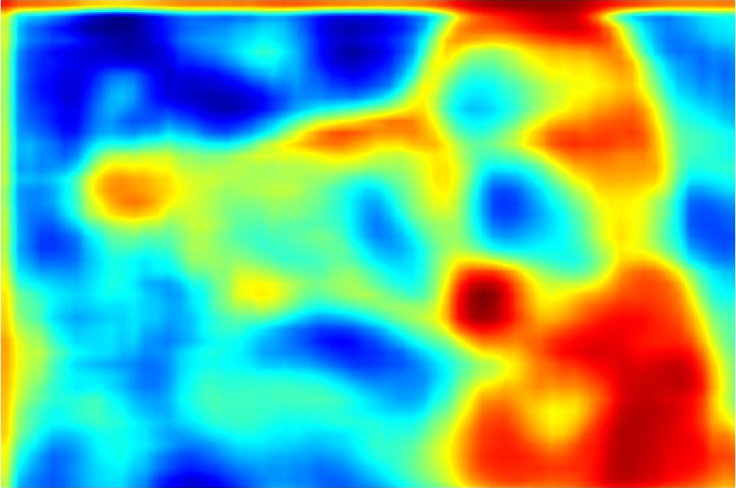
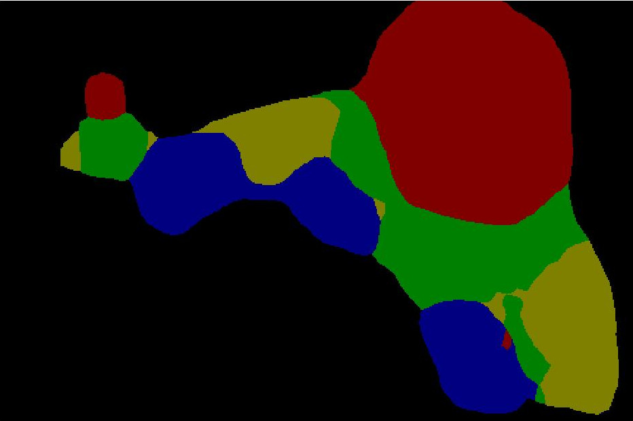
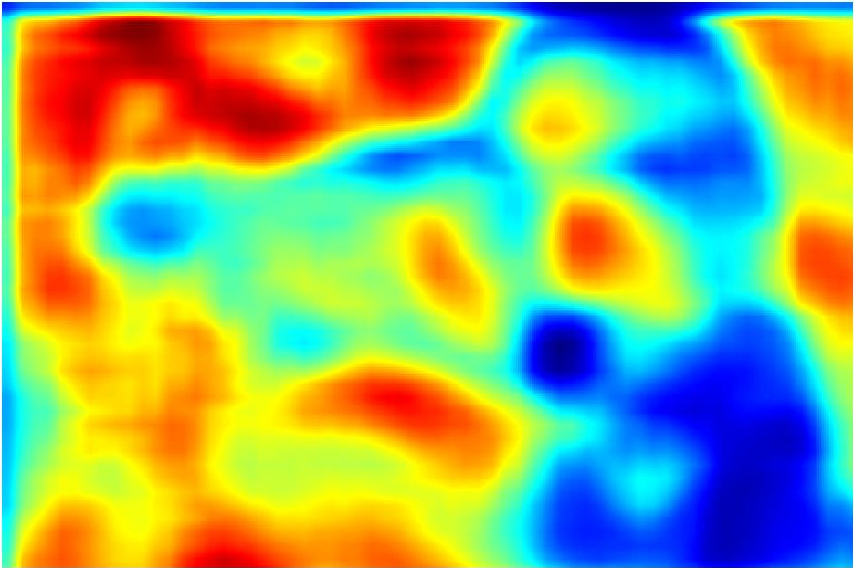
Image with scale = 0.5
Deep Convolutional
Neural Network
Score Map
x
Result
Attention to Scale
Attention
Model
+
Image with scale = 1
Deep Convolutional
Neural Network
Score Map
x

Slide 2
Image with scale = 0.5
Deep Convolutional
Neural Network
Score Map
x
Result
Attention to Scale
Attention
Model
+
Image with scale = 1
Deep Convolutional
Neural Network
Score Map
x

Slide 3
Result
x
+
x
Score
Map
Score
Map
DCNN
Attention
Model
DCNN
Attention to Scale
Image with
scale = 0.5
Image with
scale = 1

Slide 4
GT
GT
GT
GT
Output
Output
Output
Output
x
+
x
x
+
x
Pool
Attention
GT
Pool
GT
GT
Attention
GT
DCNN
DCNN
DCNN
DCNN
DCNN
DCNN
DCNN
DCNN
Multi-scale Inputs
Multi-scale Inputs
Multi-scale Inputs
Multi-scale Inputs

Slide 5
DCNN
DCNN
x
Multi-scale
Inputs
Attention
+
Output
GT
DCNN
x
GT
DCNN
DCNN
x
Multi-scale
Inputs
Attention
+
Output
GT
DCNN
x
GT

Slide 6
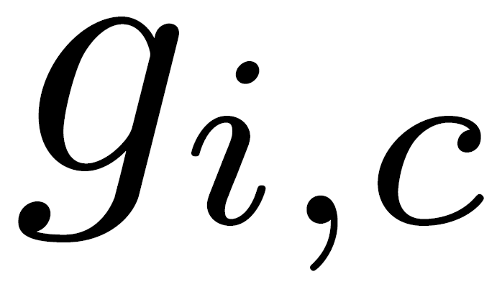
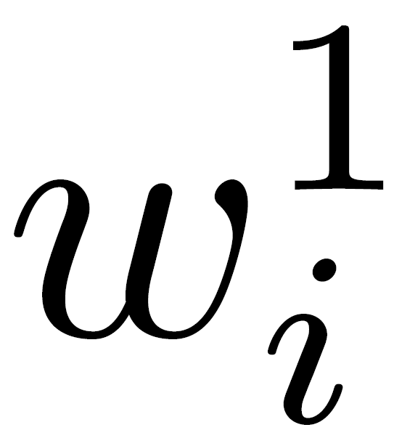
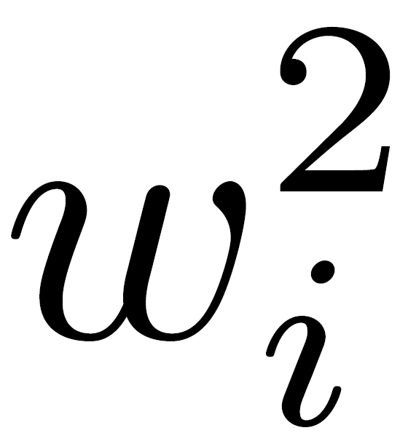
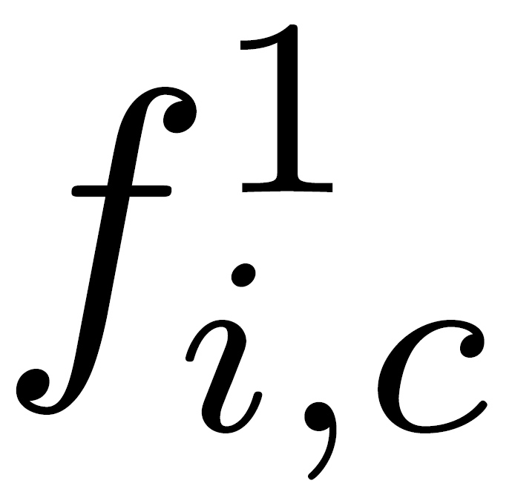
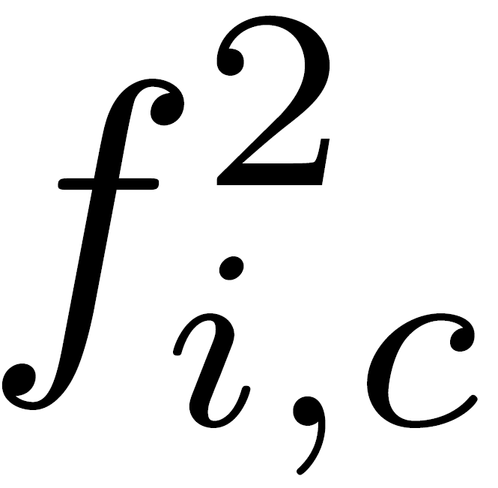
SoftMax
Output
Score
Merge
two
scales
Score
Score
C {
C {
DCNN
DCNN
Input
Input

Slide 7
SoftMax
Output
Score
Merge
two scales
Score
Score
C {
C {
FCN
FCN
Input
Scale 1
Input
Scale 2

Slide 8
Weight
Weight
Split for two scales
Weight Maps
S {
DCNN
Attention
DCNN
Input
Input

Slide 9
Weight
Weight
Split for two scales
Weight Maps
S {
FCN
Attention
FCN
Input
Scale 1
Input
Scale 2

Slide 10
Weight
Weight
Split for two scales
DCNN
Weight
Maps
DCNN
Attention
DCNN
Input
Scale 1
Input
Scale 2

Slide 11
Output
Output
Concatenated Features
Layer M
Layer M
Layer M
Layer M
.
.
.
Share
Weights
.
.
.
Share
Weights
.
.
.
.
.
.
Layer 3
Layer 3
Layer 3
Layer 3
Layer 2
Layer 2
Layer 2
Layer 2
Layer 1
Layer 1
Layer 1
Layer 1
Input
Scale 1
Input
Scale 2
Input
Input
Scale 3

Slide 12
Output
Output
Concatenated Features
Layer M
Layer M
Layer M
Layer M
.
.
.
Share
Weights
.
.
.
Share
Weights
.
.
.
.
.
.
Layer 3
Layer 3
Layer 3
Layer 3
Layer 2
Layer 2
Layer 2
Layer 2
Layer 1
Layer 1
Layer 1
Layer 1
Input
Scale 1
Input
Scale 2
Input
Scale 3
Input

Slide 13
Output
Output
Concatenated Features
Layer M
Layer M
.
.
.
.
.
.
Layer 3
Layer 3
Layer 2
Layer 2
Layer 1
Layer 1
Input
Scale 1
Input
Scale 2
Input
Input
Scale 3

Slide 14
Head
Torso
Upper Arms
Lower Arms
Upper Legs
Lower Legs

