Slide 1
Description of new version Logic
2020.5.23

Slide 2
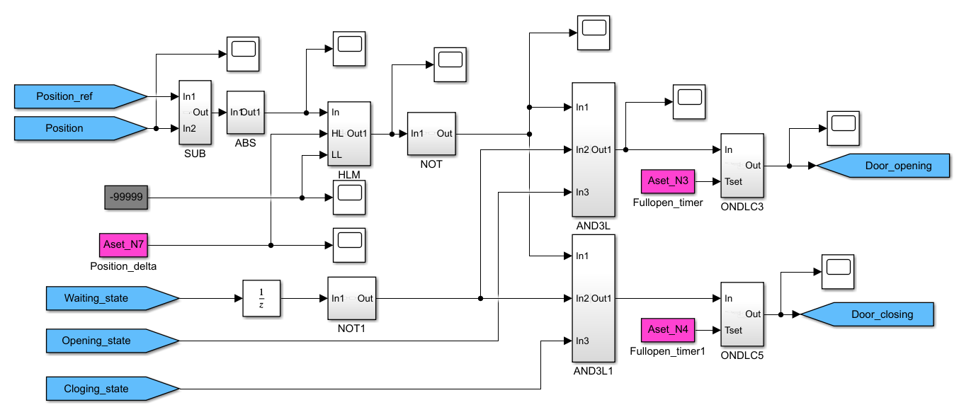

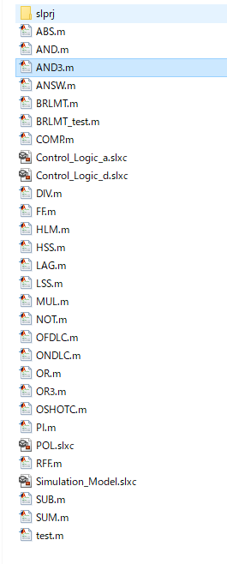

Description
MHI replaced Logic element (POL) with interpreted matlab function block.
All same type element refer to common m-file.
Attention !!
・Please use “Control_Logic_d.slx”
・Run the “main.m” before start simulation to read workspace.
・Interpreted MATLAB Fcn require Input Data type “double”.
・20200522ver and 20200523ver are not same m-file
because I add to script to transfer Data type.
・You need to change today’s m-file.

Slide 3
Result Image for the experiment of CGF
Investigation of CGF characteristics (especially weakness) with experiments.
MHI expects following result from TU.
Scenario 1
Coverage(C1)[%]
case3
90%
We can say “symbolic execution and taint analysis seems to increase coverage because these method in highly efficient test case mutations.” if we get such a result.
case1
84%
case2
86%
Iteration=1000
Iteration
=100000
Iteration=10
2min
100min
Testcase generation time[min]
Scenario 2
Coverage(C1)[%]
We can say “CGF can’t cover all coverage of MHI’s logic. Because・・・” we should investigate uncovered branch.
if we get such a result(no change coverage).
Iteration
=100000
84%
84%
Iteration=1000
84%
Iteration=10
2min
100min
Testcase generation time[min]

Slide 4
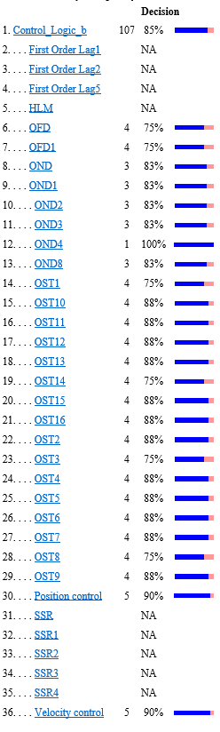

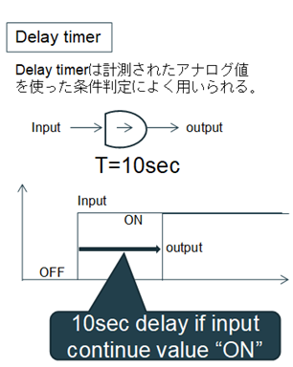
Result Image for the experiment of CGF
In addition to the HTML file, I want the following report.
MHI think investigation of uncovered result is very important to consider next step.
MHI considered logic structure to discuss when built benchmark logic.
case1
case2
case3
case4
We can see what logic CGF can't cover.
For example OND is not
enough coverage
If we check the uncovered element “OND”.
OND is on-delay timer output ON signal if input signal continue ON untill set time.
CGF can’t change candidate signal higher than set time.
This is weakness of CGF.
And we can say taint analysis
increase coverage.

