Slide 1
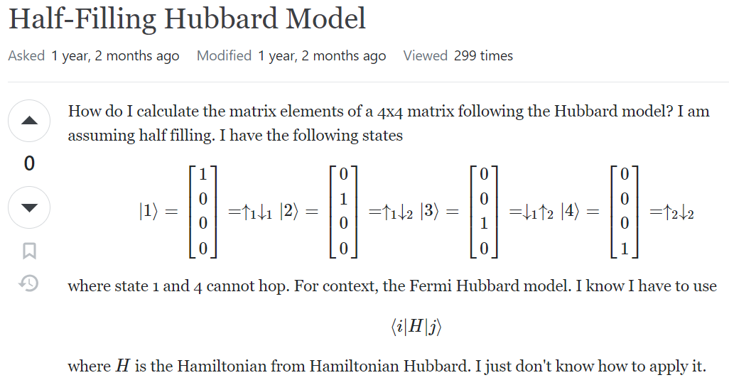
https://physics.stackexchange.com/questions/712197/half-filling-hubbard-model

Slide 2
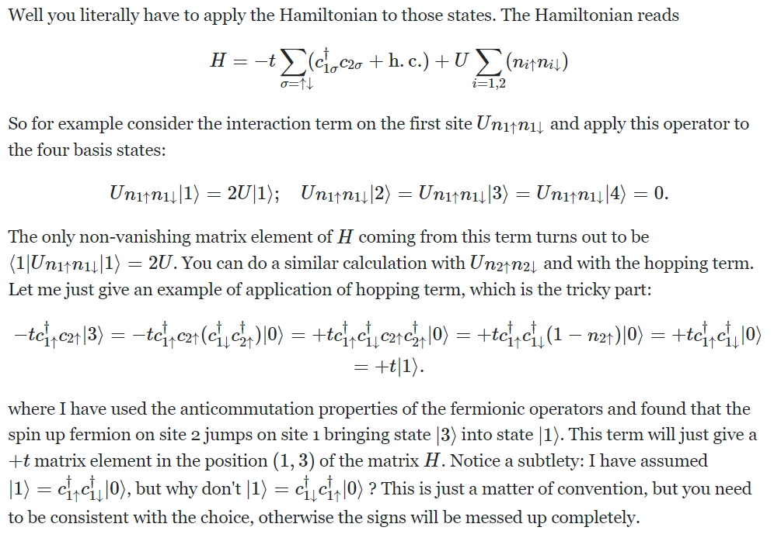

Slide 4
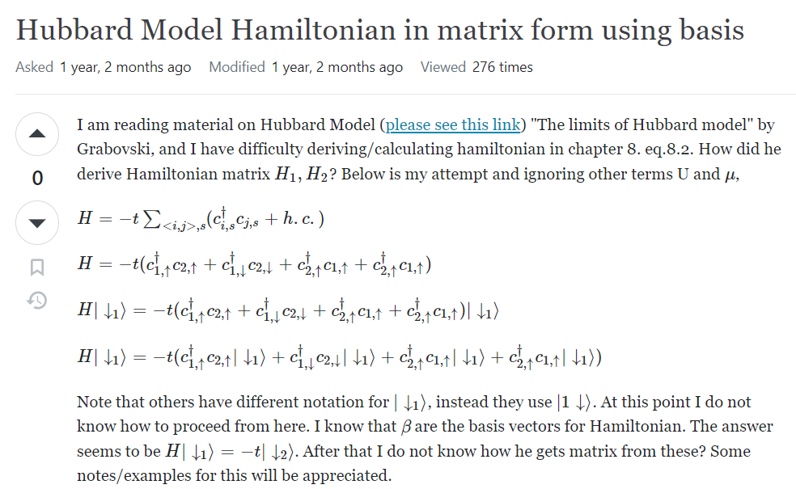
https://physics.stackexchange.com/questions/710849/hubbard-model-hamiltonian-in-matrix-form-using-basis?rq=1

Slide 5
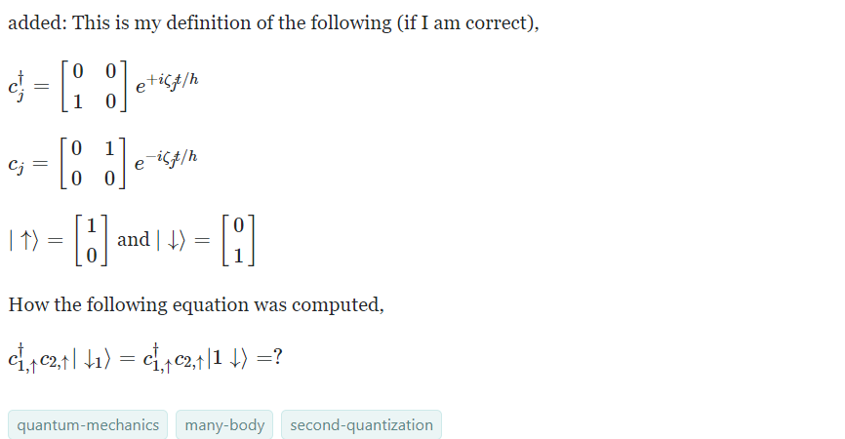

Slide 6
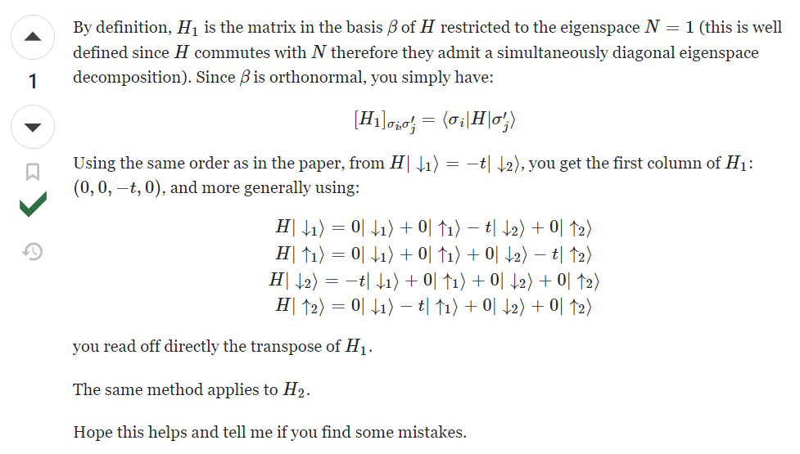

Slide 7
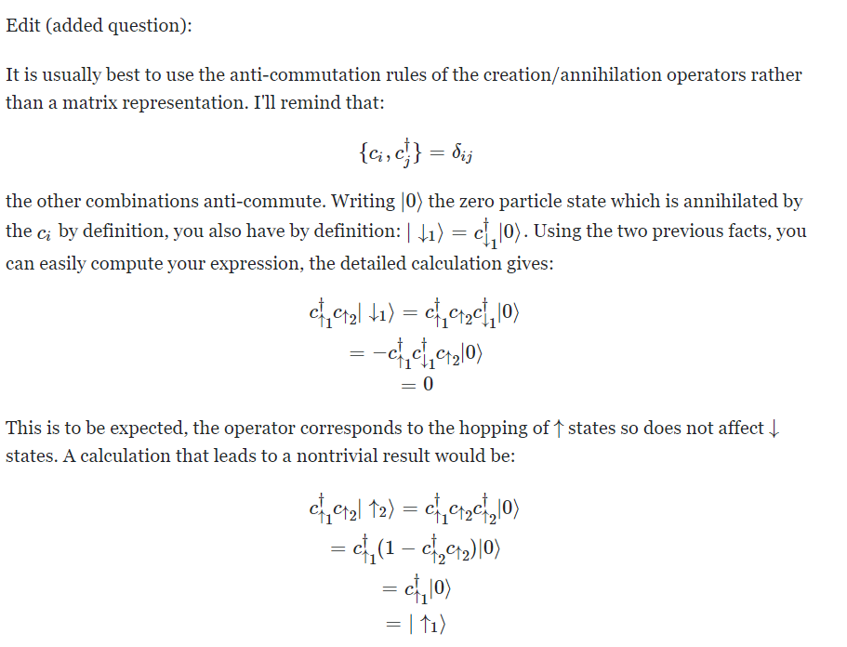

Slide 9
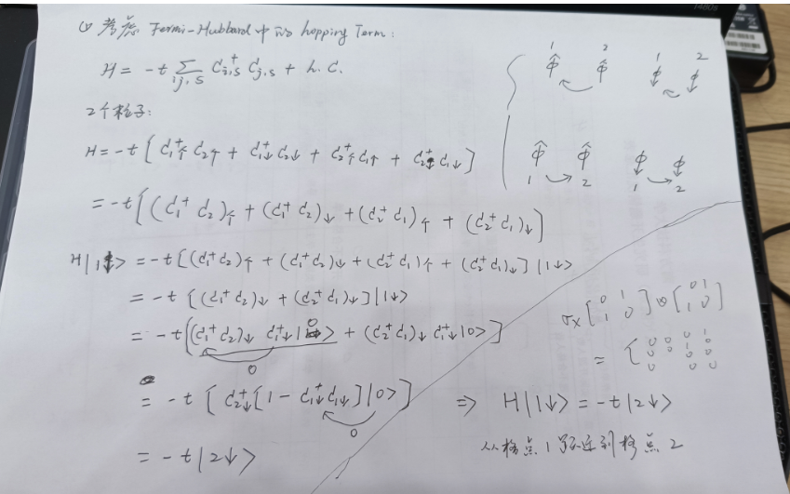

Slide 10
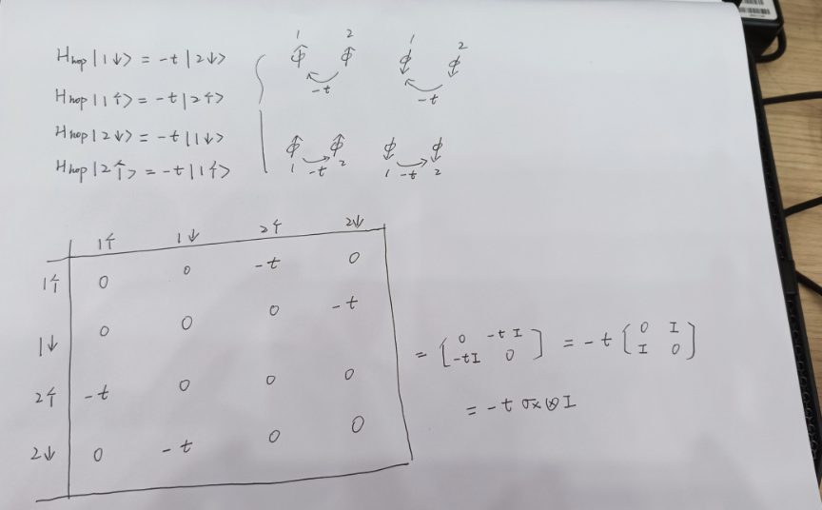

Slide 11
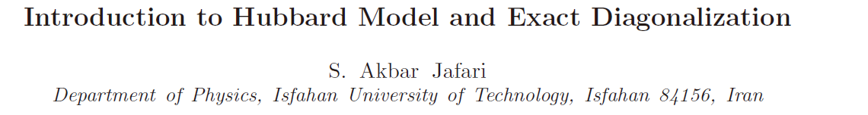

Slide 12
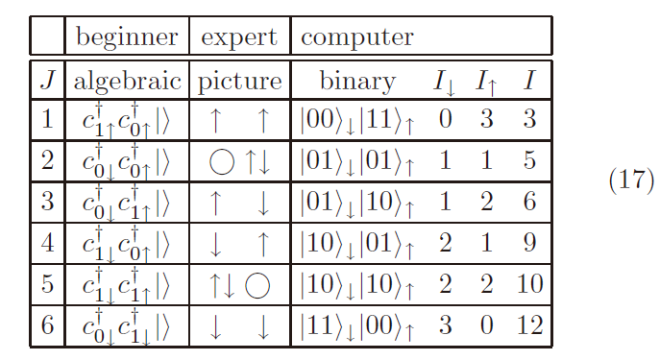
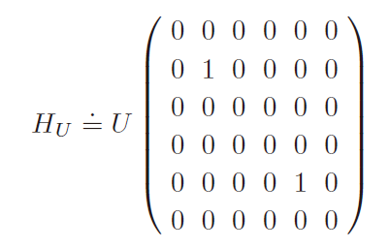
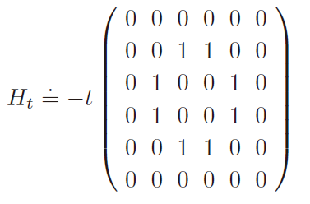
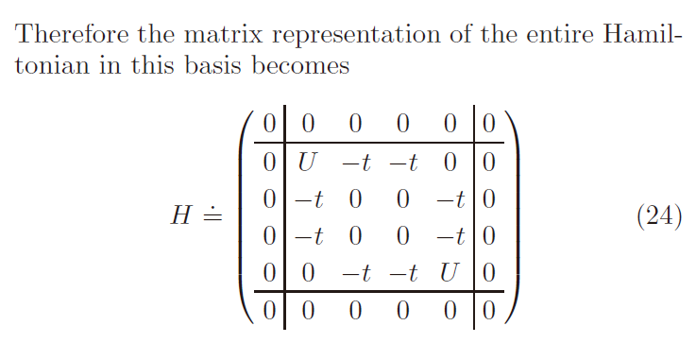
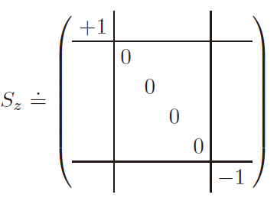

Slide 13
http://quspin.github.io/QuSpin/examples/example13.html#example13-label

Slide 14
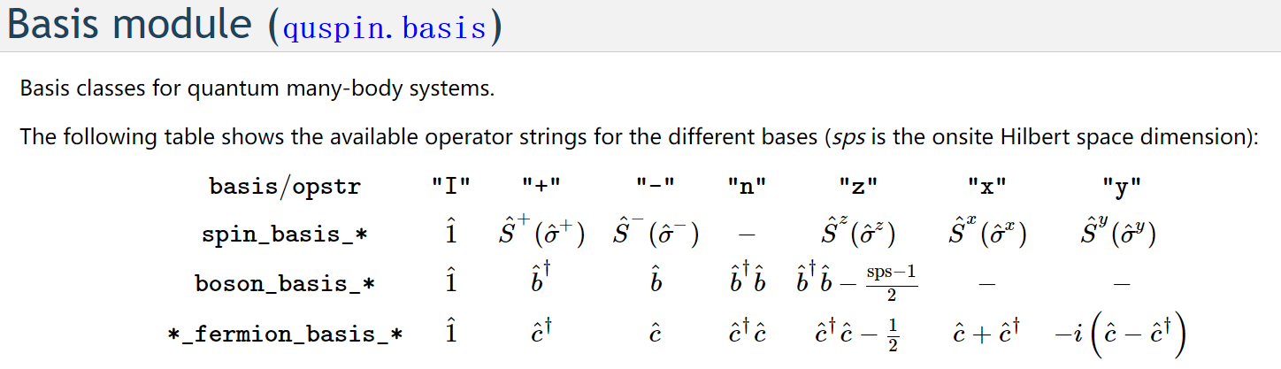

Slide 15
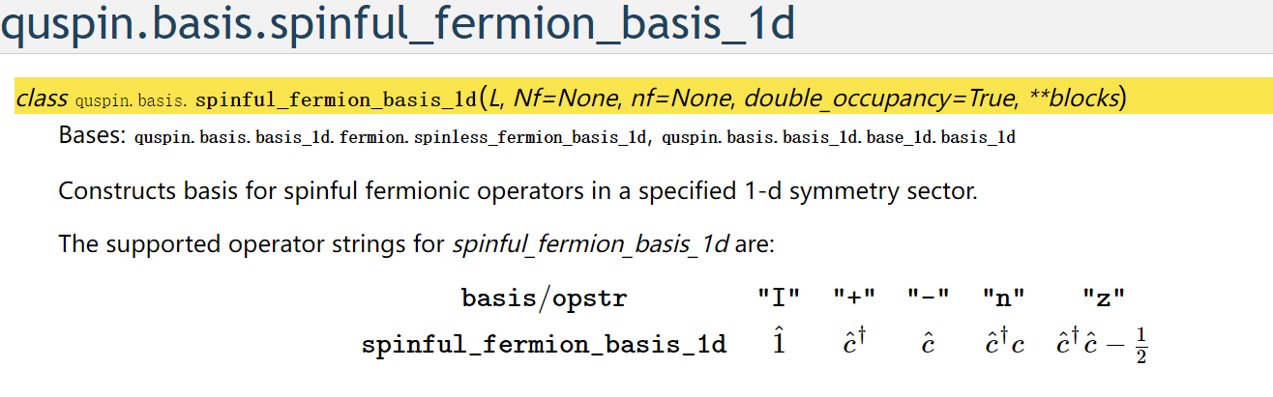
http://quspin.github.io/QuSpin/generated/quspin.basis.spinful_fermion_basis_1d.html#quspin.basis.spinful_fermion_basis_1d

Slide 16
