Slide 1
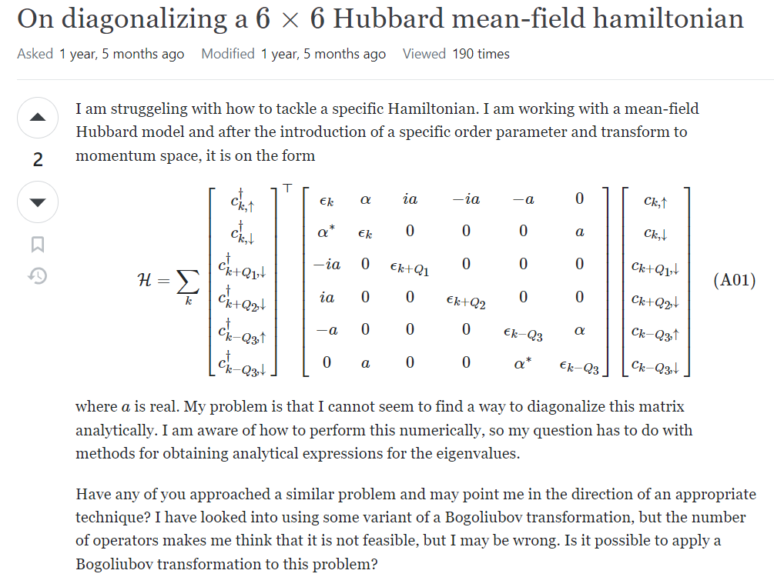
https://physics.stackexchange.com/questions/697108/on-diagonalizing-a-6-times-6-hubbard-mean-field-hamiltonian?rq=1

