Slide 1
PetShop架构分析

Slide 2
目录
PetShop概述
PetShop数据层 （ADO.NET技术)
PetShop中间层 （.NET的业务组件）
PetShop表现层 (ASP.NET技术）
PetShop安全设计
PetShop性能优化
PetShop性能测试

Slide 3
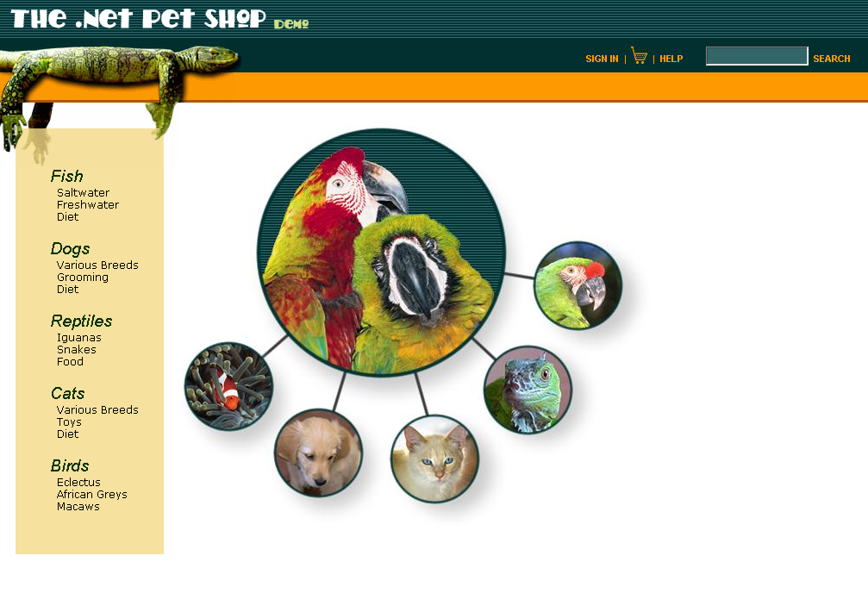
Notes:
在过去的几年中，Sun Microsystem 和Microsoft 分别在J2EE 和.NET 两个企业应用
框架的基础上，不断的改进自己的关于在线宠物销售的参考应用程序。因此，Pet Shop
成为在J2EE 和.NET 程序员们中，最为熟悉的应用问题域和系统实现。部分基于.NET 的新商
业应用程序的开发都参考，甚至重用了Pet Shop 的构架。

Slide 4
宠物商店想要什么？
商业问题陈述
  某宠物店希望拓展其业务，但不想开设其他的分店。因此，某宠物店希望使用Internet来作为一种新的销售和市场工具，来面向全美市场进行在线销售。为此，启动了一个在线宠物商店（My Pet Shop）项目来为美国国内的Internet用户提供服务。
商业目标
  在下一年度增加销售利润
  不明显增加运营费用
技术目标
  集成宠物店目前使用的销售系统
  使用目前可靠存在的、使用成本低的技术
Notes:
My Pet Shop 商业问题陈述
我们都知道需求分析的重要性，就是要了解客户到底要什么，要做到什么程度。
某宠物店希望拓展其业务，但不想开设其他的分店。因此，某宠物店希望使用
Internet来作为一种新的销售和市场工具，来面向全美市场进行在线销售。为此，启动了一个在线宠物
商店（My Pet Shop）项目来为美国国内的Internet用户提供服务
请注意表面上很普通的这一段商业问题的描述，我们可以清晰的发现如下My Pet Shop定位：
• Internet销售和市场工具
• 客户定位：面向全美市场
• 主要目标：增加利润
这些关键点，对于我们今后的需求分析和设计都是非常重要的
例如：面向全美市场而不是全球市场，可以看到我们的项目不需要考虑国际化。

Slide 5
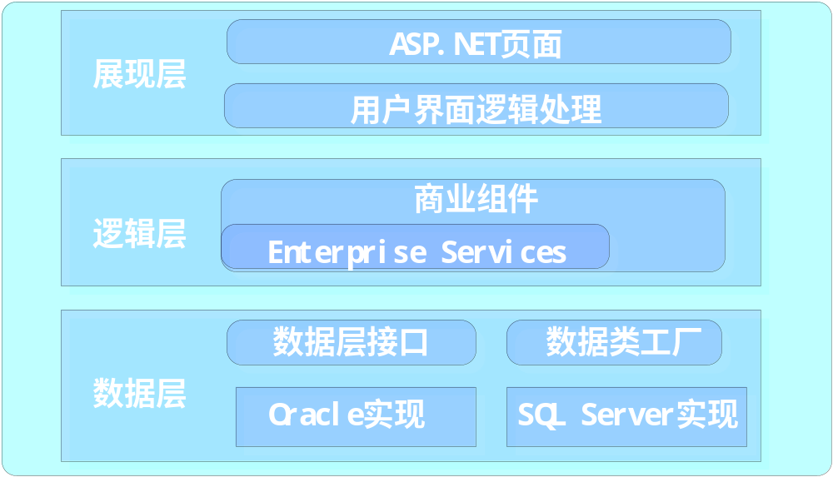
PetShop逻辑架构
Account & Product
Orders
Notes:
PetShop总的逻辑架构分为三层，如上图所示。
在设计上，ASP.NET Web窗体被用来创建展现层，并与中间逻辑层的C#商业组件相通讯。而商业组件通过ADO.NET和SQL Server工具包（即所谓的DAAB Data Access Application Block）进行数据交互。数据存取功能被完全抽象成一个数据存取层，与商业逻辑层完全分离。在这里我们描述了一个数据存取层接口和一个数据存取层工厂，通过简单的在Web.config中进行配置，相应的数据存取层类将在运行时刻动态地被加载。而且，PetShop使用了两个后端数据库，订单流程涉及两个数据库之间的分布式交易。分布式交易由.NET 服务组件使用COM+企业服务来完成。
The overall logical architecture of the .NET Pet Shop is given in Figure 3. The main focus of the design was to use ASP.NET Web Forms for the presentation tier which communicate to C# business components in a logical middle tier. In turn the business components access a back end database through ADO.NET and a SQL Server helper class known as the Data Access Application Block (DAAB) for more information on the DAAB and to download the full DAAB source code. Data Access is fully abstracted into a Data Access Layer (DAL), separate from the business logic layer (BLL). New with the .NET Pet Shop 3.0, we have introduced a DAL layer for both Oracle 9i and SQL Server 2000 databases. Class loading of the appropriate DAL layer occurs dynamically at runtime based on an application configuration setting in Web.Config. Note that .NET Pet Shop 3.0 uses two backend databases, and the order process involves a distributed transaction across these two databases. Using simple Web.Config application settings, users can deploy the .Net Pet Shop to work with single or multiple backend databases, and can freely mix SQL Server and Oracle backend databases with the distributed transaction handled by .NET Serviced Components using COM+ Enterprise Services.

Slide 6
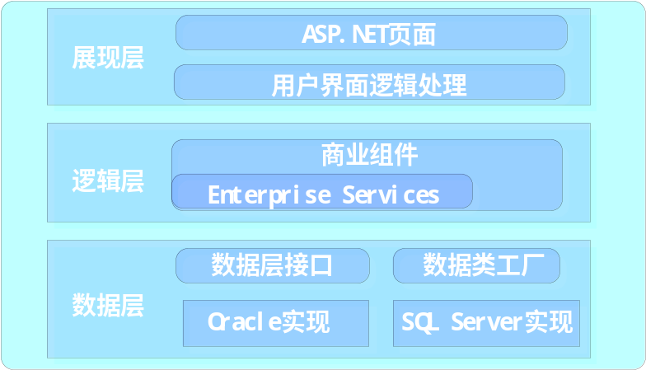
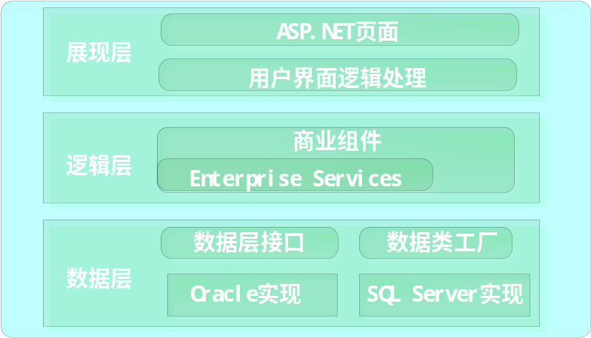
PetShop物理部署
网络负载平衡 NLB
Account & Product
Orders
Notes:
PetShop总的逻辑架构分为三层，如上图所示。
在设计上，ASP.NET Web窗体被用来创建展现层，并与中间逻辑层的C#商业组件相通讯。而商业组件通过ADO.NET和SQL Server工具包（即所谓的DAAB Data Access Application Block）进行数据交互。数据存取功能被完全抽象成一个数据存取层，与商业逻辑层完全分离。在这里我们描述了一个数据存取层接口和一个数据存取层工厂，通过简单的在Web.config中进行配置，相应的数据存取层类将在运行时刻动态地被加载。而且，PetShop使用了两个后端数据库，订单流程涉及两个数据库之间的分布式交易。分布式交易由.NET 服务组件使用COM+企业服务来完成。
The overall logical architecture of the .NET Pet Shop is given in Figure 3. The main focus of the design was to use ASP.NET Web Forms for the presentation tier which communicate to C# business components in a logical middle tier. In turn the business components access a back end database through ADO.NET and a SQL Server helper class known as the Data Access Application Block (DAAB) for more information on the DAAB and to download the full DAAB source code. Data Access is fully abstracted into a Data Access Layer (DAL), separate from the business logic layer (BLL). New with the .NET Pet Shop 3.0, we have introduced a DAL layer for both Oracle 9i and SQL Server 2000 databases. Class loading of the appropriate DAL layer occurs dynamically at runtime based on an application configuration setting in Web.Config. Note that .NET Pet Shop 3.0 uses two backend databases, and the order process involves a distributed transaction across these two databases. Using simple Web.Config application settings, users can deploy the .Net Pet Shop to work with single or multiple backend databases, and can freely mix SQL Server and Oracle backend databases with the distributed transaction handled by .NET Serviced Components using COM+ Enterprise Services.

Slide 7



组件类型
Communication
Security
Operational Management
User Interface Components
User Process Components
Service Interfaces
Business
Workflows
Business
Components
Business
Entities
Data Access Logic
Components
Service Agents
Data Source
Service
Notes:
组件的分类
UI：例如windows窗体，asp.net窗体和控件等
UP：处理可预知的用户行为，不应该和界面代码紧密结合，否则不利移植和重用
WorkFlow: BizTalk
An examination of most business solutions based on a layered component model reveals several common component types. The slide shows these component types in one comprehensive illustration.
Note The term component is used in the sense of a piece or part of the overall solution. This includes compiled software components, such as Microsoft .NET assemblies, and other software artifacts such as Web pages and Microsoft® BizTalk® Server Orchestration schedules. Although the list of component types shown is not exhaustive, it represents the common kinds of software components found in most distributed solutions.
The component types identified in the sample scenario design are:
User interface (UI) components. Most solutions need to provide a way for users to interact with the application. In the retail application example, a Web site lets customers view products and submit orders, and an application based on the Microsoft Windows® operating system lets sales representatives enter order data for customers who have telephoned the company. User interfaces are implemented using Windows Forms, Microsoft ASP.NET pages, controls, or any other technology you use to render and format data for users and to acquire and validate data coming in from them.
User process components. In many cases, a user interaction with the system follows a predictable process. For example, in the retail application you could implement a procedure for viewing product data that has the user select a category from a list of available product categories and then select an individual product in the chosen category to view its details. Similarly, when the user makes a purchase, the interaction follows a predictable process of gathering data from the user, in which the user first supplies details of the products to be purchased, then provides payment details, and then enters delivery details. To help synchronize and orchestrate these user interactions, it can be useful to drive the process using separate user process components. This way the process flow and state management logic is not hard-coded in the user interface elements themselves, and the same basic user interaction "engine" can be reused by multiple user interfaces.
Business workflows. After the required data is collected by a user process, the data can be used to perform a business process. For example, after the product, payment, and delivery details are submitted to the retail application, the process of taking payment and arranging delivery can begin. Many business processes involve multiple steps that must be performed in the correct order and orchestrated. For example, the retail system would need to calculate the total value of the order, validate the credit card details, process the credit card payment, and arrange delivery of the goods. This process could take an indeterminate amount of time to complete, so the required tasks and the data required to perform them would have to be managed. Business workflows define and coordinate long-running, multi-step business processes, and they can be implemented using business process management tools such as BizTalk Server Orchestration.
Business components. Regardless of whether a business process consists of a single step or an orchestrated workflow, your application will probably require components that implement business rules and perform business tasks. For example, in the retail application, you would need to implement the functionality that calculates the total price of the goods ordered and adds the appropriate delivery charge. Business components implement the business logic of the application.
Service agents. When a business component needs to use functionality provided in an external service, you may need to provide some code to manage the semantics of communicating with that particular service. For example, the business components of the retail application described earlier could use a service agent to manage communication with the credit card authorization service, and use a second service agent to handle conversations with the courier service. Service agents isolate the idiosyncrasies of calling diverse services from your application, and can provide additional services, such as basic mapping between the format of the data exposed by the service and the format your application requires.
Service interfaces. To expose business logic as a service, you must create service interfaces that support the communication contracts (message-based communication, formats, protocols, security, exceptions, and so on) its different consumers require. For example, the credit card authorization service must expose a service interface that describes the functionality offered by the service and the required communication semantics for calling it. Service interfaces are sometimes referred to as business facades.
Data access logic components. Most applications and services will need to access a data store at some point during a business process. For example, the retail application needs to retrieve product data from a database to display product details to the user, and it needs to insert order details into the database when a user places an order. It makes sense to abstract the logic necessary to access data in a separate layer of data access logic components. Doing so centralizes data access functionality and makes it easier to configure and maintain.
Business entity components: Most applications require data to be passed between components. For example, in the retail application a list of products must be passed from the data access logic components to the user interface components so that the product list can be displayed to the users. The data is used to represent real-world business entities, such as products or orders. The business entities that are used internally in the application are usually data structures, such as DataSets, DataReaders, or Extensible Markup Language (XML) streams, but they can also be implemented using custom object-oriented classes that represent the real-world entities your application has to work with, such as a product or an order.
Components for security, operational management, and communication: Your application will probably also use components to perform exception management, to authorize users to perform certain tasks, and to communicate with other services and applications.

Slide 8
PetShop的项目文件
项目名称
项目功能
Web
Web网页和控件
BLL
商业逻辑组件
Model
商业实体模型
DALFactory
动态的加载所需的数据库存储组件
IDAL
描述每个数据库存储组件所要实现的接口
OracleDAL
Oracle数据库存储组件
SQLServerDAL
Microsoft SQL Server数据库存储组件
ConfigTool
管理应用程序用的加密连接字符串
Utility
一组工具类库
Notes:
简述解决方案中项目的作用，为下面的code demo提供介绍的背景

Slide 9
数据存取逻辑组件
Communication
Security
Operational Management
User Interface Components
User Process Components
Service Interfaces
Business
Workflows
Business
Components
Business
Entities
Data Access Logic
Components
Service Agents
Data Source
Service
Notes:
组件的分类
UI：例如windows窗体，asp.net窗体和控件等
UP：处理可预知的用户行为，不应该和界面代码紧密结合，否则不利移植和重用
WorkFlow: BizTalk
An examination of most business solutions based on a layered component model reveals several common component types. The slide shows these component types in one comprehensive illustration.
Note The term component is used in the sense of a piece or part of the overall solution. This includes compiled software components, such as Microsoft .NET assemblies, and other software artifacts such as Web pages and Microsoft® BizTalk® Server Orchestration schedules. Although the list of component types shown is not exhaustive, it represents the common kinds of software components found in most distributed solutions.
The component types identified in the sample scenario design are:
User interface (UI) components. Most solutions need to provide a way for users to interact with the application. In the retail application example, a Web site lets customers view products and submit orders, and an application based on the Microsoft Windows® operating system lets sales representatives enter order data for customers who have telephoned the company. User interfaces are implemented using Windows Forms, Microsoft ASP.NET pages, controls, or any other technology you use to render and format data for users and to acquire and validate data coming in from them.
User process components. In many cases, a user interaction with the system follows a predictable process. For example, in the retail application you could implement a procedure for viewing product data that has the user select a category from a list of available product categories and then select an individual product in the chosen category to view its details. Similarly, when the user makes a purchase, the interaction follows a predictable process of gathering data from the user, in which the user first supplies details of the products to be purchased, then provides payment details, and then enters delivery details. To help synchronize and orchestrate these user interactions, it can be useful to drive the process using separate user process components. This way the process flow and state management logic is not hard-coded in the user interface elements themselves, and the same basic user interaction "engine" can be reused by multiple user interfaces.
Business workflows. After the required data is collected by a user process, the data can be used to perform a business process. For example, after the product, payment, and delivery details are submitted to the retail application, the process of taking payment and arranging delivery can begin. Many business processes involve multiple steps that must be performed in the correct order and orchestrated. For example, the retail system would need to calculate the total value of the order, validate the credit card details, process the credit card payment, and arrange delivery of the goods. This process could take an indeterminate amount of time to complete, so the required tasks and the data required to perform them would have to be managed. Business workflows define and coordinate long-running, multi-step business processes, and they can be implemented using business process management tools such as BizTalk Server Orchestration.
Business components. Regardless of whether a business process consists of a single step or an orchestrated workflow, your application will probably require components that implement business rules and perform business tasks. For example, in the retail application, you would need to implement the functionality that calculates the total price of the goods ordered and adds the appropriate delivery charge. Business components implement the business logic of the application.
Service agents. When a business component needs to use functionality provided in an external service, you may need to provide some code to manage the semantics of communicating with that particular service. For example, the business components of the retail application described earlier could use a service agent to manage communication with the credit card authorization service, and use a second service agent to handle conversations with the courier service. Service agents isolate the idiosyncrasies of calling diverse services from your application, and can provide additional services, such as basic mapping between the format of the data exposed by the service and the format your application requires.
Service interfaces. To expose business logic as a service, you must create service interfaces that support the communication contracts (message-based communication, formats, protocols, security, exceptions, and so on) its different consumers require. For example, the credit card authorization service must expose a service interface that describes the functionality offered by the service and the required communication semantics for calling it. Service interfaces are sometimes referred to as business facades.
Data access logic components. Most applications and services will need to access a data store at some point during a business process. For example, the retail application needs to retrieve product data from a database to display product details to the user, and it needs to insert order details into the database when a user places an order. It makes sense to abstract the logic necessary to access data in a separate layer of data access logic components. Doing so centralizes data access functionality and makes it easier to configure and maintain.
Business entity components: Most applications require data to be passed between components. For example, in the retail application a list of products must be passed from the data access logic components to the user interface components so that the product list can be displayed to the users. The data is used to represent real-world business entities, such as products or orders. The business entities that are used internally in the application are usually data structures, such as DataSets, DataReaders, or Extensible Markup Language (XML) streams, but they can also be implemented using custom object-oriented classes that represent the real-world entities your application has to work with, such as a product or an order.
Components for security, operational management, and communication: Your application will probably also use components to perform exception management, to authorize users to perform certain tasks, and to communicate with other services and applications.

Slide 10
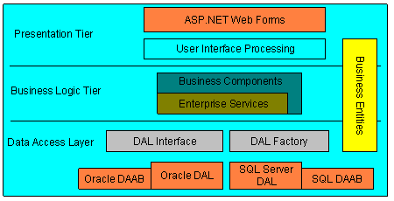
Petshop 3.0架构设计

Slide 11
PetShop数据存取逻辑组件特点
使用了工厂模式
  将数据存取接口抽象出来
  同时支持多种数据库
  可以在部署以后修改配置文件更换或者增加数据源类型
  防止使用OLEDB造成的性能损失
使用了Data Access Application Block (DAAB)

Slide 12
数据存取逻辑组件
实现了一个无状态的抽象的数据存取逻辑
使用了Helper组件简化代码
Data Access Logic
Component
Data Access Logic
Component
Data Access Helper
Component
Notes:
数据访问逻辑组件并不直接访问数据库中的数据，一般可以考虑使用一些helper组件。比如application building block中的数据访问模块（http://msdn.microsoft.com/library/en-us/dnbda/html/daab-rm.asp）
即CRUD由专门的和数据库精密关联的组件负责
需要考虑是否使用存储过程？
Regardless of the data store you choose, your application or service will use data access logic components to access the data. These components abstract the semantics of the underlying data store and data access technology (such as ADO.NET), and provide a simple programmatic interface for retrieving and performing operations on data.
Data access logic components usually implement a stateless design pattern that separates the business processing from the data access logic. Each data access logic component typically provides methods to perform Create, Read, Update, and Delete (CRUD) operations relating to a specific business entity in the application (for example, order). These methods may be used by the business processes. Specific queries can be used by your user interface to render reference data (such as a list of valid credit card types).
When your application contains multiple data access logic components, it can be useful to use a generic data access helper component to manage database connections, execute commands, cache parameters, and so on. The data access logic components provide the logic required to access specific business data, while the generic data access helper utility component centralizes data access API development and data connection configuration, and helps to reduce code duplication. A well designed data access helper component should have no negative impact on performance, and provides a central place for data access tuning and optimization. Microsoft provides the Data Access Application Block for .NET (http://msdn.microsoft.com/library/en-us/dnbda/html/daab-rm.asp), which can be used as a generic data access helper utility component in your applications when using SQL Server databases.
The slide shows the use of data access logic components to access data.
Note the following points:
Data access logic components expose methods for inserting, deleting, updating, and retrieving data. This includes the provision of paging functionality when retrieving large quantities of data.
You can use a data access helper component to centralize connection management and all code that deals with a specific data source.
You should implement your queries and data operations as stored procedures (if supported by the data source) to enhance performance and maintainability.
Note Data access logic components are recommended for all applications that need to access business data (such as products, orders, and so on). However, other products and technologies may use databases to store their own operational data, without the need for custom data access logic components. Data access logic components provide simple access to database functionality (queries and data operations), returning both simple and complex data structures. They hide invocation and format idiosyncrasies of the data store from the business components and user interfaces that consume them. Implementing your data access logic in data access logic components allows you to encapsulate all the data access logic for the entire application in a single, central location, making the application easier to maintain or extend.
You should design each data access logic component to deal with only one data store. (This means that these components do not query and aggregate data from many sources; this is done by the business components.)
When using heterogeneous transactions, your data access logic components should participate in them, but they should never be the root of the transaction. It is more appropriate to have a business component as the root of a transaction in which one or more data access logic components are used to perform database updates.

Slide 13
存取多种数据源
通用的数据存取Helper组件接口
对不同的数据源，分别实现这个接口
Data Access
Helper Interface
SQL Server
Data Access
Helper Component
Oracle
Data Access
Helper Component
OLE-DB
Data Access
Helper Component
Notes:
If you access an Oracle database or other data sources, you may prefer to abstract as much as possible the API with which you access them from your data access logic components. Microsoft has provided Oracle and OLE DB implementations of the Data Access Application Block and has stress-tested them in the context of the Nile performance benchmark. These implementations are available for download on MSDN by following the links in this article: http://msdn.microsoft.com/library/default.asp?url=/library/en-us/dndotnet/html/manprooracperf.asp .
Achieving RDBMS transparency is a complex design goal, and using data access helpers can help to mitigate some of the development, troubleshooting, and maintenance efforts. However, you will still need to test your application with each data source due to the different ways in which relational database management systems handle stored procedures, cursors, and other database artifacts.
If you are envisioning that your application may be deployed in different environments with different relational database management systems, you may want to implement your data access helpers with a common interface and provide the actual component that does the data access for a particular data source in a factory pattern. You can change the source code supplied for the Application Blocks for .NET mentioned earlier to accommodate these specific requirements.

Slide 14
PetShop数据存取逻辑组建特点
商业组件
询问
使用
数据层工厂
数据组件接口
根据配置选择
实现接口
SQL Sever数据组件实现
Oracle数据组件实现

Slide 15
ADO.NET
DataSet
  表现多个DataTable的集合，以及数据的关系和约束
  离线的数据库
  天然的XML支持
  可以在异构的系统之间传输
DataAdapter
  从数据源填充DataSet
  批量更新
DataReader

Slide 16
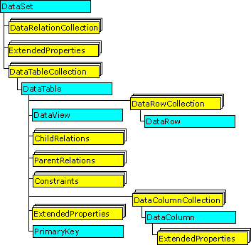
DataSet 的概念

Slide 17
DataSet 的概念(续)
DataView tableView;
DataRowView currentRowView;
tableView = new DataView(ds.Tables["Customers"]);
currentRowView = tableView[dgCustomers.SelectedIndex];
dgChild.DataSource = currentRowView.CreateChildView("CustOrders");
Customers
Orders
DataRowView
DataView
CreateChildView
DataSet

Slide 18
SqlDataAdapter
SqlDataAdapter 的定义
SqlDataAdapter 属性
  SelectCommand 从数据源读取记录
  InsertCommand 将新添加的记录从DataSet写入数据源
  UpdateCommand 将更改过的记录从DataSet写入数据源
  DeleteCommand 删除数据源中的记录
SqlDataAdapter 方法
  Fill
  Update
  Close

Slide 19
Stored Procedure vs. Direct SQL
Stored Procedure优势
  性能更好
  更灵活的安全控制
  更便于维护
  减少网络流量
  减少和数据库之间的round-trip
Stored Procedure缺点
  增大了开发的工作量
  减少了代码的可移植性
使用存储过程，如果你
  不准备开发多个数据库的支持
  逐个实现数据库的数据存取组件

Slide 20
DataSet vs. DataReader
DataSet优势
  离线的数据库，不占用宝贵的数据库连接
  很容易将修改同步到数据库
  在多个离散的结果表里面导航
  操纵多个数据源并进行合并
  将数据通过WebService传给远程客户
  数据的多次使用（排序、搜索）或者复杂耗时的处理
DataSet缺点
  在读取大量数据的时候，DataReader性能超过DataSet
  占用大量的内存
使用DataReader，如果你
  需要只读的而且只向前的数据获取
  不会发生大量并发存取
  数据量太大不能全部读入

Slide 21
Strongly Typed DataSet vs. DataSet
Strongly Typed DataSet优势
  采用对象和属性的形式，来表现数据库表和字段
  通过名称而不是索引来查找集合，使代码可读性更强
  可是使用VS.NET的Intellisense
  可以使用VS.NET自动创建
  可以使用VS.NET编辑数据关系
Strongly Typed DataSet缺点
  造成程序与数据库表结构的紧耦合，当数据库表结构发生改变，很可能要修改程序

Slide 22
组件类型
Communication
Security
Operational Management
User Interface Components
User Process Components
Service Interfaces
Business
Workflows
Business
Components
Business
Entities
Data Access Logic
Components
Service Agents
Data Source
Service
Notes:
组件的分类
UI：例如windows窗体，asp.net窗体和控件等
UP：处理可预知的用户行为，不应该和界面代码紧密结合，否则不利移植和重用
WorkFlow: BizTalk
An examination of most business solutions based on a layered component model reveals several common component types. The slide shows these component types in one comprehensive illustration.
Note The term component is used in the sense of a piece or part of the overall solution. This includes compiled software components, such as Microsoft .NET assemblies, and other software artifacts such as Web pages and Microsoft® BizTalk® Server Orchestration schedules. Although the list of component types shown is not exhaustive, it represents the common kinds of software components found in most distributed solutions.
The component types identified in the sample scenario design are:
User interface (UI) components. Most solutions need to provide a way for users to interact with the application. In the retail application example, a Web site lets customers view products and submit orders, and an application based on the Microsoft Windows® operating system lets sales representatives enter order data for customers who have telephoned the company. User interfaces are implemented using Windows Forms, Microsoft ASP.NET pages, controls, or any other technology you use to render and format data for users and to acquire and validate data coming in from them.
User process components. In many cases, a user interaction with the system follows a predictable process. For example, in the retail application you could implement a procedure for viewing product data that has the user select a category from a list of available product categories and then select an individual product in the chosen category to view its details. Similarly, when the user makes a purchase, the interaction follows a predictable process of gathering data from the user, in which the user first supplies details of the products to be purchased, then provides payment details, and then enters delivery details. To help synchronize and orchestrate these user interactions, it can be useful to drive the process using separate user process components. This way the process flow and state management logic is not hard-coded in the user interface elements themselves, and the same basic user interaction "engine" can be reused by multiple user interfaces.
Business workflows. After the required data is collected by a user process, the data can be used to perform a business process. For example, after the product, payment, and delivery details are submitted to the retail application, the process of taking payment and arranging delivery can begin. Many business processes involve multiple steps that must be performed in the correct order and orchestrated. For example, the retail system would need to calculate the total value of the order, validate the credit card details, process the credit card payment, and arrange delivery of the goods. This process could take an indeterminate amount of time to complete, so the required tasks and the data required to perform them would have to be managed. Business workflows define and coordinate long-running, multi-step business processes, and they can be implemented using business process management tools such as BizTalk Server Orchestration.
Business components. Regardless of whether a business process consists of a single step or an orchestrated workflow, your application will probably require components that implement business rules and perform business tasks. For example, in the retail application, you would need to implement the functionality that calculates the total price of the goods ordered and adds the appropriate delivery charge. Business components implement the business logic of the application.
Service agents. When a business component needs to use functionality provided in an external service, you may need to provide some code to manage the semantics of communicating with that particular service. For example, the business components of the retail application described earlier could use a service agent to manage communication with the credit card authorization service, and use a second service agent to handle conversations with the courier service. Service agents isolate the idiosyncrasies of calling diverse services from your application, and can provide additional services, such as basic mapping between the format of the data exposed by the service and the format your application requires.
Service interfaces. To expose business logic as a service, you must create service interfaces that support the communication contracts (message-based communication, formats, protocols, security, exceptions, and so on) its different consumers require. For example, the credit card authorization service must expose a service interface that describes the functionality offered by the service and the required communication semantics for calling it. Service interfaces are sometimes referred to as business facades.
Data access logic components. Most applications and services will need to access a data store at some point during a business process. For example, the retail application needs to retrieve product data from a database to display product details to the user, and it needs to insert order details into the database when a user places an order. It makes sense to abstract the logic necessary to access data in a separate layer of data access logic components. Doing so centralizes data access functionality and makes it easier to configure and maintain.
Business entity components: Most applications require data to be passed between components. For example, in the retail application a list of products must be passed from the data access logic components to the user interface components so that the product list can be displayed to the users. The data is used to represent real-world business entities, such as products or orders. The business entities that are used internally in the application are usually data structures, such as DataSets, DataReaders, or Extensible Markup Language (XML) streams, but they can also be implemented using custom object-oriented classes that represent the real-world entities your application has to work with, such as a product or an order.
Components for security, operational management, and communication: Your application will probably also use components to perform exception management, to authorize users to perform certain tasks, and to communicate with other services and applications.

Slide 23
COM+ 服务
事务支持
资源管理
同步
安全性
松耦合事件
队列组件

Slide 24
COM+ 服务
.NET Enterprise Services
  .NET 中使用 COM+ 服务的方法
  继承自 ServicedComponent 类
  声明性编程方式

Slide 25
COM+ 服务 - 实现分布式事务
[Transaction(TransactionOption.Required)]
[ObjectPooling(MinPoolSize=4, MaxPoolSize=4)]
[Guid("14E3573D-78C8-4220-9649-BA490DB7B78D")]
public class OrderInsert : ServicedComponent {
[AutoComplete]
public int Insert(OrderInfo order) {
// 数据操作1
int orderId = dal.Insert(order);
// 数据操作2
inventory.TakeStock( order.LineItems);
// 如果违反业务规则，抛出异常，自动回滚
if (order.UserId == ACID_USER_ID)
throw new Exception(ACID_ERROR_MSG);
return orderId;
}}

Slide 26
DB事务 vs. COM+ 事务 (Transaction)
DB事务的优势
  DB事务提供最快的速度
DB事务的缺点
  需要进行T-SQL编程
  不能跨越多个数据库
使用COM+
  由于使用DTC带来的开销平均起来并不高
  简化了程序设计，增强了程序的可读性

Slide 27
组件类型
Communication
Security
Operational Management
User Interface Components
User Process Components
Service Interfaces
Business
Workflows
Business
Components
Business
Entities
Data Access Logic
Components
Service Agents
Data Source
Service
Notes:
组件的分类
UI：例如windows窗体，asp.net窗体和控件等
UP：处理可预知的用户行为，不应该和界面代码紧密结合，否则不利移植和重用
WorkFlow: BizTalk
An examination of most business solutions based on a layered component model reveals several common component types. The slide shows these component types in one comprehensive illustration.
Note The term component is used in the sense of a piece or part of the overall solution. This includes compiled software components, such as Microsoft .NET assemblies, and other software artifacts such as Web pages and Microsoft® BizTalk® Server Orchestration schedules. Although the list of component types shown is not exhaustive, it represents the common kinds of software components found in most distributed solutions.
The component types identified in the sample scenario design are:
User interface (UI) components. Most solutions need to provide a way for users to interact with the application. In the retail application example, a Web site lets customers view products and submit orders, and an application based on the Microsoft Windows® operating system lets sales representatives enter order data for customers who have telephoned the company. User interfaces are implemented using Windows Forms, Microsoft ASP.NET pages, controls, or any other technology you use to render and format data for users and to acquire and validate data coming in from them.
User process components. In many cases, a user interaction with the system follows a predictable process. For example, in the retail application you could implement a procedure for viewing product data that has the user select a category from a list of available product categories and then select an individual product in the chosen category to view its details. Similarly, when the user makes a purchase, the interaction follows a predictable process of gathering data from the user, in which the user first supplies details of the products to be purchased, then provides payment details, and then enters delivery details. To help synchronize and orchestrate these user interactions, it can be useful to drive the process using separate user process components. This way the process flow and state management logic is not hard-coded in the user interface elements themselves, and the same basic user interaction "engine" can be reused by multiple user interfaces.
Business workflows. After the required data is collected by a user process, the data can be used to perform a business process. For example, after the product, payment, and delivery details are submitted to the retail application, the process of taking payment and arranging delivery can begin. Many business processes involve multiple steps that must be performed in the correct order and orchestrated. For example, the retail system would need to calculate the total value of the order, validate the credit card details, process the credit card payment, and arrange delivery of the goods. This process could take an indeterminate amount of time to complete, so the required tasks and the data required to perform them would have to be managed. Business workflows define and coordinate long-running, multi-step business processes, and they can be implemented using business process management tools such as BizTalk Server Orchestration.
Business components. Regardless of whether a business process consists of a single step or an orchestrated workflow, your application will probably require components that implement business rules and perform business tasks. For example, in the retail application, you would need to implement the functionality that calculates the total price of the goods ordered and adds the appropriate delivery charge. Business components implement the business logic of the application.
Service agents. When a business component needs to use functionality provided in an external service, you may need to provide some code to manage the semantics of communicating with that particular service. For example, the business components of the retail application described earlier could use a service agent to manage communication with the credit card authorization service, and use a second service agent to handle conversations with the courier service. Service agents isolate the idiosyncrasies of calling diverse services from your application, and can provide additional services, such as basic mapping between the format of the data exposed by the service and the format your application requires.
Service interfaces. To expose business logic as a service, you must create service interfaces that support the communication contracts (message-based communication, formats, protocols, security, exceptions, and so on) its different consumers require. For example, the credit card authorization service must expose a service interface that describes the functionality offered by the service and the required communication semantics for calling it. Service interfaces are sometimes referred to as business facades.
Data access logic components. Most applications and services will need to access a data store at some point during a business process. For example, the retail application needs to retrieve product data from a database to display product details to the user, and it needs to insert order details into the database when a user places an order. It makes sense to abstract the logic necessary to access data in a separate layer of data access logic components. Doing so centralizes data access functionality and makes it easier to configure and maintain.
Business entity components: Most applications require data to be passed between components. For example, in the retail application a list of products must be passed from the data access logic components to the user interface components so that the product list can be displayed to the users. The data is used to represent real-world business entities, such as products or orders. The business entities that are used internally in the application are usually data structures, such as DataSets, DataReaders, or Extensible Markup Language (XML) streams, but they can also be implemented using custom object-oriented classes that represent the real-world entities your application has to work with, such as a product or an order.
Components for security, operational management, and communication: Your application will probably also use components to perform exception management, to authorize users to perform certain tasks, and to communicate with other services and applications.

Slide 28
表现层
CodeBehind
Web Control
Web Control Events
Validator Control
Global.asax
Web.config

Slide 29
CodeBehind
ASP.NET 提供的新型代码编辑方法
用户界面和程序逻辑分离
  .aspx 文件保存用户界面元素
  .vb 或 .cs 文件保存 Web 窗体的程序逻辑
  默认情况下，Web 窗体文件和代码隐藏页文件名相同

Slide 30
CodeBehind优点
开发人员和网页美工人员可以独立的工作
充分利用 VS.NET 的优势，如可视化编辑、智能提示、错误检查
提高代码可读性和独立性
代码重用

Slide 31
Web Control
固有控件：与一些简单的 HTML 元素相对应的控件
Button、Label、LinkButton、ImageButton…
验证控件：验证用户输入的控件
RequiredFieldValidator、RegularExpressionValidator…
Rich 控件：提供更加丰富的用户界面的控件
Calendar、AdRotator…
列表绑定控件：显示数据列表
DataList、DataGrid…
Internet Explorer Web 控件
TreeView、ToolBar…

Slide 32
Web Control
一种封装了用户界面及相关功能的服务器端组件
声明服务器控件
具有 Runat = “server” 属性
  控件的事件发生在服务器而不是客户端
  自动保存视图状态
基于公共的对象模型
  服务器控件都是直接或间接由 System.Web.UI.Control 继承而来
  所有服务器控件都具有一些公共属性，如 ID、Text、BackColor
<asp:Button id="Button1" runat="server"
Text="Submit"/>

Slide 33
Web Control
Web Control 的生命周期
ViewState 特性
AutoPostBack 属性

Slide 34
Web Control Events
服务器端事件的特点
  可以处理由 Web 服务器控件或 HTML 服务器控件引发的事件
  事件处理过程代码由服务器解释或编译执行
  可以访问服务器资源
  只支持有限的几个事件

Slide 35
使用 ASP.NET 验证控件
CompareValidator 控件
  与给定的值比较
CustomValidator 控件
  用户自己定制校验逻辑
RangeValidator 控件
  检查输入控件的值是否在给定的有效值范围内

Slide 36
使用 ASP.NET 验证控件（续）
RegularExpressionValidator 控件
  使用正则表达式验证用户输入是否符合预定义的格式
RequiredFieldValidator 控件
  防止用户输入空值
ValidationSummary 控件
  汇总 Web 页上所有验证控件的错误信息

Slide 37
Page Events
Page_Init 事件
Page_Load 事件
Postback Data Change 事件
Postback Event 事件
Page_Unload 事件
Page_Disposed 事件

Slide 38
使用 Page.IsPostBack 属性
Page.IsPostBack 属性指示该页是否正为响应客户端回发而加载，或者它是否正被首次加载和访问
适当的使用 Page.IsPostBack 属性可以提高 ASP.NET 程序的性能
  每次请求页面都会引发 Page_Load 事件
  根据 Page.IsPostBack 属性有条件地执行代码， 避免对往返过程执行不必要的处理

Slide 39
使用 Page.IsPostBack 属性
根据Page.IsPostBack属性有条件地执行代码
private void Page_Load(object sender, System.EventArgs e)
{ if (!Page.IsPostBack)
{
// 只有在第一次请求页面时执行
}
//以下代码在每一次请求页面时都会执行
}

Slide 40
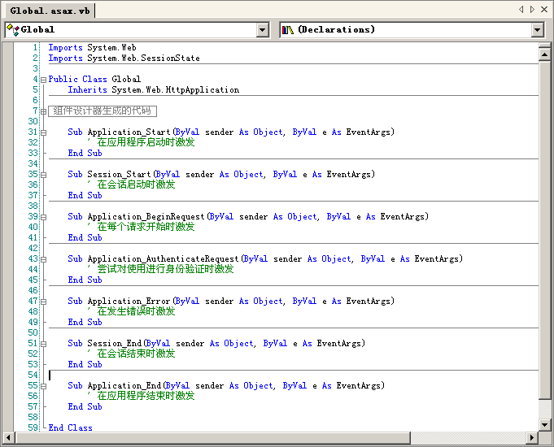
Global.asax 文件

Slide 41
组件类型
Communication
Security
Operational Management
User Interface Components
User Process Components
Service Interfaces
Business
Workflows
Business
Components
Business
Entities
Data Access Logic
Components
Service Agents
Data Source
Service
Notes:
组件的分类
UI：例如windows窗体，asp.net窗体和控件等
UP：处理可预知的用户行为，不应该和界面代码紧密结合，否则不利移植和重用
WorkFlow: BizTalk
An examination of most business solutions based on a layered component model reveals several common component types. The slide shows these component types in one comprehensive illustration.
Note The term component is used in the sense of a piece or part of the overall solution. This includes compiled software components, such as Microsoft .NET assemblies, and other software artifacts such as Web pages and Microsoft® BizTalk® Server Orchestration schedules. Although the list of component types shown is not exhaustive, it represents the common kinds of software components found in most distributed solutions.
The component types identified in the sample scenario design are:
User interface (UI) components. Most solutions need to provide a way for users to interact with the application. In the retail application example, a Web site lets customers view products and submit orders, and an application based on the Microsoft Windows® operating system lets sales representatives enter order data for customers who have telephoned the company. User interfaces are implemented using Windows Forms, Microsoft ASP.NET pages, controls, or any other technology you use to render and format data for users and to acquire and validate data coming in from them.
User process components. In many cases, a user interaction with the system follows a predictable process. For example, in the retail application you could implement a procedure for viewing product data that has the user select a category from a list of available product categories and then select an individual product in the chosen category to view its details. Similarly, when the user makes a purchase, the interaction follows a predictable process of gathering data from the user, in which the user first supplies details of the products to be purchased, then provides payment details, and then enters delivery details. To help synchronize and orchestrate these user interactions, it can be useful to drive the process using separate user process components. This way the process flow and state management logic is not hard-coded in the user interface elements themselves, and the same basic user interaction "engine" can be reused by multiple user interfaces.
Business workflows. After the required data is collected by a user process, the data can be used to perform a business process. For example, after the product, payment, and delivery details are submitted to the retail application, the process of taking payment and arranging delivery can begin. Many business processes involve multiple steps that must be performed in the correct order and orchestrated. For example, the retail system would need to calculate the total value of the order, validate the credit card details, process the credit card payment, and arrange delivery of the goods. This process could take an indeterminate amount of time to complete, so the required tasks and the data required to perform them would have to be managed. Business workflows define and coordinate long-running, multi-step business processes, and they can be implemented using business process management tools such as BizTalk Server Orchestration.
Business components. Regardless of whether a business process consists of a single step or an orchestrated workflow, your application will probably require components that implement business rules and perform business tasks. For example, in the retail application, you would need to implement the functionality that calculates the total price of the goods ordered and adds the appropriate delivery charge. Business components implement the business logic of the application.
Service agents. When a business component needs to use functionality provided in an external service, you may need to provide some code to manage the semantics of communicating with that particular service. For example, the business components of the retail application described earlier could use a service agent to manage communication with the credit card authorization service, and use a second service agent to handle conversations with the courier service. Service agents isolate the idiosyncrasies of calling diverse services from your application, and can provide additional services, such as basic mapping between the format of the data exposed by the service and the format your application requires.
Service interfaces. To expose business logic as a service, you must create service interfaces that support the communication contracts (message-based communication, formats, protocols, security, exceptions, and so on) its different consumers require. For example, the credit card authorization service must expose a service interface that describes the functionality offered by the service and the required communication semantics for calling it. Service interfaces are sometimes referred to as business facades.
Data access logic components. Most applications and services will need to access a data store at some point during a business process. For example, the retail application needs to retrieve product data from a database to display product details to the user, and it needs to insert order details into the database when a user places an order. It makes sense to abstract the logic necessary to access data in a separate layer of data access logic components. Doing so centralizes data access functionality and makes it easier to configure and maintain.
Business entity components: Most applications require data to be passed between components. For example, in the retail application a list of products must be passed from the data access logic components to the user interface components so that the product list can be displayed to the users. The data is used to represent real-world business entities, such as products or orders. The business entities that are used internally in the application are usually data structures, such as DataSets, DataReaders, or Extensible Markup Language (XML) streams, but they can also be implemented using custom object-oriented classes that represent the real-world entities your application has to work with, such as a product or an order.
Components for security, operational management, and communication: Your application will probably also use components to perform exception management, to authorize users to perform certain tasks, and to communicate with other services and applications.

Slide 42
User Process 组件接口设计
User Interface
Component
Actions
State
Events
User Process
Component
Control
Business
Entity
Business
Component
Data Access
Logic Component
Notes:
The interface of your user process components can expose the following kinds of functionality:
User process "actions" (1). These are the interface of actions that typically trigger a change in the state of the user process. Actions are implemented in user process component methods, as demonstrated by the ShowOrder, EnterPaymentDetails, PlaceOrder, and Finish methods in the code sample discussed earlier. You should try to encapsulate calls to business components in these action methods (6).
State access methods (2). You can access the business-specific and business-agnostic state of the user process by using fine-grained get and set properties that expose one value, or by exposing the set of business entities that the user process deals with (5). For example, in the code sample discussed earlier, the user process state can be retrieved through public DataSet properties.
State change events (3). These events are fired whenever the business-related state or business-agnostic state of the user process changes. Sometimes you will need to implement these change notifications yourself. In other cases, you may be storing your data through a mechanism that already does this intrinsically (for example, a DataSet fires events whenever its data changes).
Control functions that let you start, pause, restart, and cancel a particular user process (4). These functions should be kept separate, but can be intermixed with the user process actions. For example, the code sample discussed earlier contains SaveToDataBase and ResumeCheckout methods. Control methods could load required reference data for the UI (such as the information needed to fill a combo box) from data access logic components (7) or delegate this work to the user interface component (forms, controls, ASP.NET pages) that needs the data.

Slide 43
组件类型
Communication
Security
Operational Management
User Interface Components
User Process Components
Service Interfaces
Business
Workflows
Business
Components
Business
Entities
Data Access Logic
Components
Service Agents
Data Source
Service
Notes:
组件的分类
UI：例如windows窗体，asp.net窗体和控件等
UP：处理可预知的用户行为，不应该和界面代码紧密结合，否则不利移植和重用
WorkFlow: BizTalk
An examination of most business solutions based on a layered component model reveals several common component types. The slide shows these component types in one comprehensive illustration.
Note The term component is used in the sense of a piece or part of the overall solution. This includes compiled software components, such as Microsoft .NET assemblies, and other software artifacts such as Web pages and Microsoft® BizTalk® Server Orchestration schedules. Although the list of component types shown is not exhaustive, it represents the common kinds of software components found in most distributed solutions.
The component types identified in the sample scenario design are:
User interface (UI) components. Most solutions need to provide a way for users to interact with the application. In the retail application example, a Web site lets customers view products and submit orders, and an application based on the Microsoft Windows® operating system lets sales representatives enter order data for customers who have telephoned the company. User interfaces are implemented using Windows Forms, Microsoft ASP.NET pages, controls, or any other technology you use to render and format data for users and to acquire and validate data coming in from them.
User process components. In many cases, a user interaction with the system follows a predictable process. For example, in the retail application you could implement a procedure for viewing product data that has the user select a category from a list of available product categories and then select an individual product in the chosen category to view its details. Similarly, when the user makes a purchase, the interaction follows a predictable process of gathering data from the user, in which the user first supplies details of the products to be purchased, then provides payment details, and then enters delivery details. To help synchronize and orchestrate these user interactions, it can be useful to drive the process using separate user process components. This way the process flow and state management logic is not hard-coded in the user interface elements themselves, and the same basic user interaction "engine" can be reused by multiple user interfaces.
Business workflows. After the required data is collected by a user process, the data can be used to perform a business process. For example, after the product, payment, and delivery details are submitted to the retail application, the process of taking payment and arranging delivery can begin. Many business processes involve multiple steps that must be performed in the correct order and orchestrated. For example, the retail system would need to calculate the total value of the order, validate the credit card details, process the credit card payment, and arrange delivery of the goods. This process could take an indeterminate amount of time to complete, so the required tasks and the data required to perform them would have to be managed. Business workflows define and coordinate long-running, multi-step business processes, and they can be implemented using business process management tools such as BizTalk Server Orchestration.
Business components. Regardless of whether a business process consists of a single step or an orchestrated workflow, your application will probably require components that implement business rules and perform business tasks. For example, in the retail application, you would need to implement the functionality that calculates the total price of the goods ordered and adds the appropriate delivery charge. Business components implement the business logic of the application.
Service agents. When a business component needs to use functionality provided in an external service, you may need to provide some code to manage the semantics of communicating with that particular service. For example, the business components of the retail application described earlier could use a service agent to manage communication with the credit card authorization service, and use a second service agent to handle conversations with the courier service. Service agents isolate the idiosyncrasies of calling diverse services from your application, and can provide additional services, such as basic mapping between the format of the data exposed by the service and the format your application requires.
Service interfaces. To expose business logic as a service, you must create service interfaces that support the communication contracts (message-based communication, formats, protocols, security, exceptions, and so on) its different consumers require. For example, the credit card authorization service must expose a service interface that describes the functionality offered by the service and the required communication semantics for calling it. Service interfaces are sometimes referred to as business facades.
Data access logic components. Most applications and services will need to access a data store at some point during a business process. For example, the retail application needs to retrieve product data from a database to display product details to the user, and it needs to insert order details into the database when a user places an order. It makes sense to abstract the logic necessary to access data in a separate layer of data access logic components. Doing so centralizes data access functionality and makes it easier to configure and maintain.
Business entity components: Most applications require data to be passed between components. For example, in the retail application a list of products must be passed from the data access logic components to the user interface components so that the product list can be displayed to the users. The data is used to represent real-world business entities, such as products or orders. The business entities that are used internally in the application are usually data structures, such as DataSets, DataReaders, or Extensible Markup Language (XML) streams, but they can also be implemented using custom object-oriented classes that represent the real-world entities your application has to work with, such as a product or an order.
Components for security, operational management, and communication: Your application will probably also use components to perform exception management, to authorize users to perform certain tasks, and to communicate with other services and applications.

Slide 44
使用 Web.config 配置 Web 应用程序
每个 Web 应用程序有一个或多个 Web.config 文件
Web.config 文件包含了 Web 应用程序的所有配置信息
Web.config 包含的配置节涉及到各种 ASP.NET 功能
  安全，如 <authentication>
  模式，如 <processModel>
  公共应用程序配置，如 <appSettings>
  跟踪，如 <trace>

Slide 45
ASP.NET 的安全性介绍
三种身份验证方法
  Windows 身份验证
  Forms 身份验证
  .NET Passport 身份验证

Slide 46
应用性能评价
通过具体使用或压力测试发现性能方面的问题，然后寻找性能瓶颈，并结合项目进度、人员安排、技术储备等因素，提出相应的优化策略
实际使用环境分析
  真实
  难以复制
  无法事先进行
性能测试
  并发测试，是一个负载测试和压力测试的过程，即逐渐增加负载，直到系 统的瓶颈或者不能接收的性能点，通过综合分析交易执行指标和资源监控指标来确定系统并发性能的过程。负载测试（Load Testing）是确定在各种工作负载下系统的性能，目标是测试当负载逐渐增加时，系统组成部分的相应输出项，例如通过量、响应时间、CPU负载、内存使 用等来决定系统的性能。负载测试是一个分析软件应用程序和支撑架构、模拟真实环境的使用，从而来确定能够接收的性能过程。压力测试（Stress Testing）是通过确定一个系统的瓶颈或者不能接收的性能点，来获得系统能提供的最大服务级别的测试。

Slide 47
并发性能测试的目的
以真实的业务为依据，选择有代表性 的、关键的业务操作设计测试案例，以评价系统的当前性能
当扩展应用程序的功能或者新的应用程序将要被部署时，负载测试会帮助确定系统是否还能够处理期望 的用户负载，以预测系统的未来性能
通过模拟成百上千个用户，重复执行和运行测试，可以确认性能瓶颈并优化和调整应用，目的在于寻找到瓶颈问题

Slide 48
使用LoadRunner的并发性能测试
记录一个实际业务使用过程的脚本
使用不同的参数并发执行这个脚本
分析运行结果，得出应用系统的瓶颈

Slide 49
如何改进 Web 性能
优化数据库系统
使用存储过程
减少Round-Trip
使用Cache

Slide 50
Cache 对象
用于存储信息的对象
  每一个 Web 应用程序只有一个 Cache 对象，并且不能被其他 Web 应用程序访问
  Web 应用程序重启将创建 Cache 对象
  可替代应用程序变量
  不用于存储会话变量的信息
使用键/值词典结构存储和检索信息
Cache 对象的工作原理
页面请求缓存项
Cache 对象
中该项可用
是
否
创建并缓存该项
Cache("myKey") = myValue
返回所请求的缓存项
Cache["myKey"] = myValue;
Notes:
重点：
讲述 Cache 对象的基本概念；
讲述 Cache 对象的基本特点；
讲述 Cache 对象的工作原理；
注意：
强调：不同的应用程序不能互相访问对方的 Cache 对象，因此使用 Cache 对象提高 Web 应用程序的性能的空间有限，也不容易扩展；
强调：Cache 对象与 ASP.NET 的输出缓存是两个完全不同的概念，不要混淆，但不需要讲解输出缓存的概念，因为在后面的幻灯片将详细介绍输出缓存技术；
课堂提问：
应用程序变量使用什么对象保存？
Application 对象。

Slide 51
使用 Cache 对象的优点
比每次请求时创建新对象快
支持内部锁定管理
  Cache 对象使用自动锁定管理防止并发的请求同时修改 Cache 对象
自动缓存资源管理
  Cache 对象中各项不再使用时，自动删除
支持回调函数
  当从 Cache 对象中移除项时，执行回调函数代码
支持基于依赖性的移除
  如果 Cache 对象中的项与其他项或文件存在依赖关系，通过设置 Cache 对象，可以实现当该项满足给定的条件时删除该项
Notes:
重点：
讲述为什么需要使用 Cache 对象；
难点：
解释依赖性的概念；
注意：
强调：Cache 对象支持自动锁定管理，而 Application 对象不支持锁定管理，必须手动调用 Application.Lock 方法和 Application.UnLock 方法实现 Application 对象的锁定与解锁；
强调：自动缓存资源管理是 ASP.NET 提供的新特性，在此以前的版本，程序员必须手动地删除 Cache 对象中不使用的项；
简单地通过举例说明回调函数的概念。

Slide 52
使用 Cache 对象的方法
写入 Cache 对象
检索 Cache 对象中的值
‘隐式写入方法
Cache("myKey") = myValue
‘显式写入方法
Cache.Insert("myKey", myValue, Dependency, AbsoluteExpiration, _
SlidingExpiration, CacheItemPriority, CacheItemRemovedCallBack)
//隐式写入方法
Cache["myKey"] = myValue;
//显式写入方法
Cache.Insert("myKey", myValue, Dependency, AbsoluteExpiration,
SlidingExpiration, CacheItemPriority, CacheItemRemovedCallBack);
myValue = Cache("myKey")
myValue = Cache["myKey"];
Notes:
重点：
讲述如何在 Cache 对象中插入项；
讲述如何从 Cache 对象中检索值；
难点：
讲述隐式写入和显示写入的区别；
注意：
不需要详细介绍 Insert 方法的参数，下一页幻灯片将详细介绍；
强调：使用隐式写入方法不能设置 Cache 项的依赖性。

Slide 53
使用 Cache 对象的方法
Cache.Insert("key", value)
Cache.Insert("key", value, dependency)
Cache.Insert("key", value, dependency, absoluteExpiration, _
slidingExpiration)
Cache.Insert("key", value, dependency, absoluteExpiration, _
slidingExpiration, priority, CacheItemRemovedCallBack)
key | 用于引用该对象的缓存键
value | 要插入缓存中的对象
dependency | 该项的文件依赖项或缓存键依赖项
absoluteExpiration | 所插入对象将过期并从缓存中移除的时间
slidingExpiration | 最后一次访问所插入对象时与该对象过期时之间的时间间隔
priority | 该对象相对于缓存中存储的其他项的成本，由 CacheItemPriority 枚举表示
CacheItemRemovedCallback | 在从缓存中移除对象时将调用的委托
Notes:
重点：
讲述 Cache.Insert 方法的各个参数的含义；
难点：
讲述 absoluteExpiration 和 slidingExpiration 的含义及其使用方法；
注意：
说明：如果 key 或 value 参数为空，则发生 ArgumentNullException。如果将 slidingexpiration 参数设置为小于 TimeSpan.Zero 或大于一年，则发生 ArgumentOutOfRangeException。不能对同一个缓存项同时设置可调整到期和绝对到期时间。如果这样做，将发生 ArgumentException；
参考：
关于 Cache.Insert 方法参数的更多信息，请参考 MSDN 中关于“Cache.Insert 方法”的内容。

Slide 54
从 Cache 对象中移除项
使用绝对过期时间
使用弹性过期时间
使缓存项的有效性依赖于缓存中的另一项或文件
设置缓存项的优先级
Cache.Insert("myKey", myValue, Nothing, _
DateTime.Now.AddMinutes(5), Nothing)
Cache.Insert("myKey", myValue, Nothing, _
Nothing, TimeSpan.FromSeconds(20))
Response.AddCacheItemDependency("Variable.Value")
Cache.Insert("myKey", myValue, _
new CacheDependency(Server.MapPath("myDoc.xml")))
Cache.Insert("myKey", myValue, Nothing, Nothing, _
Nothing, CacheItemPriority.High, onRemove)
Notes:
重点：
讲述从 Cache 对象移除项的几种方法；
难点：
依赖性的概念；
注意：
通过举例说明为什么需要使用过期策略并强调往往需要根据实际需要使用不同的过期策略；
课堂提问：
除 Cache 对象外，在前面的课程还提到过哪些对象中的项存在时间过期的问题？
Cookie 对象和 Session 对象；
参考：
需要使用过期策略的例子：
假设需要缓存从第三方 Web 服务读取的货币兑换率并假设第三方 Web 服务的货币兑换率刷新率未10分钟一次，此时就应该使用过期策略，并设置 Cache 对象项的过期时间为10分钟，以保证用户得到的使用正确的货币兑换率；
关于过期策略的更多信息，请参考 MSDN 中关于”将项添加到缓存中”的内容；
关于依赖性的更多信息，请参考 MSDN 中关于“使用缓存键依赖项缓存页输出”的内容。

Slide 55
输出缓存的类型
页输出缓存
以用户控件的形式实现的页片段缓存
XML Web Service缓存
<WebMethod(CacheDuration:=300)> _
Public Function CachedInfo() As String
...
End Function
[WebMethod(CacheDuration=300)]
public string CachedInfo()
{
...
}
Notes:
重点：
介绍输出缓存的类型；
介绍如何在 XML Web Service 中使用缓存；
注意：
不需要详细介绍页缓存和页片段缓存，后面将有详细的介绍；
课堂提问：
WebMethod 属性的作用是什么？
指定该方法为 XML Web Service的公开方法。

Slide 56
使用页输出缓存
缓存动态网页内容
缓存整个 Web 页
使用 @ OutputCache 指令可以对页进行缓存
Duration 属性
  页或用户控件进行缓存的时间（以秒计）
<%@ OutputCache Duration="#ofseconds" Location="Any | Client | Downstream | Server | None" Shared="True | False" VaryByControl="controlname" VaryByCustom="browser | customstring" VaryByHeader="headers" VaryByParam="parametername" %>
Notes:
重点：
讲述页输出缓存的概念；
讲述如何启用页输出缓存；
难点：
讲述 @OutputCache 指令；
注意：
结合下一页幻灯片讲述 @ OutputCache 指令的设置；
参考：
关于 @ OutputCache 指令的更多信息，请参考 MSDN 中关于” @ OutputCache 指令”的内容。

Slide 57
使用页输出缓存
VaryByParam 属性
  根据参数缓存 Web 窗体的多个版本
  使用分号分隔不同的参数，如 “UserName;Password”
  VaryByParam = “none” 表示只缓存 Web 窗体的一个版本
  VaryByParam = “*” 表示页面参数的任何变化都会导致缓存页面的一个新版本
VaryByControl 属性
  用于更改用户控件的输出缓存
  字符串代表在用户控件中声明的 ASP.NET 服务器控件 ID 属性值
  只能在用户控件中使用
Notes:
重点：
解释 VaryByParam 属性的含义；
解释 VaryByControl 属性的含义；
难点：
缓存多个版本的 Web 窗体的概念；
注意：
结合上一页幻灯片介绍；
参考：
关于 @ OutputCache 指令的更多信息，请参考 MSDN 中关于“ @ OutputCache 指令”的内容。

Slide 58
使用页输出缓存
Location = "Any | Client | Downstream | Server | None"
  指定输出缓存的位置
Shared 属性
  确定用户控件输出是否可以由多个页共享
  ASP.NET 页（.aspx 文件）中的 @ OutputCache 指令不支持此属性
VaryByHeader
  分号分隔的 HTTP 标头列表，用于使输出缓存发生变化
  用户控件中不能使用
VaryByCustom
  表示自定义输出缓存的内容
  必须在应用程序的 Global.asax 文件中重写 HttpApplication.GetVaryByCustomString 方法
Notes:
重点：
解释 Location 属性的含义；
解释 Shared 属性的含义；
解释 VaryByCustom 属性的含义；
注意：
强调：要使用 VaryByCustom 属性，必须在应用程序的 Global.asax 文件中重写 HttpApplication.GetVaryByCustomString 方法，但不需要详细介绍；
参考：
关于 @ OutputCache 指令的更多信息，请参考 MSDN 中关于“ @ OutputCache 指令”的内容。

Slide 59
使用片段缓存
将需要缓存的页片段转换为用户控件
在用户控件中设置 Duration 属性和 VaryByParam 属性
<%@ OutputCache Duration="120" VaryByParam="none" %>
Notes:
重点：
解释为什么需要将需要缓存的页片段转换为用户控件；
注意：
说明：用户控件中的 @ OutputCache 指令与页的 @ OutputCache 指令的含义基本相同，但有一些属性 Web 窗体不支持，而用户控件支持，而有些属性页支持，而用户控件不支持；
参考：
关于 @ OutputCache 指令的更多信息，请参考 MSDN 中关于” @ OutputCache 指令”的内容。

