Slide 1

.NET Framework and C# Programming
C#
胡晓军

Slide 2
.NET Framework 体系结构
VB
C++
C#
J#
…
Visual Studio .NET
公共语言规范
ASP.NET
Web 表单 Web 服务
Mobile Internet Toolkit
Windows
表单
ADO.NET 和 XML
基类库
公共语言运行库
操作系统

Slide 3
Language C#
Design for .NET Framework
Component-oriented language (COM,COM+)
The main design goal of C# was simplicity rather than pure power
Features of C#
  Simplicity Type Safety
  Consistency Version Control
  Modernity Compatibility
  Object Orientation Flexibility

Slide 4
C# - Simplicity
Annoying things in C++ include,
  “->” / “::” / “.” notations
  Strict data types such as “wchar_t”, “__int64” …
  Using integer as boolean type, == vs = problem
In C#,
  Everything is “.”.
  There is no more unsigned, signed … etc.
  bool type was introduced to remove confusion

Slide 5
C# - Simplicity
In C#, there is NO pointer.
All memory management is done by the garbage collector of the .NET Runtime.
However, using “unsafe” mode, one can access memory directly.

Slide 6
C# - Modernity
Automatic Garbage Collection
Richer intrinsic model for error handling
New financial and time-based types
Modern approach to debugging

Slide 7
C# - Modernity
using System;
public class CTest {
public static void Main() {
try {
Console.WriteLine(“Testing try-catch”);
throw new NullReferenceException();
}
catch (NullReferenceException e) {
Console.WriteLine(“Exception #1”);
}
catch {
Console.WriteLine(“General Exception”);
}
finally {
Console.WriteLine(“Finally”);
}
}
}

Slide 8
C# - Modernity
using System;
namespace TestNameSpace
{
public class CTestHello
{
[conditional(“DEBUG”)]
public static void SayHello()
{
Console.WriteLine(“Hello, for Debug”);
return;
}
...
}
}

Slide 9
C# - Modernity
using System;
using TestNameSpace;
#define DEBUG
public class CTestHelloCaller
{
public static void Main(string[] args)
{
CTestHello.SayHello();
return;
}
}

Slide 10
C# - Object Orientation
Encapsulation, Inheritance, Polymorphism
No global variables or functions
Class methods are non-virtual by default.
  Reduces the possibility for unwanted over-riding
public, private, protected and internal
Only single inheritance is allowed.

Slide 11
C# - Type Safety
No uninitialized variables are usable.
Unsafe type casting is not allowed.
Data overflow, array index boundary checking

Slide 12
A simple C# example
Simple hello world.
using System;
class Hello {
public static void Main(string[] args)
{
Console.WriteLine(“hello, world”);
// print the command line arguments
for (int i = 0; i < args.Length; i++)
Console.WriteLine(“arg {0},{1}”, i, args[i]);
}
}

Slide 13











Compilation and Execution
Compilation
Source Code
Language Compiler
Code (IL)
Assembly
Metadata
Native
Code
JIT Compiler
At installation or the first time each method is called
Execution

Slide 14


The Common Language Runtime
Internals
Base Class Library Support
Thread Support
COM Marshaler
Type Checker
Exception Manager
Security Engine
Debug Engine
IL to Native
Compilers
Code
Manager
Garbage
Collector
Class Loader

Slide 15
Managed Code 执行模式
开发阶段
部署阶段
源代码
Assembly
PE header + MSIL +
Metadata + EH Table
PEVerify
public static void Main(String[] args )
{ String usr; FileStream f; StreamWriter w;
try {
usr=Environment.GetEnvironmentVariable("USERNAME");
f=new FileStream(“C:\\test.txt",FileMode.Create);
w=new StreamWriter(f);
w.WriteLine(usr);
w.Close();
} catch (Exception e){
Console.WriteLine("Exception:"+e.ToString());
}
}
编译器
public static void Main(String[] args )
{ String usr; FileStream f; StreamWriter w;
try {
usr=Environment.GetEnvironmentVariable("USERNAME");
f=new FileStream(“C:\\test.txt",FileMode.Create);
w=new StreamWriter(f);
w.WriteLine(usr);
w.Close();
} catch (Exception e){
Console.WriteLine("Exception:"+e.ToString());
}
}
执行阶段
NGEN
Evidence
Host
Policy
Manager
组件信息模块
Assembly
Loader
GAC,
app. directory,
download cache
Policy
<?xml version="1.0" encoding="utf-8" ?>
<configuration>
<mscorlib>
<security>
<policy>
<PolicyLevel version="1">
<CodeGroup class="UnionCodeGroup"
version="1"
PermissionSetName="Nothing"
Name="All_Code"
Description="Code group
grants no permissio
ns and forms the root of the code group tree.">
<IMembershipCondition clas
s="AllMembershipCondition"
version="1"/>
<CodeGroup class="UnionCodeGroup"
version="1"
PermissionSetName="FullTrust"
权限要求
授予权限
(组件)
(类型)
CLR服务
GC
Exception
Class init
Security
(方法)
Class
Loader
Vtable +
Class info
JIT +
verification
Native code
+ GC table

Slide 16
Compile Tools
.NET Framework SDK—all you need to build apps
  C# compiler
  Visual debugger
  nmake
Visual Studio.NET—the productivity rocket
  Development environment optimized for C#
  Code wizards and templates
  Smart help

Slide 17
.NET Framework SDK
C# compiler (plus Visual Basic, C++, and JScript)
  All language features
  Runs from the command line
Visual Debugger—GuiDebug
  Built on Visual Studio.NET technology
  Full access to runtime metadata
Tools
  Nmake, security, configuration, IL Disassembler, ...
Free for everyone

Slide 18
Visual Studio.NET
Built on the .NET Framework SDK
Reinvention of the concept of Visual Studio®, now with:
  Multiple-language projects
  One integrated development environment for all languages and tasks
  Integrated tools: Visual Modeler, Database Management
  Perfect help integration: Dynamic Help, IntelliSense®
Highest productivity for all:
  Rapid application development
  Large-scale projects

Slide 19
Visual Studio.NET Architecture
Visual Studio Design &
Development Environment
Easy to use, visual designers
for drag and drop development
Visual Studio
Enterprise Framework
Architectural templates and Design
patterns with policy enforcement
Microsoft.NET
Framework
Simplified Class Framework as
Building blocks – forms, data, etc
Common Infrastructure for
loosely coupled objects
CLR
Open Internet Standards
XML, HTTP, SOAP, HTML
Open internet standards

Slide 20
Table of Content
Language Features
  Predefined Types
  Operator Precedence
  C# Keyword
  Statements
  Enums
  Foreach Statement
  Collection – C# & Java
  Type System
  Unified Type System
  Fields
  Properties
  Indexers
  Package & Namespace – C# & Java

Slide 21
Predefined Types
Runtime Type C# Type Description
System.SByte sbyte Signed 8-bit value
System.Byte byte Unsigned 8-bat value
System.Int16 short Signed 16-bit value
System.UInt16 ushort Unsigned 16-bit value
System.Int32 int Signed 32-bit value
System.UInt32 uint Unsigned 32-bit value
System.Int64 long Signed 64-bit value
System.UInt64 ulong Unsigned 64-bit value
System.Char char Unicode character
System.Single float IEEE 32-bit float
System.Double double IEEE 64-bit float
System.Boolean bool True/False value
System.Decimal decimal 96-bit integer x 10⁰ -> 10²⁸
System.Object object Base of all types
System.String string String type

Slide 22
Enums
Strongly typed
  No implicit conversions to/from int
  Operators: +, -, ++, --, &, |, ^, ~
Can specify underlying type
  Byte, short, int, long
enum Color: byte
{
Red = 1,
Green = 2,
Blue = 4,
Black = 0,
White = Red | Green | Blue,
}

Slide 23
Type System
Value types
  Primitives int i;
  Enums enum State { Off, On }
  Structs struct Point { int x, y; }
Reference types
  Classes class Foo: Bar, IFoo {...}
  Interfaces interface IFoo: IBar {...}
  Arrays string[] a = new string[10];
  Delegates delegate void Empty();

Slide 24
Type Sytem
Value types
  Directly contain data, allocated in stack
  Cannot be null
Reference types
  Contain references to objects, allocated in managed heap
  May be null
int i = 123;
string s = "Hello world";
i
123
s
"Hello world"

Slide 25
Unified Type System
Smalltalk achieves this by sacrificing some efficiency and treating ints and longs as types like String or Form.
Java tries to avoid sacrificing this efficiency, and treats primitive types like in C or C++, but provides corresponding wrapper classes for each primitive - int is wrapped by Integer, double is wrapped by Double.
C# use struct to implement the value type to achieve the efficiency.

Slide 26
Unified Type System
C# allow the following code:
If we want to use a struct as an object, C# will box the struct in an object for you, and unbox the struct when you need it again:
int i = 5;
System.Console.WriteLine (i.ToString());
5.ToString()
Stack stack = new Stack ();
stack.Push (i); // box the int
int j = (int) stack.Pop(); // unbox the int

Slide 27
Unified Type System
Boxing
  Allocates Box, copies value into it
Unboxing
  Checks type of box, copies value out
int i = 123;
object o = i;
int j = (int)o;
Boxing
i
123
o
System.Int32
123
j
123
Stack Managed heap
Value Reference

Slide 28
Reference vs. Value Types
// Reference type (because of ‘class’)
class SomeRef { public Int32 x; }
// Value type (because of ‘struct’)
struct SomeVal { public Int32 x; }
static void ValueTypeDemo() {
SomeRef r1 = new SomeRef(); // Alloc in heap
SomeVal v1; // Alloc on stack (unitialized)
//SomeVal v1 = new SomeVal(); // Alloc on stack (initialized to 0)
r1.x = 5; // Pointer dereference
v1.x = 5; // Changed on stack
// See left figure on next slide
SomeRef r2 = r1; // Copies pointer only
SomeVal v2 = v1; // Alloc on stack & copies members
r1.x = 8; // Changes r1.x and r2.x
v1.x = 8; // Changes v1.x, not v2.x
// See right figure on next slide
}
Notes:
See Demo: 04D-TypeFundamentals
Step through the ValueTypeDemo() method

Slide 29
Operator Precedence
Category | Operators
Primary | x.y f(x) a[x] x++ x-- new typeof sizeof checked unchecked
Unary | + - ! ~ ++x --x (T)x
Multiplicative | * / %
Additive | + -
Shift | << >>
Relational and type testing | < > <= >= is as
Equality | == !=
Logical AND | &
Logical XOR | ^
Logical OR | |
Conditional AND | &&
Conditional OR | ||
Conditional | ?:
Assignment | = *= /= %= += -= <<= >>= &= ^= |=

Slide 30
C# Keyword
abstract as base bool break
byte case catch char checked
class const continue decimal default
delegate do double else enum
event explicit extern false finally
fixed float for foreach goto
if implicit in int interface
internal is lock long namespace
new null object operator out
override params private protected public
readonly ref return sbyte sealed
short sizeof stackalloc static string
struct switch this throw true
try typeof uint ulong unchecked
unsafe ushort using virtual void
volatile while

Slide 31
程序控制流
顺序语句
分支语句
  if .. else
  switch
循环语句
  for
  while
  do .. while

Slide 32
if分支语句
if
if .. else
true
Grade >= 60
print “Passed”
false
false
true
Grade >= 60
print “Failed”
print “Passed”

Slide 33
switch分支语句
case
:
a
true
case
a action(s)
break;
false
true
case
:
b
case
b action(s)
break;
false
.
.
.
true
case
:
z
case
z action(s)
break;
false
default
action(s)
break;
Switch on string

Slide 34
循环语句
for
while
  while (expression) statement
  先判断再执行
do .. while
  do statement while (expression)
  先执行再判断
for
keyword
Control variable
name
Final value
of control variable
for
(
int
counter = 1; counter <= 5; counter++ )
Initial value
of control variable
Increment
of control variable
Loop-continuation condition

Slide 35
Statement Features
foreach ( type_identifier in expression ) embedded-statement
using ( resource-acquisition ) embedded-statement
No bool type in C/C++ -- if ( expression != 0 )
Java has Boolean -- if ( expression != 0 )

Slide 36
foreach Sample
Iteration of arrays
Iteration of user-defined collections (IEnumerable )
public static void Main(string[] args) {
foreach (string s in args) Console.WriteLine(s);
}
foreach (Customer c in customers.OrderBy("name")) {
if (c.Orders.Count != 0) {
...
}
}

Slide 37
Collection－C# & Java
C++/Java
C#
1. while (! collection.isEmpty()) {
Object o = collection.get();
collection.next();
...
2. for (int i = 0; i < array.length; i++)...
foreach (object o in collection)...
2. foreach (int i in array)...

Slide 38
using statement
static void Copy(string sourceName, string destName) {
Stream input = File.OpenRead(sourceName);
try {
Stream output = File.Create(destName);
try {
byte[] b = new byte[65536];
int n;
while ((n = input.Read(b, 0, b.Length)) != 0) {
output.Write(b, 0, n);
}
}
finally {
output.Close();
}
}
finally {
input.Close();
}
}
static void Copy(string sourceName, string destName) {
Stream input = File.OpenRead(sourceName);
Stream output = File.Create(destName);
byte[] b = new byte[65536];
int n;
while ((n = input.Read(b, 0, b.Length)) != 0) {
output.Write(b, 0, n);
}
output.Close();
input.Close();
}
static void Copy(string sourceName, string destName) {
using (Stream input = File.OpenRead(sourceName))
using (Stream output = File.Create(destName)) {
byte[] b = new byte[65536];
int n;
while ((n = input.Read(b, 0, b.Length)) != 0) {
output.Write(b, 0, n);
}
}
}

Slide 39
using statement
Acquire, Execute, Release pattern
Works with any IDisposable object
  Data access classes, streams, text readers and writers, network classes, etc.
using (Resource res = new Resource()) {
res.DoWork();
}
Resource res = new Resource(...);
try {
res.DoWork();
}
finally {
if (res != null) ((IDisposable)res).Dispose();
}

Slide 40
面向对象
Language Features
  Classes
  Structs
  Interfaces
  Polymorphism – C# & Java
  Versioning
  Operator Overloading
  Delegates
  Event

Slide 41
Classes
Single inheritance
Multiple interface implementation
Class members
  Constants, fields, methods, properties, indexers, events, operators, constructors, destructors
  Static (class) and instance members
  Nested types
Member access
  Public, protected, internal, private

Slide 42
Access Protection
Adopts C++ model
  public ⇨ Everyone may call or access
  protected ⇨ Only members may access
  private ⇨ Only members of exactly this class
Expands C++ model
  sealed ⇨ Can't use as base class
  internal ⇨ Public access only within assembly
  protected internal ⇨ Protected in assembly

Slide 43
Structs
Like classes, except
  Stored in-line, not heap allocated
  Assignment copies data, not reference
  No inheritance
Ideal for light weight objects
  Complex, point, rectangle, color
  int, float, double, etc., are all structs
Benefits
  No heap allocation, less GC pressure
  More efficient use of memory

Slide 44
Interfaces
Multiple inheritance
Can contain methods, properties, indexers, and events
Private interface implementations
interface IDataBound
{
void Bind(IDataBinder binder);
}
class EditBox: Control, IDataBound
{
void IDataBound.Bind(IDataBinder binder) {...}
}

Slide 45
Interfaces – C# & Java
Interface – the base of component based language
Polymorphism
  Example --
  Object container can contain any Object
  Interface more power than Inheritance
Java and C#
  Java language dependant
  C# language independent but CLR dependent

Slide 46
Polymorphism – C# & Java
Virtual methods allow object oriented languages to express polymorphism.
By default in Java, all methods are virtual.
In C#, like C++, the virtual keyword must be used so that the method will be called by the base class.
In C#, it is also required that the override keyword is needed to specify that a method should override a method (or implement an abstract method) of its base class.
Class B {
public virtual void foo () {}
}
Class D : B {
public override void foo () {}
}

Slide 47
Polymorphism – C# & Java
The "new" keyword is added to the declaration, indicating the method is intentionally hiding the base class's method.
Class B {
public virtual void foo () {}
}
Class D : B {
public override void foo () {}
}
Class N : D {
public new void foo () {}
}

Slide 48
Operator Overloading
Allows for the specification of an operator in the context of a class you have defined.
Binary Operators
  + - * / % & | ^ << >> == != > < >= <=
Unary Operators
  + - ! ~ ++ --
Only available in C#, not VB.NET
Notes:
KEY MESSAGE:
SLIDE SCRIPT:
Just like C++, C# supports operator overloading.
SLIDE TRANSISTION: Operator overloading example
ADDITIONAL INFORMATION FOR PRESENTER:

Slide 49
Operator Overloading
Java
  No
C#
  Language extensibility
  You can define + - * / for
    Polynomial
    Complex number, Rational number
    Vector
    Matrix

Slide 50
Delegates
Java – Inner class adapter
C# --
  Strong typed (Type safe) class
  Object class encapsulated method pointer
  Delegates were first introduced in Microsoft's Visual J++
Sun's and Microsoft's arguments for and against delegates can be found at:
http://www.Javasoft.com/docs/white/delegates.html
http://msdn.microsoft.com/visualj/technical/articles/delegates/truth.asp

Slide 51
Delegates
Object oriented function pointers
Multiple receivers
  Each delegate has an invocation list
  Thread-safe + and - operations
Foundation for Framework events
delegate void MouseEvent(int x, int y);
delegate double Func(double x); // Func-type
Func func = new Func(Math.Sin); // func-instance
double x = func(1.0);

Slide 52
Creating and Firing an Event
Define the event signature
public delegate void EventHandler(object sender, EventArgs e);
Define the event and firing logic
public class Button
{
public event EventHandler Click; /Define event
protected void OnClick(EventArgs e) { /Firing Logic
if (Click != null) Click(this, e);
}
}
/ Constructor call

Slide 53
Handling an Event
Define and register event handler
public class MyForm: Form
{
Button okButton;
public MyForm() {
okButton = new Button(...);
okButton.Caption = "OK";
okButton.Click += new EventHandler(OkButtonClick); /Register
}
void OkButtonClick(object sender, EventArgs e) { /Define
ShowMessage("You pressed the OK button");
}
}

Slide 54
Properties
Properties are “smart fields”
  Natural syntax, accessors, inlining
public class Button: Control
{
private string caption;
public string Caption {
get {
return caption;
}
set {
caption = value;
Repaint();
}
}
}
Button b = new Button();
b.Caption = "OK";
String s = b.Caption;

Slide 55
Property – C# & Java
C++/Java
C#
public int getSize() {
return size;
}
public void setSize (int value) {
size = value;
}
public int Size {
get {return size;
}
set {size = value;
}
}

Slide 56
Indexers
Indexers are “smart arrays”
  Enables an object to indexed like an array
  Can be overloaded
public class ListBox: Control
{
private string[] items;
public string this[int index] {
get {
return items[index];
}
set {
items[index] = value;
Repaint();
}
}
}
ListBox listBox = new ListBox();
listBox[0] = "hello";
Console.WriteLine(listBox[0]);

Slide 57
Package & Namespace
Java Package
  Package(==Directory)
  A Java source file has to be in the right directory and can only contain one public type or one public class.
C# Namespace
  a complete separation between physical packaging and logical naming.
  Each source file can contribute to multiple namespaces and can take multiple public classes.

Slide 58
“Pointers, I need pointers!”
C# supports
  Intrinsic string type
  Rich garbage-collection model
  By-reference parameters using ref
    void increment(ref int value, int by)
  Outbound parameters using out
    bool add(int a, int b, out int c)
Eliminates vast majority of C++ uses of pointers
Pointers are available for code marked unsafe
unsafe void crypt(byte[] arr)
{
byte * b = arr;
...
}

Slide 59
Unsafe Code
COM integration, invoke cover most cases
Unsafe code
  Low-level code without leaving the box
  Enables unsafe casts, pointer arithmetic
Declarative pinning
  Fixed statement
Basically “inline C”
unsafe void Foo() {
char* buf = stackalloc char[256];
for (char* p = buf; p < buf + 256; p++) *p = 0;
...
}

Slide 60
Unsafe Code
class FileStream: Stream
{
int handle;
public unsafe int Read(byte[] buffer, int index, int count) {
int n = 0;
fixed (byte* p = buffer) {
ReadFile(handle, p + index, count, &n, null);
}
return n;
}
[dllimport("kernel32", SetLastError=true)]
static extern unsafe bool ReadFile(int hFile,
void* lpBuffer, int nBytesToRead,
int* nBytesRead, Overlapped* lpOverlapped);
}

Slide 61
Overflow checking
Integer arithmetic operations
  C, C++, Java silently overflow
checked vs. unchecked contexts
  Default is unchecked, except for constants
  Change with “/checked” compiler switch
int i = checked(x * y);
checked {
int i = x * y;
}

Slide 62
Generics
public class List
{
private object[] elements;
private int count;
public void Add(object element) {
if (count == elements.Length) Resize(count * 2);
elements[count++] = element;
}
public object this[int index] {
get { return elements[index]; }
set { elements[index] = value; }
}
public int Count {
get { return count; }
}
}
public class List<ItemType>
{
private ItemType[] elements;
private int count;
public void Add(ItemType element) {
if (count == elements.Length)
Array.Resize(ref elements,count * 2);
elements[count++] = element;
}
public ItemType this[int index] {
get { return elements[index]; }
set { elements[index] = value; }
}
public int Count {
get { return count; }
}
}
List intList = new List();
intList.Add(1);
intList.Add(2);
intList.Add("Three");
int i = (int)intList[0];
List intList = new List();
intList.Add(1); // Argument is boxed
intList.Add(2); // Argument is boxed
intList.Add("Three"); // Should be an error
int i = (int)intList[0]; // Cast required
List<int> intList = new List<int>();
intList.Add(1); // No boxing
intList.Add(2); // No boxing
intList.Add("Three"); // Compile-time error
int i = intList[0]; // No cast required

Slide 63
Generics
Why generics?
  Compile-time type checking
  Performance (no boxing, no downcasts)
  Reduced code bloat (typed collections)
C# generics vs. C++ templates
  C# generics are checked at declaration
  C# generics are instantiated at run-time
C# generics vs. proposed Java generics
  C# generics work over entire type system
  C# generics preserve types at run-time

Slide 64
Generics
Type parameters can be applied to
  Class, struct, interface, and delegate types
class Dictionary<KeyType, ValueType> {...}
struct Pair<FirstType, SecondType> {...}
interface IComparer<T> {...}
delegate ResType Func<ArgType, ResType>(ArgType arg);
Dictionary<string, Customer> customerLookupTable;
Dictionary<string, List<Order>> orderLookupTable;
Dictionary<int, string> numberSpellings;

Slide 65
Generics
Type parameters can be applied to
  Class, struct, interface, and delegate types
  Methods
class Array
{
public static T[] Create<T>(int size) {
return new T[size];
}
public static void Sort<T>(T[] array) {
...
}
}
string[] names = Array.Create<string>(3);
names[0] = "Jones";
names[1] = "Anderson";
names[2] = "Williams";
Array.Sort(names);

Slide 66
Generics
Constraints
  One base class, multiple interfaces, new()
  Specified using “where” clause
interface IComparable { int CompareTo(object obj); }
class Dictionary<K, V>
{
public void Add(K key, V value) {
...
switch (((IComparable)key).CompareTo(x)) {
...
}
}
}
interface IComparable { int CompareTo(object obj); }
class Dictionary<K, V> where K: IComparable
{
public void Add(K key, V value) {
...
switch (key.CompareTo(x)) {
...
}
}
}
interface IComparable<T> { int CompareTo(T obj); }
class Dictionary<K, V>: IDictionary<K, V> where
K: IComparable<K>,
V: IKeyProvider<K>,
V: IPersistable,
V: new()
{
...
}

Slide 67
The .NET Framework Class Library
There are more than 7000 types (Classes, structs, interfaces, enumerations and delegates) in FCL.
FCL is organized around 100 namespaces.
  I/O (File and Stream)
  Collections (Hash Tables and Dynamic Arrays)
  Regular Expressions
  Internet Classes (HttpWebRequest, HttpWebResponse, System.WebMail)
  Data (DataReaders, DataSets, Data Adapters)
  Reflection

Slide 68
File and I/O Streams
Common classes
  BinaryReader, BinaryWriter
  BufferdStream
  Directory, DirectoryInfo, Path
  File, FileInfo, FileStream, FileSystemInfo
  MemoryStream, Stream, StreamWriter, StreamReader, TextReader, TextWriter
  IOException
Other namespaces
  System.Net.Sockets

Slide 69
Typical I/O
Open a file using a FileStream object.
BinaryRead & BinaryWriter for binary reads and writes.
StreamReader & StreamWriter for text reads and writes
Close FileStream
举例：Scramble.cs

Slide 70
Collections
Hash Tables
Hashtable aTable = new Hashtable();
aTable.Add(“Sunday",“Domingo");
aTable[“Monday"] = “Lunes";
foreach (DictionaryEntry entry in aTable)
Console.Write(“Key={0}, Value={1}\n”,entry.Key,entry.Value);
ArrayList
public class ArrayList : IList,ICollection,IEnumerable,ICloneable
ArrayList aList = new ArrayList();
aList.Add(“aaa”);
aList[1] = “bbb”; //error
Console.WriteLine(aList[0]);

Slide 71
Internet Classes
System.Net
  Cookie, CookieCollection,
  Dns
  FileWebRequest,FileWebResponse
  HttpVersion,HttpWebRequest,HttpWebResponse
  IPAddress,IPEndPoint,IPHostEntry
  SocketAddress
  WebClient,WebException,WebPermission
  WebProxy,WebRequest,WebResponse
  ...
  举例：LinkList.cs

Slide 72
System.Web.Mail
System.Web.Mail provides a managed interface to SMTP.
  MailMessage, represents e-mail messages
  MailAttachment, represents attachments
  SmtpMail, places a friendly wrapper around the host system’s SMTP mail service
  MailMessage message = new MailMessage();
  message.From = “you@mailserver.com”;
  message.To = “friend@othermailserver.com”;
  message.Subject = “test”;
  message.Body = “data”;
  SmtpMail.SmtpServer = “mailserver.com”;
  SmtpMail.Send(message);

Slide 73
Data Types
ADO.NET
Common classes:
  Connection(OleDbConnection,SQLConnection)
  Command(SQLCommand,OleDbCommand)
  DataReader(OleDbDataReader,SQLDataReader)
  DataSet,DataAdapter
  Exception

Slide 74
Reflection
In .NET, reflection means inspecting the metadata to obtain information about an assembly, a module or a type.
Managed modules contain metadata that describe their content and their data structures, in something called a manifest
ILDASM
classes implemented in System.Reflection
举例：asmInfo.cs

Slide 75
Attributes
We can think of attributes as ways to “decorate” or specify declarative information about the code. For example, the access modifiers of a class (public, protected, private) are attributes.
C# gives us the mechanism to define attributes at the level of class, structs, interface, method, field, property,event,...
AttributeUsage, Conditional, Obsolete
举例： Conditional

Slide 76
Windows Form
Typically, programs running Windows Forms are local, managed applications, that take their graphical elements from the FCL’s System.Windows.Forms and System.Drawing namespaces.
These applications contain CIL and metadata, and run under the control of the CLR.

Slide 77
Programming Model
Applications based on Forms use objects from the following NameSpaces:
  System.Windows.Forms.{Form,Menu,Clipboard,Button,Textbox,ListView} and others
System.Windows.Forms.Application is a class that contains a method called Run that implements a Message Pump, which actively captures and routes events (messages) from the KB, the mouse, and the system.
System.Drawing contains so called GDI+ objects, such as Pen, Brush, Bitmap, Image, and others, that are the graphical elements displayed in a Drawing object.
举例：Hello World in Windows Forms

Slide 78
Hello World in Windows Forms
There are four key concepts:
  1. The declaration of the name spaces being used.
  2. Inheriting from Form.
  3. Overriding the method Form.OnPaint
  4. Starting in Main Application.Run with a new Form Object.
Note that the argument to OnPaint is a PaintEventArgs object that contains both a Graphics and a ClipRectangle object.
Also note that Graphics.DrawString can be called with or without a Format object.

Slide 79
Application Class
The System.Windows.Forms.Application class wraps the basic functionality to start a .NET application.
This class has methods to start and stop applications and their threads, and to process Windows Messages:
  DoEvents()
  Exit()
  ExitThread()
  Run()
The class also has events and properties to synchronize execution.

Slide 80
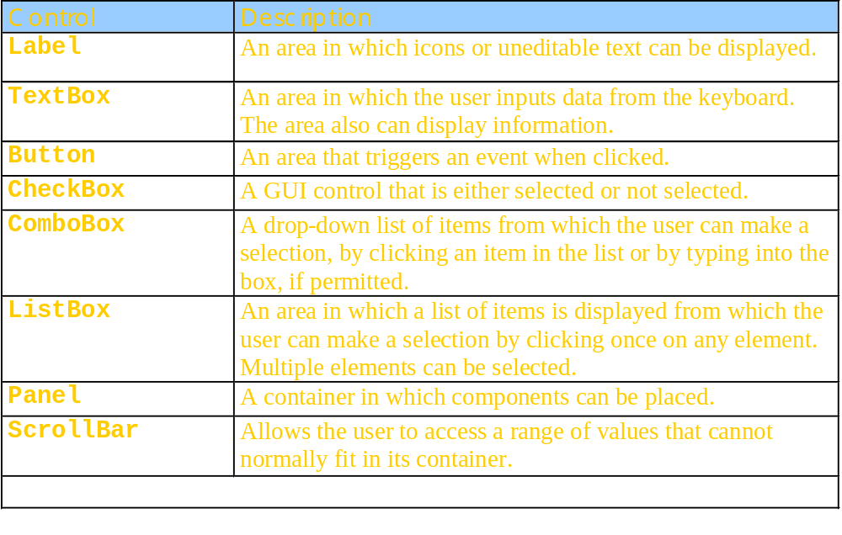
Some basic GUI components

Slide 81
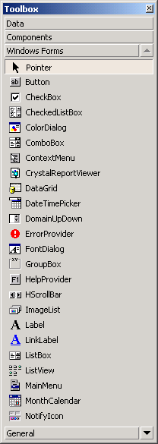
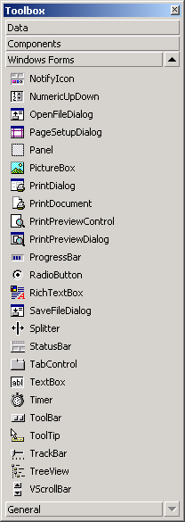
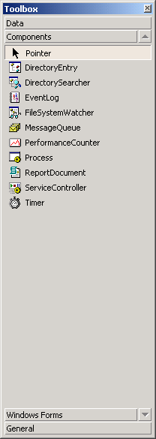
Components and Controls Windows Forms

Slide 82
Event-Handling Model
calls
Handler 1 for event E
calls
Object A raises event E
Delegate for event E
Handler 2 for event E
Handler 3 for event E

Slide 83
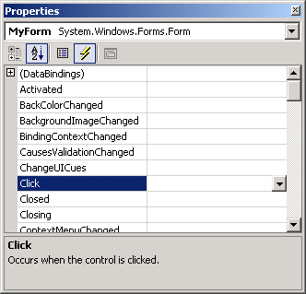
Basic Event Handling
Events icon
List of events supported by control
Selected event
Current even handler (none)
Event description

Slide 84
GDI+
GDI+ is and an enhanced version of the original GDI that has existed since the first version of Windows. GDI+ comes with Windows XP or with other versions of Windows (Windows 2000) when the .NET SDK is installed.

Slide 85
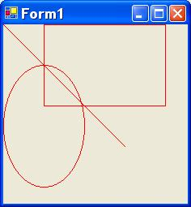
Graphics Device Interface (GDI+)
Good for 2D shapes on Windows Forms
Used to draw all Windows user-interface elements
Uses tools from the System.Drawing namespace
  These classes wrap native GDI functions in the Windows API
举例：gdi.cs

Slide 86
Introduction to GDI+
Graphics Device Interface
GDI has been around forever
  Before Windows 95
GDI+ is the .NET version of GDI
Like everything in .NET, GDI+ is easier to use and has more features than regular-old GDI

Slide 87
New Stuff in GDI+
Antialiasing (Edge smoothing)
Gradient brushes
Splines
Transformation and Matrices
Alpha Blending (Transparency)

Slide 88
What is GDI+ used for?
Used to draw the Windows interface elements
  Controls (Buttons, TextBoxes, etc)
  Anything else you need to draw in your window - as long as it does not need to be fast (DirectX)

Slide 89
Important GDI+ Objects
System.Drawing Namespace
  Graphics: Main object used to draw on a surface
  Pen, Brush, Font, Bitmap / Image
  Rectangle, Point, Size, Color
System.Drawing.Drawing2D Namespace
  Advanced 2D drawing support
  Matrices, blending, paths

Slide 90
Less Important GDI+ Objects
System.Drawing.Design Namespace
  Used to implement toolboxes / graphics editing functions
System.Drawing.Imaging Namespace
  Support for encoding / decoding many common image formats
System.Drawing.Printing Namespace
  Used to implement printing from your application
System.Drawing.Text Namespace
  Access to the user’s font collection

Slide 91
Some of the Crucial Classes of the GDI+
Class Description
Bitmap Represents bitmapped images
Font Defines font attributes: size, typeface, and so on
HatchBrush Defines fills performed with hatch patterns
LinearGradientBrush Defines fills performed with linear gradients
Pen Defines the appearance of lines and curves
SolidBrush Defines fills performed with solid colors
TextureBrush Defines fills performed with bitmaps

Slide 92
Animation
Your code in OnPaint runs everytime the window needs to be redrawn
  Window Dragged, Resized, Maximized
You can make this code run more often by calling the Refresh() method on your form (which will call OnPaint)
Add a Timer which calls Refresh on every “tick” to get animation
  If you really need animation, probably want to use DirectX

Slide 93
Exception Handling 1/2
.NET handles exception directly, i.e., without the intervention of a language( as is done in C++, Java, Lisp).
The .NET exception handling infrastructure includes blocks of
Try
Catch
Finally
Throw
The blocks have the same type of functionality you have seen before in C++, Lisp and Java.

Slide 94
Exception Handle 2/2
Read like this:
  try running this code ...
  ... if error occurs, catch what I can deal with ...
  ...finally allow me to do some manual cleanup work
Example
try
{
//... run code
}
catch(SomeException e)
{
//... handle
}
finally
{
//...end gracefully
}

Slide 95
Thread
System.Threading contains classes for multi-thread programming:
  ThreadStart
  Thread
New Thread(new ThreadStart(worker))
线程间的数据交互通过实例化一个对象进行

Slide 96
Thread安全与同步
Monitors
Mutex
Locks
ReaderWriterLocks
Events

