Slide 1
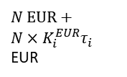




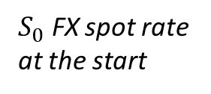

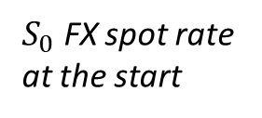

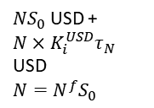
1) At $T_{0}$ (start)
2) During the term
3) At $T_{f}$ (maturity)
Party B
Party B
Party B
$N^{f}$EUR
$N$USD
$$N=N^{f}S_{0}$$
$N×K_{i}^{EUR}τ_{i}$ EUR
$N×K_{i}^{USD}τ_{i}$ USD
$N$ EUR +
$N×K_{i}^{EUR}τ_{i}$ EUR
$NS_{0}$USD +
$N×K_{i}^{USD}τ_{N}$ USD
$$N=N^{f}S_{0}$$
Party A
Party A
Party A
$S_{0}$ FX spot rate at the start
$S_{0}$ FX spot rate at the start

Slide 2
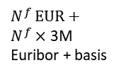




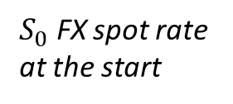

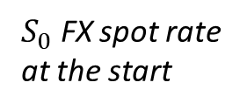

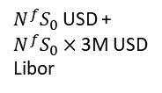
1) At $T_{0}$ (start)
2) During the term
3) At $T_{f}$ (maturity)
Party B
Party B
Party B
$N^{f}$EUR
$N^{f}S_{0}$USD
$N^{f}×$ 3M Euribor + basis
$N^{f}S_{0}×$3M USD
Libor
$N^{f}$ EUR +
$N^{f}×$ 3M Euribor + basis
$N^{f}S_{0}$USD +
$N^{f}S_{0}×$3M USD
Libor
Party A
Party A
Party A
$S_{0}$ FX spot rate at the start
$S_{0}$ FX spot rate at the start

Slide 3

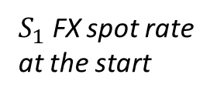


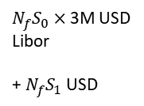
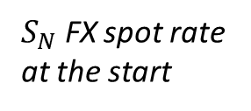


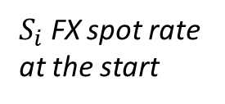

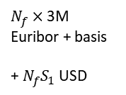
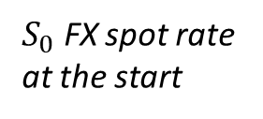

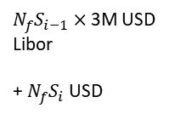
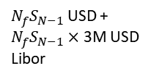


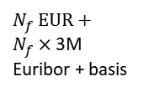
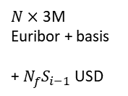
1) At $T_{0}$ (start)
2) During the term at $T_{i}, i=1, …, N−1$
3) At $T_{N}$ (maturity)
Party B
Party B
Party B
Party B
$$⋯$$
$$⋯$$
$N_{f}$EUR
$N_{f}S_{0}$USD
$N_{f}×$ 3M Euribor + basis
+ $N_{f}S_{1}$ USD
$N_{f}S_{0}×$3M USD
Libor
+ $N_{f}S_{1}$ USD
$N×$ 3M Euribor + basis
+ $N_{f}S_{i−1}$ USD
$N_{f}S_{i−1}×$3M USD
Libor
+ $N_{f}S_{i}$ USD
$N_{f}$ EUR +
$N_{f}×$ 3M Euribor + basis
$N_{f}S_{N−1}$USD +
$N_{f}S_{N−1}×$3M USD
Libor
Party A
Party A
Party A
Party A
$$⋯$$
$$⋯$$
$S_{0}$ FX spot rate at the start
$S_{1}$ FX spot rate at the start
$S_{i}$ FX spot rate at the start
$S_{N}$ FX spot rate at the start

