Slide 1
Simulation model for SoftStop
PRO24_0006_IBC&EMB-RT for VSS
September 2025

Slide 2
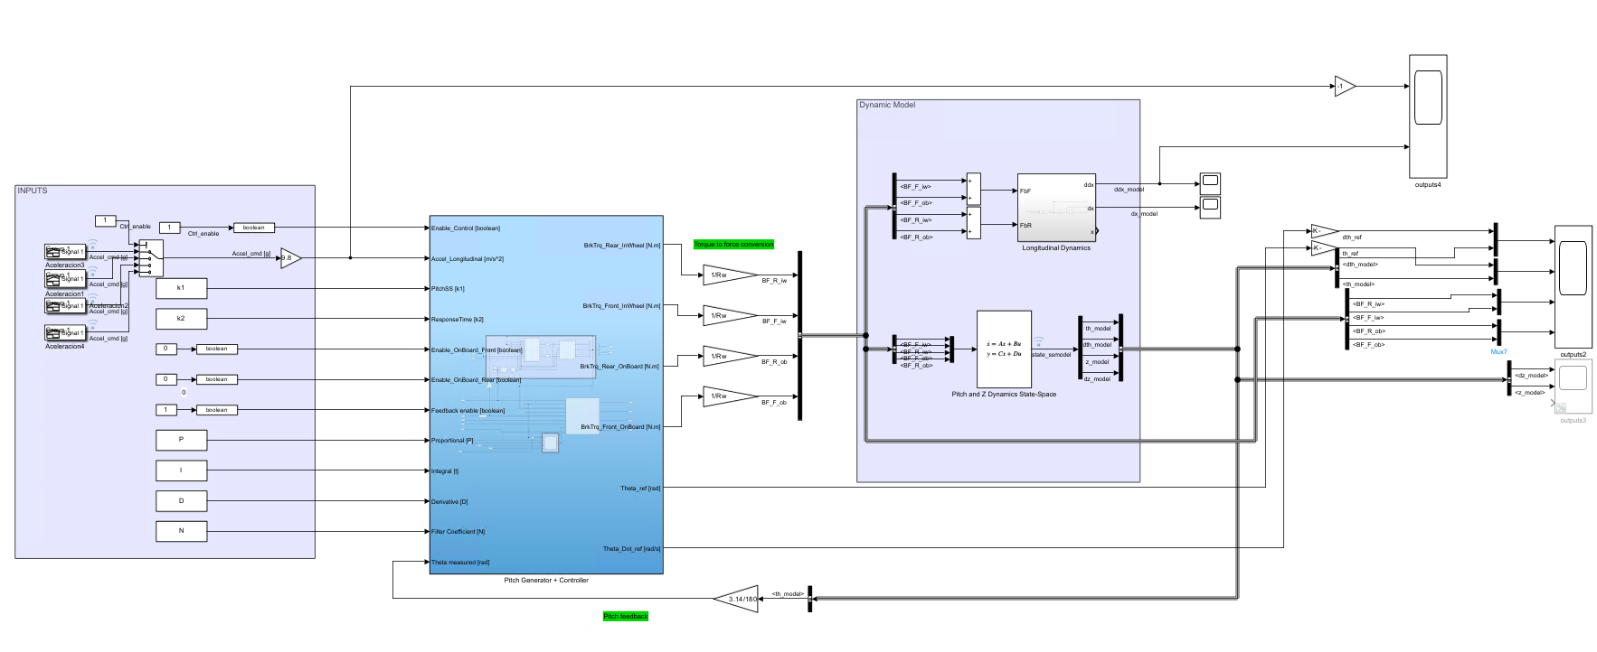
Simulink Simulation Model
The Simulink model provides a detailed representation of the modeling and control for SoftStop. It includes both the detailed controller and the simplified model of the vehicle dynamics. The simulation model can be decomposed in 3 main blocks:
Input Data
+
Controller parameters
Pitch Reference Generator
+
Controller (FB and FF)
Simplified Vehicle
Dynamic model

Slide 3
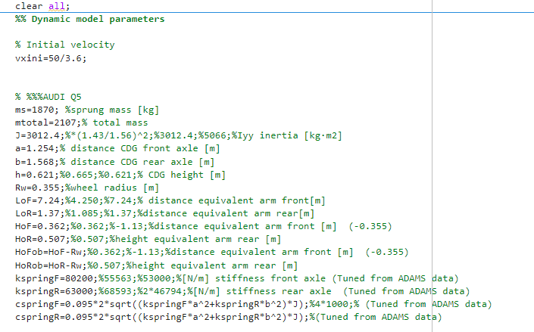
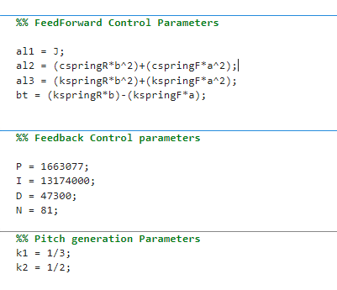
Input Data + Control parameters
The file initializes the model parameters.
It primarily contains the vehicle parameters and the matrices that define the state-space representation of the simplified vehicle model.
The behavior of the controller and the reference generation can be adjusted by modifying the parameters: P, I, D, and N for feedback control, and k1 and k2 for reference generation.
The default values correspond to the nominal values used for the FMU tests in ADAMS.

Slide 4
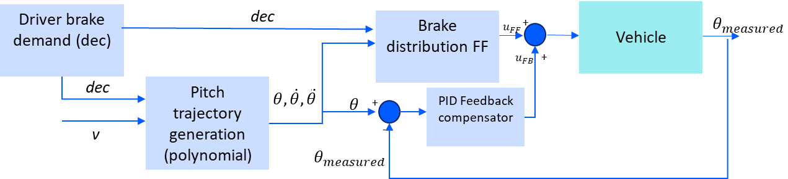



Pitch Reference Generator + Controller (FB and FF)
The controller follows the same input/output structure as the tested FMUs. Based on the pitch reference generation and the controller parameters, it takes a deceleration command as input to generate a pitch reference and a force distribution according to the controller parameters.
It supports the same modes of operation:
Feedback: on/off
Rear axle: in-wheel or on-board
Front axle: in-wheel or on-board
Input Variables
Enable control | Activate the control system. When false, the output torques are all 0.
Accel Longitudinal | Desired longitudinal acceleration of the vehicle.
PitchSS k1 | Gain to adjust stationary value of pitch generator
ResponseTime k2 | Gain to adjust time response of pitch generator
Enable On-Board Front | Enables on-board braking on the front axle
Enable On-Board Rear | Enables on-board braking on the rear axle
Feedback Enable | Enables the feedback controller
Theta Measured | Actual pitch angle from vehicle sensors
Proportional | Gain of proportional component of Feedback Ctr
Integral | Gain of integral component of Feedback Ctr
Derivative | Gain of derivative component of Feedback Ctr
FilterCoefficient | Filter coeficient for derivative of Feedback Ctr
$$F_{bR}=\frac{α_{1}\ddot{θ}+α_{2}\dot{θ}+α_{3}θ−(h−tanφ_{F}a{)m}_{s+u}\ddot{x}}{(h−tanφ_{R}b)−(h−tanφ_{F}a)}$$
$$F_{bF}=\frac{(h−tanφ_{R}b)m_{s+u}\ddot{x}−α_{1}\ddot{θ}−α_{2}\dot{θ}−α_{3}θ}{(h−tanφ_{R}b)−(h−tanφ_{F}a)}$$
Pitch Ref Generator
Parameters
Feed-Forward control law: Parameters $α_{1}$… defined in initialization script
On-Board Front | On-Board Rear | Feedback Enabled
0 | 0 | 0
1 | 0 | 0
0 | 1 | 0
1 | 1 | 0
0 | 0 | 1
1 | 0 | 1
0 | 1 | 1
1 | 1 | 1
Control mode
selector
Sensor measurement
Feedforward only
Adjustable
PID
Parameters
Feedforward +
Feedback control

Slide 5
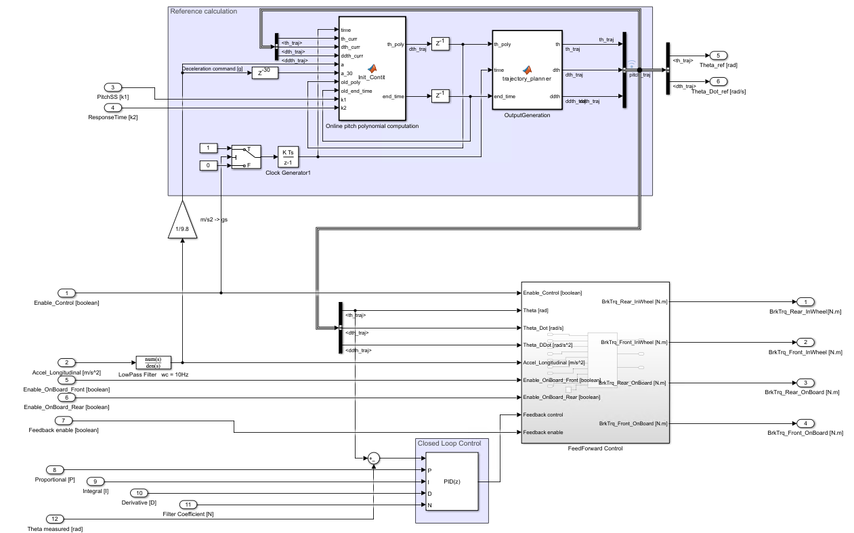

Pitch Reference Generator + Controller (FB and FF)
Pitch trajectory generation (polynomial)
The controller block is composed by the following main blocks:
Pitch trajectory generation:
Polynomial calculation: Computes a smooth pitch trajectory polynomial based on k1, k2, and the desired deceleration. The polynomial is updated in real time in response to changes in the deceleration command .
Pitch signal generation: Using the current polynomial, this module generates the corresponding pitch signals, including pitch, pitch rate, and pitch acceleration.
PID Feedback compensator: Computes the feedback component, based on the pitch tracking error.
Brake distribution FF: First, it computes the feedforward braking control based on the pitch and deceleration reference signals. Then, depending on the selected mode of operation (in-wheel or on-board, with or without feedback), it adapts the control by adding feedback if enabled and distributing the braking torque to the outputs accordingly to the mode of operation.
Polynomial calculation
Pitch signal generation
Brake distribution FF
PID Feedback compensator
$$F_{bR}=\frac{α_{1}\ddot{θ}+α_{2}\dot{θ}+α_{3}θ−(h−tanφ_{F}a{)m}_{s+u}\ddot{x}}{(h−tanφ_{R}b)−(h−tanφ_{F}a)}$$
Feed-Forward control law: Parameters $α_{1}$… defined in initialization script
$$F_{bF}=\frac{(h−tanφ_{R}b)m_{s+u}\ddot{x}−α_{1}\ddot{θ}−α_{2}\dot{θ}−α_{3}θ}{(h−tanφ_{R}b)−(h−tanφ_{F}a)}$$

Slide 6
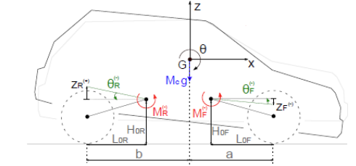




Simplified Vehicle Dynamic model
The simplified model used for the pitch and heave dynamics are the following. This information is coded into a state-space representation in the simulation model.
Equations for pitch and heave dynamics of sprung mass
Pitch Inertia
Pitch stiffness and damping
Heave coupling
$J\ddot{θ}+\left(K_{sR}b^{2}+K_{sF}a^{2}\right)θ+\left(c_{dR}b^{2}+c_{dF}a^{2}\right)\dot{θ}+\left(K_{sR}b−K_{sF}a\right)z+\left(c_{dR}b−c_{dF}a\right)\dot{z}={(h−tanφ_{R}b)F}_{bR_IW}+{(h−tanφ_{F}a)F}_{bF_IW}$ + ${(h−tan\hat{φ_{R}}b)F}_{bR_OB}+{(h−tan\hat{φ_{F}}a)F}_{bF_OB}$
Torque from braking forces (in-wheel)
Torque from braking forces (on board)
Heave mass
Pitch coupling
Heave stiffness and damping
$$m_{s}\ddot{z}+\left(K_{sR}b−K_{sF}a\right)θ+\left(c_{dR}b−c_{dF}a\right)\dot{θ}+\left(K_{sR}+K_{sF}\right)z+\left(c_{dR}+c_{dF}\right)\dot{z}=$$
$$−tanφ_{R}F_{bR_{IW}}+tanφ_{F}F_{bF_{IW}}−tan\hat{φ_{R}}F_{bR_OB}+tan\hat{φ_{F}}F_{bF_OB}$$
Torque from braking forces (in-wheel)
Torque from braking forces (on board)
$$F_{bR}$$
$$tanφ_{F}$$
$$tanφ_{R}$$
$$F_{bF}$$

Slide 7

¡Thank you!

Slide 8
主要流程：
信号采集与预处理
获取驾驶员压力请求、车辆速度、加速度、坡度等信号。
判断各类信号有效性和系统状态（如Boost状态、信号完整性等）。
软停激活判据
检查舒适停车开关、Boost系统、信号有效性等，决定是否允许软停。
检查其他性能子系统（如ABS等）是否激活，防止冲突。
采用延时机制，避免性能子系统刚退出时立即进入软停。
坡度补偿
根据坡度查表调整驻车压力，防止车辆在坡道上溜车。
车辆行驶方向判定
检查所有车轮是否为前进方向，作为软停激活的前提。
状态机管理
状态包括：OFF、STANDBY、ACTIVE、FAILURE。
进入ACTIVE状态需满足一系列判据（如压力、速度、加速度、坡度、方向等）。
状态切换时重置计时器和相关标志。
压力请求计算
ACTIVE状态下，根据车辆速度、停止状态、加速检测等，动态调整压力请求。
坡道、滚动、反向驾驶等特殊情况做压力补偿。
SSM（自动泊车等）特殊场景下，压力请求做斜坡上升。
压力速率限制
对压力变化速率做滤波和限幅，保证舒适性和安全性。
低Boost检测
检查Boost压力是否低于阈值，计时后置低Boost标志。
软停结束与复位
车辆速度高于阈值、压力请求低于阈值、性能子系统激活等，均会退出软停。
退出时压力做斜坡恢复，防止突变。
轮个体接口
将压力请求和速率分配到每个车轮，便于后续轮个体控制

Slide 9
输入读取：从 Db_Input、WhlSpd、ArbBoost/Bhs/PerfMode 等读取车速、车轮转向、坡度、制动踏板请求、Boost 状态、SSM/驻车相关信号等。
激活条件判定：判断是否满足软停触发条件（速度阈、制动踏板释放/接近停止、方向一致性、Boost/系统允许、信号完整性等）。
状态机/计时器：管理 OFF/Standby/Active 等状态，使用定时器防抖与延时退出（避免与其它子系统冲突）。
压力计算：计算每个轮的目标驻车/保持压力（考虑坡度补偿、方向、停止后保持压力、速度相关梯度等）。
速率限制与滤波：对压力上/下调速率进行限幅和平滑，以保证舒适性。
输出与仲裁：将结果写入 DbSoft 结构，并可能与 Arb/Boost/Bhs 等模块协同仲裁。
NVRAM：读取/写回可能的配置或累计计数等。

