Slide 1




KNOWLEDGE SHARING SESSION
Understanding LLMs
& Agentic AI
From neural networks to autonomous agents — a practical guide for everyone
45-minute session
All levels welcome
Interactive & practical

Slide 2




TODAY'S AGENDA
01
What is an LLM?
8 min
Training, architecture & how it works
02
Tokenization
5 min
How AI reads and writes language
03
Agentic AI
10 min
When AI takes action, not just answers
04
Corporate Applications & AI Tools
12 min
Claude Code, RAG, Vector DB, LangChain & LangGraph
05
2026 Trends
10 min
Frontier research & new paradigms

Slide 3
PART 01
What is a
Large Language Model?
Training · Architecture · How it really works

Slide 4



01 · LLM INTRODUCTION
LLM: Powerful “Autocomplete” based on probability
A Large Language Model (LLM) is a type of AI designed to understand, generate, and process human-like text by training on massive datasets, typically using a transformer-based neural network.
Trained on the entire bit world
LLMs by the numbers
Books, articles, websites, code — billions of documents from the internet.
1T+
Parameters in frontier models
Predicts the next word
~$100M+
Instead of memorizing facts, it learns statistical patterns: what words follow what. Every response is built one token at a time, choosing the most likely next word given context.
Estimated training cost for top models

Slide 5
02 · TOKENIZATION
Tokens: The Building Blocks of Language AI
"ChatGPT is amazing!" → broken into tokens:
Chat
G
PT
is
amazing
!
#400
#1647
#2894
#4141
#5388
#6635
A token ≠ a word
Context window
Why it matters
Tokens are subword units. Common words are one token; rare words split into multiple. 1 token ≈ ¾ of an English word on average.
Models have a limit on how many tokens they can 'remember' at once (context window). GPT-4 Turbo: 128K tokens ≈ a full novel.
You pay per token with APIs. Long prompts cost more. Knowing this helps you write efficient prompts and understand model limits.
Tokenizer Playground: Tokenizer Playground

Slide 6


01 · LLM INTRODUCTION
How an LLM is Trained
Pre-Training
Post-Training
1
2
3
4
5
Collect Data
Token-Level Internet Document Simulator
Supervised Fine-Tuning (SFT)
Reinforcement Learning with Human Feedback
(RLHF)
Deployment
Gather trillions of words from web, books, code. Clean and filter for quality.
Model learns to predict the next token. Runs for weeks on thousands of GPUs.
Model discerns between good responses and bad responses, learning styles and format
Humans rate outputs. The model is fine-tuned to be helpful, harmless, honest (RLHF).
Serving the model through API, such as ChatGPT, Claude, Gemini
Key insight: The model never memorizes answers — it learns the structure of language itself.

Slide 7
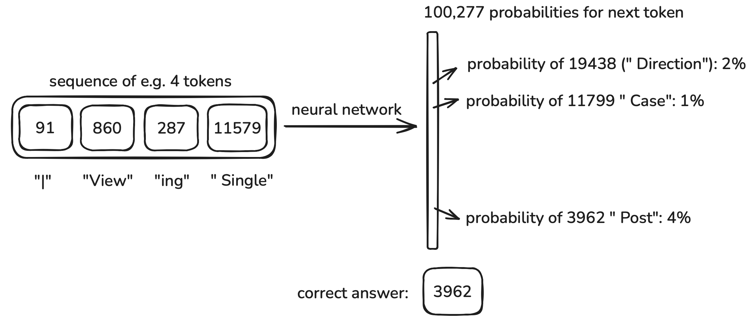
01 · LLM INTRODUCTION
How an LLM is Trained: Pre-Train Stage
with transformer layers
Model Architecture Visualizer: Model Architecture Visualizer

Slide 8
PART 02
Agentic AI
and Corporate Applications
When AI stops answering and starts doing

Slide 9
02 · AGENTIC AI and Corporate Applications
TD Prism Applications – Spotlight Use Case

Slide 10
02 · AGENTIC AI and Corporate Applications
From Question-Answering to Taking Action
Traditional LLM Chat
Agentic AI
→ You ask → It answers
✓ You set a goal → It figures out steps
→ Responds in text
✓ Takes actions in the real world
→ No memory between sessions
✓ Maintains memory across tasks
→ Passively waits for input
✓ Proactively plans and executes
→ Cannot browse, run code, or send emails
✓ Can use tools: web, code, email, APIs
→ Single turn: one prompt, one response
✓ Multi-step: loops until goal is achieved

Slide 11


04 · CORPORATE APPLICATIONS
Where Companies Are Deploying AI Today
Customer Service
Code Generation
Knowledge Search
AI chatbots handling tier-1 support, reducing wait times and freeing human agents for complex cases.
Developers use Copilot-style tools to autocomplete, review, and document code. 30–50% productivity gains reported.
Enterprise search across internal documents, wikis, and emails. Instant answers from thousands of PDFs.
Data Analysis
Process Automation
Risk & Compliance
Natural language queries on databases. 'Show me sales by region last quarter' without writing SQL.
Agentic AI handles multi-step workflows: invoice processing, HR onboarding, compliance checks.
Automated contract review, policy checking, and regulatory monitoring at scale.

Slide 12
02 · AGENTIC AI and Corporate Applications
What to Watch Out For
Hallucinations
Data Privacy
AI can confidently produce incorrect information. Always verify critical facts. Use RAG (Retrieval-Augmented Generation) to ground responses in your data.
Sensitive data sent to AI APIs may leave your network. Choose on-prem or private-cloud deployments for confidential information.
Over-reliance
Integration Cost
Teams may stop thinking critically. AI should augment human judgment, not replace it — especially for strategic or ethical decisions.
Connecting AI to legacy systems takes engineering effort. Start with low-risk pilots before enterprise-wide rollouts.

Slide 13
02 · AGENTIC AI and Corporate Applications
Claude Code and OpenAI Codex
AI coding assistants that read your entire codebase and act like a senior developer by your side
Claude Code (Anthropic)
Codex (OpenAI)
$ claude
Claude Code ready. How can I help?
> Find all API calls missing error handling
Scanning 47 files...
Found 3 issues in payments.js, auth.js
Applying fixes... Done!
Works in your terminal. Sees your full repo.
codex >
Sandbox ready.
> Write unit tests for checkout.py
Analyzing checkout.py...
Generated 12 tests, ran in sandbox: 12/12 passed
Saved to test_checkout.py
Runs tasks in a safe cloud sandbox.
Key insight: You stay in charge. The AI handles the repetitive work so you focus on logic and design.

Slide 14
02 · AGENTIC AI and Corporate Applications
Retrieval-Augmented Generation (RAG)
Stop hallucinations. Ground AI answers in your actual company data.
1. User Question
“What is our refund policy?”
2. Search Docs
Vector similarity search on company docs
3. Retrieve Context
Top 3 matching paragraphs returned
4. LLM Answers
Grounded in retrieved facts, not guesses
Without RAG
With RAG
LLM only uses training data (cut off months ago). Fabricates or guesses company-specific answers. Dangerous for legal, HR, or finance queries.
AI retrieves from your actual documents first. Answer is grounded in your current policies, updated data, and proprietary knowledge. Cites sources.
Why it matters for enterprise: Your data stays internal. AI becomes an expert on your company’s knowledge, not just the internet.

Slide 15
02 · AGENTIC AI and Corporate Applications
Vector Database
The engine behind RAG — stores meaning, not just text, so AI can find what’s relevant
How it works: Text → Numbers
Similarity Search Example
Every document gets converted to a vector — a list of numbers capturing its meaning:
“Refund within 30 days”
↓ embedding model
[0.82, -0.31, 0.14, 0.67, ...]
Similar meaning = similar numbers. “Can I get my money back?” lands near the refund policy — even though the words are different.
Query: “Can I get my money back?”
Refund Policy doc — 90% match
FAQ: Returns & Exchanges — 60%
Shipping Guide — 30%
Top match is injected into the prompt as context. AI answers with real data.
Common databases: Pinecone, Weaviate, pgvector (PostgreSQL extension), Chroma, Qdrant. Most cloud providers now offer built-in vector search.

Slide 16
02 · AGENTIC AI and Corporate Applications
LangChain and LangGraph
The developer toolkit for building AI agents — LangChain for pipelines, LangGraph for stateful workflows
LangChain
LangGraph
A framework for chaining LLM calls into pipelines. Connect your model to tools, memory, and data sources with a few lines of code.
Best for: RAG apps, chatbots, document Q&A
Pro: Huge ecosystem, fast to prototype
Con: Linear flows only; limited for complex multi-step agents
Built on LangChain, models agents as a graph: nodes are actions, edges are decisions. Enables loops, branching, and human-in-the-loop checkpoints.
Best for: Multi-step agents, approval workflows
Pro: Handles cycles, state, and conditional routing
Con: Steeper learning curve; heavier for simple tasks
LangGraph agentic loop: START → Plan → Use Tools → Check Result → Done? → Yes: END | No: loop back to Plan
Rule of thumb: Start with LangChain for simple RAG and Q&A apps. Graduate to LangGraph when your agent needs to loop, branch, or pause for human review.

Slide 17
PART 03
2026 Trends &
Frontier Research
What’s the new “buzzword”

Slide 18



05 · 2026 TRENDS & FRONTIER RESEARCH
01
Memory System
HOT
AI agents now require persistent memory across sessions. Three layers: in-context (prompt), external (vector DB), and continual learning (weights). Harness Engineering — Agent = Model + Harness — is the 2026 architecture paradigm for reliable, grounded agents.
02
Agentic “Super Agents” & Multi-Agent Systems
HOT
AI agents that plan, use tools, and complete complex tasks autonomously. Multi-agent dashboards let teams orchestrate fleets of specialized agents. Real examples: Claude Code, GitHub Copilot Workspace, Anthropic Cowork, Google Agentspace.
03
Corporate Adoption
HOT
Frontier models are being distilled into compact versions (SLMs). Runs on your laptop or phone. Enables offline AI and cost-efficient deployments.
04
“Autoresearch” by Andrej Kaparthy
HOT
Karpathy’s vision: AI that autonomously reads papers, forms hypotheses, runs experiments, and iterates — compressing months of human research into hours. Already emerging in drug discovery and materials science labs via AI co-scientists.
06
AI Safety & Alignment
WATCH
As AI systems become more autonomous, keeping them aligned with human intent becomes critical. Interpretability, and tractability research remain as key 2026 focus area.

Slide 19
Thank You
Questions & Discussion
Slides available on request · Built with curiosity and a lot of tokens

Slide 20
Resource Page
Resources

