Slide 1



KNOWLEDGE SHARING SESSION
Agentic AI & Evaluation
From Chatting to building— a practical guide for everyone
2026-08-07
Internal - CBCC

Slide 2



TODAY'S AGENDA
01
From ChatGPT to Codex
02
Agentic AI System
03
Evaluation
04
Demo Walkthrough

Slide 3
03 · AGENTIC AI EVALUATION
From ChatGPT to Codex
The evaluation of AI Products
SA
Sam Altman
MAY–NOV 2024
MAY 2025
JUN–JUL 2026
@sama • Nov 30, 2022
Multimodal + tools
Codex
Fable / Mythos 5
GPT-5.6 Sol
“today we launched ChatGPT.
try talking with it here:”
GPT-4o • Computer Use
• Model Context Protocol
Cloud agent edits, tests
and proposes changes
Long-horizon, tool-rich
frontier systems
The public starting point
MAR 2023
FEB 2025
JAN–JUL 2025
GPT-4 + Claude
Claude Code
Institutional AI
Frontier assistants:
multimodal + steerable
An agent works directly
inside the terminal
ChatGPT Gov • Claude Gov
enterprise + defense use
ADOPTION EXPANDS
Each stage adds users, workflows, controls, and institutional responsibility.
PERSONAL USERS
BUILDERS
ENTERPRISES
AGENTIC WORK
PUBLIC SECTOR + DEFENSE
Everyday conversations
Apps through APIs
Secure business workflows
Delegated, multi-step tasks
Governed institutional deployment
The trajectory is not only smarter models—it is a shift from answering questions to completing consequential work.
Dates: official OpenAI and Anthropic launch announcements.

Slide 4
03 · AGENTIC AI EVALUATION
From ChatGPT to Codex
Scaling Law & Engineering Wonder
WHAT MAKES THE MODEL MORE CAPABLE?
1
Compute & scale
2
Better training data
3
Model architecture
4
Post-training
5
Inference reasoning
Parameters, training compute
Quality, diversity, feedback
Efficiency and longer context
Instruction following, alignment
More work on hard problems
THE UNLOCK: AUGMENT THE MODEL WITH A SYSTEM AROUND IT
FOUNDATION LLM
AUGMENTATION LAYER
AGENTIC AI SYSTEM
Think &
communicate
Give the model context and capabilities
Reason, act, and adapt (ReACT)
Context & memory
Tools & APIs
UNDERSTAND
+
+
Relevant knowledge and state
+
Search, calculate, transact
Understand language
OBSERVE
GOAL
PLAN
Reason over context
Runtime & terminal
Orchestration
completion
>_
Execute code and commands
✓
Planning, controls, guardrails
Generate a response
OUTPUT: WORDS
ACT
THE TRANSITION
Model intelligence determines what AI can reason about.
Tools + runtime determine what it can do.
This is the bridge from conversational AI to systems that can complete work across software, devices, and real-world workflows.

Slide 5
TODAY'S AGENDA
01
From ChatGPT to Codex
02
Agentic AI System
03
Evaluation
04
Demo Walkthrough

Slide 6
03 · AGENTIC AI EVALUATION
Agentic AI System
“Agentic” is not a magic product category, it is a design choice
“When building applications with LLMs, we recommend finding the simplest solution possible, and only increasing complexity when needed. This might mean not building agentic systems at all.
Agentic systems often trade latency and cost for better task performance, and you should consider when this tradeoff makes sense.”
- Anthropic, “Building Effective Agents” (Dec 2024).

Slide 7
03 · AGENTIC AI EVALUATION
Agentic AI System
From workflow automation to agentic systems
More predictable
More flexible
Fixed code
LLM as helper
LLM as controller
Fixed path
Model supports steps
Model directs progress
Conventional workflow
LLM-assisted workflow
Agentic system
Sequence is pre-defined
LLM interprets or drafts
LLM chooses next step
Rules decide every branch
Code still controls path
Tools read or change systems
Reliable when work is stable
Useful when language is part of the work
Guardrails constrain autonomy
We are mostly here

Slide 8
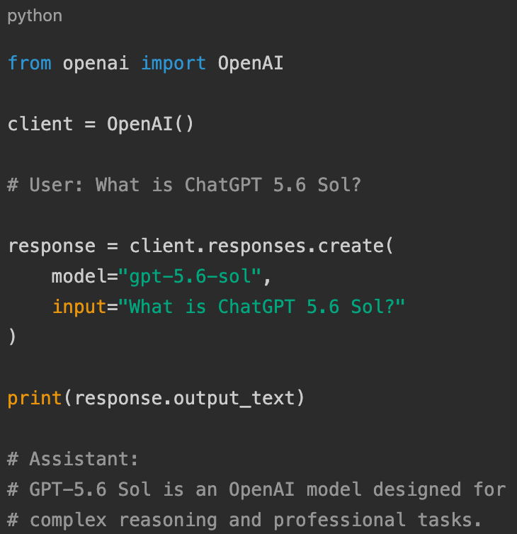
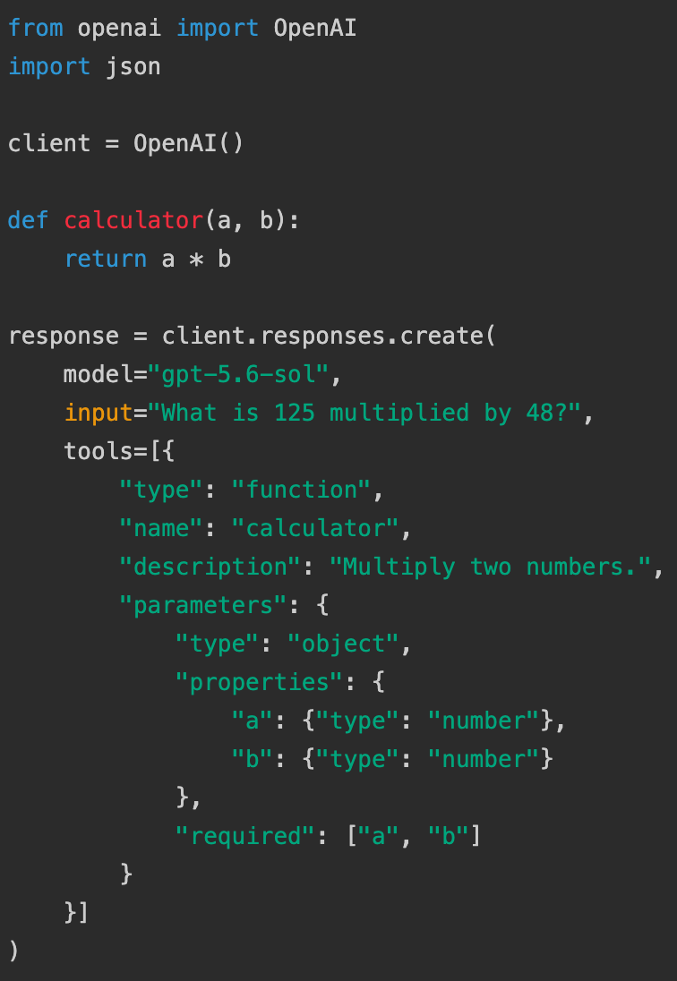
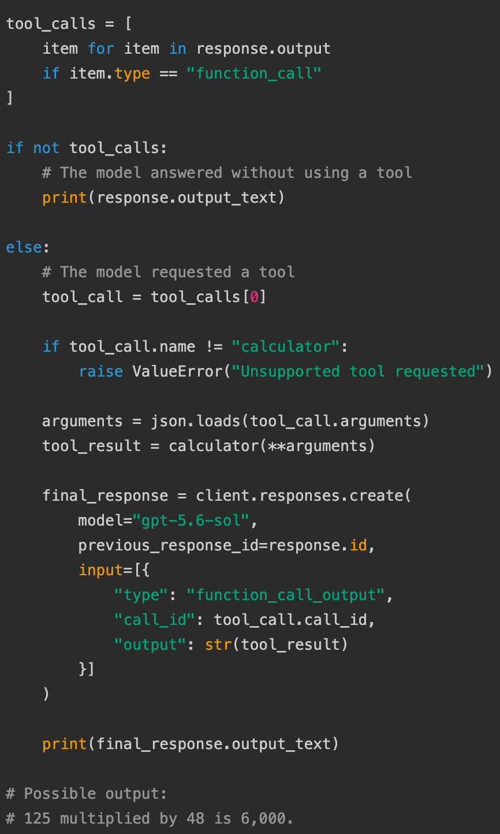
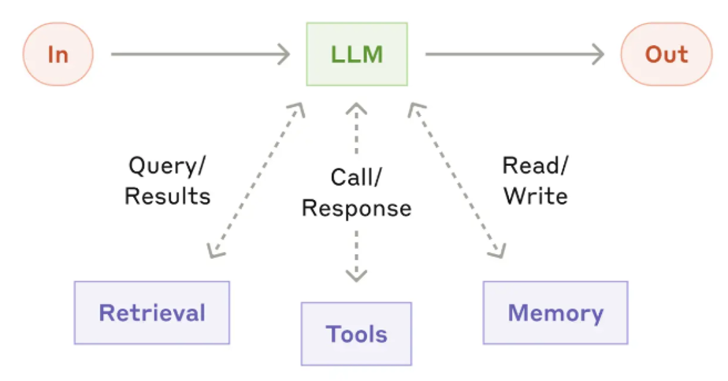
03 · AGENTIC AI EVALUATION
Agentic AI System
The augmented LLM, the building block of agentic system
Simple Chat
Workflow with tools

Slide 9
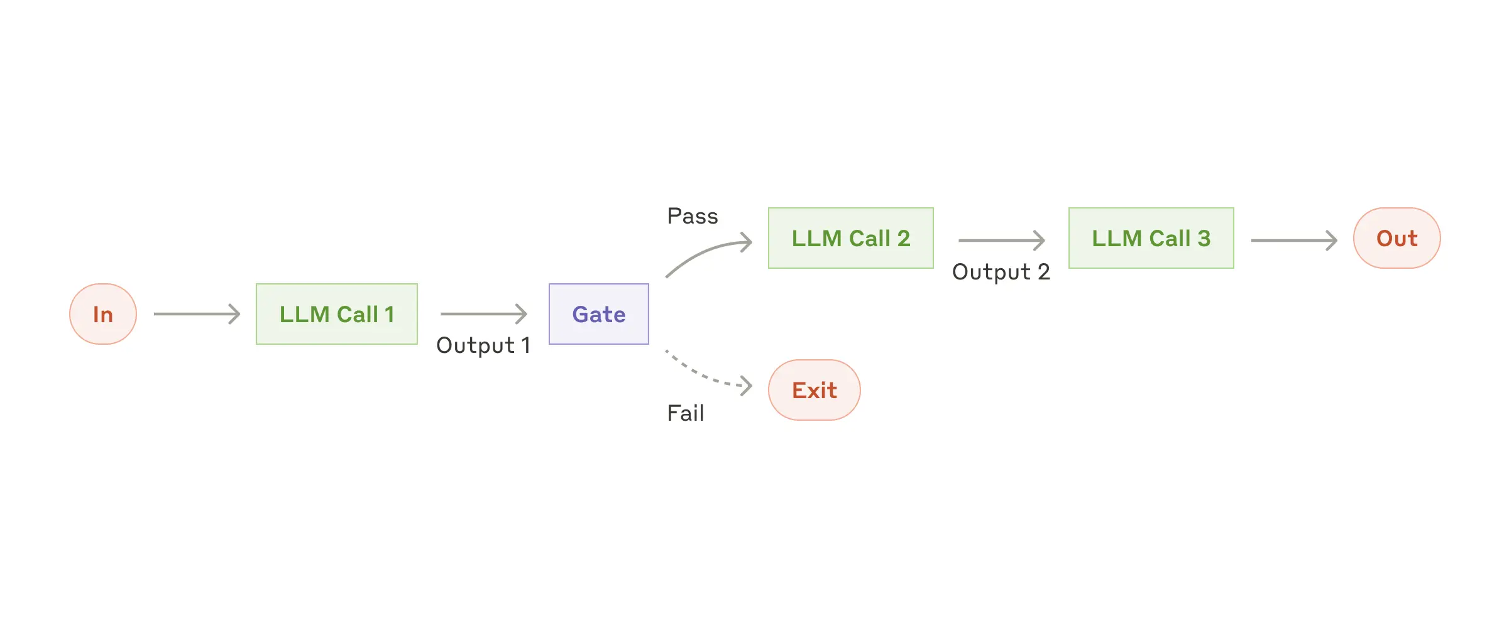
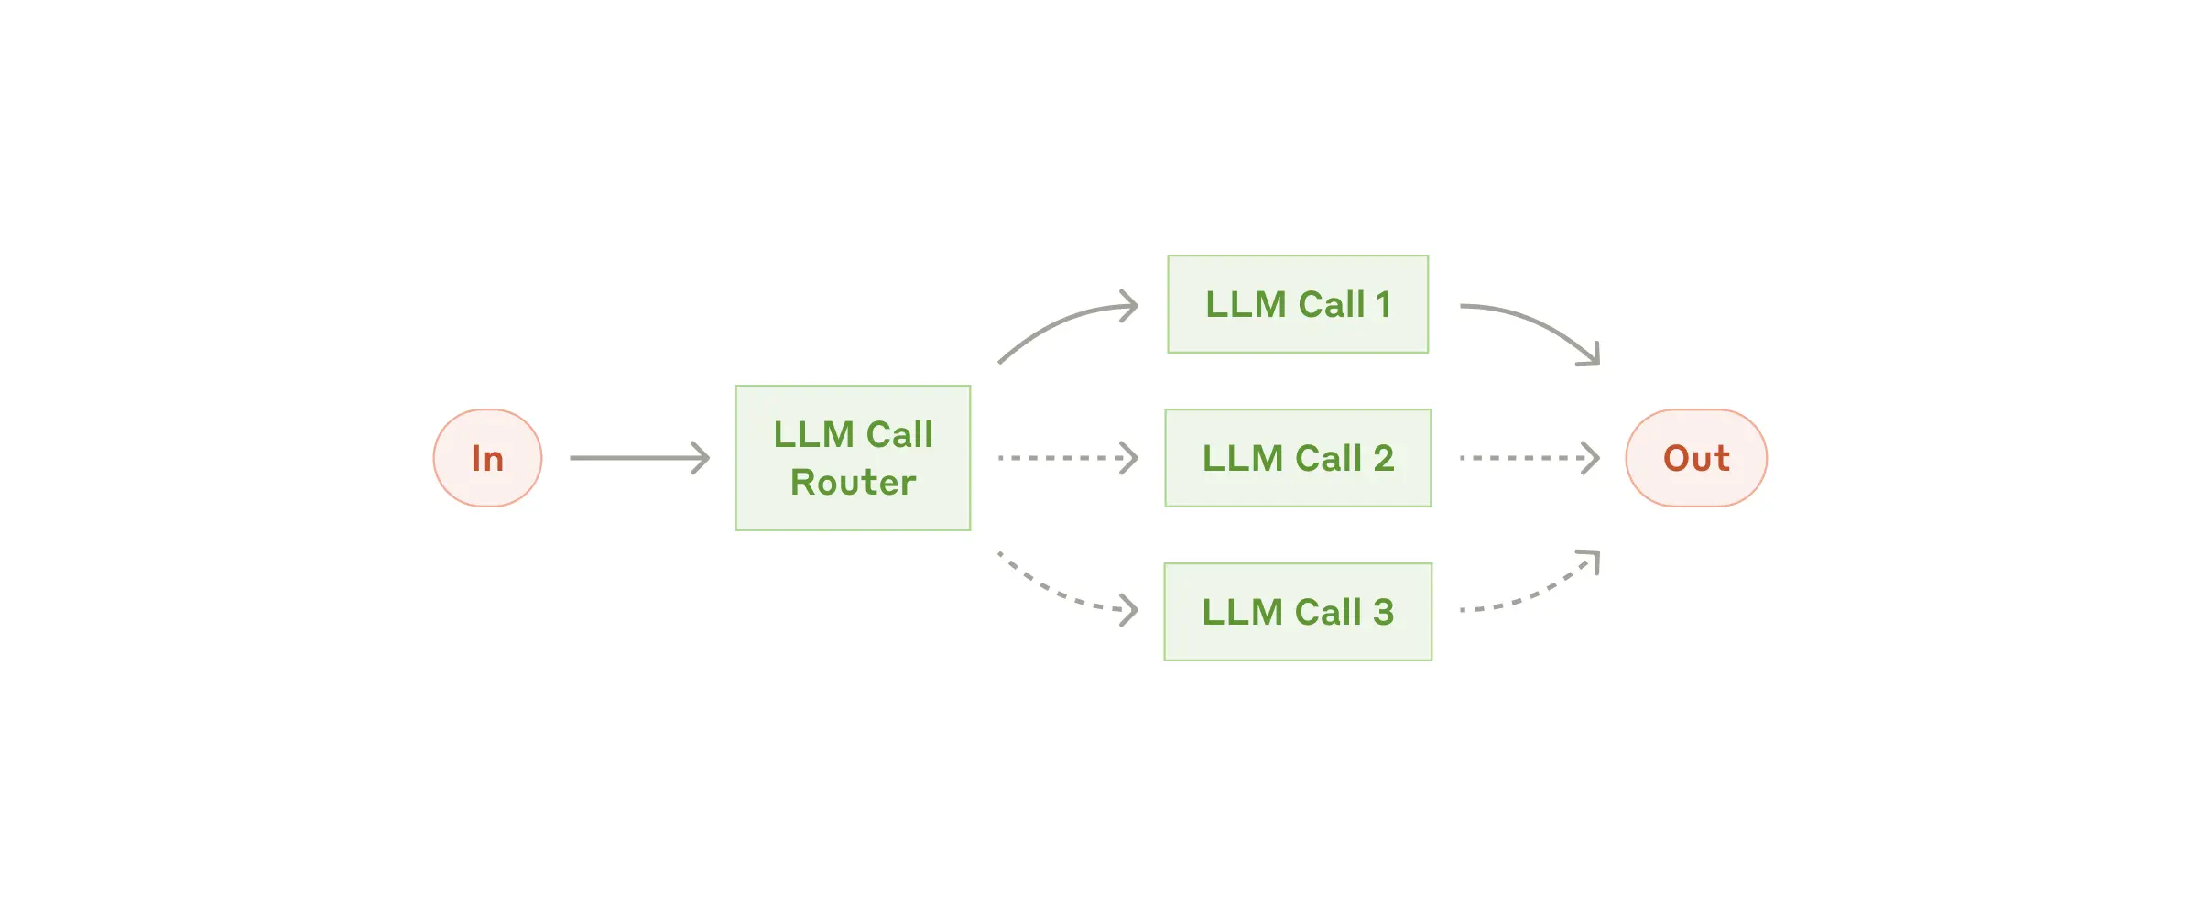
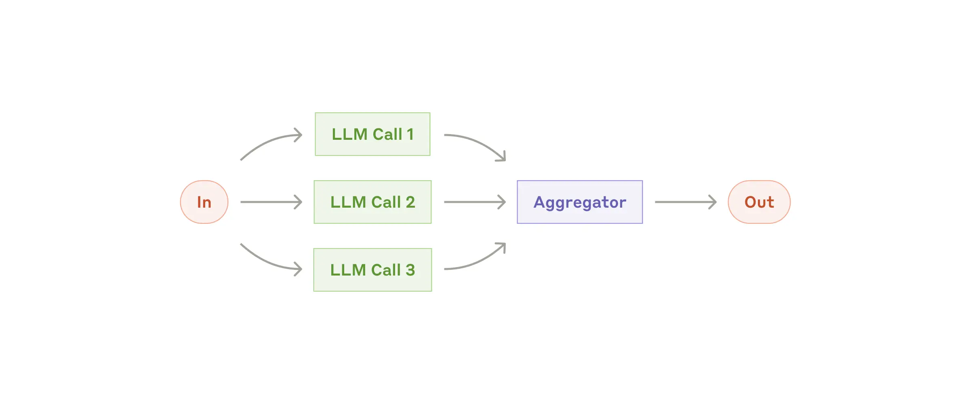
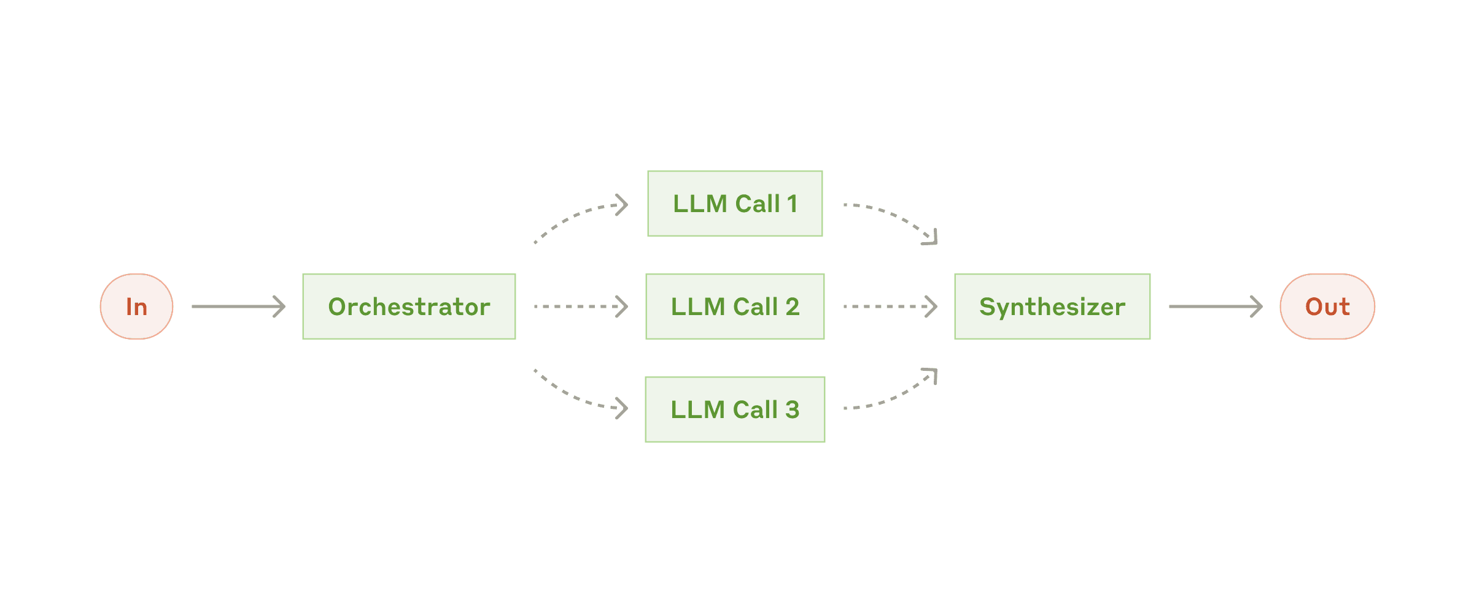
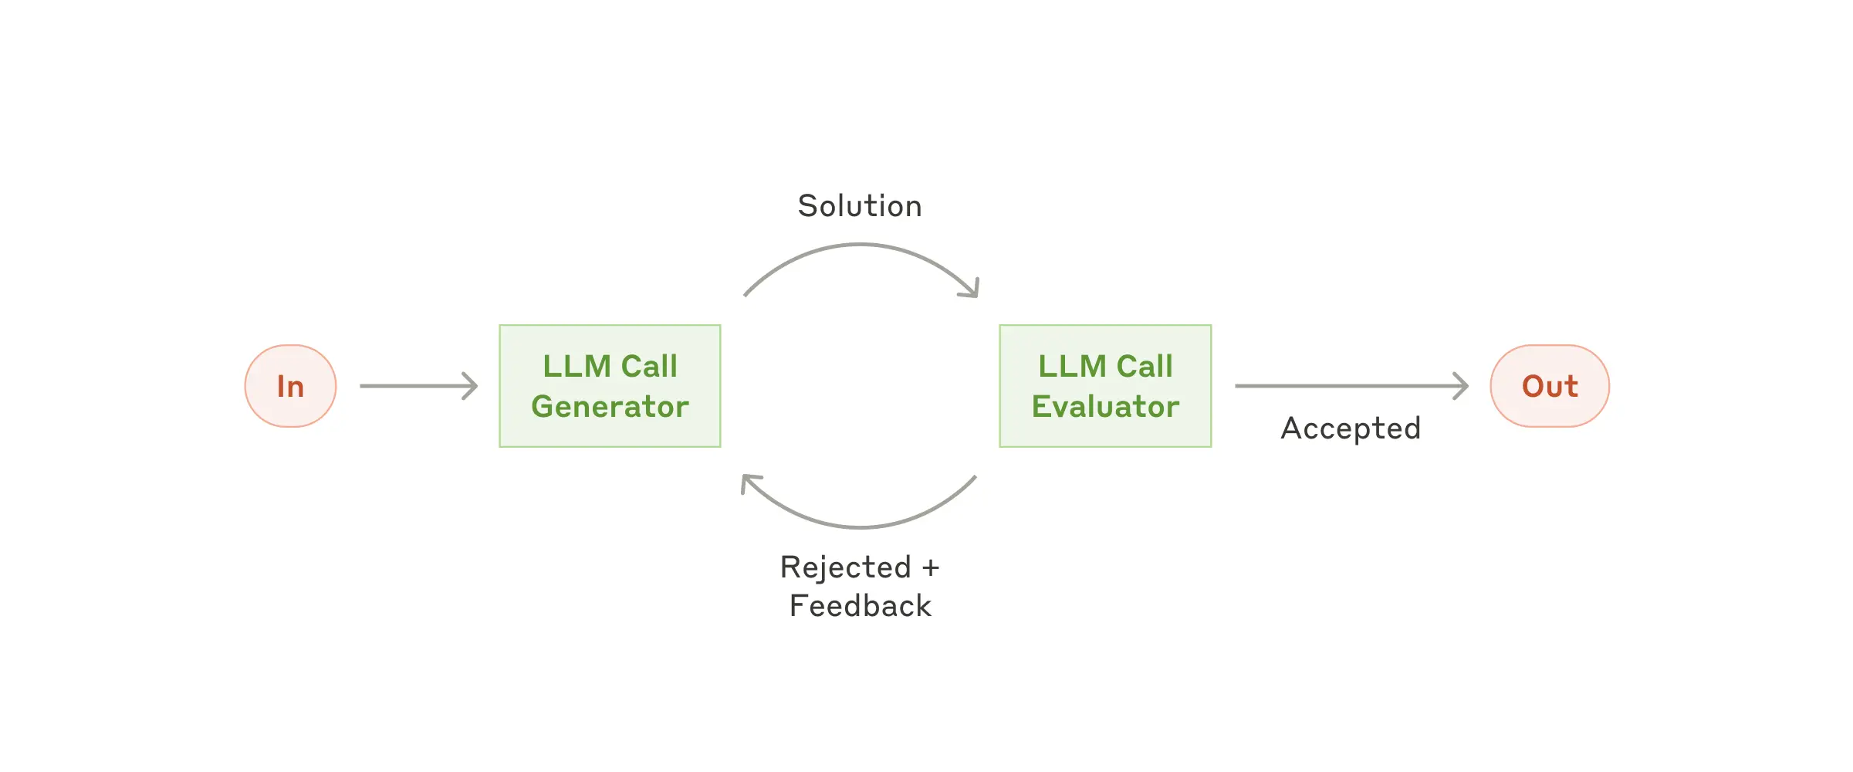
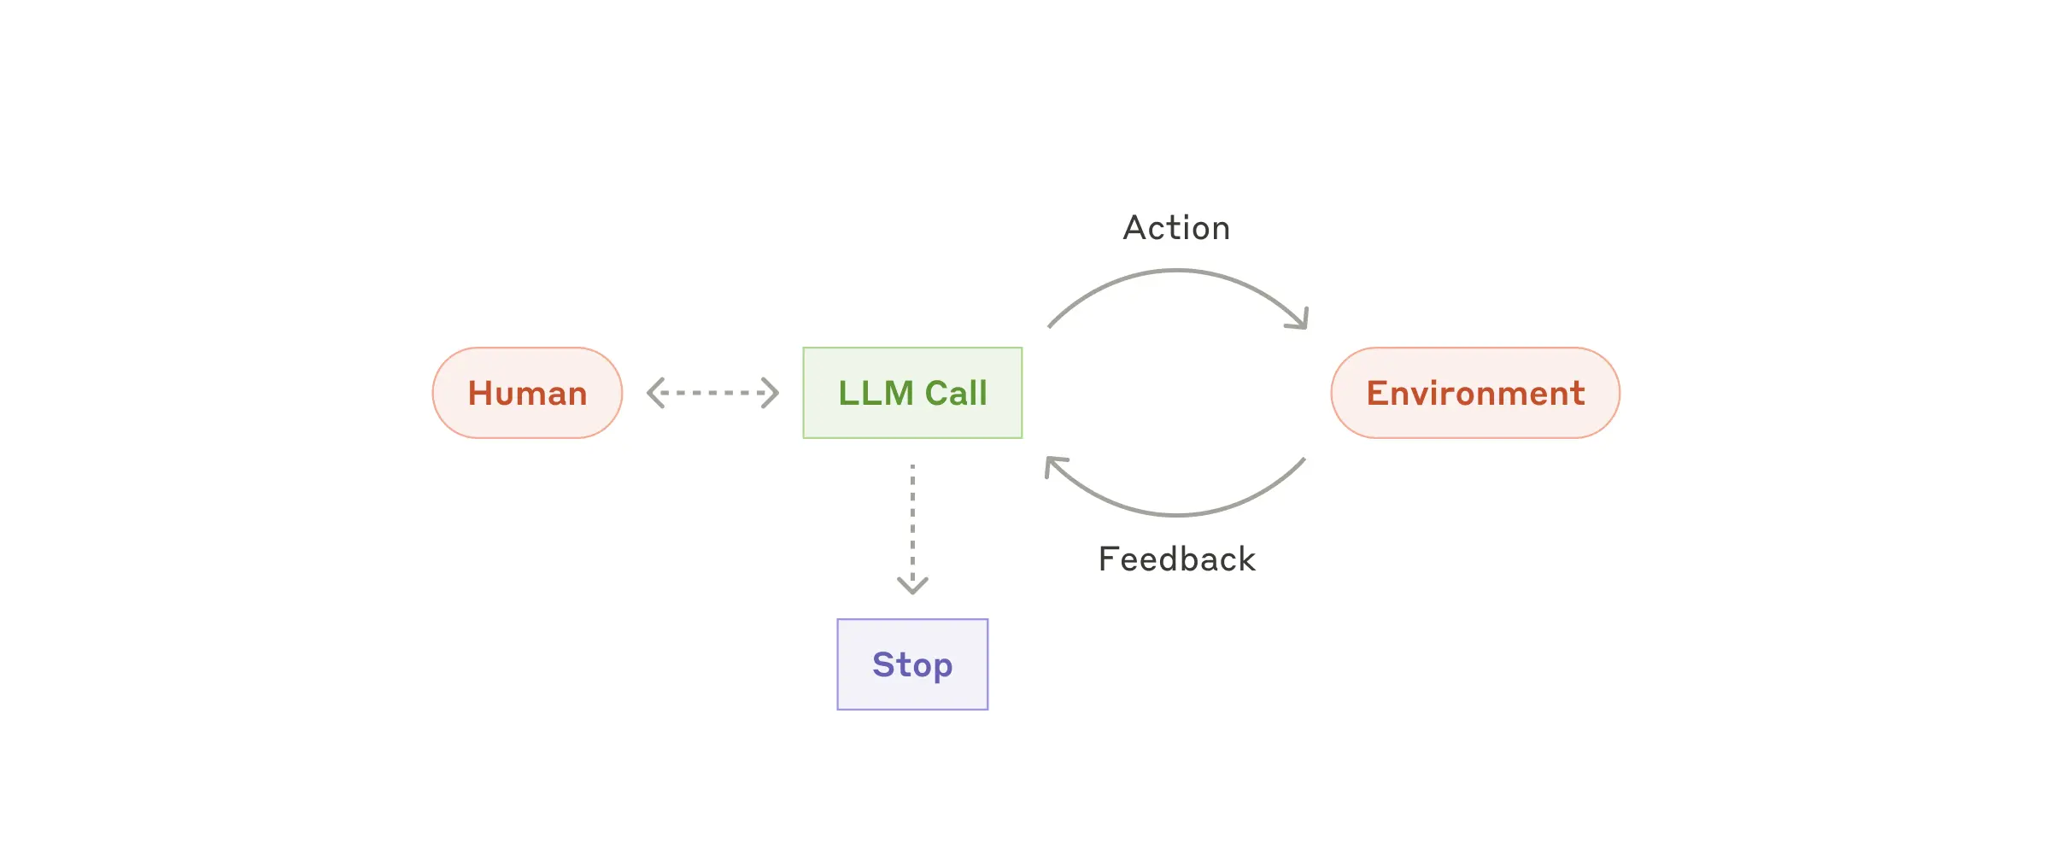
03 · AGENTIC AI EVALUATION
Agentic AI System
Workflow/Agent Design Pattern Examples
Prompt chaining
Routing
Parallelization
Orchestrator-workers
Evaluator-optimizer
Autonomous agent
Source diagrams: Anthropic, “Building Effective Agents” (Dec 2024).

Slide 10
TODAY'S AGENDA
01
From ChatGPT to Codex
02
Agentic AI System
03
Evaluation
04
Demo Walkthrough

Slide 11









03 · AGENTIC AI EVALUATION
Evaluation
No universal framework exists yet — but a common industry pattern is emerging
Generative AI
VS.
Agentic AI Systems
Prompt
→
Response
Goal → Decisions → Tools → Actions → System state
Primarily evaluate output quality
Evaluate both results and behavior
No universal framework exists yet — but a common industry pattern is emerging
1
Goal & Success Criteria
2
Outcome Evaluation
3
Trajectory Evaluation
Define the goal, environment, and available tools
Specify the expected outcome and acceptable final system state
Identify required steps, flexible paths, and critical failures
Did the agent complete the task?
Is the final answer, action, or system state correct and complete?
Did the result satisfy the user and business objective?
How did the agent reach the result?
Did it choose appropriate tools, decisions, and sequences?
Did it recover from errors without unnecessary loops or actions?
4
Safety & Constraint Adherence
5
Efficiency, Reliability &
Operational Quality
6
Continuous Evaluation &
Monitoring
Did it respect permissions, policies, and approval boundaries?
Did it protect sensitive data and avoid unauthorized actions?
Were failures handled through refusal, stopping, or escalation?
Measure latency, cost, tool calls, retries, and human intervention
Test consistency across repeated runs and varied scenarios
A successful agent may still be unreliable or inefficient
Turn important cases into regression tests
Re-evaluate when prompts, tools, models, or workflows change
Monitor production behavior, drift, and new failure modes

Slide 12
03 · AGENTIC AI EVALUATION
Evaluation
Evaluation Methods
GRADERS
OPERATIONAL MEASURES
TEST ENVIRONMENT
Code checks
Checks exact outputs or state
Example: assert customer_id is not None
Metrics
Measure efficiency, reliability, and cost
Example: cost = $0.14, latency = 8.2s, tool calls = 6
Benchmark / Validation Set
Defines the cases used for evaluation
Example: 50 normal + edge + safety scenarios
Trace checks
Checks required order of steps
Example: assert approval_t < send_result_t
What each method mainly answers
LLM-as-a-judge
Scores qualitative behavior
Example: “Was the response clear and complete?”
Correct result?
Code checks
Correct process?
Trace checks
Good quality?
LLM judge
Business sense?
Human review
Operationally viable?
Metrics
How robust across cases?
Benchmark set
Human review
Reviews ambiguous or high-risk runs
Example: “Was escalation appropriate?”

Slide 13
03 · AGENTIC AI EVALUATION
Evaluation
The evaluated object is not just a final answer — it is the whole run.
How the Methods Work Together
Agent run
Multiple graders
Evaluation result
Task input
✓
Code checks
Objective pass/fail
Outcome
PASS
Reasoning / decisions
→
Trace assertions
Sequence and constraints
Trajectory
FAIL
Tool calls
Safety gates
FAIL
evidence
J
LLM judge
Rubric-based quality
Efficiency
7 calls
Intermediate results
Human review
Expert calibration
H
Overall
FAIL
Final response
#
Metrics
Cost, latency, retries
Final system state
Critical failure overrides average score
Use case-specific design: choose graders based on what evidence is objective, subjective, risky, or operationally important.

Slide 14
03 · AGENTIC AI EVALUATION
Evaluation
Deterministic Tests in Practice
A. COMPONENT / OUTPUT CHECKS
B. TRACE / TRAJECTORY ASSERTIONS
What it means
Check exact outputs, fields, states, or business rules.
What it means
Evaluate system execution trace or policy constraint.
assert customer_id is not None
assert selected_card_id == expected_card_id
assert final_state == "ACTIVE"
assert api_result["status"] == "success"
assert auth_step < account_lookup_step
assert eligibility_step < action_step
assert approval_step < send_result_step
assert escalation_step is not None if risk_flagged
Questions this answers
• Was the result objectively correct?
• Did the state or output match expectations?
Questions this answers
• Did the agent follow the required process?
• Did it skip, repeat, or reorder critical steps?
Key idea: both types are deterministic, but one checks the result while the other checks the path taken to get there.

Slide 15
03 · AGENTIC AI EVALUATION
Evaluation
LLM-as-a-Judge and Human Review
Example artifacts sent for review
Transcript excerpt:
Agent: “Your request is complete and the result is ready.”
Rubric:
• Was the explanation clear?
• Was it complete?
• Was the action appropriately explained?
• If escalated, was escalation justified?
LLM judge
Input: transcript + rubric
Output:
• clarity = 4/5
• completeness = 3/5
• explanation = acceptable
Summary: good quality, but one detail was omitted
Human reviewer
What humans mainly do:
• label gold-standard examples
• calibrate the judge rubric
• review ambiguous or high-risk runs
• spot-check automated scores over time
How they complement each other
LLM judge scales subjective evaluation; human review provides calibration, business context, and a safety backstop.
Best use: let the LLM score many runs, then use humans to verify difficult cases and audit the judge itself.

Slide 16
03 · AGENTIC AI EVALUATION
Evaluation
Metrics and Operational Measures
API cost
$0.14 / run
tokens × price
Latency
8.2s
end-to-end time
Tool calls
6
including retries
Simple examples
Total API cost = input tokens + output tokens + tool-call usage
Latency = model time + tool time + retries
Reliability can also include failure rate, timeout rate, or repeated-step rate
Retry count
1
failure recovery
Human handoff
12%
escalation rate
Success rate
91%
task completion
Why metrics vary by use case
Customer-service agent: latency, handoff rate, resolution rate
Research agent: cost, coverage, citation quality
Action-taking agent: safety failures, retries, intervention rate
Conclusion: operational metrics are universal in concept, but the exact metrics that matter depend on the agent’s use case.

Slide 17
03 · AGENTIC AI EVALUATION
Evaluation
Benchmarks & Continuous Evaluation
Evaluation set
1
Normal cases
1
2
3
Release / improve
2
Edge cases
Use results to decide whether the system is safer, better, faster, or still blocked.
Run agent
Apply graders
Compare versions
3
Tool failures
Same cases
Outcome + trace + judge + metrics
Prompt / model / tools
4
Safety cases
✓
5
Adversarial cases
Each case includes: input, expected behavior, environment state, grader(s), and critical failure rules.
Production feedback loop
Real failure → root-cause review → new evaluation case → regression test → improved system
Practical takeaway: a benchmark is not only a public leaderboard. For most workplace agents, the most valuable benchmark is an internal scenario set that reflects real workflows and risks.

Slide 18
TODAY'S AGENDA
01
From ChatGPT to Codex
02
Agentic AI System
03
Evaluation
04
Demo Walkthrough

Slide 19
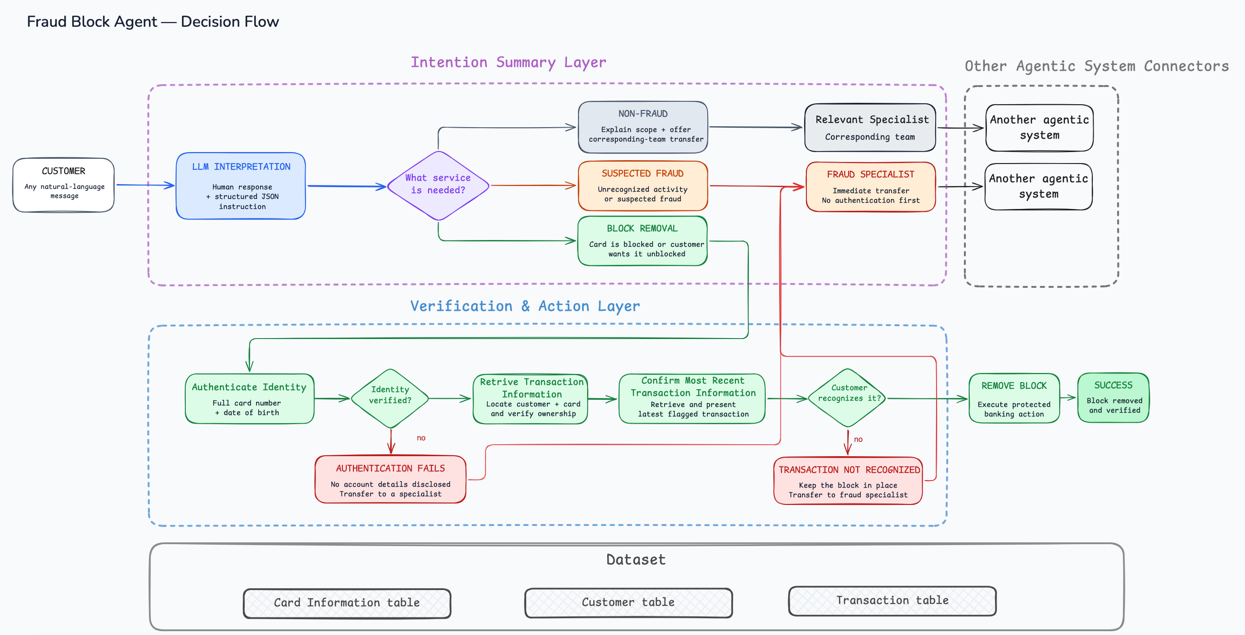
03 · AGENTIC AI EVALUATION
Demo Walkthrough
Introduction to demo use case

Slide 20
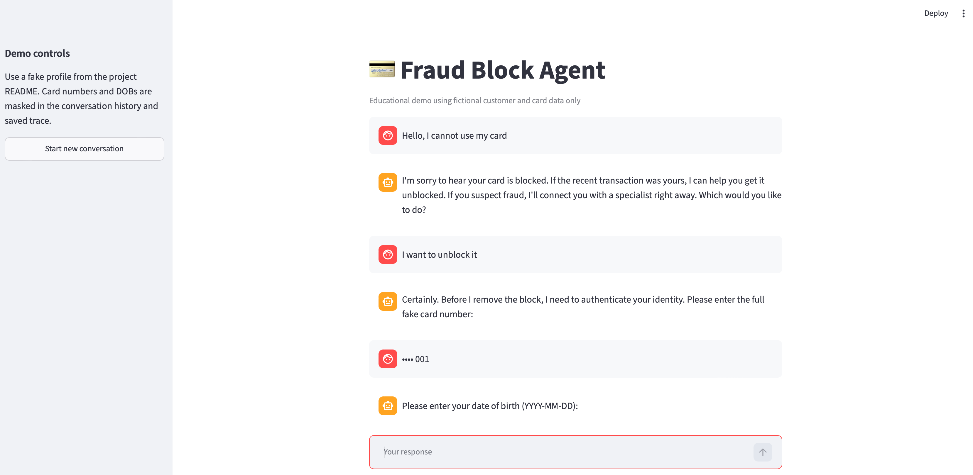
03 · AGENTIC AI EVALUATION
Demo Walkthrough
Demo preview
python3 -m streamlit run fraud_block_agent_demo/chat_ui.py

Slide 21
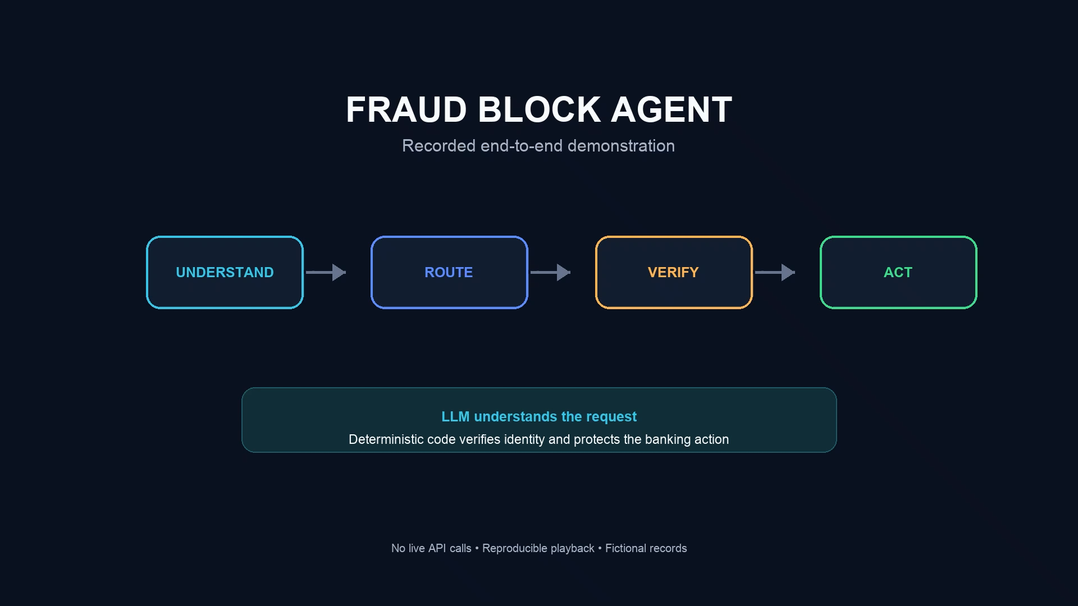

Slide 22
03 · AGENTIC AI EVALUATION
Demo Walkthrough
Evaluation Methods Revisit
GRADERS
OPERATIONAL MEASURES
TEST ENVIRONMENT
Code checks
Checks exact outputs or state
Example: assert customer_id is not None
Metrics
Measure efficiency, reliability, and cost
Example: cost = $0.14, latency = 8.2s, tool calls = 6
Benchmark / Validation Set
Defines the cases used for evaluation
Example: 50 normal + edge + safety scenarios
Trace checks
Checks required order of steps
Example: assert approval_t < send_result_t
What each method mainly answers
LLM-as-a-judge
Scores qualitative behavior
Example: “Was the response clear and complete?”
Correct result?
Code checks
Correct process?
Trace checks
Good quality?
LLM judge
Business sense?
Human review
Operationally viable?
Metrics
How robust across cases?
Benchmark set
Human review
Reviews ambiguous or high-risk runs
Example: “Was escalation appropriate?”

Slide 23
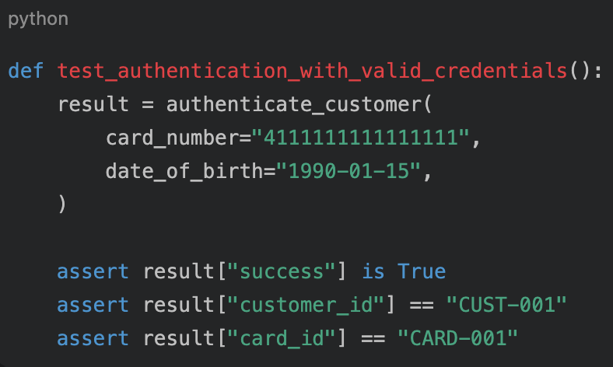
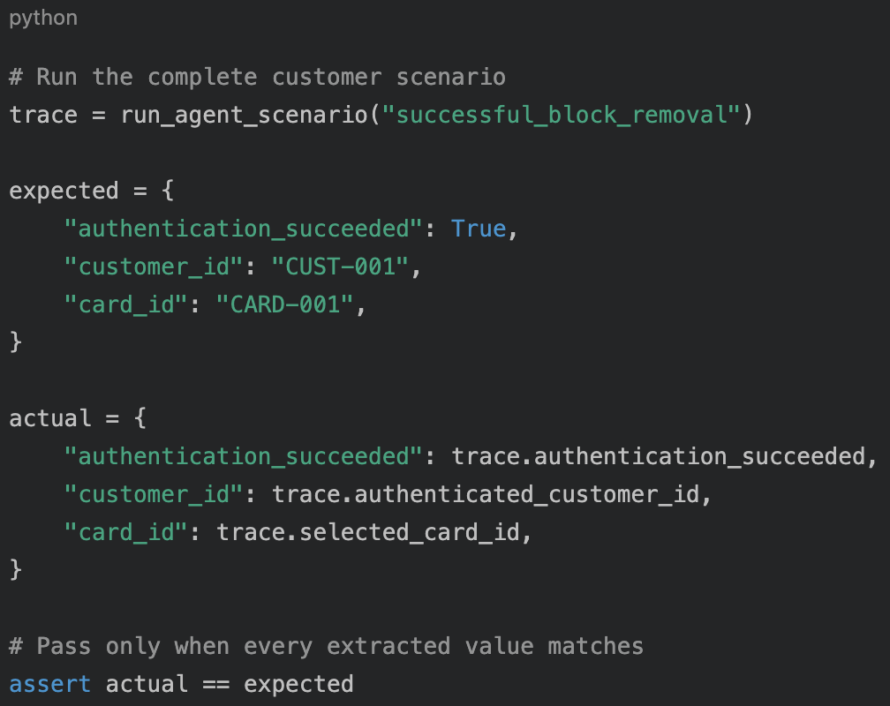
03 · AGENTIC AI EVALUATION
Demo Walkthrough
Evaluation: Code Checks/Unit Test
SHARED SCENARIO
Card number: 4111111111111111
DOB: 1990-01-15
Expected customer: CUST-001
Expected: Authentication succeeds
UNIT TEST
Isolated component
DETERMINISTIC CODE CHECK
Complete agent session
Evidence source:
direct function return
Evidence source:
structured trace from the complete run
Proves:
the authentication function works when called correctly
Proves:
the workflow reached authentication and produced the expected result
KEY DIFFERENCE
A unit test validates the component directly; a code check validates that the complete agent reached and used that component correctly.

Slide 24
03 · AGENTIC AI EVALUATION
Demo Walkthrough
Evaluation: Trajectory Integrity
Definition:
Evaluates the intermediate decisions, actions, tool use, evidence, and state transitions an agent followed to reach an outcome.
What trajectory checks can evaluate
Required steps
Prohibited steps
Order & dependencies
Tool selection
Arguments & evidence
Efficiency
Did mandatory actions occur?
Were forbidden actions avoided?
Did prerequisites happen first?
Were appropriate tools used?
Were the correct inputs used?
Were calls or loops unnecessary?
SEQUENCING EXAMPLE
CUST-002 • CARD-002 • Expected final status: block removed
Evaluation goal: recognize incorrect execution sequencing – block removal before confirming transaction
EXPECTED TRAJECTORY
FAULTY RECORDED TRAJECTORY
EVALUATION RESULT
1 authentication_success
1 authentication_success
Outcome check
PASS
2 ownership_verified
2 ownership_verified
active == active
3 transaction_retrieved
3 transaction_retrieved
4 transaction_recognized
4 eligibility_approved ← TOO EARLY
Sequencing check
5 eligibility_approved
5 block_removed ← TOO EARLY
recognition before approval
FAIL
6 block_removed
6 transaction_recognized
position 6 < position 4 = false
7 final_state_verified
7 final_state_verified
Overall trajectory result: FAIL

Slide 25
03 · AGENTIC AI EVALUATION
Demo Walkthrough
Evaluation: Operational Metrics
Operational metrics show whether an agentic AI system delivers reliable, efficient, safe, and cost-effective outcomes at scale. They reveal issues such as high latency, excessive transfers, customer drop-off, unnecessary API usage, and workflow failures.
Cost-Benefit Analysis on system cost
OTHER OPERATIONAL METRICS
500,000 annual connected customer calls (Annual cost: 5000,000 calls x $14 = $7,000,000)
Customer outcome
Annual workload entering the fraud-block agent
Containment rate
Resolved without human transfer
Successful removal rate
Safe automated blocks removed
60% successful block removal
40% unsuccessful sessions
Drop rate
Customers leaving before resolution
300,000 sessions × 6 API calls
200,000 sessions × 5 API calls
Routing and escalation
= 1,800,000 API calls
= 1,000,000 API calls
Fraud transfer rate
Suspected fraud sent to specialist
Non-fraud transfer rate
Wrong-department demand
2,800,000 annual Claude Fable 5 API calls
1.7346B input × $10/MTok = $17,346
Authentication failure
Failed or suspicious verification
Per-call proxy: 619.5 input + 106.5 output tokens
298.2M output × $50/MTok = $14,910
Efficiency, reliability, and safety
ANNUAL MODEL API COST
Annual Cost if adapting agentic system
DIRECT COST ADVANTAGE
Calls / tokens / cost
Per session and successful outcome
$2,820,736
$4.2 million
(60% reduction)
p50 / p95 latency
Typical and slow customer experience
$32,256
Clarification / retries
Loops, parsing, and tool instability
Annual Cost without agentic system
Safety violations
Protected actions without evidence
Successful + unsuccessful traffic
$7,000,000
ASSUMPTIONS AND SOURCE
500,000 annual calls; 60% successful at 6 API calls; 40% unsuccessful at 5; $14 avoided human handling per successful call.
Claude Fable 5: $10/MTok input; $50/MTok output.
Token proxy comes from one measured Fable 5 session. Excludes telephony, infrastructure, monitoring, maintenance, and human escalation costs.
Source: anthropic.com/news/claude-fable-5-mythos-5

Slide 26
03 · AGENTIC AI EVALUATION
Demo Walkthrough
Evaluation: Benchmarks/Validation Sets
DEFINITION
A benchmark contains representative scenarios and expected behaviors used to measure how agent performance changes across versions.
TWO EXECUTION MODES — ONE REUSABLE BENCHMARK
BENCHMARK / VALIDATION SET
EACH BENCHMARK RUN REPORTS
Scenarios + expected behavior
Outcome / code checks
Expected business result
OFFLINE DETERMINISTIC RUN
LIVE MODEL RUN
Trajectory checks
Required steps and dependencies
Recorded model outputs
Current prompt + model API
Tests orchestration, tools, controls, state, and graders
Tests interpretation, prompt quality, and integration
Safety checks
Prohibited actions avoided
Operational metrics
Calls, tokens, cost, and latency
HYBRID EVALUATION REPORT
ILLUSTRATIVE VERSION COMPARISONS
Example values—not measured project results
MODEL UPGRADE — HIGHER QUALITY, HIGHER COST
PROMPT CHANGE — REGRESSION REQUIRES INVESTIGATION
Result
Current model
Advanced model
Result
Prompt v1
Prompt v2
Scenarios passed
8/10
9/10
Scenarios passed
9/10
7/10
Correct routing / trajectory
90% / 80%
100% / 90%
Correct routing / trajectory
100% / 90%
80% / 70%
Structured output
100%
100%
Structured output
100%
90%
Average API calls
2.4
3.1
Average API calls
2.6
3.4
Cost / latency
$0.028 / 2.9s
$0.052 / 4.2s
Cost / latency
$0.030 / 3.2s
$0.039 / 4.6s
Decision
Baseline
Weigh quality vs. cost
Decision
Current version
Investigate — do not release
Benchmarking makes change measurable: compare quality, safety, cost, and latency before deciding whether to release.

Slide 27
Thank You
Questions & Discussion
Built with curiosity and a lot of tokens

Slide 28
04 · HOW TO EVALUATE
How the Methods Work Together
Different artifacts from one run are routed to different evaluators.
Agent run
Input: user request + context
Processing: plan, tool calls, decisions
Output artifacts:
• final response
• trace / tool-call log
• final system state
• usage + latency metrics
Code checks
Evaluates: system state
Output: PASS
Why: final_state == "ACTIVE"
Scenario from validation set
“Case 17: user request with approval required”
Final response
Final judgment on this run
Outcome / code checks: PASS
Trace checks: FAIL
LLM judge: 4/5
Metrics: PASS
Overall decision: FAIL
Reason: a required process step was skipped, so a hard safety gate failed.
Trace / tool log
Trace checks
Evaluates: tool order
Output: FAIL
Why: approval step missing
System state
LLM judge
Evaluates: quality of reply
Output: 4/5
Why: clear, but incomplete
Usage metrics
Human review
Evaluates: edge-case appropriateness
Output: Review not needed
Metrics
Evaluates: cost / latency
Output: PASS
Why: $0.09, 6.8s, 5 calls

Slide 29
04 · HOW TO EVALUATE
Benchmark / Validation Set
A benchmark is the set of cases on which the agent is repeatedly tested; it is not the grader itself.
Typical contents of a validation set
• normal cases
• edge cases
• tool-failure cases
• safety / policy cases
• adversarial cases
• expected outputs or behaviors
• graders and thresholds
1. Select scenario
e.g., Case 17
2. Run agent
produce artifacts
4. Compare versions
A vs B vs new release
5. Regression suite
keep important failures
3. Apply graders
code + trace + judge
Continuous improvement loop
Production failure → add new case → re-run benchmark → prevent regressions
Takeaway: the validation set defines what scenarios the agent faces; the graders determine how each run is scored.

Slide 30



02 · AGENTIC AI and Corporate Applications
What to Watch Out For
Hallucinations
Data Privacy
AI can confidently produce incorrect information. Always verify critical facts. Use RAG (Retrieval-Augmented Generation) to ground responses in your data.
Sensitive data sent to AI APIs may leave your network. Choose on-prem or private-cloud deployments for confidential information.
Over-reliance
Integration Cost
Teams may stop thinking critically. AI should augment human judgment, not replace it — especially for strategic or ethical decisions.
Connecting AI to legacy systems takes engineering effort. Start with low-risk pilots before enterprise-wide rollouts.

