Slide 1
图像处理论文报告
《Single Image Haze Removal Using Dark Channel Prior》
汇报人：计科1506-郭浩宇
学号：1030415617
指导老师：周世兵

Slide 2
Title
Single Image Haze Removal Using Dark Channel Prior
Admission, TPAMI 2011
Authors
Kaiming He
Jian Sun
Xiaoou Tang

Slide 3
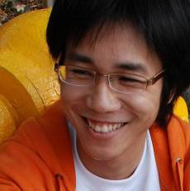
1st Author
Kaiming He
Ph. D candidate, Multimedia Laboratory, IE, CUHK
BS, Academic Talent Program, THU, 2007
Papers:
Single Image Haze Removal Using Dark Channel Prior, TPAMI 2011
Mask R-CNN, ICCV 2017 Best Paper
Focal Loss for Dense Object Detection, ICCV 2017 Best Student Paper
Deep Residual Learning for Image Recognition, CVPR 2016, Best paper
Image Super-Resolution Using Deep Convolutional Networks, TPAMI 2015
Homepage: http://kaiminghe.com/

Slide 4
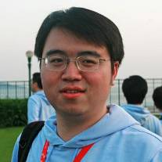
2nd Author
Jian Sun
Lead Researcher, Visual Computing Group, MSRA
BS(1997), MS (2000) and Ph.D (2003) Xi’an Jiaotong University
Papers:
Zhong Wu, Qifa Ke, and Jian Sun. A Multi-Sample, Multi-Tree Approach to Bag-of-Words Image Representation. ICCV'09.
Litian Tao, Lu Yuan, and Jian Sun. SkyFinder: Attribute-based Sky Image Search. SIGGRAPH’09.
Jiangyu Liu, Jian Sun, and Heung-Yeung Shum. Paint Selection. SIGGRAPH’09
Kaiming He, Jian Sun, and Xiaou Tang. Single Image Haze Removal using Dark Channel Prior. CVPR’09
Zhong Wu, Qifa Ke, Michael Isard, and Jian Sun. Bundling Features for Large Scale Partial-Duplicate Web Image Search. CVPR’09
Homepage: http://research.microsoft.com/en-us/people/jiansun/

Slide 5
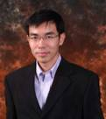
3rd Author
Xiaoou Tang
Professor, Multimedia Laboratory, IE, CUHK
BS (1990, USTC), MS (1991, Roch.), PhD (1996, MIT)
Papers: (~, IJCV, TPAMI, ICCV, CVPR,)
C. Xu, J. Liu, and X. Tang, “2D Shape Matching by Contour Flexibility,” TPAMI’09.
J. Liu, L. Cao, Z. Li, and X. Tang, “Plane-Based Optimization for 3D Object Reconstruction from Single Line Drawings,” TPAMI’08.
L. Cao, J. Liu, and X. Tang, “What the Back of the Object Looks Like: 3D Reconstruction from Line Drawings without Hidden Lines,” TPAMI’08.
Homepage: http://www.ie.cuhk.edu.hk/people/xotang.html

Slide 6
Keywords
Dehaze&Defog: the core aim of the algorithm is to remove the haze and fog from images
Image restoration: the algorithm more or less restores the images, despite the noise
Depth estimation: a high-quality depth map can also be obtained as a byproduct of haze removal

Slide 7
Abstract
In this paper, we propose a simple but effective image prior - dark channel prior to remove haze from a single input image.
本文提出了一种简洁高效的用于单幅输入图像去雾的图像先验 - dark channel prior
The dark channel prior is a kind of statistics of the haze-free outdoor images. It is based on a key observation - most local patches in haze-free outdoor images contain some pixels which have very low intensities in at least one color channel.
Dark channel prior 基于一种对无雾的图像的统计规律：在无雾图像中，大部分图像块中至少有一个颜色通道具有很小的颜色强度值

Slide 8
Abstract
Using this prior with the haze imaging model, we can directly estimate the thickness of the haze and recover a high quality haze-free image.
利用dark channel prior，可以直接从一幅有雾的图像中估计出雾的浓度，并恢复出高质量的去雾图像
Results on a variety of outdoor haze images demonstrate the power of the proposed prior. Moreover, a high quality depth map can also be obtained as a by-product of haze removal.
大量户外有雾图像上的实验结果证明了dark channel prior的有效性，并且在去雾的同时，能得到高质量的图像深度图（副产品）。

Slide 9
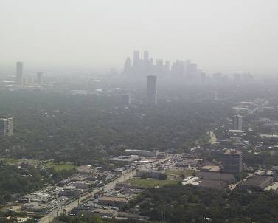
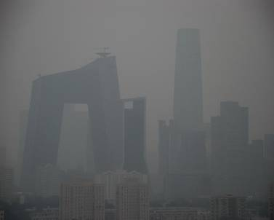
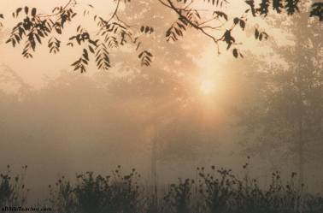
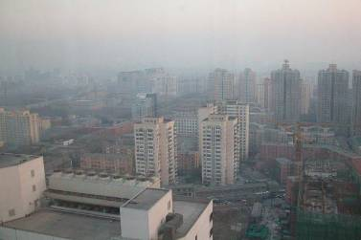
Hazy Images

Slide 10
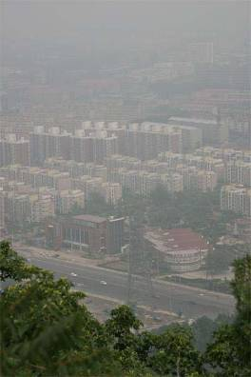
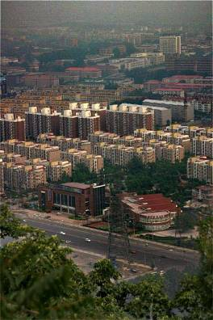
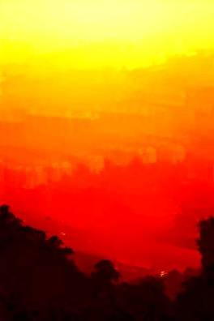
目标
去雾图像J
输入有雾图像I
深度图像

Slide 11
Hazy Image Model
在Computer Vision中广泛应用的带雾图像模型：
:观测到的图像
:场景辐射度（去雾后的图像）
A :全局大气光照
t :介质（雾）的透过率
已知I, 求解J, A, t, 病态问题

Slide 12
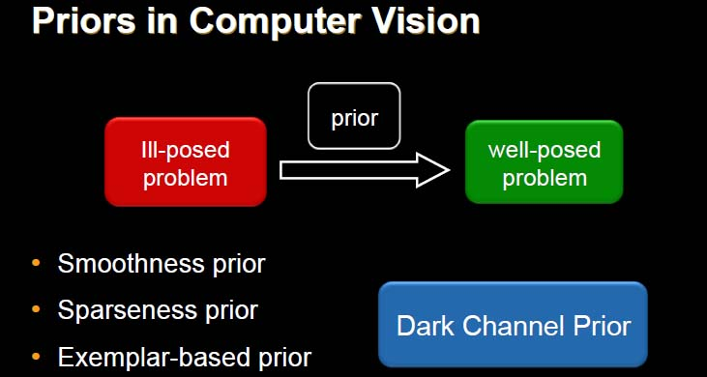
Motivation
*This slide is from Kaiming He’s talking slides in TPAMI,11.

Slide 13
Motivation
有雾的图像中，不同位置的雾，浓度往往是不同的，于是首先利用dark channel prior估计出雾的透过率图 （transmission map, 反应了图像中雾的浓度变化）
利用雾的透过率图恢复场景的辐射度J（去雾的图像）

Slide 14
Dark Channel Prior
在一个非天空区域的无雾图像块中，某些像素中至少有一个颜色通道，具有很低的颜色强度值
图像J的第c个颜色通道
以像素x为中心的块
作者在实验中对于600x400的图像取块的大小为15x15

Slide 15
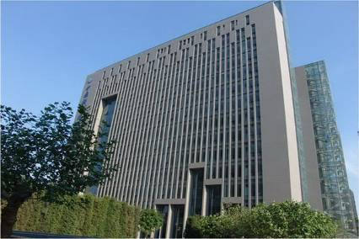
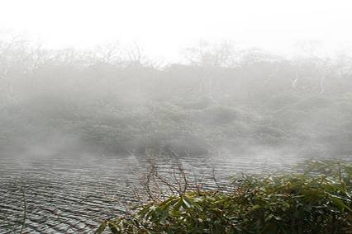
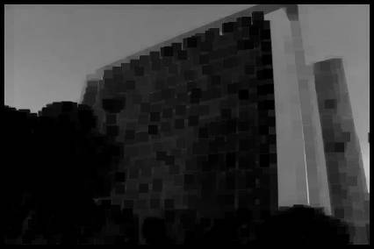
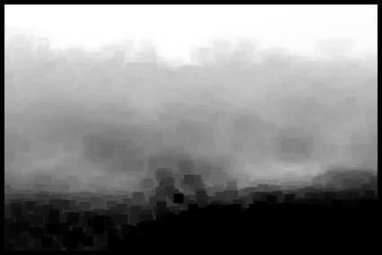
Dark Channel Prior

Slide 16
Dark Channel Prior
随机选了5000幅户外无雾图像，并手工将天空区域裁剪掉
Image size: 500x500, patch size: 15x15
75% dark channel values = 0
86% dark channel values < 16
90% dark channel values < 25
So

Slide 17
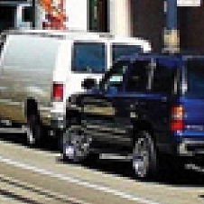
Dark Channel Prior
为什么会存在Dark Channel Prior这样的规律？
图像中存在阴影
物体是彩色的
黑色物体

Slide 18
Transmission Estimation
假定在一个局部块中，透过率 是常数，并且已知全局大气光照A
对带雾图像块的一个颜色通道c上计算dark channel
图像块所有通道的dark channel

Slide 19
Transmission Estimation
根据Dark Channel Prior有：

Slide 20
Transmission Estimation
恰好是在用A归一化后的带雾图像上
计算的Dark Channel，从而可以求得初始的

Slide 21
Transmission Map Refinement
Using a soft matting algorithm
A. Levin, D. Lischinski, and Y. Weiss. A closed form solution to natural image matting. CVPR’06
K. He之前在MSRA一直在做image matting的工作，直接拿来对transmission map作细化
：细化后的介质透过率图
：A. Levin提出的Matting Laplacian Matrix
：归一化参数，实验中取0.0001

Slide 22
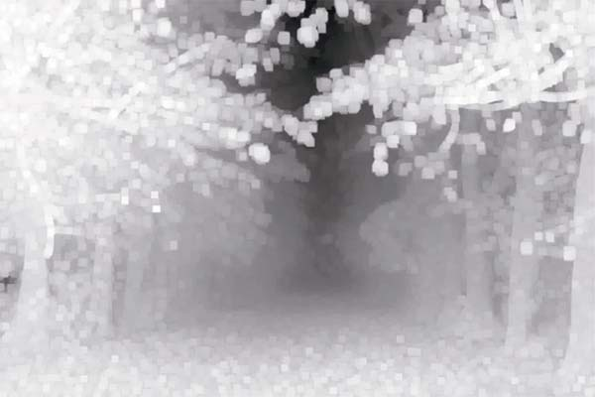
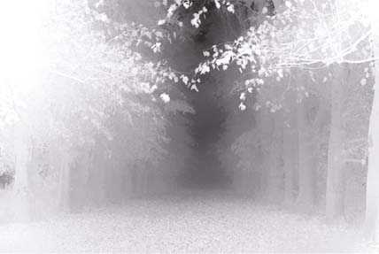
Transmission Map Refinement

Slide 23
Scene Radiance Recovery
估计出transmission map 后如果假定A已知，那么根据

Slide 24
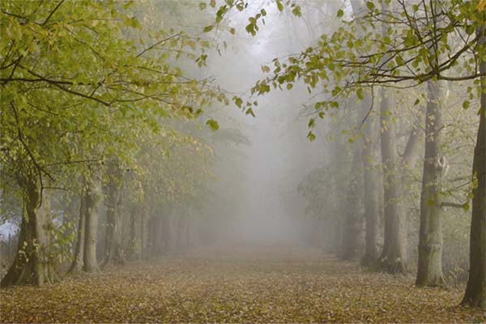
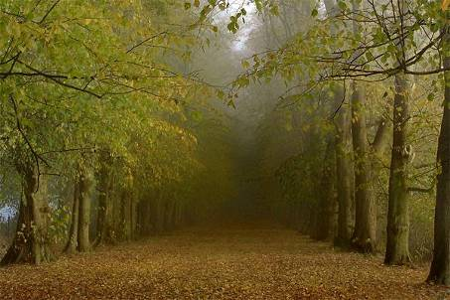
Scene Radiance Recovery
有的像素点估计出的t(x)可能非常接近0，容易使结果J产生噪声，于是：
t₀相当于保留了少量的雾

Slide 25
Atmospheric Light (A) Estimation
之前只是在假定A已知的条件下进行公式推导
前人在估计A时，大多直接选择输入图像I中最亮像素的亮度值作为A的估计
而本文根据dark channel图估计A
找到dark channel map中亮度最高的0.1%像素所对应的原图像I中像素
把原图像I中这些像素最大的亮度值作为A的估计

Slide 26
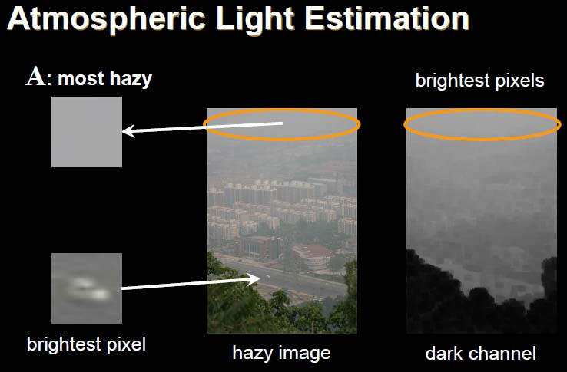
Atmospheric Light (A) Estimation
*This slide is from Kaiming He’s talking slides in TPAMI,2011

Slide 27
Related Works
之前单幅图像去雾的代表性方法：
最大化局部对比度：R. Tan, Visibility in Bad Weather from a Single Image, CVPR’08
独立成分分析：R. Fattal, Single Image Dehazing, SIGGRAPH’08

Slide 28
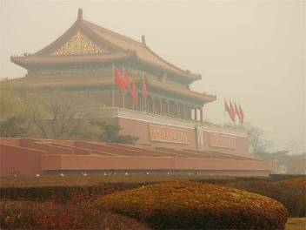
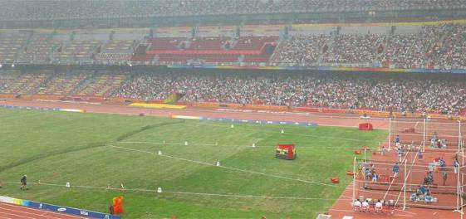
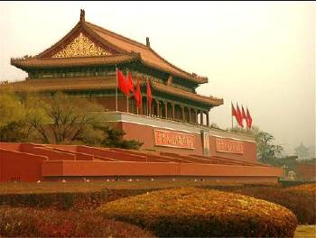
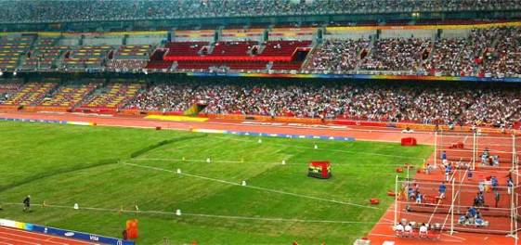
Show Time

Slide 29
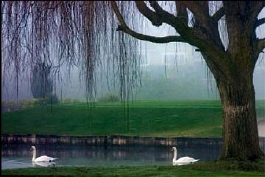
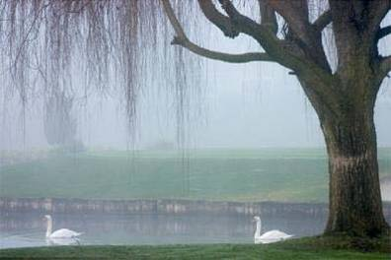
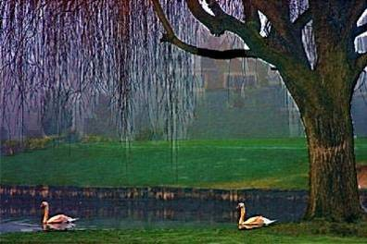
Show Time
Dark Channel Prior
Original
Tan CVPR’08

Slide 30
Comments on this paper
何恺明: “电脑游戏带来的灵感”，“大道之行在于简, 三个审稿人都给出了最高的评分。他们认为我们的方法简单而有效”
汤晓鸥: “方法非常简单”，“对于一个很困难的问题，给出了很好的结果”，“发现了一个基本的自然规律并且应用在实际的问题中”
“in CV, a practically working system > a demo system > a method or an idea”

Slide 31
Analysis&Conclusion
Prior information being simple and efficient, ideal effect on removing the haze
Creative in proposing the idea of reversing the dark_channel to zero so as to get the images without haze
Smooth atmospheric transfer function using the design of ‘Soft Matting’ , efficient but too complicated
Taking 2 seconds(C++) to deal with a 600*400 image, far from the standard of real-time analysis

Slide 32
Improvement ideas

Slide 33
感谢聆听！
Presented by 郭浩宇
guohaoyu110@gmail.com

