Slide 1

TDD（测试驱动开发）
杨中科

Slide 2

主要内容
01
单元测试 Unit Test
02
集成测试 Integration Test
03
E2E测试 End2End
04
案例分享

Slide 3
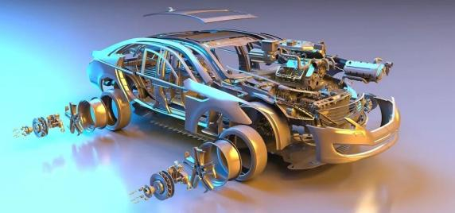
为什么要做测试？

Slide 4
测试的概念
Fake=Stub+Mock
Regression
Test Case:
Arrange/Act/Assert
Dependency

Slide 5
测试的常见类型
单元测试 Unit Test
集成测试 Integration Test
E2E测试 End To End Test
UAT测试 User Acceptance Test
性能测试、可用性测试、安全测试、渗透测试……

Slide 6
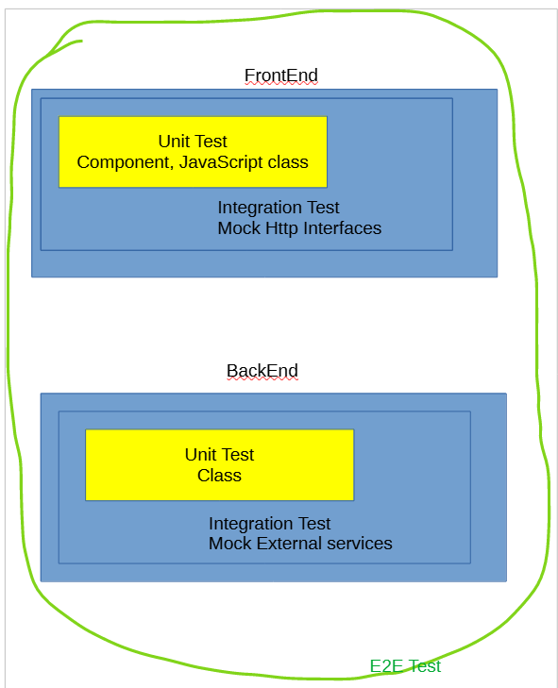

Slide 7
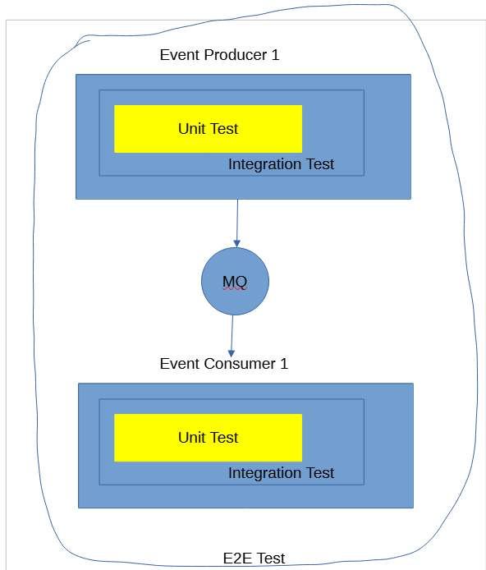

Slide 8
TDD(Test Driven Development)
1、误区：先写测试，再写代码？TDD!=Test First Development
2、TDD促进开发人员的自组织及自我驱动。
3、TDD不仅是确保当前代码运行正确，更是为重构提供信心。

Slide 9
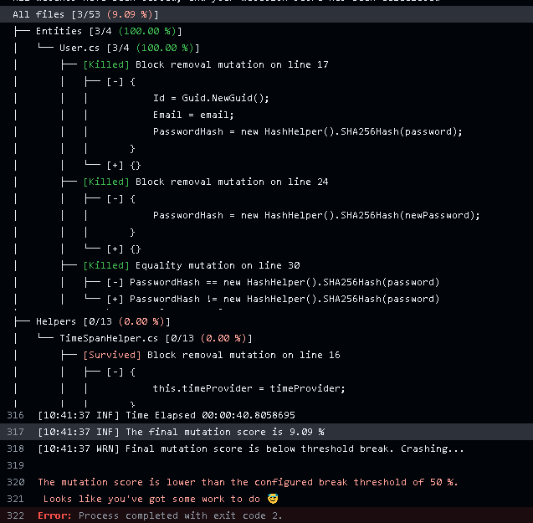

Slide 10
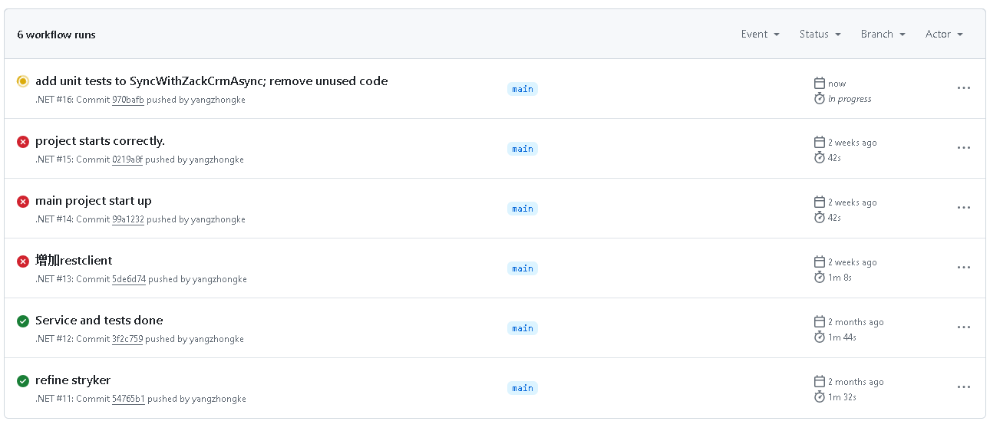
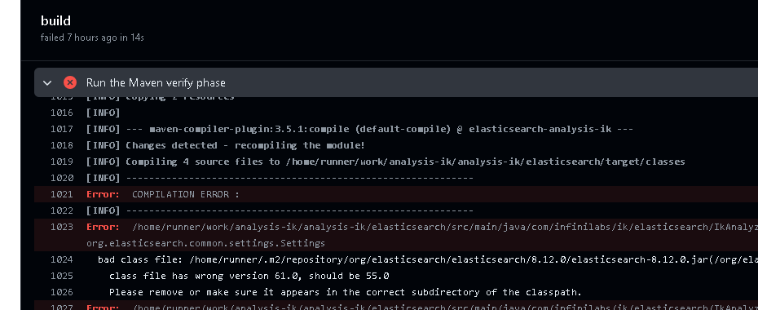

Slide 11
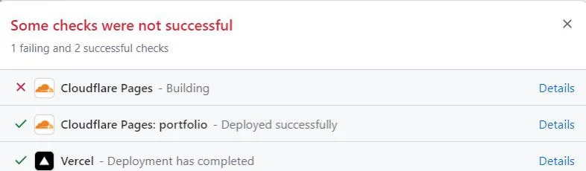

Slide 12
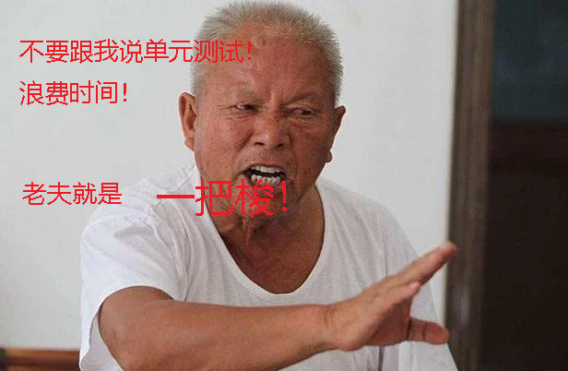
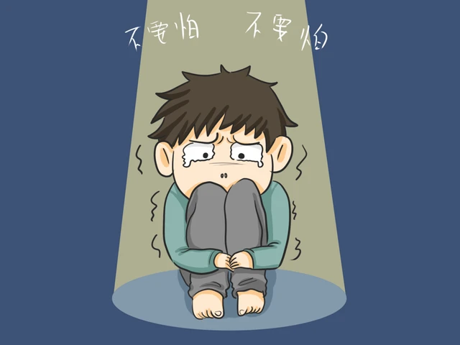
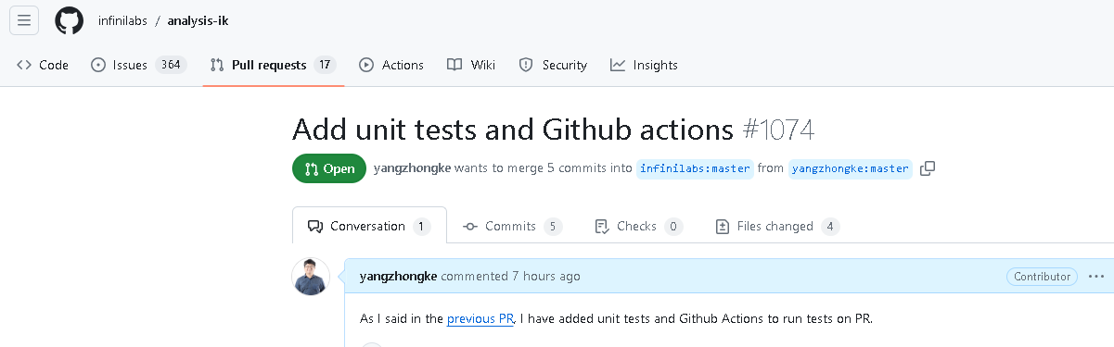
Before
After

Slide 13
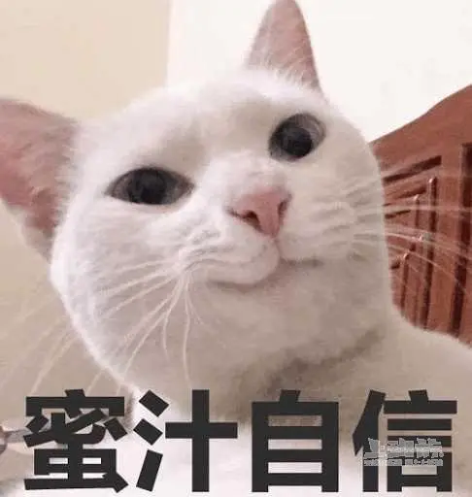

Slide 14
编写测试的技术
1、Unit Test：XUnit……
2、Integration Test：In-memory database、Wiremock……
3、E2E Test: Play Wright……

Slide 15
命名
sut
expected
actual should_fail_when_account_is_null()

Slide 16
案例 1
https://github.com/yangzhongke/analysis-ik
单元/集成测试+Fake+GitHub Actions

Slide 17
案例 2 PlayWright做E2E
用VSCode打开Tripitaka_Reader_E2E_Tests，编辑器中运行其中一两个tests

Slide 18
案例 3
https://github.com/yangzhongke/ZackShop VS本地打开项目
1、看项目结构：测试放到单独的项目；测试代码的namespace和被测试代码的保持一致。
2、看GitHub Actions和实际运行，推送一个更新试一下
3、没有业务逻辑的代码可以不测。
4、通过Stryker做mutation，更全面的单元测试覆盖检查。
5、单元测试典型例子：AuthOpenAPIs.UnitTests/UserServiceTests
6、集成测试的典型例子：AuthOpenAPIs.IntegrationTests

Slide 19
什么是好的测试？
Automated and repeatable
Easy to run
Run quickly
Consistent in results
Fully isolated
Easy to read
Easy to understand expectations and problems
Trustworthy

Slide 20
Avoiding logic in tests 1
Bad
Good
User user1 = new User(2600);
User user2 = new User(2800);
User user3 = new User(3000);
int acualTotal = sut.Calc(user1, user2, user3);
int expectedTotal = user1.Salary+user2.Salary+user3.Salary;
totalSalary.Should().Be(expectedTotal);
User user1 = new User(2600);
User user2 = new User(2800);
User user3 = new User(3000);
int totalSalary = sut.Calc(user1, user2, user3);
totalSalary.Should().Be(8400);

Slide 21
Avoiding logic in tests 2
Good
Bad
Student student1 = new Student("Zack");
Student student2 = new Student("Xiaodi");
Student student3 = new Student("Emma");
User[] actualUsers = sut.Map(student1, student2, student3);
foreach(User actualUser in actualUser)
{
actualUser.Name.Should().NotNull();
}
Student student1 = new Student("Zack");
Student student2 = new Student("Xiaodi");
Student student3 = new Student("Emma");
User[] actualUsers = sut.Map(student1, student2, student3);
actualUsers[0].Name.Should().NotNull();
actualUsers[1].Name.Should().NotNull();
actualUsers[2].Name.Should().NotNull();

Slide 22
Avoiding logic in tests 3
Bad
Good
User user = sut.Create("yzk","123456");
user.PasswordHash.Should().Be(hash.Calc("123456"));
User user = sut.Create("yzk","123456");
user.PasswordHash.Should().Be("e10adc3949ba59abbe56e057f20f883e");

Slide 23
How to test an abstract class
Per test per class

Slide 24
Testable code
1. Avoid static classes or static methods:
String connStr = ConfigHelper.ReadString(“ConnStr”);
2. Interfaces rather than classes.
3. SOLID.

Slide 25
Anti-pattern: Constrained Test Order
Don’t guarantee that tests will run in a specific order.

Slide 26
Anti-pattern: Hidden Test Call
[Test]
public void CreateAnalyzer_GoodNameAndBadNameUsage()
{
logan = new LogAnalyzer();
logan.Initialize();
bool valid = logan.IsValid("abc");
Assert.That(valid, Is.False);
CreateAnalyzer_GoodFileName_ReturnsTrue();
}
[Test]
public void CreateAnalyzer_GoodFileName_ReturnsTrue()
{
bool valid = logan.IsValid("abcdefg");
Assert.That(valid, Is.True);
}

Slide 27
Anti-pattern: multiple asserts in a single test
[Test]
public void Test1()
{
Assert.AreEqual(3, Sum(1,2));
Assert.AreEqual(7, Sum (5,2));
Assert.AreEqual(0, Sum (1,-1);
}
[Test] [InlineData(3,1,2)]
[InlineData(7,5,2)]
[InlineData(0,1,-1)]
public void Test1(int result, int i1, int i2)
{
Assert.AreEqual(result, Sum(i1,i2));
}

Slide 28
Materials
1. The art of unit testing
2. Testcontainers: https://dotnet.testcontainers.org/

Slide 29
Cheat sheet
1. Unit test: Xunit, AutoFixture, AutoFakeItEasy, FluentAssertions
2. Integration test: Wiremock, WebApplicationFactory, DBHelper.
3. E2E test: Play wright, docker, Testcontainers
4. Others: Pipeline, GitHub Actions
5. Open source: https://github.com/yangzhongke/ZackShop

Slide 30
FAQ

