Slide 1
主讲人：杨中科 工作自动化 1案例：获取公司信息1

Slide 2
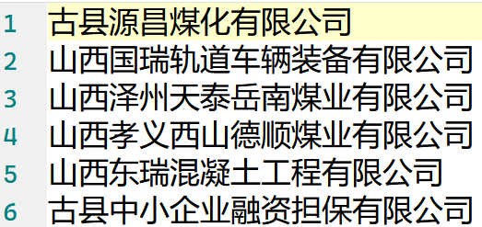
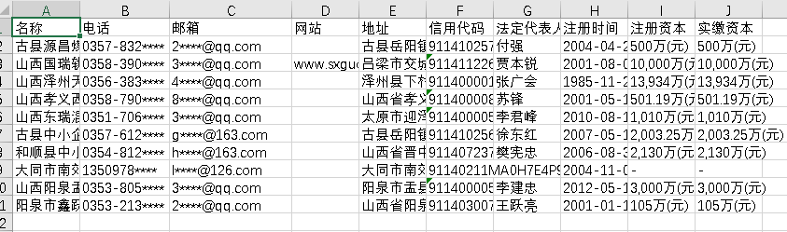
需求
给定一个公司名字的列表，到“爱企查”中获取公司的地址、电话、注册资本等信息，导出到Excel文件。
Notes:
import com.yzk18.GUI.GUI; import com.yzk18.commons.DesktopHelpers; import com.yzk18.commons.IOHelpers; import com.yzk18.docs.ExcelHelpers; import org.openqa.selenium.By; import org.openqa.selenium.TimeoutException; import org.openqa.selenium.WebElement; import org.openqa.selenium.chrome.ChromeDriver; import org.openqa.selenium.support.ui.ExpectedConditions; import org.openqa.selenium.support.ui.WebDriverWait; import java.time.Duration; import java.util.LinkedList; import java.util.List; public class Test1 { public static void main(String[] args) throws InterruptedException { System.setProperty("webdriver.chrome.driver", "C:\\Program Files\\Google\\Chrome\\Application\\chromedriver.exe"); ChromeDriver driver = new ChromeDriver(); //等待登录 driver.get("https://aiqicha.baidu.com/"); GUI.msgBox("登录完成后，点击【确定】键继续"); WebDriverWait driverWait = new WebDriverWait(driver, Duration.ofSeconds(5)); String[] companyNames = IOHelpers.readAllLines("E:\\主同步盘\\我的坚果云\\UoZ\\SE101-玩着学编程\\Part7课件\\公司名单.txt"); LinkedList<CompanyInfo> list = new LinkedList<>(); for(String companyName : companyNames) { //System.out.println(companyName); driver.get("https://aiqicha.baidu.com/s?q="+companyName); checkVCode(driver); driverWait.until(ExpectedConditions.visibilityOfElementLocated(By.className("company-list"))); List<WebElement> cards = driver.findElement(By.className("company-list")).findElements(By.className("card")); WebElement card = cards.get(0); String href = card.findElement(By.tagName("a")).getAttribute("href"); driver.get(href); checkVCode(driver); driverWait.until(ExpectedConditions.visibilityOfElementLocated(By.id("detail-main"))); CompanyInfo companyInfo = new CompanyInfo(); companyInfo.setName(companyName); WebElement addr = driver.findElement(By.xpath("//span[text()='地址：']/following-sibling::*[1]")); companyInfo.setAddress(addr.getText()); WebElement email = driver.findElement(By.xpath("//span[text()='邮箱：']/following-sibling::*[1]")); companyInfo.setEmail(email.getText()); companyInfo.setId(driver.findElement(By.className("social-credit-code-text")).getText()); WebElement legalRep = tryFindElement(driver,By.xpath("//td[text()='法定代表人']/following-sibling::*[1]")); if(legalRep!=null) { companyInfo.setLegalRep(legalRep.findElement(By.tagName("a")).getText()); } WebElement paidinCapital = driver.findElement(By.className("table-paidinCapital-lable")); companyInfo.setPaidInCapital(paidinCapital.getText()); WebElement regCapital = driver.findElement(By.xpath("//td[text()='注册资本']/following-sibling::*[1]")); companyInfo.setRegisteredCapital(regCapital.getText()); WebElement phoneNum = driver.findElement(By.xpath("//span[text()='电话：']/following-sibling::*[1]")); companyInfo.setPhoneNum(phoneNum.getText()); WebElement regDate = driver.findElement(By.xpath("//td[text()='成立日期']/following-sibling::td[1]")); companyInfo.setRegDate(regDate.getText()); var webSite = driver.findElements(By.className("website")); if(webSite.size()>0) { companyInfo.setWebSite(webSite.get(0).getText()); } list.add(companyInfo); } driver.close(); driver.quit(); var workbook = ExcelHelpers.createXLSX(); var sheet = workbook.createSheet(); ExcelHelpers.setCellValue(sheet,0,0,"名称"); ExcelHelpers.setCellValue(sheet,0,1,"电话"); ExcelHelpers.setCellValue(sheet,0,2,"邮箱"); ExcelHelpers.setCellValue(sheet,0,3,"网站"); ExcelHelpers.setCellValue(sheet,0,4,"地址"); ExcelHelpers.setCellValue(sheet,0,5,"信用代码"); ExcelHelpers.setCellValue(sheet,0,6,"法定代表人"); ExcelHelpers.setCellValue(sheet,0,7,"注册时间"); ExcelHelpers.setCellValue(sheet,0,8,"注册资本"); ExcelHelpers.setCellValue(sheet,0,9,"实缴资本"); for(int i=0;i<list.size();i++) { var companyInfo = list.get(i); ExcelHelpers.setCellValue(sheet,i+1,0,companyInfo.getName()); ExcelHelpers.setCellValue(sheet,i+1,1,companyInfo.getPhoneNum()); ExcelHelpers.setCellValue(sheet,i+1,2,companyInfo.getEmail()); ExcelHelpers.setCellValue(sheet,i+1,3,companyInfo.getWebSite()); ExcelHelpers.setCellValue(sheet,i+1,4,companyInfo.getAddress()); ExcelHelpers.setCellValue(sheet,i+1,5,companyInfo.getId()); ExcelHelpers.setCellValue(sheet,i+1,6,companyInfo.getLegalRep()); ExcelHelpers.setCellValue(sheet,i+1,7,companyInfo.getRegDate()); ExcelHelpers.setCellValue(sheet,i+1,8,companyInfo.getRegisteredCapital()); ExcelHelpers.setCellValue(sheet,i+1,9,companyInfo.getPaidInCapital()); } ExcelHelpers.saveToFile(workbook,"e:/1.xlsx"); DesktopHelpers.openFile("e:/1.xlsx"); } static WebElement tryFindElement(ChromeDriver driver,By by) { var elements = driver.findElements(by); if(elements.size()<=0) { return null; } else { return elements.get(0); } } static void checkVCode(ChromeDriver driver) { WebDriverWait driverWait = new WebDriverWait(driver, Duration.ofSeconds(1)); try { driverWait.until(ExpectedConditions.visibilityOfElementLocated(By.className("mod-vcodes"))); } catch (TimeoutException ex) {} if(driver.findElements(By.className("mod-vcodes")).size()>0) { GUI.msgBox("需要通过验证，完成后点【确定】"); } } }

Slide 3
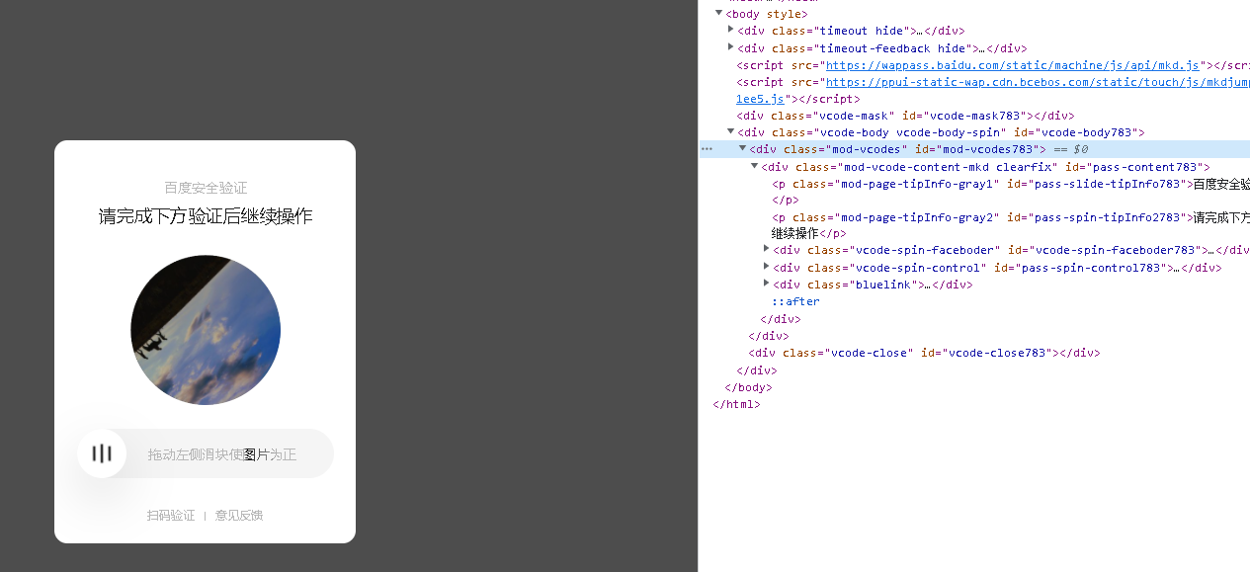
技术问题1
行为验证码的问题：识别；wait；
Notes:
SQL的水很深。

Slide 4
技术问题2
XPath
比如，查找文本为“地址：”的span的下一个兄弟元素：
driver.findElement(By.xpath("//span[text()='地址：']/following-sibling::*[1]"));
Notes:
import com.yzk18.GUI.GUI; import com.yzk18.commons.DesktopHelpers; import com.yzk18.commons.IOHelpers; import com.yzk18.docs.ExcelHelpers; import org.openqa.selenium.By; import org.openqa.selenium.TimeoutException; import org.openqa.selenium.WebElement; import org.openqa.selenium.chrome.ChromeDriver; import org.openqa.selenium.support.ui.ExpectedConditions; import org.openqa.selenium.support.ui.WebDriverWait; import java.time.Duration; import java.util.LinkedList; import java.util.List; public class Test1 { public static void main(String[] args) throws InterruptedException { System.setProperty("webdriver.chrome.driver", "C:\\Program Files\\Google\\Chrome\\Application\\chromedriver.exe"); ChromeDriver driver = new ChromeDriver(); //等待登录 driver.get("https://aiqicha.baidu.com/"); GUI.msgBox("登录完成后，点击【确定】键继续"); WebDriverWait driverWait = new WebDriverWait(driver, Duration.ofSeconds(5)); String[] companyNames = IOHelpers.readAllLines("E:\\主同步盘\\我的坚果云\\UoZ\\SE101-玩着学编程\\Part7课件\\公司名单.txt"); LinkedList<CompanyInfo> list = new LinkedList<>(); for(String companyName : companyNames) { //System.out.println(companyName); driver.get("https://aiqicha.baidu.com/s?q="+companyName); checkVCode(driver); driverWait.until(ExpectedConditions.visibilityOfElementLocated(By.className("company-list"))); List<WebElement> cards = driver.findElement(By.className("company-list")).findElements(By.className("card")); WebElement card = cards.get(0); String href = card.findElement(By.tagName("a")).getAttribute("href"); driver.get(href); checkVCode(driver); driverWait.until(ExpectedConditions.visibilityOfElementLocated(By.id("detail-main"))); CompanyInfo companyInfo = new CompanyInfo(); companyInfo.setName(companyName); WebElement addr = driver.findElement(By.xpath("//span[text()='地址：']/following-sibling::*[1]")); companyInfo.setAddress(addr.getText()); WebElement email = driver.findElement(By.xpath("//span[text()='邮箱：']/following-sibling::*[1]")); companyInfo.setEmail(email.getText()); companyInfo.setId(driver.findElement(By.className("social-credit-code-text")).getText()); WebElement legalRep = tryFindElement(driver,By.xpath("//td[text()='法定代表人']/following-sibling::*[1]")); if(legalRep!=null) { companyInfo.setLegalRep(legalRep.findElement(By.tagName("a")).getText()); } WebElement paidinCapital = driver.findElement(By.className("table-paidinCapital-lable")); companyInfo.setPaidInCapital(paidinCapital.getText()); WebElement regCapital = driver.findElement(By.xpath("//td[text()='注册资本']/following-sibling::*[1]")); companyInfo.setRegisteredCapital(regCapital.getText()); WebElement phoneNum = driver.findElement(By.xpath("//span[text()='电话：']/following-sibling::*[1]")); companyInfo.setPhoneNum(phoneNum.getText()); WebElement regDate = driver.findElement(By.xpath("//td[text()='成立日期']/following-sibling::td[1]")); companyInfo.setRegDate(regDate.getText()); var webSite = driver.findElements(By.className("website")); if(webSite.size()>0) { companyInfo.setWebSite(webSite.get(0).getText()); } list.add(companyInfo); } driver.close(); driver.quit(); var workbook = ExcelHelpers.createXLSX(); var sheet = workbook.createSheet(); ExcelHelpers.setCellValue(sheet,0,0,"名称"); ExcelHelpers.setCellValue(sheet,0,1,"电话"); ExcelHelpers.setCellValue(sheet,0,2,"邮箱"); ExcelHelpers.setCellValue(sheet,0,3,"网站"); ExcelHelpers.setCellValue(sheet,0,4,"地址"); ExcelHelpers.setCellValue(sheet,0,5,"信用代码"); ExcelHelpers.setCellValue(sheet,0,6,"法定代表人"); ExcelHelpers.setCellValue(sheet,0,7,"注册时间"); ExcelHelpers.setCellValue(sheet,0,8,"注册资本"); ExcelHelpers.setCellValue(sheet,0,9,"实缴资本"); for(int i=0;i<list.size();i++) { var companyInfo = list.get(i); ExcelHelpers.setCellValue(sheet,i+1,0,companyInfo.getName()); ExcelHelpers.setCellValue(sheet,i+1,1,companyInfo.getPhoneNum()); ExcelHelpers.setCellValue(sheet,i+1,2,companyInfo.getEmail()); ExcelHelpers.setCellValue(sheet,i+1,3,companyInfo.getWebSite()); ExcelHelpers.setCellValue(sheet,i+1,4,companyInfo.getAddress()); ExcelHelpers.setCellValue(sheet,i+1,5,companyInfo.getId()); ExcelHelpers.setCellValue(sheet,i+1,6,companyInfo.getLegalRep()); ExcelHelpers.setCellValue(sheet,i+1,7,companyInfo.getRegDate()); ExcelHelpers.setCellValue(sheet,i+1,8,companyInfo.getRegisteredCapital()); ExcelHelpers.setCellValue(sheet,i+1,9,companyInfo.getPaidInCapital()); } ExcelHelpers.saveToFile(workbook,"e:/1.xlsx"); DesktopHelpers.openFile("e:/1.xlsx"); } static WebElement tryFindElement(ChromeDriver driver,By by) { var elements = driver.findElements(by); if(elements.size()<=0) { return null; } else { return elements.get(0); } } static void checkVCode(ChromeDriver driver) { WebDriverWait driverWait = new WebDriverWait(driver, Duration.ofSeconds(1)); try { driverWait.until(ExpectedConditions.visibilityOfElementLocated(By.className("mod-vcodes"))); } catch (TimeoutException ex) {} if(driver.findElements(By.className("mod-vcodes")).size()>0) { GUI.msgBox("需要通过验证，完成后点【确定】"); } } }

Slide 5
完成单个公司的信息抓取
……
Notes:
import com.yzk18.GUI.GUI; import com.yzk18.commons.DesktopHelpers; import com.yzk18.commons.IOHelpers; import com.yzk18.docs.ExcelHelpers; import org.openqa.selenium.By; import org.openqa.selenium.TimeoutException; import org.openqa.selenium.WebElement; import org.openqa.selenium.chrome.ChromeDriver; import org.openqa.selenium.support.ui.ExpectedConditions; import org.openqa.selenium.support.ui.WebDriverWait; import java.time.Duration; import java.util.LinkedList; import java.util.List; public class Test1 { public static void main(String[] args) throws InterruptedException { System.setProperty("webdriver.chrome.driver", "C:\\Program Files\\Google\\Chrome\\Application\\chromedriver.exe"); ChromeDriver driver = new ChromeDriver(); //等待登录 driver.get("https://aiqicha.baidu.com/"); GUI.msgBox("登录完成后，点击【确定】键继续"); WebDriverWait driverWait = new WebDriverWait(driver, Duration.ofSeconds(5)); String[] companyNames = IOHelpers.readAllLines("E:\\主同步盘\\我的坚果云\\UoZ\\SE101-玩着学编程\\Part7课件\\公司名单.txt"); LinkedList<CompanyInfo> list = new LinkedList<>(); for(String companyName : companyNames) { //System.out.println(companyName); driver.get("https://aiqicha.baidu.com/s?q="+companyName); checkVCode(driver); driverWait.until(ExpectedConditions.visibilityOfElementLocated(By.className("company-list"))); List<WebElement> cards = driver.findElement(By.className("company-list")).findElements(By.className("card")); WebElement card = cards.get(0); String href = card.findElement(By.tagName("a")).getAttribute("href"); driver.get(href); checkVCode(driver); driverWait.until(ExpectedConditions.visibilityOfElementLocated(By.id("detail-main"))); CompanyInfo companyInfo = new CompanyInfo(); companyInfo.setName(companyName); WebElement addr = driver.findElement(By.xpath("//span[text()='地址：']/following-sibling::*[1]")); companyInfo.setAddress(addr.getText()); WebElement email = driver.findElement(By.xpath("//span[text()='邮箱：']/following-sibling::*[1]")); companyInfo.setEmail(email.getText()); companyInfo.setId(driver.findElement(By.className("social-credit-code-text")).getText()); WebElement legalRep = tryFindElement(driver,By.xpath("//td[text()='法定代表人']/following-sibling::*[1]")); if(legalRep!=null) { companyInfo.setLegalRep(legalRep.findElement(By.tagName("a")).getText()); } WebElement paidinCapital = driver.findElement(By.className("table-paidinCapital-lable")); companyInfo.setPaidInCapital(paidinCapital.getText()); WebElement regCapital = driver.findElement(By.xpath("//td[text()='注册资本']/following-sibling::*[1]")); companyInfo.setRegisteredCapital(regCapital.getText()); WebElement phoneNum = driver.findElement(By.xpath("//span[text()='电话：']/following-sibling::*[1]")); companyInfo.setPhoneNum(phoneNum.getText()); WebElement regDate = driver.findElement(By.xpath("//td[text()='成立日期']/following-sibling::td[1]")); companyInfo.setRegDate(regDate.getText()); var webSite = driver.findElements(By.className("website")); if(webSite.size()>0) { companyInfo.setWebSite(webSite.get(0).getText()); } list.add(companyInfo); } driver.close(); driver.quit(); var workbook = ExcelHelpers.createXLSX(); var sheet = workbook.createSheet(); ExcelHelpers.setCellValue(sheet,0,0,"名称"); ExcelHelpers.setCellValue(sheet,0,1,"电话"); ExcelHelpers.setCellValue(sheet,0,2,"邮箱"); ExcelHelpers.setCellValue(sheet,0,3,"网站"); ExcelHelpers.setCellValue(sheet,0,4,"地址"); ExcelHelpers.setCellValue(sheet,0,5,"信用代码"); ExcelHelpers.setCellValue(sheet,0,6,"法定代表人"); ExcelHelpers.setCellValue(sheet,0,7,"注册时间"); ExcelHelpers.setCellValue(sheet,0,8,"注册资本"); ExcelHelpers.setCellValue(sheet,0,9,"实缴资本"); for(int i=0;i<list.size();i++) { var companyInfo = list.get(i); ExcelHelpers.setCellValue(sheet,i+1,0,companyInfo.getName()); ExcelHelpers.setCellValue(sheet,i+1,1,companyInfo.getPhoneNum()); ExcelHelpers.setCellValue(sheet,i+1,2,companyInfo.getEmail()); ExcelHelpers.setCellValue(sheet,i+1,3,companyInfo.getWebSite()); ExcelHelpers.setCellValue(sheet,i+1,4,companyInfo.getAddress()); ExcelHelpers.setCellValue(sheet,i+1,5,companyInfo.getId()); ExcelHelpers.setCellValue(sheet,i+1,6,companyInfo.getLegalRep()); ExcelHelpers.setCellValue(sheet,i+1,7,companyInfo.getRegDate()); ExcelHelpers.setCellValue(sheet,i+1,8,companyInfo.getRegisteredCapital()); ExcelHelpers.setCellValue(sheet,i+1,9,companyInfo.getPaidInCapital()); } ExcelHelpers.saveToFile(workbook,"e:/1.xlsx"); DesktopHelpers.openFile("e:/1.xlsx"); } static WebElement tryFindElement(ChromeDriver driver,By by) { var elements = driver.findElements(by); if(elements.size()<=0) { return null; } else { return elements.get(0); } } static void checkVCode(ChromeDriver driver) { WebDriverWait driverWait = new WebDriverWait(driver, Duration.ofSeconds(1)); try { driverWait.until(ExpectedConditions.visibilityOfElementLocated(By.className("mod-vcodes"))); } catch (TimeoutException ex) {} if(driver.findElements(By.className("mod-vcodes")).size()>0) { GUI.msgBox("需要通过验证，完成后点【确定】"); } } }

Slide 6
谢谢
我是杨中科
一名快乐的程序员

