Slide 1
HW 3
ZhouYang

Slide 2
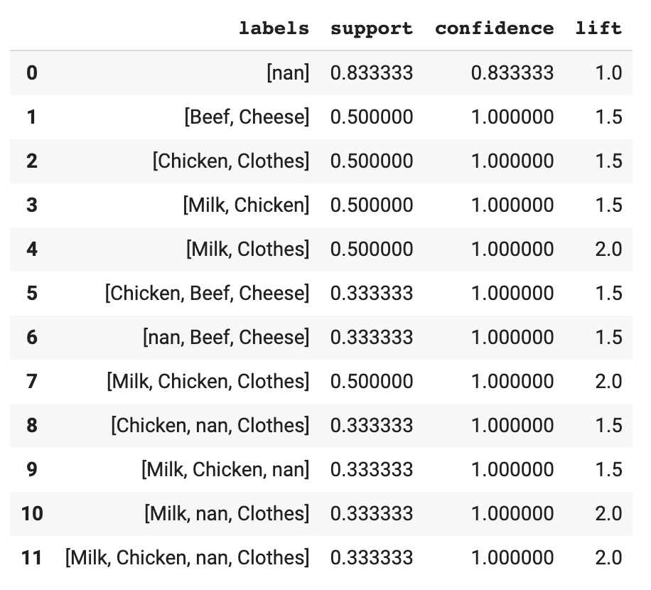
minsup=0.3,mincof=0.8

Slide 3
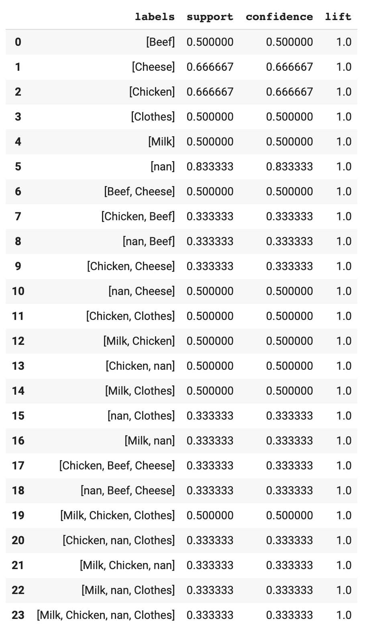
minsup=0.3

Slide 4
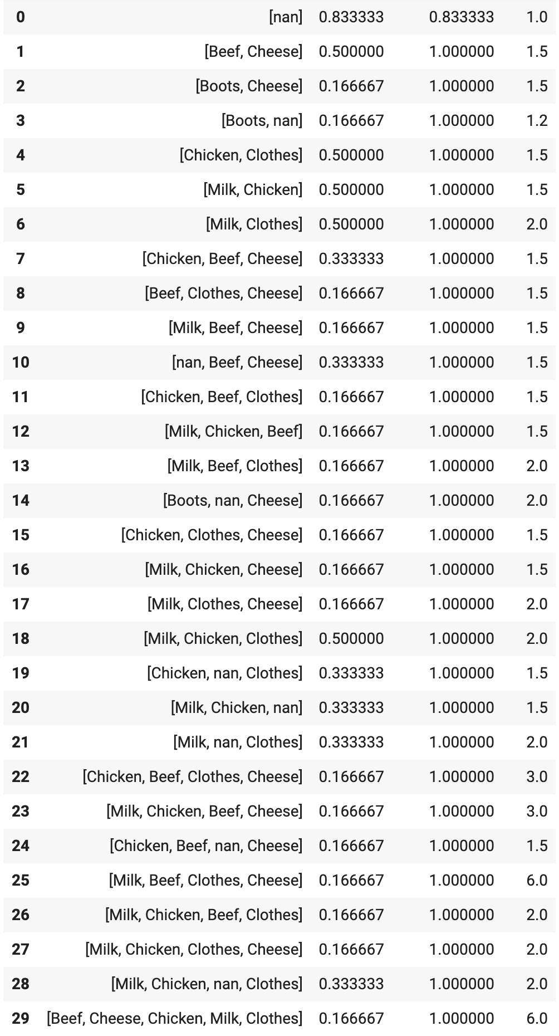
mincof=0.8

Slide 5

Thanks

