Slide 1
HW 3
ZhouYang

Slide 2
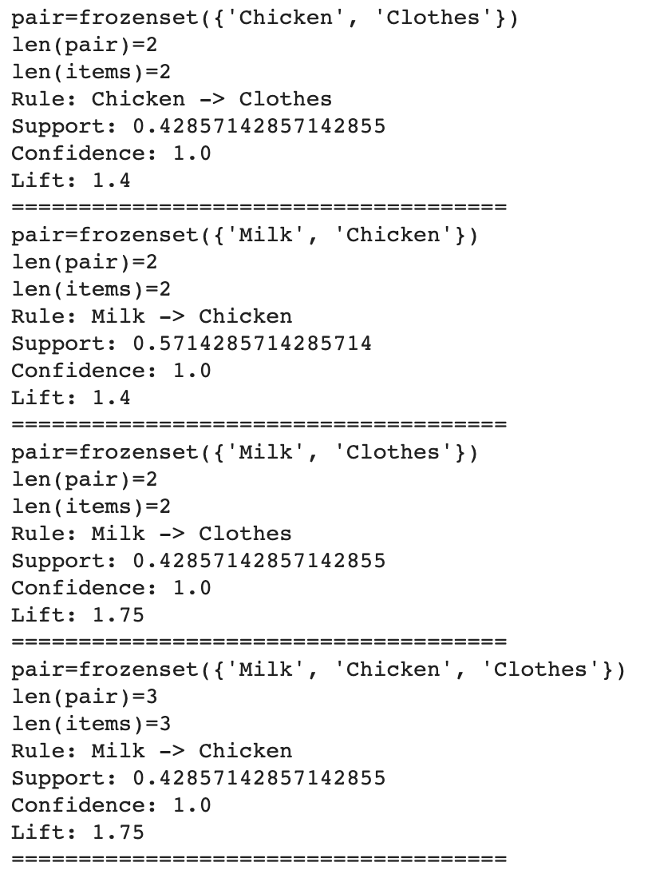

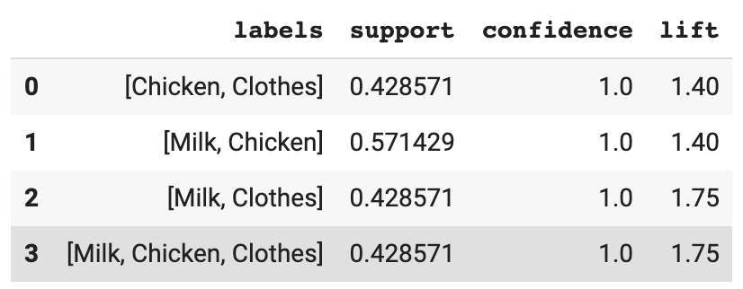
minsup=0.3,mincof=0.8

Slide 3

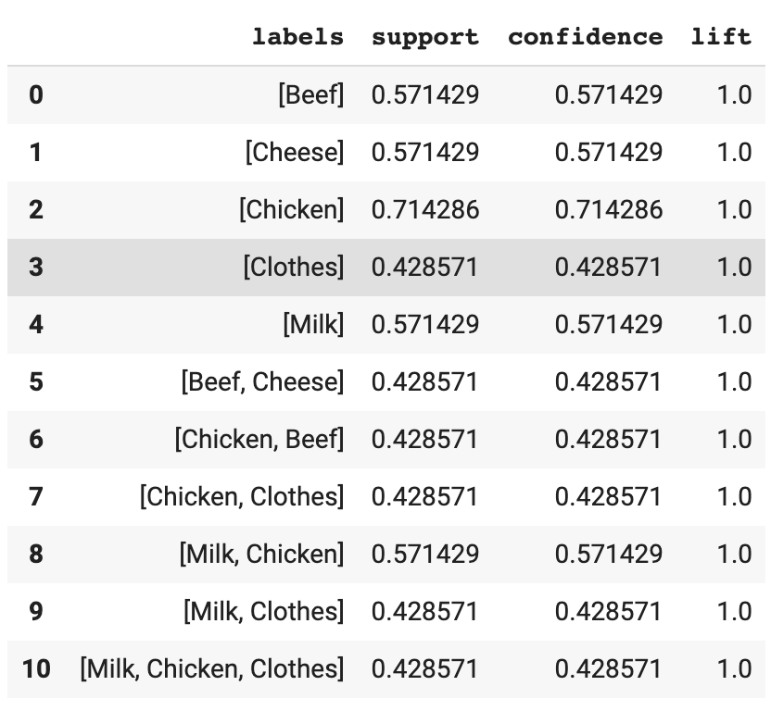
minsup=0.3

Slide 4
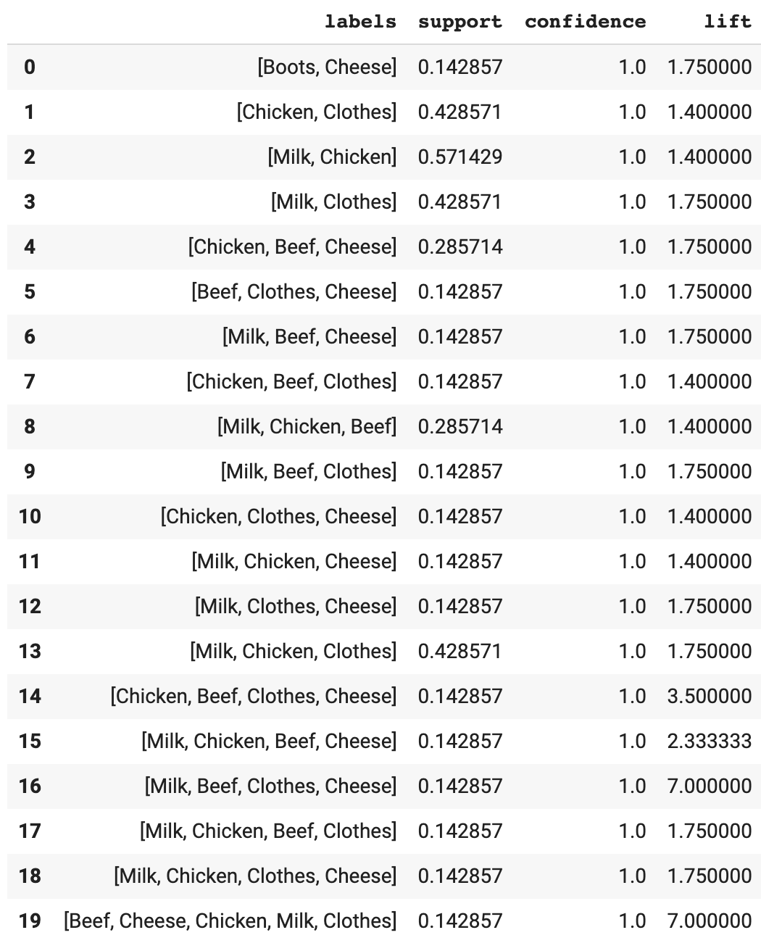

mincof=0.8

Slide 5

Thanks

