Slide 1
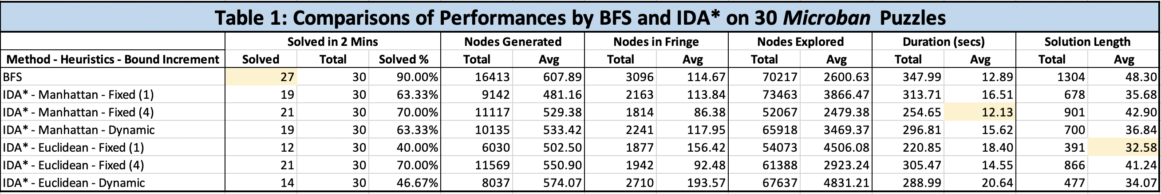
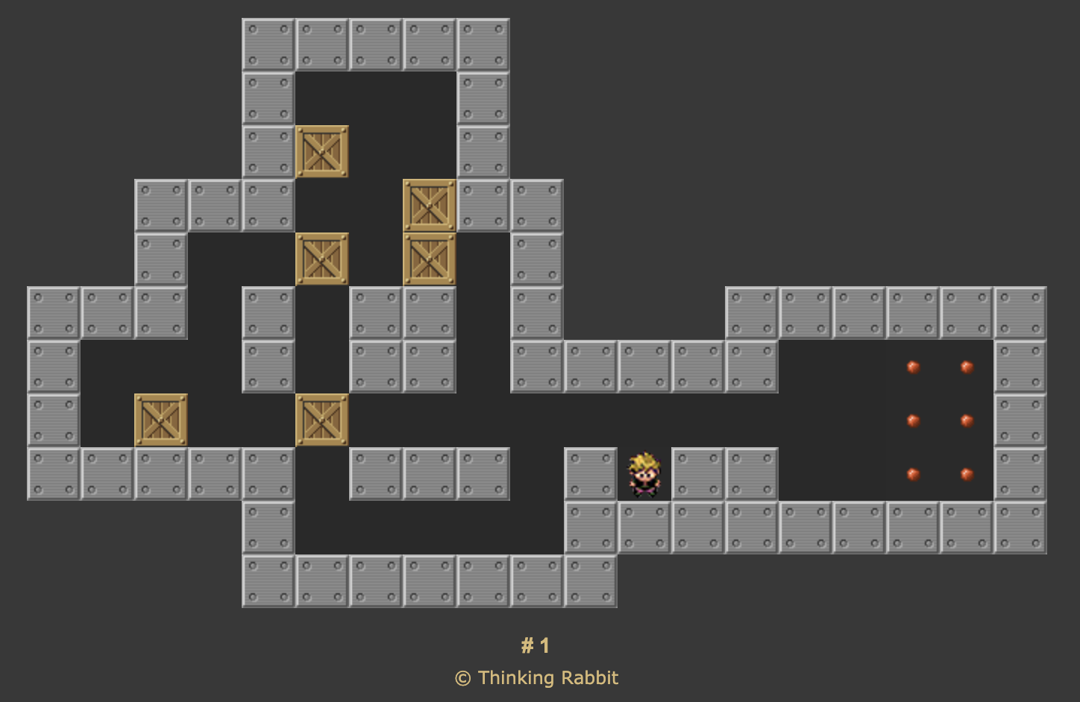
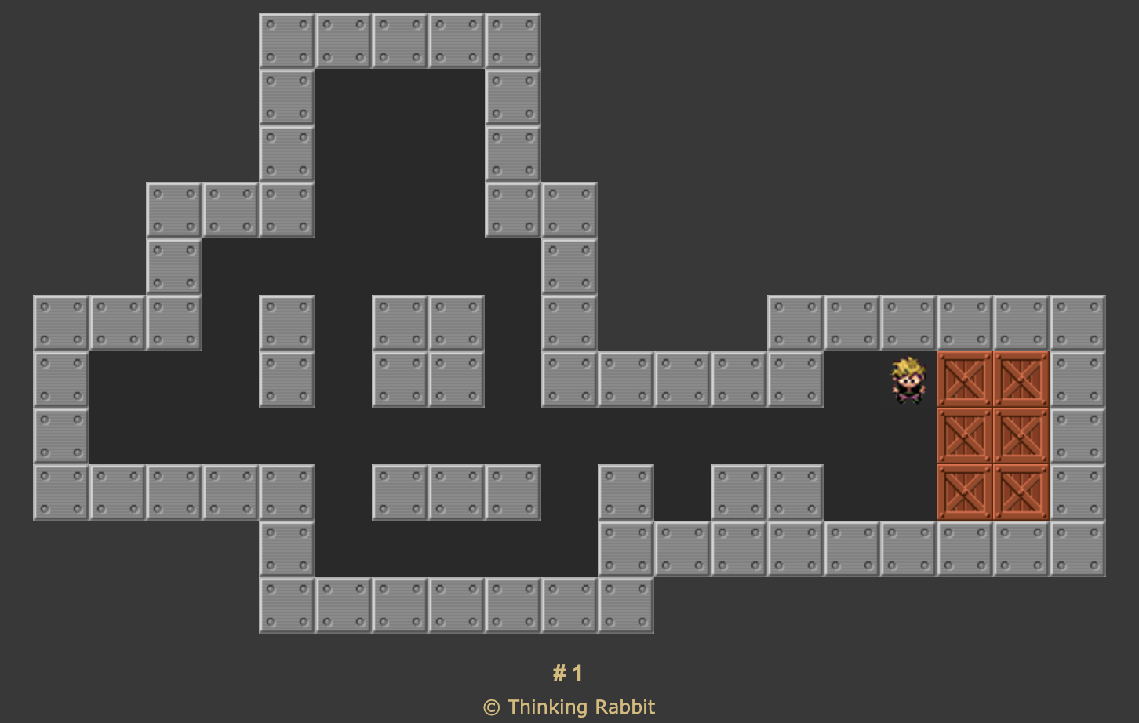
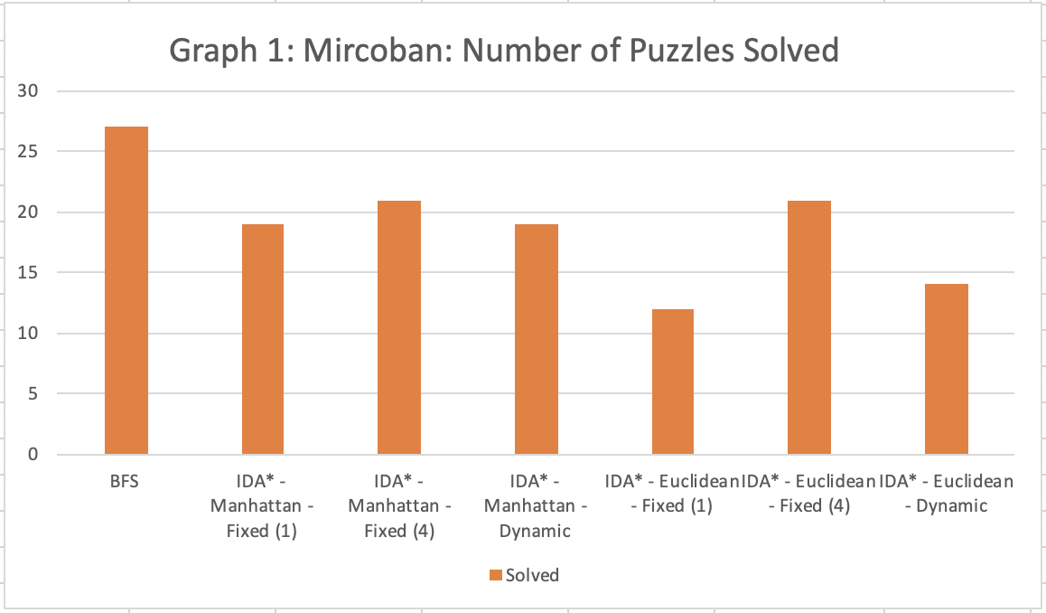
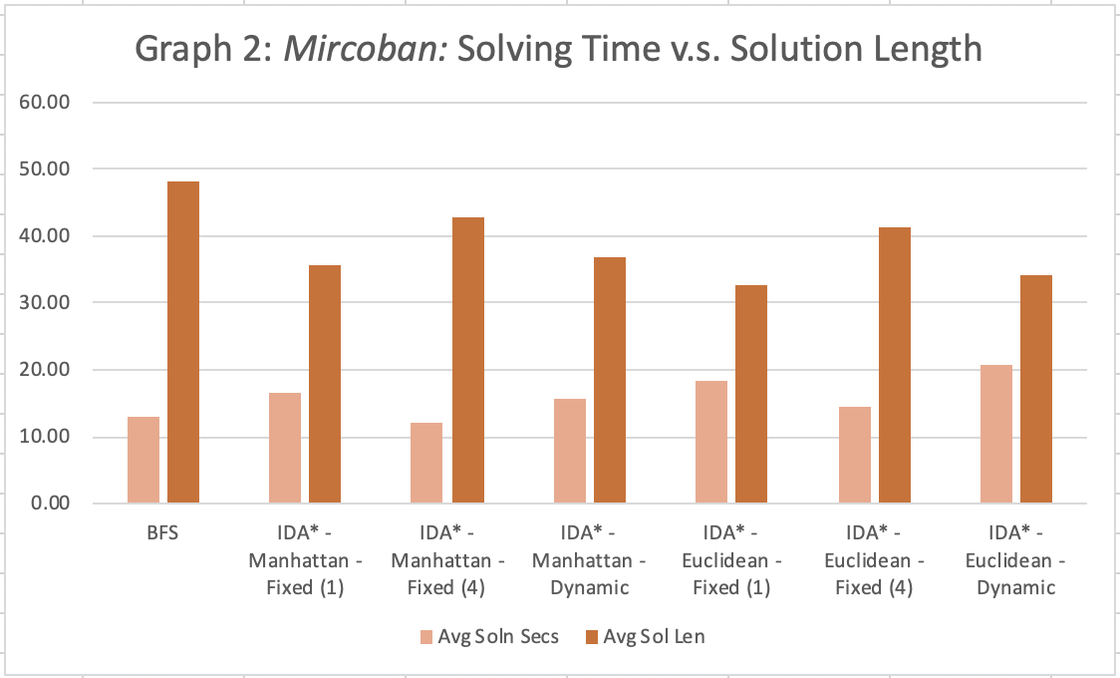
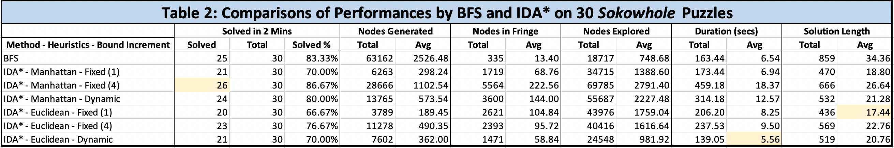
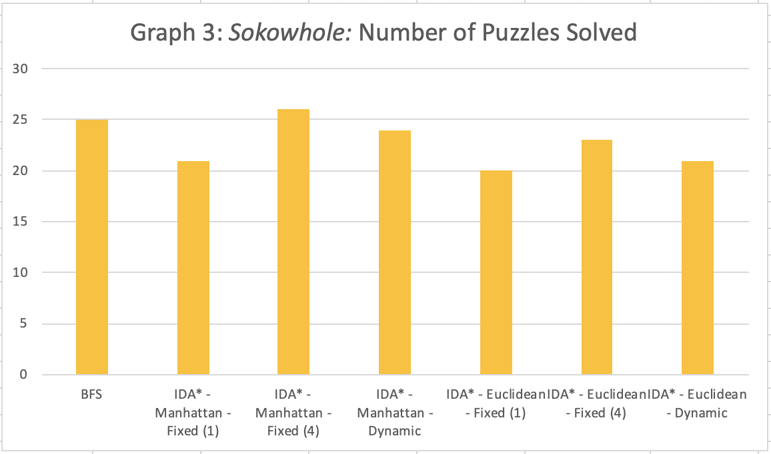
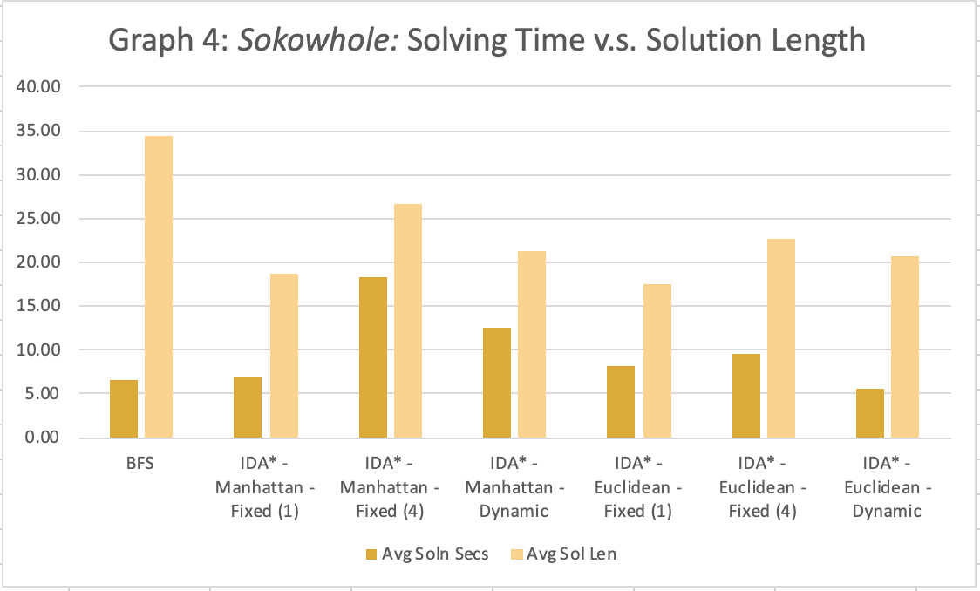
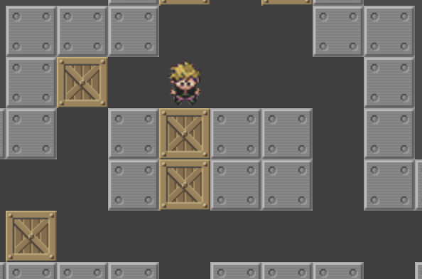
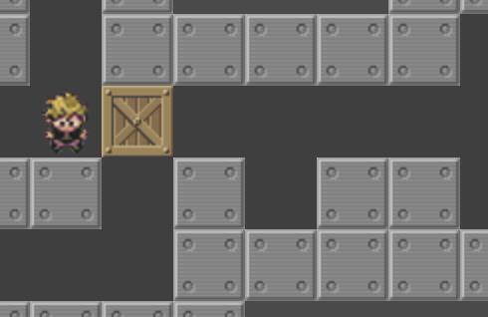
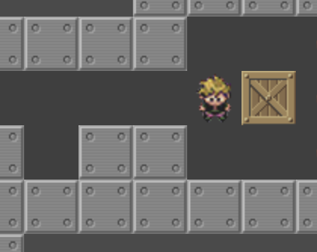
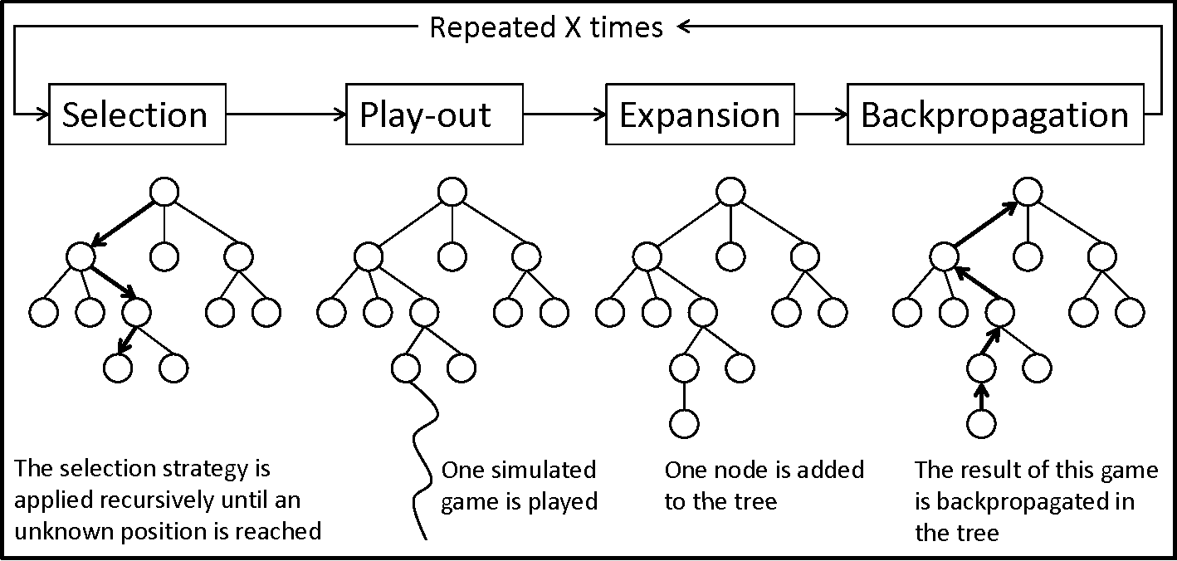
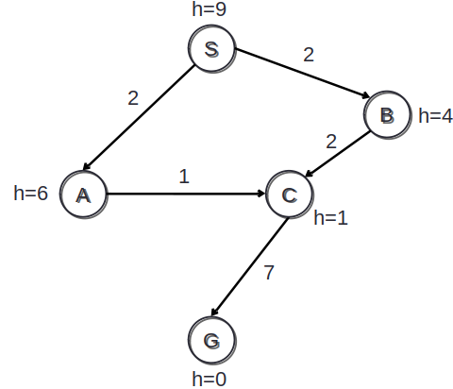
Sokoban, Solved: Modeling Sokoban Puzzles as Search Problems Matthew Days and Yangzi Jiang Davidson College Departments of Mathematics and Computer Science
Overview
4. Results
Create a program that uses different search algorithms to solve Sokoban
Search algorithms like IDA* & MCTS have numerous real-world applications
AI planning, pathfinding in video games, autonomous vehicles
Sokoban represents a complex domain in which to evaluate these algorithms
Solving Sokoban is difficult - it is a NP-hard, PSPACE-complete problem
Figure 1: Initial State of the original level-1 Sokoban Puzzle
Figure 2: Solved State of the original level-1 Sokoban Puzzle
2. Sokoban Features
A puzzle game created in 1981 by Hiroyuki Imabayashi published by Thinking Rabbit
Sokoban is a Japanese word meaning “warehouse keeper”
Objective: Players push boxes vertically or horizontally into designated goal spaces
NP-hard, PSPACE-complete
At least as difficult as NP-complete problems and requires large memory spaces
Deadlocks: Need to detect a deadlocks as they would render puzzle unsolvable
Tunnels: Model consecutive pushes along the tunnel as one move to reduce complexity
Figure 3: Two examples of deadlocks due to frozen boxes.
Figure 4: FIve consecutive right pushes
3a. Iterative Deepening A* (IDA*)
3b. Monte Carlo Tree Search (MCTS)
5. Conclusion
Graph search algorithm that uses heuristic function as guide
Trade off between time and space:
IDA* Saves storage space with DFS & pruning
Addresses the high space-complexity issue with with Sokoban.
Vanilla IDA* is more
time-costly as it may
revisit the same states
Transition hashtable
to record
visited states
MCTS does not require domain-specific knowledge, only legal moves and goal conditions (this lack of knowledge causes a performance hit)
Modeled Sokoban as a search problem to test various search algorithms
BFS runtime outperformed IDA* runtime
Result of heuristic calculation, which allows for less nodes generated
IDA*: move-optimal; BFS not
As puzzle difficulty increases, performance declines dramatically
MCTS too slow to solve Sokoban without optimizations & domain dependent info
Further exploration:
More domain-specific info: improved deadlocks, PI-corrals, goal & tunnel macros
Improved heuristics: Minmatching (minimum cost perfect matching in bipartite graph of boxes and goals)
6. Acknowledgements & Sources
We would like to thank Dr. Raghu Ramanujah for his guidance on this project
Game figures: Original puzzle game written by Hiroyuki Imabayashi; © 1982 by THINKING RABBIT Inc. JAPAN; retrieved from sokoban.info
Notes:
1

