Slide 1
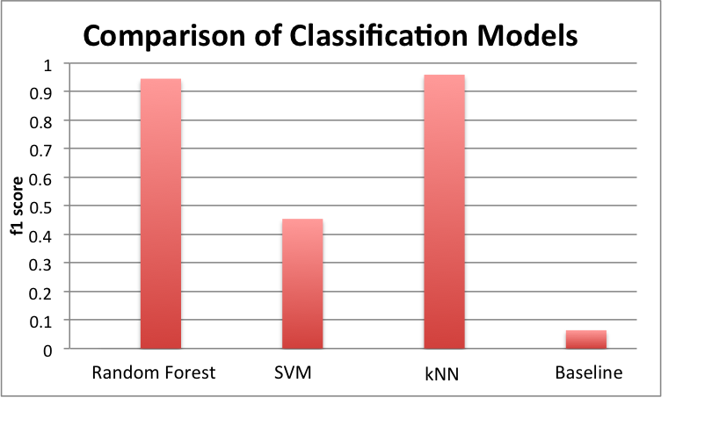
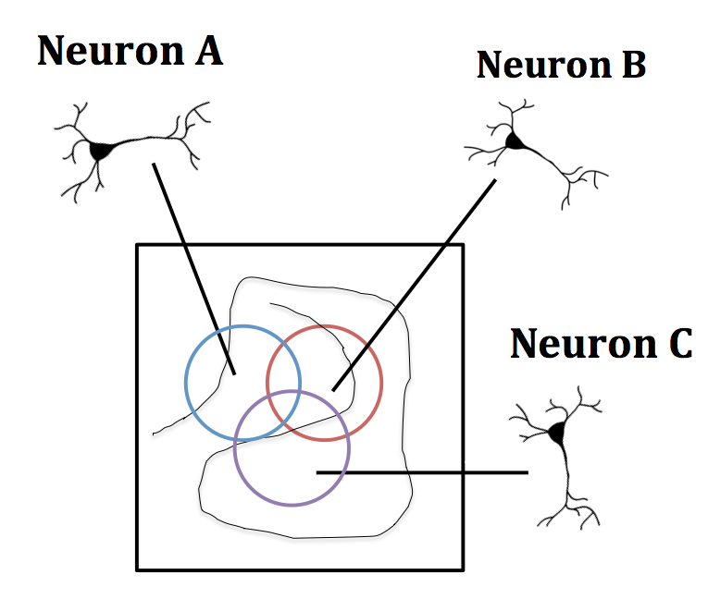
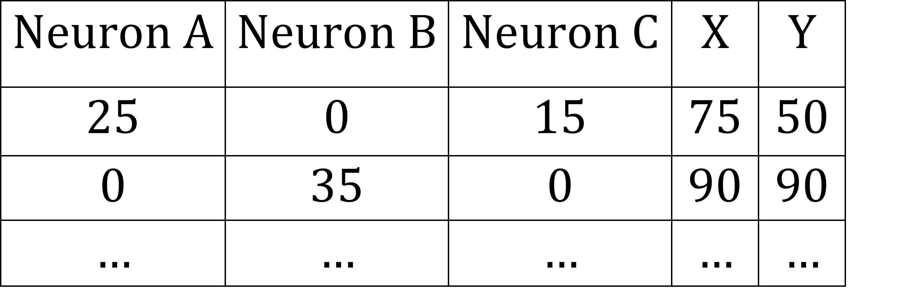
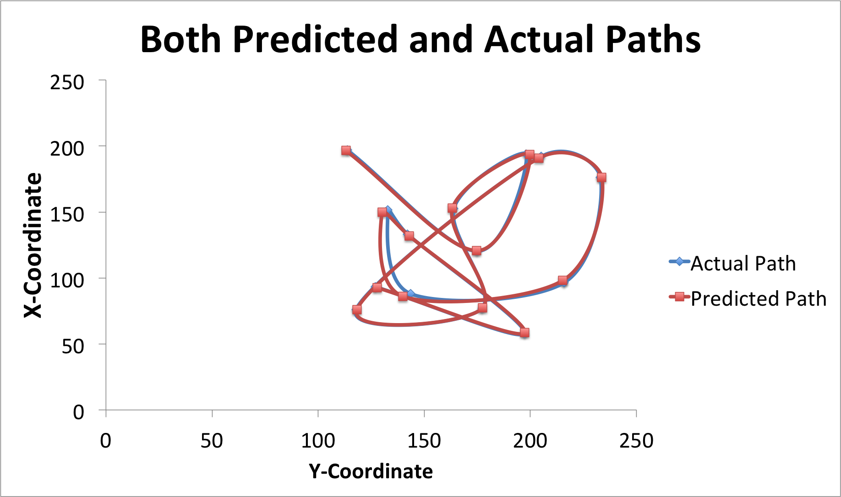
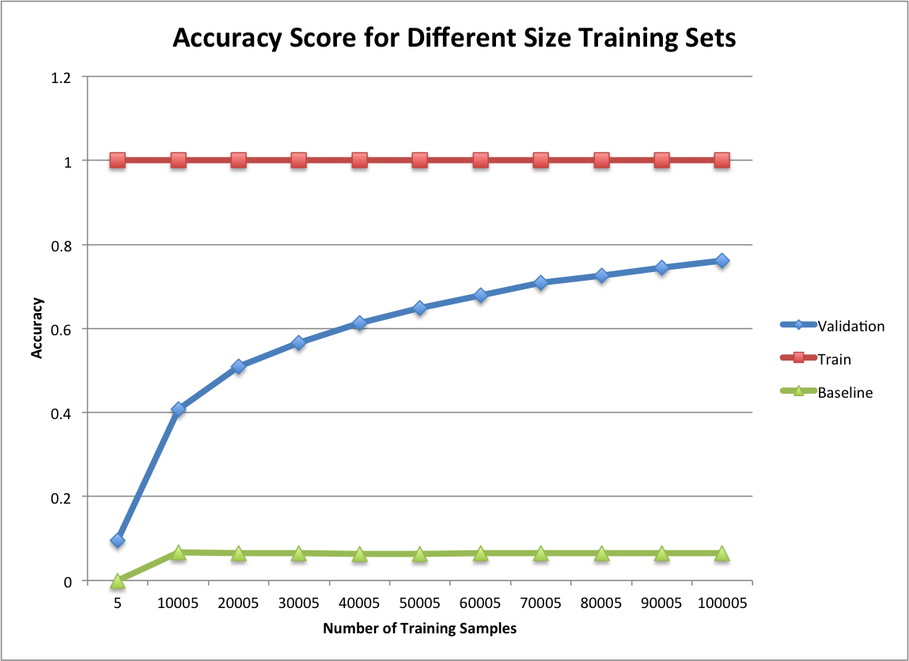
Sokoban, Solved: Modelling Sokoban Puzzles as Search Problems Matthew Days and Yangzi Jiang Davidson College Departments of Mathematics and Computer Science
3c. Monte Carlo Search Tree (MCST)
Random Forest- Optimal number of trees is 200
SVM- Optimal penalty parameter of cthe error term is 5.0
kNN- Optimal number of neighbors is 1 and distance metric is Manhattan
1.Abstract/Introduction
4. Results
Neurons in the Hippocampus of rats
Exhibit increased neural activity when rat is in
specific area of environment
Areas are known as receptive fields
Set of all receptive fields cover the environment
In typical place cell experiments, the firings of
neurons in CA1 of the hippocampus are recorded
while a rat explores an open field
Random Forest
Optimal number of trees is 200
kNN
Optimal number of neighbors is 1
Optimal distance metric is Manhattan
Neural Network
Optimal number of hidden layers is 4
Optimal size of hidden layers is 500
Optimal activation function for the hidden layers is hyperbolic tangent
Optimal algorithm for weight optimization is stochastic gradient descent
Optimal L2 penalty (α) parameter is 0.8
 | Euclidean Error
Random Forest | 16.297
K-Nearest Neighbors | 2.0167
Neural Network | 11.934
Random | 88.376
4. Experiment
Place cell experiments:
Random Forest- Optimal number of trees is 200
SVM- Optimal penalty parameter of cthe error term is 5.0
kNN- Optimal number of neighbors is 1 and distance metric is Manhattan
2. Sokoban: The Game
Training examples = number of firings of each neuron in a 150 ms interval
Features = recordings from 71 neurons
Labels were the location of the rat:
Classification- location in 4x4 grid
Regression- Cartesian coordinates
3a. Iterative Deepening A* (IDA*)
Random Forest- Optimal number of trees is 200
SVM- Optimal penalty parameter of the error term is 5.0
kNN- Optimal number of neighbors is 1 and distance metric is Manhattan
Data Characteristics- high variance
Model selection:
Classification- Support Vector Machine, K-nearest neighbor, Random Forest
Regression- Neural Network, K-nearest neighbor, Random Forest
3. Iterative Deepening A* (IDA*)
6. Conclusion
7. Conclusion
3b. Simplified Memory A* (SMA*)
Random Forest- Optimal number of trees is 200
SVM- Optimal penalty parameter of the error term is 5.0
kNN- Optimal number of neighbors is 1 and distance metric is Manhattan
For classification, our best performing model is kNN
For regression, our best performing model is kNN
We successfully predicted the path of a rat from place cell activity with an error of 2.0167
Future Work:
Build models for other rats
Build models that predict a rat’s location from grid cell activity
Random Forest- Optimal number of trees is 200
SVM- Optimal penalty parameter of cthe error term is 5.0
kNN- Optimal number of neighbors is 1 and distance metric is Manhattan
Random Forest- Optimal number of trees is 200
SVM- Optimal penalty parameter of the error term is 5.0
kNN- Optimal number of neighbors is 1 and distance metric is Manhattan
3c. Monte Carlo Search Tree (MCST)
Random Forest- Optimal number of trees is 200
SVM- Optimal penalty parameter of cthe error term is 5.0
kNN- Optimal number of neighbors is 1 and distance metric is Manhattan
Notes:
<number>

