Slide 1
Research Experience 1 Topography in 2-D turbulence

Slide 2
Abstract
Seafloor topography is essential for oceanic fluid dynamics from many perspectives, and it is believed to enhance energy dissipation in oceanic flows. This study numerically examines the impact of small-scale topography on the dynamics of quasi-geostrophic barotropic flows. We found that the direction of energy transfer varies depending on the range of topographic amplitude.

Slide 3
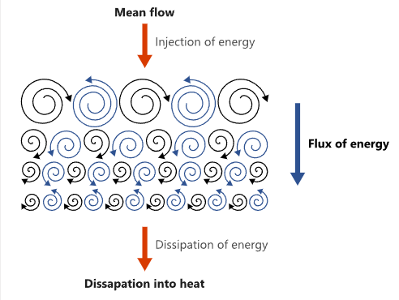
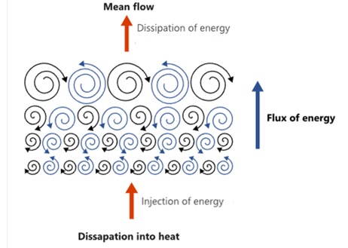

2-D turbulence
Unlike three-dimensional turbulence, two-dimensional turbulence lacks vortex stretching, resulting in many unusual behaviors.
3-D:Kolmogorov’s 4/5th inertial range law
energy cascade
2-D:inverse energy cascade

Slide 4
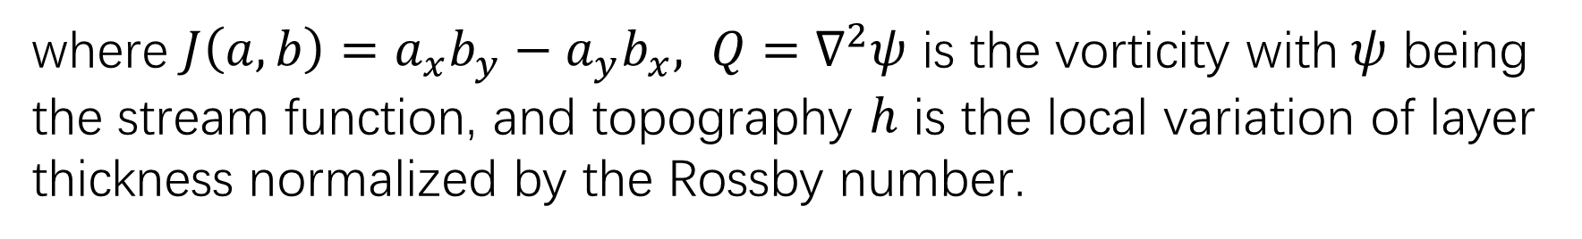
Governing equations
Including the forcing and dissipation effects, the dimensionless quasi-geostrophic equation becomes:
$$∂_{t}Q+J\left(ψ,Q\right)+J\left(ψ,h\right)=−αQ+υ∇^{6}Q+M_{F}k_{f}^{1/2}F$$
where $J\left(a,b\right)=a_{x}b_{y}−a_{y}b_{x}, Q=∇^{2}ψ$ is the vorticity with$ψ$ being the stream function, and topography $h$ is the local variation of layer thickness normalized by the Rossby number.

Slide 5
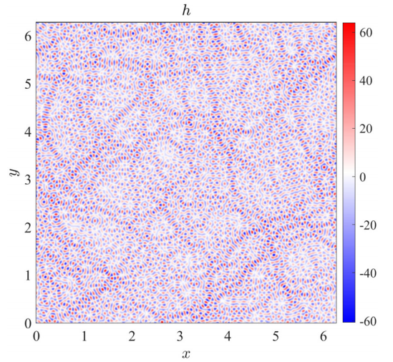
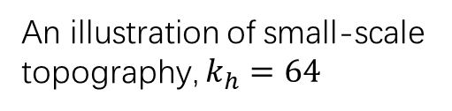
Topography
Topography influences the ocean circulation on various temporal and spatial scales. It affects the stability of large-scale flows and changes their associated mixing characteristics.
Topography at different scales has varying effects on the system.
An illustration of small-scale topography, $k_{h}=64$

Slide 6

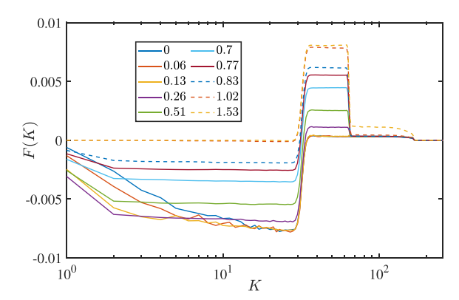
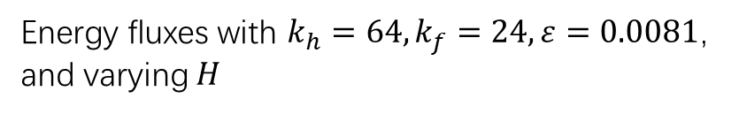
Numerical simulation
We applied a Fourier transform to the governing equations for numerical simulation and calculated the resulting energy flux:
Energy fluxes with $k_{h}=64,k_{f}=24,ε=0.0081$, and varying $H$

Slide 7
Numerical simulation
Topography enhances energy transfer to smaller scales.
When ℎ exceeds a certain threshold, on scales much larger than the topography, the topography can facilitate energy transfer to even larger scales before dissipation.
When the scale of the topography is relatively small, it can, in certain cases, unexpectedly influence larger scales.

Slide 8
Summary and discussion
In summary, we discover a novel phenomenon where small-scale topography enhances energy condensation in quasi-geostrophic turbulence. Current ocean parameterizations are inadequate for capturing the topography-enhanced energy flux presented in this paper. Therefore, our findings bring about challenges in ocean modeling.

Slide 9
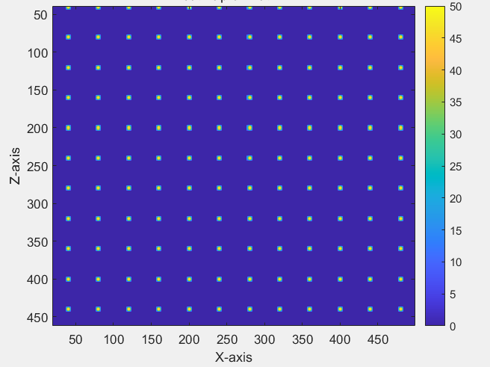

Other work
The previous discussion explored the impact of small-scale topography on two-dimensional turbulence. Other work includes examining the effects of large-scale topography with embedded small-scale structures. When $h$ is large, it is expected that large-scale structures containing similar small-scale features to the topography will form.
In this case, the topography height is 𝐻, the spacing between topographic features is 𝐿 (representing large-scale information), and the topography width is 𝑙 (representing small-scale information). Previous experience suggests that the resulting vorticity structure is related to the ratio of 𝐻/𝑙 and 𝐿.

Slide 10
Personal gains
I have mastered the basic theory of turbulence and gained a deeper understanding of classical theories such as those by Kolmogorov.
I have reviewed the methods of using MATLAB to solve computational fluid dynamics problems.
have improved my skills in literature research, as well as in communication and discussions with my professors.

Slide 11
Reference
[1] Erik Lindborg, Can the atmospheric kinetic energy spectrum be explained by two-dimensional turbulence, J. Fluid Mech. (1999), vol. 388, pp. 259–288.
[2] Jin-Han Xie and Oliver Bühler, Exact third-order structure functions for two-dimensional turbulence, J. Fluid Mech. (2018), vol. 851, pp. 672–686.
[3] Lin-Fan Zhang and Jin-Han Xie, Spectral condensation and bidirectional energy transfer in quasi-geostrophic turbulence above small-scale topography, Phys. Fluids 36, 086601 (2024)
[4] Lennard Miller, Bruno Deremble, and Antoine Venaille, Gyre Turbulence: Anomalous Dissipation in a Two-Dimensional Ocean Model

