Slide 1
Research Experience 2 Quantum computing and fluid mechanics

Slide 2
Abstract
Quantum computing has emerged to be the next disruptive technology since Feynman pointed out the enormous potential of quantum simulation. Compared to conventional digital computing, quantum computing can dramatically reduce the execution time. We attempt to use quantum computing to solve fluid mechanics problems.

Slide 3
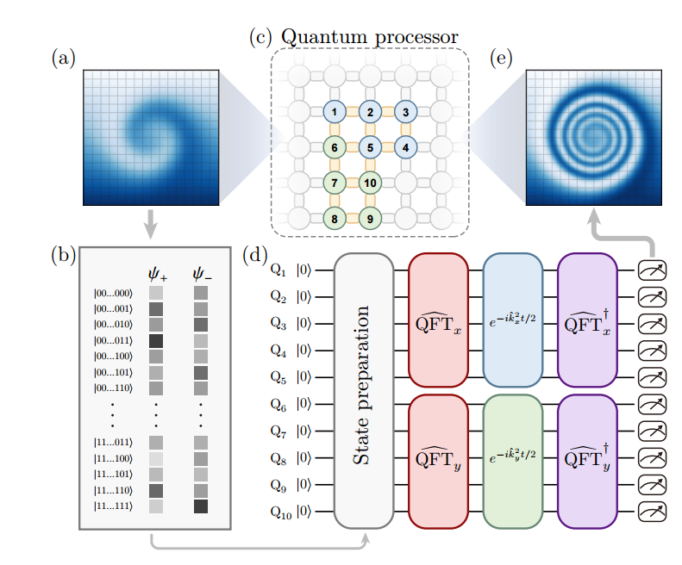
How to proceed ?
(1) Encoding the physical information of fluid into quantum state information. [(a),(b)]
(2) Linearizing the Navier-Stokes equations or transport equations, or transforming them into the Schrödinger form, and then constructing quantum circuits for computation based on the specific forms (sometimes requiring a Fourier transform of the quantum states). [(c),(d)]
(3) Extracting the physical information of the fluid from the resulting quantum states. [(e)]

Slide 4
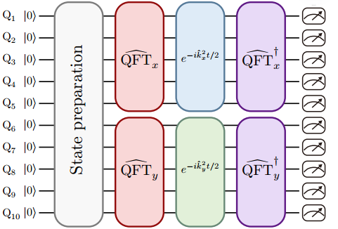
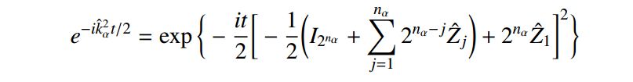
Some of my research
Finding a universal form of quantum circuits that can compute a wider variety of equations.
A senior in the same research group has studied the form $e^{−ik^{2}t/2}$. Allowing it to be decomposed into basic quantum gate circuits.

Slide 5
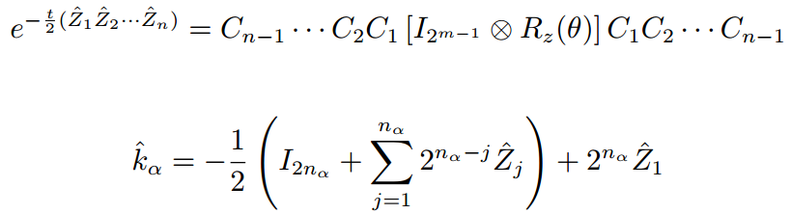
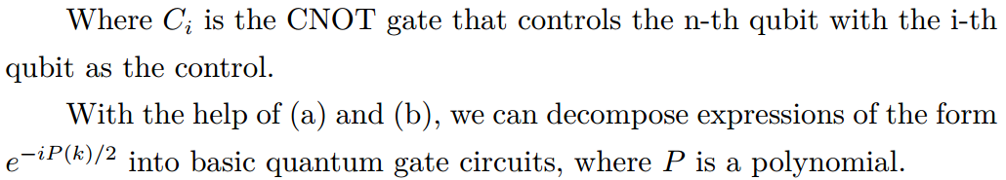
Building on my senior's research, I discovered that the square of 𝑘 can be replaced with a polynomial form of 𝑘, which can further be approximated through a Taylor expansion for a general form.
(a)
(b)

Slide 6
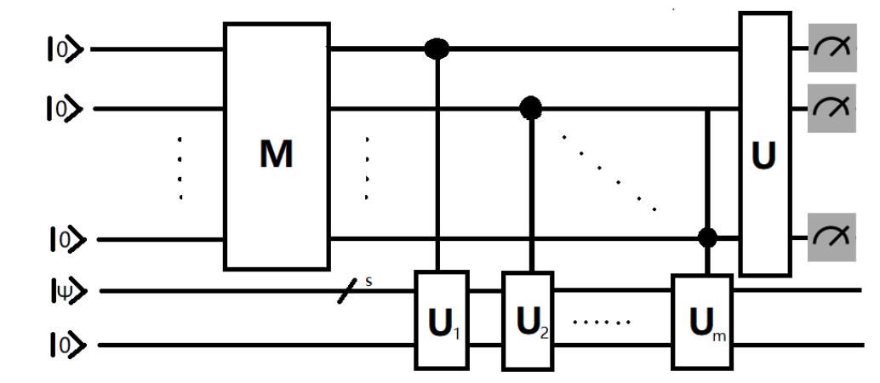
Another discovery: a method was found to extract physical information from multiple quantum states simultaneously.
The original measurement method required constructing multiple quantum circuits for measurement. However, the newly discovered method allows obtaining results through multiple measurements using a single quantum circuit. For detailed information, please refer to [Quantum Measurement.pdf] on my personal website.

Slide 7
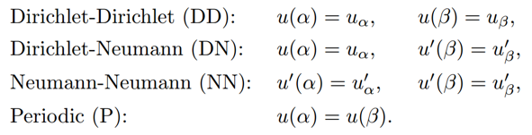
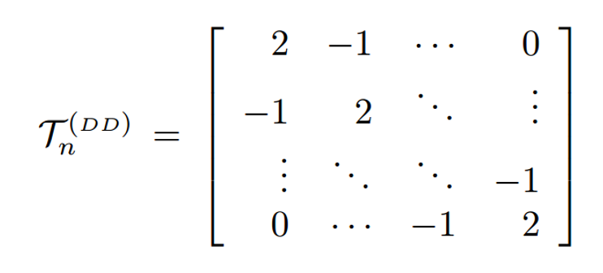
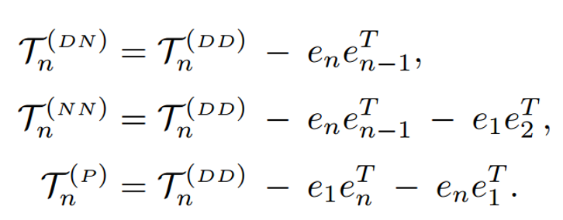
Recent work
We consider problems with boundary conditions. For different boundary conditions, there are fast diagonalization methods for the matrices corresponding to the difference schemes. We can base our quantum computation on this approach to address boundary value problems.

Slide 8
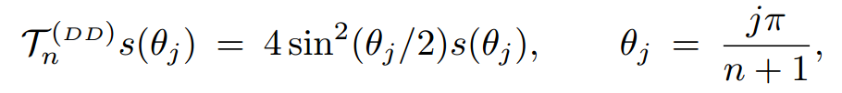
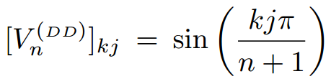
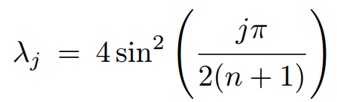
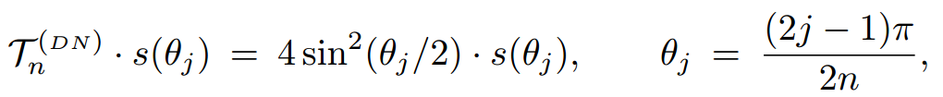
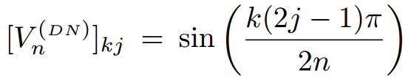
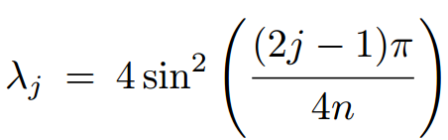
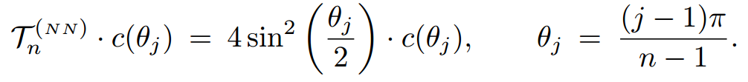
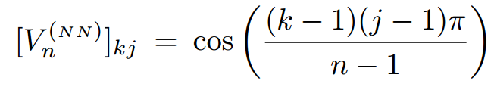
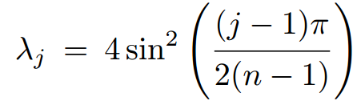

Fast diagonalization of different numerical schemes
For the four schemes, we can decompose them quickly :$T=V^{−1}DV$
$$s\left(θ_{j}\right)={(sinθ_{1},sinθ_{2},…,sinθ_{n})}^{T}$$
$$D=Diag(λ_{1},λ_{2},…,λ_{N})$$

Slide 9




Handling computational problems
By applying appropriate methods (such as block-encoding or Fourier transform) to the diagonal matrix, we can transform it into a unitary diagonal matrix related to the wavenumber. Then, we can construct a quantum circuit composed of basic quantum gates for computation using the previous method.
Current difficulties:
The analysis of eigenvalue decomposition for higher-order numerical schemes has not been conducted yet, and it is unclear whether they have a unified format.
In problems with boundary conditions, the use of block-encoding and Fourier transforms may be more challenging.

Slide 10
Summary and discussion
In our research, we have studied various issues related to using quantum computing methods to solve problems encountered in computational fluid dynamics. For example, how to efficiently extract physical information from quantum states, how to transform different types of equations into a form suitable for quantum computing, and how to address boundary value problems, among others.

Slide 11
Reference
[1] Zhengyuan Yang, Linjie Li, Kevin Lin, Jianfeng Wang, Chung-Ching Lin,Zicheng Liu, Lijuan Wang, The Dawn of LMMs:Preliminary Explorations with GPT-4V(ision).
[2] Ali Kashefi, Tapan Mukerji, ChatGPT for Programming Numerical Methods.
[3] Zhaoyuan Meng and Yue Yang, Quantum computing of fluid dynamics using the hydrodynamic Schrödinger equation, PHYSICAL REVIEW RESEARCH 5, 033182 (2023).
[4] Zhaoyuan Meng and Yue Yang, Quantum spin representation for the Navier-Stokes equation.
[5] Zhen Lu, Yue Yang, Quantum computing of reacting flows via Hamiltonian simulation.

Slide 12
Reference
[6] Zhaoyuan Meng,Jiarun Zhong, Shibo Xu, Ke Wang,Jiachen Chen, Feitong Jin, Xuhao Zhu, Yu Gao, Yaozu Wu, Chuanyu Zhang, Ning Wang, Yiren Zou, Aosai Zhang, Zhengyi Cui, Fanhao Shen, Zehang Bao, Zitian Zhu, Ziqi Tan, Tingting Li, Pengfei Zhang, Shiying Xiong, Hekang Li, Qiujiang Guo, Zhen Wang, Chao Song, H. Wang, and Yue Yang, Simulating unsteady fluid flows on a superconducting quantum processor.

