Slide 1
Data SCIENCE
Lecture: 2
Mohsen Chitsaz, Ph.D.
Senior Principal Data Scientist at Symantec

Slide 2
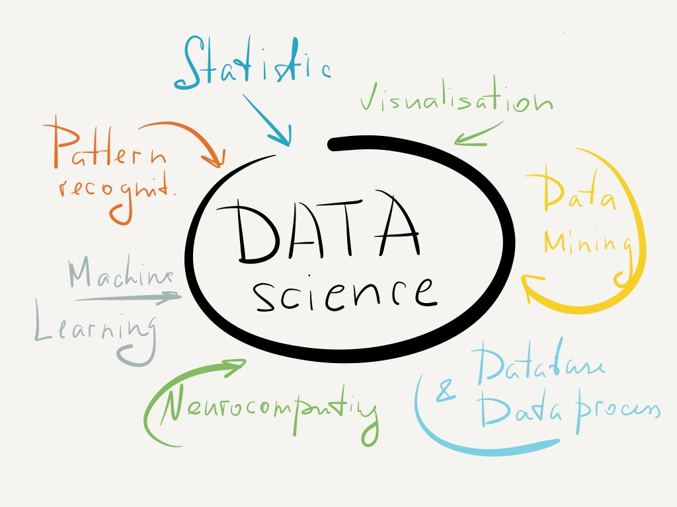
Statistics
Visualization
Data Mining
Database
Neuro-computing
Machine Learning
Pattern Recognition

Slide 3

DATA MODELING LIFE CYCLE
Data Gathering
Data Clean up
Data Modeling
Visualization
Validation

Slide 4
DATA MODELING LIFE CYCLE
Data Gathering
Data Clean up
Data Modeling
Visualization
Validation

Slide 5


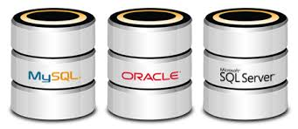


DATA GATHERING AND CLEANSING
DATA

Slide 6
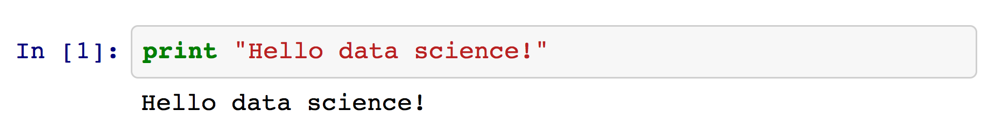
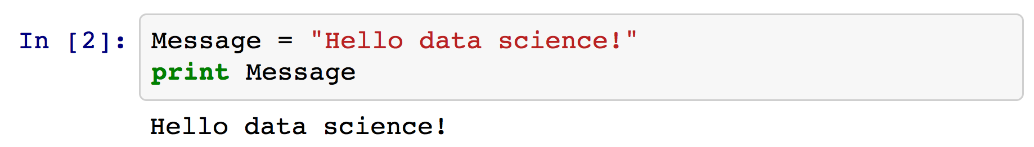
EXAMPLE 2.1. First python program “Hello Data Science!” and introduction to python
Notes:
Switch to live ipython notebook

Slide 7
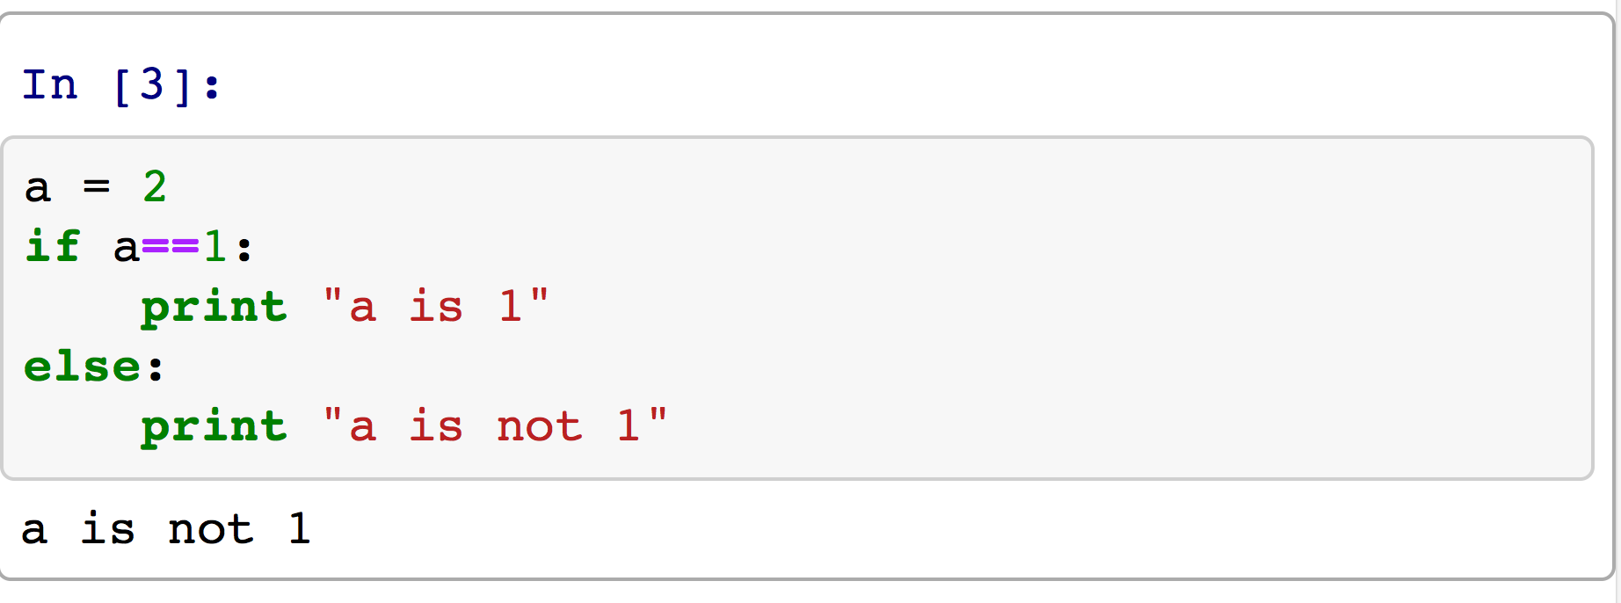
EXAMPLE 2.2. Control workflow – if, else, break, continue, pass
Notes:
Switch to live ipython notebook

Slide 8
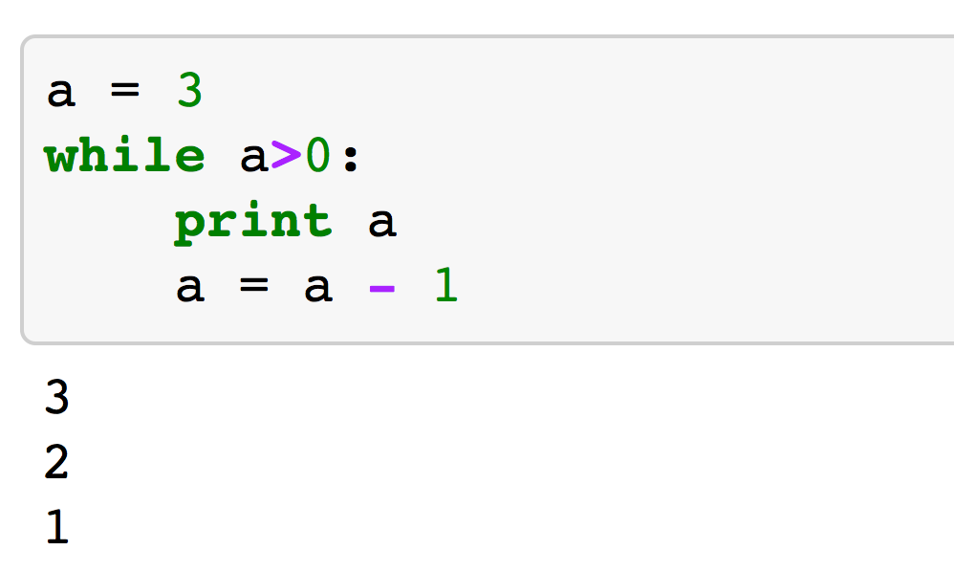
EXAMPLE 2.3. Control workflow – while, continue, break, pass
Notes:
Switch to live ipython notebook

Slide 9
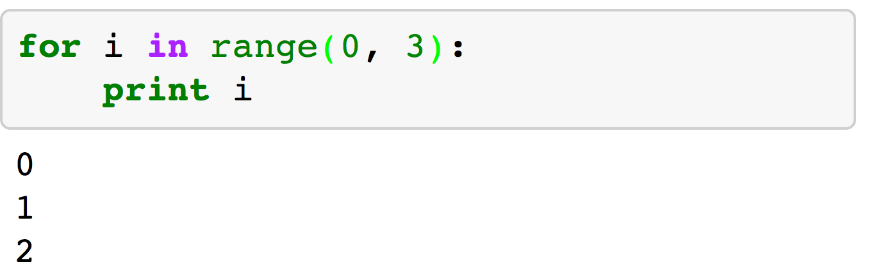
EXAMPLE 2.4. Control workflow – for, continue, break, pass
Notes:
Switch to live ipython notebook

Slide 10
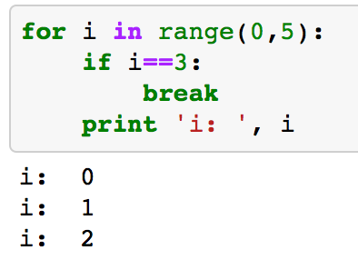
EXAMPLE 2.5. Control workflow – for, continue, break, pass
Notes:
Switch to live ipython notebook

Slide 11
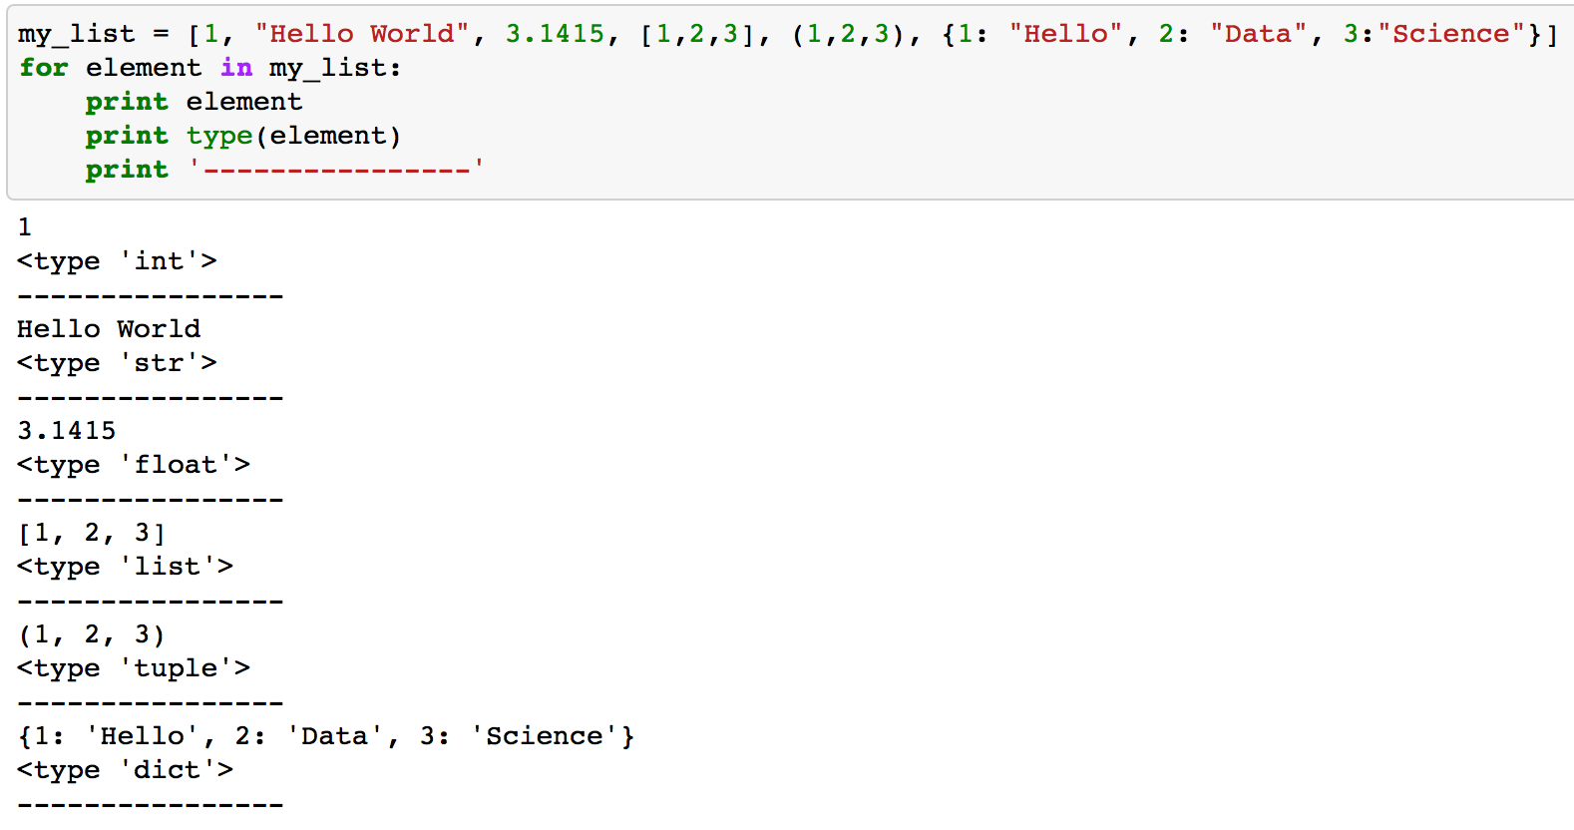
EXAMPLE 2.6. Data Types
Notes:
Switch to live ipython notebook

Slide 12
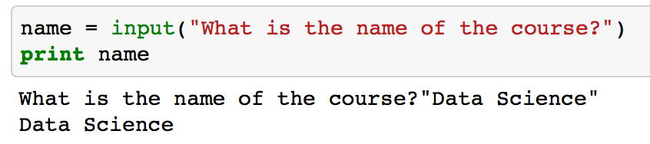
EXAMPLE 2.7. Take an input from the console
Notes:
Switch to live ipython notebook

Slide 13
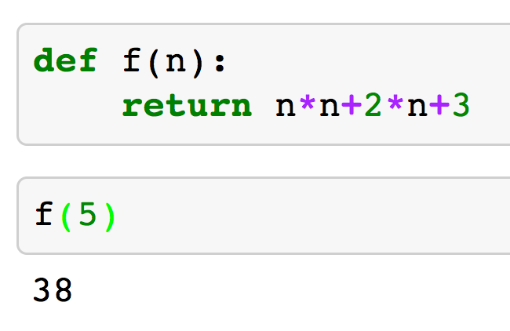
EXAMPLE 2.8. Defining a function in python
Notes:
Switch to live ipython notebook

Slide 14
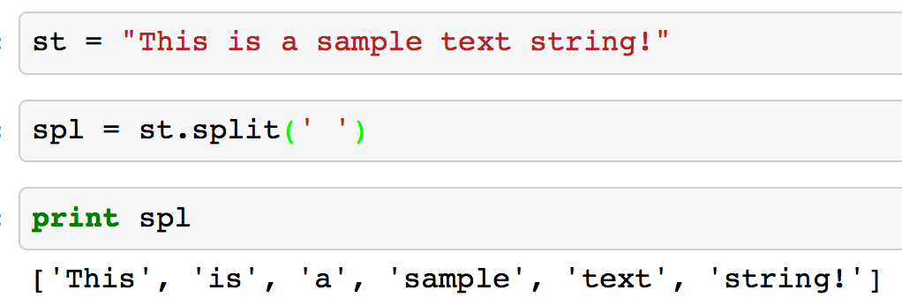
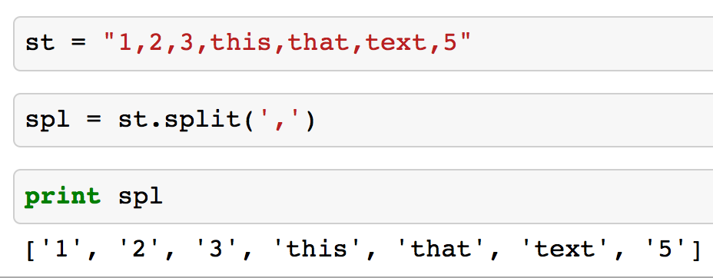
EXAMPLE 2.9. Split string using delimiter
Notes:
Switch to live ipython notebook

Slide 15
Exercise 2.1. (in class exercise)
Write a piece of code that takes your name as input and prints out the letters in reverse order.
e.g.
Katie → eitaK
John → nhoJ
Notes:
Switch to live ipython notebook

Slide 16
Exercise 2.2. (in class exercise)
Write a function that takes n as input and prints out the the first n-th element of Fibonacci numbers.
Fibonacci numbers: 1, 1, 2, 3, 5, 8, 13, 21, 34, …
f(n-2)+f(n-1) → f(n)
Notes:
Switch to live ipython notebook

Slide 17
Exercise 2.3. (in class exercise)
Write a function that takes i and j as input and returns back the value of corresponding pascal triangle. (consider multiple solutions)
1
1 1
1 2 1
1 3 3 1 → i=4, j=3
1 4 6 4 1
1 5 10 10 5 1 → i=6, j=5
Notes:
Switch to live ipython notebook

Slide 18
DATA GATHERING AND CLEANSING
DATA

Slide 19
EXAMPLE 2.8. Opening CSV files
1) Open the GDP.csv file
2) Read the file
3) Extract lines
4) Extract pieces of information from each line
5) Create a dictionary that maps country code to GDP
6) Create a map that maps country name to country code
G
Notes:
Switch to live ipython notebook

Slide 20
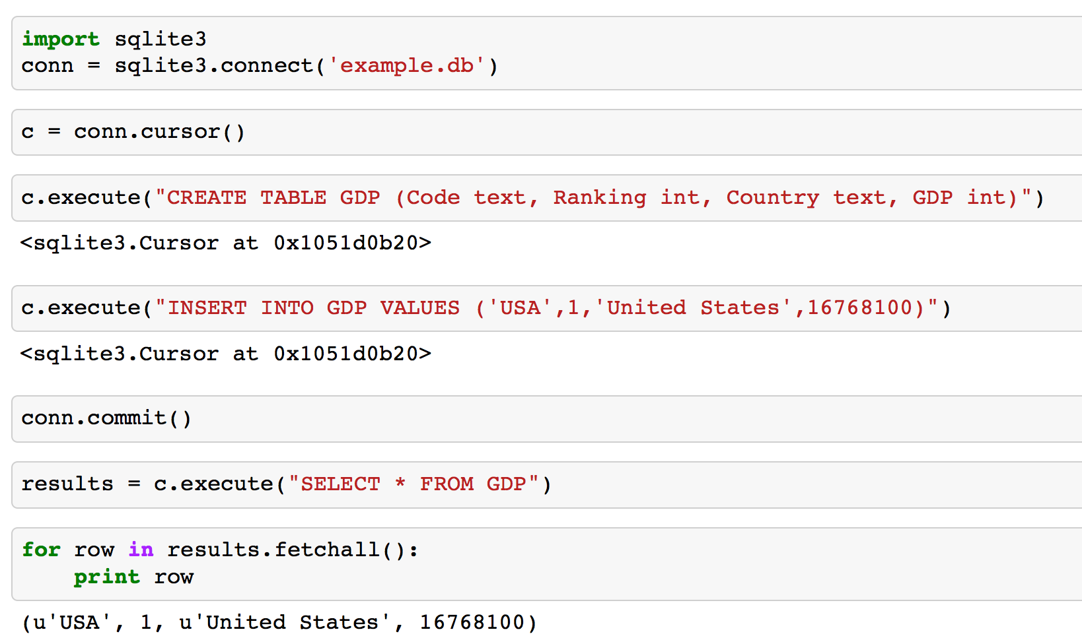
EXAMPLE 2.9. sqlite3
G
Notes:
Switch to live ipython notebook

Slide 21
EXAMPLE 2.9. Exporting data into sqlite3
1) Open the GDP.csv file
2) Read the file
3) Extract lines
4) Extract pieces of information from each line
5) Create a dictionary that maps country code to GDP
6) Create a map that maps country name to country code
7) Insert all of the values extracted from previous steps into a sqlite3 database.
8) Select countries that their ranking is higher than 10 and find their average GDP.
G
Notes:
Switch to live ipython notebook

Slide 22
What did we achieve so far?
- Opening CSV files
- Parsing the file and extracting pieces of information
- Creating in-memory database (sqlite3)
- Exporting information into sqlite3
G
Notes:
Switch to live ipython notebook

Slide 23
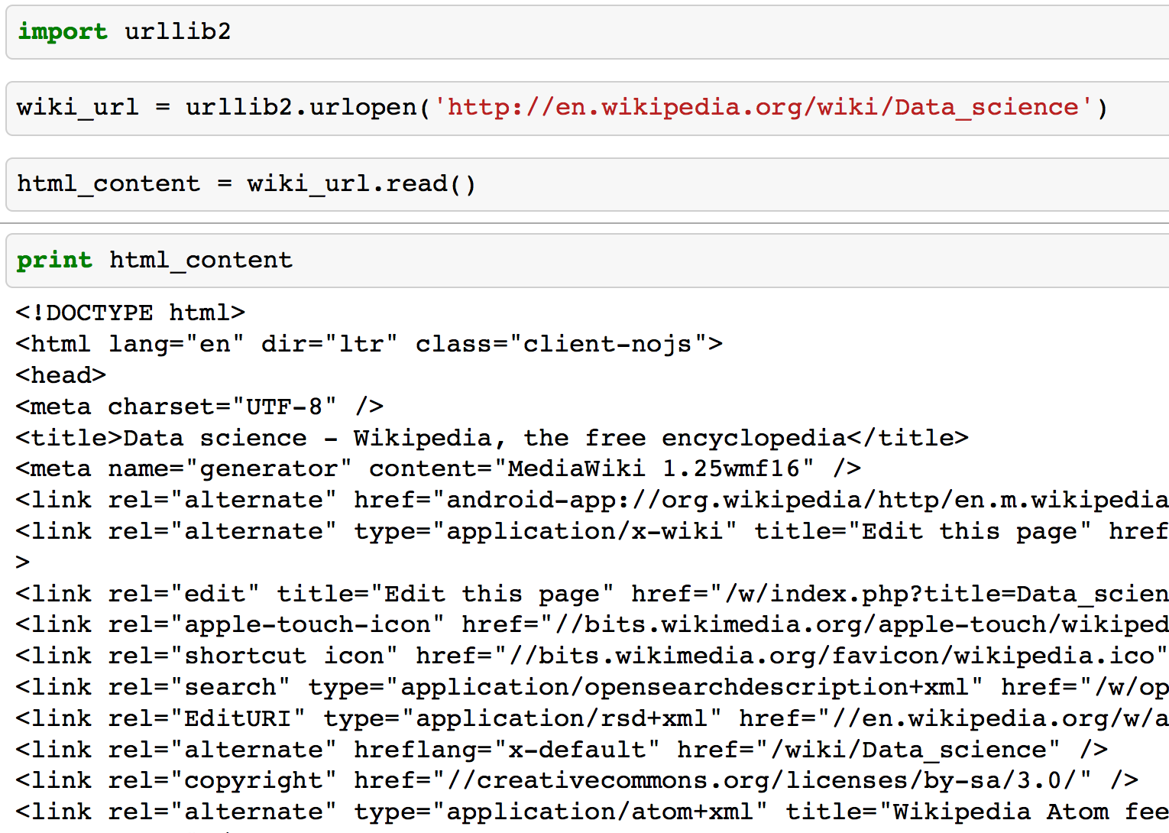

EXAMPLE 2.10. Opening a url
G
Notes:
Switch to live ipython notebook

Slide 24
Exercise 2.4. Parsing the web and storing into sqlite3
1. Open the Data Science page of wikipedia http://en.wikipedia.org/wiki/Data_science
2. Extract all of urls and store them in a list
3. Create a sqlite3 database and store these links in the database
4. Query the database and print the links
Notes:
Switch to live ipython notebook

Slide 25
Numpy Basics
1. Data Types
2. Array Creation
3. I/O with Numpy
4. Indexing
5. Broadcasting
6. Structure Arrays
7. Subclassing ndarray
Notes:
Switch to live ipython notebook

Slide 26
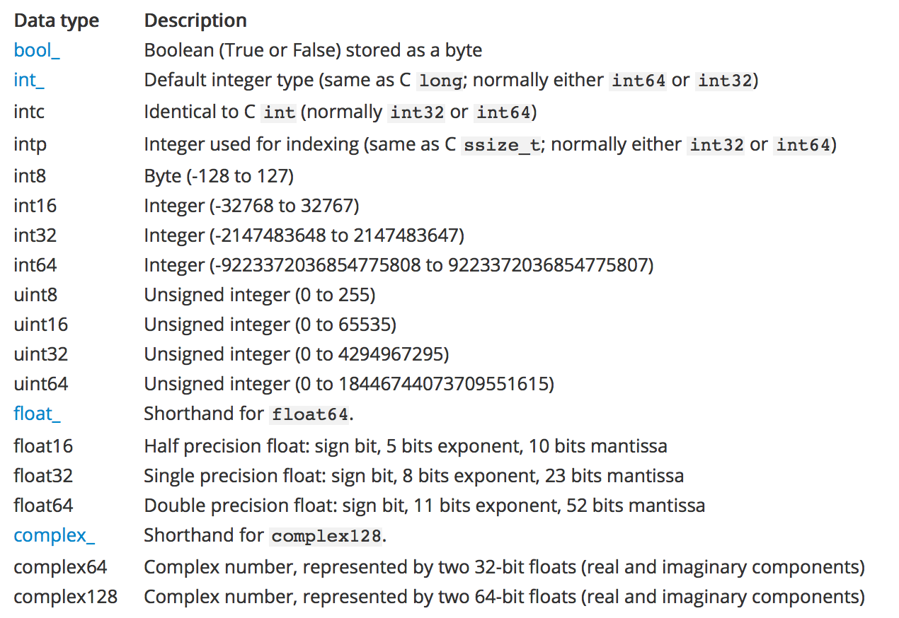
Numpy > Data Types
Notes:
Switch to live ipython notebook

Slide 27
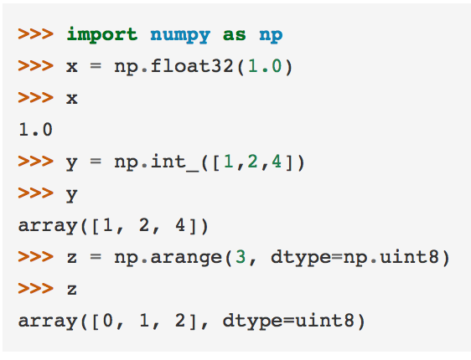
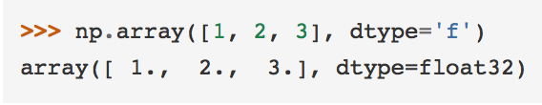
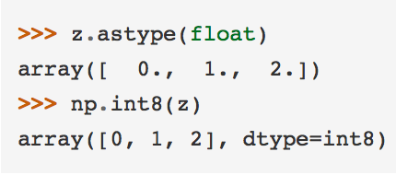
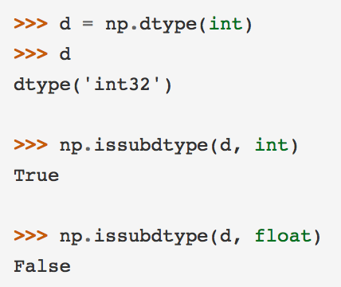
Numpy > Data Types
1
2
3
4
Notes:
Switch to live ipython notebook

Slide 28
1
Numpy > Data Types
2
3
4
Notes:
Switch to live ipython notebook

Slide 29
1
Numpy > Data Types
3
2
4
Notes:
Switch to live ipython notebook

Slide 30
1
Numpy > Data Types
4
2
3
Notes:
Switch to live ipython notebook

Slide 31
Numpy > Array Creation
There are 5 general mechanisms for creating arrays:
- Conversion from other Python structures (e.g., lists, tuples)
- Intrinsic numpy array array creation objects (e.g., arange, ones, zeros, etc.)
- Reading arrays from disk, either from standard or custom formats
- Creating arrays from raw bytes through the use of strings or buffers
- Use of special library functions (e.g., random)
Notes:
Switch to live ipython notebook

Slide 32
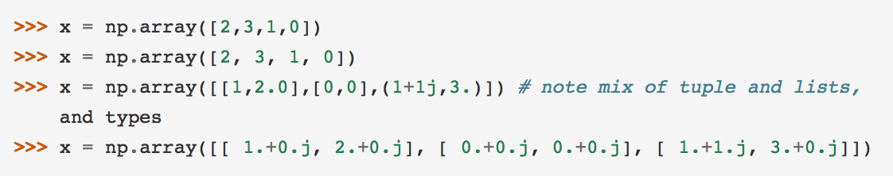
Conversion from other python structures
Notes:
Switch to live ipython notebook

Slide 33
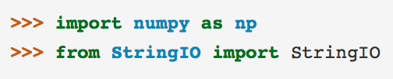
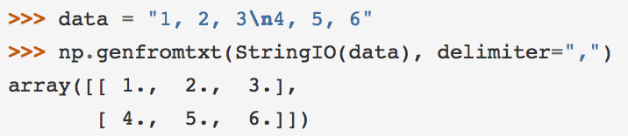
I/O with Numpy
(genfromtxt, StringIO)
Notes:
Switch to live ipython notebook

Slide 34
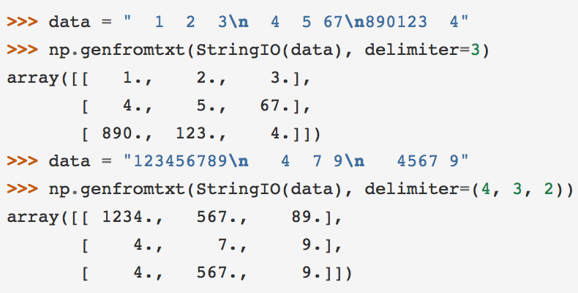
I/O with Numpy
(genfromtxt, StringIO)
Notes:
Switch to live ipython notebook

Slide 35
Exercise 2.2. (in class exercise)
Write a piece of code that reads the file located at:
http://samplecsvs.s3.amazonaws.com/SalesJan2009.csv
Notes:
Switch to live ipython notebook

Slide 36
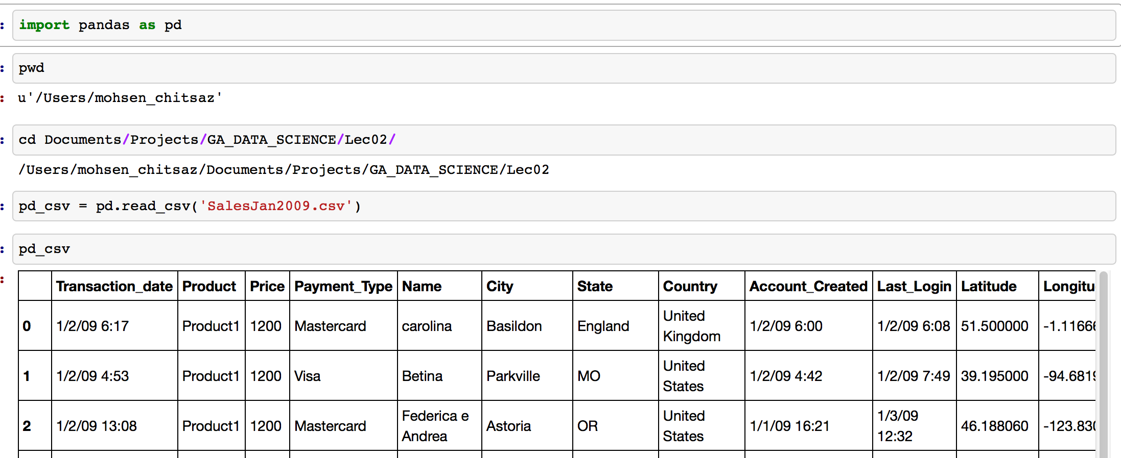
I/O with Pandas
Notes:
Switch to live ipython notebook

Slide 37
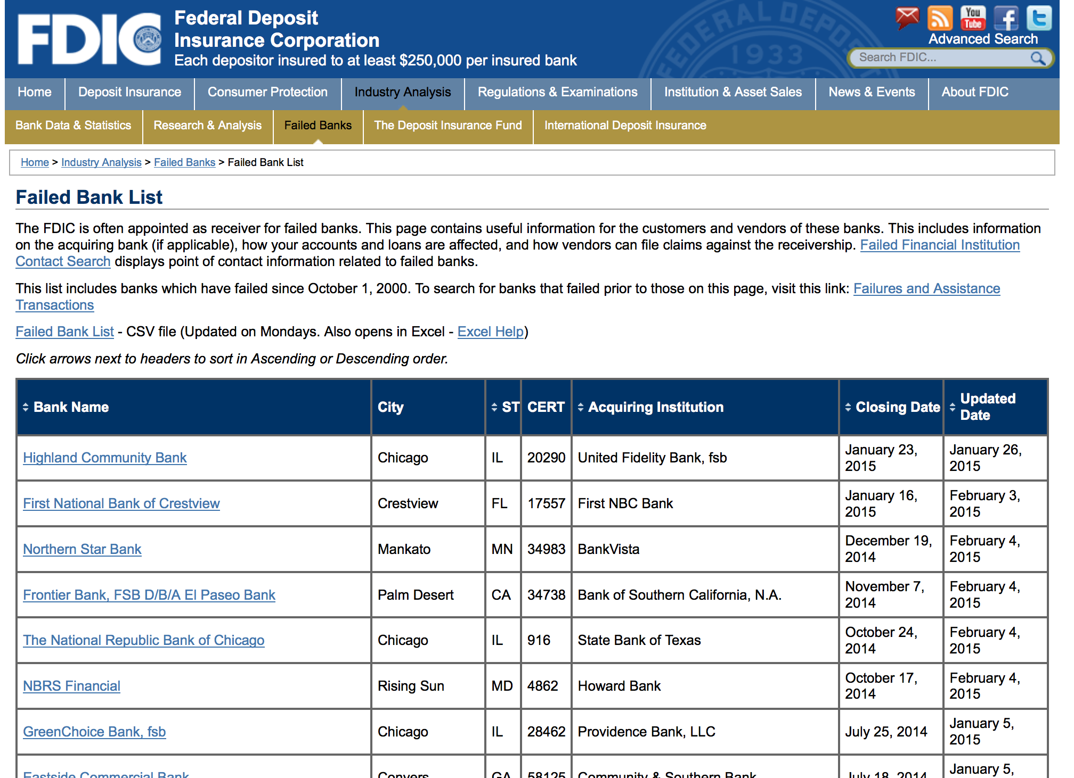
I/O with Pandas (reading a html table)
Notes:
Switch to live ipython notebook

Slide 38
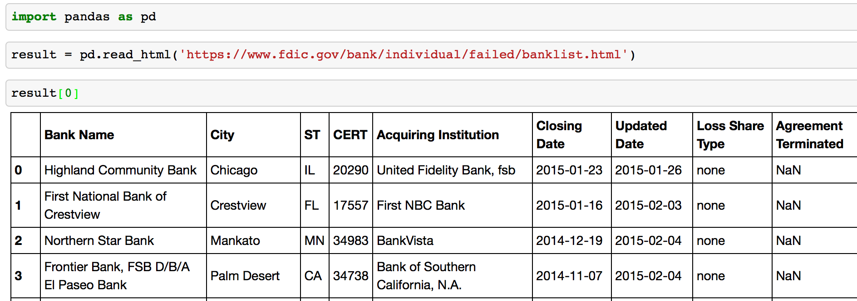
I/O with Pandas (reading a html table)
Notes:
Switch to live ipython notebook

Slide 39
I/O with Pandas (reading a html table)
Notes:
Switch to live ipython notebook

Slide 40
I/O with Pandas (reading a html table)
Notes:
Switch to live ipython notebook

Slide 41
QUESTIONS? :-)

