Slide 1
On Binary Trees

Slide 2
Tree Rotations
Done to rebalance tree
Can be slightly confusing... so

Slide 3
The way to remember
The direction, eg. “Left” in Left rotation, is where the 'root' node will be at after rotation
A picture speaks a thousand words... so

Slide 4
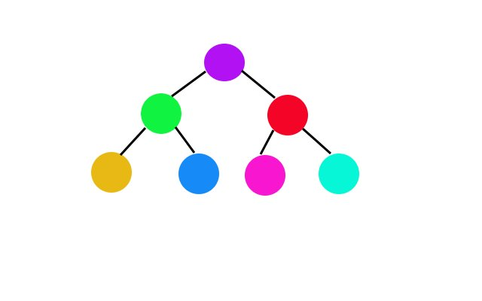
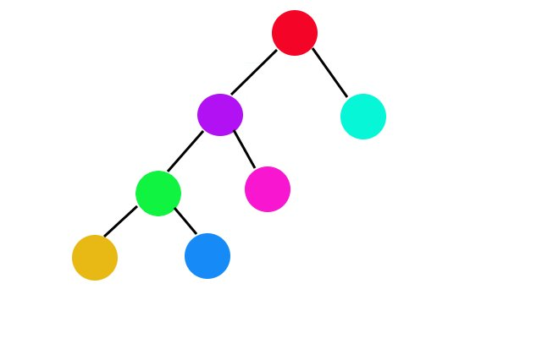
Left Rotation
I was the root node and
I'm on the left!!!
Hence, left rotation

Slide 5
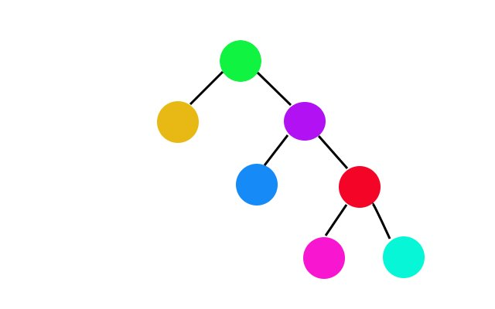
Right Rotation
I was the root node and
I'm on the right!!!
Hence, right rotation

Slide 6
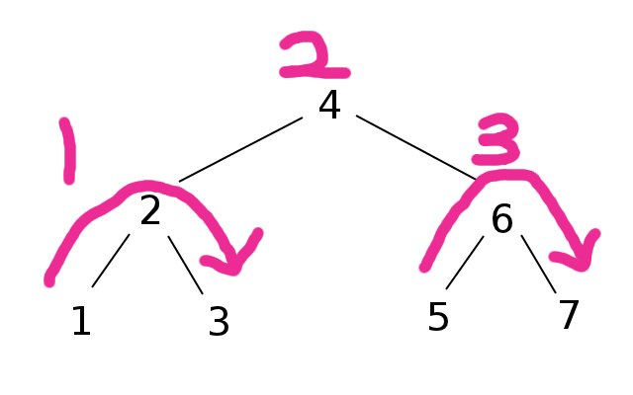
In order traversal
Usage:
Gives sorted order of keys (however you defined “sorted”)

Slide 7
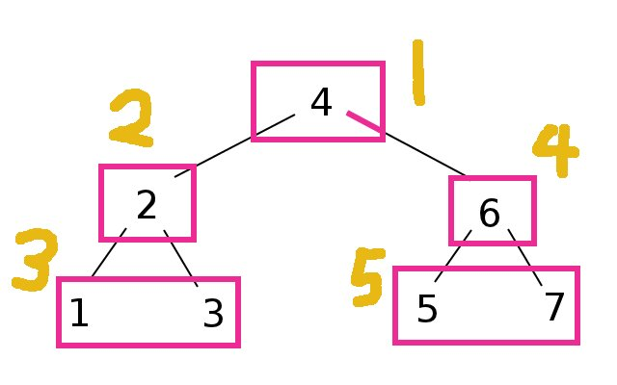
Preorder Traversal
Usage: Cloning a tree

Slide 8
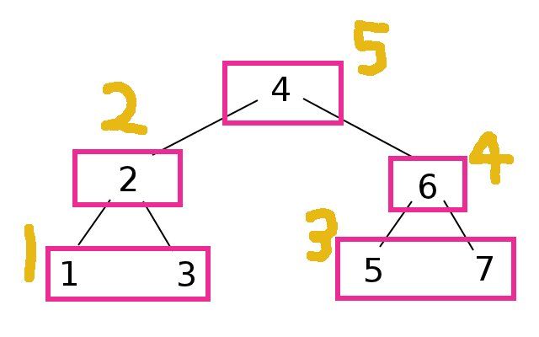
Postorder Traversal
Usage to be revealed...

Slide 9
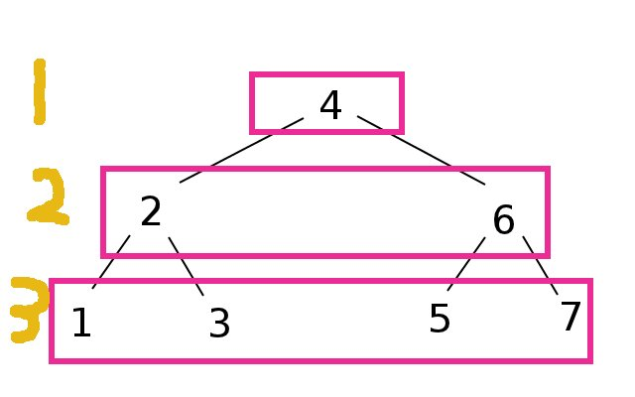
Level order Traversal
Usage: Printing the tree

Slide 10
Demo
(Inorder, Preorder, Level order traversals)

Slide 11
Postorder Traversal
The most useless traversal???
NOT!

Slide 12
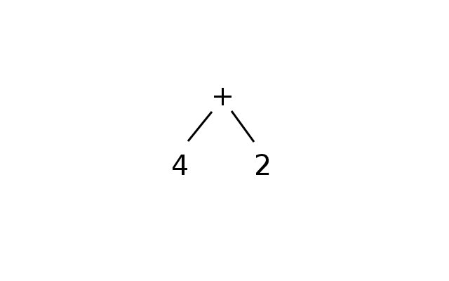
Postorder Traversal (cont)
Used to model computations!
Eg.
+ 4 2

Slide 13
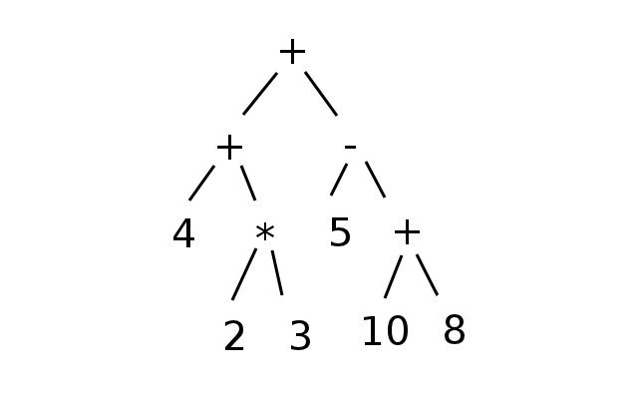
Postorder Traversal (cont)
So we can have computations like:
(2 * 3) + 4 + (5 – (10 + 8))
= 10 + -13
= -3

Slide 14
Postorder Traversal (cont)
I've written a parser for this
This tree shall be represented as:
+ + 4 * 2 3 – 5 + 10 8
The parser recognizes the above input and spits out the correct
output.

Slide 15
Postorder traversal demo

Slide 16
What's included for this lab
Height balanced BST using very simple balancing algorithm (insert + search, no delete)
Parser for prefix syntax that builds a tree and computes using postorder traversal (C code)
Splay Tree (insert + search, no delete)

Slide 17
https://github.com/yanhan
Code + Slides
https://github.com/yanhan/cs2010

Slide 18
Splay Trees (Bonus, see code)

