Slide 1

Steam game analysis
By Yan Han

Slide 2

Table of contents
01
03
05
Steam
Handling of Data
Machine learning
02
04
06
Project goals
Graphs
Demo
What is Steam?
Explanation to how I handle the dataset
Explanation to how I did machine learning
Train a machine to predict the number of owner
Explanation to all the graph that I have made
Streamlit Demo

Slide 3
What Is Steam
Steam is a digital Dsitribution platform
It was created during 2003
Change the landscape of game development
Remove the need for physical discs
Notes:
Steam is a digital distribution platform developed by valve. It was introduced in 2003 as a system for games to be updated but has been developed to become where developers can publish their games while users purchase games on the platform.
Steam change the landscape of game development as it gave a way for games to be updated after launch and this allows for an efficient way for games to be purchase and installed onto the computers. The platform made it so the need for physical disc is no longer needed. Without the use of a physical disc the developers are able to patch out some unexpected bugs they find after releasing the game. With steam being introduce it allowed for people to play connect, form community and discuss.

Slide 4
Valve’s founder
Gabe Newell is a co-founder along side Mike Harrington for valve
Steam was create through the passion for gaming the co-founder had
The founders has also publish some of their games they created on steam
Notes:
Gabe newell was playing a pivotal role in the creation and implementation of steam. Gabe use to work in Microsoft this allow him to bring valuable experience and expertise to the development of steam which then ensures the success of steam as a digital distribution platform. Gabe has been very hands on with the development of steam allowing steam to become one of the leading platform for gaming and digital entertainment. Gabe has always emphasized on the community engagement, creativity and player focused initiatives such as early access program.

Slide 5
Critically Aclaimed Games
Half life 2
Counter Strike Source
TF 2
Portal ½
Notes:
Half life 2 success lies in the immersive storytelling with innovative gameplay mechanics.
Counter Strike Source success lies in the addictive gameplay mechanic of a first person multiplayer shooter games
Team fortress 2 is somewhat similar to counter strike however it allows for more strategical planning with your team as the game is a class base shooter
Portal is a puzzle platformer game that explore the idea of a portal gun to traverse the world while completing complex puzzles.

Slide 6
02
Project goals
Train the model to predict the number of owner

Slide 7
Parts
EDA
Prediction
Cleaning dataset to then analyzing the dataset to create graphs and see corolations
Create a predictive model to show the number of owners a game would have base on the data given

Slide 8
Project goals
EDA
Clean data
Model
Plot Graphs to show corrolation and trends
Clean the data to be usable in analysis
Create a predictive model

Slide 9
Dataset
The dataset I used is the steam dataset from Kaggle
Problems I faced when Cleaning :
The genre are and platform are all in one column
Null Hypothesis:
Does genre have an effect on the number of owners

Slide 10
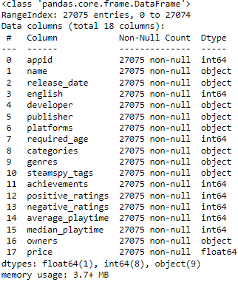
When I first read the Data
There was not much cleaning of the data that I needed to do since the data nad no null value

Slide 11
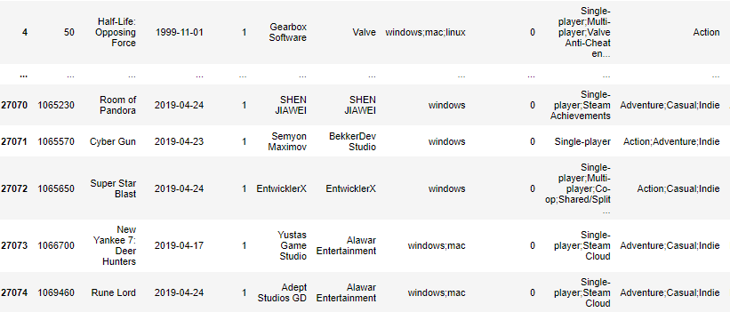
When I first read the Data
But the problem with platform and Genre looked like this

Slide 12
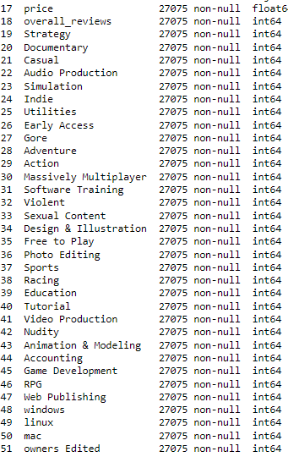
How I Fixed the problem
What I did was create a different columns for the different unique genre. I also did the same for platform problem

Slide 13
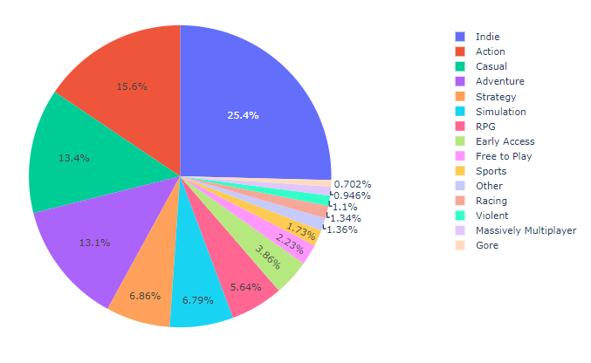
Most Common genre

Slide 14
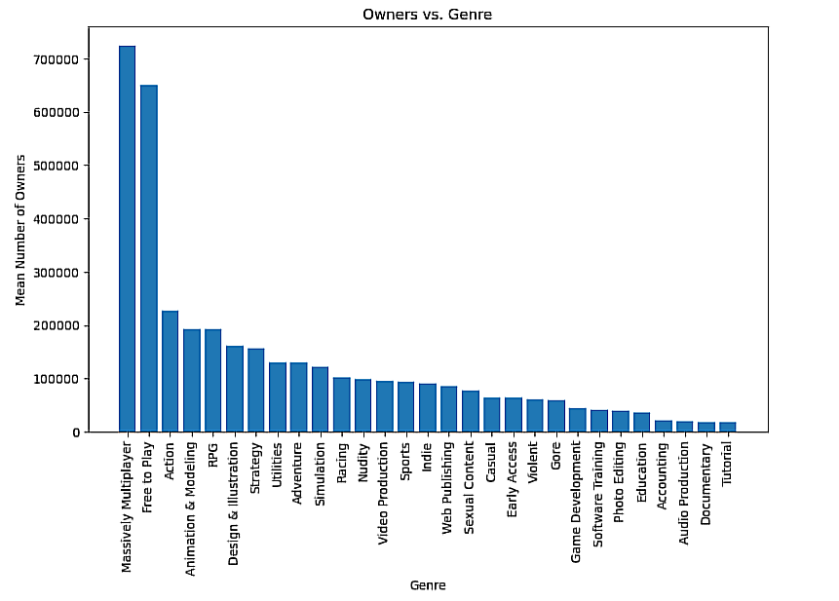
Average owners a Genre has

Slide 15
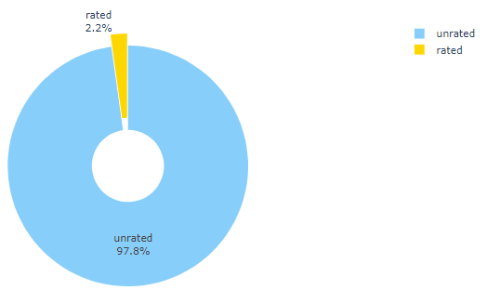
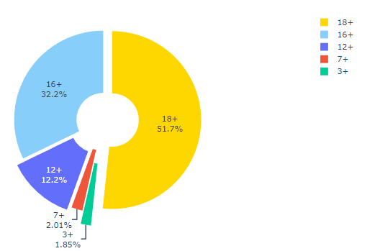
Game Age Rating

Slide 16
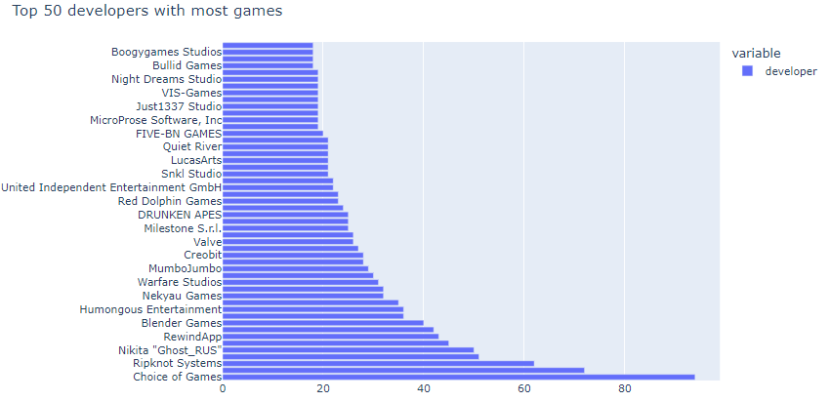
Developers with the most game

Slide 17
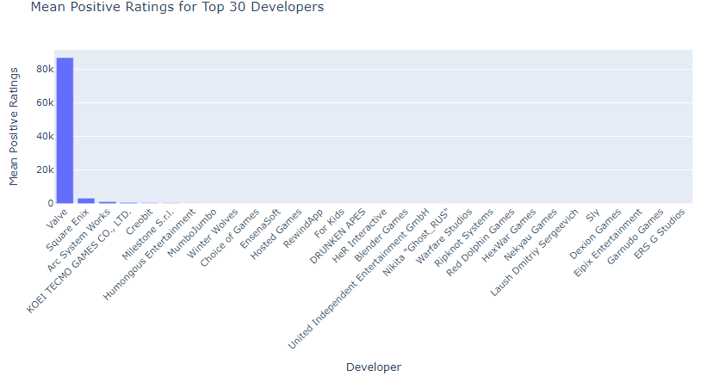
Most positive rating Developers

Slide 18
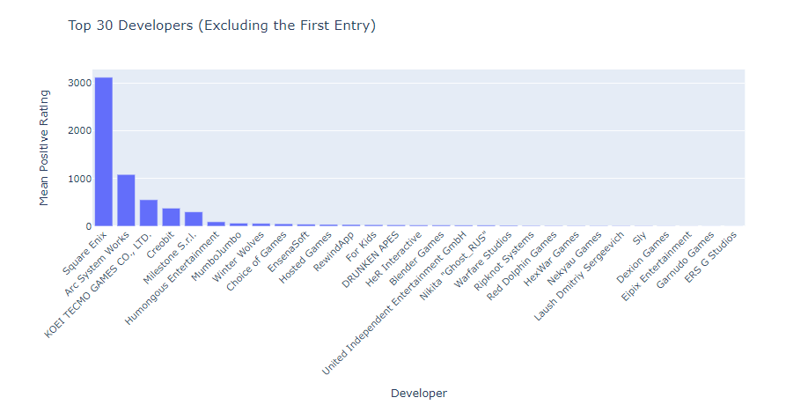
Most positive rating Developers

Slide 19
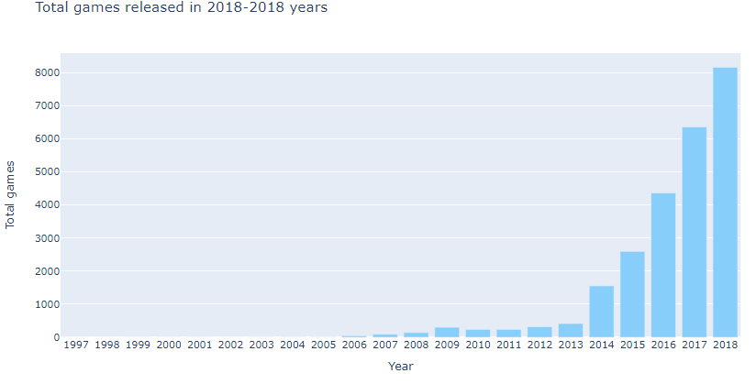
Games Release over the years

Slide 20
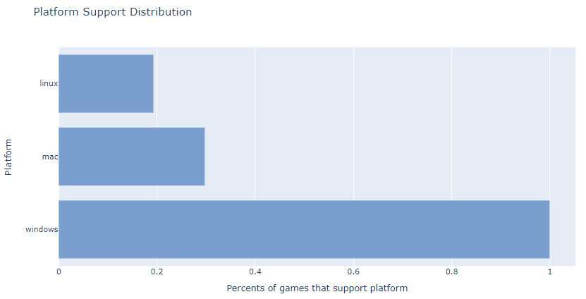
In General Platform Support

Slide 21
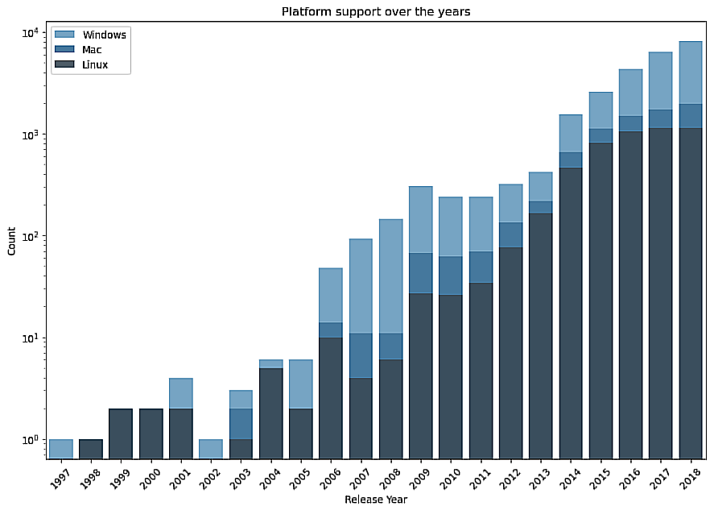
Platform Support over the years

Slide 22
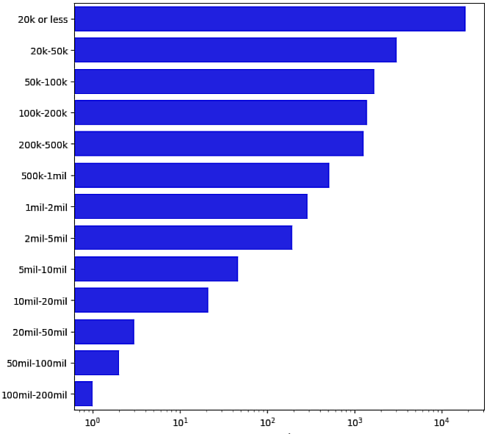
Game Owner range

Slide 23
Conclusion

Slide 24
05
Machine Learning

Slide 25
Training The machine
Droping the data
Converting Data
Splitting Data
Training model

Slide 26
Method Used
Random Forest Tree
Bagging
Boosting
01
02
03
Accuracy: 96.2%
Accuracy:95.3%
Accuracy: 84.2%

Slide 27

Demo
Streamlit Demo

