Slide 1
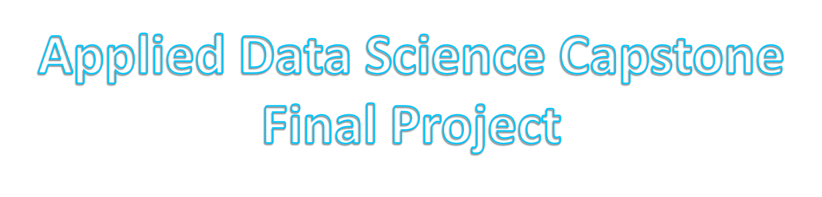

Slide 2
Synopsis
In this final project, we would like to recommend an investor in North York ,Toronto who want to invest a lunch bar in local community. The investor should open this lunch bar where it is closest to its customers in order to be easy accessed. which neighbourhood (in that borough) would be a better choice for the investor to open the lunch bar in that neighbourhood?
Our mission is to find the most suitable neighbourhood.

Slide 3
Three major sources:
Postal-code-level location data: Toronto's data from Wikipedia. These dataset provides the information of postal codes, boroughs and neighbourhoods of Toronto.
Coordinates data from geopy library in Python, which provide the longitude and latitude according to the “address”(Toronto)
Foursquare API geocode data, which contains most common venues according to the neighbourhood.

Slide 4
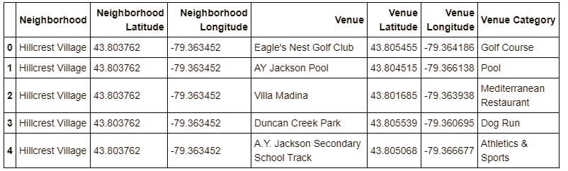
“Foursquare”
About "Foursquare" locational information. A typical request from Foursquare will provide us with the following information:

Slide 5
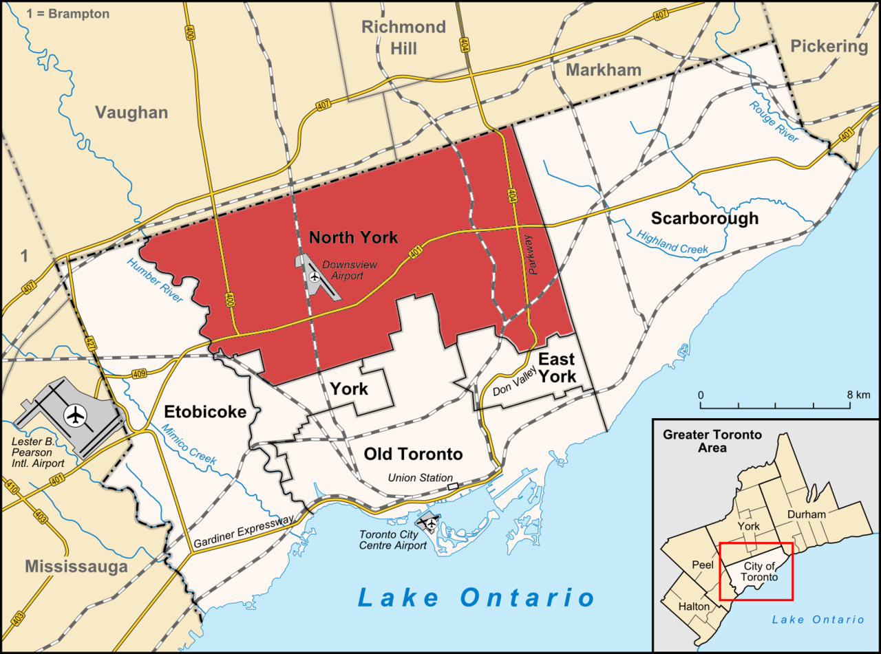
North York is an administrative area and former city in Toronto, Ontario, Canada. It is located directly north of Old Toronto, between Etobicok to the west and Scarborough to the east. As of the 2011 Census, it had a population of 655,913.
Data Souce: wikipedia(https://en.wikipedia.org/wiki/North_York)

Slide 6
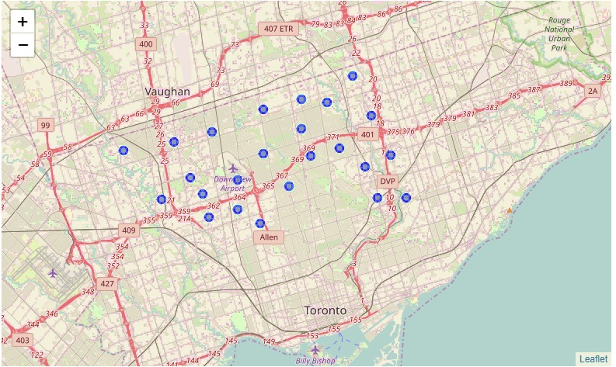
The Neighbourhoods in North York
There are 23 Neighbourhoods:
'Hillcrest Village', 'Fairview, Henry Farm, Oriole', 'Bayview Village', 'Silver Hills, York Mills', 'Willowdale South', 'York Mills West', 'Willowdale West', 'Parkwoods', 'Don Mills North', 'Flemingdon Park, Don Mills South', 'Bathurst Manor, Downsview North, Wilson Heights', 'Northwood Park, York University', 'CFB Toronto, Downsview East', 'Downsview West', 'Downsview Central', 'Downsview Northwest', 'Victoria Village', 'Bedford Park, Lawrence Manor East', 'Lawrence Heights, Lawrence Manor', 'Glencairn', 'Maple Leaf Park, North Park, Upwood Park', 'Humber Summit', 'Emery, Humberlea‘.

Slide 7
We need use Foursquare to get Locational Data for Each Venue in Every Neighborhood
After finding the list of neighborhoods, we then connect to the Foursquare API to gather information about venues inside each and every neighborhood.
Which include: 'Golf Course', 'Pool', 'Dog Run', 'Athletics & Sports', 'Toy / Game Store', 'Shopping Mall', 'Airport', 'Bus Stop', etc.

Slide 8
Our Mission: To find a good location for a Lunch bar.
Therefore we want to find a neighborhood have the most of shops, Department Stores, bus station, Gym etc.

Slide 9
Assumption: different stores and shops have same custome volume.
1. Processing the Retrieved Data and Creating a DataFrome for All the Venues inside the Area of North York.
2. When the data is completely gathered, we will perform processing on that raw data to find our desirable features for each venue.
3.Our main feature is the category of that venue.
4. the column "Venue's Category" wil be hotspot of that area and different venues will have different feature-columns.
5. we will integrate all shop columns to one column "Total Shops" and all Stores columns to "Total Stores" column.
6. The dataset is fully ready to be used for machine learning (and statistical analysis) purposes.

Slide 10
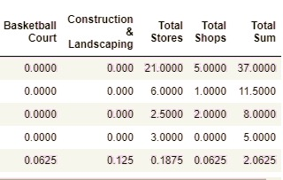
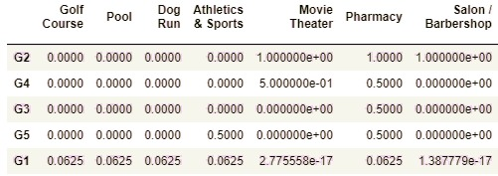
The Process
Applying one of Machine Learning Techniques (K-Means Clustering) Here we cluster neighborhoods via K-means clustering method. We think that 5 clusters is enough and can cover the complexity of our problem. After clustering we will update our dataset and create a column representing the group for each neighborhood.
The Best Group is G2

Slide 11
The Result:
The Best Group is Group 2 (37 venues)
The Second Best is Group 4(11.5 venues)
Discussion:
Based on the 5 group cluster, the Group 2(Fairview, Henry Farm, Oriole) is best group which total stores, shops and other related venues is 37 compared with the second best group(Group4) only have 12 stores

Slide 12
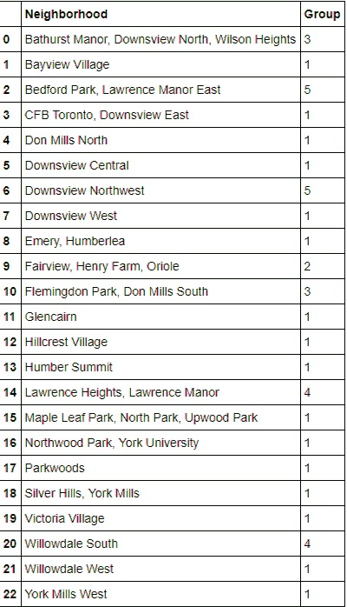
Group 2:
Fairview, Henry Farm, Oriole

Slide 13
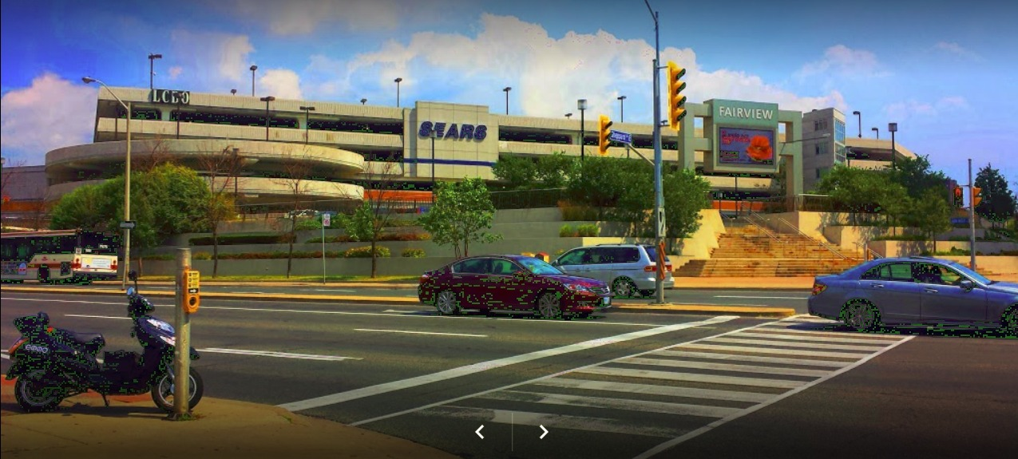
Conclusion
I would like to recommend the investor from North York to invest a lunch bar in the neighbour of Fairview, Henry Farm or Oriole.
Image is from Google Maps

Slide 14


