Slide 1


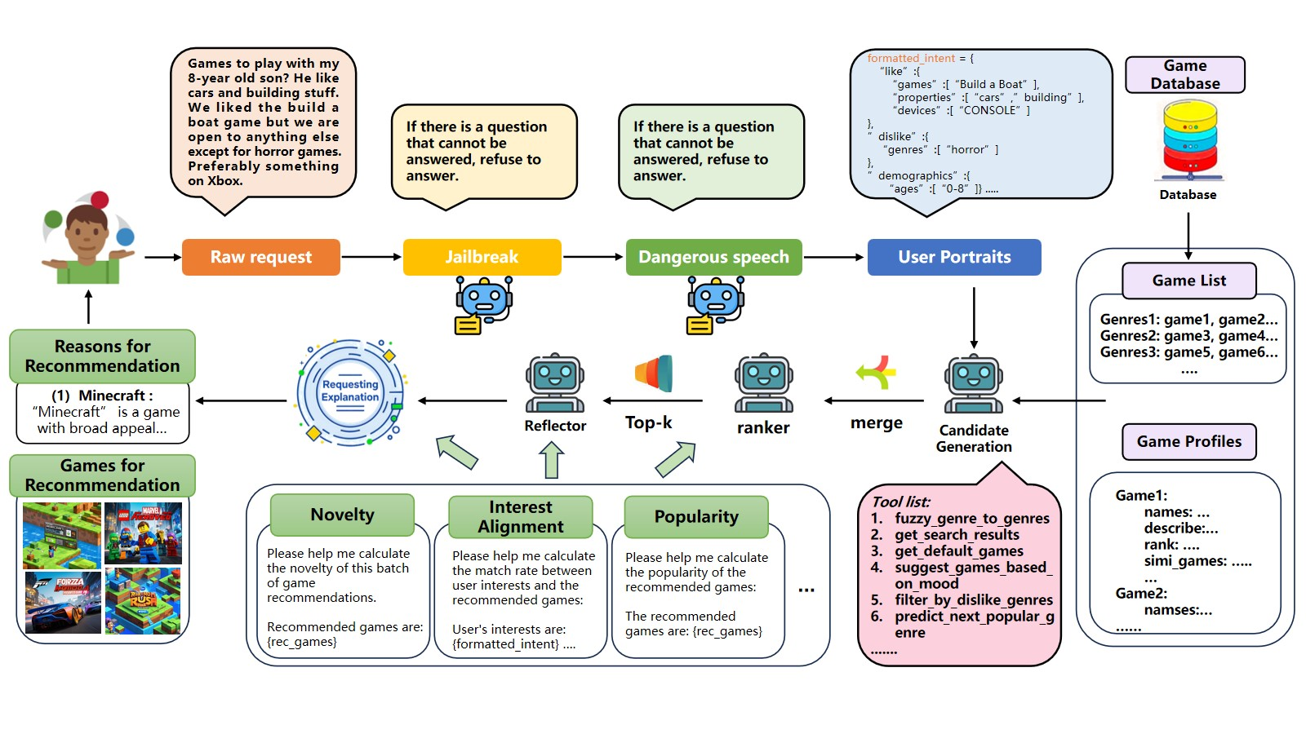
Toward Safe and Human-Aligned Game Conversational Recommendation via Multi-Agent
Decomposition
Zheng Hui¹, Xiaokai Wei¹, Yexi Jiang¹, Kevin Gao¹, Chen Wang¹, Frank Ong², Se-eun Yoon¹, Rachit Pareek¹, Michelle Gong¹
¹ Roblox Corporation ² University of Cambridge
Problem
Method
3
Multi-LLM Ranking & Reflection
ENSEMBLE
Key Results
Game conversational recommendation is a fundamentally harder CRS problem than movies: catalogs change daily, preferences are driven by how a player interacts — mechanics, skill level, platform, solo vs. multi — not by theme, and open-ended conversation invites adversarial prompts.
GPT-4o and Gemini rank in parallel over five criteria — popularity, preference match, similarity to history, genre alignment, age suitability — and a weighted average fuses their scores. A small exploration term keeps long-tail candidates in play. A reflection agent then re-ranks the top candidates using detailed game profiles, trading a little diversity for sharper relevance.
SYSTEM (GPT-4O)
HIT@5
JP
EXP
Base LLM
0.23
✘
—
OMuleT
0.24
✘
—
MACRec
0.21
✘
1.7
MATCHA (ours)
0.29
✔
4.2
Overview of MATCHA: safety agents → tool-augmented candidate generation → multi-LLM ranking & reflection → multi-dimensional explanation.
+20% Hit@5 · −24% popularity bias · 97.9% adversarial defense
Static, monolithic LLM recommenders do not survive these three pressures at once.
1
Risk Control Agent
SAFETY
4
Multi-Dimensional Explanation
EXPLAIN
Jailbreak Prevention — RA-LLM random-drop: mask input tokens, watch the response change.
Two models + a reflection pass beat a single larger model on a fast-evolving catalog.
Motivation
76.2%
23.8%
7.8%
Chain-of-thought intent detection + crafted fallback policies (binary adversarial flag).
Category preferences — why this genre / sub-genre fits the user's stated taste.
Headline Numbers
game title recognition
game hallucination
unsafe game CRS
Dangerous-content detection as a second-layer filter on both query and model output.
97.9%
0.29
Three gaps: complex interaction-driven constraints, knowledge recency, and adversarial safety.
Similarity to past picks — mechanics, style, and theme match to prior favorites.
Hit@5
Jailbreak Defense
−24%
Pop-Bias Δ
RA-LLM
CoT intent
crafted policies
Demographics + popularity/novelty — age-appropriate signals, ratings, recency, and fresh-but-credible picks.
+27.8 pts over GPT-4o (70.1%)
4.2/5
Explanation
Takeaway
2
Five Agents, One Recommendation
PIPELINE
Explanations are scored along four dimensions and capped by an explanation quota to keep latency bounded. Virtual judges and human annotators both rate MATCHA explanations at ~4/5, agreeing with each other and correlating with user-reported satisfaction.
Multi-LLM Rank
Safety + recency must be first-class agents, not afterthoughts.
Safety
→
Intent + Tools
→
→
Reflect
→
Explain
Decomposing game CRS into specialized, safety-first agents yields accurate, diverse, safe recommendations where monolithic LLMs hallucinate — at +0.21 s/turn.
Each agent owns one concern. The full system adds only +0.21 s/turn over a single-agent baseline.
17
+0.21s
2×
A safe, accurate recommendation without a reason is a recommendation nobody trusts.
live retrieval tools
latency vs single-agent
LLM ensemble

