Slide 1


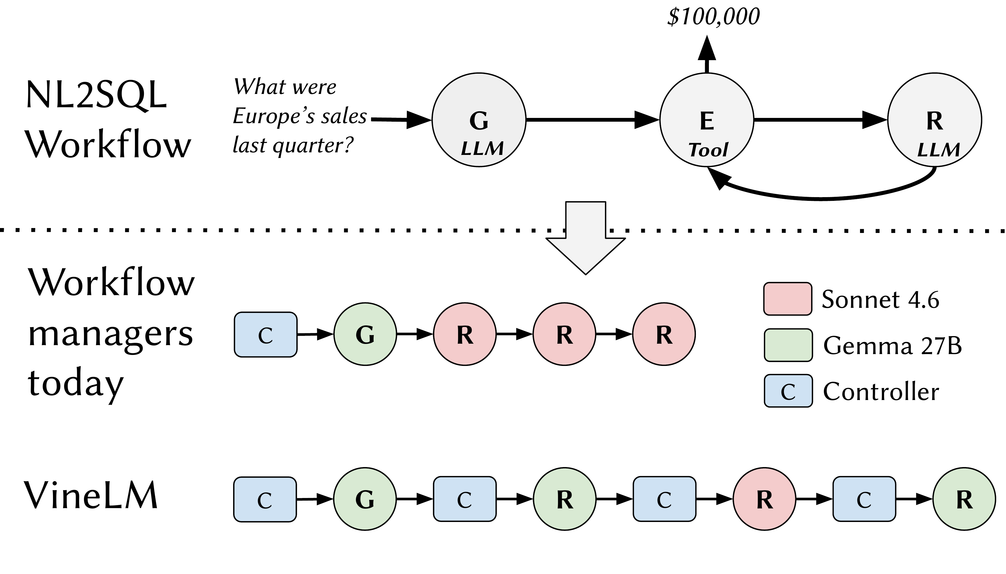
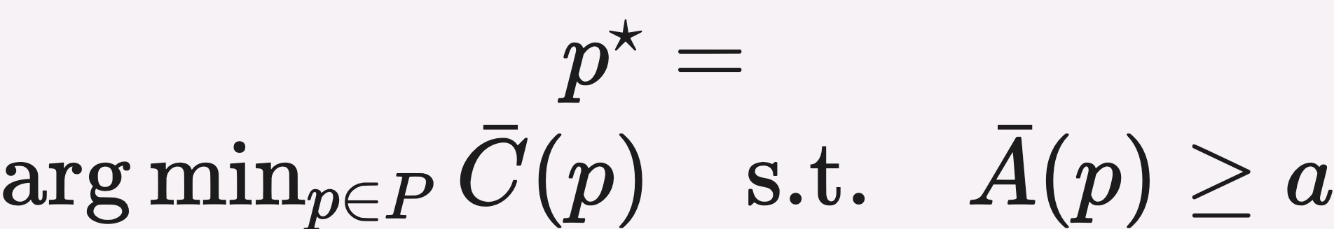
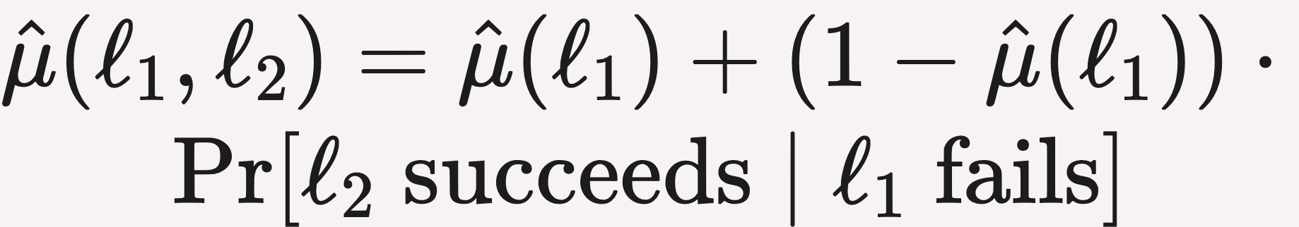
VineLM: Trie-Based Fine-Grained Control for Agentic Workflows
Nikos Pagonas, Matthew Lou, Tianyi Peng, Dan Rubenstein, Kostis Kaffes
¹Columbia University
Paper
PROBLEM
METHOD
3
Dynamic re-rooting
online control
KEY RESULTS
Agentic workflows interleave configurable LLM stages with tool stages and refinement loops — yet managers like Murakkab bind each stage to one model up front and never revisit the choice at runtime.
After each stage the controller re-roots the trie and searches only the remaining subtrie under the remaining budget — optionally inflating latency estimates from a load model. Replanning overhead stays below 1% of the fastest LLM call.
METHOD
METRIC
Full offline profiling
100%
VineLM (2% coverage)
0.2–2%
98–99.8% lower profiling cost · +18% accuracy
Coarse-grained control collapses a loop into one average plan, leaving real accuracy on the table.
4
Cascade decomposition
unbiased fill-in
SO WHAT → VineLM beats the best static config: +18% accuracy, −85% SLO violations.
NL2SQL workflow example (G, E, R).
1.04%
column-mean MAE (vs 1.45% VineLM-Lite)
MOTIVATION
1
Execution trie
search space
HEADLINE NUMBERS
Refinement loops should be optimized as a sequence of model choices, not by binding one model to the whole loop.
98–99.8%
pick the min-cost path that meets the accuracy SLO
cascade decomposition — depth-unbiased fill-in
+18%
lower profiling cost
Nodes are model-choice prefixes; each root-to-leaf path is one workflow run
FILL-IN ESTIMATOR
SIGNED ERROR
−85%
latency-SLO violations
The decision space explodes: the NL2SQL workflow alone induces 584 feasible model-choice paths — exhaustive profiling is infeasible.
Direct averaging
−49.5%
accuracy at equal budget
Annotated with cost, latency, accuracy — all three monotone along each path
Prefix fill-in
optimistic
vs best static (Murakkab-style) config
~1%
column-mean MAE @ 2%
Cascade decomposition
≈ unbiased
2
Offline estimation
cheap profiling
DEPTH
OBSERVED
1
Cascade sampling + checkpointing — profile shared prefixes once, reuse across paths
Depth-1 (8 paths)
97%
TAKEAWAY
Runtime variability makes offline averages miss the SLO.
Depth-2 (64 paths)
17%
Agentic workflows should be controlled by online policies over execution prefixes — an annotated trie — rather than fixed workflow-level model assignments; the trie plus cascade decomposition makes fine-grained control practical at ~1% profiling cost.
WHY NOW
Depth-3 (512 paths)
1.8%
Static plans fail in opposite ways — a strong model blows the budget while a cheap one returns the wrong answer; only a mixed-model path does both right.
2
Subtree fill-in — propagate success to descendants
Depth-dependent missingness — later stages are only reached when earlier ones run
Profiles paths in cascade order so deeper stages are only queried when earlier ones run; shared prefixes are computed once.
Low-rank smoothing cuts MAE 1.45% → 1.04%, max error 6.29% → 4.33%

